Slide 1

Project : DNA Based Disease Prediction
Course Code : CSBB 311
Course Title : Machine Learning
Course Instructor :
Dr. Gautam Kumar
Presented By :
Bharat Kumar 231210034
Kaushlendra 231210057
CSE1 G2
National Institute of Technology Delhi
*
Notes:
*

Slide 2
Contents
Introduction
Objectives
Literature Survey
Dataset Used
Methodology
Results and Discussion
Conclusion
References
*

Slide 3
Introduction
Every person’s DNA is unique and controls traits and chances of getting diseases.
Sometimes a gene may be common but can still cause disease if it is faulty or in the wrong position.
Modern genome sequencing gives us large genetic data, but it is difficult to study manually.
Many diseases are caused by changes in multiple genes, not just one.
Doctors and researchers need a better way to analyze this big genetic data.
*

Slide 4
Objectives
To identify genetic variations linked to different diseases.
To check how multiple genes may combine to cause a disease.
To assist doctors and researchers by simplifying large genetic data.
To support discovering or verifying Single Nucleotide Polymorphism (SNP) disease relationships across populations.
Develop an efficient system for predicting the Polygenic Risk Scores (PRS) of the Diseases.

Slide 5
Literature Survey
Many studies show how genetic variations affect human health and disease.
Researchers explore links between DNA changes, gene mutations, and disease identification.
IEEE Xplore: DNA-Based Disease Prediction Using Pathway Analysis
This Research paper provides methods ( ML models or DL models ) like
SVM , Random Forest and Neural Network to identify Disease.
Genome-Wide Association Studies (GWAS):
Offers statistical data on SNP IDs, effect sizes (beta scores), and related diseases.
1000 Genomes Project:
Produced 80M+ genetic variants, including SNPs.
Supplies reference panels for genotype prediction and population-level frequency data.

Slide 6
Dataset Used
Model Trained on following Datasets :
GWAS catalog -
The Dataset includes SNPIDs along with their respective effect sizes, p – values and associated Disease.
Patient Data -
The Dataset includes patient’s SNPIDs and their Genotype with PRS.
Attribute Extracted from these data :
RSID, chromosome (CHR), SNP position (POS), reference allele (REF), alternate allele (ALT) , genotype and associated disease trait.

Slide 7
Methodology
Data Collection Data collects from GWAS and 1000 Genome Project websites.
Feature Extraction :
Extracted SNP positions, alleles, and known disease-associated markers.
Data Preprocessing :
Remove redundant columns, Missing value Handling, SNP to Disease Mapping,
Encoding genotypes into numerical format (0, 1, 2).
Model Training :
Trained four machine learning models — Logistic Regression, Random Forest, SVM, and Gradient Boosting — using labeled SNP–disease datasets.

Slide 8
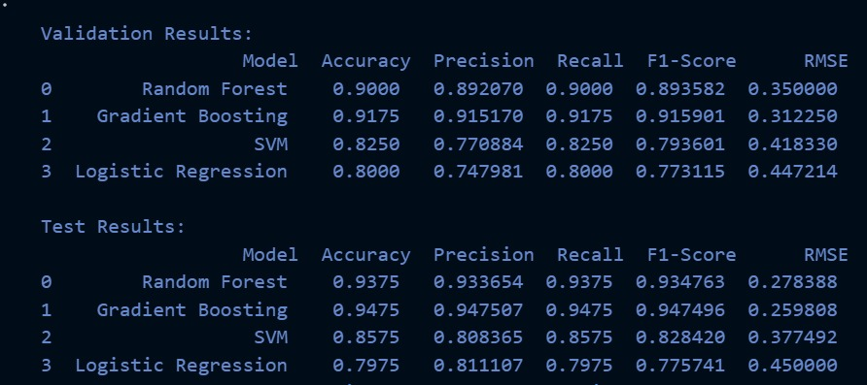
Methodology
Model Evaluation :
Compared model performance using metrics like accuracy, precision, and error rate to identify the best-performing model.
Prediction & Report Generation :
Used the best model to predict disease risks and generated a clear, easy-to- understand report for each patient.

Slide 9
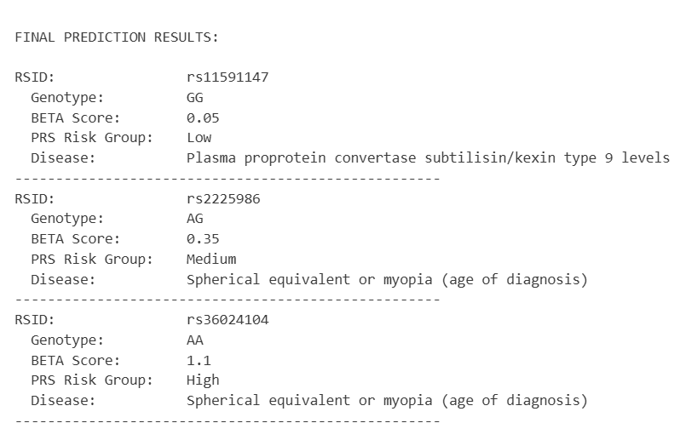
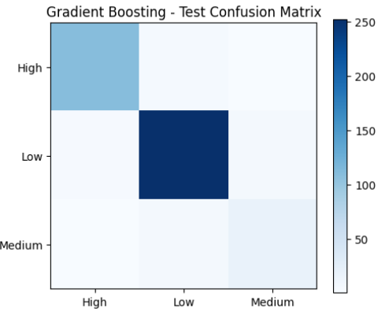
Results and Discussion
Prediction

Slide 10
Conclusion
Successfully build a model that predicts possible disease risks based on DNA information.
By analyzing SNP and genotype variations and their associated disease, the system provides a foundation for gene c diagnostics and personalized medicine.
Helps doctors and researchers quickly identify disease risks from a patient’s DNA.
Future work:
Future improvements can include a user-friendly UI, a larger dataset, deep-learning models, and adding real clinical data for better accuracy.

Slide 11
References
GWAS Catalog – https://www.ebi.ac.uk/gwas/
1000 Genomes Project – https://www.interna onalgenome.org/
IEEE Xplore - https://ieeexplore.ieee.org/document/7976867
Scikit-learn Documentation – https://scikit-learn.org/
*

Slide 12
THANK YOU
*
Notes:
*

