Slide 1
TECHNOVA 2026 — NATIONAL AI INNOVATION CHALLENGE
A small business shouldn’t need a developer, five different apps, and ₹20,000 — just to go digital.
LOCAH
One business. One identity. Everything it needs to go digital, operate and grow.
Team The Think Tank · submission deck

Slide 2
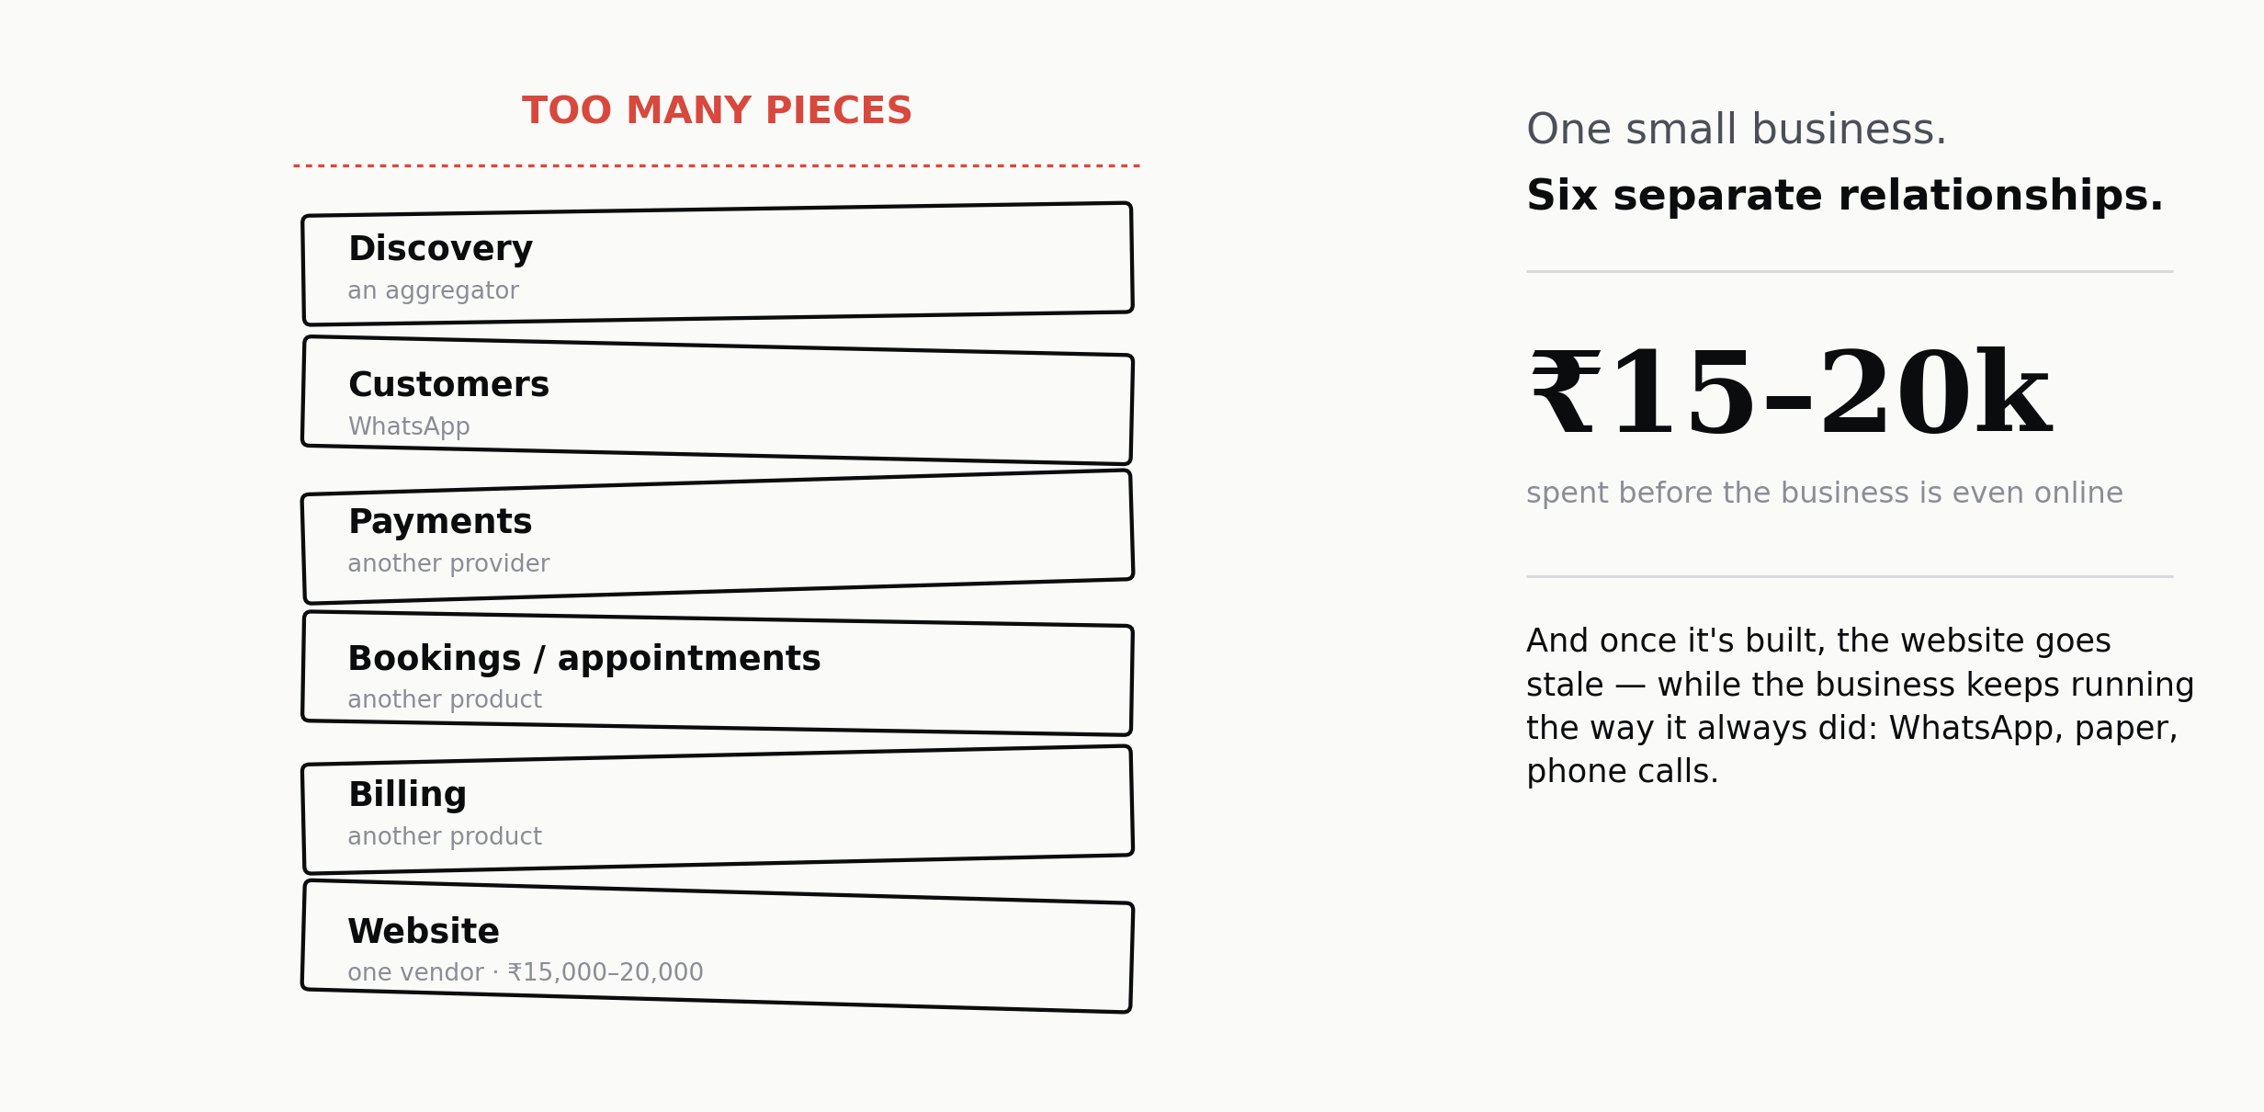
THE PROBLEM
Going digital, the hard way.
What a small business actually goes through just to get online — today.
LOCAH · TECHNOVA 2026
02 / 20

Slide 3
THE REALIZATION
We were selling them a website — when what they actually needed was a digital business.
A boring problem. A massive surface area. Millions of small businesses hit the same wall, every single day. We’re not trying to solve everything — we’re solving the first layer, properly.
LOCAH · TECHNOVA 2026
03 / 20

Slide 4
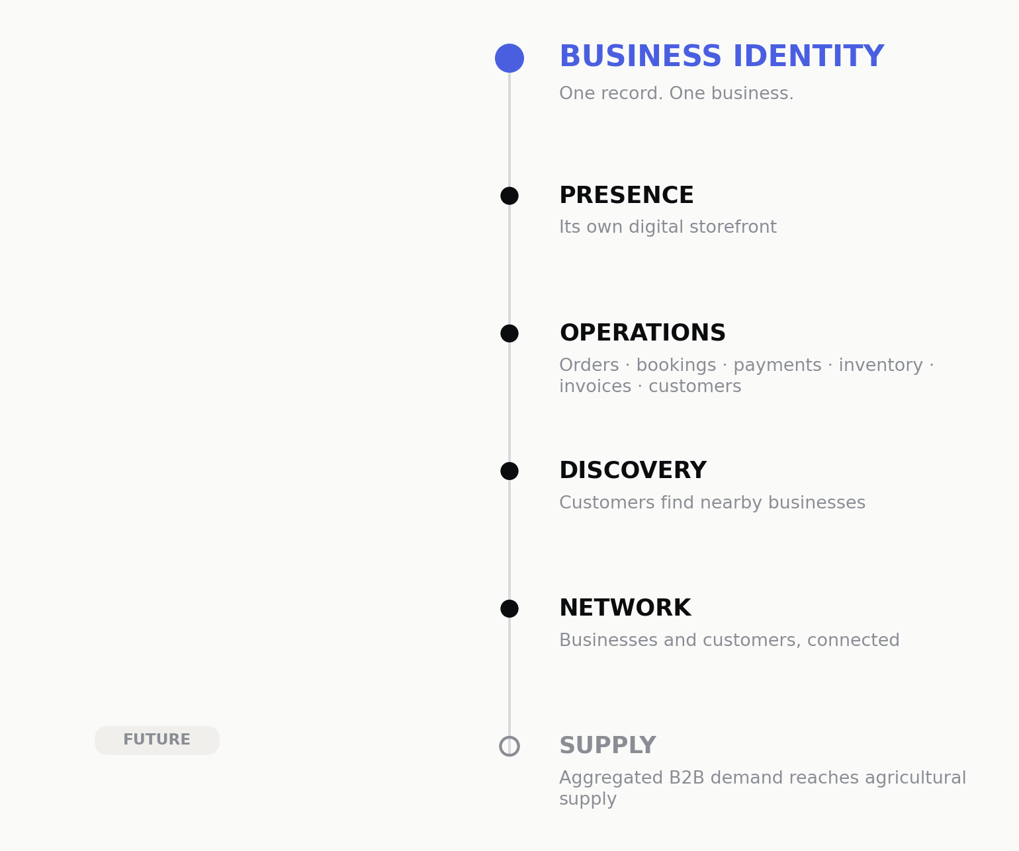
WHAT LOCAH ACTUALLY PROVIDES
Not a website. Not an app. A layer businesses build on.
LOCAH · TECHNOVA 2026
04 / 20

Slide 5
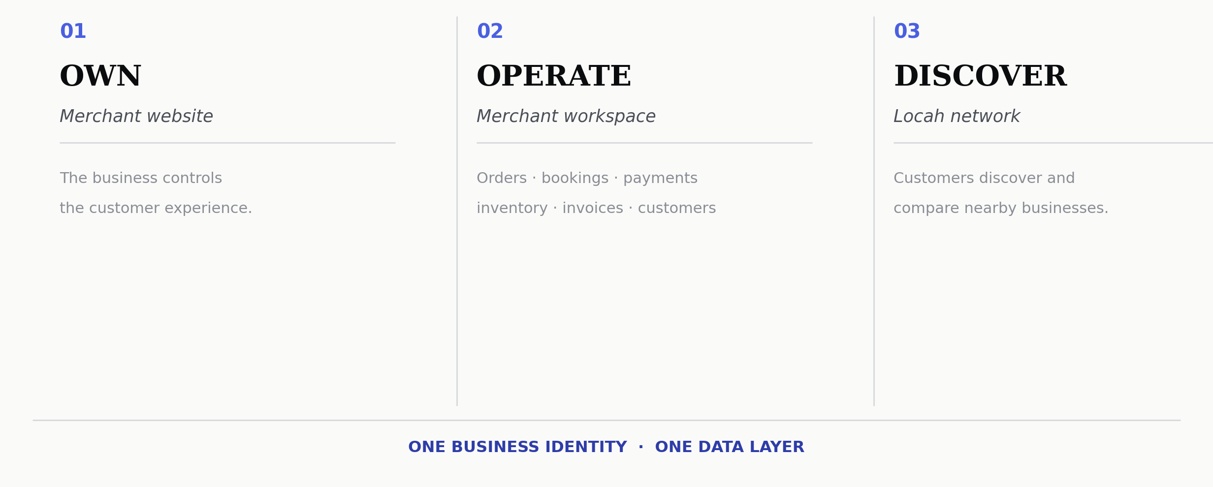

THE PRODUCT, TODAY
One identity. Three surfaces.
Business type is configuration — not a separate application.
LOCAH · TECHNOVA 2026
05 / 20

Slide 6
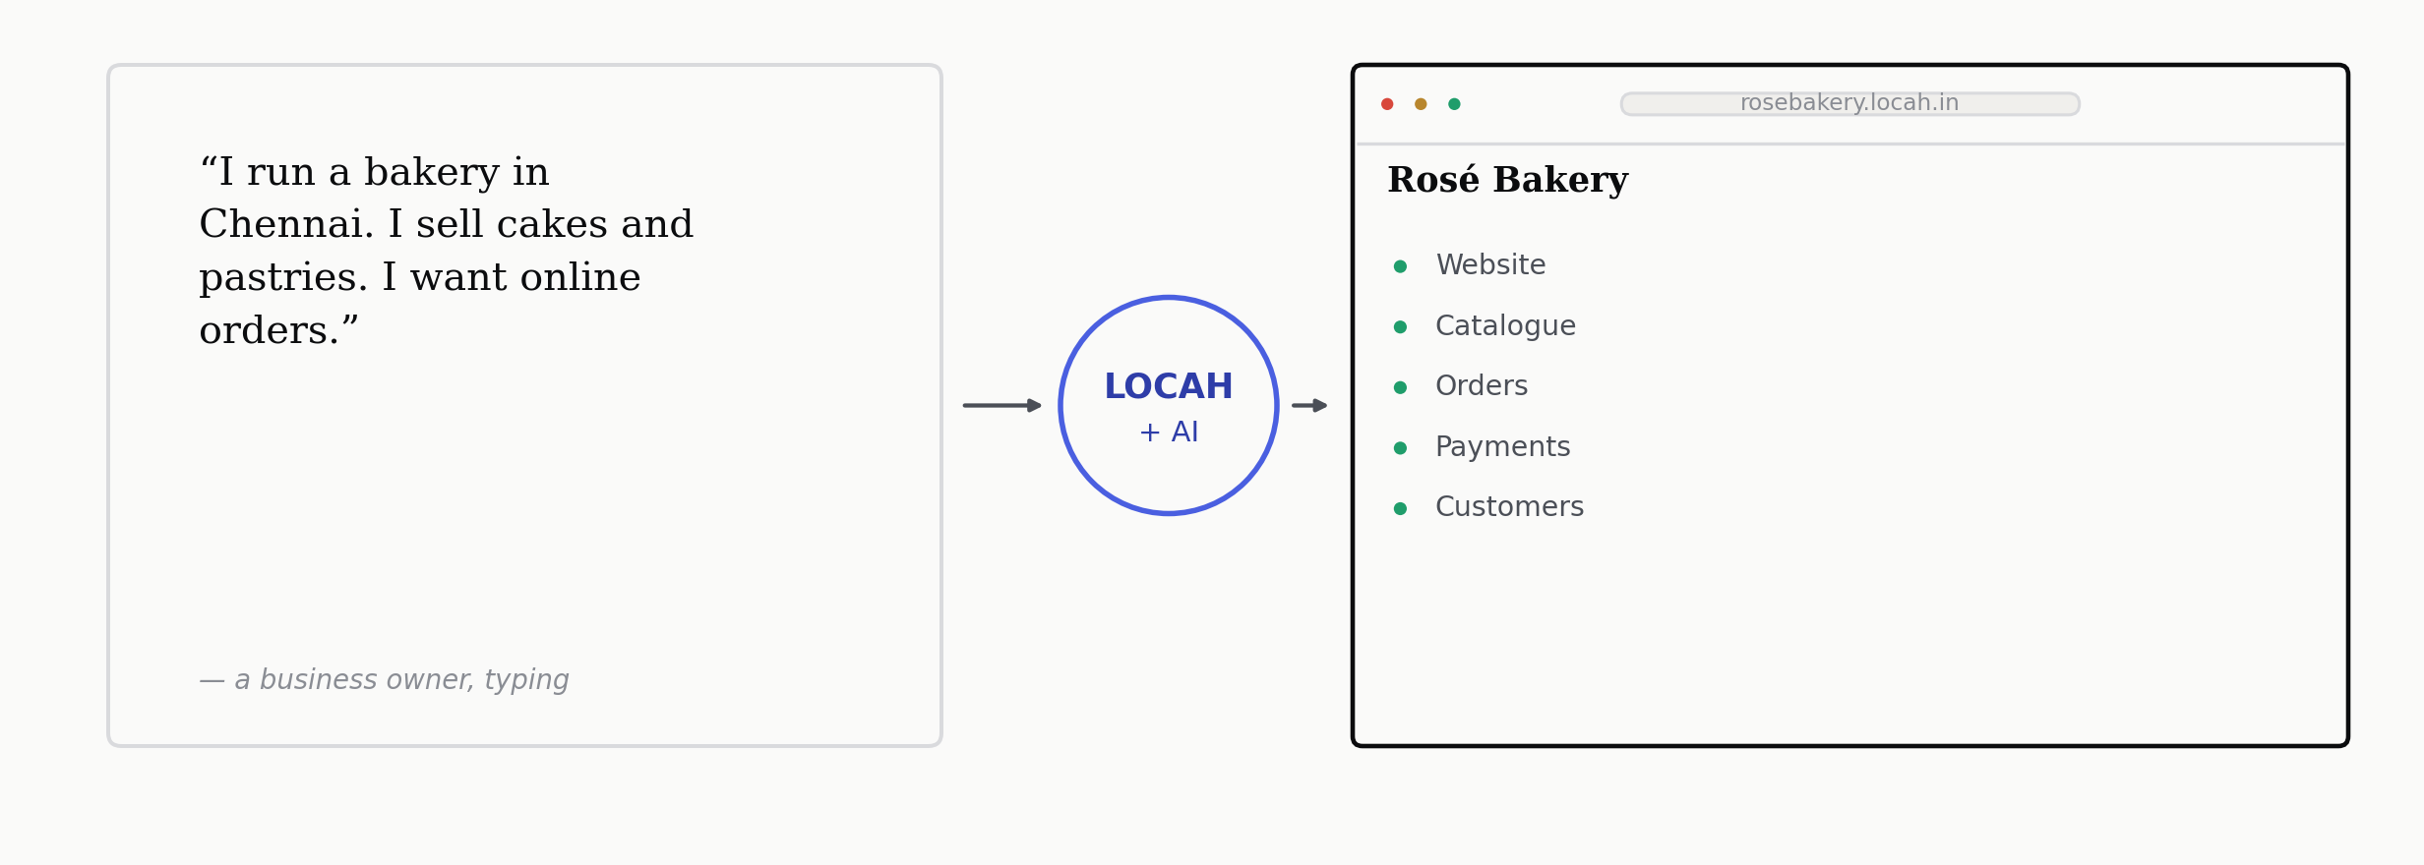
HOW IT STARTS
Tell Locah what your business does.
Locah turns that into a working digital business — in minutes, not weeks.
LOCAH · TECHNOVA 2026
06 / 20

Slide 7
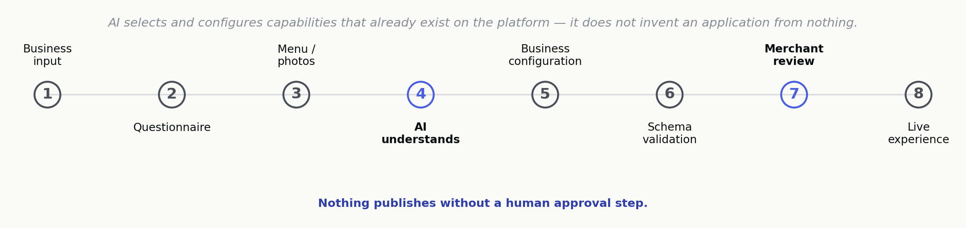
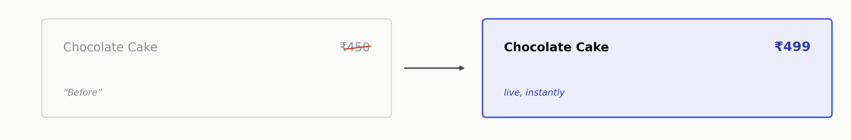
HOW THE AI ACTUALLY WORKS
AI configures a real system — it doesn’t invent one.
Your business website is editable like a document — not maintained like software.
LOCAH · TECHNOVA 2026
07 / 20

Slide 8
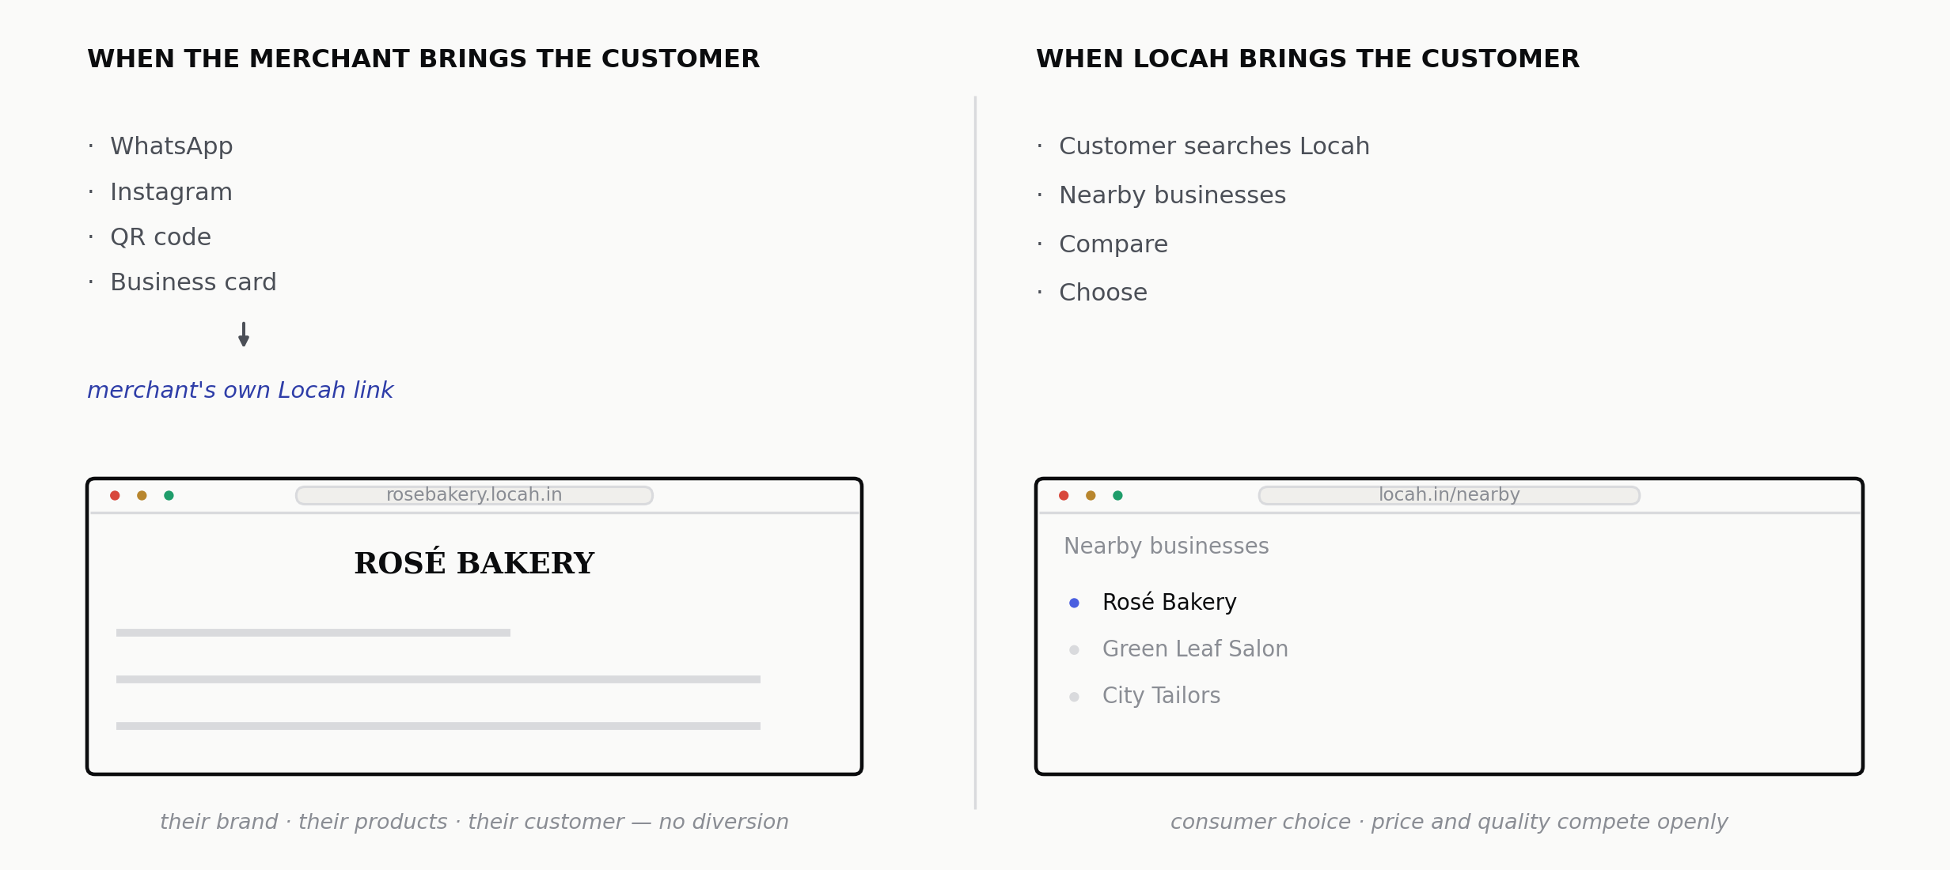
THE CORE INNOVATION
The website within a website.
LOCAH · TECHNOVA 2026
08 / 20

Slide 9
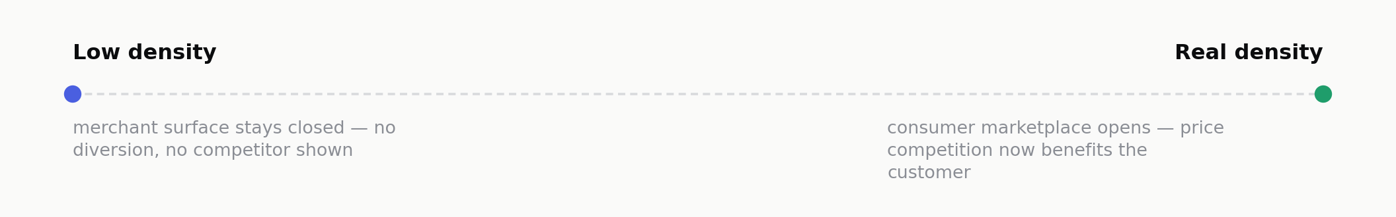
THE PRINCIPLE
Merchant-owned traffic stays merchant-owned.
Network traffic becomes consumer choice.
The privilege scales with density:
LOCAH · TECHNOVA 2026
09 / 20

Slide 10
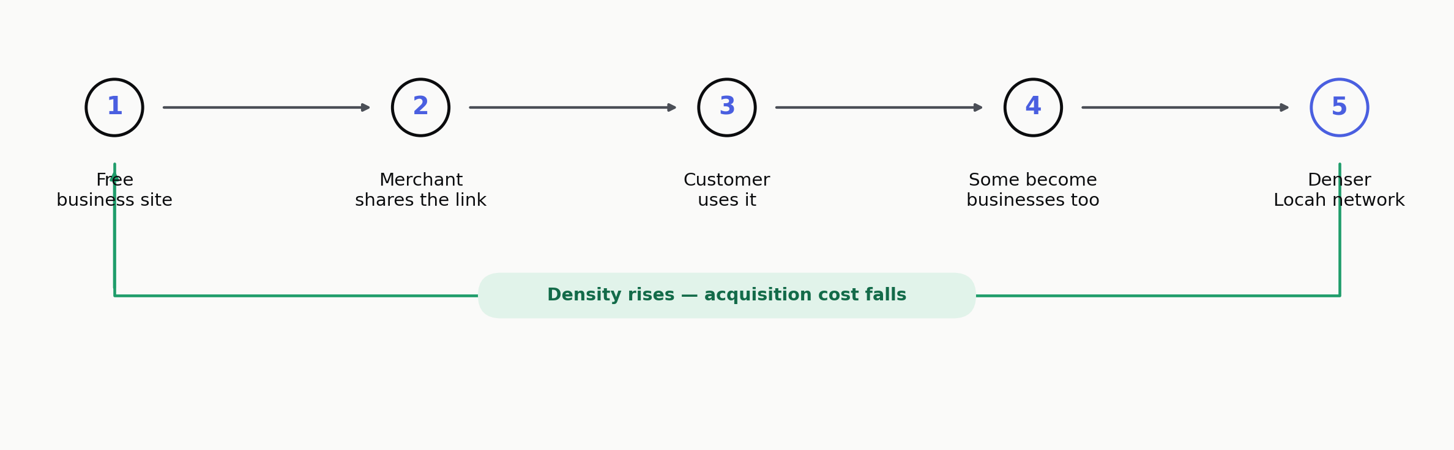
WHY GROWTH IS FREE
Every merchant becomes a distribution channel.
We don’t have to buy every customer. The businesses already have them.
LOCAH · TECHNOVA 2026
10 / 20

Slide 11
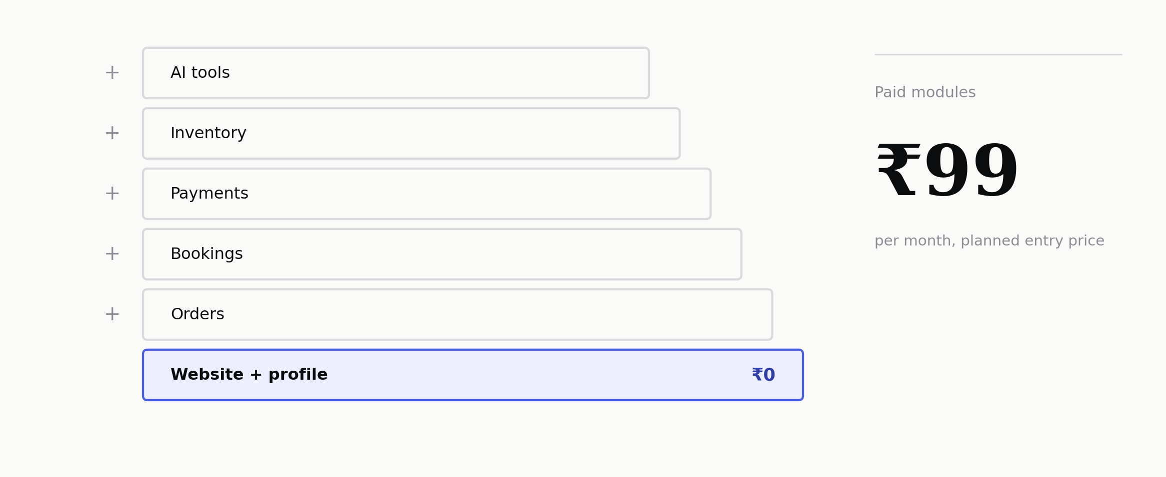
PRICING
Don’t buy software you don’t need.
Start free. Switch on what you need. Pay for what you use.
LOCAH · TECHNOVA 2026
11 / 20

Slide 12
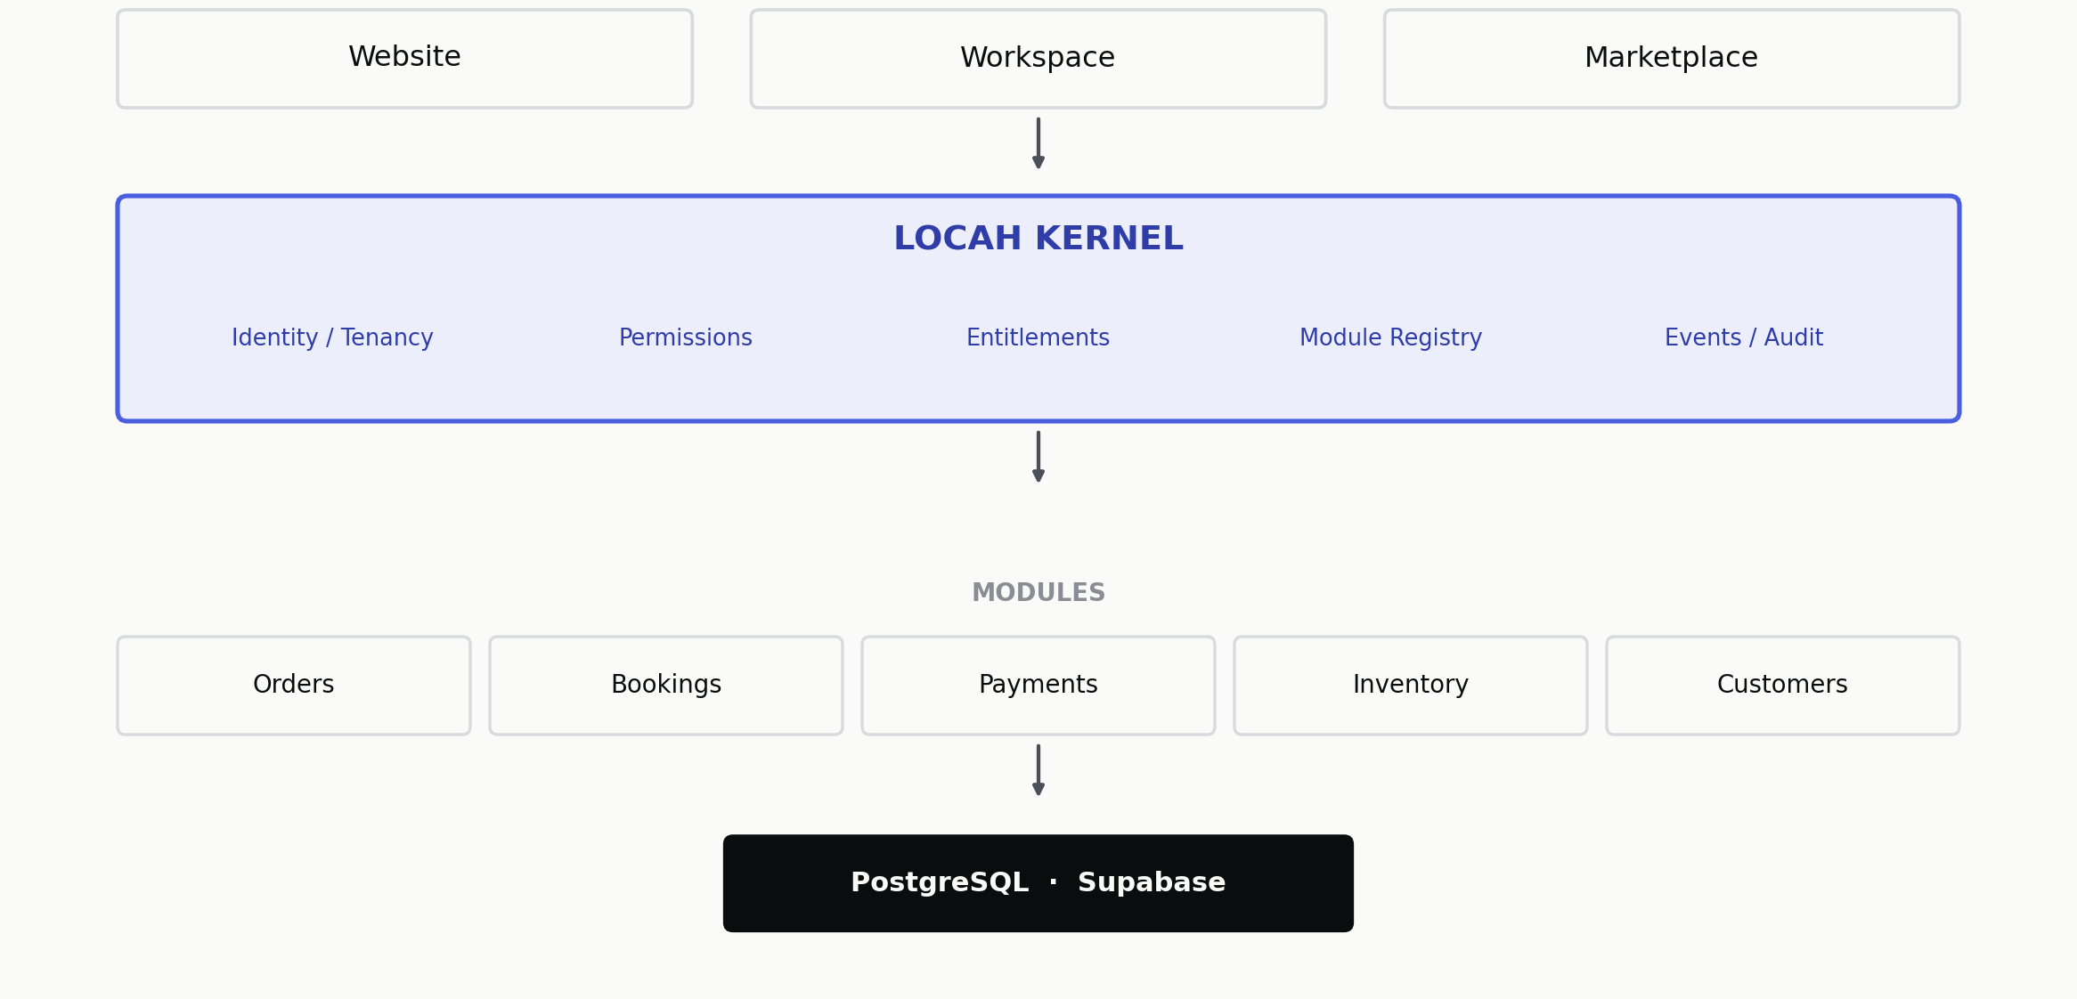
UNDER THE HOOD
Surfaces on top. One kernel underneath.
LOCAH · TECHNOVA 2026
12 / 20

Slide 13
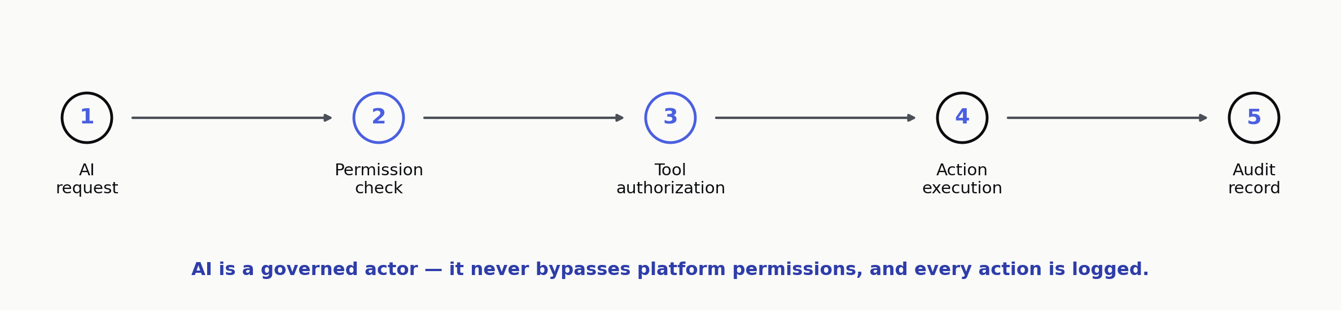
AI, GOVERNED
AI cannot bypass platform permissions.
Every AI action is scoped to one business — it cannot read another business’s data.
Tool access is explicitly configured per AI employee — entitlement alone authorizes nothing.
Every interaction is written to an audit record. Financial or sensitive actions require approval.
LOCAH · TECHNOVA 2026
13 / 20

Slide 14
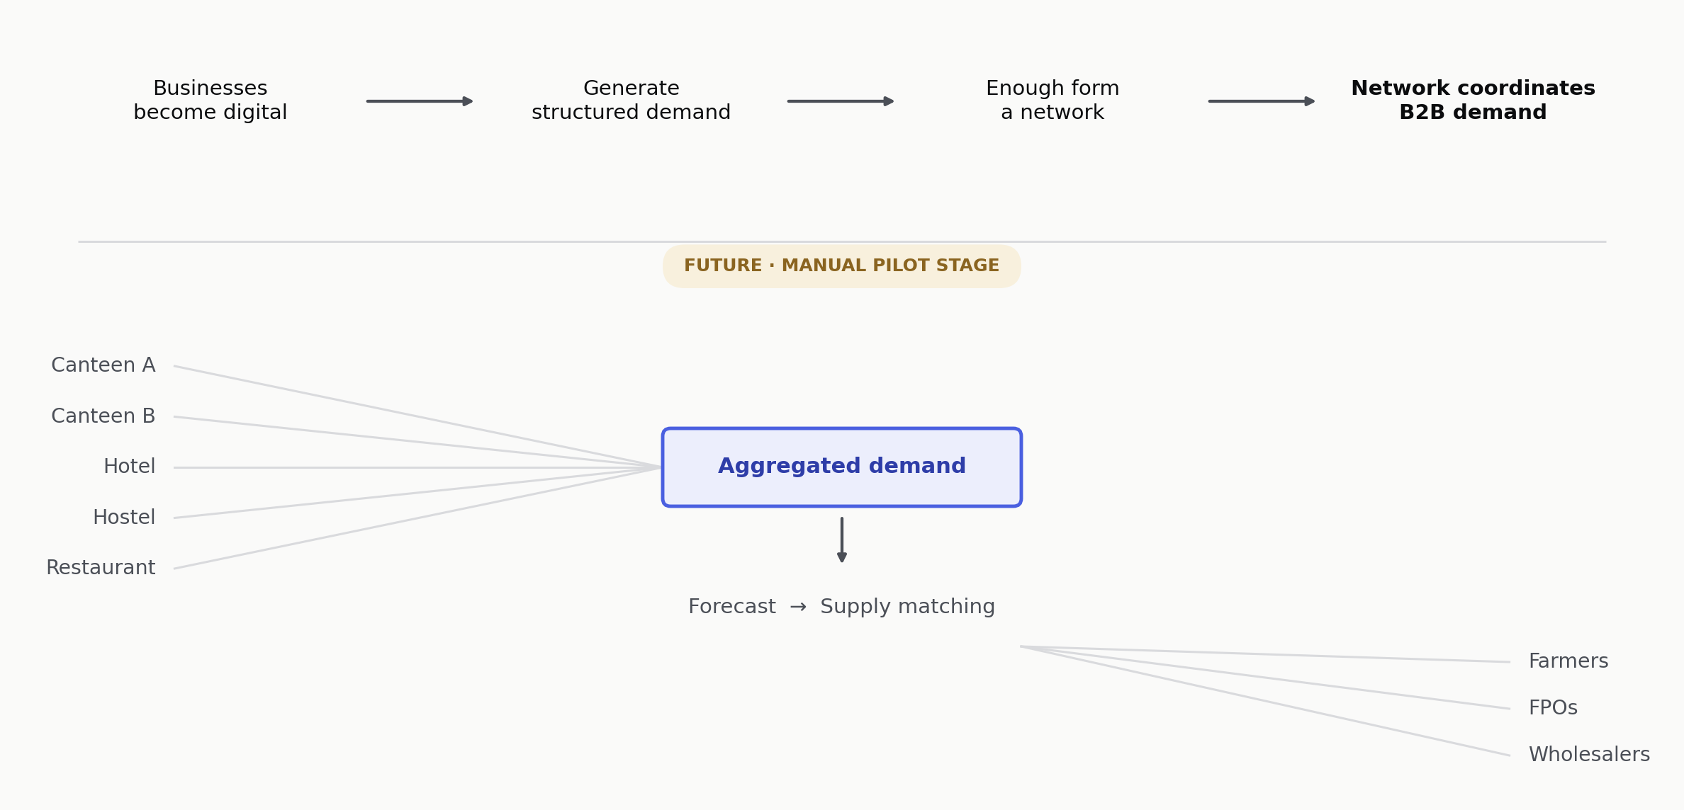
THE NETWORK EXPANDS — FUTURE
Businesses first. Then their demand. Then the network coordinates it.
We are not building another vegetable marketplace. We are building the coordination layer between fragmented demand and fragmented supply.
LOCAH · TECHNOVA 2026
14 / 20

Slide 15
WHY THIS IS DIFFERENT
Presence. Operations. Discovery. One identity.
FREELANCER
WEBSITE
SaaS TOOLS
AGGREGATORS
LOCAH
Gives presence.
Gives operations.
Gives discovery.
Presence + Operations + Discovery.
Not operations. Not discovery.
Fragmented — a different vendor for every function.
But the platform owns the customer relationship.
One identity. Merchant-owned traffic. AI-assisted setup. Modular pricing.
LOCAH · TECHNOVA 2026
15 / 20

Slide 16
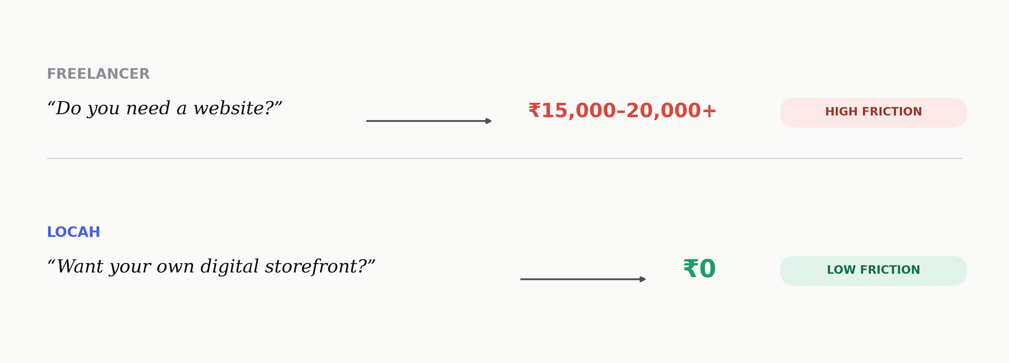
GO-TO-MARKET
We sell exactly what freelancers already sell.
We just remove the price.
LOCAH · TECHNOVA 2026
16 / 20

Slide 17
BUSINESS MODEL & IMPACT
A modular platform. A measurable impact.
Free to start · usage-based modules planned from ₹99/month · Locah Supply extends the model to B2B
ECONOMIC
SOCIAL
ENVIRONMENTAL
Lower digitisation cost
Accessible to non-technical owners
Demand forecasting
A new sales channel
Vernacular, voice-first interaction — planned
Less agricultural wastage
Less software fragmentation
An independent merchant presence
Aggregated procurement
Better inventory decisions
Local discovery for customers
Fewer unnecessary trips
LOCAH · TECHNOVA 2026
17 / 20

Slide 18
PROOF — CURRENT STATUS
Built, verifiably — not claimed.
BUILT
IN PROGRESS
NEXT
Platform kernel — identity, tenancy, entitlement, audit
Merchant workspace UI — 7 of 15 core pages, 4 of 10 module pages
First Chennai cluster — VIT Chennai, Kelambakkam, Sholinganallur
Commerce primitives — orders, bookings, invoicing, COD payment
AI onboarding integration
Founder-led onboarding, free tier
Presence & marketplace indexing foundation
Payment provider integration — COD live, Razorpay next
Locah Supply — manual B2B pilot
Row-level security — 60 policies authored & tested
Consumer marketplace app
API test suite — 166 of 167 passing on a live hosted database
“Because the fastest way to lose a technical evaluator is to claim a finished platform and demo a partially wired one.” — everything above is verifiable in the repository.
LOCAH · TECHNOVA 2026
18 / 20

Slide 19
RISKS — AND WHAT WE’RE VALIDATING NEXT
Five real risks. Five deliberate answers.
Merchants don’t adopt
Free entry, zero commitment — the first outcome is their own live site.
AI produces wrong output
Constrained generation, schema validation, mandatory human approval. Nothing auto-publishes.
Marketplace cold start
The consumer surface stays closed until merchant density in one cluster is real.
B2B adoption is slow
WhatsApp and voice first — not another app to install.
Inference cost
Small open-weight models for cheap tasks; frontier models only where quality matters.
Asking TECHNOVA for: mentoring on two-sided marketplace sequencing and compliance, incubation space for the first Chennai cluster, and industry introductions for the Supply pilot.
LOCAH · TECHNOVA 2026
19 / 20

Slide 20
THE BIG VISION
From one small business
to a local digital network.
One identity. One operating layer. One network.
Locah starts by giving a small business the digital infrastructure it could never justify building alone. When thousands of those businesses become connected, the infrastructure becomes a network.
LOCAH
The digital layer between local businesses and the people around them.
Team The Think Tank · Kausik G H · Rithik Raju · Gowtham

