Slide 1
SimpleBlog
Software Testing and Quality Assurance
Mini Project (II)
Submitted by:
Aditya Jadhav (41332)
Karan Kangude (41340)
Kaustubh Odak (41341)

Slide 2
Title
Problem Definition
Create a small web-based application by selecting relevant system environments/platforms and programming languages. Narrate concise Test Plan consisting of features to be tested and bug taxonomy. Narrate scripts in order to perform regression tests. Identify the bugs using Selenium WebDriver and IDE and generate test reports encompassing exploratory testing.
Perform web testing and identify the bugs using Selenium WebDriver and IDE and generate test reports encompassing exploratory testing on a self deployed web app.

Slide 3
Objective
Test Environment
Perform testing on a blogging site and write test cases.
64-bit Linux/Windows Operating System
Node.js v14.x LTS or above
NPM v7.x (latest-7) or above
Yarn v1.22.x (latest)
Selenium WebDriver and IDE
Mozilla Firefox (or gecko-based browser) / Google Chrome (or chromium-based browser)

Slide 4
Use cases
Tech Stack
Features
View posts
Create post
Edit post
Delete post
Dynamic theming
Markdown support

Slide 5
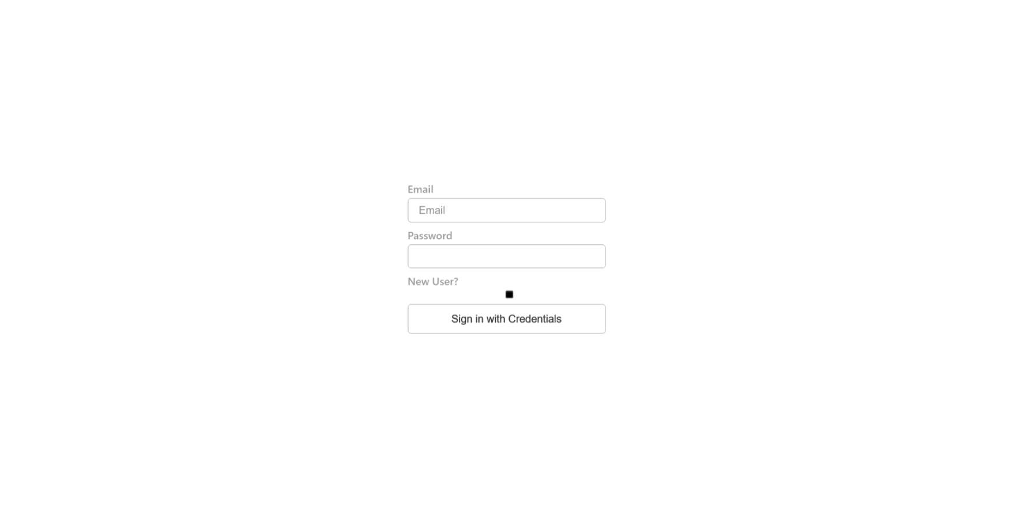
Screenshots - Authentication

Slide 6
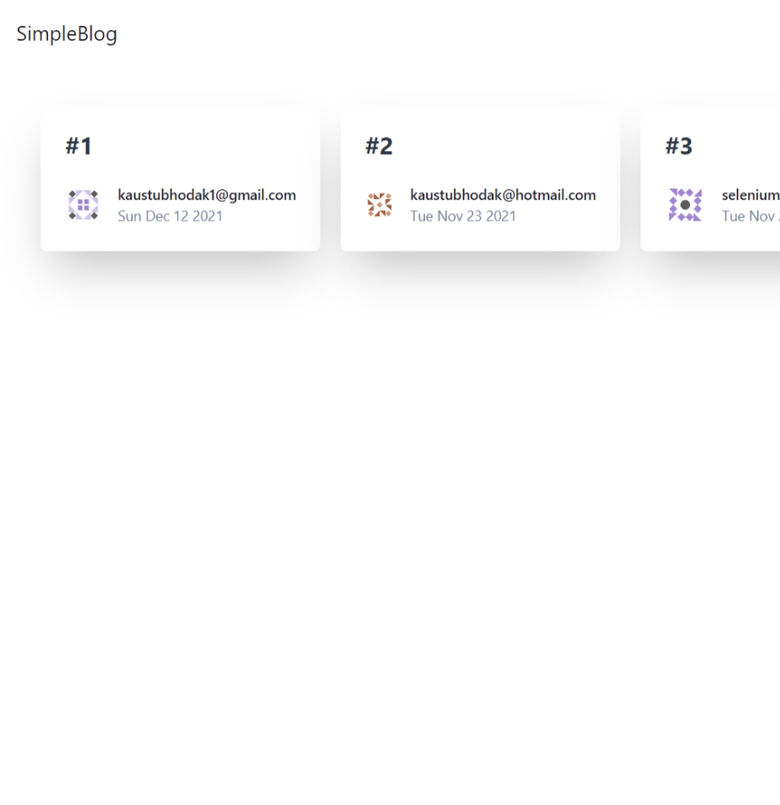
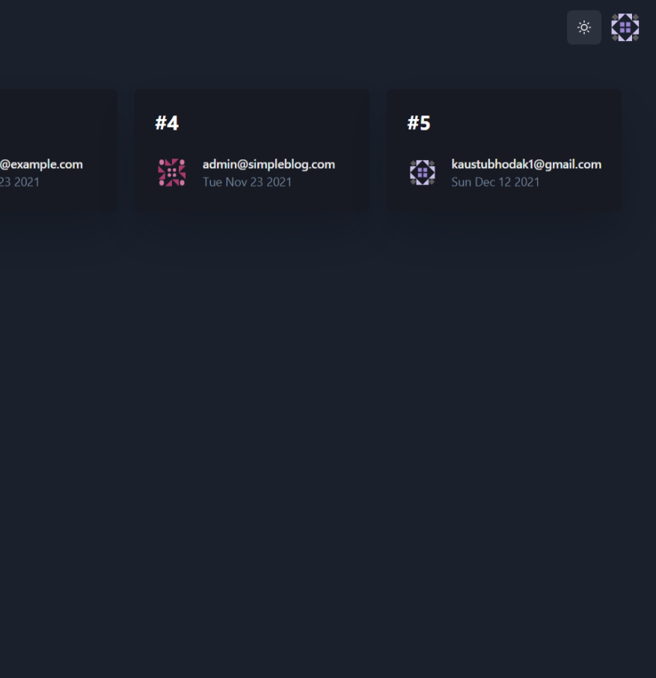
Screenshots - View posts (Light & Dark Theme comparison)

Slide 7
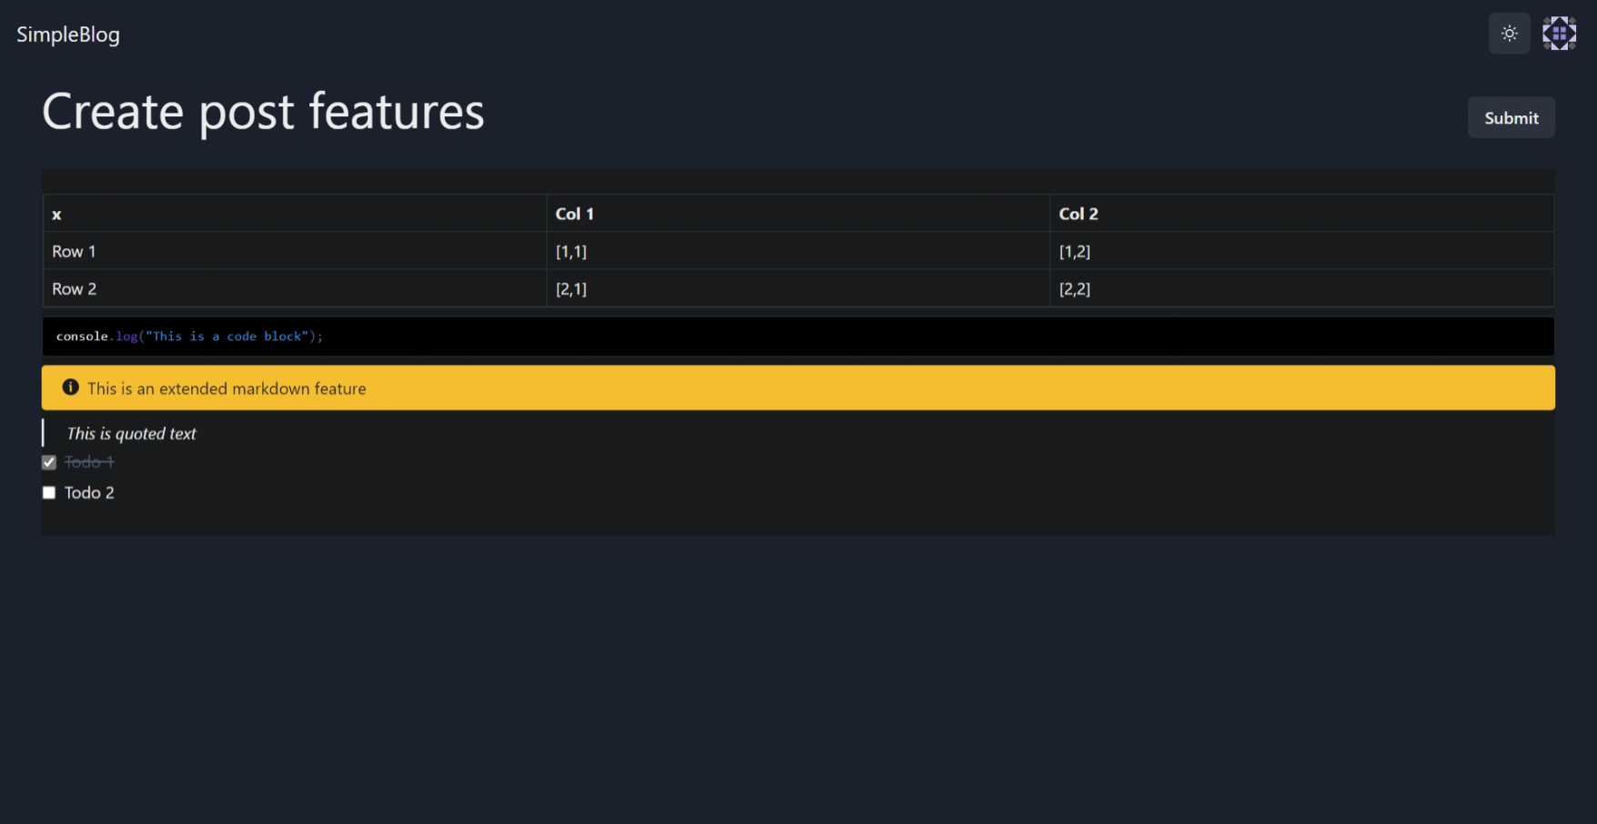
Screenshots - Create post with markdown

Slide 8
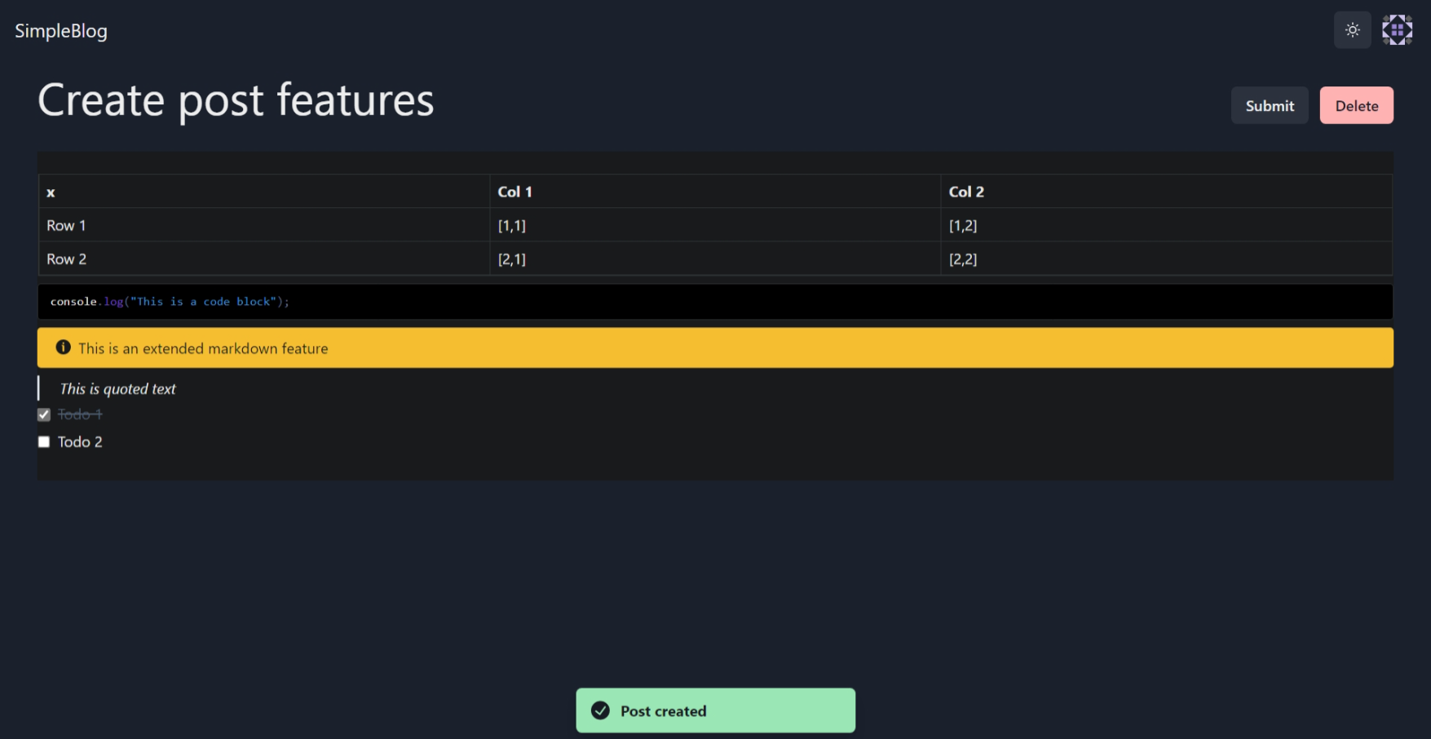
Screenshots - View post (edit/delete)

Slide 9
Features tested
Login user
Valid credentials
Invalid credentials
Missing fields
Register user
Valid fields
User already exists
Create post
Missing fields
Valid fields
Delete post
Edit post
Logout

Slide 10
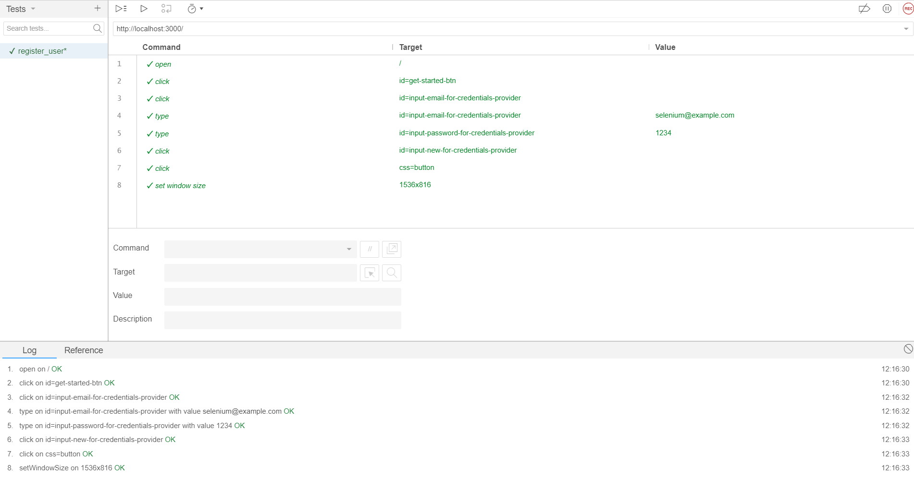
Test - Register user

Slide 11
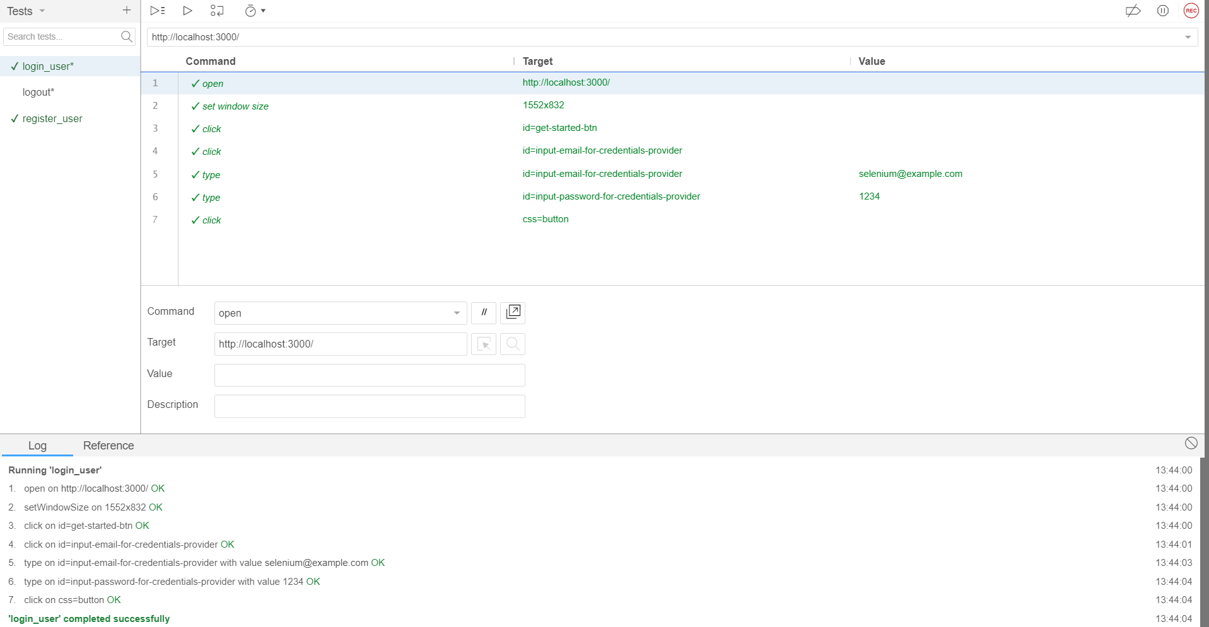
Test - Login user

Slide 12
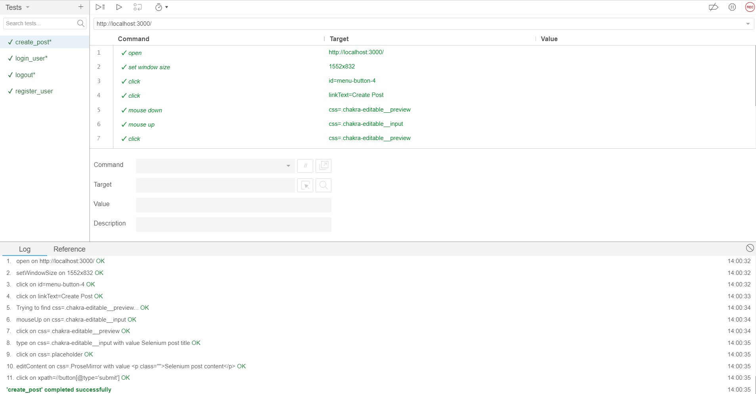
Test - Create post

Slide 13
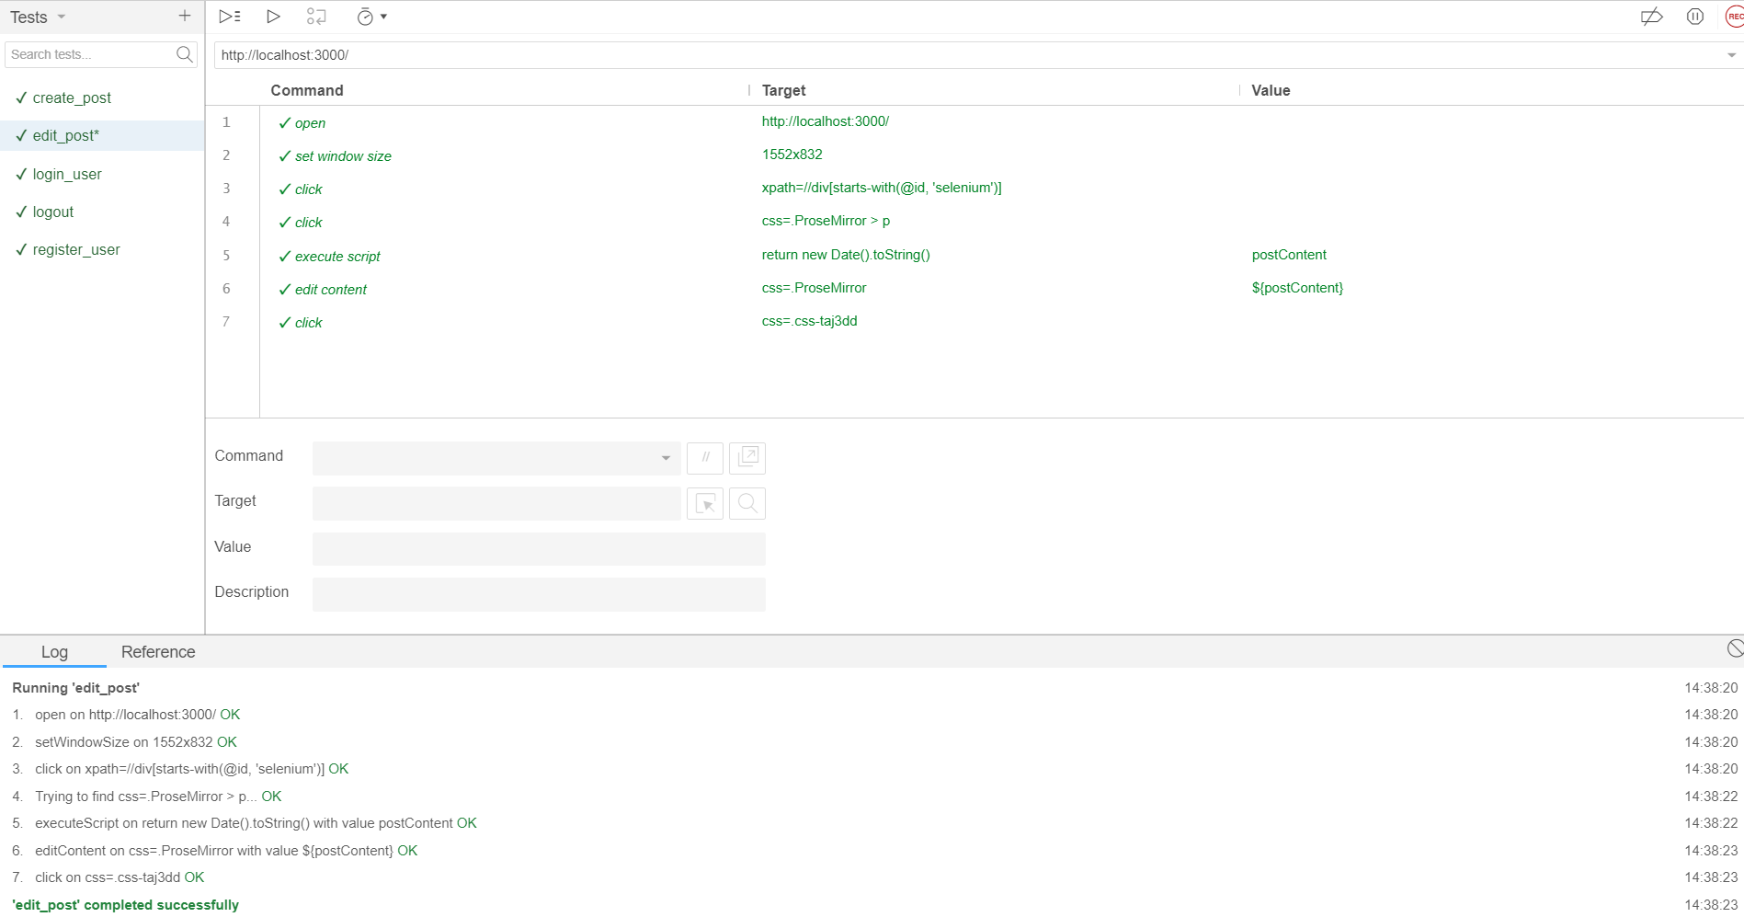
Test - Edit post

Slide 14
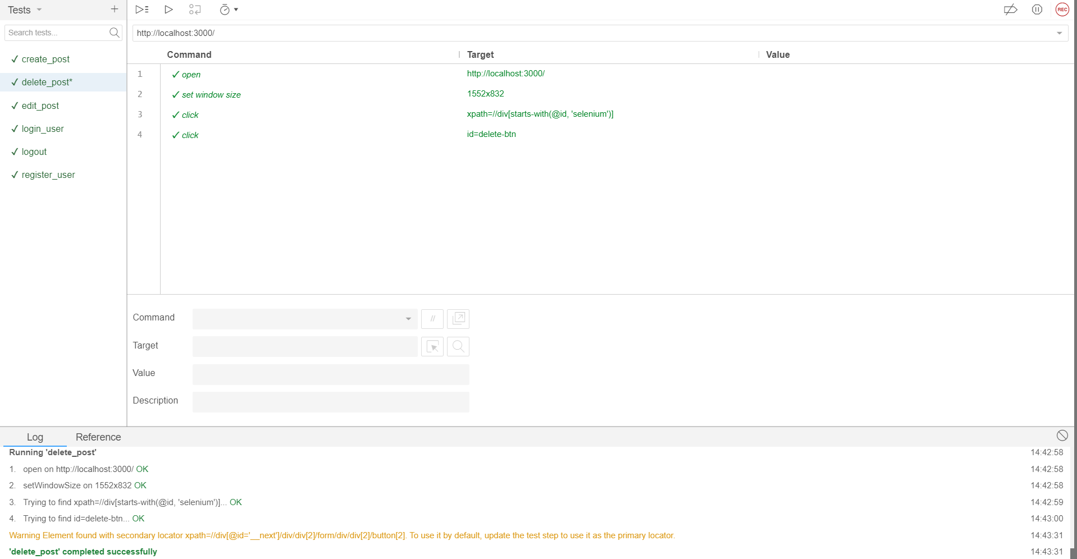
Test - Delete post

Slide 15
Code
// Module imports
const { Builder, By, Key, until } = require('selenium-webdriver')
const assert = require('assert')
const { describe, it, beforeEach, afterEach } = require('mocha')
// Test suite
describe('test_suite', function() {
this.timeout(30000)
let driver
let vars
beforeEach(async function() {
driver = await new Builder().forBrowser('chrome').build()
vars = {}
})
afterEach(async function() {
await driver.quit();
})
it('test_name', async function () {
// test body
})
})

Slide 16
Code - Sample test (invalid user login)
it('login_user_invalid', async function() {
await driver.get("http://localhost:3000/")
await driver.manage().window().setRect({ width: 1552, height: 832 })
await driver.findElement(By.id("get-started-btn")).click()
await driver.findElement(By.id("input-email-for-credentials-provider")).click()
await driver.findElement(By.id("input-email-for-credentials-provider")).sendKeys("selenium@example.com")
await driver.findElement(By.id("input-password-for-credentials-provider")).sendKeys("12345")
await driver.findElement(By.css("button")).click()
{
const elements = await driver.findElements(By.xpath("//p[contains(.,\'Sign in failed. Check the details you provided are correct.\')]"))
assert(elements.length)
}
})

Slide 17
Conclusion
Performed automated tests on self-developed blogging website and verified the absence of bugs and defects.

