Slide 1
2D Poisson Equation in PETSc

Slide 2
PETSc
PETSc, the Portable, Extensible Toolkit for Scientific Computation, includes a large suite of scalable parallel linear and nonlinear equation solvers, ODE integrators, and optimization algorithms for application codes written in C, C++, Fortran, and Python.
PETSc includes support for managing parallel PDE discretizations including parallel matrix and vector assembly routines.
Why PETSc?
Handles large-scale computations.
Supports a wide range of solvers and preconditioners.
Highly customizable and efficient for parallel computing environments.

Slide 3
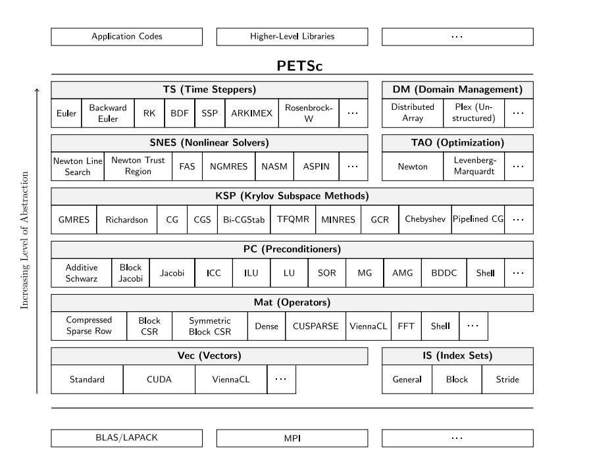
Numerical Libraries in PETSc

Slide 4
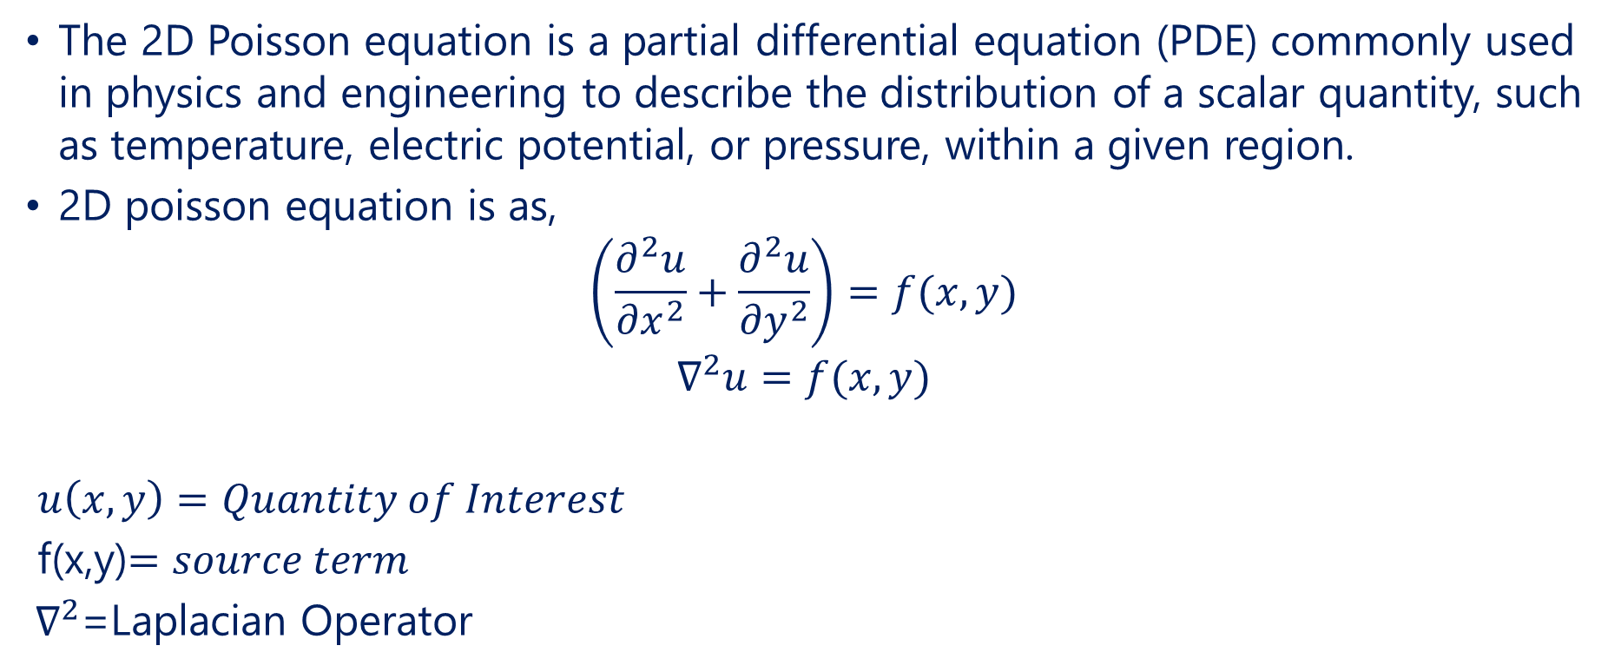
Poisson Equation
The 2D Poisson equation is a partial differential equation (PDE) commonly used in physics and engineering to describe the distribution of a scalar quantity, such as temperature, electric potential, or pressure, within a given region.
2D poisson equation is as,
$$\left(\frac{∂^{2}u}{{∂x}^{2}}+\frac{∂^{2}u}{{∂y}^{2}}\right)=f(x,y)$$
$$∇^{2}u=f(x,y)$$
$u\left(x,y\right)=Quantity of Interest$
f(x,y)$=source term$
${ ∇}^{2}$=Laplacian Operator

Slide 5
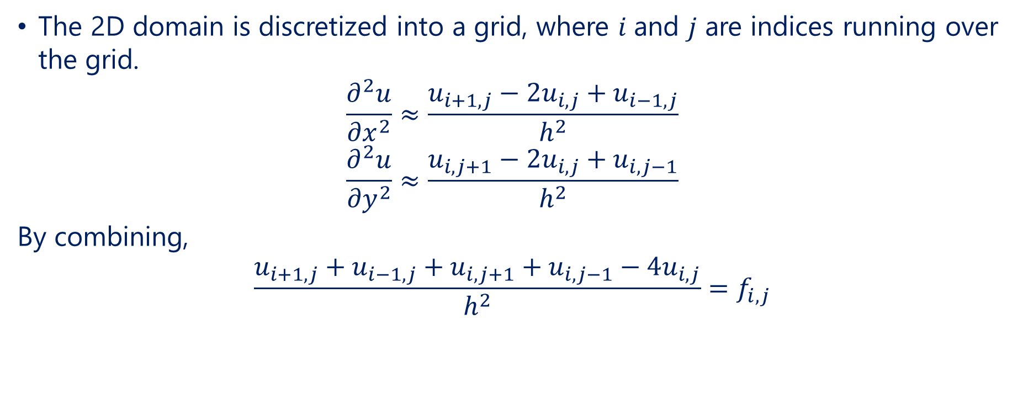
Discretization of the Poisson Equation
The 2D domain is discretized into a grid, where 𝑖 and 𝑗 are indices running over the grid.
$$\frac{∂^{2}u}{{∂x}^{2}}≈\frac{u_{i+1,j}−{2u}_{i,j}+u_{i−1,j}}{h^{2}}$$
$$\frac{∂^{2}u}{{∂y}^{2}}≈\frac{u_{i,j+1}−{2u}_{i,j}+u_{i,j−1}}{h^{2}}$$
By combining,
$$\frac{u_{i+1,j}+u_{i−1,j}+u_{i,j+1}+u_{i,j−1}−4u_{i,j}}{h^{2}}=f_{i,j}$$

Slide 6
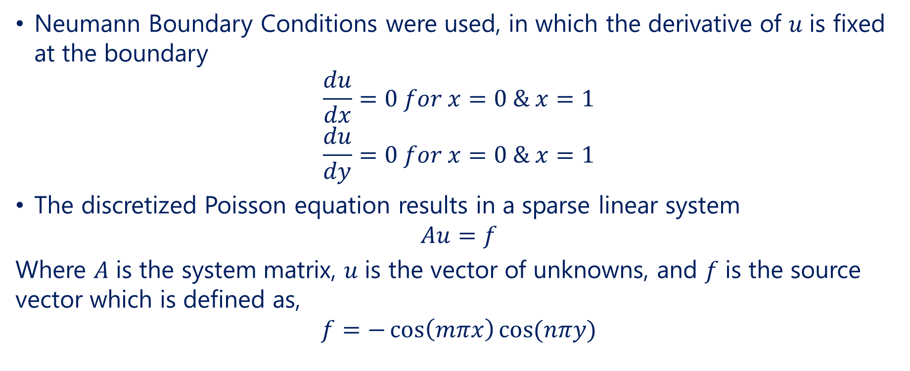
Boundary Condition
Neumann Boundary Conditions were used, in which the derivative of 𝑢 is fixed at the boundary
$$\frac{du}{dx}=0 for x=0 \& x=1$$
$$\frac{du}{dy}=0 for x=0 \& x=1$$
The discretized Poisson equation results in a sparse linear system
$$Au=f$$
Where 𝐴 is the system matrix, 𝑢 is the vector of unknowns, and 𝑓 is the source vector which is defined as,
$$f=−\cos\left(mπx\right)cos⁡(nπy)$$

Slide 7
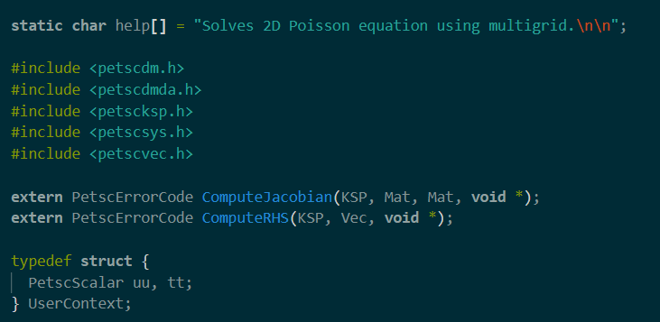
Libraries
Petscdm: Includes the PETSc Data Management (DM) routines, which are used for handling the problem domain and its decomposition.
Petscdmda: Includes routines specific to the Distributed Array (DA) object, which is often used for structured grids, such as the 2D grid in this case.
Petscksp: Includes the PETSc Krylov Subspace Solver (KSP) routines, which are used to solve linear systems.
Petscsys: Includes system-level routines, such as error handling and utility functions
Petscvec: Includes routines for vector operations
Defines a structure named User Context to hold user-defined data.
Declaration of Functions, They are used for computing the Jacobian matrix and the right-hand side (RHS) vector for the linear system.

Slide 8
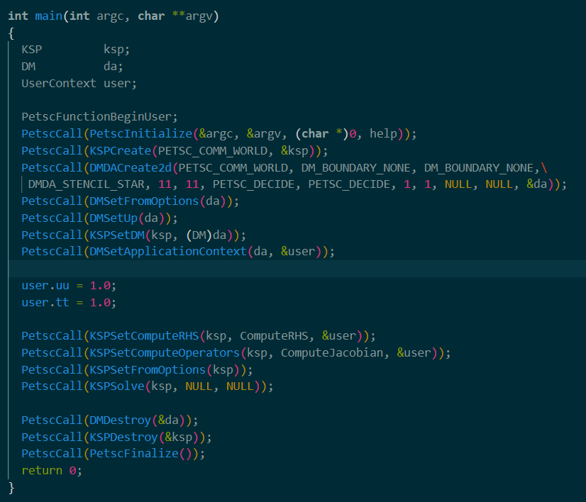
Function Declaration
PetscInitialize: Initializes the PETSc library.
KSPCreate: Creates a new KSP (Krylov Subspace Solver) context.
DMDACreate2d: Creates a 2D distributed array (grid) for the problem
DMSetFromOptions: Configures the DM object based on command-line options or default values.
DMSetUp: Sets up the DM object, which includes allocating memory and other initialization tasks.
KSPSetDM: Associates the DM object with the KSP solver. This allows the solver to use the grid defined by da.
DMSetApplicationContext: Sets user-defined data to the DM object. This data can be accessed by the functions that compute the RHS and Jacobian.
PetscFinalize: Finalizes the PETSc library, cleaning up any remaining resources.
Number of grid points in each dimension
Initialize User Data

Slide 9
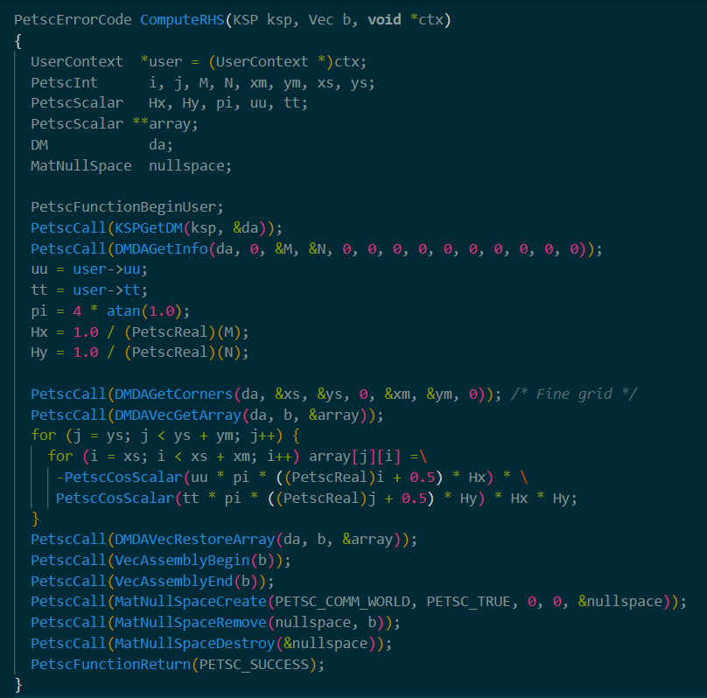
Computation of RHS
Integer variables for loop indices and grid dimensions.
Scalar variables for grid spacing, constant values, and user-defined parameters.
uu, tt: Retrieve user-defined parameters from the user context.
pi: Computes the value of π.
Hx, Hy: Computes the grid spacing in x and y directions.
Loop to compute RHS
Assemble the vector b, ensuring that it is correctly set up for use in the solver.

Slide 10
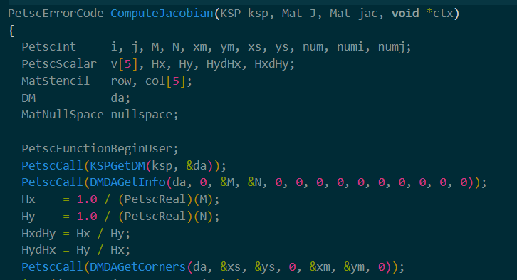
Computation of Jacobian Matrix
Integer variables for loop indices and grid dimensions
Scalars for storing matrix values and grid spacing.
MatStencil is a structure used to specify matrix rows and columns for sparse matrices.
Calculate grid spacing in x and y directions.
Calculate ratios of grid spacings.

Slide 11
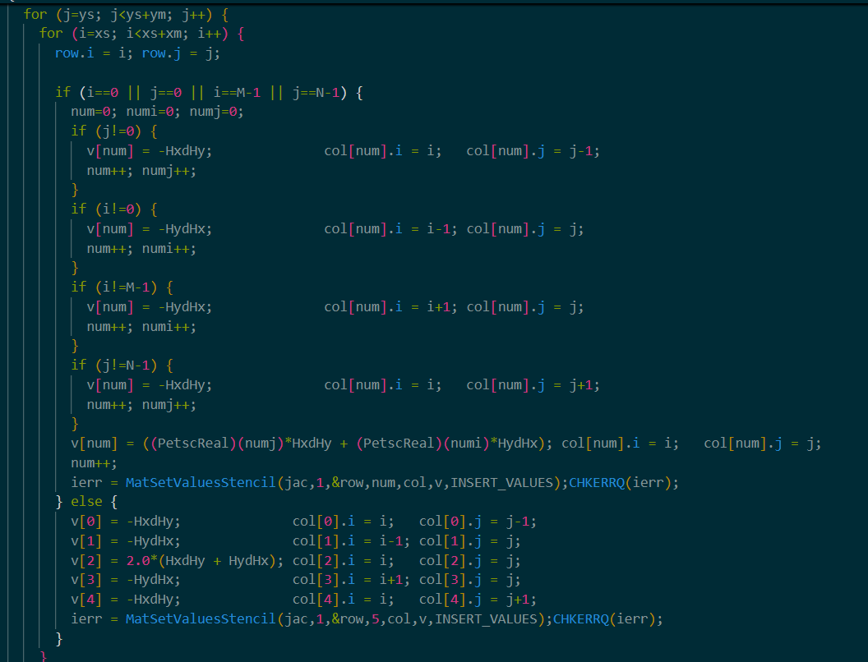
Computation of Jacobian Matrix
Loop iterates over the local grid portion to fill in the Jacobian matrix.
For points on the boundary of the grid, the matrix entries are adjusted based on the boundary conditions
The Jacobian entries for boundary points are computed differently from interior points.
For non-boundary points, the Jacobian is computed with the standard finite difference stencil for the 2D Poisson equation.

Slide 12
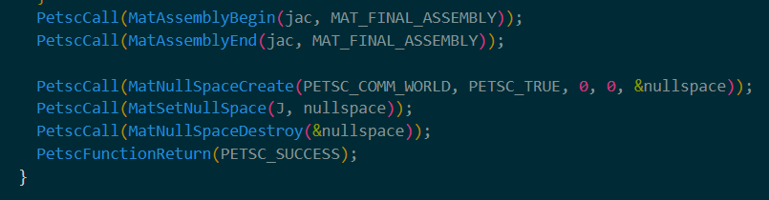
Computation of Jacobian Matrix
MatAssemblyBegin & MatAssemblyEnd: Complete the assembly of the Jacobian matrix. This is necessary to finalize the matrix before it is used in the solver.
MatNullSpaceCreate: Creates a null space object to manage null space in the matrix.
MatSetNullSpace: Sets this null space for the matrix J
MatNullSpaceDestroy: Frees the memory associated with the null space object.

Slide 13
Common Viewing and Monitoring Options
Viewing Options
-vec_view | Gives a text representation
-mat_view draw: : | can visualize some objects
-vec_view binary:sol.bin:, -vec_view : : matlab, -vec_view socket | alternative formats
-mat_view : :ascii_info, -mat_view ::ascii_info_detailed | sometimes provides extra information
Monitoring Options
ksp_monitor or –ksp_monitor_draw | display the residual
-ksp_monitors_cancel | can disable dynamically
-ksp_monitor_true_residual | can use the true residual
-ksp_gmres_Krylov_monitor | can display different subobject
-ksp_monitor_singular_value | can display the spectrum

Slide 14
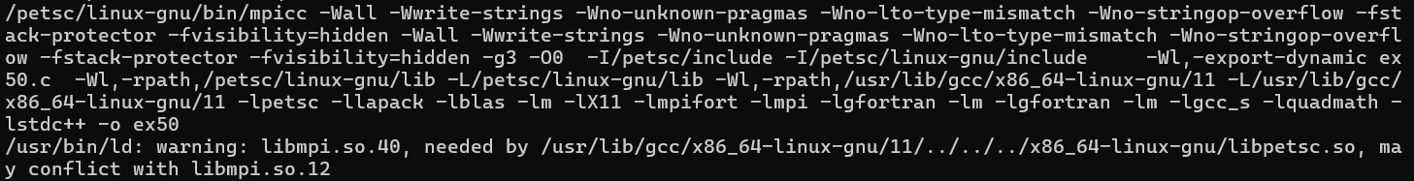
Running the Code
make ex50 VERBOSE=1
mpirun –np 4 ./ex50 -da_grid_x 100 -da_grid_y 100 -pc_type mg -pc_mg_levels 1 -mg_levels_0_pc_type ilu -mg_levels_0_pc_factor_levels 1 -ksp_monitor -ksp_view
-da_grid_x 100 -da_grid_y 100: Sets the number of grid points and defines the resolution of the computational grid.
-pc_type mg: Specifies the type of preconditioner to use. In this case, mg stands for multigrid, a method that accelerates the convergence of iterative solvers by solving the problem on multiple levels of grid resolution.

Slide 15
Running the Code
-pc_mg_levels 1: This option sets the number of levels in the multigrid hierarchy to 1. Since the multigrid preconditioner works by solving the problem on a hierarchy of coarser grids, specifying 1 level means that only one grid level is used.
-mg_levels_0_pc_type ilu: Specifies the type of preconditioner to use on the coarsest grid level (level 0) within the multigrid hierarchy. ilu stands for Incomplete LU (Lower-Upper) factorization, which is an approximate factorization technique used to precondition the matrix.
-mg_levels_0_pc_factor_levels1: This option sets the level of fill for the ILU preconditioner on the coarsest grid level (level 0). A value of 1 means that the ILU factorization will include elements up to the first level of fill.
-ksp_monitor: Enables monitoring of the Krylov Subspace Method (KSP) solver. This option will print information about the convergence of the solver at each iteration.
-ksp_view: This option displays the details of the KSP solver configuration and status after solving the system. It is useful for verifying solver settings and performance.

Slide 16
More ways to run the code
-pc_type mg -pc_mg_type full -ksp_type cg -ksp_monitor_short -da_refine 3 -mg_coarse_pc_type svd -ksp_view
-pc_type mg -pc_mg_type full -ksp_monitor_short -da_refine 5 -mg_coarse_ksp_type cg -mg_coarse_ksp_converged_reason -mg_coarse_ksp_rtol 1e-2 -mg_coarse_ksp_max_it 5 -mg_coarse_pc_type none -pc_mg_levels 2 -ksp_type pipefgmres -ksp_pipefgmres_shift 1.5
Conjugate Gradient method for solving linear system
Refines the mesh 3 times
Uses SVD as the preconditioner for the coarse grid
Set the relative tolerance for convergence
Sets the maximum no.of iteration for the coarse grid

Slide 17
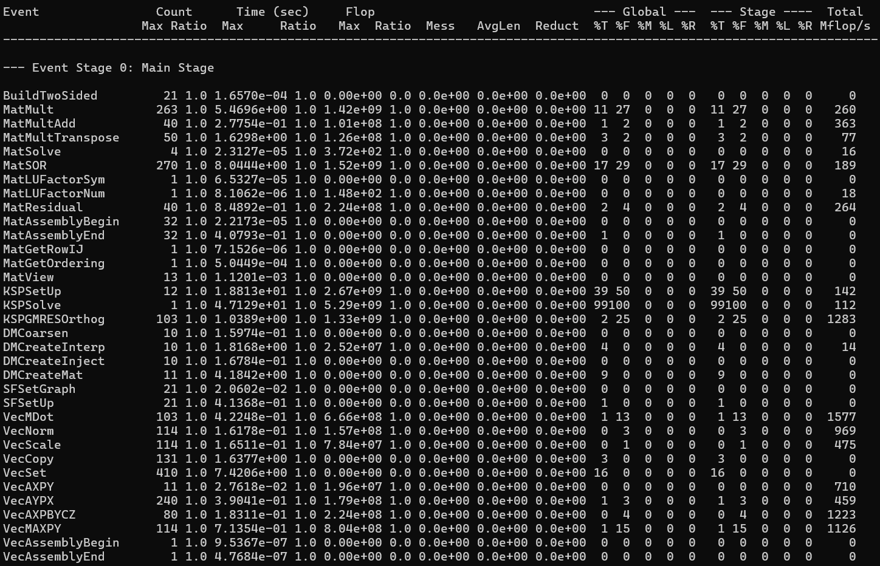
Code Profiling (4-Processors)

Slide 18

Code Profiling (3-Processors)

Slide 19
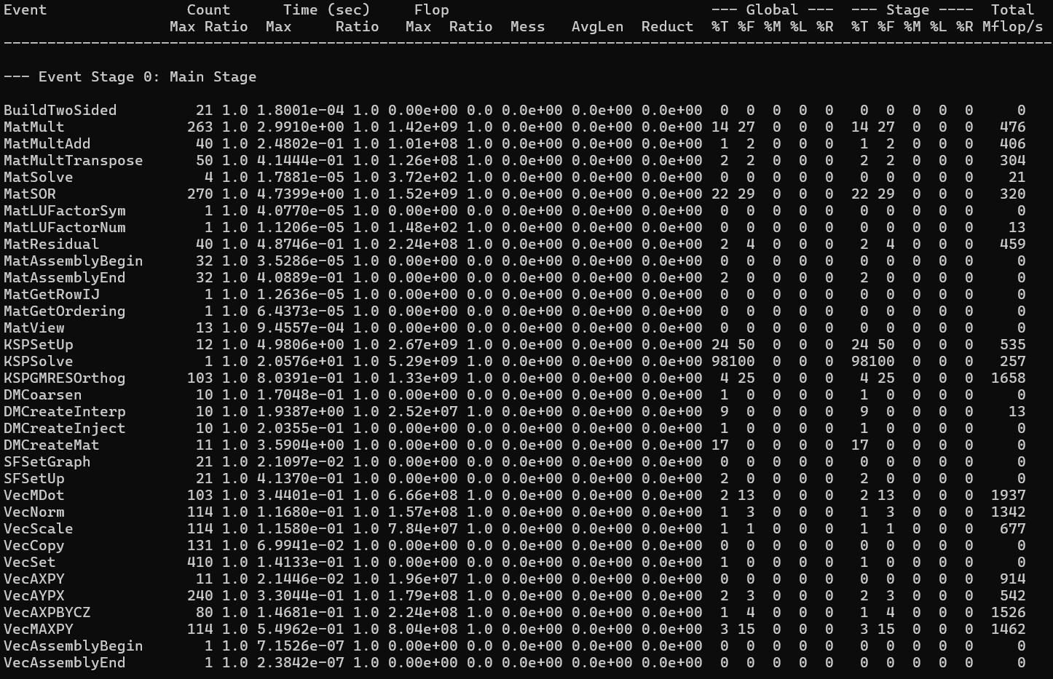
Code Profiling (2-Processors)

Slide 20

Code Profiling (1-Processors)

Slide 21
References
https://petsc.org/release/manual/
https://petsc.org/release/tutorials/
https://www.mcs.anl.gov/petsc/documentation/tutorials/INL05/tutorial.pdf

