Slide 1


Plant Disease Identification System Using CNN
E23CSEU1206-Kaushtubh Tiwari
E23CSEU1213-Arnav Ahlawat

Slide 2
Introduction
Agriculture plays a vital role in the global economy.
Plant diseases can drastically affect yield and farmer income.
Manual disease identification is time-consuming and error-prone.
Our solution: An AI-powered system to detect plant diseases from images using CNN.

Slide 3
Motivation
Developing an efficient and accurate plant disease identification system using machine learning techniques to aid farmers and agricultural experts in timely and accurate detection, with the objective of improving crop yield, reducing losses, and promoting sustainable agricultural practices

Slide 4
Literature Review
Traditional Methods
Historically, plant disease diagnosis relied on manual visual inspection by agricultural experts or extension workers.
These methods are labor-intensive, time-consuming, and prone to human error.
Farmers in remote areas often lack access to such expertise, resulting in delayed or incorrect diagnosis.
Machine Learning Approaches
Earlier attempts at automating plant disease identification involved traditional ML classifiers:
Support Vector Machines (SVM): Used for leaf disease classification based on handcrafted features like texture and color.
K-Nearest Neighbors (KNN) and Random Forests (RF): Applied with basic image preprocessing, yielding moderate accuracy.
Limitation: These approaches required manual feature extraction, which is not scalable or generalizable.

Slide 5
Literature Review (Continued)
Rise of Deep Learning
The emergence of Convolutional Neural Networks (CNNs) revolutionized image classification tasks.
CNNs automatically extract features, allowing end-to-end training on raw image data without manual intervention.
AlexNet, VGGNet, and ResNet architectures have been widely used in agricultural image datasets.
Identified Gaps
Deployment: Most existing research focuses on model training but not real-world deployment.
User Interface: Few studies integrate the model into a user-friendly web/mobile application.
Localization: Lack of support for localized languages or real-time feedback.
Explainability: Limited research on making predictions interpretable for end users.
Our Contribution
Builds upon successful CNN-based methods for disease identification.
Uses the well-established PlantVillage dataset for robust training.
Implements a full-stack deployment: Model served via FastAPI, frontend via ReactJS, backend with NodeJS, and data stored in MongoDB.
Focus on accessibility: System designed for ease of use by non-technical users such as farmers and agricultural workers.

Slide 6
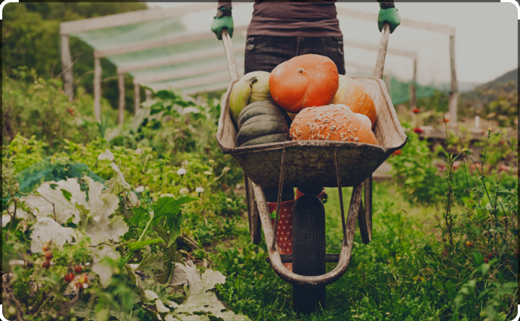
Importance of Enhancing Agricultural Practices with Machine Learning
To automates the process, allowing quick detection.
To analyzes vast data to provide accurate and precise disease identification, minimizing misdiagnosis.
To automates identification, optimizing resource allocation and enhancing crop productivity.
To reduces crop losses, minimizes pesticide use, and promotes environmentally friendly farming methods.
To Empowers users with valuable knowledge and tools for disease identification and management.

Slide 7

Tech Stack
Machine Learning – CNN – Image identification
Data – Collected from PlantVillage
ML API – Using Flask Backend
HTML/CSS – Frontend
Flask - Backend

Slide 8
ML Model – Process Overview
Dataset collection – PlantVillage dataset for plant diseases.
Preprocessing the collected dataset.
Splitting the dataset into Train, Test and Validation dataset.
Transfer Learning for image classification using MobileNetV2 architecture as a base with pre-trained weights on ImageNet.
Training the model – Epochs: 5
Checking the model’s performance on the validation and test dataset by checking the accuracy of the model.
Testing the model for various images.
Saving the trained model.

Slide 9

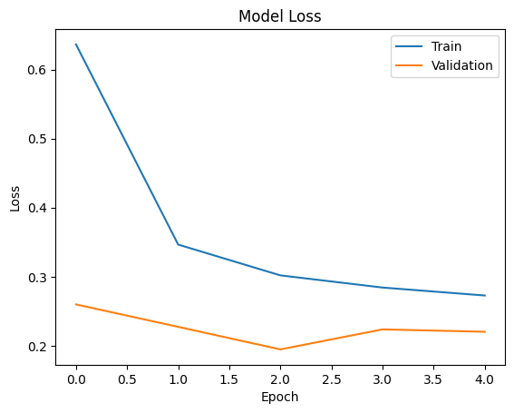
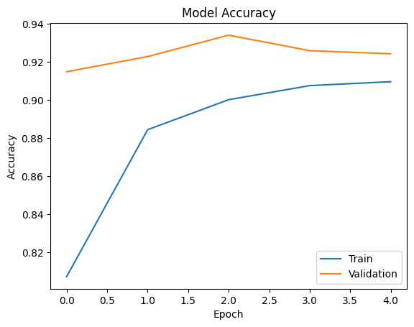
Result and Analysis

Slide 10
Model Integration and Flow
FastAPI is used to load the saved ML model and serve as an API
The image uploaded by the user is fed to the ML model over the API
The model predicts and returns the name of the corresponding disease
The returned disease name is used to fetch data from MongoDB
The fetched data is displayed to the user

Slide 11
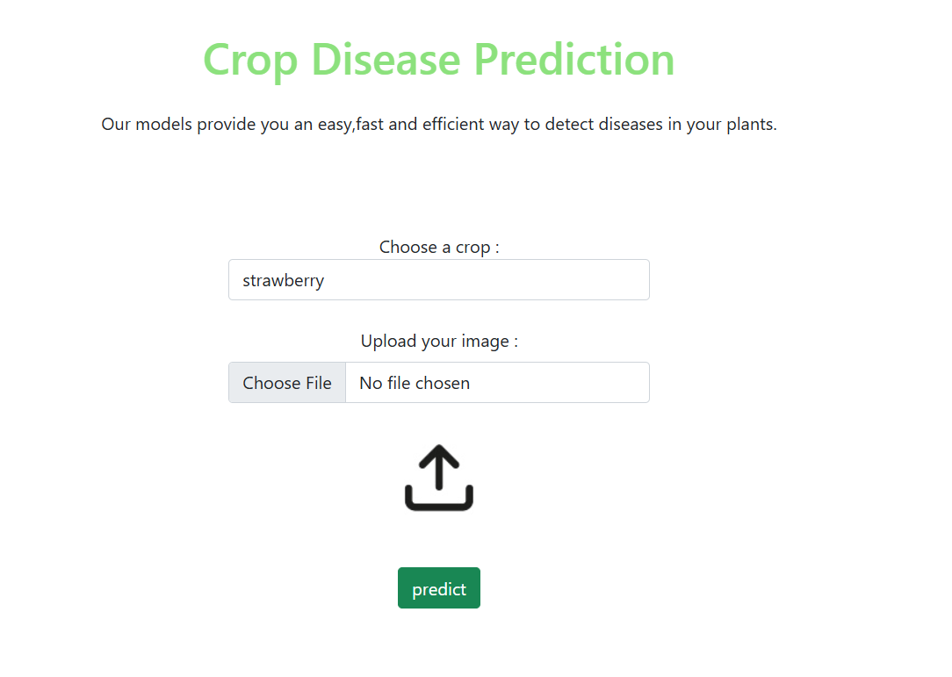
PREDICTION PAGE
Capture and save the image of leaf
Simply drag and drop the image or Click inside the box to browse
Click on the predict button to get the result.

Slide 12
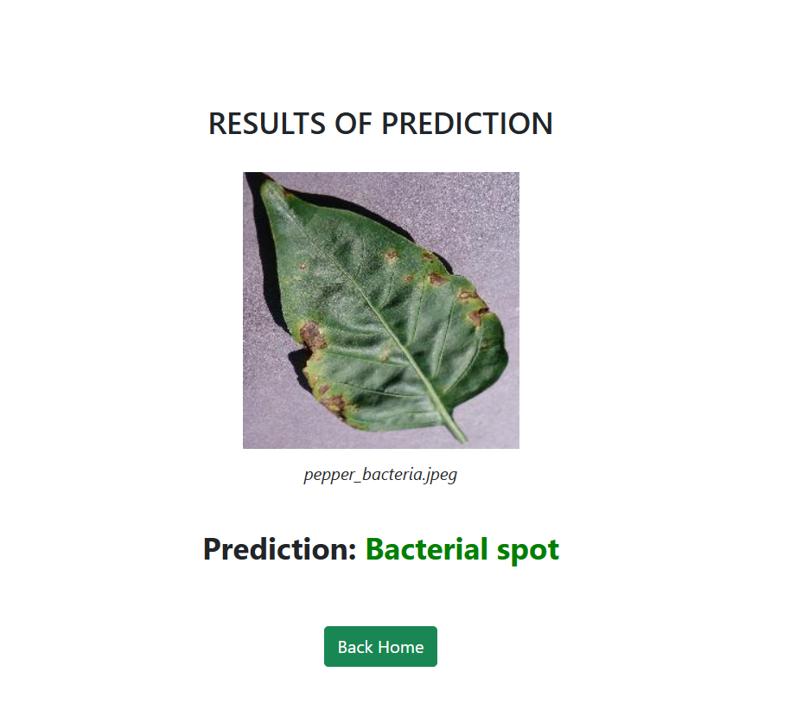
PREDICTION RESULT

Slide 13
Future Scope
Accuracy Improvement -
CNN based feature extraction using Shallow VGG
Then classifying them using Random forest and Xgboost classifier
Support for more diseases -
Collect more dataset and train the model to detect those diseases
Support for Crop Recommendation and Fertilizer Recommendation later on.

Slide 14
Thank You!

