Slide 1




People quit long surveys, and take their business with them
67%
of customers won’t finish a long survey
1 in 5
75%+
of drop-outs quit past halfway, after you paid to reach them
customers have stopped buying from a brand because its survey was too long
Tired respondents rush, skip and quit: the data is biased and the spend is wasted.
Sources: Hyken & RingCentral, Forbes 2024 · Impact & Insight Toolkit, 2015–24 data · Ghafourifard, J Caring Sci 2024
Notes:
Surveys are how businesses learn what customers think, but most surveys are a chore. Two out of three customers won’t finish a long survey. Worse, almost one in five (19%) have stopped doing business with a company because its survey was too long, and 23% because it kept sending too many. So a bad survey costs answers and customers.
Even the people who start don’t finish: in nine years of survey data, over three quarters of those who dropped out had already got past the halfway point. You paid to reach them and still lost the answers.
Research on survey fatigue says the same thing: bored respondents give careless answers, skip questions or quit, which biases the data and wastes the resources spent collecting it.
Extra figures if asked: 72% of customers never hear back after completing a survey; 71% assume nothing will change because of their feedback (Forbes / Hyken, 2024). Incentives can lift response rates by 10–15% (Ghafourifard, 2024).
Transition: So what if a survey didn’t feel like a survey at all?

Slide 2
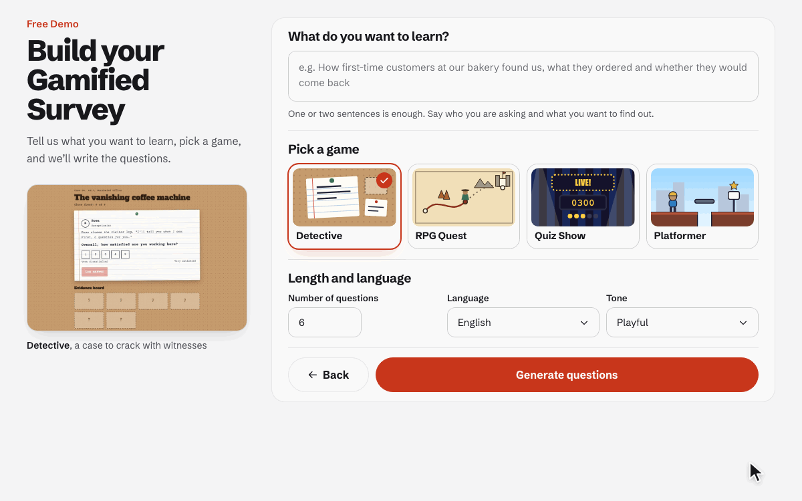
From one sentence to a survey game
1
Say what you want to learn
One or two sentences, in plain words
2
Pick a game and a tone
Detective, RPG quest, quiz show or platformer, in English or Hindi
3
Click Generate
AI writes the questions and a story game around them
Notes:
This is the whole setup. The business types what it wants to learn in a sentence or two, for example how first-time customers at a café found them and whether they’d come back.
Then they pick one of four games (detective, RPG quest, quiz show or platformer), the number of questions, the language (English or Hindi) and the tone.
They click Generate, and the AI writes the survey questions and a story game around them. Next they can edit everything in the Game Editor and publish a short link.

Slide 3
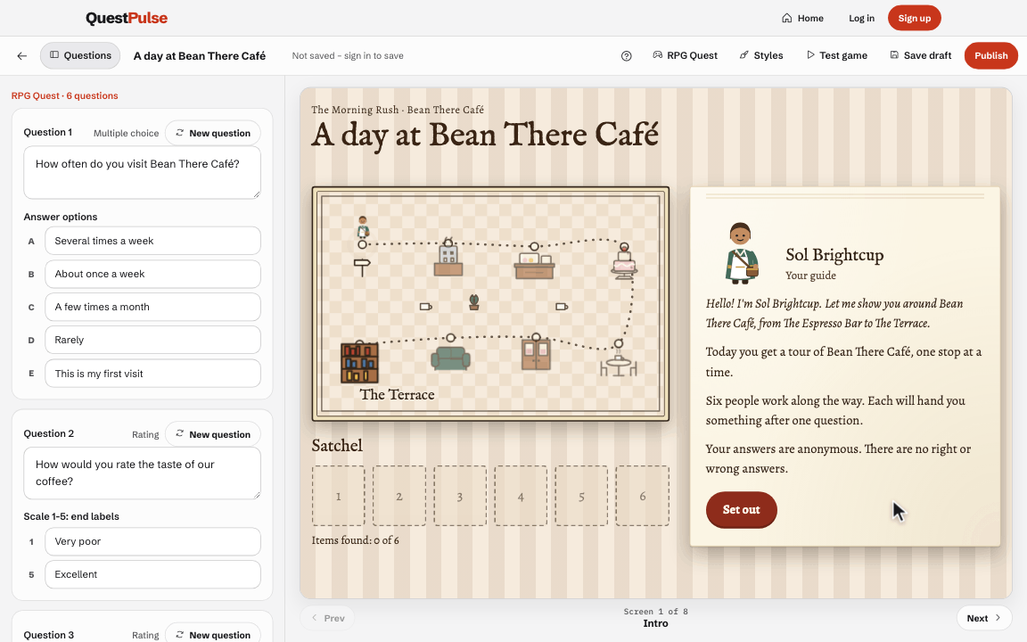
Fine-tune it in the Game Builder
1
Edit any question
Change the wording and options, or ask AI for a new one
2
See the real game
A live preview, screen by screen, as players will see it
3
Make it yours, then publish
Name, fonts and colours, then one short link to share
Notes:
After Generate, the business lands in the Game Builder. The questions are on the left, and the real game runs in the middle as a live preview.
Every question can be edited: the wording, the answer options, the scale labels. If one isn’t right, “New question” asks the AI for another in the same style.
In the clip, the survey is renamed and the title in the game changes as it’s typed. Then Styles recolours the whole game, including the map, cards and buttons, and the colours always stay readable.
When it looks right, Publish gives one short link to share, with an optional coupon for everyone who finishes.

Slide 4
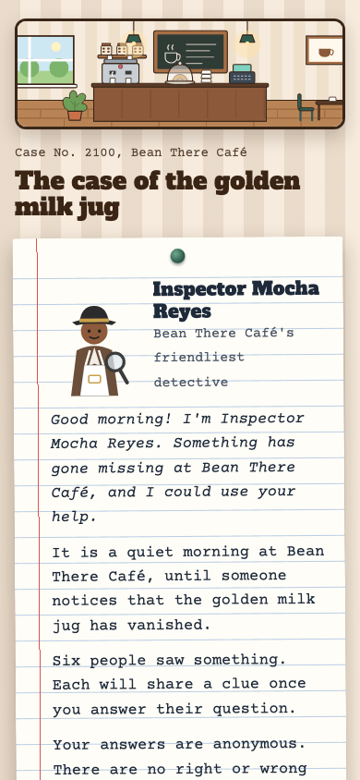
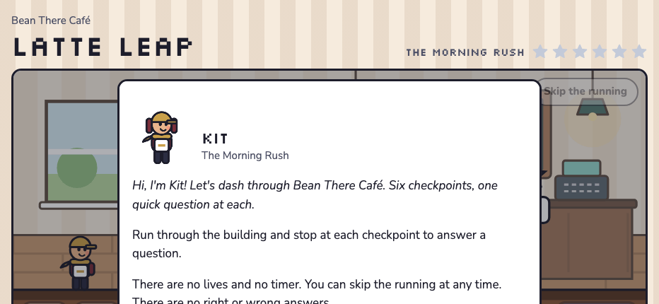
Players just tap and play, on any phone
Detective · upright
Platformer · sideways
Notes:
This is what the customer sees: a short link opens a game, with no app to install and no sign-up.
On the left, the detective game with the phone held upright. Each witness asks one question, and every answer pins a clue to the evidence board.
On the right, the platformer with the phone turned sideways. The player runs and jumps to a checkpoint, answers the question there and collects a star. There are no lives and no timer, and the running can be skipped, so it never gets in the way of answering.
Every finished game saves one response, and it can earn the player a coupon.

