Slide 1
Loan Lending Case Study
By Kausthub Kesavadas

Slide 2
Problem Statement
As part of finance team of Loan Lending Company, identify risky applicant based on number of attributes to minimize the amount of credit loss to the Company
Use exploratory data analysis and visualize data to find risky applicants.

Slide 3
Analysis Approach
Data Cleaning and imputing
From a total of 111 columns cleaned up null value columns, columns with only single value and columns with null values > 10%
Brought dataset down from 39717,111 -> 37543, 42
Univariate Analysis performed on
Grade: the grade is the category given to loan applicant based on which the risk of the loan is assessed in a way
Home ownership: whether loan applicant had own, rent, or other kind of house
Verification status: whether income verified, income source verified or income not verified
Term Length: Length of the loan
Purpose : Purpose of the loan
Segmented Univariate Analysis on
Interest Rate: Binning the interest rates to find observations
Installment amount: Segmented analysis to identify an new connections

Slide 4
Overall Observations
People with a weaker grade (C,D,E,F,G) of loan are more likely to default on the loans.
People with weaker subgrades (C5,D5,E5,F5,G5) are more likely to default on the loans
People with higher interest rates are more likely to default on loans
Even if the income is verified, there is likelihood of the person defaulting on loans
As term value increases the chances of the person defaulting increases

Slide 5
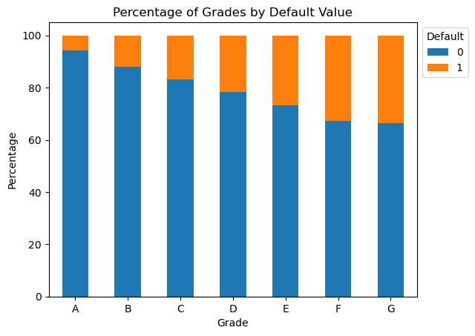
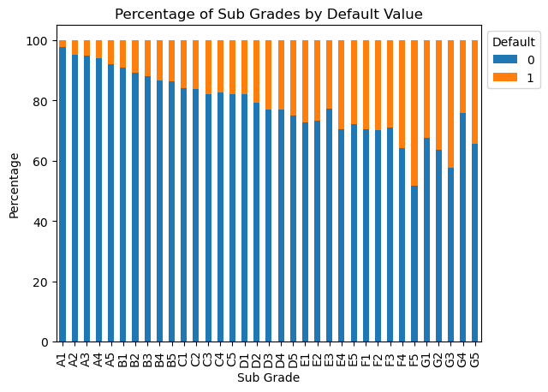
Grade Analysis
Analysing Grade and Sub Grades: There is a significant correlation between Grades. The weaker the grade the more likelihood of defaulting on the loan. Grades. Grades D,E,F,G showed around 20%+ chance of defaulting on the loan
Within the same grade Subgrades with higher numbers have higher defaulting chances

Slide 6
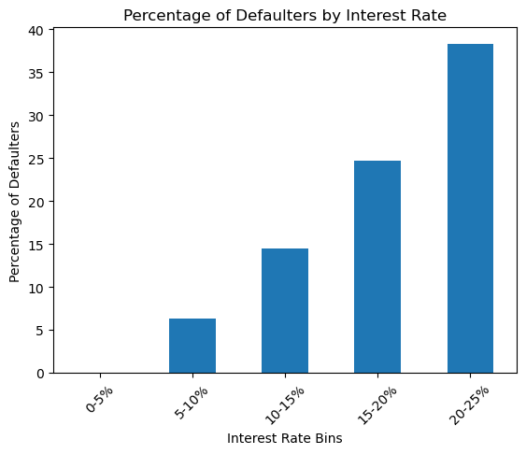
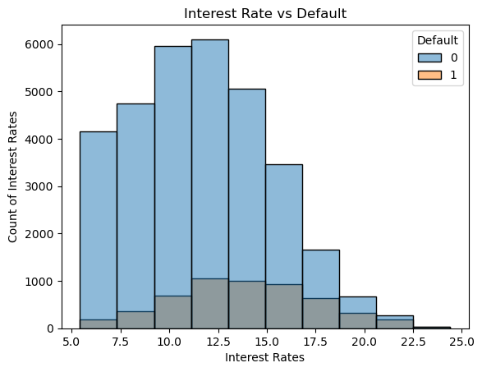
Loan Interest Rate Analysis
As the interest rates go higher the applicants tend to default on the loans
Interest Rates having 12.5% or higher have higher chances of defaulters

Slide 7
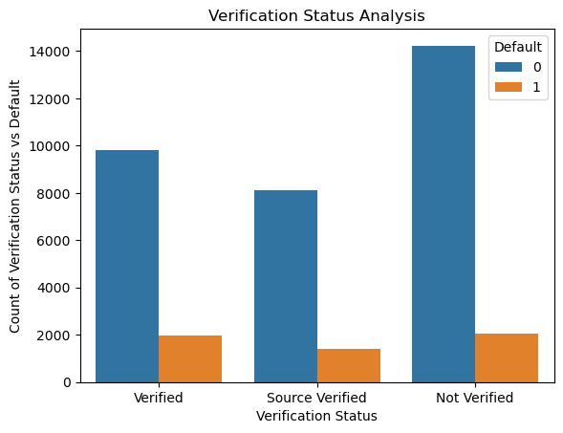
Verification Status
Verifying the income or the income source does not prevent the applicant from defaulting on the loan

Slide 8
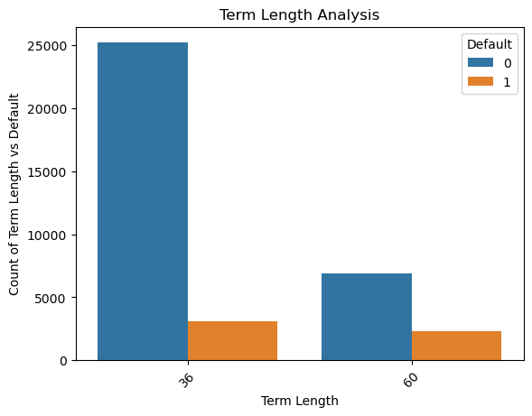
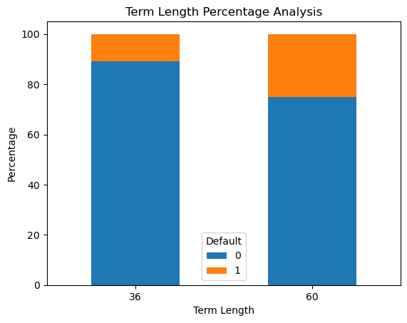
Term Length
The higher the term length the more chances of the applicant defaulting on the loan

Slide 9
Final Observations
People with a weaker grade (C,D,E,F,G) of loan are more likely to default on the loans.
People with weaker subgrades (C5,D5,E5,F5,G5) are more likely to default on the loans
People with higher interest rates are more likely to default on loans
Even if the income is verified, there is likelyhood of the person defaulting on loans
As term value increases the chances of the person defaulting increases

