Slide 1
Online Ad Click Prediction for Outbrain on Kaggle
Team Members:
Shoili Pal, Kyle Zimmerman, Joseph Phillips, Kaustubh Mohite and Arjun Mishra

Slide 2
Introduction
Outbrain, the web’s leading content discovery platform, makes 250 billion personalized recommendations each month, globally
The objective of the competition is to predict which content recommendation users are more likely to click on
Notes:
Improving the algorithm will influence users all around the world and create a better consumer journey on news sites, with improved engagement

Slide 3
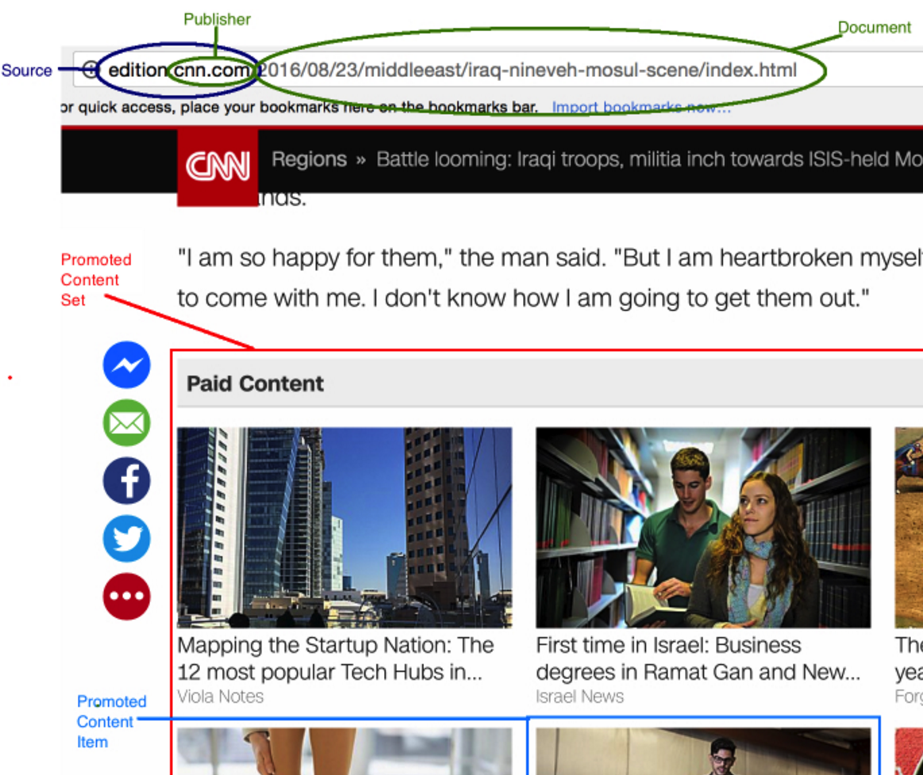
The Data
Dataset size > 100 Gb
Train – Anonymized data about the recommendation display, Ads & whether the Ad was clicked or not
Supporting datasets:
Page-views: Anonymized user ids, traffic source, platform, location and time
Website details: Anonymized publisher id, advertiser id, campaign id and article category
Notes:
After train, talk about the test not having just the binary variable of whether the ad was clicked or not.

Slide 4
Modeling Approaches
Clustering
Neural Networks
Markov Chains
Factorization Methods
Ensemble Methods?

Slide 5
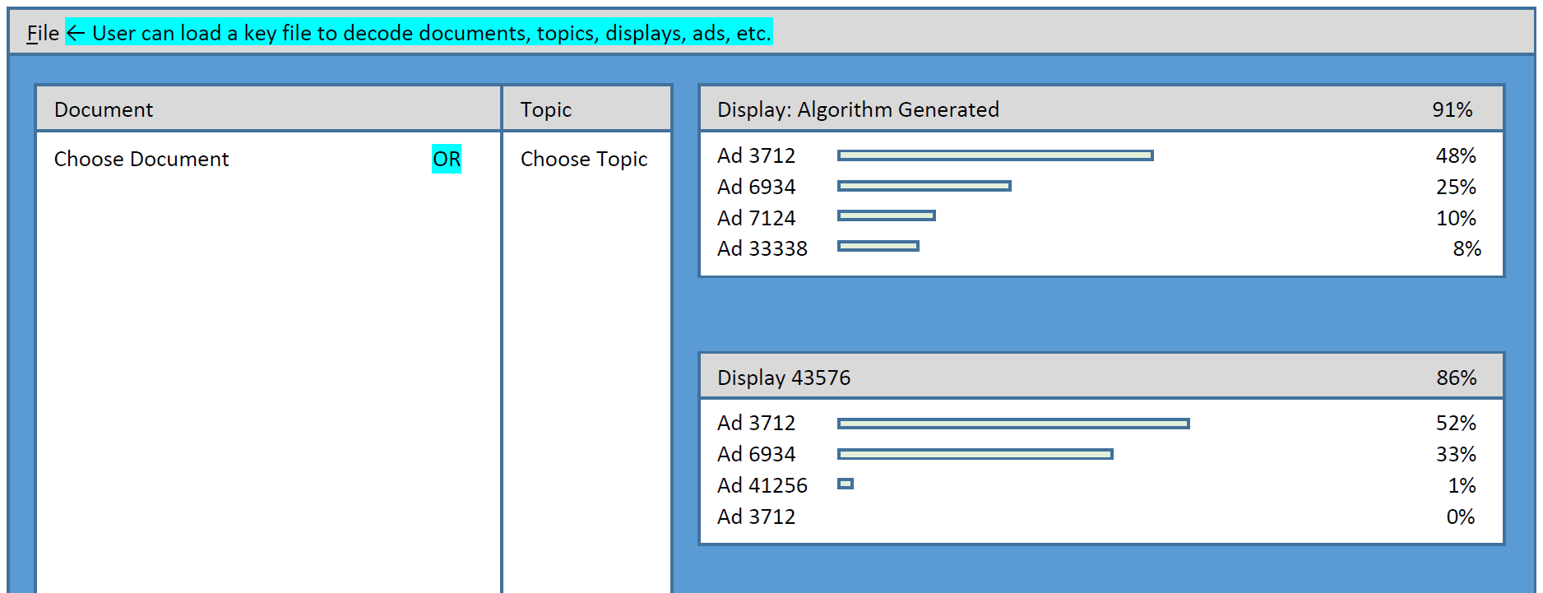
Interface
The dashboard will be a live recommender system
Notes:
AS there is geographical data present, we will visualize that to derive inference about the clicks.

