Slide 1

HOME SECURITY SYSTEM
GROUP MEMBERS
ATHARVA MANE (19ET311) ( Software and Hardware)
KAUSTUBH ADHAV (17ET002) ( Software and Hardware)
SATYAJEET PATIL (18ET036) ( Software and Hardware )

Slide 2
OBJECTIVES
Now a days , many people are away from their home for various reasons like traveling , Business purpose or migration. So this might have higher probability that the house get looted by Dakaits. So this system is made to inform the owner of house and also inform the neighbors by using alarm
Features :-
1 ) Detection of any moving physical thing entered in house
2 ) Buzzer alarm
3 ) Informing owner about detection by message and call

Slide 3
INTRODUCTION
In this project we have used 8051microcontroller for controlling the whole process of the project. A PIR sensor is used for sensing human presence. And when PIR sensor sense any movement in targeted area of room then it gives a HIGH logic to microcontroller and then Microcontroller take place and make a call via GSM module using AT commands. Controller calls to a predefined mobile number and at the same time it also sends a message to the same number via GSM Module

Slide 4
MARKET SURVEY
According to research of Times of India, single burglary can occurs in every 3 minutes and single fire catches in every 1.25 hour in India. So there is wide scope of use of Home Security System.
The Home Security System Market is expected to grow at a CAGR (Compound Annual growth rate) of 7% over the forecast period 2021 to 2026. The home security system market has been growing at a tremendous rate. Every year, new trends emerge and improve old technology, making the home security sector more effective. The demand for home security systems is likely to be driven by the growing adoption of smart homes where smart security systems are an integral part.

Slide 5
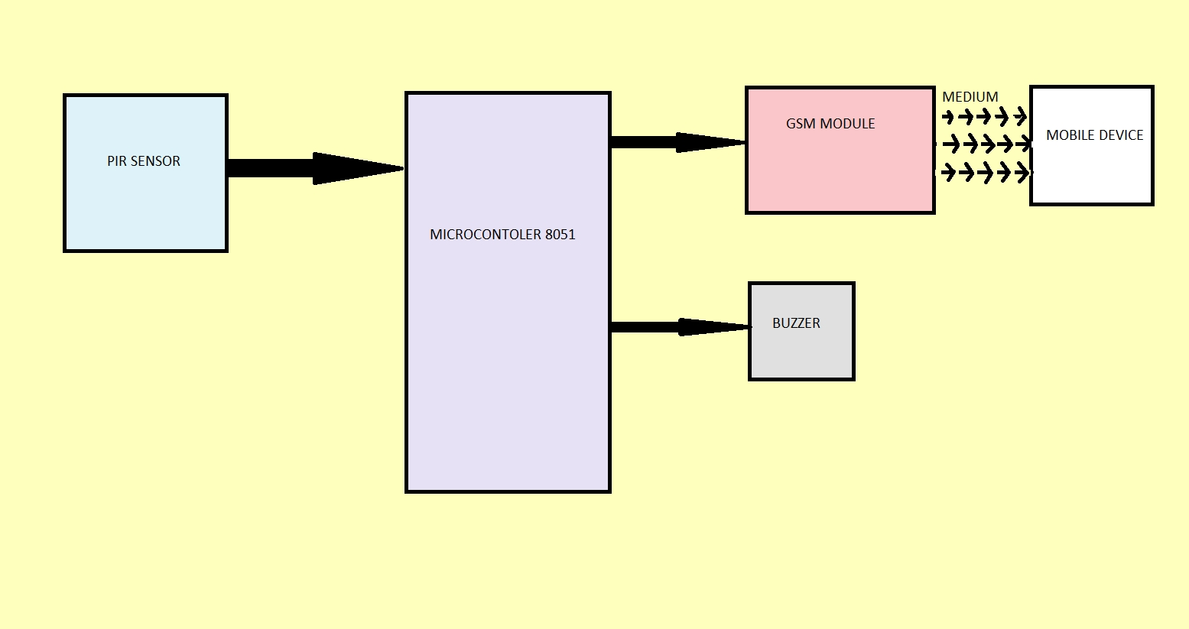
BLOCK DIAGRAM

Slide 6
Components
1) MICROCONTROLER 8051
2) GSM MODULE
3) PIR SENSOR MODULE
4) L293D MOTOR DRIVER
5) BUZZER
6) CAPACITORS
7) RESISTORS
8) MAX232 UART MODULE

Slide 7
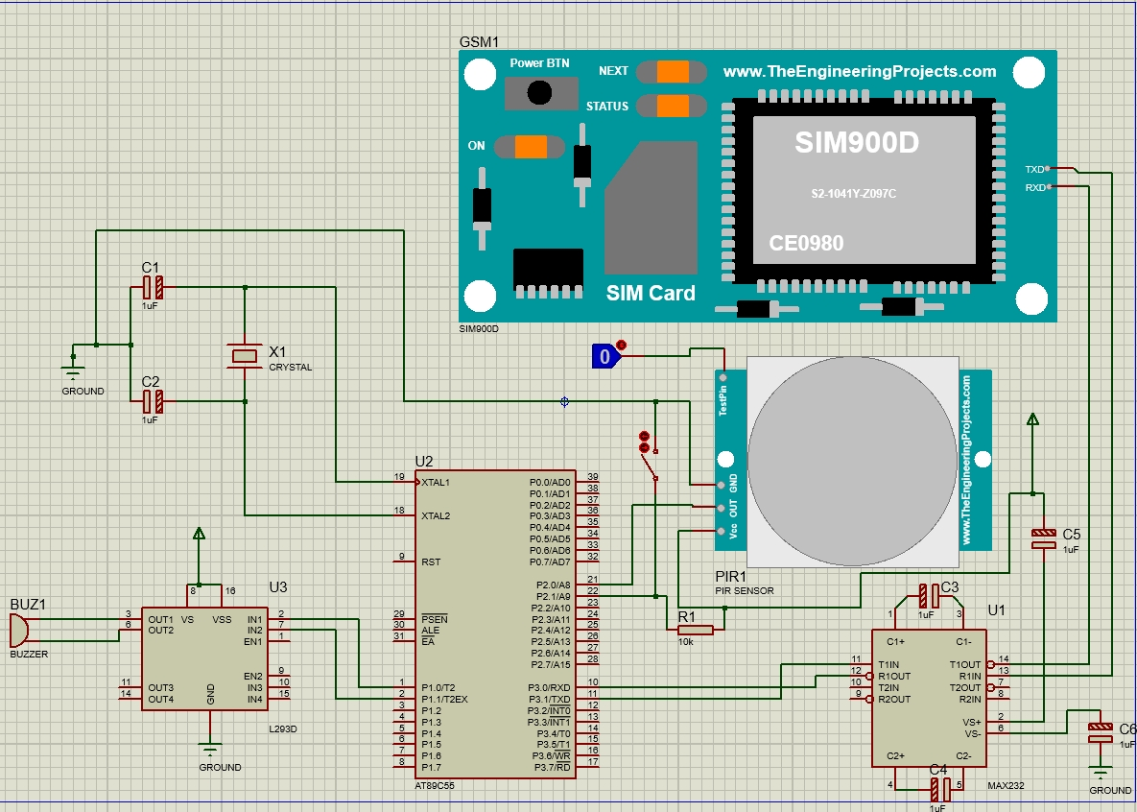
CIRCUIT DIAGRAM

Slide 8
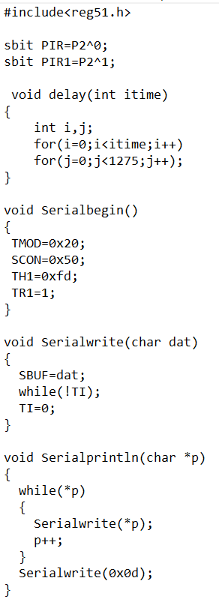
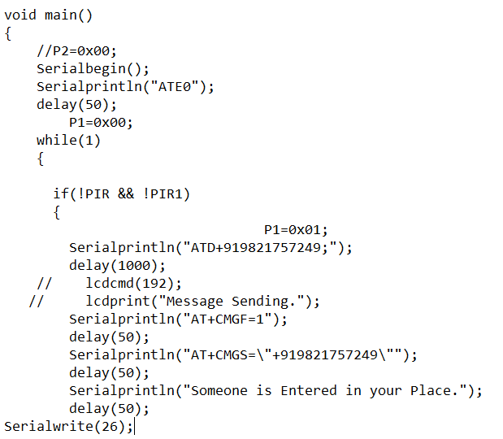
PROGRAM

Slide 9
ADVANTAGES and DISADVANTAGES
ADVANTAGES :-
1) This system provides security by buzzer so that people around your house get information about things
2) This system sends you message also on your mobile number so that you will get informed about something happening with your subject and you can take action on it
DISADVANTAGES :-
1)If your mobile don’t have range or is in aeroplane mode then you will not get message from system. So you have to be always in range

Slide 10
FUTURE UPGRADES
1 ) Locking home after detection of moving body
2 ) Capturing the photo or video if owner want to capture
3 ) Inform the POLICE with permission of owner
4 ) Including password protected door locking system

Slide 11
CONCLUSION
This project has taught us the practical implementation of the devices we learned theoretically
We designed the device which can detect the motion and inform to owner and also use alarm to inform neighbors
This project gave us real time experience of how to manage the work

