Slide 1

Musical Frequency Note Detection
BY:-
Aditya Kadu: 31234
Manish Godbole: 31226
Kaustubh Josh: 31233
SEMINAR GUIDE:- PROF . R.A. Kulkarni

Slide 2
CONTENT
PROBLEM DEFINITION
INTRODUCTION
MOTIVATION
LITERATURE SURVEY
ARCHITECTURAL DIAGRAM OF MODEL
ALGORITHM
IMPLEMENTATION
FUTURE ENHANCEMENT
CONCLUSION
REFERENCES
Q&A

Slide 3
PROBLEM STATEMENT
Developing a system capable of taking an audio file as input and extracting musical notes present within it. Our goal is to develop a robust and accurate tool that can analyze audio recordings and provide a detailed representation of the musical notes, and thereby enabling various applications. This problem involves solving complex issues related to audio signal processing, pattern recognition, and data analysis, with the ultimate aim of enhancing our understanding and interaction with music through technology.

Slide 4
INTRODUCTION
The Universal Language of Music: Music transcends borders and cultures, connecting people and conveying emotions worldwide.
Exploring Musical Note Frequencies: Our research delves into the mechanics of musical notes and advanced technology's role in their precise identification.
Wide-Ranging Applications: Musical frequency note detection impacts music theory, education, audio processing, and technology innovations.
Science Meets Art: Bridging technology and music, our research inspires creativity, education, and innovation for a richer understanding of melodies.

Slide 5
MOTIVATION
Unlocking Musical Secrets: By applying advanced data science techniques and scientific methodologies, we've unveiled the intricate patterns and frequencies that make up musical notes. This deepens our understanding of music and offers practical applications in audio processing, signal analysis, and data-driven research.
A Nexus of Innovation: The fusion of music, science, and technology creates a dynamic space where innovation and creativity flourish. Beyond the confines of our research, this interdisciplinary approach promises groundbreaking developments in music technology and data analysis.
Empowering Art and Science: Our research journey is an invitation to unravel the hidden mechanics of music through data-driven exploration. It's an opportunity to empower the fusion of art and science, driving progress not only in machine learning and data analysis but also in the broader realms of music theory and education. As we traverse this path, we contribute to a world where technology enriches our understanding of music, enabling us to harness the true potential of this universal language.

Slide 6
LITERATURE SURVEY
Physical Audio Signal Processing: This study delves into song characteristics, focusing on note extraction from piano songs, proposing an algorithm for note detection. It addresses the challenge of recognizing notes in songs with unknown compositions.
Deep Learning for Audio Signal Processing: The article reviews real-time onset detection techniques, offering suggestions for improvements. It introduces a novel algorithm using sinusoidal modeling for onset detection. The study comprehensively evaluates detection accuracy and computational performance.
Pitch Estimator for Noisy Speech Signals: This research introduces an optimization-based neural network (OBNN) for musical note recognition. It advances the recognition of musical notes through diverse methodologies, providing an extensive review of existing approaches.
Self-Supervised Learning of Audio Representations: This paper explores the principles of physical modeling in digital audio processing. It emphasizes mathematical and computational foundations, allowing for the creation of highly realistic virtual instruments and audio effects, significantly enhancing digital music synthesis and audio processing quality.

Slide 7
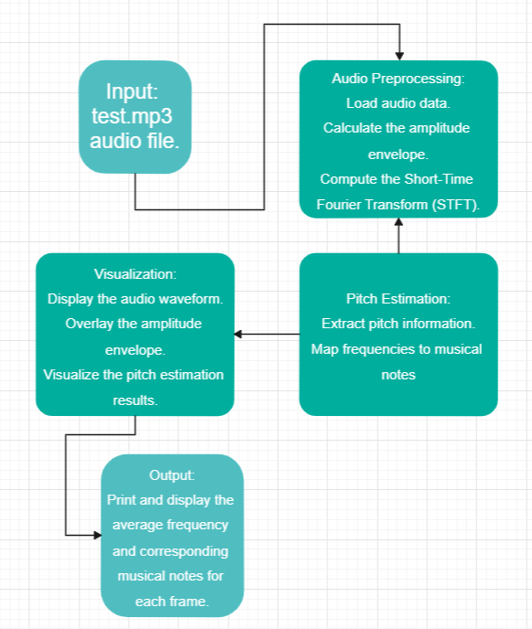
ARCHITECTURAL DIAGRAM

Slide 8
ALGORITHM TAKEN TO IMPLEMENT
Audio Loading: The code begins by loading an audio file ('test.mp3') using the `librosa.load` function, obtaining the raw audio waveform and its sampling rate (SR). This step prepares the data for subsequent analysis.
Waveform Visualization: It proceeds with visualizing the audio waveform using Matplotlib. This visualization represents the amplitude of the audio signal over time, providing a visual understanding of the audio's characteristics.
Amplitude Envelope: To analyze the signal's variations, two functions, `amp_env` and `fancy_amp`, are used to compute the amplitude envelope. The amplitude envelope captures the maximum amplitude within specified frame sizes, which is a crucial feature for various audio processing tasks.

Slide 9
ALGORITHM
Time and Frame Calculation: The code calculates the and frame indices for the amplitude envelope using the `librosa.frames_to_time` function, enabling alignment of the envelope with time for visualization.
Visualizing the Envelope: Another Matplotlib plot is generated, displaying the audio waveform and overlaying the amplitude envelope in red. This visualization helps in understanding how the amplitude changes over time.
Short-Time Fourier Transform (STFT): To delve into the audio's time- frequency characteristics, the code computes the STFT using `librosa.stft`. The STFT provides a detailed representation of the audio signal in the time and frequency domains.

Slide 10
ALGORITHM
Pitch Detection: For pitch analysis, the code uses the `librosa.piptrack` function to identify pitch frequencies in each frame. This process is achieved by tracking the peaks in the magnitude of the STFT.
Note Mapping: A dictionary, `note_mapping`, is defined to map detected frequencies to their corresponding musical note names, allowing for easier interpretation of the pitch information.
Average Pitch Calculation: The code calculates the average pitch within specific frame intervals to provide a more generalized view of the audio's pitch characteristics. It calculates the mean pitch, ignoring any NaN values in the pitch data.
Displaying Results: Finally, the code prints and displays the average frequency and corresponding musical notes for each set of frames at specified intervals

Slide 11
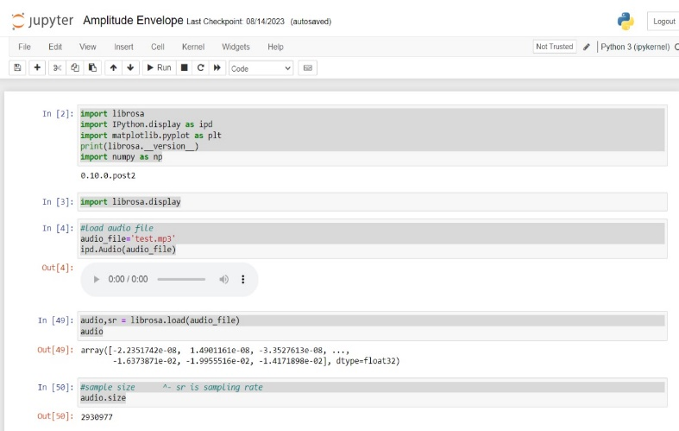
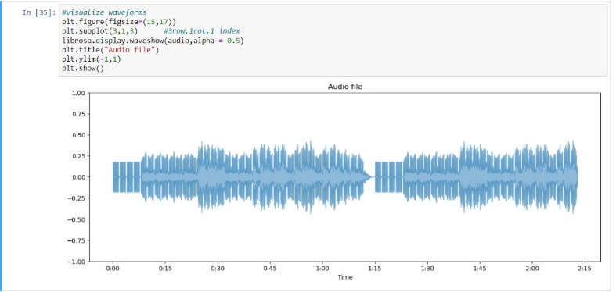
RESULT

Slide 12
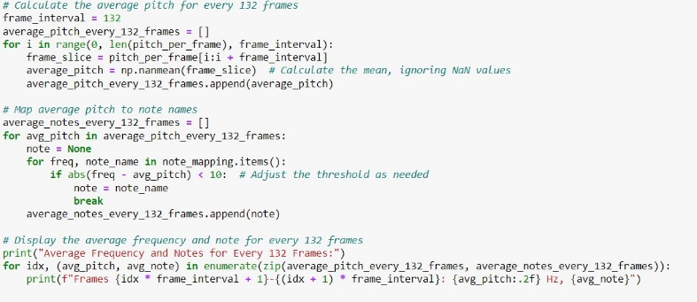
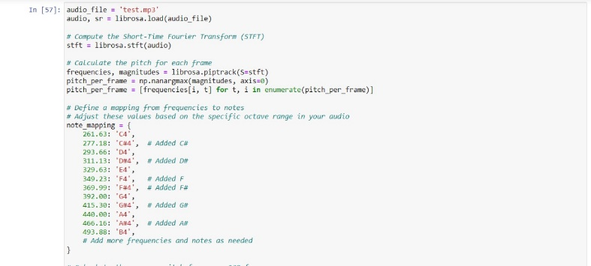
RESULT

Slide 13
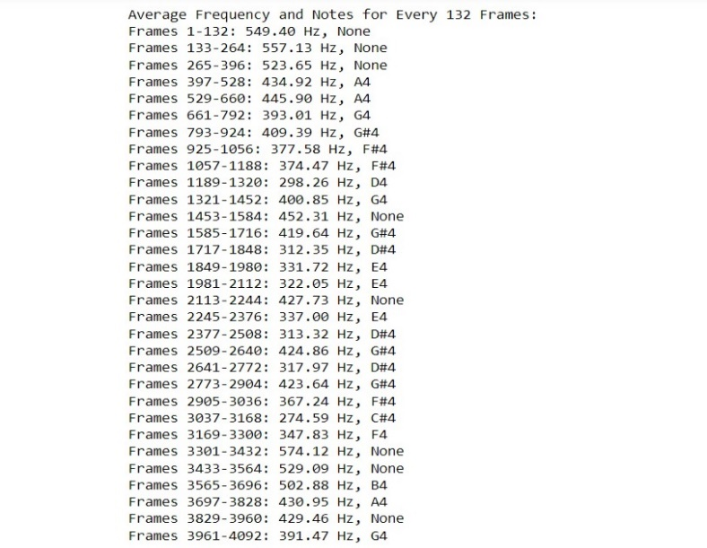
RESULT

Slide 14
FUTURE ENHANCEMENT
Improved Accuracy: Future research can focus on refining algorithms to enhance accuracy in complex musical scenarios. Leveraging deep learning techniques, such as neural networks, can lead to more robust note detection systems.
Generalization: Developing models that can recognize musical notes across various instruments and genres is a promising area of study. Transfer learning and domain adaptation techniques can be explored to achieve this.
Real-time Applications: Advancements in hardware and algorithm optimization can enable real-time note detection in live music performance and interactive applications.

Slide 15
FUTURE ENHANCEMENT
Music Education: Implementing note detection technology in music education tools can revolutionize how students learn and practice music.
Interdisciplinary Integration: Integration with fields like cognitive science, psychology, and neuroscience can lead to a deeper understanding of how humans perceive and create music.
Data-Driven Music Research: Note detection, when applied at scale, can facilitate large-scale musicological research, enabling data-driven insights into music history, trends, and cultural influences.

Slide 16
CONCLUSION
In our exploration of musical frequency note detection, we've unveiled its profound impact on music and technology. Accurate note identification is pivotal in music education, transcription, and audio processing, enhancing teaching and learning while aiding musicians in performance and composition. Advancements in technology, like digital signal processing and machine learning, make automated note detection accessible and efficient, fostering creativity.
Our research emphasizes the need for rigorous investigation, diverse datasets, robust algorithms, and ongoing refinement for system reliability. This convergence of music, education, and technology enriches artistic expression. As we continue to innovate, a future where music is more accessible and comprehensible for all becomes apparent. This research offers a glimpse into the vast potential of musical note detection.

Slide 17
REFERENCES
Smith, Julius O. "Physical Audio Signal Processing for Virtual Musical Instruments and Audio Effects." W3K Publishing, 2010.
H. Purwins, B. Li, T. Virtanen, J. Schlüter, S. -Y. Chang and T. Sainath, "Deep Learning for Audio Signal Processing," in IEEE Journal of Selected Topics in Signal Processing, vol. 13, no. 2, pp. 206-219, May 2019, doi: 10.1109/JSTSP.2019.2908700.
S. A. Shedied, M. E. Gadalah and H. F. VanLundingham, "Pitch estimator for noisy speech signals," Smc 2000 conference proceedings. 2000 ieee international conference on systems, man and cybernetics. 'cybernetics evolving to systems, humans, organizations, and their complex interactions' (cat. no.0, Nashville, TN, USA, 2000, pp. 97-100 vol.1, doi: 10.1109/ICSMC.2000.884971.
S. Wang, A. Politis, A. Mesaros and T. Virtanen, "Self-Supervised Learning of Audio Representations From Audio-Visual Data Using Spatial Alignment," in IEEE Journal of Selected Topics in Signal Processing, vol. 16, no. 6, pp. 1467-1479, Oct. 2022, doi: 10.1109/JSTSP.2022.3180592.
Hendrik Purwins , Bo Li , Tuomas Virtanen , Jan Schluter ¨ , Shuo-Yiin Chang, and Tara Sainath, “Deep Learning for Audio Signal Processing” in Hendrik Purwins , Bo Li , Tuomas Virtanen , Jan Schluter ¨ , Shuo-Yiin Chang, and Tara Sainath, “Deep Learning for Audio Signal Processing” in IEEE Journal of Selected Topics in Signal Processing, vol. 13, no. 2, May 2019.
Jay K. Patela, E.S.Gopia. “Musical Notes Identification using Digital Signal Processing”. 3rd International Conference on Recent Trends in Computing 2015 (ICRTC-2015)
John Glover*, Victor Lazzarini and Joseph Timoney. “Real-time detection of musical onsets with linear prediction and sinusoidal modeling”. EURASIP Journal on Advances in Signal Processing.
Allabakash Isak Tamboli* and Rajendra D. Kokate. “An Effective Optimization-Based Neural Network for Musical Note Recognition”.

Slide 18
Q/A

