Slide 1



Investigating Language Preference of Multilingual RAG Systems
The 63rd Annual Meeting of the Association for Computational Linguistics
(ACL 2025)
Jeonghyun Park
LILAB
Department of
Artificial Intelligence
Chung-Ang University

Slide 2
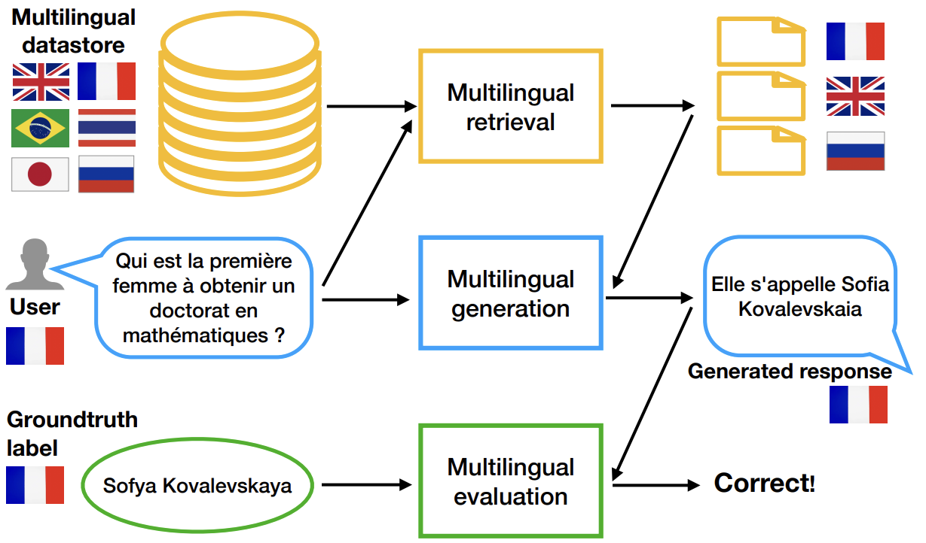
Multilingual RAG (mRAG) System
Retrieval-augmented Generation (RAG) pipeline that:
For queries and knowledge (data) stores spanning multiple languages, retrieves relevant context across those languages
Multilingual Retrieval-Augmented Generation (mRAG) systems enhance language models by integrating external multilingual information to produce context-aware responses.
Generates a grounded answer based on retrieved contexts in the user’s language
Retrieval-augmented generation in multilingual settings (KnowLLM 2024)

Slide 3
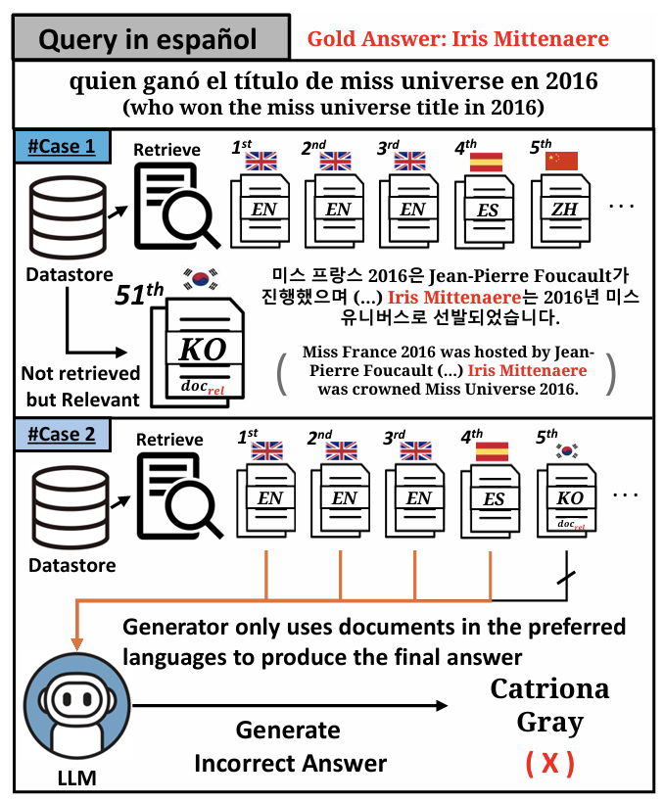
Multilingual RAG – Motivations (Challenges)
Failure cases of mRAG system
However, because mRAG systems favor certain languages, the retriever often pulls in irrelevant contexts and this language preference present in both the retriever and the generator ultimately degrades the system’s generation quality.
(Case 1) Retriever may prioritize high-resource or query-language documents—at the expense of truly relevant information in low-resource language.
(Case 2) Even if relevant documents are retrieved, the generator might favor passages in the query language or Latin scripts, ignoring essential evidence in lower-resource languages and resulting in inaccurate outputs

Slide 4
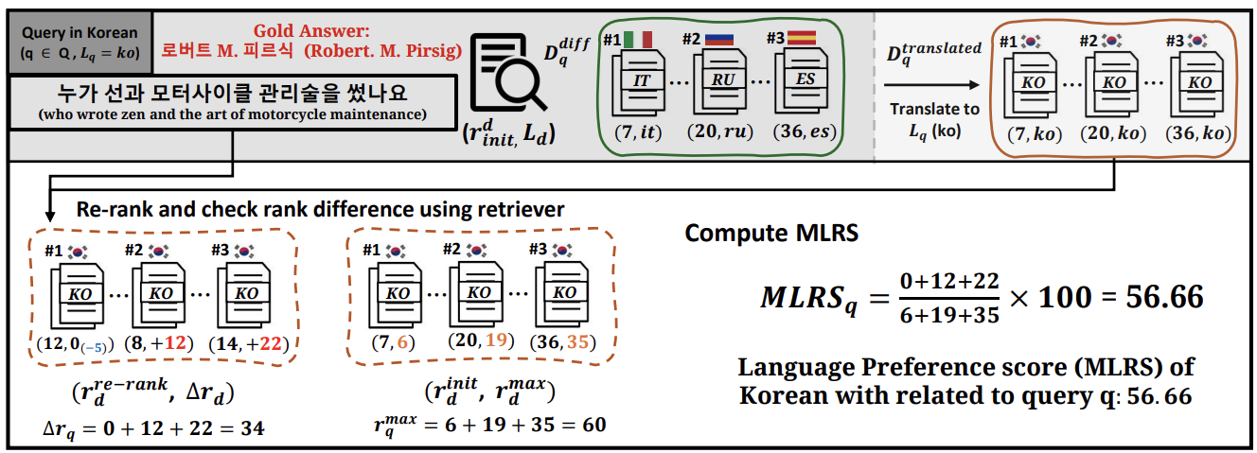
Language Preference – Retriever Level (Proposed Metric)
Proposed metric, MultiLingualRankShift (MLRS) that measures language preference at the retriever level
  Compute ranking improvements when documents in the non-query language are translated into query language
  To normalize the score, MLRS also reflect maximum (possible) rank improvement for each document

Slide 5
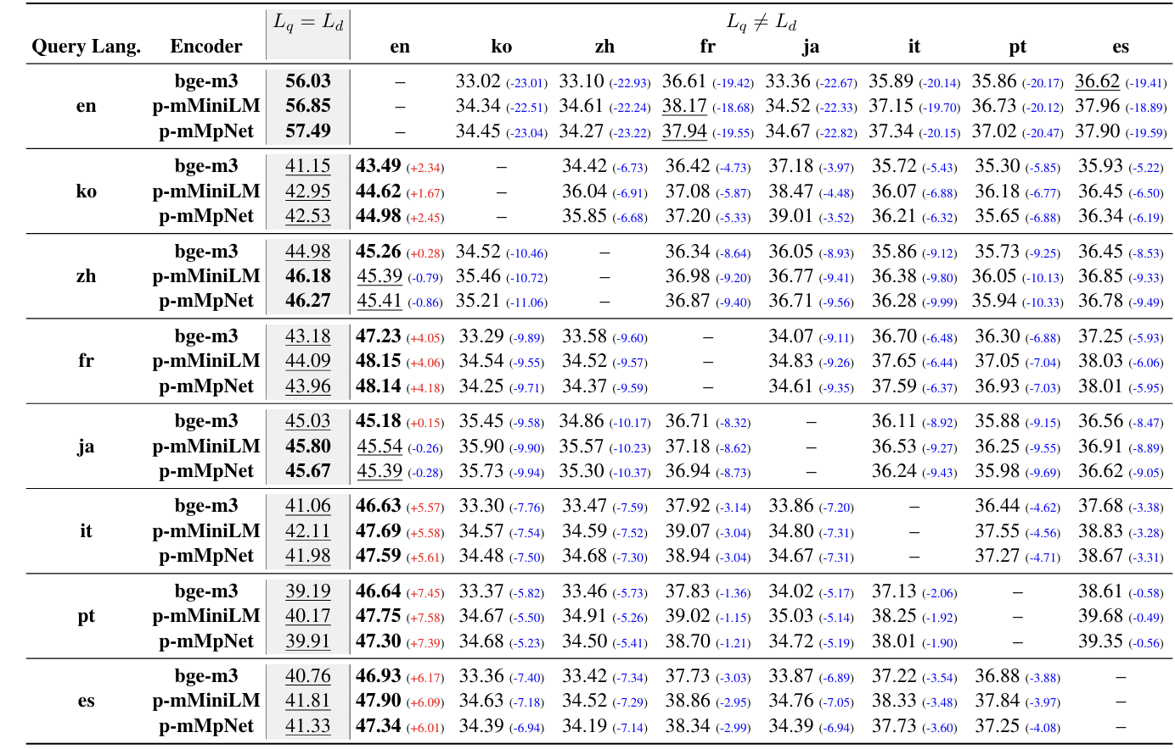
Language Preference – Retriever Level (Results)

Slide 6
Language Preference – Retriever Level (Results)

Slide 7
Language Preference – Retriever Level (Results)

Slide 8
Language Preference – Retriever Level (Results)

Slide 9
Language Preference – Retriever Level (Results)

Slide 10
Language Preference – Generator Level (way to measure)
Generate answer in different languages
Query
Answer_en
Answer_ko
Answer_zh
. . .
Answer_pt
Answer_ko
0.90
Answer_zh
0.88
English Preference
of Generator
Answer_en
.
.
.
Compute average multilingual embedding similarity
English Preference of Generator: 0.903
Answer_pt
0.93

Slide 11
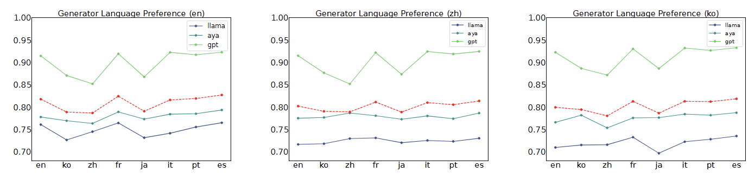
Language Preference – Generator Level (Results)
Generators prefer:
  Latin script languages (en, fr, it, pt, es)
  Query language but not big effect

Slide 12
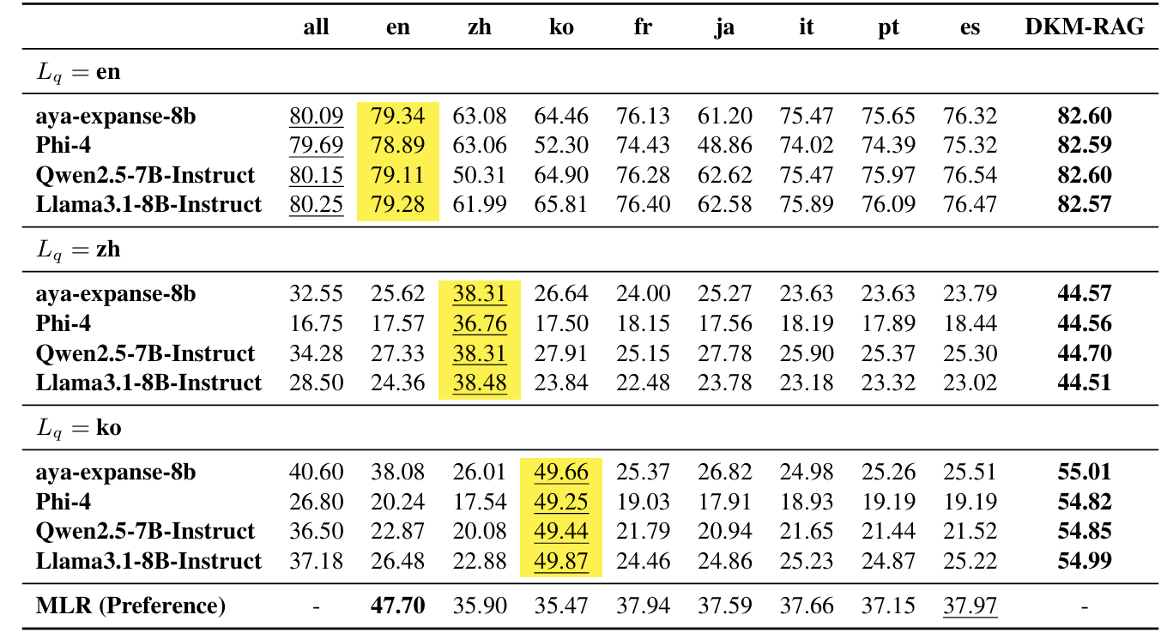
Language Preference – mitigating strategy (Proposed Method)
For query in English: retrieving from datastores in various languages (all strategy) is effective
For query in non-English: retrieving from datastores in various languages and translate to query language is effective
For English query,

Slide 13
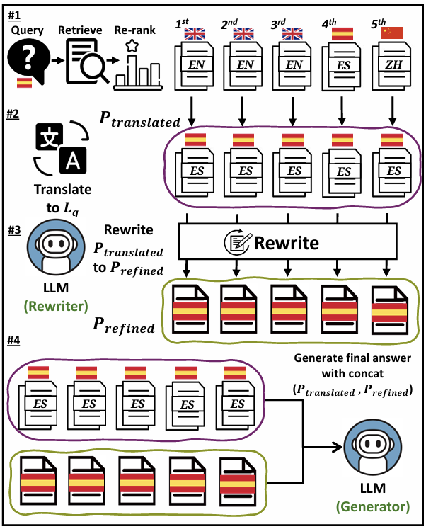
Language Preference – mitigating strategy (Proposed Method)
Proposed Dual-Knowledge Multilingual RAG (DKM-RAG):
  For a given query, retrieves documents from datastores in various languages and re-rank documents
  Translate all non-query language documents into query language
  Refine translated passages to filter inaccuracies and enrich the retrieved information with more reliable content
  Finally, concatenate translated passage and refined passage, generating final answer with them

Slide 14
Language Preference – mitigating strategy (Results)

Slide 15
Conclusion
Investigated language preferences in mRAG systems
Proposed a metric that measures the language preference of retrievers by checking the rank difference between the translated passage and the original one
Experiments reveal that retrievers prefer high-resource and query language but do not always yield better generation performance
  Generators often favor the query language or Latin scripts, resulting in inconsistent outputs
Proposed DKM-RAG which integrates translated passages with internal knowledge
  Empirical results show that DKM-RAG consistently enhances mRAG performance across diverse languages

