Slide 1

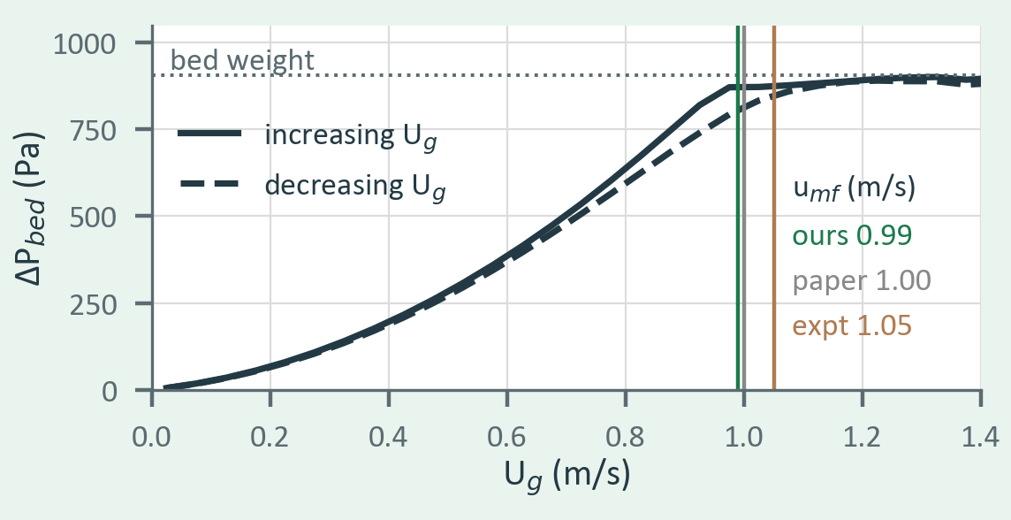
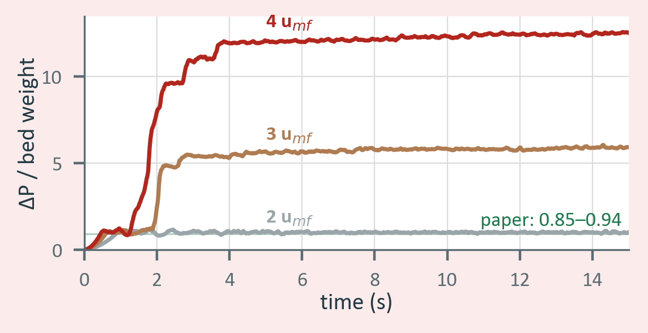
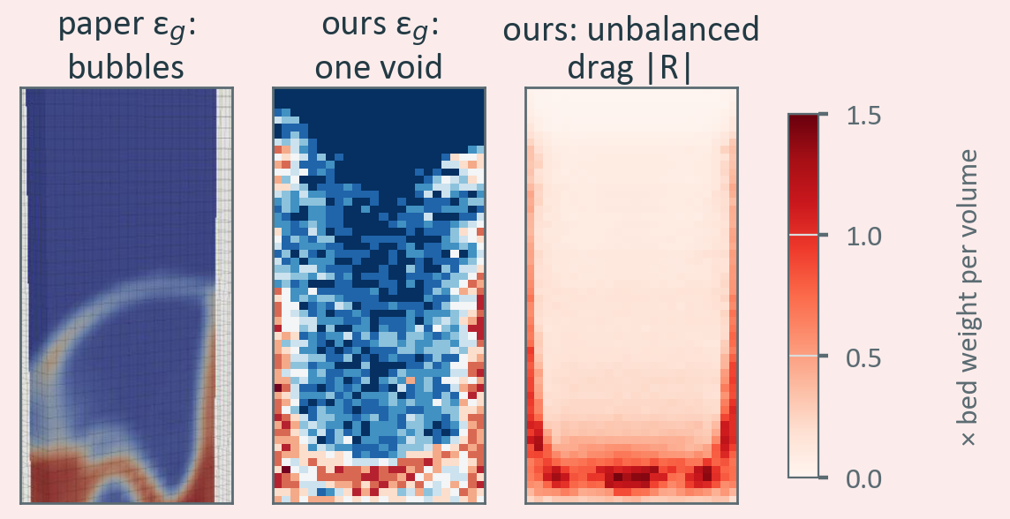
Reproducing a CFD-DEM Fluidized-Bed Study in Python
Kaustubh Ashok · 24B1522
Motivation and Objective
Gas-fluidized beds run reactors, dryers and combustors, and CFD-DEM is the standard way to simulate them. Objective: reproduce Liu & van Wachem (2019) for the NETL Geldart-D bed with a soft-sphere DEM code written from scratch in Python (Numba, 3,380 particles), coupled to the gas one-way and quasi-two-way (1-D), and find where such a simple gas model stops working.
● Key findings — one result reproduced, two not
✔ Reproduced Minimum fluidization
✘ Failed Plug lift at 3–4 u_mf
✘ Failed Bubbles at 2 u_mf
ΔP rises with gas velocity and levels off at the bed weight. u_mf = 0.99 ± 0.01 m/s over 14 beds, vs 1.00 m/s (paper) and 1.05 m/s (experiment).
ΔP climbs to 6× and 12× the bed weight (paper: 0.85–0.94×). Gas solved only per row cannot bypass the bed, so it lifts the whole bed against the lid.
One central void instead of discrete bubbles. No gas momentum equation: in bed cells ≈ 60 % of the local weight is drag that no pressure gradient balances.
EN 649
Main reference: D. Liu, B. van Wachem, Powder Technol. 343 (2019) 145–158
Code: github.com/kaustubh2005ashok-tech/en649-fluidized-bed
Notes:
Success: u_mf from 14 beds per coupling matches the paper within 1 %. Failure 1: at 3 and 4 u_mf the 1-D gas model lifts the bed as a plug. Failure 2: at 2 u_mf the bed fluidizes but without discrete bubbles, because gas momentum is not conserved cell by cell: the drag in a cell is balanced only by one pressure gradient per row, which leaves on average 60 % of the local bed weight unbalanced in bed cells.

