Slide 1
C#

Slide 2
Abstract Class
Abstract classes are classes that contain one or more abstract methods. An abstract method is a method that is declared, but contains no implementation.
Eg. public abstract void MyMethod(); //abstract method
An abstract class can contain either abstract methods or non abstract methods.
We can not create a object of abstract class. Access member using derived class.

Slide 3
Note that an abstract class does not mean that it should contain only abstract members ,also it contain non abstract members.
For example:
abstract class absClass
{
public void NonAbstractMethod()//non-abstract member
{
Console.WriteLine("NonAbstract Method");
}
}

Slide 4
Program =Abstract class
using System;
namespace abstract1
{
//Creating an Abstract Class
abstract class absClass
{
//A Non abstract method
public int AddTwoNumbers(int Num1, int Num2)
{
return Num1 + Num2;
}
public abstract int MultiplyTwoNumbers(int Num1, int Num2);
}

Slide 5
//A Child Class of absClass
class absDerived : absClass
{
static void Main(string[] args)
{
absDerived calculate = new absDerived();
int added = calculate.AddTwoNumbers(10, 20);
int multiplied = calculate.MultiplyTwoNumbers(10, 20);
Console.WriteLine("Addition:{0}", added);
Console.WriteLine("Multiplication:{0}", multiplied);
Console.ReadLine();
}
public override int MultiplyTwoNumbers(int Num1, int Num2)
{
return Num1 * Num2;
}
}
}

Slide 6
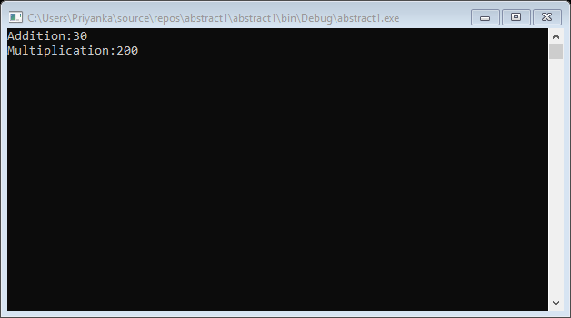
OUTPUT

Slide 7
Virtual
The virtual keyword is used to modify a method, property,
indexer, or event declaration and allow for it to be overridden in
a derived class .
public virtual double Area()
{
return x*y;
}
By default, methods are non-virtual. We can't override a non-virtual method.

Slide 8
A virtual method is created in the base class that can be overriden in the derived class.
We create a virtual method in the base class using the virtual keyword and that method is overriden in the derived class using the override keyword.

Slide 9
Program :virtual method
using System;
namespace virtual2
{
public class Base
{
public virtual void Test()
{
Console.WriteLine("This is the base version of the virtual method");
}
}
public class Derived : Base
{
public override void Test()
{
Console.WriteLine("This is the derived version of the virtual method");
}
}

Slide 10
class Program
{
static void Main()
{
Base b1 = new Base();
b1.Test();
Base b2 = new Derived();
b2.Test();
Console.ReadLine();
}
}
}

Slide 11
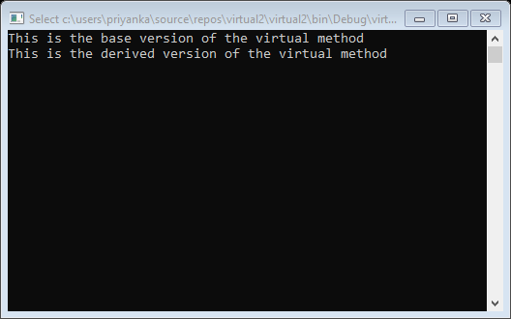
OUTPUT

Slide 12
Delegate
A delegate is a reference type variable that holds the reference to a method. The reference can be changed at runtime.
Delegates are especially used for implementing events and the call-back methods. All delegates are implicitly derived from the System.Delegate class.
Syntax for delegate declaration is –
delegate<return_type><delegate_name><Parameter_list>
Example -
Public delegate int MyDelegate(string s);

Slide 13
Instantiating Delegates:
Once a delegate type is declared, a delegate object must be created with the new keyword and be associated with a particular method. When creating a delegate, the argument passed to the new expression is written similar to a method call, but without the arguments to the method
For example-
public delegate void printString(string s);
……
printString ps1=new printString(WriteToScreen);
printString ps2=new printString(WriteToFile);

Slide 14
Program:Delegate
using System;
delegate int NumberChanger(int n);
namespace delegateApp1
{
class TestDelegate
{
static int num = 10;
public static int AddNum(int p)
{
num += p;
return num;
}
public static int MultNum(int q)
{
num *= q;
return num;
}
public static int getNum()
{
return num;
}

Slide 15
static void Main(string[] args)
{
//create delegate instances
NumberChanger nc1 = new NumberChanger(AddNum);
NumberChanger nc2 = new NumberChanger(MultNum);
//calling the methods using the delegate objects
nc1(25);
Console.WriteLine("Value of Num: {0}", getNum());
nc2(5);
Console.WriteLine("Value of Num: {0}", getNum());
Console.ReadKey();
}
}
}

Slide 16
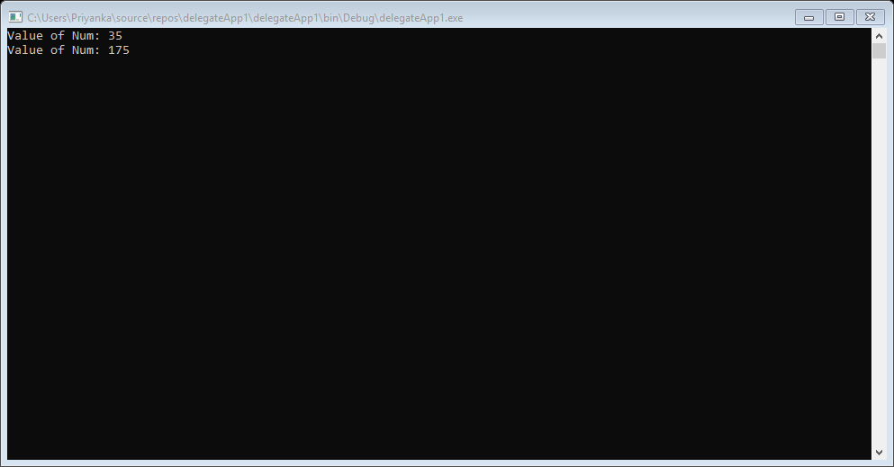
OUTPUT

Slide 17
Events
Events are user actions such as key press, clicks, mouse movements, etc., or some occurrence such as system generated notifications. Applications need to respond to events when they occur. For example, interrupts. Events are used for inter-process communication.

Slide 18
Program:Event
using System;
namespace eventApp2
{
public delegate string MyDel(string str);
class EventProgram
{
event MyDel MyEvent;
public EventProgram()
{
this.MyEvent += new MyDel(this.WelcomeUser);
}
public string WelcomeUser(string username)
{
return "Welcome " + username;
}

Slide 19
static void Main(string[] args)
{
EventProgram obj1 = new EventProgram();
string result = obj1.MyEvent("Tutorials Point");
Console.WriteLine(result);
Console.ReadLine();
}
}
}

Slide 20
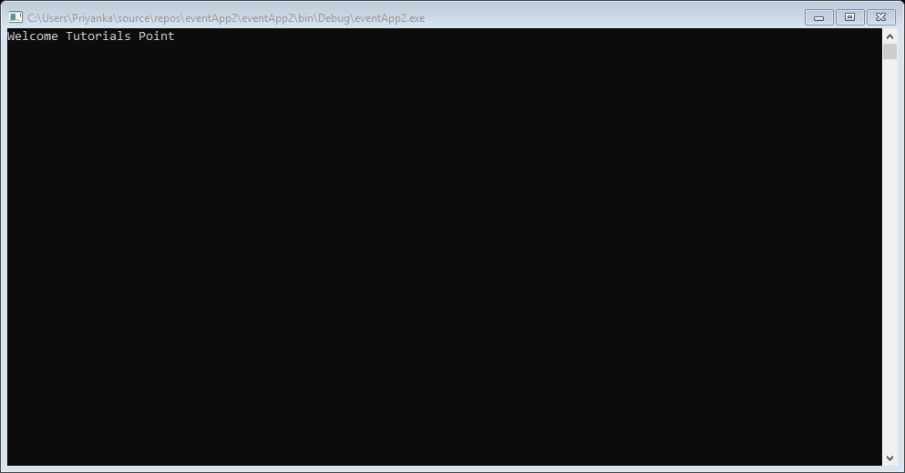
OUTPUT

Slide 21
Reflection
Reflection objects are used for obtaining type information at runtime. The classes that give access to the metadata of a running program are in the System.Reflection namespace.
The System.Reflection namespace contains classes that allow you to obtain information about the application and to dynamically add types, values, and objects to the application.

Slide 22
Applications of Reflection:
Reflection has the following applications −
It allows view attribute information at runtime.
It allows late binding to methods and properties
It allows creating new types at runtime and then performs some tasks using those types.

Slide 23
Program:Reflection
using System;
using System.Reflection;
using System.Text;
using System.Threading.Tasks;
namespace reflectioneApp1
{
class Program
{
static void Main(string[] args)
{
var assembly = Assembly.GetExecutingAssembly();//The assembly that contains the code that is currently executing.
Console.WriteLine(assembly.FullName);
var types = assembly.GetTypes(); // Gets the types defined in this assembly.
foreach(var type in types )
{
Console.WriteLine("Type:" +type.Name);

Slide 24
var props = type.GetProperties();// Returns all the public properties of the current Type.
foreach (var prop in props)
{
Console.WriteLine("\tProperty:"+prop.Name +"ProprtyType:"+prop.PropertyType);
}
var fields = type.GetFields();// Returns all the public fields of the current Type.
foreach (var field in fields)
{
Console.WriteLine("\t field"+field.Name);
}
var methods = type.GetMethods();// Gets the methods of the current Type.
foreach (var method in methods)
{
Console.WriteLine("\t Method:"+method.Name);
}
}
Console.ReadLine();
}
}
}

Slide 25
public class sample
{
public string Name { get; set; }
public int Age;
public void MyMethod()
{
}
}

Slide 26
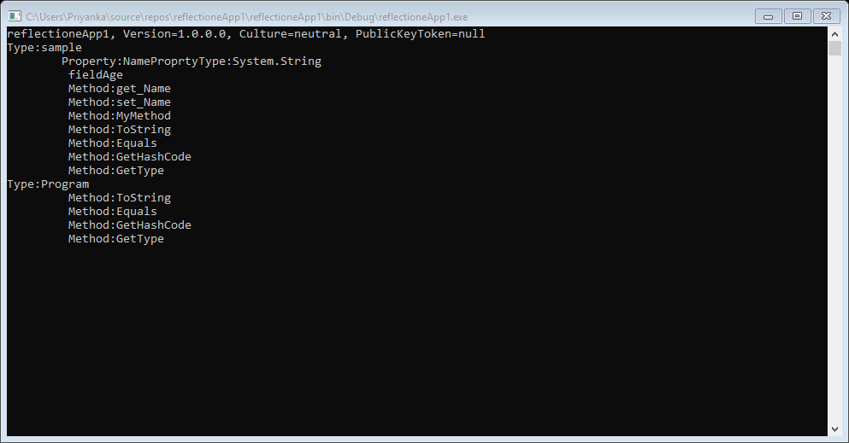
OUTPUT

Slide 27
Attribute
An attribute is a declarative tag that is used to convey information to runtime about the behaviours of various elements like classes, methods, structures, enumerators, assemblies etc. in your program.
Attributes are used for adding metadata, such as compiler instruction and other information such as comments, description, methods and classes to a program.

Slide 28
in your program. You can add declarative information to a program by using an attribute. A declarative tag is shown by square ([ ]) brackets placed above the element it is used for.
Syntax for specifying an attribute is as follows −
[attribute(positional_parameters, name_parameter = value, ...)]
element

Slide 29
Program:Attribute
#define DEBUG
using System;
using System.Diagnostics;
public class Myclass
{
[Conditional("DEBUG")]
public static void Message(string msg)
{
Console.WriteLine(msg);
}
}

Slide 30
class Test
{
static void function1()
{
Myclass.Message("In Function 1.");
function2();
}
static void function2()
{
Myclass.Message("In Function 2.");
}
public static void Main()
{
Myclass.Message("In Main function.");
function1();
Console.ReadKey();
}
}

Slide 31
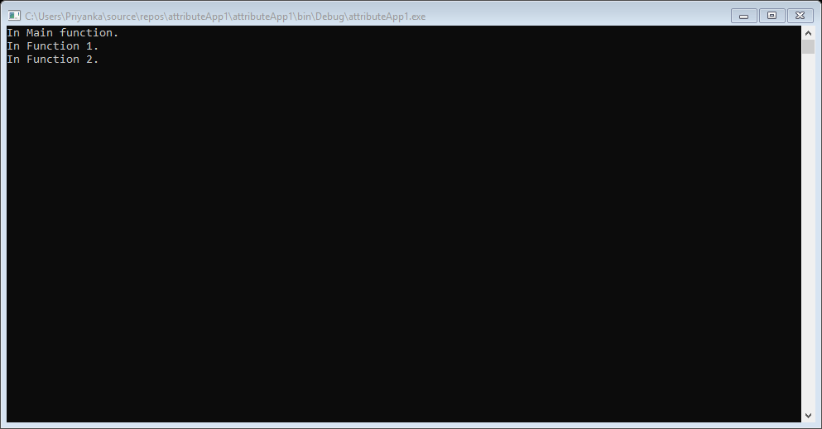
OUTPUT

