Slide 1

Udyam Digital
From 17 days and 3 visits to 10 minutes and zero paperwork
A tap-first, multilingual sign-up for small businesses, with a GenAI assistant and lookup-first KYC
Team JIO · Kaustubh Aggarwal · Vatsal Raj Agarwal
Case: Project Udyam Digital (Accel Business)
Notes:
Udyam Digital turns Accel Business's slow, visit-led MSME sales into a 10-minute self-serve journey on the owner's phone, in their language. Working prototype: Owner app, KYC check and Sales & partner desk.

Slide 2

93% of leads never get connected, and most losses are fixable
5,000 leads in one quarter produced 368 activations. The steepest drop is between needs assessment and an accepted quote.
17.6 days
₹15,053
3 calls
average lead to activation
to acquire one business, vs a ₹6,900 median monthly bill
each customer made to chase order status
64% of drops after first contact are fixable
827
no time for a visit, or visit never scheduled
385
quote too complex or too slow to arrive
273
missing documents, paperwork, signatory, mismatches
280
only wanted a mobile plan (never shown what fits)
167
install delayed, no fibre at site, payment failed
GST is the gate: 9.6% of GST holders activate, vs 2.0% without
Source: smb_leads.csv (synthetic case data), 5,000 leads, Tier 1–2 cities, Apr–Jun 2026. 64% = 1,932 fixable of 3,038 drops after first contact.
Notes:
Only 7.4% of leads activate, after 17.6 days and three status calls. It costs about ₹15,000 to acquire a business that pays a median ₹6,900 a month. Most drop reasons after first contact are process problems: no time for a visit, slow or confusing quotes, paperwork, installation delays. Those are exactly what a digital journey removes.

Slide 3
Start with professional offices; micro shops go self-serve only
Bundles below are what our rule engine recommends for a typical business in each segment, priced from the catalogue.
 | Segment | Leads | Convert | Cost per activation | Avg bill /month | Payback | Recommended bundle (rule engine) | Price /month | Channel
1 | Professional offices Clinic, CA firm, coaching | 25% | 11.1% | ₹10,694 | ₹6,795 | 1.6 mo | Fibre 300, 3 business SIMs, 5 email IDs, cloud backup, 5 antivirus · 12-month contract | ₹4,915 | Self-serve first, Saathi chat
2 | Micro retail & services Kirana, salon, pharmacy | 54% | 4.1% | ₹20,007 | ₹2,504 | 8.0 mo | Fibre 100, 2 SIMs, UPI billing tablet, 2 CCTV cameras (no GST needed) · 12-month contract | ₹2,594 | Self-serve only, no-GST bundle
3 | Multi-site businesses Restaurant or retail chain | 15% | 11.0% | ₹15,614 | ₹31,233 | 0.5 mo | Fibre 300 × 4 sites, SD-WAN, failover, POS × 4, 16 CCTV, 5 SIMs · 24-month contract | ₹26,567 | Assisted: field sales + app
4 | Small manufacturers Textile, auto-parts unit | 6% | 12.8% | ₹15,324 | ₹19,979 | 0.8 mo | Leased line 20 Mbps, 8 SIMs, 25 email IDs, antivirus, 5 machine sensors · 24-month contract | ₹19,137 | Field / partner + app
Why professional offices first
Why micro must be self-serve
Why keep people for the big two
11% convert, payback in 1.6 months, 14% churn. 86% have GST, so KYC is a lookup.
₹20,007 to acquire a ₹2,504/month shop: 8-month payback. 47% lack GST, so the advisor offers a no-GST bundle.
₹20,000–31,000 monthly bills and 8–11% churn justify a visit. The field team uses the same app, so nothing is re-keyed.
Source: smb_leads.csv (synthetic). Cost per activation = acquisition spend ÷ activations. Prices are catalogue entry prices, excluding GST.
Notes:
Professional offices convert at 11%, pay back acquisition in 1.6 months and churn least among the self-serve segments, so they launch first. Micro shops are 55% of the base but cost ₹20,000 to acquire for a ₹2,500 bill, so they must be served only through the cheap self-serve channel, with a bundle that needs no GST. Multi-site businesses and manufacturers have ₹20,000–31,000 bills, so field sales and partners keep them, using the same app.

Slide 4
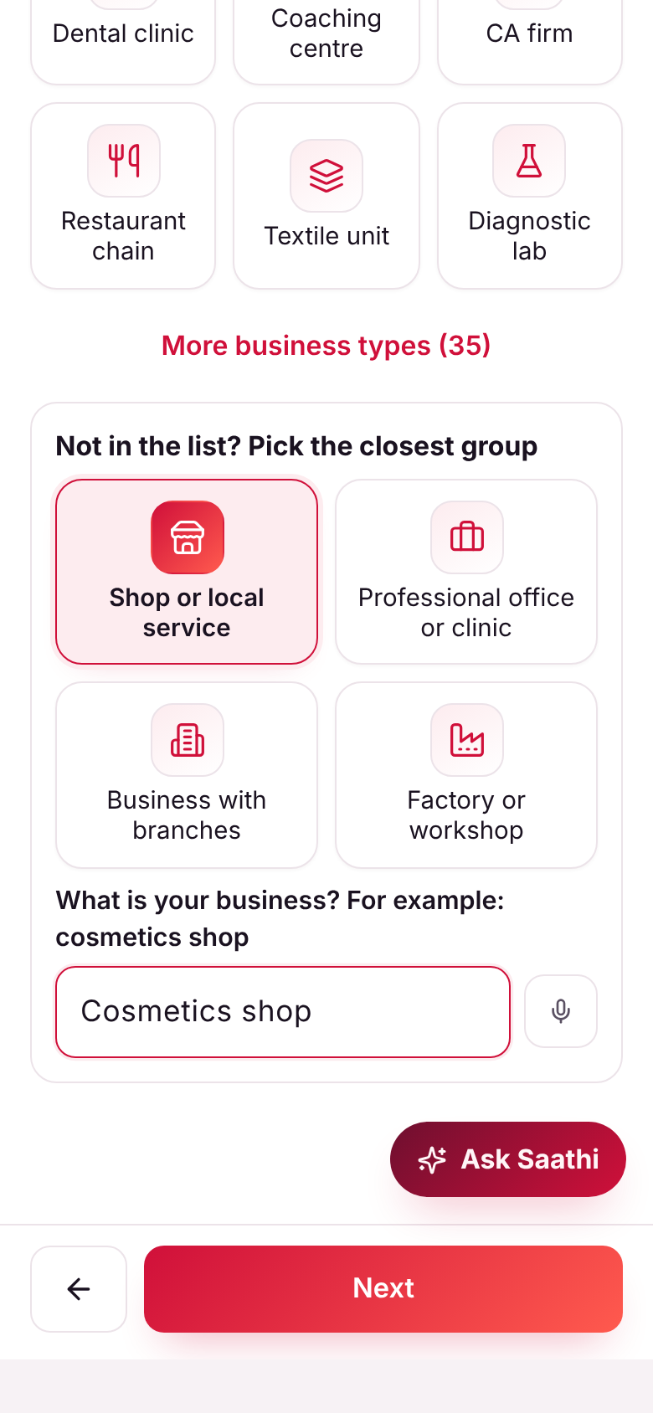
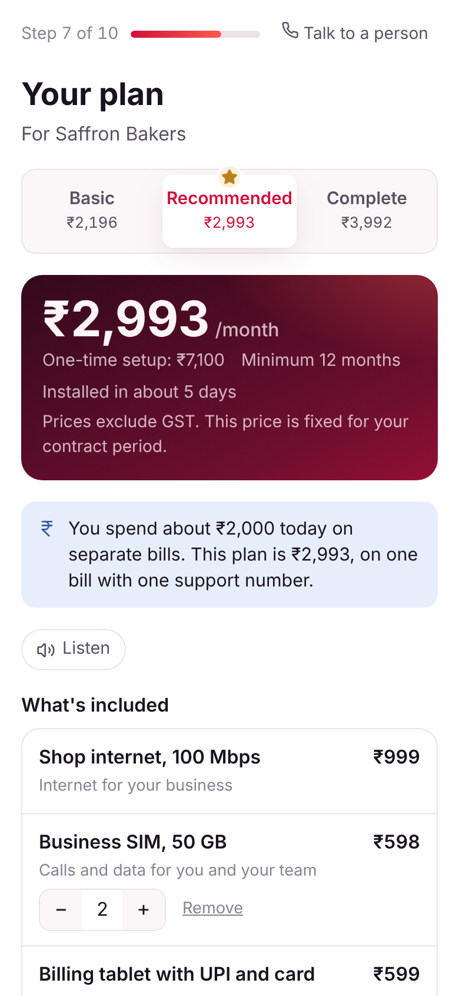
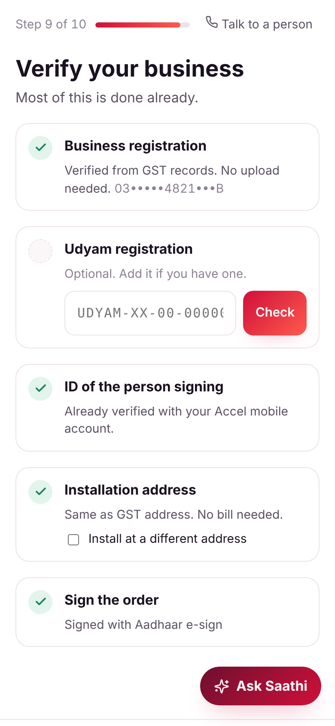
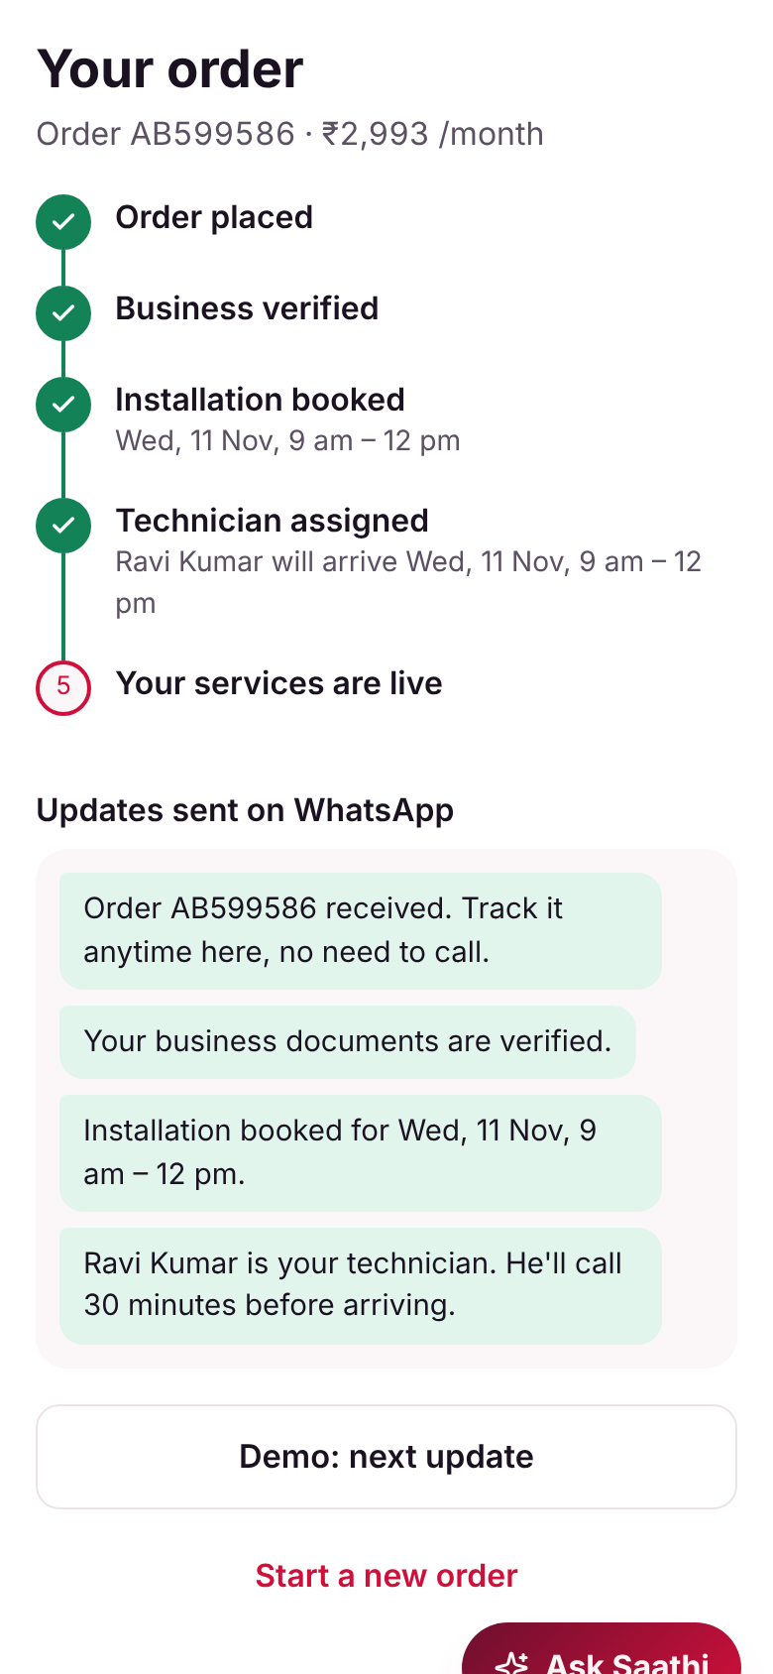
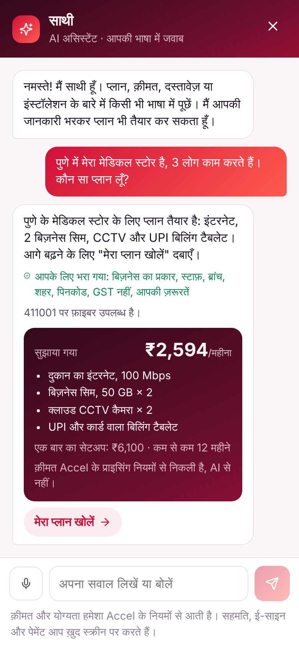
One tap-first journey: from interest to installed in ~10 minutes
Working prototype: Hindi and English complete, Marathi started, voice input on every question, progress saved after every tap.
1 Advisor
2 One clear price
3 Smart KYC
4 Tracker
5 Saathi (GenAI)
Tap a card or speak; not listed? Pick a group
Three plans, one monthly price, editable add-ons
GSTIN & Udyam lookup, DigiLocker, Aadhaar e-sign
Self-booked install slot, WhatsApp updates
Knows your answers; ask doubts at any step
No sales visit needed (827)
Clear, instant quote (385)
Minutes, not paperwork (273)
No status chasing
Any language, no repeating
Notes:
The owner never sees a product code. They tap what kind of business they run, or describe it in their own words, say how big it is, check their pincode, and pick what they want to do: take UPI payments, watch the shop on their phone, reach customers on WhatsApp. The rule engine builds three plans with one monthly price. KYC is mostly lookups. They book the installation slot themselves, set up UPI AutoPay, and get WhatsApp updates. Saathi, the GenAI assistant, can do all of this from one message in Hindi or any language. Opened mid-way, it already knows every answer and the plan on screen, so the owner just asks their doubt.

Slide 5
GenAI talks and explains; rules decide; code checks every rupee
The model never chooses a product or a price, so there is nothing for it to hallucinate.
Owner's phone
GenAI layer (Saathi)
Decision layer (code)
Lookups
Tap cards in Hindi, English, Marathi
Voice on every question
Camera blur check
Answers in any language
One message → filled-in form
Proposes answers as JSON only
Rule engine: 25 products, eligibility
Guard re-checks every plan
KYC validator, lead score
GSTIN and Udyam registries
DigiLocker, Aadhaar e-sign
UPI AutoPay, pincode check
0
7
₹777
DPDP
rule breaks in 15,000 plans
planted KYC problems caught
invented “offer” blocked
privacy by design
Replay of all 5,000 leads × 3 plans. Today's process sold 53 rule-breaking bundles and activated 22 on cancelled GSTINs.
Cancelled and altered GSTINs, tilted and blurry scans, name mismatch, stale bill, missing Udyam (fetched by lookup).
Every ₹ amount the AI writes is matched against the rules' numbers. A mismatch is replaced before the owner sees it.
One purpose-bound consent. Lookups instead of uploads. No bill if installing at the GST address. IDs masked; documents deleted 90 days after activation.
Verified by the prototype's test suite (npm test): replay of smb_leads.csv, the 12 specimen applicants K01–K12, and the AI guard tests.
Notes:
We use GenAI only where it removes real effort: understanding a message in any language and turning it into a filled-in form and a priced plan. Where a tap does the job better, such as picking a broad business group, we don't use AI. It never decides. It can only propose answers from fixed lists; code validates them, the rule engine prices the plan, and a guard re-checks every bundle. Every rupee amount in an AI reply is checked against the rules' numbers. In testing, an invented ₹777 offer was blocked. KYC decisions are plain code: GSTIN check digit, registry status, name and address match, 90-day bill age. It caught all seven planted problems in the specimen documents.

Slide 6
Rivals sell products; we build the bundle from the owner's needs
What each offers small businesses today, and where Udyam Digital wins.
Player | What they offer small businesses | Their edge | Where Udyam Digital wins
JioBusiness | Fibre, voice and productivity bundles from ₹901/month (2021); Broadband Max 801 adds attendance and meeting apps (2026) | Price leader, apps bundled in | Same fixed bundle for every business. Ours is built from what the owner wants to do, with eligibility checked
Vi Business | Employee mobile plan (₹349) with security, cloud and Google Workspace add-ons; PayU payments and WhatsApp store (2024) | Payments and productivity partners | Mobile-plan led. We put broadband, CCTV, billing and WhatsApp on one bill
Tata Tele Business | Broadband, leased line, SD-WAN, Smartflo cloud telephony, Microsoft and Google SaaS | Broadest SMB portfolio | Buying starts with a call-back form. Ours is self-serve in ~10 minutes, or assisted
Local ISPs and resellers | Cheap local broadband, sold in person | Price, proximity, trust | No SLA, separate bills and support numbers. We make the reseller our partner (partner mode)
Single-product apps | Instant online sign-up for one product, e.g. WhatsApp tools at ₹1,499–3,200/month platform fee | Speed | One product each. We match their speed across a 25-product bundle
Our edge: needs-based bundle · lookup-first KYC in minutes · GenAI in the owner's language · one bill and a tracker · partners sell through the same app
Sources: Business Today (2021), The Tech Outlook (2026), TelecomTalk (2024), tatatelebusiness.com (2025), go4whatsup.com (2026).
Notes:
Jio competes on price with fixed bundles. Vi leads with mobile plans plus partner add-ons. TTBS has the broadest portfolio but still sells through call-backs. Local resellers win on price and trust but give no SLA and no single bill. Digital apps offer instant sign-up, but for one product each. Nobody combines a bundle built from the owner's needs, near-instant KYC, vernacular AI and one bill. We also turn resellers into partners instead of competing with them.

Slide 7
Impact: 2.3× more businesses connected, at under half the cost
Model applied to last quarter's 5,000 leads, with acquisition spend unchanged.
854
₹6,484
₹4.0 cr
Rollout
1
0–3 months
activations a quarter, vs 368 today
cost per activation, vs ₹15,053
extra recurring revenue a year from one quarter's leads
Professional offices and micro self-serve in 3 Tier-1 cities, Hindi and English, Saathi live
2
3–6 months
Assumes half of visit, quote and installation drops and 60% of document drops are recovered; other stages unchanged. Revenue at the ₹6,900 median bill.
All 10 languages, WhatsApp front end, partner mode for channel partners
Metric | Today | Target
Lead to activation | 7.4% | 15%+
Days from lead to live | 17.6 | ≤ 5
Cost per activation | ₹15,053 | ≤ ₹6,500
Status calls per customer | 3.0 | ≤ 1
6-month churn | 15.2% | ≤ 10%
Plans breaking eligibility rules | 53 | 0
3
6–12 months
Multi-site and manufacturers through field sales on the app; all Tier 1–2 cities
People and partners, not replaced but redeployed
Field sales take ₹20,000+/month accounts, using the app on site
Resellers sign shops up in partner mode and earn commission
Unclosed leads go to a callback queue ranked by lead score
Model: numbers.mjs on smb_leads.csv (synthetic). Targets are for 12 months after launch.
Notes:
If the journey recovers half of the visit, quote and installation drops and 60% of the document drops, last quarter's 5,000 leads would give about 854 activations instead of 368: 2.3 times as many, at about ₹6,484 each with the same spend, adding about ₹4 crore a year in recurring revenue from one quarter's leads. We'd track five metrics: lead to activation, days to live, cost per activation, status calls per customer, and 6-month churn, plus zero eligibility breaches as a guardrail. Field sales and resellers aren't replaced: they work on the big accounts and sign shops up through the same app.

