Slide 1
Introduction to Grunt
Grunt as a build tool for JS

Slide 2
What is Grunt?
JavaScript task runner
Cross-platform , built on top of NodeJS
Works by executing tasks
Can be used for Develop-Build-Deploy
Enables team to write consistent code
Maintain coding standards within teams
Automate your build process
Automate testing and deployment and release process

Slide 3
Grunt as JS task runner
Development phase – scaffolding, htmlhint, jshint
Build – compile, test runner, code coverage, css minification, minification, concatenation
Deploy – versioning, git tags, copy

Slide 4
JS Project setup
Install NodeJS
Install grunt
npm install –g grunt-cli
cd <project_dir>
Create package.json at root level or use npm init
Add grunt as dev dependency
npm install grunt --save-dev
Create Gruntfile.js(root level)
module.exports = function(grunt){
grunt.initConfig(
{
pkg: grunt.file.readJSON('package.json')
});
grunt.registerTask('default', []);
};
Notes:
1. npm install –g grunt-cli will install Grunt command line module globally
2. npm install grunt will install Grunt locally in the <project_dir>
3. --save-dev adds Grunt dependencies as a development dependencies in your package.json

Slide 5
Adding a plugin to Gruntfile.js
Install locally using command line and add it as dependency to package.json
npm install <plugin> --save-dependency
Or manually add dependency to package.json
Sample:
"devDependencies": {
"grunt": "~0.4.2",
"grunt-htmlhint": "*",
"matchdep": "*",
"grunt-contrib-watch": "*",
"grunt-contrib-clean": "~0.5.0",
"grunt-contrib-jshint": "~0.8.0",
"grunt-bump": "0.0.13",
"grunt-contrib-cssmin": "~0.7.0"
}

Slide 6
Start with development
Validate with htmlhint
Add index.html
Add htmlhint dependency to package.json
npm install OR (use --save-dev)
Add htmlhint task to Gruntfile.js
Load task using “matchdep”
//add this line before grunt.initConfig
//load all tasks with grunt
require("matchdep").filterDev("grunt-*").forEach(grunt.loadNpmTasks
Automate using grunt watch
npm install grunt-watch –-save-dev
Add index.html to watch task in Gruntfile.js
Notes:
grunt.loadNpmTasks('grunt-htmlhint');
Defines a wrapper function with “grunt” is taken as an argument
~1.2.3 := >=1.2.3-0 <1.3.0-0 "Reasonably close to 1.2.3". When using tilde operators, prerelease versions are supported as well, but a prerelease of the next significant digit will NOT be satisfactory, so 1.3.0-beta will not satisfy ~1.2.3.

Slide 7
Grunt can be useful in
Development
clean
htmlhint
jshint
istanbul-code-coverage for Unit tests and code coverage
minify
Deployment and Release
copy
versioning(bump)
release (Create git tag and push)
Deploy – upload artifacts using grunt-shell commands
Build Phase
htmlhint
watch

Slide 8
Simple GruntFile.js
module.exports = function(grunt){
//load all tasks with grunt-
require("matchdep").filterDev("grunt-*").forEach(grunt.loadNpmTasks);
grunt.initConfig({
pkg: grunt.file.readJSON('package.json'),
//Automate
watch: {
html: {
files: ['index.html'],tasks: ['htmlhint']
},
js: {
files: ['js/validator.js'], tasks: ['uglify']
}
},
//Htmlhint
htmlhint: {
build: {
options: {
'tag-pair': true,
'id-unique': true,
},
src: ['index.html']
}
},
//Clean
clean: { build: ['build‘] },
//JSHint
jshint: {
all: ['js/**/*.js'],
options: {
curly: true,
eqeqeq: true,
forin: true,
maxdepth: 3,
maxstatements: 50
}
},
//Minify js
uglify: {
build: {
files: {
'build/js/validator.min.js': ['js/validator.js']
}
}
},
grunt.registerTask('default', []);
grunt.registerTask('build', ['clean', 'htmlhint', 'jshint', 'cssmin:combine','uglify']);
});
};

Slide 9
Custom tasks
Custom project-specific tasks may be defined in external .js files and loaded via the grunt.loadTasks method.
Simple tasks can be added to Gruntfile.js
module.exports = function(grunt) {
// A very basic default task.
grunt.registerTask('default', 'Log some stuff.‘, function() { grunt.log.write('Logging some stuff...').ok();
});
};

Slide 10
Advantages
Good community support
Built on top on NodeJS
Readily available plugins for basic tasks
Can add custom tasks
Can be integrated with Gradle

Slide 11
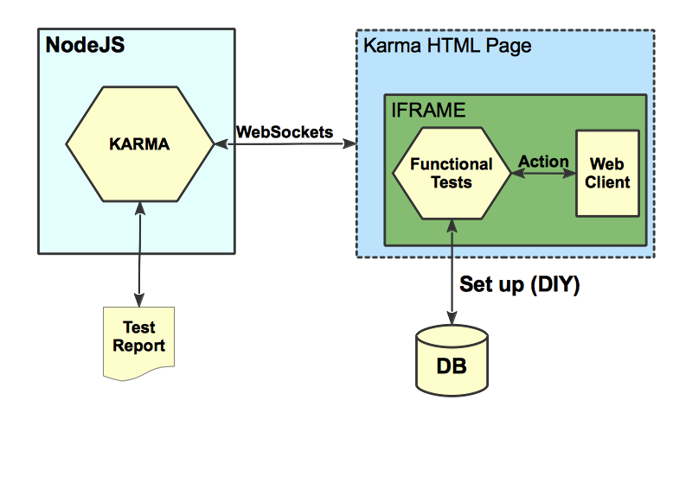
Karma

Slide 12
References
http://gruntjs.com/getting-started
http://coding.smashingmagazine.com/2013/10/29/get-up-running-grunt/
Demo app
git@github.com:tejaswita/js-with-grunt.git

