Slide 1
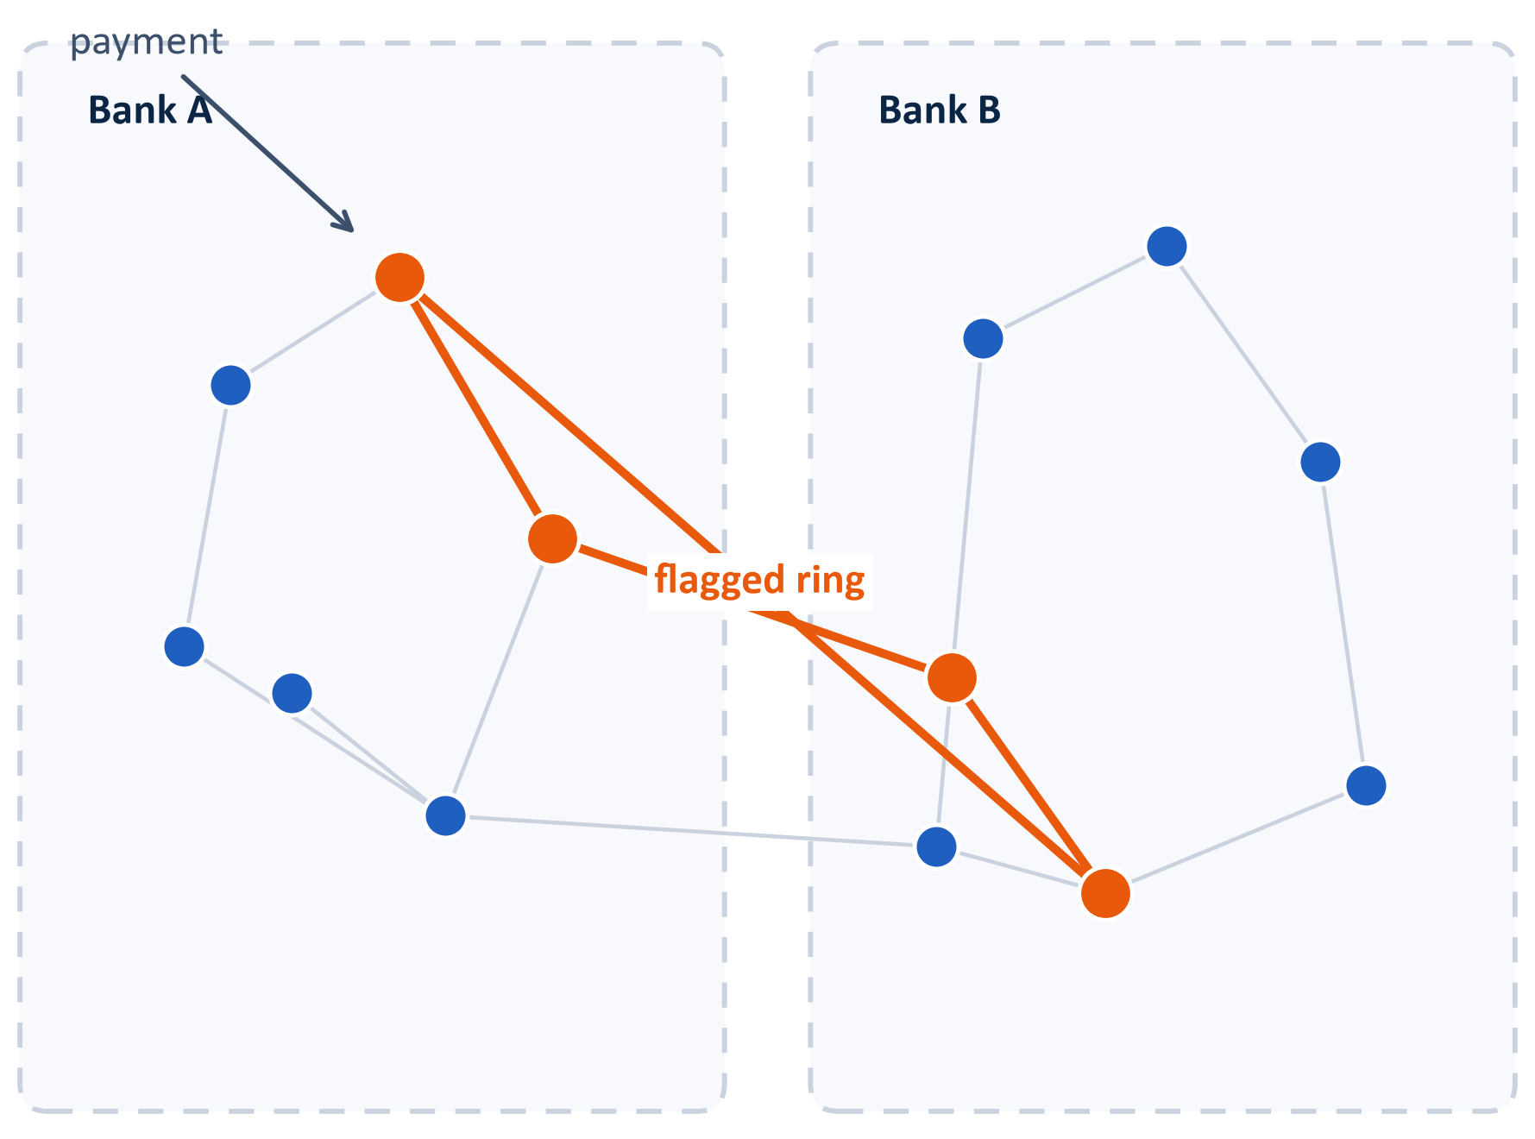
MuleNet
Catching money-mule rings across banks without sharing customer data
Team: [TEAM NAME]
Kaustubh Handore · Astha Sonwane
Track: AI & Fraud Detection
Citi × NPCI Drunix Hackathon 2026
An ordinary payment in Bank A — the laundering ring behind it crosses banks.
In this deck: problem → today's defences → our approach → data & model → evaluation → risks → plan
1
Notes:
Good morning, we are [TEAM NAME] - Kaustubh Handore and Astha Sonwane. We are pitching MuleNet, a federated graph model that catches money-mule rings spread across banks. The picture on the right is the whole idea: an ordinary payment lands in one bank, but the ring behind it crosses banks. Banks never share customer data, only model updates. In the next five minutes we cover the problem, our approach, and how we plan to prove it. Likely judge question: why graphs? Short answer: laundering is a chain of accounts, and chains are exactly what graphs represent.

Slide 2
01 · THE PROBLEM
Fraud money leaves through chains of mule accounts that span banks
1 · Victim pays
A real customer sends money to what looks like an ordinary payee
UPI FRAUD, FY 2023-24
₹1,087 cr
payment
2 · Funds hop through mule accounts
Money moves quickly across accounts recruited for laundering
UPI fraud losses in 2023-24, up from ₹573 crore in 2022-23
rapid transfers
3 · Cash-out
13.4 lakh
Money exits through withdrawals or purchases and is hard to trace
reported UPI fraud cases in the same year
Each bank sees only its own slice of the chain
We will re-check both figures against the RBI Annual Report before the finale.
Pooling customer data across banks conflicts with the DPDP Act, 2023 (ss. 4-6: consent and purpose limitation)
Source: Finance Ministry data tabled in Parliament, 2024; PwC India analysis of RBI data
2
Notes:
Let us walk the money first. A real customer pays an ordinary-looking payee, the funds hop through recruited mule accounts, and cash-out happens fast. Each bank holds one slice of that chain, so no single bank can see the whole ring. The number on the right is from government data tabled in Parliament in 2024: UPI fraud losses reached 1,087 crore rupees in FY 2023-24, up from 573 crore the year before - we will re-verify it against the RBI Annual Report before the finale. The obvious fix, pooling all customer data, runs into the DPDP Act. Judge question we expect: how current is this number? Answer: FY 2023-24 is the latest full year in that data release, and we will refresh it if newer official figures are published.

Slide 3
02 · TODAY'S DEFENCES
Today's defences each miss the network
Approach
How it works
Why it misses mule rings
Rule engines
Hand-written thresholds and blacklists, updated after new fraud is seen
Rules encode past patterns; a new ring shape passes until someone rewrites the rules
Single-transaction ML (XGBoost etc.)
Scores each payment on its own features, one payment at a time
Every hop looks ordinary alone, so the ring shape never shows up in one record
Centralised data pooling
Banks upload raw customer data into one shared store
Conflicts with the DPDP Act, 2023 (ss. 4-6: consent and purpose limitation), so it is not deployable
Every option either sees too little, or asks for data banks cannot legally share.
3
Notes:
Three families of defences exist today. Rule engines encode yesterday's fraud, so new ring shapes pass until someone rewrites them. Single-transaction models score each payment in isolation, and every individual hop looks ordinary on its own. Centralised pooling would see the ring but demands data banks cannot legally share - DPDP sections 4 to 6 are the consent and purpose-limitation provisions, now cited on the slide. Judge question: why not just add more rules? Answer: rules are per-pattern, rings are per-structure, and structure is exactly what our model represents.

Slide 4
03 · OUR APPROACH
MuleNet: banks train one shared model, and no customer data leaves
One federated training round
1
Bank A
receives: weight updates only
Each bank builds a graph from its own transactions
local GNN training
Secure aggregation server
2
Bank B
FedAvg averaging
A GNN trains locally inside the bank
local GNN training
averaged weights (FedAvg)
Bank C
3
Only model weight updates are sent out
local GNN training
Global model
aggregated from all banks
4
The server averages the updates (FedAvg)
updated global model returns to every bank
5
The global model returns; scoring runs inside each bank
4
Notes:
Here is one training round. Each bank builds a graph from its own transactions and trains a graph neural network locally. Only the weight updates leave the bank, the server averages them with FedAvg, and the improved global model comes back for scoring inside each bank. No raw transaction and no account identity ever crosses the boundary. Judge question: what exactly is inside a weight update? Answer: numbers describing how the model should change, not transactions - and the next slide shows precisely what is shared and what is not.

Slide 5
04 · ARCHITECTURE
Architecture: what stays in the bank and what is shared
Bank A
transactions · local graph · local GNN
averaged global model
model parameters
risk score + ring flag
Secure aggregation server
Global model
Scoring API
Drunix / NPCI layer
Bank B
transactions · local graph · local GNN
payment decision
Bank C
transactions · local graph · local GNN
Decision
model weight updates only
allow / step-up verification / block
flagged ring → analysts
Stays inside the bank
Shared
raw transactions · account identities · local graph
model weights · boundary-node embeddings · no raw data
5
Notes:
This is the full architecture. The banks keep transactions, account identities and the local graph. What travels is only model weight updates, and on the way back the global model serves scoring through an API so the decision fits inside the payment flow. The Drunix and NPCI layer turns the score into allow, step-up verification, or block, and analysts additionally receive the flagged ring. Judge question: where does cross-bank context enter if edges between banks stay local? Answer: boundary-node embeddings, and we flag that as a main risk later in the deck.

Slide 6
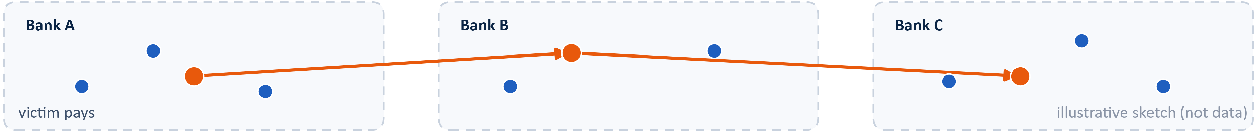
05 · DATA & MODEL
Data and model: PaySim, split across simulated banks
Data
Model
~6.36M
~0.13%
Accounts are nodes; transactions are edges
transactions over 30 days
flagged as fraud
Node features: amount, velocity, balance change, counterparty count, hop depth
[VERIFY against downloaded file]
GraphSAGE, 2 layers, with class-weighted loss for the fraud imbalance
We assign accounts to 3–4 simulated banks
Federated with Flower: the server averages weight updates (FedAvg)
We inject synthetic multi-hop mule rings that cross banks, because public data has few real rings
Public simulated data is a stand-in; real cross-bank data is not available to us.
Source: PaySim synthetic financial dataset, as distributed [VERIFY: confirm transaction count and fraud rate against the downloaded file]
6
Notes:
We train and test on PaySim, a public simulator with about 6.36 million transactions over 30 days, around 0.13 percent flagged as fraud; we will verify both numbers against the file we download. We split accounts across three or four simulated banks and inject multi-hop rings that cross banks, because public data contains few real rings - the strip at the bottom is a sketch of that, not real output. The model is a two-layer GraphSAGE with a class-weighted loss for the imbalance, federated with Flower. Judge question: is PaySim good enough? Honest answer: it is a stand-in, and the slide says so in plain words.

Slide 7
06 · HOW WE DIFFER
How MuleNet differs from a typical fraud model
Dimension
Typical approach
MuleNet
What it looks at
One payment in isolation
The network around it: accounts and the links between them
Whose data
One bank's own customers only
Many banks at once, without sharing raw data
Privacy
Not a design constraint; pooling is the usual shortcut
Designed in: only model weight updates ever leave
Output
A verdict for the payment
A verdict plus the ring graph for analysts
Model
Rules or boosted trees on flat features
Federated GraphSAGE on account graphs
7
Notes:
This table is the honest comparison. The key rows are data and privacy: typical models see one bank's data, and pooling is the usual shortcut that data-protection law now blocks. MuleNet sees the network around a payment, learns from many banks at once, and only weight updates ever leave. The output differs too: we return a verdict plus the ring graph. Judge question: does federated training cost accuracy? Answer: usually a little, and our evaluation plan on the next slides is built to measure and report that gap.

Slide 8
07 · HACKATHON THEME
Innovation, scale and impact
Innovation
Scale
Impact
Federated learning plus graph neural networks, aimed at mule rings that cross banks
A new bank joins by training locally and sending only weight updates
Earlier detection of laundering chains as they form
The ring structure is the signal - it lives between banks, not inside one
No central data lake is created at any point
Analysts receive the ring graph, not just a verdict
Federation makes that structure legal to learn from
Per-round cost grows with model size, not with data size
Designed to fit data-protection rules from the start
8
Notes:
Innovation, scale and impact, in the hackathon's own terms. Innovation: federated learning plus graph models aimed exactly at cross-bank mule rings. Scale: a new bank joins by training locally, there is no central data lake, and per-round cost grows with model size rather than data size. Impact: earlier detection of laundering chains, and analysts receive the ring rather than a bare verdict. Judge question: what is the marginal cost of onboarding a bank? Answer: one local training setup, because nothing central has to be rebuilt.

Slide 9
08 · EVALUATION PLAN
How we will prove it works
Model
Data it sees
What it shows
Demo plan
Single-bank XGBoost
One bank's transactions, flat features
Baseline without graph structure
PLANNED - NOT YET RUN
1. Score the same payments with one bank's own model alone
Single-bank GNN
One bank's transaction graph
What graph structure alone adds
2. Score them again with the federated model
Centralised GNN (upper bound)
All banks' data pooled - not deployable
The ceiling if privacy were ignored
3. Show a ring that the single bank scores low and the federated model flags
Federated GNN (ours)
Local graphs; only weights shared
The gap to the ceiling, reported honestly
Metrics we will report: PR-AUC; recall at fixed precision; ring-level recall; false positives per 1,000 payments; scoring latency.
And we will show why: the ring graph, and the edges that raised its score.
9
Notes:
Nothing on this slide has been run yet, and we label it planned for that reason. We will compare four models: single-bank XGBoost, single-bank GNN, a centralised GNN as the upper bound, and our federated model, and we will report the gap to that bound honestly. The metrics are PR-AUC, recall at fixed precision, ring-level recall, false positives per thousand payments, and scoring latency. The demo will show one ring that Bank A alone scores low and the federated model flags, and we will show why - the ring graph and the edges that raised its score. Judge question: what if the federated model cannot beat the single-bank baseline? Answer: then we report that, because a negative result measured properly is still useful evidence.

Slide 10
09 · RISKS
Main risks and how we handle them
Risk
Why it matters
Our plan
Cross-bank edges are split between banks
A hop from Bank A to Bank B lives in neither local graph
Exchange boundary-node embeddings across banks; fall back to a single-bank graph model if that fails
Federated model may trail a centralised one
Averaged updates can lose accuracy compared with pooled training
Report the gap to the upper bound honestly; tune aggregation rounds and local epochs
Simulated data may not match real fraud
PaySim patterns differ from live UPI traffic
Say so explicitly; test on injected rings and on PaySim's own fraud labels
NPCI API access is not guaranteed
The real-time path depends on sandbox approval
Mock the API layer now and swap in the sandbox when access is granted
10
Notes:
Four risks we have planned around. Cross-bank edges are split between banks, so we will exchange boundary-node embeddings and can fall back to a single-bank graph model. The federated model may trail the centralised one, and we commit to reporting that gap rather than hiding it. PaySim is a stand-in for real traffic, so we test on injected rings and say clearly what it cannot show. And if NPCI sandbox access does not come through, the API layer is mocked and swappable. Judge question: which risk worries you most? Answer: honestly, data realism, which is why we scope our claims to what PaySim can support.

Slide 11
10 · PLAN & TEAM
Plan from launch to finale
9 Oct
10 Oct – 22 Nov
4 Dec
Launch
Coding round
Grand finale
1 · Baseline graph model
2 · Federated training
3 · Scoring API + explainability
4 · Dashboard + Drunix
5 · Testing and freeze
Team
QR
Kaustubh Handore
Astha Sonwane
Team lead · graph model
Federated training · evaluation
[add repo link]
Our ask: NPCI sandbox access, and feedback from Citi's fraud analysts during the coding round.
11
Notes:
The plan against the real dates. Launch on 9 October; coding from 10 October to 22 November, in five phases: baseline graph model, federated training, scoring API with explainability, dashboard with Drunix integration, then testing and freeze; grand finale on 4 December. The team: Kaustubh owns the graph model, Astha owns federated training and evaluation; the QR goes to our repository. And we end with a concrete ask - sandbox access and fraud-team feedback. Judge question: what is your first checkpoint? Answer: a working single-bank graph model early in the coding window, because everything federated builds on it.

Slide 12
APPENDIX · FOR Q&A ONLY
Backup: method details and the legal questions we are checking
FedAvg, in one line
GraphSAGE, our configuration
Legal questions we are checking
wₜ₊₁ = Σₖ (nₖ / n) · wₖ
2 layers; each node aggregates messages from sampled neighbours
[VERIFY: whether fraud scoring can rely on 'legitimate uses' under s. 7, or needs fresh customer consent]
Each bank trains on its own data only
Mean aggregation, chosen for stability on skewed transaction graphs
[VERIFY: legal view on whether model weights and embeddings count as personal data]
The global update weights each bank by its share of training examples
Hidden size and sampling depth tuned during the coding round
[VERIFY: RBI requirements on storage of payment system data]
A standard, well-studied scheme - we add no new theory
Backup for questions only — we skip this slide in the main run-through.
12
Notes:
We keep this slide hidden unless a judge digs into the method. FedAvg: the server computes a weighted average of the banks' weights, weighted by each bank's share of training examples. GraphSAGE: two layers with neighbour sampling keeps the computation bounded inside each bank. The red items are legal checks we will complete before claiming compliance - we will not hand-wave them. Judge question: do weight updates leak personal data? Answer: that is exactly the open question we are getting a legal opinion on, and boundary-node embeddings are designed to be aggregated statistics rather than raw records.

