Slide 1
AI-Driven Gaming Addiction Screening System
A multimodal, privacy-conscious mobile platform for early detection and parental awareness
behaviour · chat · voice → one screening signal a parent can act on
Kaustubh Agarwal (PES1UG23CS291) · Khushee P Kiran (PES1UG23CS303) Kanak Goyal (PES1UG23CS279) · Vidisha Murali (PES1UG23CS681)
Guide: Prof. Shridevi Sawant · Team PW26_SAS-03 · PES University, 2026
Notes:
One sentence, identical from all four of us: "a deployed, multimodal screening system for parents that measures how a child plays, not just how long — externally validated against a clinical instrument, with its limitations named before you ask." If there is room: the study returned two results we did not want; we report both.

Slide 2
Phase III — where each expectation is evidenced
System testing · V&V · deployment · final results · performance analysis · research paper
Phase III expectation | What we did | Evidence
System testing | 291 automated tests + 7 research-integrity guards in CI (backend on SQLite + Postgres, Android JVM, paper↔data guards); load smoke, API fuzz, CVE + MobSF audits; on-device resource drill on real hardware | slide 14 · TESTING.md · ci.yml
Validation & verification | Held-out / speaker-independent / in-domain evaluation; ablations with 95 % CIs; external construct validation vs IGDS9-SF (n = 103); accent-fairness audit; 7 research-integrity guards | slides 10–12 · docs/*.json · ml/tests/
Deployment | Live cloud backend (Render + Neon Postgres, HTTPS, tokens); signed APKs v2.4.0 on GitHub, validated on device; consented family pilot ran 23 days | slide 4 · DEPLOY.md · GitHub Releases
Final experimental results | Behaviour 91.6 % (synthetic); chat PR-AUC 0.825 in-domain, ≥ 0.95 precision on 3 registers; voice 0.574 speaker-independent; ρ = 0.317 vs clinical instrument, leads hours baseline (97% of paired resamples; partial excludes zero) | slides 6–12 · model_metadata.json
Performance analysis (tables & graphs) | PR curve · confusion matrices · reliability diagrams · ablation tables · survey correlation table + feature chart · device resource table · fairness-by-accent table | slides 6–14 · docs/figures/
Complete research paper draft | 48-page paper: architecture, methodology, 11-dataset audit, results, ablations, external validation, fairness audit, ethics & limitations, 48 references — numbers pinned to the data by CI | docs/PROJECT_PAPER.pdf
Everything on this slide is reproducible from the public repository — and 7 CI tests fail the build if the paper and the data disagree.
PW26_SAS-03 · AI-Driven Gaming Addiction Screening · PES University
2
Notes:
Use this as the map for the panel: every Phase III expectation has a slide, a repo artefact and a number behind it. If time is short, this slide plus slides 12 and 14 carry the grade. Point at the artefact column — everything is reproducible from the public repository, and 7 CI tests fail the build if the paper and the data disagree.

Slide 3
Problem & Scope
Screening, not diagnosis — and why existing tools miss the pattern
▪ Internet Gaming Disorder is WHO-recognised (ICD-11) — parents notice late, from the outside
▪ Existing tools: self-report questionnaires or blunt screen-time counters / blockers
▪ Ours: passive, multi-signal screening surfaced to a parent — with a plain-language "why"
▪ NOT a diagnostic instrument — a "talk to your child / consider help" signal
▪ Scoped to minors by design: a guardian in the loop is what makes screening the unwilling possible
Volume tells you how long. We measure how — late-night play, rapid re-logins, binges, rising toxicity, voice stress.
PW26_SAS-03 · AI-Driven Gaming Addiction Screening · PES University
3
Notes:
Set the scope before an examiner sets it for you: screening, not diagnosis — diagnosis needs a clinician. The gap: questionnaires need the child's honest cooperation; screen-time counters cannot tell 3 hours of healthy play from 3 hours of compulsive play. Behaviour patterns, in-game communication and voice stress together can. Children specifically: a guardian with duty of care is what makes SCREENING — reaching the person who would not self-report — both possible and proportionate; an adult version is either a self-help journal or spyware. (DEFENSE_NOTES §1)

Slide 4
System Overview & Deployment
Three tiers, live in production — not localhost
ChildApp (Android)
Flask backend (cloud)
ParentApp (Android)
passive capture session telemetry · IME + accessibility chat gated mic → on-device STT anti-tamper · consent-gated
Render + Neon Postgres · HTTPS · tokens 3 models + availability-weighted fusion SHAP "why" · alerts · drift monitor export scope = delete scope
dashboard + 14-day trend real-time alerts (all guardians) feedback loop → threshold tuner capture-coverage transparency
▪ SQLite in dev / Postgres (Neon) in production — one code path, CI runs both dialects
▪ Signed release APKs on GitHub; v2.4.0 current, validated on real hardware (2026-08-18)
▪ Consent is versioned and fails closed: bump the version → ingestion 403s until re-consent
PW26_SAS-03 · AI-Driven Gaming Addiction Screening · PES University
4
Notes:
Walk left to right: ChildApp captures session telemetry, game chat (custom keyboard + accessibility), and gated mic segments; the Flask backend scores each channel and fuses them; ParentApp polls dashboards and receives push alerts to every guardian. It is LIVE — Render + Neon Postgres, HTTPS, token auth — and sideload-distributed by design (a family-consent install, not a Play Store product). (DEFENSE_NOTES §8)

Slide 5
Why Three Channels
They fail independently — fusion treats each as an optional witness
▪ Behaviour needs days of telemetry; chat exists only when the child types; voice only when they speak
▪ Fusion prior 40 / 30 / 30, renormalised over the channels present this session
▪ Weights follow measured reliability — voice is lowest for a reason we show, not hide
▪ Genre multiplier and band thresholds are priors, env-tunable — the first things we took to external data
Channel | Signal | Real training data | Weakest link (stated)
Behaviour | 10 objective session features | labels synthetic; distributions from 2 real surveys | labels
Chat | calibrated toxicity, 3 registers | 5 real corpora incl. in-game (CONDA) + Hindi (HASOC) | field data thin
Voice | STT→toxicity + acoustic emotion | 4 real speech corpora, 154 speakers | acted adult speech
PW26_SAS-03 · AI-Driven Gaming Addiction Screening · PES University
5
Notes:
A missing channel contributes nothing rather than a fake neutral score — an earlier version imputed missing modalities and diluted real signal. Behaviour dominates because it is always eventually present and best measured. Say now: "the voice weight is lowest because we MEASURED it as the weakest channel — slide 8 shows that number honestly." (DEFENSE_NOTES §1, §5)

Slide 6
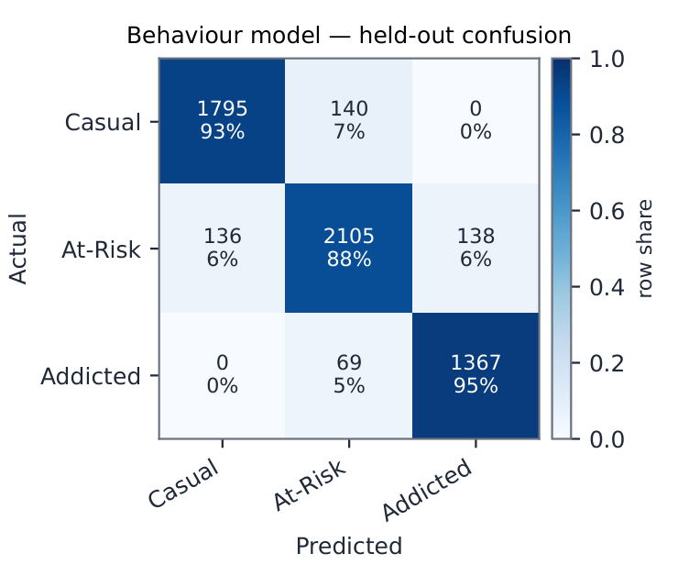
Behaviour Model
Random Forest on ten measured features — calibrated, explainable, honest about its labels
▪ Random Forest (200 trees × depth 6) on 10 objective features — the model never sees the 10 derived proxies
▪ 91.6 % test accuracy · macro-F1 0.918 · 5-fold CV 0.921 ± 0.002 — errors only ever land in an adjacent band
▪ Isotonic calibration: Brier 0.134 → 0.128; top-label ECE 0.062 → 0.015
▪ Labels are synthetic — grounded on real psychometrics (n = 11,191 + 13,464); stated on every slide it matters
Ten pattern-and-volume features in; how a child plays, not just how long. The proxies parents see are explanations, never inputs.
PW26_SAS-03 · AI-Driven Gaming Addiction Screening · PES University
6
Notes:
Two attack points, answer both proactively. (1) Why RF, not deep learning: bake-off on tabular data — RF wins on accuracy-per-cost and gives SHAP-friendly explanations parents see. (2) Synthetic labels: no public dataset pairs device telemetry with addiction labels — we audited candidates (slide 13). Grounding: IGDS9-SF Latin-America (11,191 real MOBA players) fixes severity base rates; Gamers & Anxiety (13,464) grounds behaviour–severity relations. The 20→10 feature cut: the 10 derived proxies are functions of the first 10; keeping them makes SHAP circular — ablation 0.9191 vs 0.9160, CIs overlap. Say plainly: 91.6% is a synthetic-distribution number; slide 12 is where the score meets real labels. (DEFENSE_NOTES §2)

Slide 7
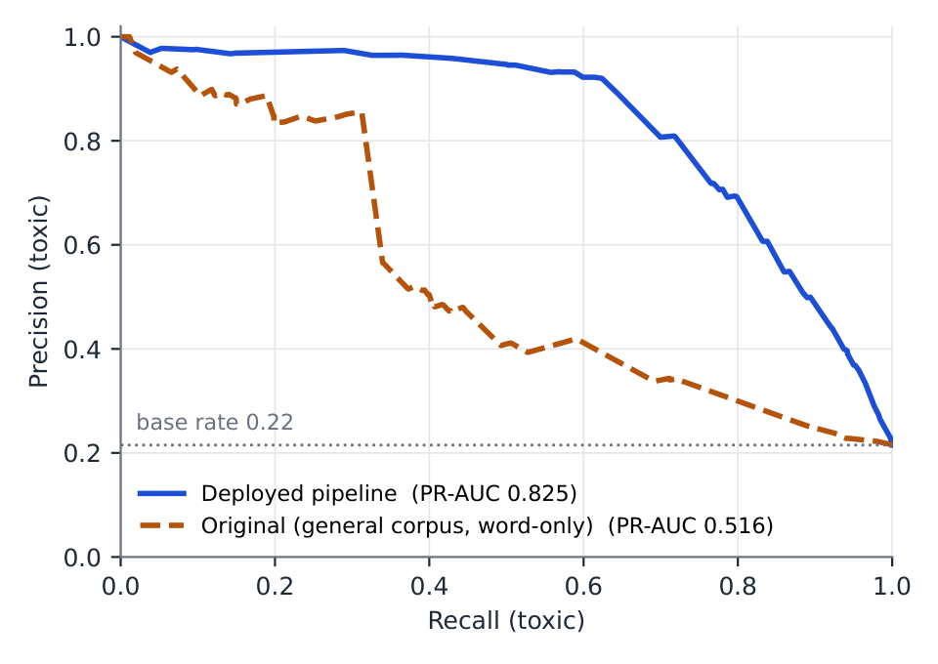
Chat Model
Domain data beats model capacity — and the threshold is a product decision
▪ TF-IDF (word 1–2g + char_wb 3–5g) → LogReg → isotonic; noisy-OR fusion with a Hinglish / Devanagari lexicon
▪ In-domain (CONDA game chat): PR-AUC 0.825 [0.807, 0.841] — off-the-shelf toxic-BERT: 0.709
▪ At alert threshold 0.95: precision 0.956, recall 0.428 — ≥ 0.95 precision on every register at one threshold
▪ Dual-script Hindi (HASOC 2019 + clean-wiki counterweight): held-out precision 0.968 / 0.958 — near-zero before
Ablation (chat, held-out CONDA) | PR-AUC | 95 % CI
full recipe (deployed) | 0.825 | [0.807, 0.841]
− char_wb n-grams | 0.794 | [0.776, 0.811]
− CONDA domain data | 0.511 | [0.487, 0.535]
PW26_SAS-03 · AI-Driven Gaming Addiction Screening · PES University
7
Notes:
The threshold story is the strongest 60 s of the talk: at the realistic ~3.5% toxic base rate, threshold 0.5 gives precision 0.235 — a parent gets ~3 false alarms per real one and stops reading alerts. At the deployed 0.95, precision is 0.956 at recall 0.428: we consciously trade recall to keep alerts credible (the session-level streak alert recovers coverage). Threshold is env-tunable; a Beta-posterior tuner adjusts it from parent feedback, capped at ±0.05 per run and human-applied. Why no BERT: 512 MB serving budget, real-time per-message scoring, and off-the-shelf toxic-BERT scores 0.709 on the same split — 12 points BELOW the domain-trained classical pipeline. (DEFENSE_NOTES §3, §5)

Slide 8
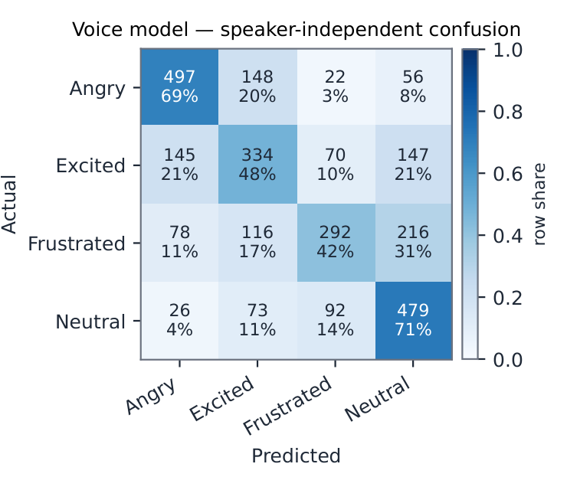
Voice Channel — two paths
On-device speech-to-text, and acoustic emotion trained on real speech
▪ Path 1: on-device Vosk STT (Indian English) → transcript → the same chat toxicity model
▪ Path 2: 36 acoustic features → HistGB emotion, trained on real corpora (RAVDESS, CREMA-D, EMO-DB, URDU)
▪ Speaker-independent accuracy 0.574 (chance 0.25) — random splits said 0.657: 8.3 points was speaker leakage
▪ Headroom measured: frozen w2v2 embeddings + same classifier → 0.776 — the ceiling a deployable distillation could reach
Raw audio is never retained: on-device STT, server-side deletion after feature extraction, VAD-gated capture.
PW26_SAS-03 · AI-Driven Gaming Addiction Screening · PES University
8
Notes:
Pre-empt "57% is weak": chance on 4 classes is 25%; the interesting part is the 8.3-point gap — with random splits the model memorised VOICES, not emotions, and the split choice even flipped which model won the bake-off. An honest 0.574 beats an inflated 0.657 in front of any examiner. Transcription happens on-device; a short WAV goes up over HTTPS and raw audio is deleted server-side after feature extraction. Measured on hardware (slide 14): the default voice path costs ~14% of one core. Known gap (slide 16): acted adult emotion ≠ child gaming speech. (DEFENSE_NOTES §4)

Slide 9
Fusion & Alerting
Max-not-mean, a threshold above best-F1, and a feedback loop that learns from parents
▪ Weighted fusion 40/30/30 over channels present this session; genre multiplier; observation mode for < 3 sessions
▪ Session chat risk = max of per-message calibrated scores — one credible threat is not diluted by clean lines
▪ Alert at 0.95, deliberately above best-F1 (0.85): false alarms cost the only thing that matters — trust
▪ Parent "accurate / false alarm" verdicts → Beta-posterior threshold tuner (capped ±0.05, human-applied)
▪ Every prior we could not fit we stress-tested: removing the genre multiplier flips 34 % of served bands
Operating point | Precision | Recall | Meaning for a parent
0.85 (best-F1) | 0.800 | 0.703 | 1 in 5 alerts is wrong
0.90 | 0.888 | 0.623 | ~1 in 9 wrong
0.95 (deployed) | 0.956 | 0.428 | ~1 in 23 wrong — alerts stay credible
PW26_SAS-03 · AI-Driven Gaming Addiction Screening · PES University
9
Notes:
Max-not-mean: one credible threat matters more than a hundred clean messages diluting it. Sitting above best-F1 is a CHOICE — the asymmetric cost is parents ignoring alerts. Know both operating points: 0.85 → P 0.800/R 0.703; 0.90 → P 0.888/R 0.623. Feedback tuner: Beta posterior, ±0.05 cap per run, minimum-evidence floor, recommendations a human applies via env vars — no automatic loop can drift. (DEFENSE_NOTES §5)

Slide 10
Built for India — the differentiator
Code-mixed chat in three registers, a Devanagari keyboard, and an accent-fairness audit
▪ Indian kids' game chat is code-mixed: English + romanised Hindi + Devanagari — all three at ≥ 0.95 precision
▪ Native Devanagari keyboard in the Wellbeing Keyboard — Hindi captured even in canvas games (Roblox)
▪ Accent-fairness audited on Svarah (6,656 clips / 117 speakers): 0 false alerts in 9.61 h of benign speech, every accent group
▪ Honest capture matrix shown to parents — including the blind spots (browser games, in-game VOIP holding the mic)
Accent group (L1 family) | clips | STT word-error rate | benign-speech false alerts
Dravidian | 1798 | 34.6 % | 0
Indo-Aryan | 4456 | 38.1 % | 0
Tibeto-Burman (Northeast) | 402 | 60.8 % | 0
The chain degrades toward silence, never toward accusation — but it hears some accents markedly worse. A coverage gap, named.
PW26_SAS-03 · AI-Driven Gaming Addiction Screening · PES University
10
Notes:
This is what makes it OURS, not a re-skin of a US parental-control app. English-only toxicity models miss most Indian gaming abuse. We measured the gap and closed it: a script-prior bug (a Devanagari corpus with a 53% offensive rate taught the model that Devanagari ITSELF looked toxic) surfaced from our own smoke test; a clean-Hindi Wikipedia counterweight fixed it. The keyboard matters because a third-party Hindi keyboard inside a canvas game is invisible to capture; ours is not. Fairness: every Svarah clip through the deployed STT and the served scorer — zero false alerts in 9.6 h across every accent group, but WER 35% Dravidian vs 61% Tibeto-Burman: a coverage gap on Northeast accents, not an accusation gap; named as the highest-leverage STT improvement. (DEFENSE_NOTES Hindi + fairness Q&As)

Slide 11
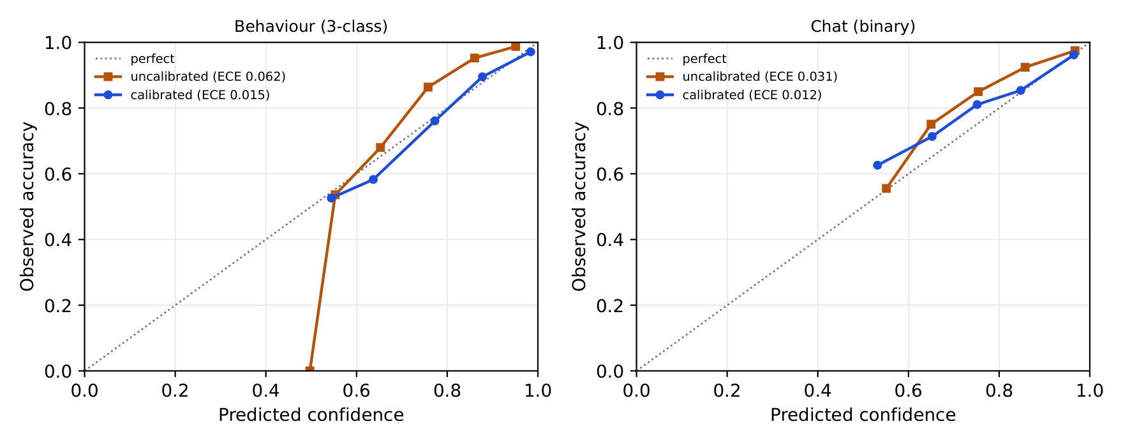
Verification — evaluation methodology
Every design choice has a measured counterfactual
▪ Held-out only, seeds recorded; voice = speaker-independent; chat = in-domain (real game chat), not general-corpus
▪ Ablations: one component removed per row, bootstrap 95 % CIs (1,000 resamples) — "better" only when intervals separate
▪ MCC + PR-AUC alongside F1 (base rates are extreme); direct calibration proof: ECE 0.062 → 0.015 (behaviour)
▪ Biggest finding: remove CONDA domain data → PR-AUC 0.825 → 0.511 — data beats architecture
▪ Negative results reported: voice augmentation neutral; genre multiplier unsupported; 4 of 5 proxy names discredited
Reliability diagrams: calibrated confidence vs observed accuracy, both channels
7 research-integrity tests in CI pin the paper's numbers to the committed JSONs — a stale figure fails the build.
PW26_SAS-03 · AI-Driven Gaming Addiction Screening · PES University
11
Notes:
This slide is what separates the project from "we trained a model." Every design choice has a measured counterfactual. Headline lesson: data > architecture — losing domain data costs 31 PR-AUC points, more than every architecture choice combined — and three transformer benchmarks (Detoxify on chat, w2v2 on voice, MuRIL on Hindi) confirm it: capacity helps in-distribution, domain and register fit decide. Mention the reported NEGATIVE result: voice augmentation was measured and found neutral — we say so instead of hiding it. And now (slide 12) the pipeline output is anchored OUTSIDE its own training distribution. (DEFENSE_NOTES §6)

Slide 12
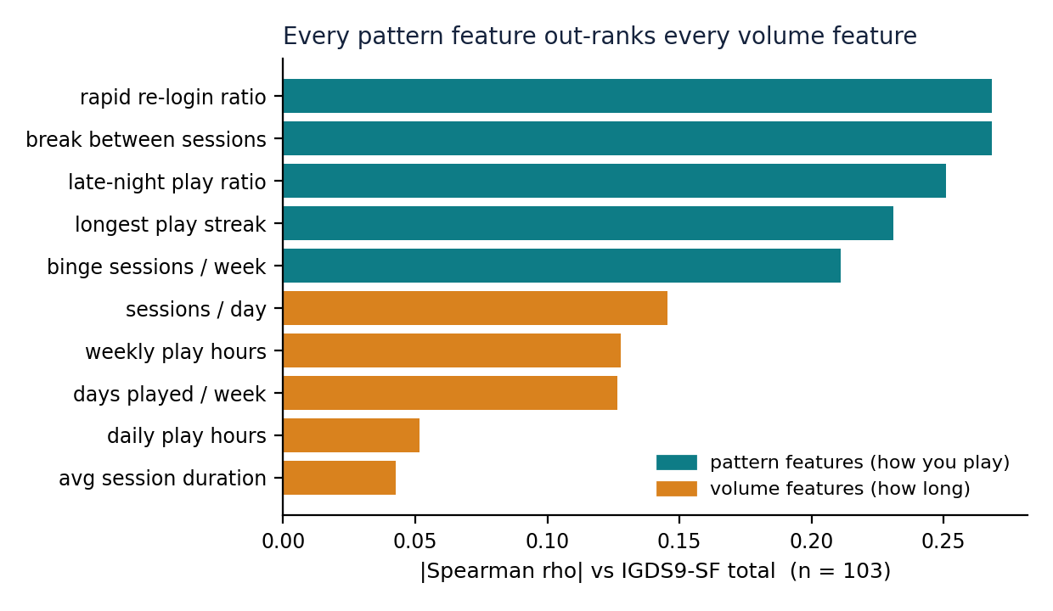
Validation — does the score mean anything?
An IGDS9-SF survey, scored through the deployed pipeline, against real labels
▪ Anonymous adult IGDS9-SF survey — 134 raw → 104 usable; pattern answers scored through the deployed serving path
▪ Construct validity: ρ = 0.317 [0.137, 0.478] vs the clinical instrument — CI excludes zero
▪ Leads the screen-time baseline it replaces in 97.4 % of paired resamples: hours ρ = 0.147 (CI spans zero); Δρ = +0.167 [-0.002, 0.341] — CI grazes zero; the partial carries the claim
▪ Not a screen-time proxy: partial ρ = 0.303 with hours removed
▪ Signal is in pattern features (0.330) not volume (0.128) — formal paired contrast +0.199 [0.019, 0.380], excludes zero
▪ Two results against us: genre multiplier p = 0.598; 4 of 5 proxy names track nothing → labels renamed in the product
 | ρ vs IGDS9-SF | 95 % CI
Model risk score | 0.317 | [0.137, 0.478]
Self-reported hours/week | 0.147 | [-0.053, 0.339]
Paired difference | +0.167 | [-0.002, 0.341]
Partial (hours removed) | 0.303 | [0.110, 0.476]
Model beats the hours baseline in 97.4 % of paired resamples. Caseness metrics withheld by design (1 disordered-range respondent).
Left: every pattern feature out-ranks every volume feature — no interleaving. The design premise, confirmed against real labels rather than assumed.
PW26_SAS-03 · AI-Driven Gaming Addiction Screening · PES University
12
Notes:
This is the slide the whole project builds toward — protect its time. Every other number in the deck is measured INSIDE our own training distribution; this one is measured outside it, against an instrument we did not design, on people who never touched the app. Lead with the comparison, not the magnitude — 0.32 sounds modest until you say the baseline every commercial parental-control tool ships reaches 0.147 with a CI spanning zero — and volunteer that the paired delta grazes zero after the late batch, so the partial correlation (0.303, CI excluding zero) carries the incremental claim. Pre-empt the two follow-ups: WHY NO SENSITIVITY/SPECIFICITY — one respondent scored in the disordered range; the script refuses caseness metrics below ten positives, a guard written before we saw the data. WHY KEEP THE GENRE MULTIPLIER — the null is underpowered (32%), not decisive, and removing it flips 34% of served bands; it stays flagged and env-tunable. Close on the two negative results: volunteer them. A validation study that only confirms is not one. (DEFENSE_NOTES §10)

Slide 13
Dataset Audit
Eleven real open corpora adopted by measured trial — and the ones we rejected, with reasons
▪ Adopted (11): Gamers & Anxiety (13,464) · IGDS9-SF LatAm (11,191) · CONDA · Davidson · HASOC 2019 Hindi · clean-Hindi Wikipedia · RAVDESS + CREMA-D + EMO-DB + URDU (9,817 clips)
▪ + our own primary data: the IGDS9-SF survey (n = 104 usable) — no open dataset pairs the instrument with the pattern variables we measure
▪ + eval-only: Svarah Indian-accent English (6,656 clips, CC BY 4.0) for the fairness audit
▪ Rejected with evidence: Kaggle "Predict Online Gaming Behavior" (synthetic; engagement ≠ addiction) · "Mobile App Usage" (3/10 features, credential-walled)
▪ Reality-checked one hand-set prior against real phone telemetry (StudentLife): heavy-band late-night sits above the 90th percentile of normal student use
PW26_SAS-03 · AI-Driven Gaming Addiction Screening · PES University
13
Notes:
We downloaded and inspected the rejected sets rather than dismissing them from their descriptions — provenance analysis showed one is synthetically generated with engagement labels, not addiction labels. Examiners like rejected-with-reasons more than adopted-without-reasons. Plus two datasets we collected/used ourselves: the IGDS9-SF survey (primary data) and Svarah (eval-only, gated download, not redistributed). (DEFENSE_NOTES §7)

Slide 14
System Testing & Engineering Quality
Tested, load-verified, watched in production — and measured on real hardware
▪ 291 automated tests + 7 research-integrity guards, all in CI: 181 backend (run on both SQLite & Postgres 16) + 110 Android JVM; the guards fail the build if paper and data disagree
▪ Load-verified: 288 concurrent requests, 0 errors, p50 66 ms; API fuzzed (schemathesis), CVE-audited, MobSF static audit clean
▪ Weekly drift monitor vs the production DB (PSI/KS); signed-token auth, rate limiting, authz regression tests
▪ Anti-tamper on record: even adb could not uninstall the app past the Device-Admin block without the parent PIN
On-device cost (Galaxy M52, 15-min Roblox) | English STT (default) | Dual Hindi+English toggle | Gate
CPU, averaged | 14 % of one core (game: 215 %) | 51–72 % (~4–5×) | < 2× — fails
RAM (PSS) mean / peak | 288 / 301 MB | 399 / 419 MB | < 400 MB — fails
Thermal throttling | none | none | none — passes
Verdict | ships as default | default OFF — measured reason
PW26_SAS-03 · AI-Driven Gaming Addiction Screening · PES University
14
Notes:
Two stories if asked: (1) the Postgres CI job caught a real dialect bug in the drift script the day it was added — exactly the "works locally, fails in prod" class it exists for; (2) the device drill (2026-08-18, Galaxy M52): the default monitoring path costs ~14% of one core — about 1/15th of the game it monitors — and 288 MB; the dual Hindi+English STT toggle costs 4–5× the CPU and peaks at 419 MB, FAILING our own acceptance gate, which is exactly why it ships default OFF. A measurement that failed a feature is worth more than one that flattered it. Also on record: adb could not uninstall the app past the Device Admin block — the anti-tamper working against a developer with USB access. (DEFENSE_NOTES §8 + battery Q&A)

Slide 15
Privacy & Ethics
Consent that fails closed, symmetric export/delete, and the tensions we name instead of hide
▪ Explicit onboarding consent, versioned, fails closed; revoking a capture permission alerts the parent — no silent failure
▪ STT on-device; raw audio deleted after feature extraction; VAD gates the mic; no raw media retained anywhere
▪ `/api/user/export` = everything held (credentials excluded); deletion scope identical to export — one table inventory in code
▪ Parental monitoring of a minor, by design — visibility over prevention: alerts, not blocks; never covert toward the child
▪ Named tensions: the crisis-alert asymmetry (a refusal, not an oversight) · sensing blindspots (browser games) · adult-only validation cohort
A monitoring boundary honestly disclosed to the parent beats a privacy regression that closes it.
PW26_SAS-03 · AI-Driven Gaming Addiction Screening · PES University
15
Notes:
Lead with the strongest fact: what a parent can see is exactly what gets erased — export and deletion cover the same 15 tables. If pressed on the mic: layered mitigations in order — consent, on-device transcription, server-side raw-audio deletion, speech-gated capture. Then the two tensions we state ourselves: (a) the crisis asymmetry — profanity alerts a parent, a self-harm disclosure to the companion does not, DELIBERATELY: we refused to hard-code a contested clinical judgement; the tiered wellbeing-check design is documented as a proposal pending clinical review; (b) sensing blindspots — browser/webview games are invisible because the boundary is "installed apps", and closing it needs screen capture or URL surveillance, which we refuse. (DEFENSE_NOTES §9)

Slide 16
Limitations & What Is Still Open
Partial in a specific, nameable way — and we will not blur the line
▪ Training labels still synthetic — the 91.6 % is a synthetic-distribution number, and the survey does not upgrade it
▪ Validated: the score's meaning (ρ = 0.317; partial vs hours excludes zero). Not validated: its accuracy at the clinical cut-off
▪ The blocker is quantified: 1 disordered-range respondent in 104 usable → need ~157 usable at the 6.4 % base rate
▪ Adults, self-reported, cross-sectional — the deployment target is adolescents, measured, over time
▪ Voice trained on acted adult emotion (gap quantified: leakage 8.3 pts; missing domain data 31 PR-AUC pts); dual-STT fails our resource gate
▪ One remaining tier: a per-child cohort (guardian IGDS9-SF + telemetry) — needs ethics approval; the submission is the next artefact
PW26_SAS-03 · AI-Driven Gaming Addiction Screening · PES University
16
Notes:
The framing shifted this year: the weakest part USED to be that nothing was externally validated; now it is that validation is partial in a specific, nameable way. Draw the line explicitly — construct validity is measured, caseness accuracy is not, and we will not blur them. That distinction is what a sharp examiner is probing for, so say it first. Then: "the contribution is not a solved clinical instrument — it is a fully built, honestly measured screening pipeline where every claim traces to a runnable script, including the claims our own validation study refused to support, and the fix our own drill falsified." (DEFENSE_NOTES §10, §11)

Slide 17
Final Results, Conclusion & Live Demo
Reproducibility and honesty as features — with the evidence to prove it
▪ Deployed end-to-end system · 3 real-data-grounded models · every design choice ablated with CIs
▪ Externally validated: ρ = 0.317 vs IGDS9-SF, leading the screen-time baseline (97 % of paired resamples) — signal in how, not how long
▪ Built for India: three-register chat, Devanagari keyboard, accent-fairness audited (0 false alerts / 9.6 h)
▪ Reproducible: every number on these slides is one script in the repo; 7 CI guards pin the paper to the data
▪ Future is data-first: per-child cohort (ethics-gated) → child-speech adaptation → per-family thresholds
▪ Live demo — backup video ready
The thesis survived contact with real labels. Two of its components did not — and we shipped the paper that says so.
PW26_SAS-03 · AI-Driven Gaming Addiction Screening · PES University
17
Notes:
Close on the differentiator: reproducibility and honesty as features — now with the strongest possible evidence for it, a validation study we ran on ourselves that returned two results we did not want, and a device drill that failed one of our own features. Then demo per DEMO_RUNBOOK.md; if Wi-Fi/devices misbehave, switch to the video without apologising. Future work is deliberately data-first, not model-first — "the gap is data, not architecture."

