Slide 1
Find My Naukri Portal
Axis School Of Fintech Batch 8
(Axis - 8 JFS- B08)
Presentation by-
Name : Kaustubh Bhale
Batch: Axis8JFSB08
Email: kaustubhbhale154@gmail.com

Slide 2
Abstract
Find My Naukri is a application which connects employers and job seekers.
Jobs seekers can find and apply for the job of their choice.
Employer can post multiple jobs opportunities, recruitment events for the candidates.
Both job seekers and employers need to register in order to carry on the placement activity.

Slide 3
Aims and Objectives
To develop a user-friendly, convenient and available job portal which will make the employment process easier.
The main objective of this project is to give job seekers a platform for finding right job.
To bring job recruiters and job seekers at single place to fast pace the job finding activity.
To manage, store and track the information of employers and job seekers.

Slide 4
Modules involved in the Project
Role | Functionality
Admin / Admin Of the company | Responsible for posting new job openings, recruitment events, update or delete a particular job
User/ Job Seeker | End user of the website. Can apply for the jobs, recruitment events posted by the admin. View list of companies currently hiring.

Slide 5
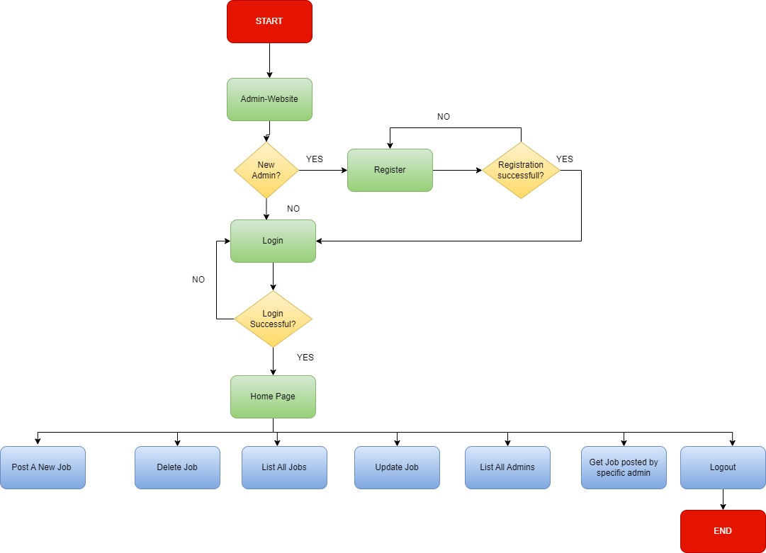
Project Workflow-Admin

Slide 6
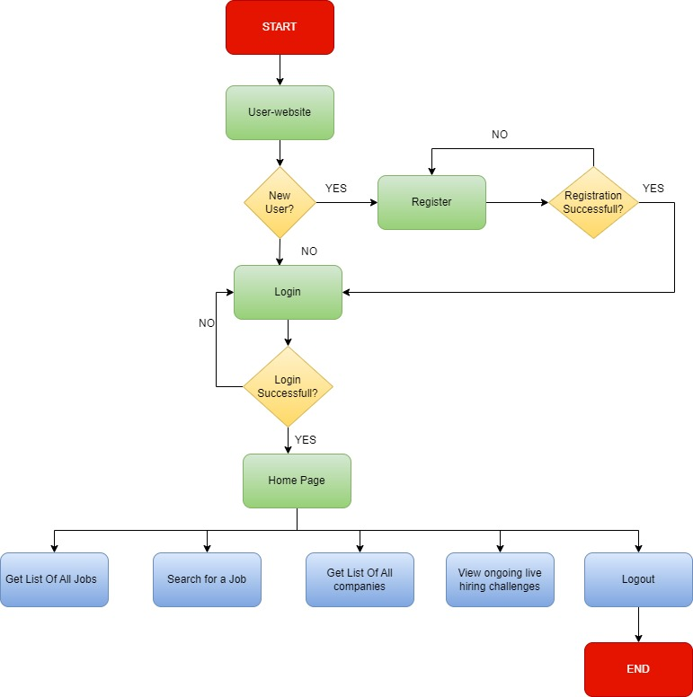
Project-Workflow – User

Slide 7
List of Micro-Services(Backend)
ADMIN-SERVICE
JOB-SERVICE
USER-SERVICE
API-GATEWAY
SERVICE-REGISTRY

Slide 8
ADMIN-SERVICE
PORT – 6005
Base Url : http://localhost:6005/admin/
FIELDS – admin_number , adminId, name, email , password, mobile, company.
Functionality -
CRUD Operations
Signup
Login
Post Job
Details Of Jobs posted by other admins

Slide 9
JOB-SERVICE
PORT – 6001
Base Url : http://localhost:6001/job/
FIELDS – job_number , jobTitle, description, compensation ,eligibility,adminId.
Functionality –
CRUD Operations
Search Job By Title
Get All Jobs

Slide 10
USER-SERVICE
PORT – 6002
Base Url : http://localhost:6002/user/
FIELDS – userId, firstName, lastName, email , password,workExperience,contactNumber.
Functionality -
CRUD Operations
Signup
Login
View All Jobs
Apply For Job(s).

Slide 11
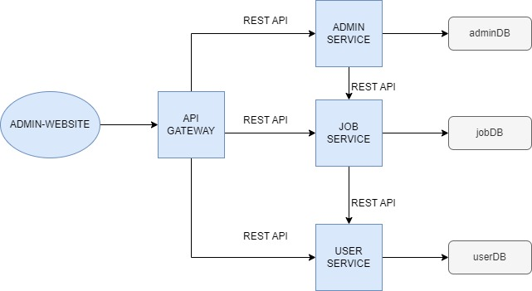
API-GATEWAY
PORT : 9025
Accessing every micro service via a single port.

Slide 12
SERVICE-REGISTRY
PORT : 8761 (default port)
Registering other micro services a client.

Slide 13
Functional Requirements
Sign Up for admin and users.
Login for admin and users.
Posting a job update for candidates.
Posting new live hiring challenges for job seekers.
Applying for a job by candidate.
Getting Job posted by particular admin.

Slide 14
Non Functional Requirements
High Performance
Availability
Reliable
Scalable

Slide 15
Technologies Used
Backend : Java
Frontend : React , React Bootstrap
Database : MongoDB
Testing API : Postman
Architecture: Micro-Services
API-Documentation : Swagger-UI

Slide 16
THANK YOU !

