Slide 1

Project Title -Seasonal Agriculture Performance Analysis
Student Name:- Kaustubh Vikas Shinde
College Name- Ng Acharya & Dk Marathe College
AICTE STU ID : STU6a22f975a6c2d1780676981

Slide 2

PROBLEM STATEMENT
(Agricultural activities are influenced by seasonal variations in environmental conditions, farming practices, resource availability and market conditions. As a result, agricultural performance may differ from one season to another. However, raw agricultural data does not clearly explain how agricultural performance changes across seasons or what patterns can be observed in different seasonal conditions. The problem is to analyze the given agricultural dataset and investigate seasonal differences in agricultural performance by identifying meaningful patterns, trends, relationships and variations within the available data.

Slide 3
Project Description
• Comprehensive exploratory analysis of 4,000 agricultural farm records spanning 8 Indian states across Kharif, Rabi, and Zaid seasons.
• Implemented robust missing data imputation using crop- and season-specific medians for environmental variables and crop yields.
• Evaluated water-use efficiency and economic profitability across 4 irrigation systems (Drip, Sprinkler, Flood, Rainfed).
• Derived evidence-based seasonal planning guidelines to minimize climate risk and enhance farmer margins.

Slide 4

WHO ARE THE END USERS?
1. Farmers & Agricultural Collectives (FPOs): Informed crop selection and clear ROI evidence for transitioning to modern micro-irrigation.
2. Agricultural Policymakers (NABARD / Ministry of Agriculture): Targeted subsidy disbursement for irrigation during high-risk seasons (Zaid) and seasonal buffer stocking.
3. Agri-Tech Firms & Supply Chain Planners: Accurate demand forecasting for seasonal inputs (fertilizers, pesticides) and cold storage optimization.

Slide 5

Technology Used
• Environment: Python 3.10+ in Jupyter Notebook
• Data Manipulation: Pandas, NumPy
• Statistical Data Visualization: Matplotlib, Seaborn
• Version Control: Git, GitHub

Slide 6
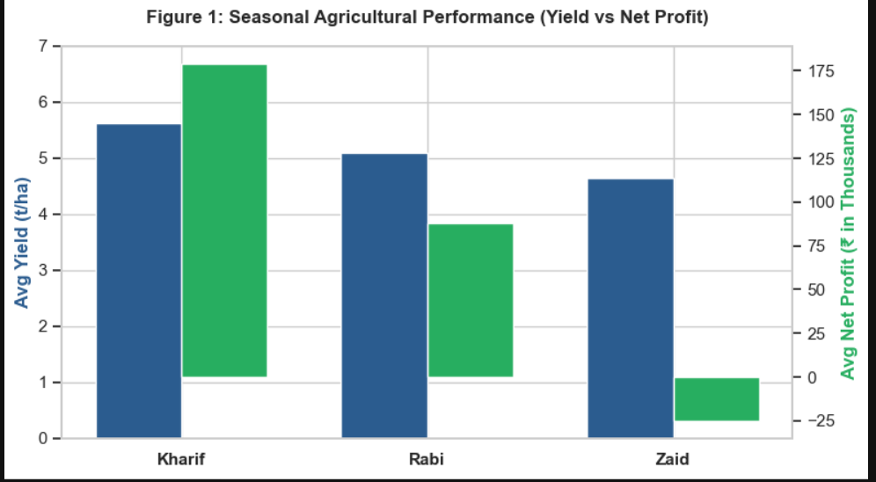
RESULTS
• Kharif Dominance: Delivers highest mean yield (5.64 t/ha) and net profit (₹1,78,915), aided by monsoon rainfall (mean: 852.1 mm).
• Rabi Stability: Moderate yield (5.08 t/ha) and stable returns (₹87,689) in temperate conditions (mean: 23.5°C).
• Zaid Deficit: Faces an average net loss of -₹24,805 per farm due to thermal stress (mean: 31.0°C) and water shortage.

Slide 7
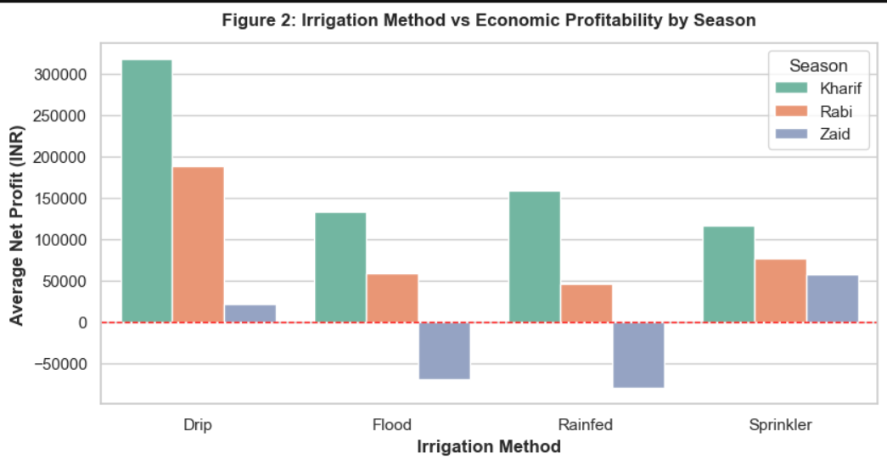
RESULTS
• Drip Superiority: The only irrigation method maintaining positive profitability in all three seasons (Kharif: ₹3.17L, Rabi: ₹1.88L, Zaid: +₹21.3k).
• Flood Irrigation Pitfalls: Severe losses in Zaid (-₹69.8k) due to high evaporative loss.
• Rainfed Vulnerability: Extreme drop in profitability during dry periods (-₹79.5k in Zaid).

Slide 8
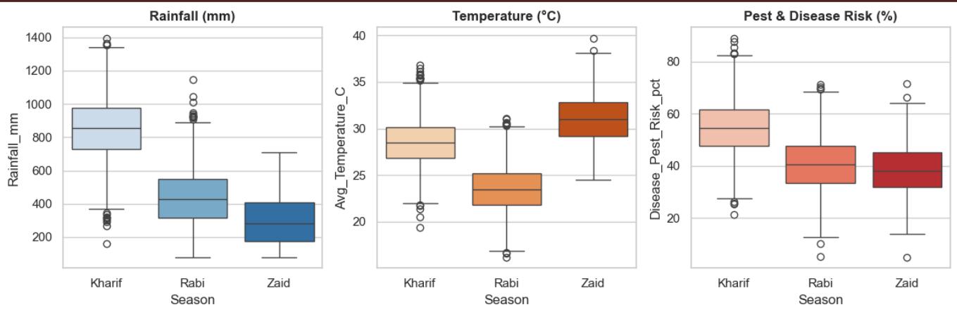
RESULTS
• Kharif Pest Risk: Warmth combined with high humidity (71.8%) raises disease/pest risk scores to 54.5% (peaking at 88.9%).
• Rabi Favorable Window: Lowest overall disease/pest hazard (40.5%), lowering pesticide requirement.
• Zaid Heat: Extreme daytime heat (>38°C) acts as the primary productivity inhibitor.

Slide 9
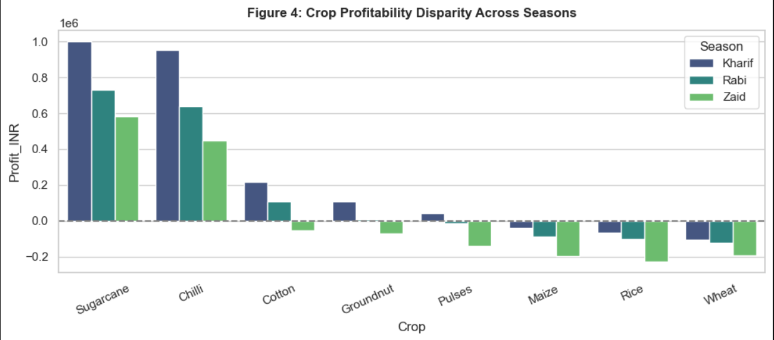
RESULTS
• Cash Crops: Sugarcane and Chilli generate substantial net profits across all seasons.
• Food Grains: Rice, Wheat, and Maize operate on thin margins, and suffer heavy net losses in Zaid (Rice: -₹2.27L, Maize: -₹1.94L).

Slide 10
Future scope
• Machine Learning Predictive Modeling: Deploy XGBoost or Random Forest regressions to predict yield and profit margins based on real-time soil/weather inputs.
• Precision IoT Irrigation: Integrate soil-moisture sensor triggers for automated drip cycles to minimize water waste in summer.
• Cloud Analytics Dashboard: Build an interactive Streamlit or Power BI dashboard for regional crop planning simulations.

Slide 11
GitHub Link
https://github.com/kaustubhh-source/Seasonal-Agriculture-Performance-Analysis

Slide 12
VOIS Course completion certificate -
Course name- Data Visualization

Slide 13
Thank you
.
.

