Slide 1
Falcon 9: Will it Land?
Data Science Capstone Project
Kaustubh Joshi August 20, 2021
Visit:
https://github.com/kaustubhjoshi1910/DSCP
for all code

Slide 2
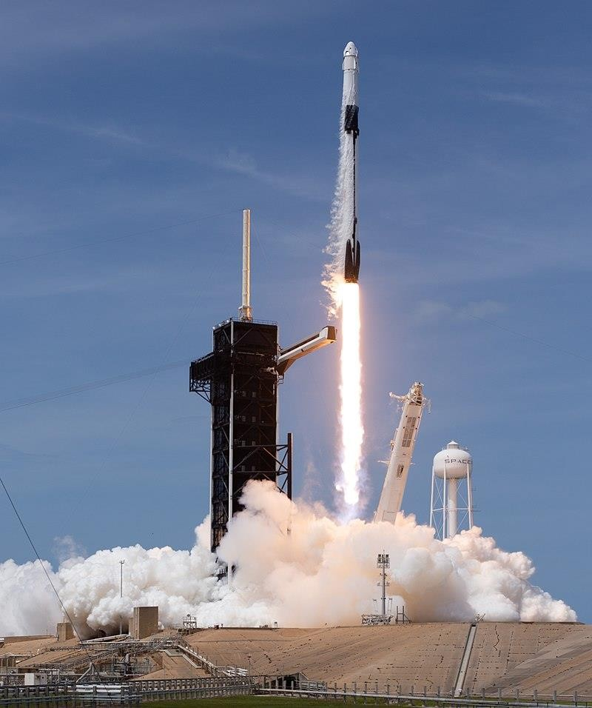
Outline
Executive Summary
Introduction
Methodology
Results
Conclusion
Appendix
2

Slide 3
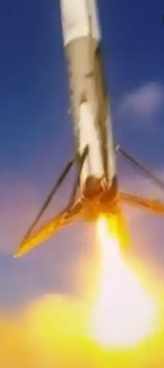
Executive Summary
Question:
Given public data, can we accurately predict if the Falcon 9 will land successfully?
Data was collected using:
SpaceX's REST API Webscraping
The following ML Models were Optimised and Compared: KNN, SVM, Decision Tree, Logistic Regression
We can predict with 88.9% accuracy whether or not Falcon 9 will land given its launch conditions. False positives are the largest concern
3

Slide 4
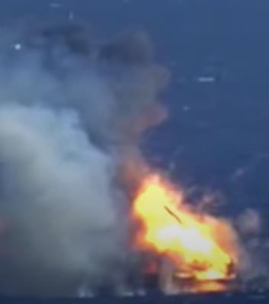
Introduction
The problem:
SpaceX Falcon 9 rocket launch cost: $62 million
Other companies: $165 million dollars
The difference? SpaceX can reuse the first stage.
But what if the rocket fails and does not land?
The Advantage:
Using public data, we have developed a predictive model to classify whether a Falcon 9 landing will be successful
If we can use this model to determine when Falcon 9 will fail, we can compete with SpaceX for contracts
4

Slide 5


Methodology Overview
Data collection:
Method 1: SpaceX's REST API
Method 2: Webscraping from Wikipedia
Data wrangling
Missing values replaced
Categorical Variables (including target) one-hot encoded
Performed exploratory data analysis (EDA) using visualization
and SQL
Constructed interactive visual analytics using Folium and Plotly Dash
Constructed and evaluated predictive classification models
KNN, SVM, Decision Tree, Logistic Regression
5

Slide 6
Data collection via
SpaceX REST API
Obtained data using Python's "requests" package and decode as a json file using the json method requests.get(spacex_url).json()
Collected past launch data by making HTTP
requests in Python to the SpaceX REST API:
https://api.spacexdata.com/v4/launches/past
Read result into a Pandas DataFrame and selected only the relevant features: 'rocket', 'payloads', 'launchpad', 'cores', 'flight_number', 'date_utc'
Jupyter Notebook with completed code:
https://github.com/kaustubhjoshi1910/DSCP/blob/fc08b22d5de9e229b54dd760b8955b8e57568d29/DataCollection_SpaceXAPI.ipynb
Unpack each feature into multiple columns such as Booster Version, Grid Fins, Orbit, etc and keep only the Falcon 9 data
Replaced missing payload mass information with the average payload mass and
6

Slide 7
Data collection via
Webscraping
Used "requests" on a historical snapshot of Wikipedia's Falcon 9 Launches page
Collected past launch data from Wikipedia
Snapshot:
https://en.wikipedia.org/w/index.php?title=List_ of_Falcon_9_and_Falcon_Heavy_launches&oldid
=1027686922
Decoded response into HTML text using the text attribute and passed the result to BeautifulSoup to parse the HTML
Jupyter Notebook with completed code:
https://github.com/kaustubhjoshi1910/DSCP/blob/fc08b22d5de9e229b54dd760b8955b8e57568d29/data_collection_scraping.ipynb
Used "find_all" to identify all the HTML tables then looped over each row and column to extract data
Saved the information into a dictionary that was transformed into a Pandas Dataframe
7

Slide 8
Data wrangling
Relevant Jupyter Notebook: https://github.com/smairs/SpaceX_Stage_1/blob/3b0b51b081eda71a29d0c8551780 c98a15383a1c/SpaceX_Data_Wrangling_EDA.ipynb
Explored the fraction of missing data per column - 41% of LandingPad data was null
Explored Data types and parsed the landing outcomes (target variable) to create a categorical variable for Success (1) or Failure (0)
Produced information on:
The number of flights per site The occurrence of each orbit The occurrence of each outcome
One-hot encoded features:
"Orbits", "LaunchSite", "LandingPad", and "Serial"
for Visualisation and Modelling
Constructed the one-hot encoded target variable from the 8 landing outcomes
8

Slide 9
EDA with Data Visualisation Methods
Chart Plotted | Reason
Launch Site vs Flight Number (Scatterplot: Coloured by Success or Failure) | To assess which sites are problematic and if the success rate has changed over flight number
Launch Site vs Payload (Scatterplot: Coloured by Success or Failure) | To note any trends in success rate with payload and link that to the launch site
Success Rate versus Orbit Type (Bar Plot) | To note if the orbit has any significant effect on the landing success rate
Orbit Type Versus Flight Number (Scatterplot: Coloured by Success or Failure) | To note whether specific orbit types have become more successful over flight number
Orbit Type Versus Payload (Scatterplot: Coloured by Success or Failure) | To note the combined impact of payload weight and height of orbit on the success rate
Launch Success Rate over time (Line Plot) | To determine if the SpaceX missions are becoming increasingly more successful with time
Jupyter Notebook for EDA Visualisation:
https://github.com/kaustubhjoshi1910/DSCP/blob/fc08b22d5de9e229b54dd760b8955b8e57568d29/eda%20_data_visualisation.ipynb
10

Slide 10
EDA with SQL Methods
SQL was used to perform the following queries:
Unique Launch Site Names
Launch Site Names beginning with CCA (Cape Canaveral)
Calculating the Total Payload Mass
Calculating the Average Payload Mass by F9 v1.1
Identifying the first successful ground landing date
Boosters that have a successful drone ship landing with payload between 4000 and 6000 kg
The total number of successful and failure mission outcomes
The Boosters that have carried the maximum payload
The 2015 failed drone landings by month
Landing outcomes between 2010-06-04 and 2017-03-20 ranked by occurrence
Jupyter Notebook for EDA with SQL:
https://github.com/kaustubhjoshi1910/DSCP/blob/fc08b22d5de9e229b54dd760b8955b8e57568d29/eda%20with%20sql.ipynb
11

Slide 11
Interactive Map Methodology
On an interactive map:
Marked the SpaceX launch sites to note reasons why the rockets would be fired from these key sites
Made clustered (expandable) markers for the launch records of each site to quickly determine success rates
Calculated distances and drew lines indicating the nearest railways, cities, highways, and coastline to determine if there were resonable explanations for the chosen launch site positions
Jupyter Notebook for Interactive map (Folium):
https://github.com/kaustubhjoshi1910/DSCP/blob/fc08b22d5de9e229b54dd760b8955b8e57568d29/DV%20with%20folium.ipynb

Slide 12
An Interactive Dashboard
An interactive dashboard was assembled to quickly note trends and analyse the data in a simple GUI app
A pie chart showing the landing success rates for "All" launch sites together or any of the sites is included (options given by dropdown menu). The launch site is a major determining factor on the predicted success of the landing
A plot of Success or Failure versus Payload mass, coloured by Booster version for "All" or any of the launch sites is also included with a movable slider to select Payload mass range. In this way we can determine if certain payload ranges are more likely to fail the landing

Slide 13
Predictive analysis Methodology (Classification)
We standardized the dependent data via the z-score split the samples into:
80% Training, 20% Testing The Testing data was 18 samples
We defined our one-hot encoded feature set in a pandas dataframe as the dependent variables, separating "Class" as the target
We fit each model using the training data, then scored the testing data via 2 metrics:
The Jaccard Score and the F1 Score
We also used LogLoss evaluation for the LR
We then defined ranges of parameters to test models using cross-validation by way of GridSearchCV for 4 classification models: Logistic Regression, SVM, KNN, Decision Tree
The final scores were derived using the optimal parameters identified by cross-validation
Jupyter Notebook for ML Modelling:
https://github.com/kaustubhjoshi1910/DSCP/blob/430418327421471a4ce0f14b41e4b5b1c4ca3f83/ml%20prediction.ipynb
14

Slide 14
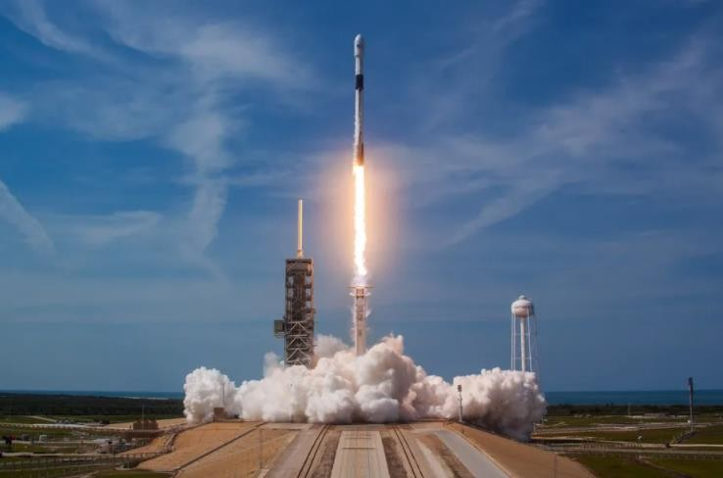
Results
Exploratory data analysis results
Interactive analytics demo in screenshots
Predictive analysis results

Slide 15
EDA with Visualization
Jupyter Notebook:
https://github.com/kaustubhjoshi1910/DSCP/blob/fc08b22d5de9e229b54dd760b8955b8e57568d29/eda%20_data_visualisation.ipynb

Slide 16
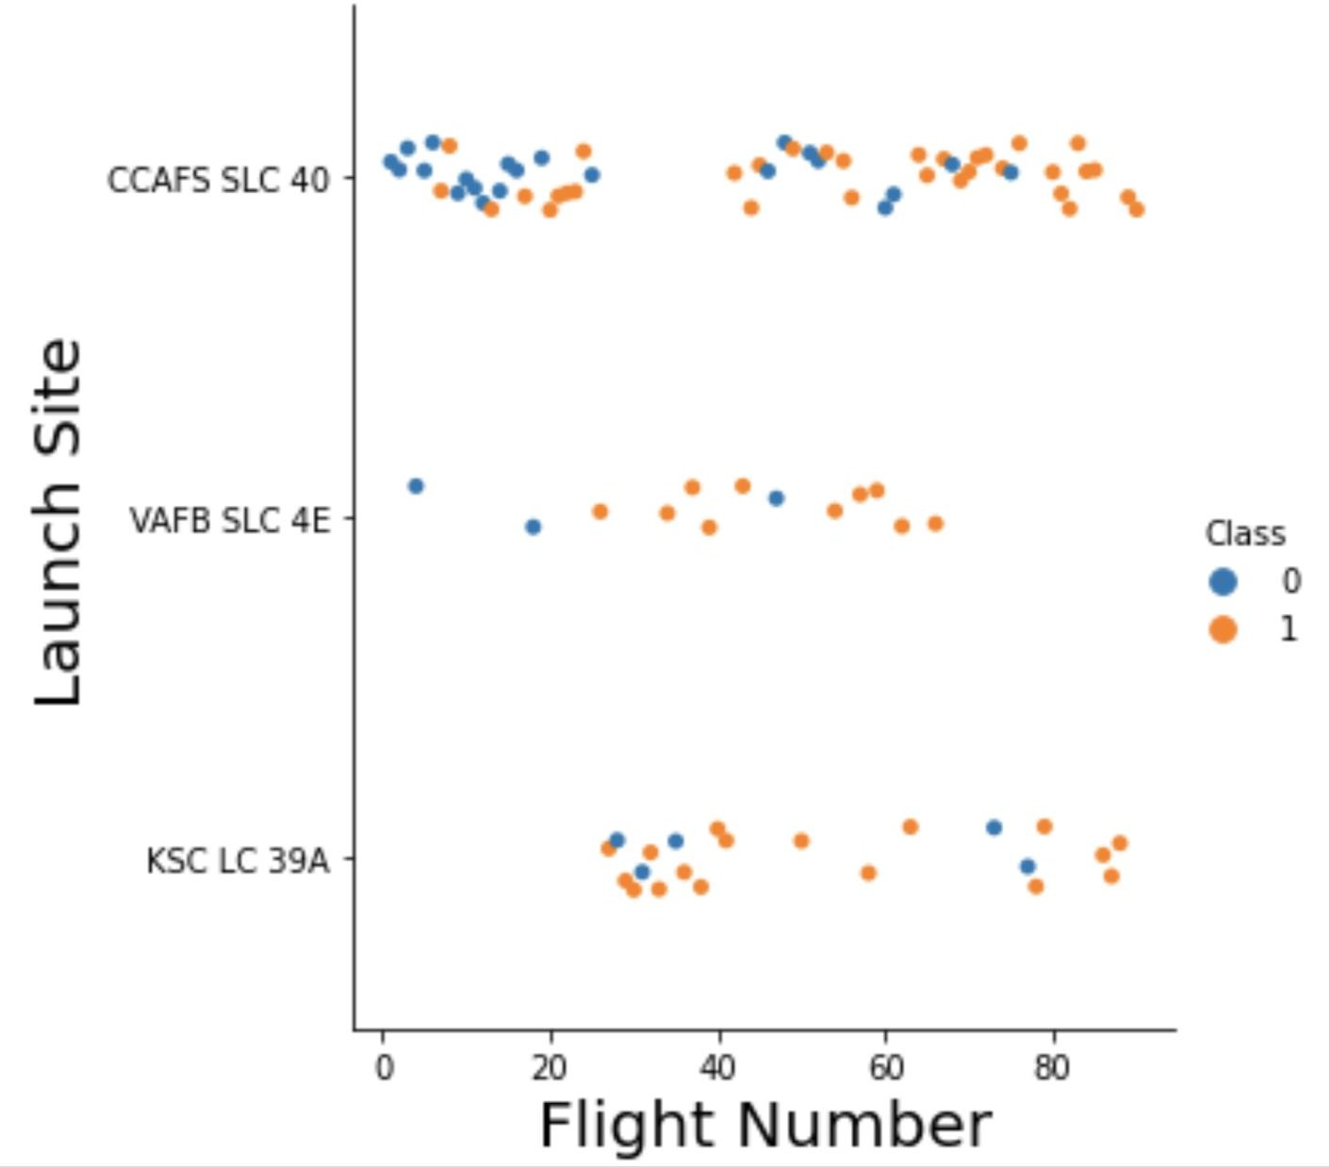
Flight Number vs. Launch Site
Blue: Failed Orange: Success
The earliest 6 flights were all failures while the most recent 13 were all successes.
The CCAFS SLC 40 launch site has a higher
number of launches than the other two sites.
VAFB SLC 4E and KSC LC 39A have higher success
rates.
The first flights launched from KSC LC 39A were
during a gap in flights launched from CCAFS SLC 40

Slide 17
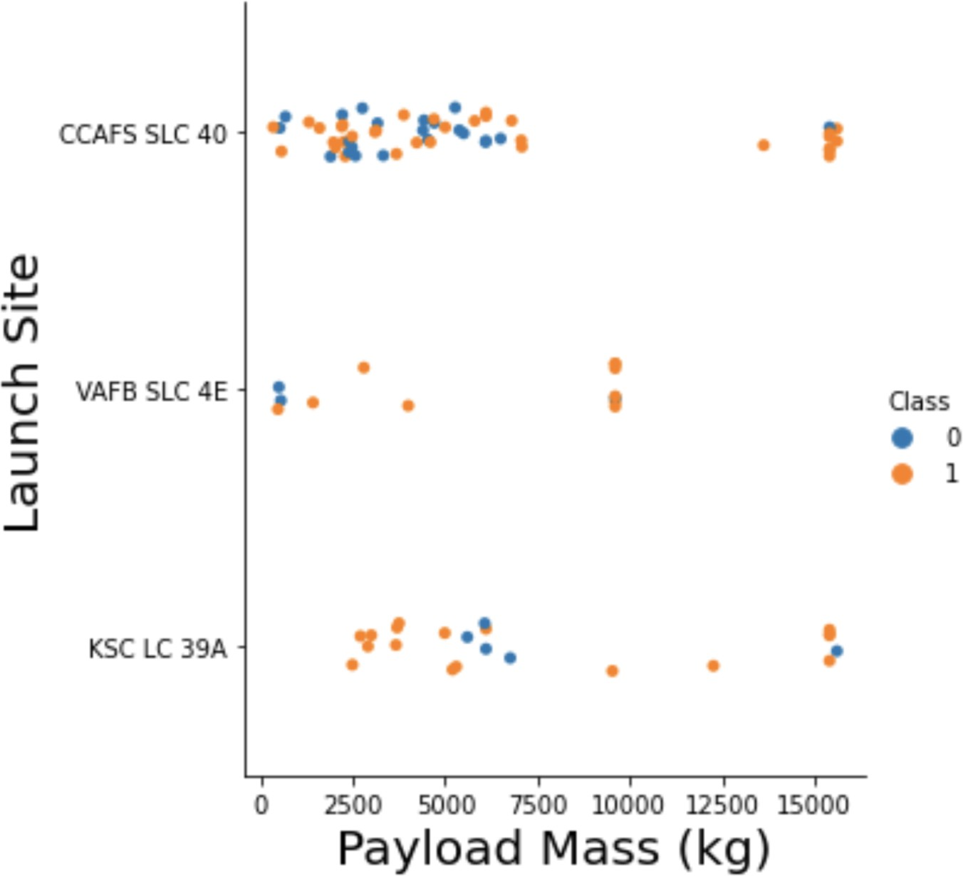
Payload vs. Launch Site
Blue: Failed Orange: Success
The highest payload masses have a high success rate
The lowest payload masses (<~5000 kg) launched from KSC LC 39A were all successful
There are ~standard payload weights as indicated by the vertical patterns

Slide 18
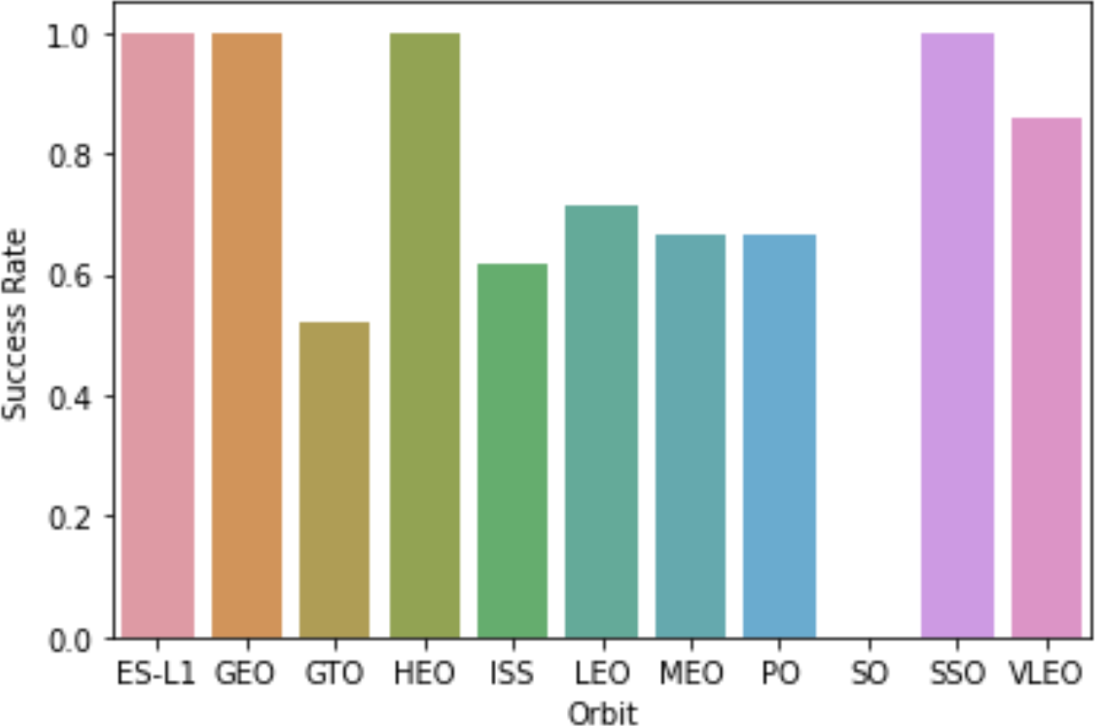
Success rate vs. Orbit type
The orbits with 100% success are:
ES-L1
GEO
HEO
SSO
The orbits with the lowest success rates (in ascending order) are:
SO
GTO
ISS
MEO = PO

Slide 19
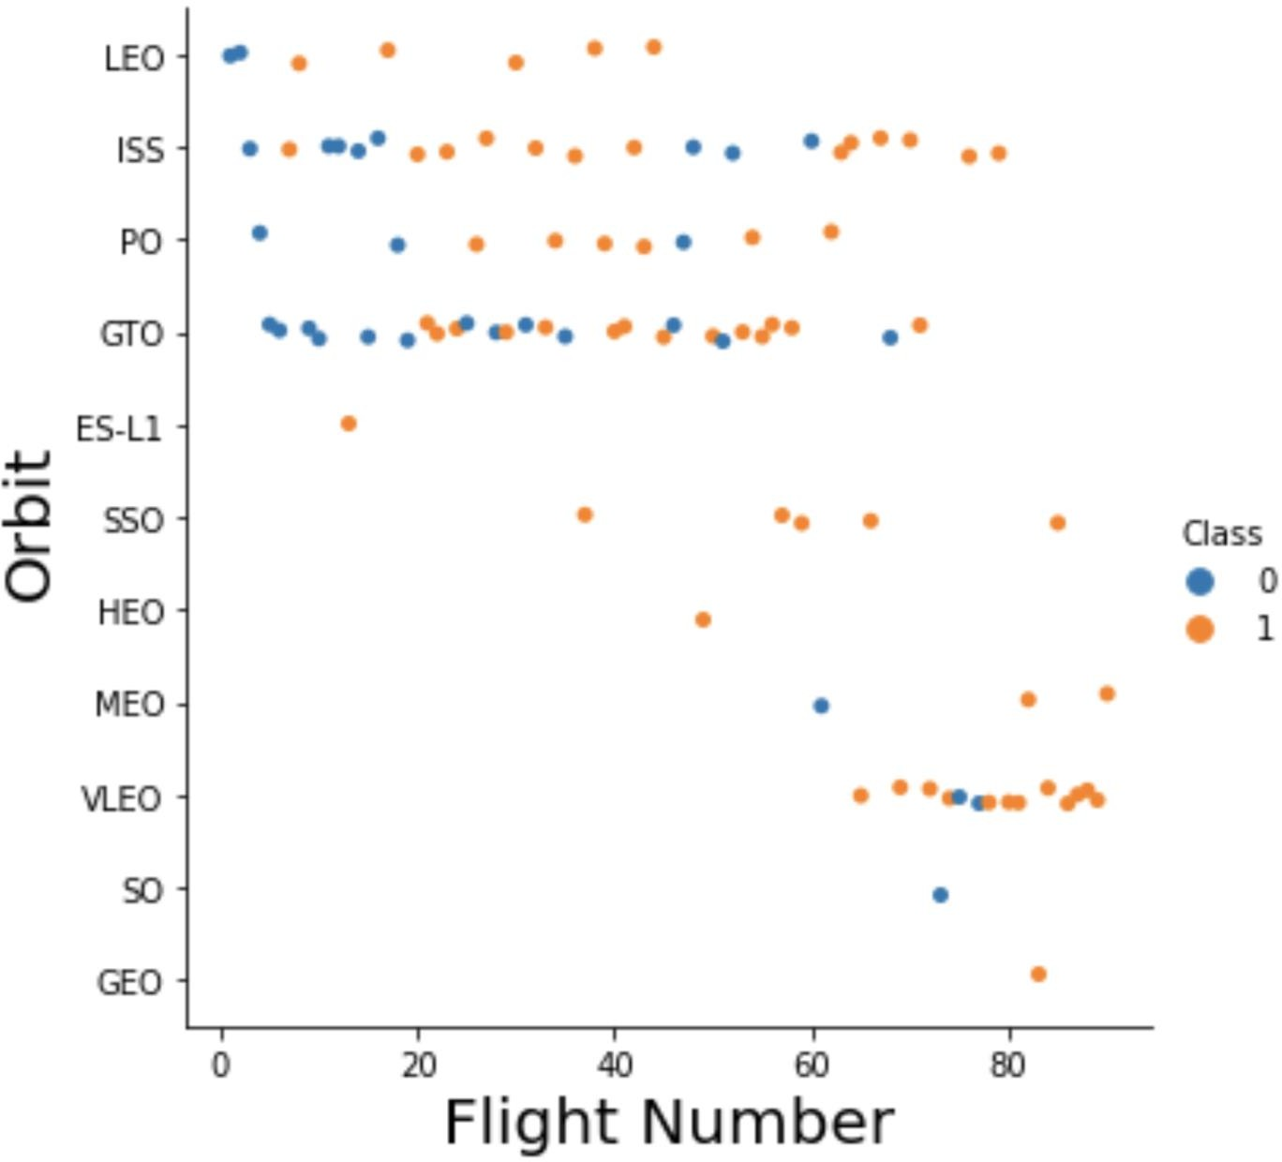
Flight Number vs. Orbit type
Blue: Failed
Orange: Success
The SSO, LEO. and VLEO orbits have a very high success rate
The GTO orbit has a poor success rate and there is no obvious relationship between flight number and success for this orbit
20

Slide 20
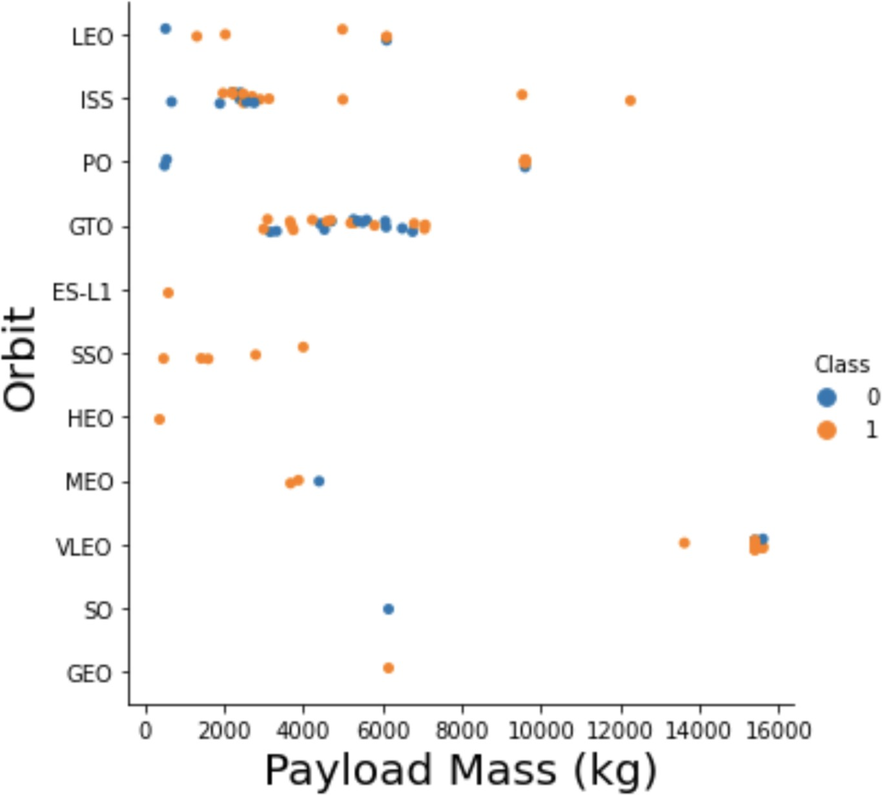
Payload vs. Orbit type
Blue: Failed Orange: Success
Heavy payloads have a negative impact on GTO orbits
The heaviest payloads have
all gone to VLEO orbit
The lightest payload success rate has varies dramatically depending on the orbit

Slide 21
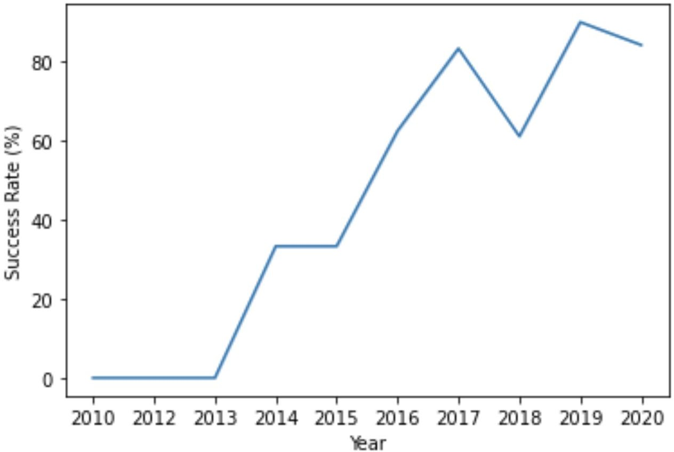
Launch success yearly trend
Clearly, the success rate has increased dramatically between 2013 and 2020

Slide 22
EDA with SQL
Jupyter Notebook:
https://github.com/kaustubhjoshi1910/DSCP/blob/fc08b22d5de9e229b54dd760b8955b8e57568d29/eda%20with%20sql.ipynb

Slide 23
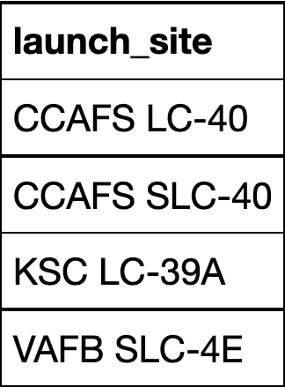
All launch site names
Using the "distinct" procedure, we can easily select the unique launch sites from our SQL relational database

Slide 24
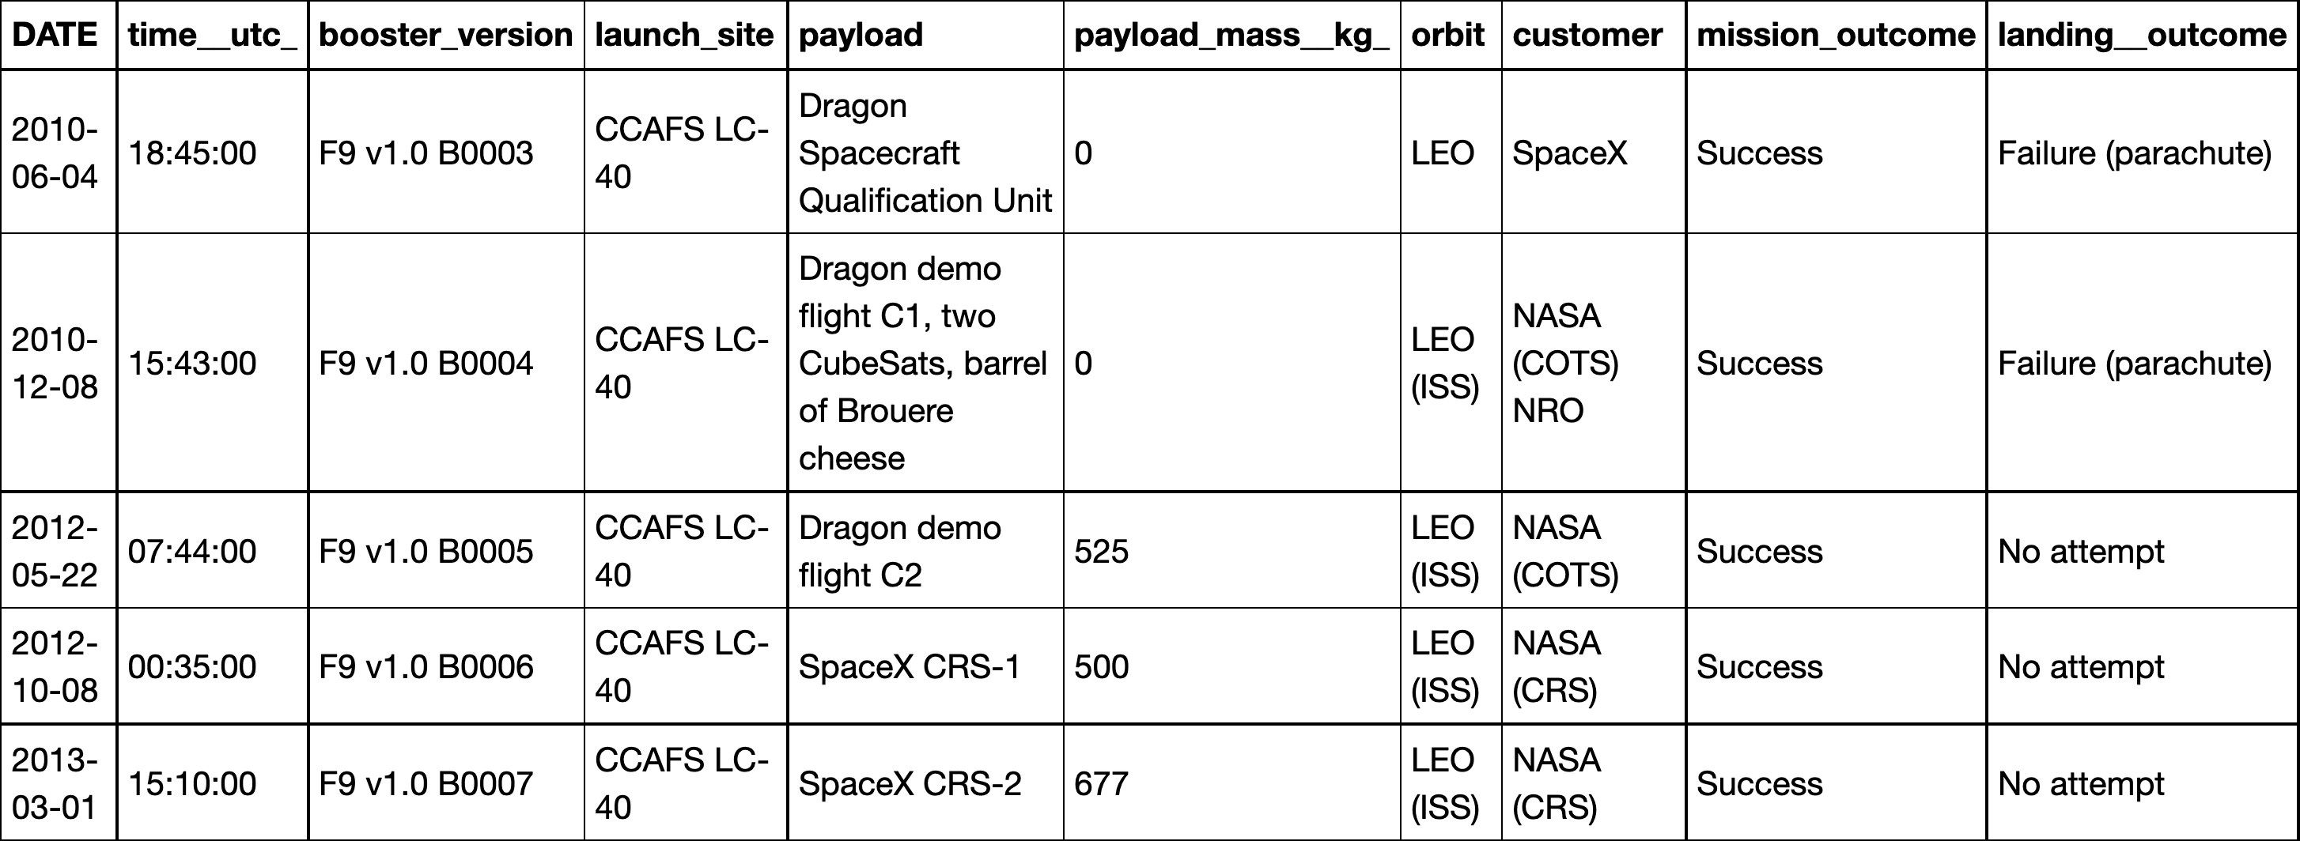
Launch site names begin with
`CCA`
We were required to present 5 records where launch sites begin with the string 'CCA'. This is accomplished using "like" and limiting the output

Slide 25
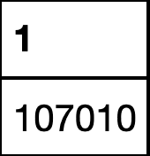
Total payload mass
SQL's SUM used in conjunction with "LIKE" and the "%" wildcards make this an easy task. I also could have renamed the column "Total" by using "AS".
The total payload launched by NASA is: 107,010 kg

Slide 26
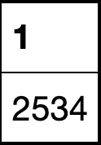
Average payload mass by F9 v1.1
The AVG mass carried by F9 v1.1 is 2,534 kg

Slide 27
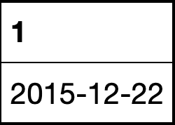
First successful ground landing date
The first successful landing outcome on the ground
pad was achieved on December 22, 2015

Slide 28
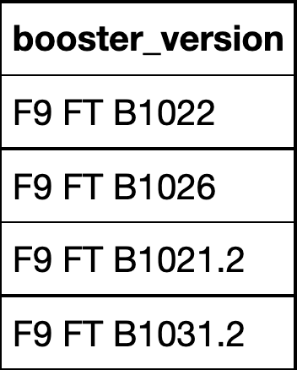
Successful drone ship landing with payload between 4000 and 6000
The boosters listed here have success in landing on the drone ship and have a payload mass between 4,000 and 6,000 kg

Slide 29
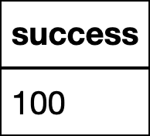
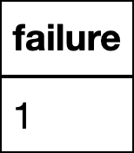
Total number of successful and failure mission outcomes
Only 1 out of 100 missions were a failure within the
results tabulated here

Slide 30
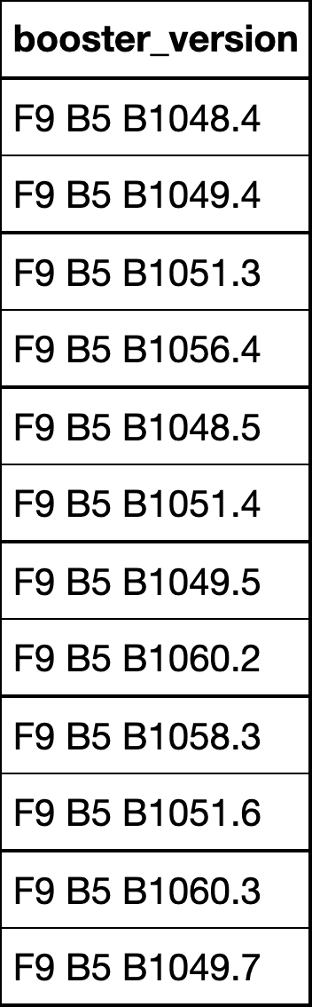
Boosters carried maximum payload
The boosters listed here have carried the maximum
payload mass

Slide 31
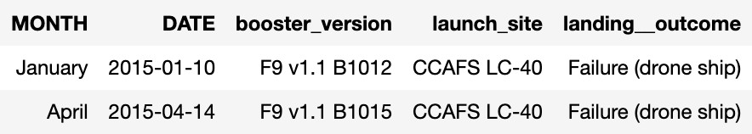
2015 Failed Drone Records
There were 2 failed drone ship landings in 2015.
One in January and the other in April,
Both times the F9 v1.1 booster was used (B1012
and B1015)

Slide 32
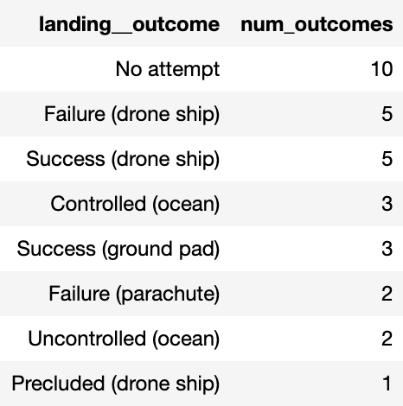
Rank count of landing outcomes between 2010-06-04 and 2017-03-20
Between 2010-06-04 and 2017-03-20, there were
8 successes: 5 on the drone ship and 3 on the
ground pad
7 Failures: 5 on the drone ship and 2 on the ground
pad
In this time, a successful drone ship landing was
only 50% probable

Slide 33
Interactive map with Folium
Jupyter Notebook:
https://github.com/kaustubhjoshi1910/DSCP/blob/fc08b22d5de9e229b54dd760b8955b8e57568d29/DV%20with%20folium.ipynb

Slide 34
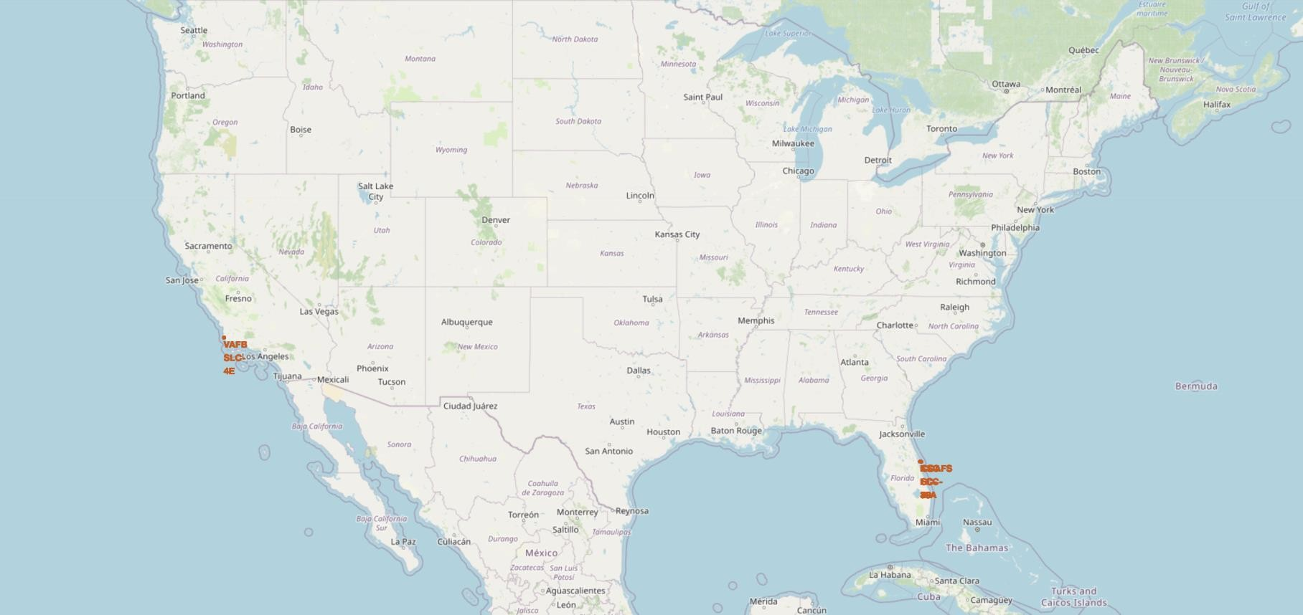
Launch Site Locations
The Earth spins on its axis such that locations near the equator rotate faster than at the poles. Launching near the equator gives the rockets a "headstart", lessening the amount of fuel it takes to reach the initial equatorial speed
The launch sites are also near the ocean so the rockets can be launched outward from populated areas in the case of a
catasrophic failure
35

Slide 35

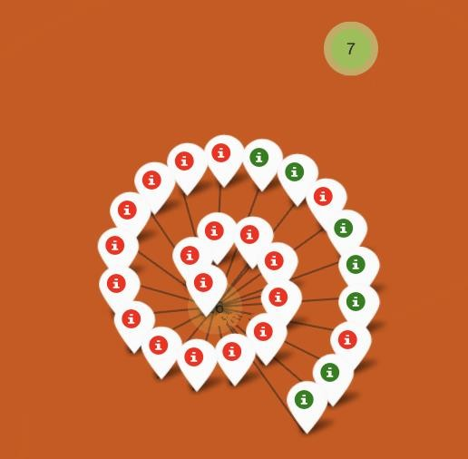
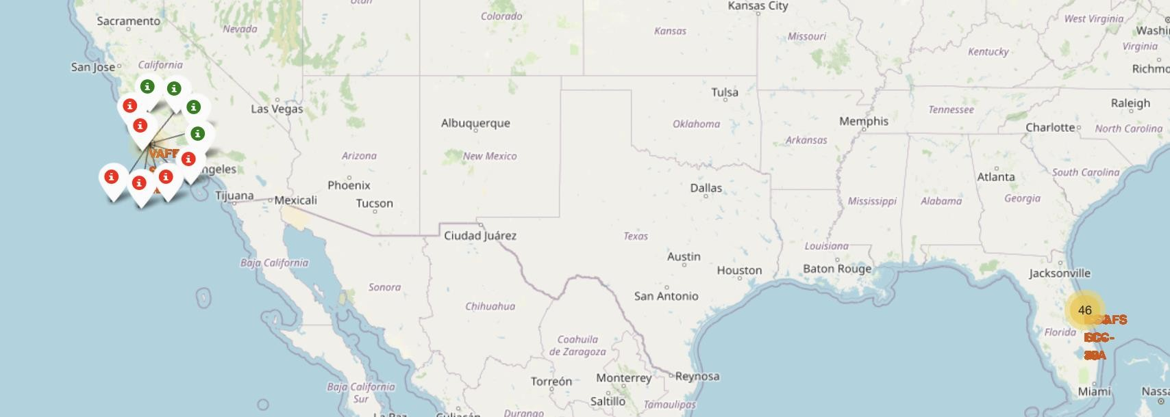
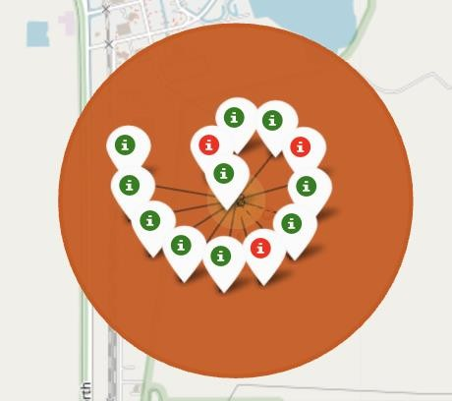
Locations coloured by Launch Record
CCAFS LC-40
CCAFS SLC-40
KSC-LC 39A
VAFB SLC-4E
This geospatial analysis shows that the
KSC-LC 39A Launch Site is by far the most successful

Slide 36
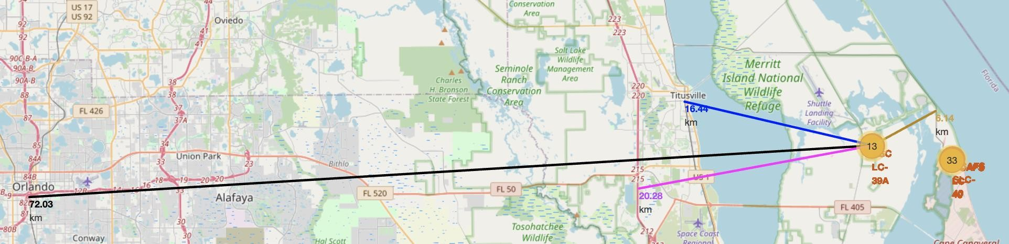
Launch Site Proximities
The launch sites are significantly distant from railways and populated centres for the safety
in case of catastrophic events.
The rockets are close to the coast line so they can be shot, avoiding population centers in the ciritical first stages of launch

Slide 37
Build a Dashboard with Plotly Dash
Python Code:
https://github.com/kaustubhjoshi1910/DSCP/blob/fc08b22d5de9e229b54dd760b8955b8e57568d29/DV%20with%20plotly.py

Slide 38
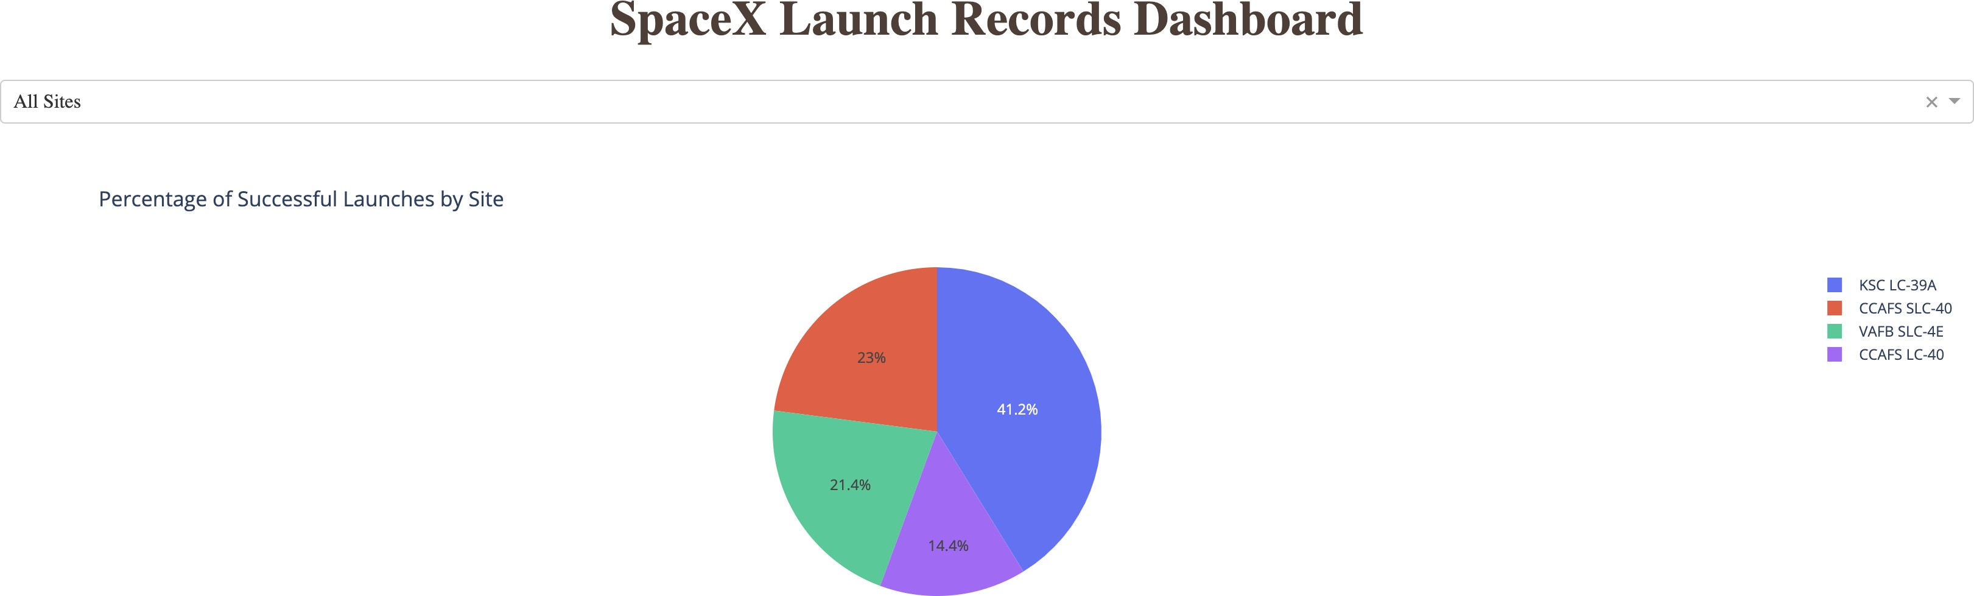
Launch Records Dashboard
KSC LC-39A - 41.2% of all successful launches

Slide 39
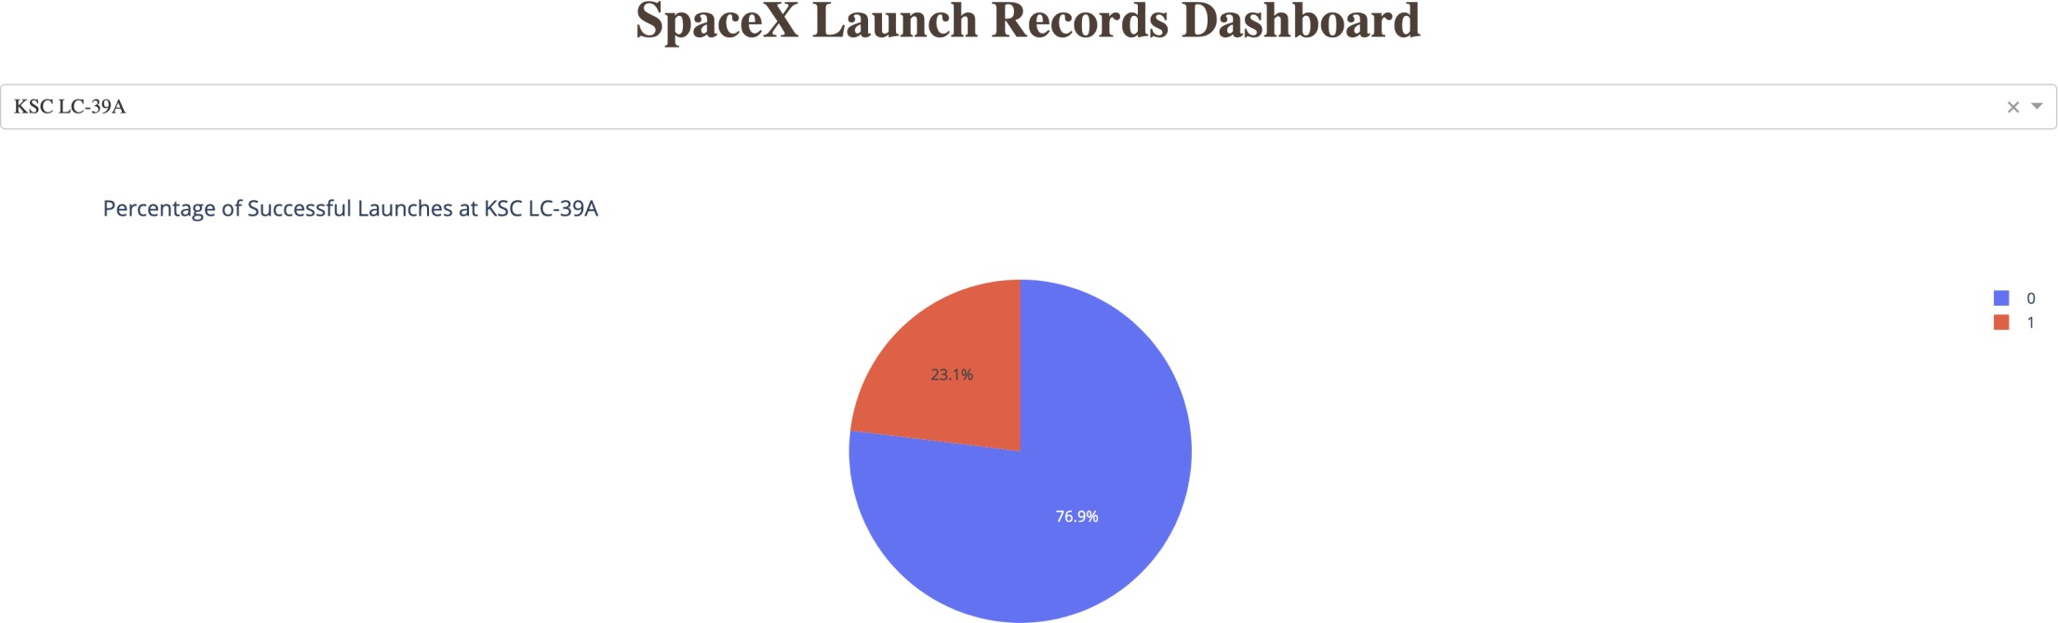
<Dashboard screenshot 2>
KSC LC-39A: 77% of all launches are successful

Slide 40
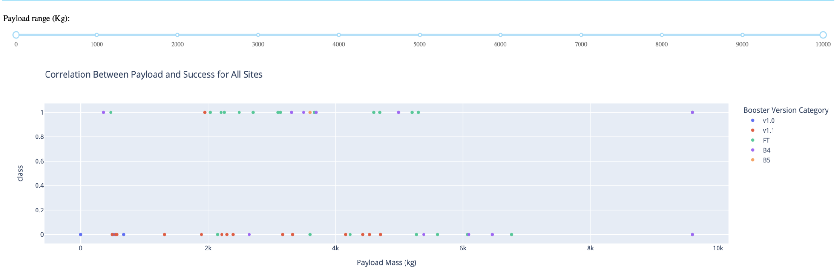
Success vs Payload (By Booster)
All Payloads between 0 and 10,000 kg
*The FT booster has the highest launch success rate
We see high rates of success between 2,000 and 4,000 kg and also
under 500 kg
The lowest rates of success are between 500kg to 2000kg
And 6000kg to 8000kg
41

Slide 41
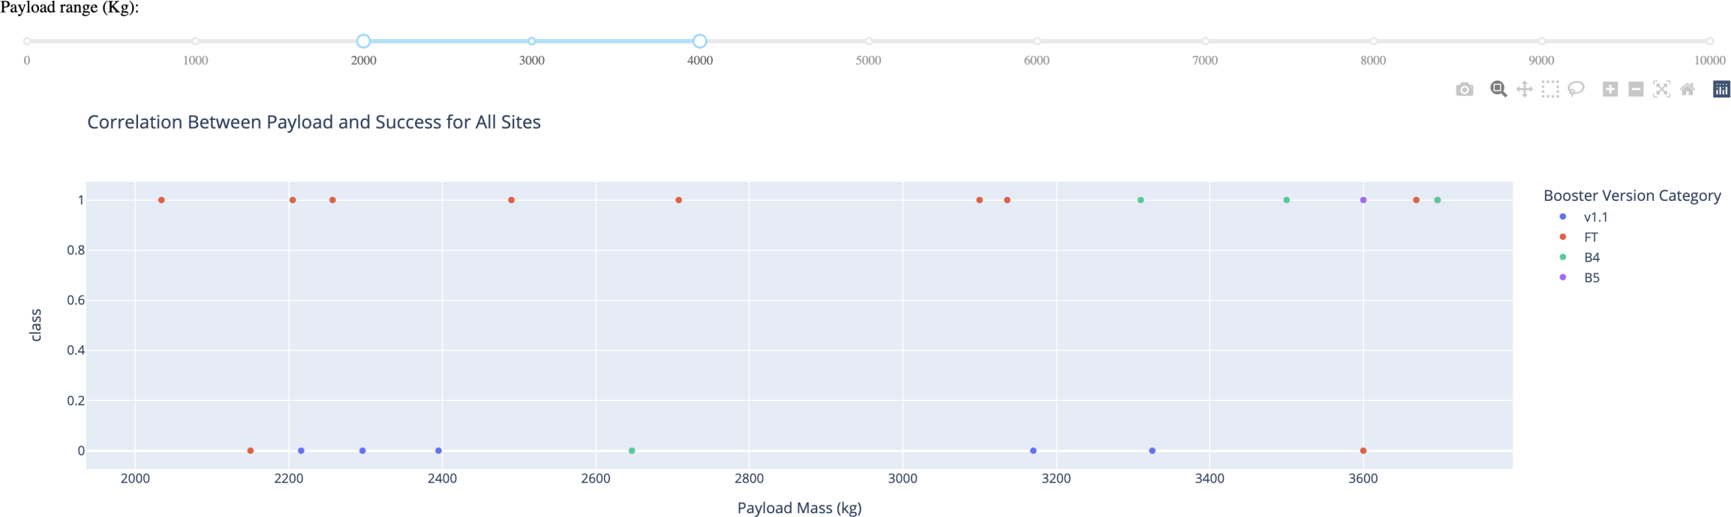
Success vs Payload (By Booster)
All Payloads between 2k and 4k kg
Here we have adjusted the view to show the 2000 -> 4000 kg
Results in more details

Slide 42
Predictive analysis (Classification)
Python Code:
https://github.com/kaustubhjoshi1910/DSCP/blob/430418327421471a4ce0f14b41e4b5b1c4ca3f83/ml%20prediction.ipynb

Slide 43
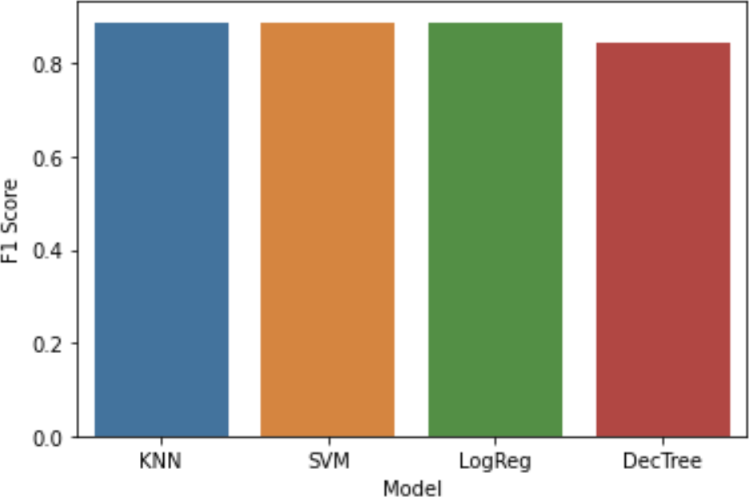
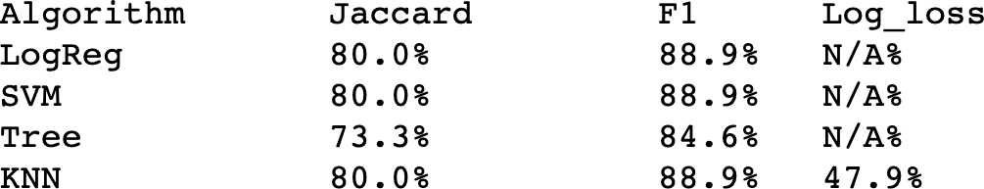
Classification Accuracy
We found that 3 out of the 4 models were able to produce the same accuracy of 88.9% on the test set (via the F1 score). Decision Tree performed the worst
As we will see on the next slide, the major concern is the false positives

Slide 44
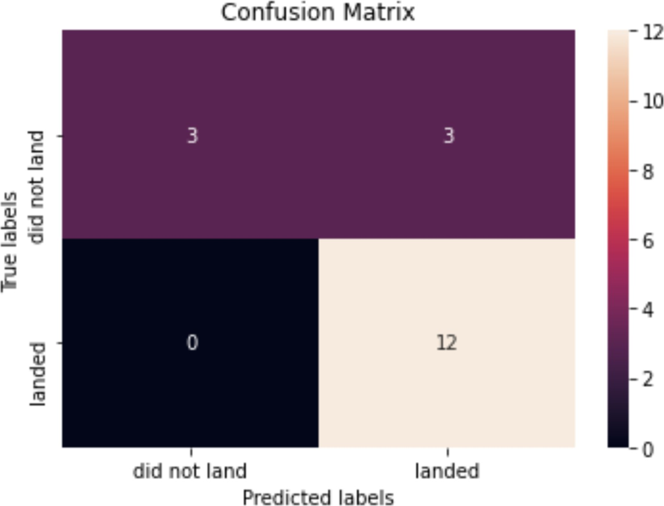
Confusion Matrix
The confusion matrices are the
same for 3 out of 4 models (Decision Tree is the Exception)
The True Positives, here, are in the bottom right. We can see that the model very accurately predicts when Falcon 9 will land successfully
The False Positives are in the top right. Clearly, the model is less tuned to predicting when a failure will occur.
Said in another way, The Precision is 0.8 and The Recall is 1

Slide 45
CONCLUSION
Using a public dataset we can model whether or not Falcon 9 will land given its launch criteria to an accuracy of 88.9%
False Positives are the largest concern
3 out of 4 models produced the same result: Logistic Regression, SVM, and KNN
A dashboard and several notebooks have been compiled for further research

Slide 46
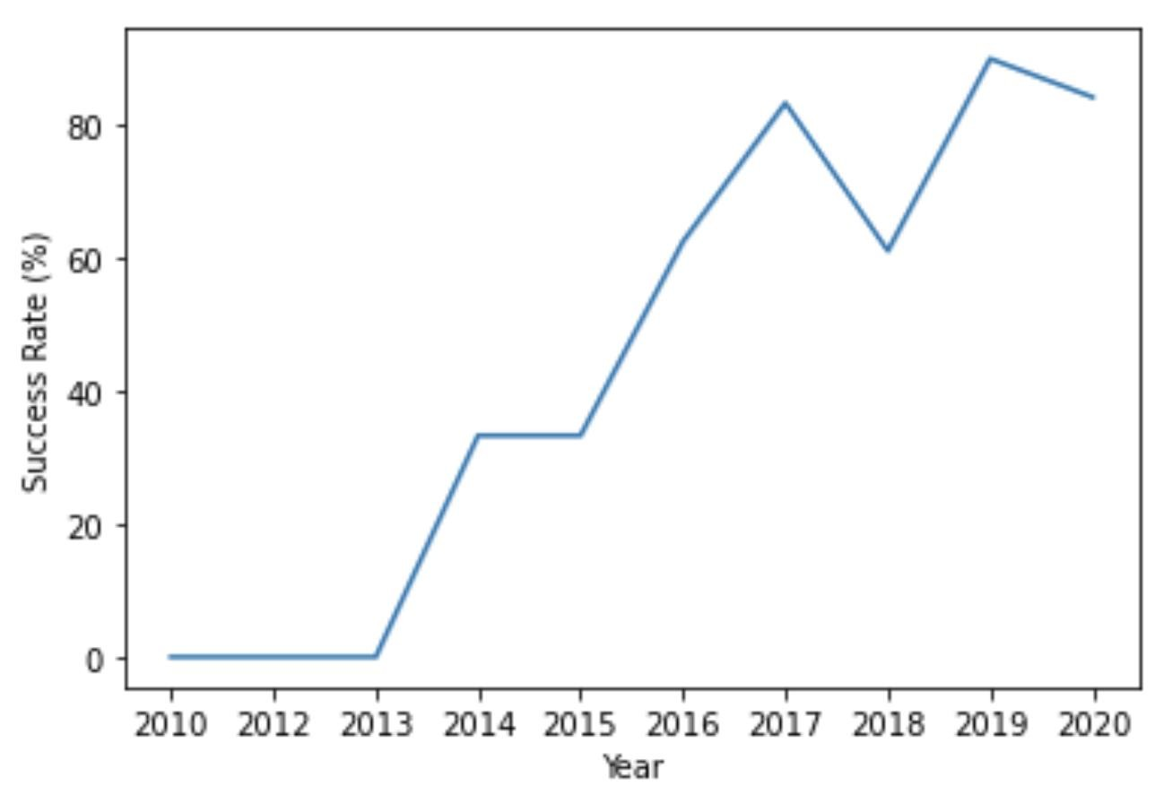
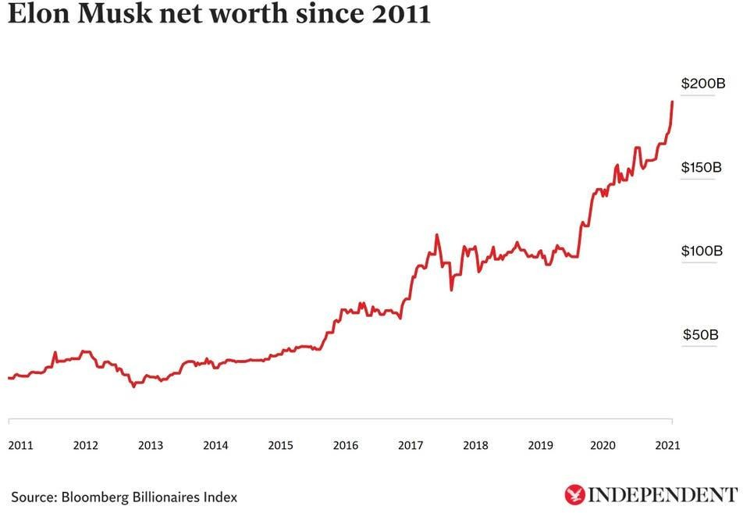
APPENDIX
Additional Analysis: Elon Musk's Net Worth tracks with the success
of SpaceX very closely
47

