Slide 1
QUANTUM ERROR CORRECTION
Q-DecodeQEC
Comparative syndrome decoding +
passive vs active memory correction
Real IBM Quantum repetition-code data
M0 MWPM · M1 MLP · M2 MOR router
Kaustubh Ladda | Trinexis × IEEE | IBM Qiskit Fall Fest 2026
Evidence snapshot: 26 October 2026
Q-DECODEQEC · IBM Qiskit Fall Fest 2026
01

Slide 2
01 · PROBLEM SETUP
A small code, a practical decoding problem
Goal: infer whether the logical observable flipped from syndrome-derived detector bits.
Distance-3 repetition memory
One shot → one logical-flip prediction
Three data qubits · two parity checks · three syndrome rounds
8 detector bits
Decoder
0 / 1
D0
D1
D2
binary input
classical CPU
predicted flip
Check 0
Z0Z1
Check 1
Z1Z2
Repeated measurements expose temporal changes.
CLASSICAL TRACK
HARDWARE TRACK
ibm_marrakesh source data
ibm_fez memory experiment
Scope: bit-flip (X) errors, not arbitrary quantum noise.
4,000 train · 1,000 internal test
2,000 unlabelled final-test shots
16 circuit variants · 4,000 shots
Passive offline decode vs active feedback
Q-DECODEQEC · IBM Qiskit Fall Fest 2026
02

Slide 3
02 · METHODS
Three decoders, two controls
All methods are evaluated on the same 1,000 labelled internal-test shots.
CONTROLS
No-flip baseline
Exact pattern lookup
Required decoder comparison ↓
M0
MWPM / PyMatching
M1
Neural MLP
M2
MOR difficulty-aware router
Graph-based minimum-weight matching
Classical multilayer perceptron
Select identity, matching or neural path
8 detector nodes · 18 edges
8/8 hand-built syndrome tests passed
(64, 64) hidden units · 4,801 parameters
Decision threshold tuned on validation
Routes by detector-weight class
Platt scaling calibrates probabilities
Fastest required decoder
Lowest internal-test point estimate
Saves some neural calls; higher latency
The final 2,000-shot holdout has no labels; it is for frozen predictions, not scoring.
Q-DECODEQEC · IBM Qiskit Fall Fest 2026
03

Slide 4
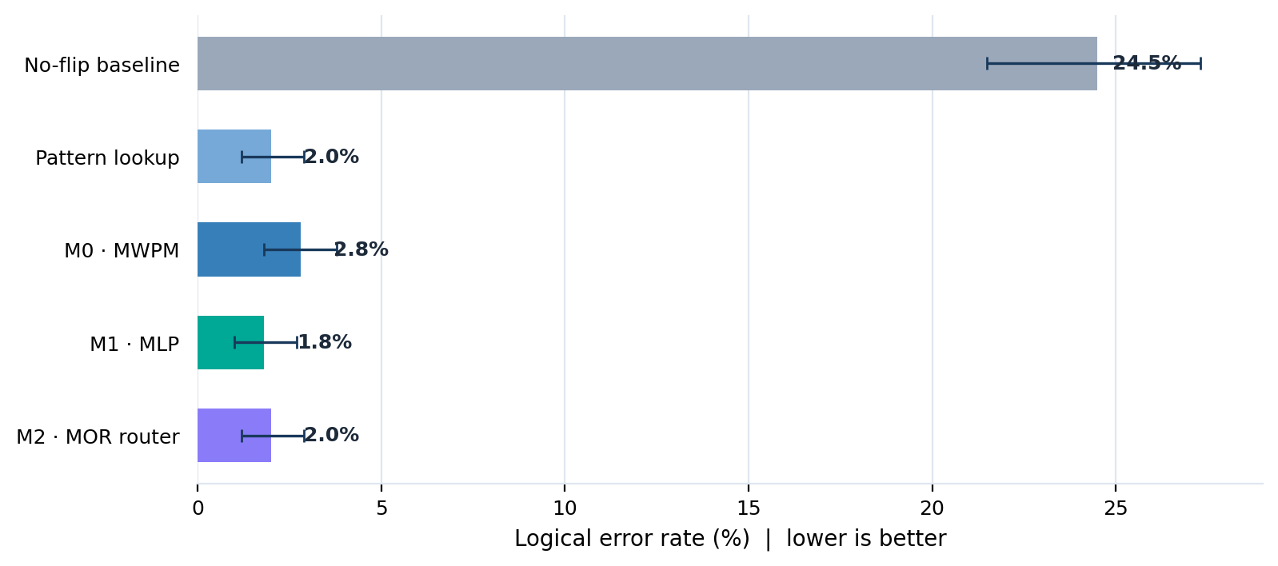
03 · MAIN RESULT
Decoding cuts the measured error rate sharply
Internal test: 1,000 labelled shots · logical error rate (LER) = fraction of wrong predictions.
24.5% → 1.8%
No-flip baseline → M1 MLP
18 errors out of 1,000 shots for M1.
What the benchmark says
All three required decoders achieve LER below 3%.
M1 has the lowest point estimate: 1.8%.
Its lead over lookup is not statistically resolved.
Error bars show 95% bootstrap intervals.
Q-DECODEQEC · IBM Qiskit Fall Fest 2026
04

Slide 5
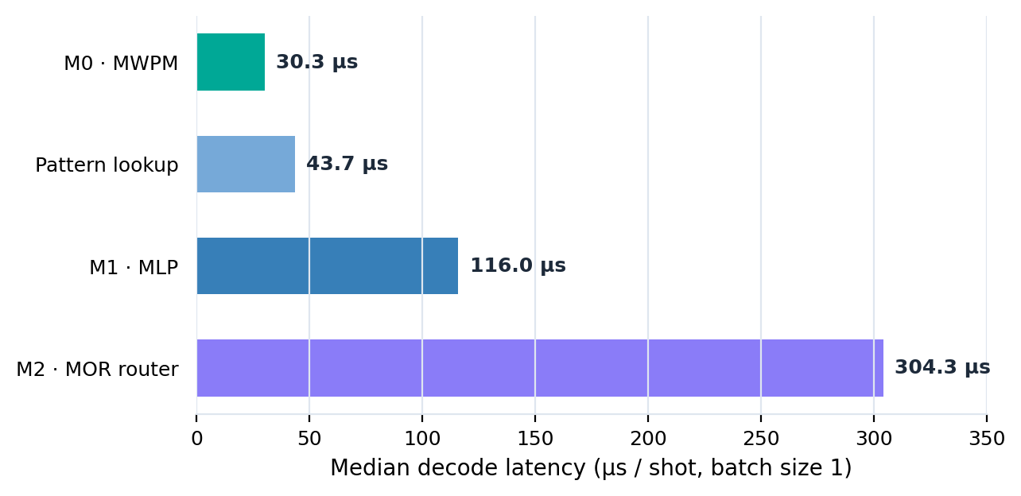
04 · INTERPRETING THE RESULTS
The best point estimate is not automatically the winner
The predeclared rule compares paired bootstrap intervals first, then uses latency to break ties.
Median classical latency (batch size 1)
Why the report selects M0
M1 vs lookup: ΔLER = −0.002
95% paired interval: [−0.005, 0.000]
INCONCLUSIVE COMPARISON
Among statistically tied required decoders, M0 is fastest at 30.3 µs p50.
Calibration improved for M2
Expected calibration error (ECE)
0.032 → 0.016
Platt scaling improved probability reliability, but did not make M2 faster: 304.3 µs p50.
Measurements are Python CPU-side timings, not QPU feedback-loop latency.
Q-DECODEQEC · IBM Qiskit Fall Fest 2026
05

Slide 6
05 · REAL HARDWARE
Passive logging vs active correction on ibm_fez
A separate device experiment tests whether applying a conditional X inside the circuit helps the memory outcome.
BACKEND
PHYSICAL LINE
CIRCUIT SET
QPU TIME
ibm_fez
22–23–24–25–26
8 configs × 2 versions
5.0 s total
PASSIVE
ACTIVE
Measure and store syndrome history
Use the last syndrome to trigger conditional X
Memory
circuit
Syndrome
registers
Offline
decoder
Memory
circuit
Last
syndrome
Conditional
X gate
M0 / M1 / M2 applied after the hardware run.
16 circuits × 250 shots = 4,000 shots total (2,000 per condition).
Important distinction: labelled training data came from ibm_marrakesh; this passive/active circuit experiment ran separately on ibm_fez.
Q-DECODEQEC · IBM Qiskit Fall Fest 2026
06

Slide 7
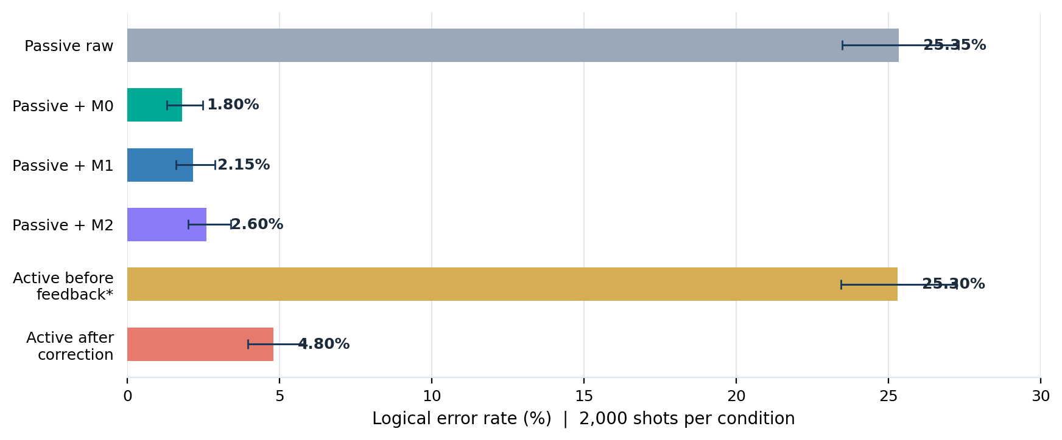
06 · HARDWARE FINDINGS
Active feedback helps, but offline decoding helps more
Pooled results: 2,000 shots per condition · error bars are Wilson 95% intervals.
25.3% → 4.8%
Active on-device correction
Large reduction versus leaving the memory uncorrected.
What matters
Passive + M0: 1.8% LER (36/2,000 errors).
Active after correction: 4.8% (96/2,000).
A last-syndrome rule can add errors on fault types that do not affect the observable.
*Active-before-feedback is reconstructed from the active circuit registers; it is not a second submitted passive circuit.
Q-DECODEQEC · IBM Qiskit Fall Fest 2026
07

Slide 8
07 · REPRODUCIBILITY
Evidence and integrity were part of the experiment
The result package was designed to be auditable, not only to report a winning number.
22
34
8 / 8
2 / 2
data files hash-verified
evidence files indexed
matching graph tests passed
IBM jobs re-queried and verified
Reproducibility flow
01
02
03
04
Audit input schema
Train / tune
Freeze + hash
Verify outputs
exact detector-layout checks
fixed seeds · train-only tuning
models and prediction manifests
shot alignment · job ledger
Final holdout: 2,000 rows were predicted only after model freeze. Because labels were not supplied, no final-test accuracy or LER is claimed.
Q-DECODEQEC · IBM Qiskit Fall Fest 2026
08

Slide 9
08 · CONCLUSION
Promising decoding gains, with honest limits
The study demonstrates a reproducible small-code workflow—not quantum advantage or scalable fault tolerance.
Three findings to remember
Next steps
01
Decoding works
Collect more labelled shots across jobs and backends.
Internal-test LER drops from 24.5% to 1.8–2.8%.
Test larger code distances and more syndrome rounds.
02
M1 is not a proven winner
Its 1.8% point estimate is not resolved from lookup or M0 by paired intervals.
Refine active correction to avoid unnecessary X gates.
03
Hardware correction is nuanced
Profile M2 and test faster routing policies.
Active feedback reaches 4.8%; offline M0 reaches 1.8% on passive shots.
Thank you
Q-DecodeQEC · Kaustubh Ladda
Q-DECODEQEC · IBM Qiskit Fall Fest 2026
09

