Slide 1
CONSUMER LENDING · MODEL REVIEW COMMITTEE
Pricing the Bet:
A Credit Scoring Model
307,511 applications · 1.7M bureau records · one sealed test · the decision in dollars
Kaustubh Patil · 20 August 2026
Notes:
One line if asked early: we built and validated a default-probability model, it beats the scorecard baseline decisively, the dollar case is quantified on a sealed test book, and we found and fixed a compliance defect on the way. Recommendation is deploy, with conditions.

Slide 2
THE PROBLEM
Eight percent of approved loans go bad — and the costs are lopsided
8.07%
13×
65% / 5%
92%
of funded loans end in
payment difficulties
cost of a missed default vs a
wrongly-declined good customer
loss-given-default vs lifetime
margin — the asymmetry's source
accuracy of a useless model that
approves everyone — why AUROC, not accuracy
The underwriting question: at application time, with only the form and the bureau file, how likely is this applicant to stop paying — and where is the profit-maximizing line between approve and decline?
Notes:
Cost of getting it wrong, concretely: approving a future default loses ~65% of the exposure; declining a good customer forfeits ~5% lifetime margin. That 13x asymmetry is why the decline threshold, not the model, encodes the risk appetite - and why we quantify everything in dollars later.

Slide 3
OUR APPROACH
Clean data, honest splits, three models, one sealed test
1
2
3
4
TWO TABLES
CLEAN & SPLIT
FIVE-Cs FEATURES
THREE MODELS
307,511 applications +
1.7M credit-bureau records
(Character evidence, per applicant).
Sentinel audit (the 1,000-year
employee), missingness-as-signal,
stratified 70/15/15, test sealed.
153 features: capacity ratios,
bureau aggregates, external-score
combos, K-Means peer groups.
Logistic scorecard · Random
Forest · tuned Gradient Boosting.
One pipeline, CV-safe by design.
Leakage is structurally impossible: every fitted transform (imputers, encoders, clusterer, models) lives inside one sklearn Pipeline, re-fitted per CV fold. No class weighting — calibrated probabilities are required downstream, so asymmetric costs are handled at the decision threshold instead.
Notes:
Details for Q&A only: DAYS_EMPLOYED=365243 sentinel on 18% of rows (pensioners) fixed to NaN+flag; building-info block half-missing handled with a block flag; missingness itself is predictive (no EXT_SOURCE_1 = higher risk) so we keep indicators. Keep this slide under 3 minutes.

Slide 4
RESULTS · 1 OF 4
Three models, one scoreboard
Model | Val AUROC | Test AUROC | Gini (test) | KS (test) | Fit time
Prior baseline | 0.500 | — | — | — | 8 s
Logistic scorecard | 0.756 | 0.757 | 0.514 | 0.382 | 11 s
Random Forest | 0.758 | — | — | — | 40 s
Gradient Boosting (default) | 0.769 | — | — | — | 16 s
Gradient Boosting tuned (selected) | 0.773 | 0.774 | 0.547 | 0.416 | 27 s
Nonlinearity pays 1.7 AUROC points over the scorecard. Tuning: randomized search, 3-fold CV on train only. Overfit check: 5-fold CV 0.768 ± 0.005 ≈ validation 0.773 ≈ test 0.774 — three independent readings agree; the train score (0.832) is never quoted as performance.
Notes:
'Why not deep learning?' - tabular data with 153 features and strong categorical structure is where boosted trees still win; the Module 2 project covers the DL case. 'Is 0.774 good?' - for application-only + bureau data without behavioral/transaction history, 0.77-0.78 is solid; adding the remaining relationship tables is the known headroom.

Slide 5
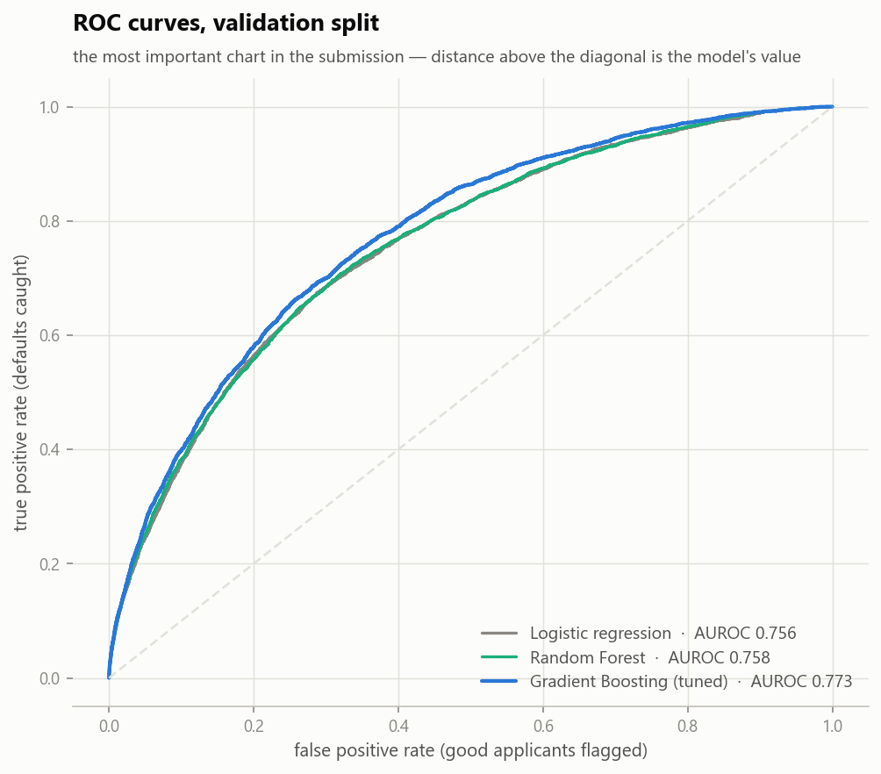
RESULTS · 2 OF 4 — THE HEADLINE
The ROC curve: 0.774 on a sealed test set
0.774
test AUROC · sealed set
0.416
KS — max separation of
good and bad applicants
~1/3
of all defaults sit in the
top risk decile alone
0.067
Brier score — probabilities,
not just rankings
Notes:
Stay here. X-axis: share of good applicants we'd wrongly flag; Y-axis: share of eventual defaults we'd catch. The working point the profit curve picks: catch 74.5% of defaults while flagging about a third of the book. The gray and green curves (scorecard, forest) overlap - the boosting margin is the whole visible gap.

Slide 6
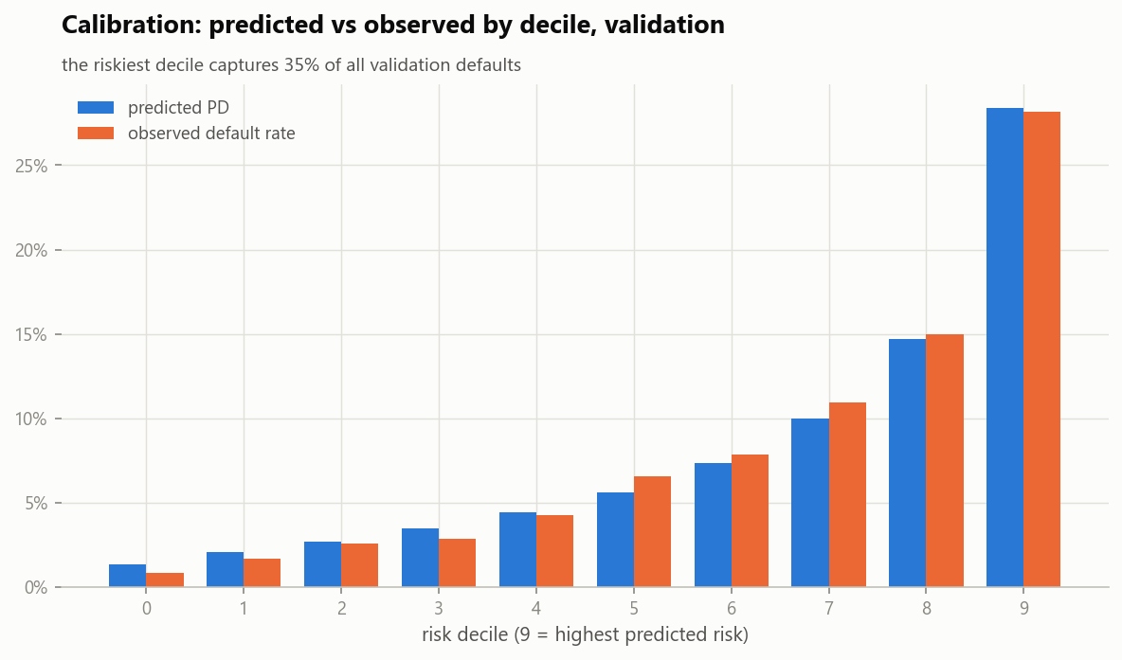
RESULTS · 3 OF 4
The probabilities are honest — which is what makes them priceable
Predicted ≈ observed, decile by decile.
This is why we refused class weighting: it would have inflated every PD and broken this chart.
Calibrated PDs feed three consumers: the profit threshold, risk-based pricing, and the adverse-action reasons.
Notes:
If the risk officer asks about the top decile: predicted ~28%, observed ~28-30% - the model knows who its worst applicants are AND by how much. Quarterly recalibration check is in the monitoring plan: observed > 1.25x predicted in 2+ deciles triggers recalibration.

Slide 7
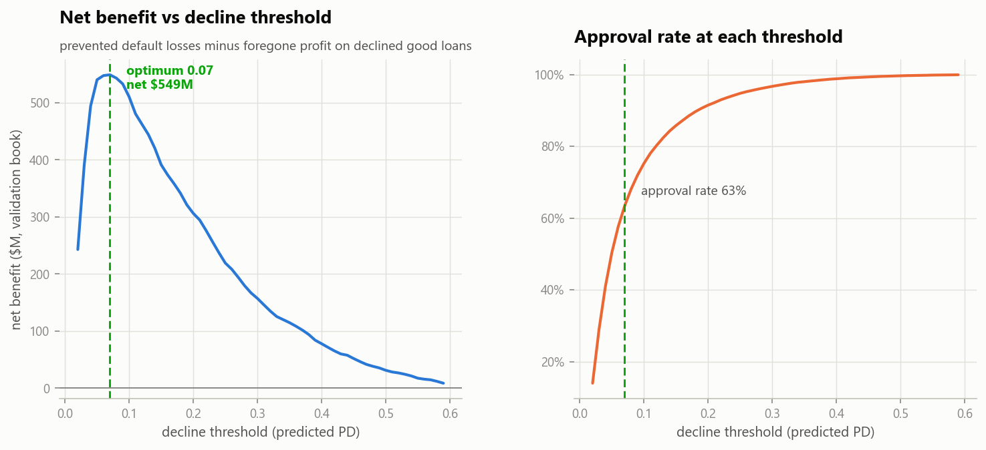
RESULTS · 4 OF 4 — THE DECISION
Where to draw the line, and what the line is worth
+$578.7M
net benefit on the 46,127-application
test book vs approving everyone
74.5%
of eventual defaults declined
before funding (2,773 loans)
63.2%
approval rate at the optimum
(threshold: PD ≥ 7%)
Assumptions on the table: LGD 65%, lifetime margin 5%, exposure = requested credit. The threshold is leadership's dial — every point on the blue curve is a policy.
Notes:
This is the slide the CIO funds. If they want a higher approval rate: move right along the curve and read the cost - e.g. threshold 0.10 approves ~75% and nets ~$480M. The model doesn't choose risk appetite; it prices it. Both baseline comparisons matter: net benefit is vs approve-everything; the scorecard at its own optimal threshold nets materially less (the AUROC gap compounds through the tails).

Slide 8
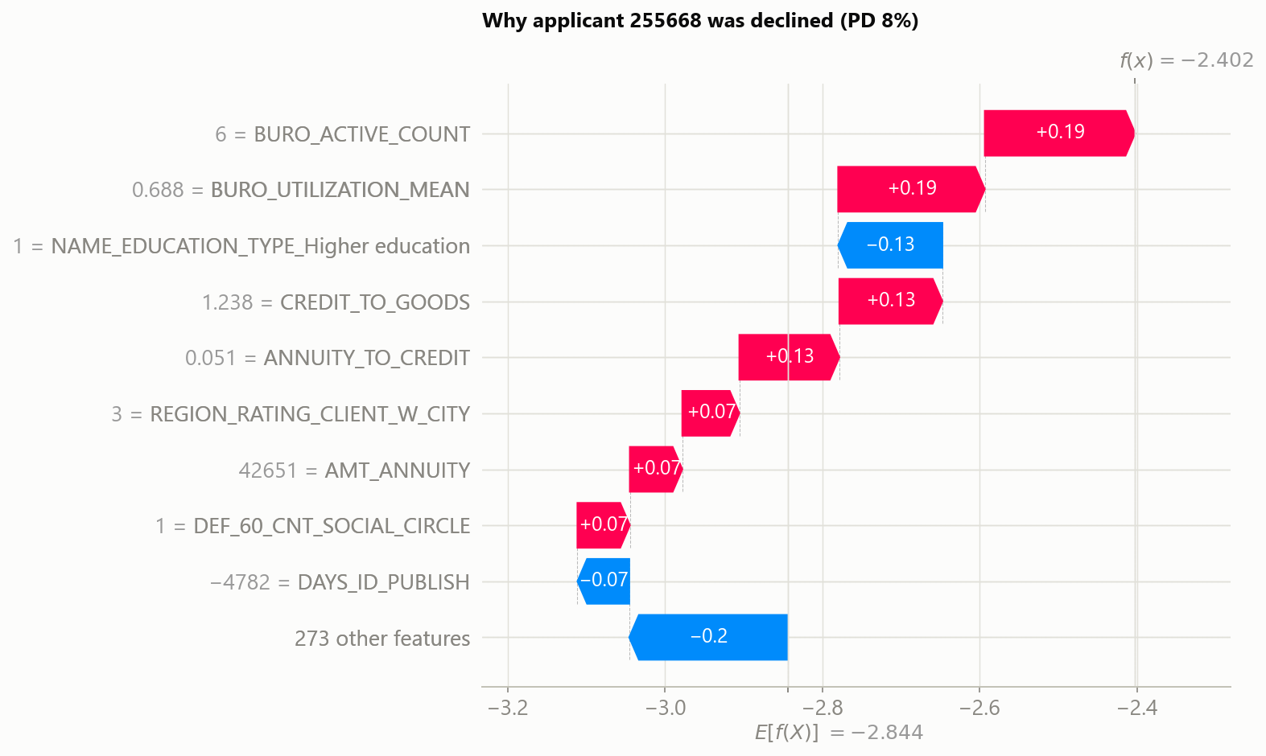
EXPLAINABILITY
Every decline comes with its reasons — by construction
ADVERSE ACTION NOTICE (generated)
Predicted probability of payment difficulties: 8.3%
Principal reasons for the decision:
1. Number of active credit obligations at other lenders
2. High utilization of existing credit lines
3. Requested credit high relative to purchase value
4. High payment burden on requested credit
SHAP decompositions sum exactly to each prediction; the top-4 risk-increasing factors translate to consumer language via a reviewed reason map — the FCAC/ECOA requirement, automated.
Notes:
Waterfall: this specific applicant's PD built up factor by factor from the 8% base rate. Global picture (beeswarm, in the appendix figures): external scores dominate, then age/tenure, then bureau burden - all in the economically expected direction. That agreement between model logic and lending logic is what makes SHAP evidence, not decoration.

Slide 9
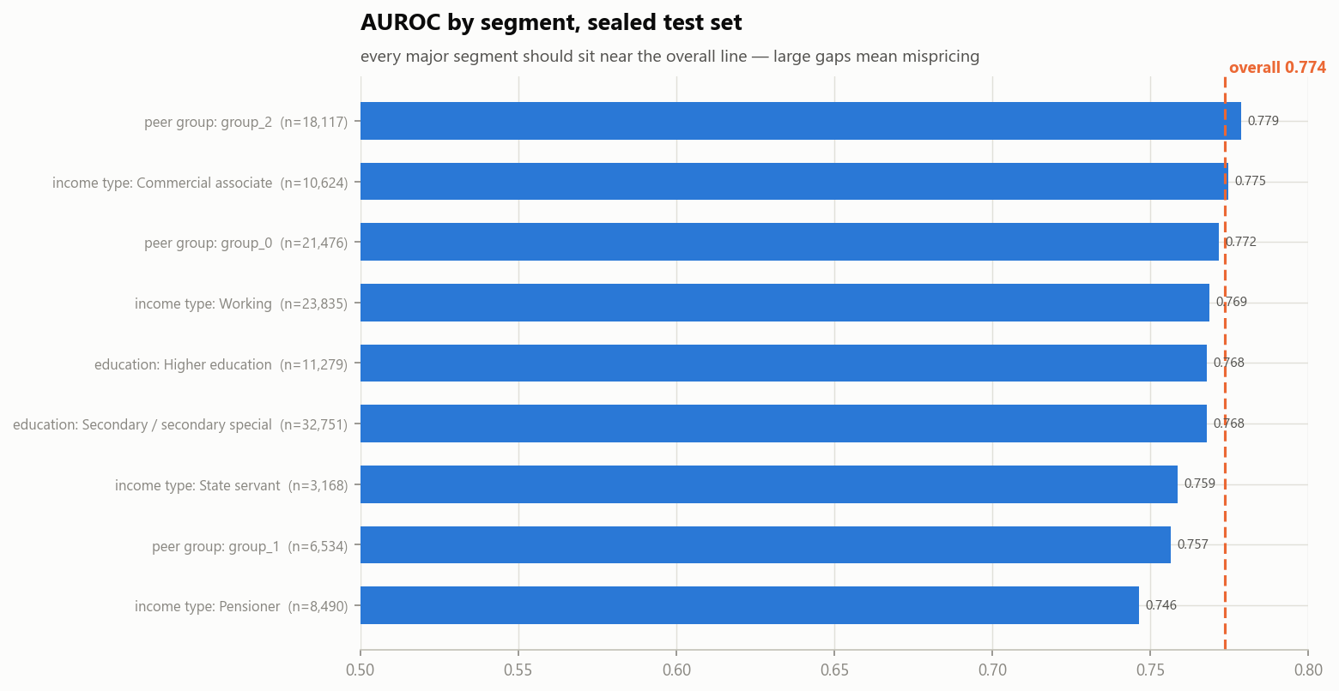
STABILITY & LIMITATIONS
The monitoring is demonstrated — and the model's limits are stated
PSI monitoring, fired for real
Random-split control ≈ 0 (stable, as it must be). Simulated severe recession: PSI 0.34 — alarm raised. Monthly in production.
No temporal validation possible
The dataset carries no dates; splits are random. PSI + monthly retraining are the compensating controls until dated cohorts exist.
Approved-population bias
The model never saw applicants the old process declined. Reject-inference is the top item in the iteration plan.
Notes:
Segment chart: AUROC by peer group, income type, education - every major segment near the overall line; thin-file group is the weakest and gets a manual-review lane. PSI thresholds: <0.10 stable, 0.10-0.25 monitor, >0.25 investigate.

Slide 10
FAIRNESS · AND THE RECOMMENDATION
We found a compliance defect, fixed it, and priced the fix
THE DEFECT
Gender was a model input — prohibited in credit decisions regardless of accuracy. Measured impact at the production threshold: male adverse-impact ratio 0.75, age 20–35 AIR 0.62 (four-fifths screen: 0.80).
THE FIX
Retrained the exact champion without gender: test AUROC 0.7731 vs 0.7736 — the fix costs less than a thousandth of a point. Age effects remain: risk-based and monotone (young riskier), documented as business necessity with quarterly re-audit of proxy pathways.
RECOMMENDATION — DEPLOY, WITH CONDITIONS
Ship the gender-free pipeline · adverse-action reasons on every decline · monthly PSI vs frozen reference · quarterly fairness re-audit · manual-review lane for thin files · monthly champion/challenger retraining.
A model that beats the baseline, prices its own decisions, explains itself, and survived a fairness audit — that is what deployable means.
Notes:
If challenged on age: ECOA-style frameworks permit age in scoring when it does not disadvantage the elderly - here the elderly are FAVORED; the young-applicant effect is risk-justified and documented. Gender had no such defense, so it's gone, and the cost was nil. Close on the recommendation box.

Slide 11
APPENDIX · Q&A BACKUP
Pre-answered: the questions we expect
'How do we know it is not overfit?'
'What happens when the economy changes?'
CV 0.768 ± 0.005 ≈ val 0.773 ≈ sealed test 0.774. Train (0.832) is quoted only to show we checked the gap; capacity was regularized by the search (L2 = 10).
Score PSI vs frozen train reference, monthly. Demonstrated: severe-recession simulation raises PSI 0.34 (investigate band); random-split control ≈ 0.
'Why these dollar numbers?'
'Can it explain an individual decline?'
Prevented losses = declined defaulters' exposure × 65% LGD; cost = declined good customers' exposure × 5% margin. Every assumption is a named constant in src/config.py.
Yes - SHAP top-4 risk contributors, mapped to consumer language, generated for every declined applicant. Illustrated end-to-end in notebook 05.
'Which features matter most?'
'What would 4 more weeks buy?'
External bureau scores (mean/min combos), then age and employment tenure, then bureau burden (utilization, active credits, overdue history), then capacity ratios.
The remaining relationship tables (previous applications, installments, card balances) - the known accuracy headroom; reject-inference; out-of-time validation on dated cohorts.
Notes:
Not presented - backup only. Deeper backup lives in the notebooks: sentinel audit (02), peer-group profiles (03), decile tables (04), segment/fairness detail (05).

