Slide 1
CONSUMER LENDING · MODEL REVIEW COMMITTEE
Pricing the Bet
A credit scoring model for the application desk, and what it is worth to the book
Kaustubh Patil
20 August 2026
Notes:
Open with the one line: I built a model that decides who to lend to, I can prove what it is worth in dollars, and I found and fixed a compliance problem on the way. Recommendation is deploy, with conditions. Then move to the two applicants.

Slide 2
02 / 13
THE PROBLEM
Two applicants walk in. On paper, they look the same.
APPLICANT A
APPLICANT B
Borrows $20,000 and pays every instalment.
Borrows $20,000 and stops paying after six months.
+$1,000
−$13,000
the bank earns its 5% lifetime margin
the bank loses 65% of what it lent
One Applicant B costs the bank thirteen Applicant A's.
WHY THIS IS HARD
About 8 of every 100 loans we approve turn out to be a B. I cannot tell them apart by looking, and the two mistakes do not cost the same, so the entire job is working out which one is sitting in front of us before any money moves.
Notes:
Land the asymmetry, not the percentage. A wrongly declined good customer costs me a small margin. A wrongly approved bad one costs me most of the loan. Thirteen to one. That ratio is why the cut-off, not the model, is where the money is decided. If asked: 65% loss given default, 5% lifetime margin, both named constants in the code.

Slide 3
03 / 13
MY APPROACH
What I actually did, in four steps
01
02
03
04
Gathered the evidence
Cleaned it honestly
Built the signals
Tried three models
307,511 past applications, joined to 1.7M records of how those same people repaid other lenders.
Fixed the data's lies (one field claimed a thousand years of employment) and locked away a test set I would not touch until the end.
153 measures a lender actually cares about: what they earn, what they owe, whether they have paid people back before.
From a simple points checklist to a modern one, judged on the same evidence, under the same rules.
WHY YOU CAN TRUST THE NUMBER THAT FOLLOWS
The test set was sealed until the very last step, and every cleaning rule was learned from the training data only. That matters because it is the difference between a number that holds up in production and a number that only ever looked good in a notebook.
Notes:
Keep this fast, 45 seconds. The one point a technical reviewer will test: leakage. Every fitted transform lives inside one pipeline, refitted per cross-validation fold, so the test set could not leak into training even by accident. Sentinel detail if asked: DAYS_EMPLOYED = 365243 on 18% of rows, almost all pensioners, fixed to missing plus a flag.

Slide 4
04 / 13
RESULTS · THE SCOREBOARD
Three ways to make the call
THE CHECKLIST
THE COMMITTEE
THE APPRENTICE
Logistic scorecard
Random forest
Gradient boosting
Adds up points, like an underwriter with a rulebook. Easy to explain, but it can only draw straight lines.
Hundreds of small opinions, each looking at part of the file, then a majority vote.
Each round studies the last round's mistakes and corrects them. Slowest to train, sharpest answer.
0.757
0.758
0.774
SELECTED
That score is AUROC: given any good customer and any bad one, how often does the model correctly rank the bad one as riskier?
mine: 0.774
0.50 to 0.65
coin flip to weak
0.65 to 0.70
usable, not good
0.70 to 0.78
industry normal on this kind of data
0.80 and up
needs behavioural data I do not have
READING THE SCALE HONESTLY
0.80 is not the target. On application-and-bureau data alone, without any behavioural history, this sits where a good model should sit.
Notes:
For the business people: 0.774 means if I line up a good customer and a bad one at random, the model puts the bad one higher three times out of four. For the technical people: sealed test AUROC 0.774, Gini 0.547, KS 0.416, and cross-validation, validation and test agree within half a point. Why not deep learning: on 153 tabular features boosted trees still win.

Slide 5
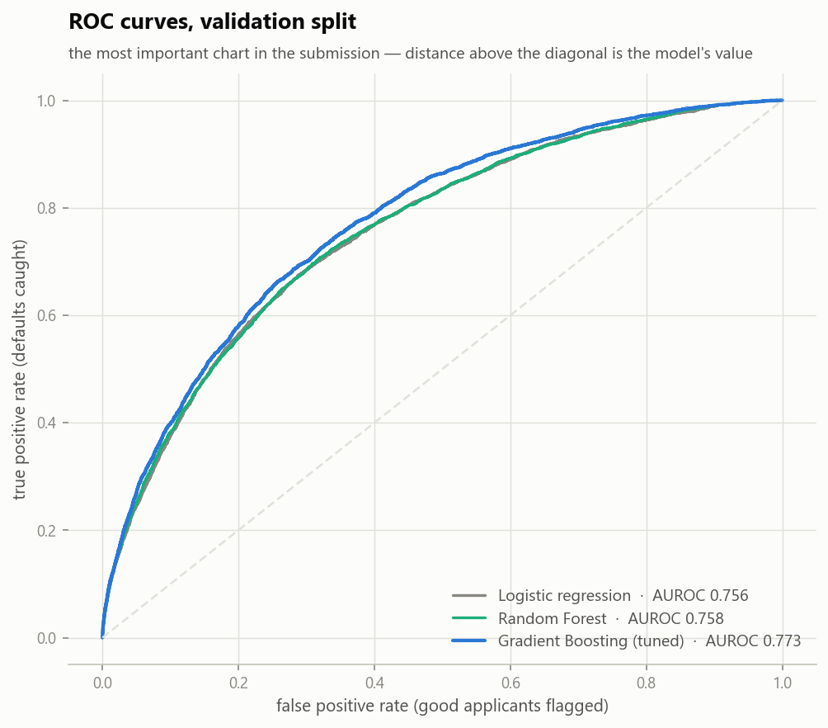
05 / 13
RESULTS · SEPARATION
How cleanly does it separate good from bad?
3 in 4
times, it ranks the bad customer above the good one
1 in 3
of every default sits in the riskiest tenth of the book
WHY THIS MATTERS
Risk is concentrated, not smeared evenly across the book. That concentration is what makes a single cut-off worth drawing at all.
The blue curve is the model I chose. The higher it sits above the dotted line, the better it is telling the two apart.
Notes:
Do not explain ROC mechanics unless asked. The business translation is the left number: three times out of four it puts the bad customer above the good one. If a technical reviewer asks for the working point: 74.5% of defaults caught while flagging about a third of the book, and that point is chosen by the profit curve, not by me.

Slide 6
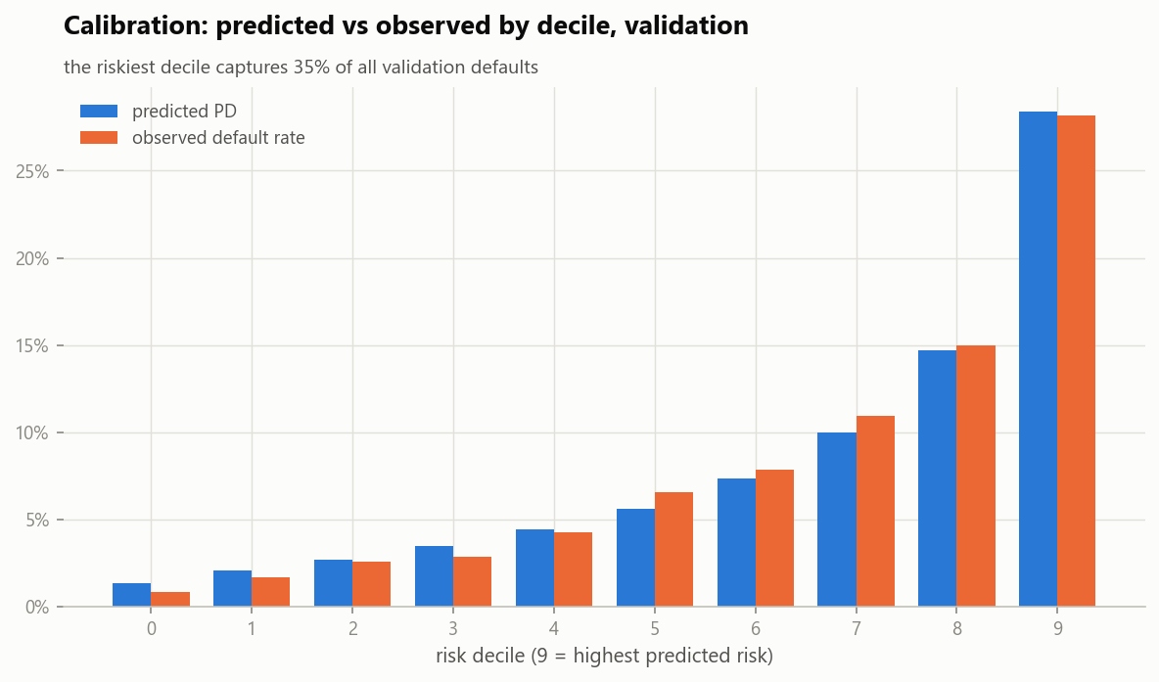
06 / 13
RESULTS · HONESTY
When it says 20%, does 20% actually happen?
Yes. Decile by decile, predicted risk lines up with what actually happened.
RISKIEST TENTH OF APPLICANTS
28% predicted → 29% actual
This is the difference between a model that ranks and a model you can price with. A ranking tells me who is riskier. An honest probability tells me how much to expect to lose, which is the number the next slide turns into money.
A CHOICE I MADE
I deliberately refused a common shortcut that would have made the model look better on paper and broken this chart.
Notes:
The shortcut is class weighting. It boosts the rare class and inflates every predicted probability. It would have improved nothing that matters and destroyed the dollar maths and the decline reasons, both of which need the probability to be literally true. Recalibration trigger is in the monitoring plan: observed above 1.25x predicted in two or more deciles.

Slide 7
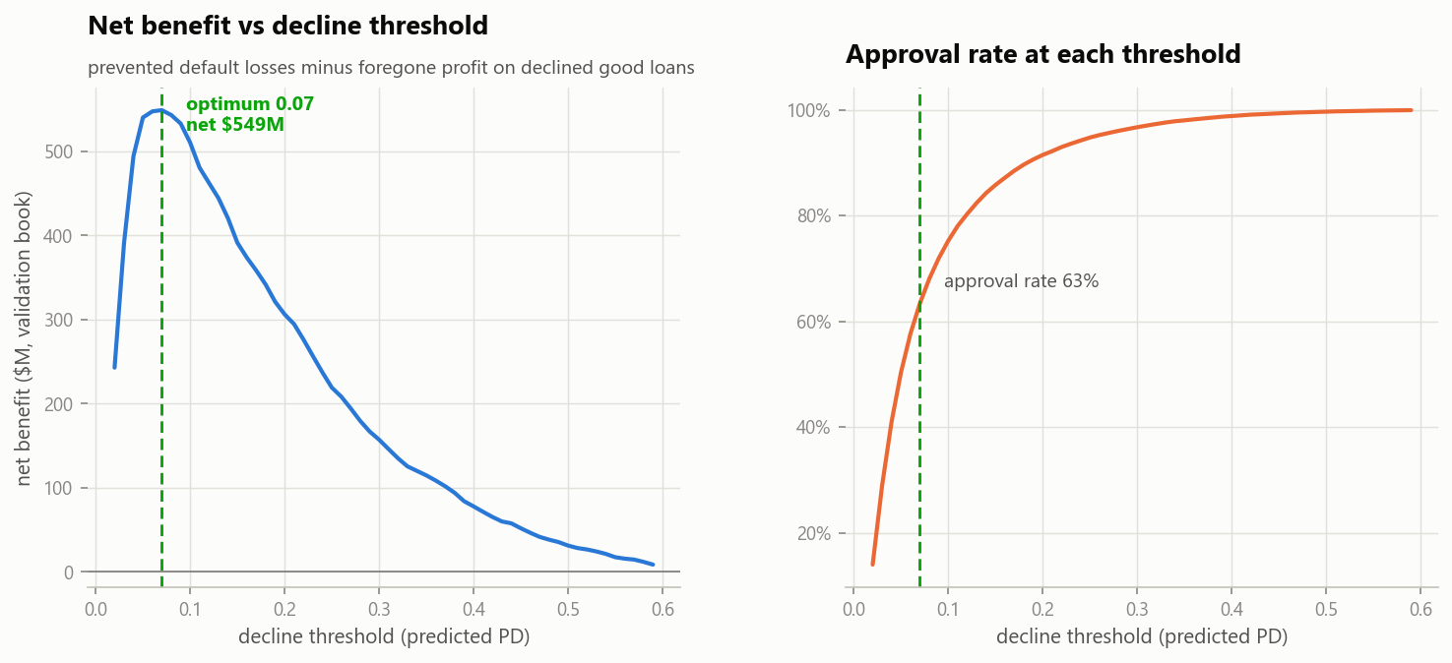
07 / 13
THE DECISION
Where I drew the line, and why it is not arbitrary
NET BENEFIT ON THE SEALED TEST BOOK
+$578.7M
versus approving everyone, across 46,127 applications
WHY 7%, AND NOT SOME OTHER NUMBER
A good loan earns 5%. A bad one loses 65%.
5% ÷ (5% + 65%) = 7.1%
63.2%
74.5%
That is the break-even: past it, a loan stops making money. I swept the real profit curve over 46,127 loans and it landed on 7%. Two independent routes, the same answer.
of applicants approved at that line
of future defaults stopped before funding
Notes:
This is the slide the CIO funds, so slow down. The threshold is leadership's dial, not mine: move it right and you approve more and earn less, for example 10% approves about 75% of applicants and nets around $480M. The model does not choose the risk appetite, it prices whichever one you choose. If asked where 578.7 comes from: prevented losses of $972.0M minus $393.3M of margin given up on good customers I declined.

Slide 8
08 / 13
EXPLAINABILITY
Every “no” comes with a receipt
WHAT THE CUSTOMER RECEIVES
HOW I KNOW THOSE ARE THE REAL REASONS
“Your application was declined. The main reasons were:”
The model does not hand me a score and stay silent. It hands me the score broken into every factor that built it, and those pieces add up to the score exactly.
1. You are using a high share of the credit you already have
2. Your external credit score is low
So the four reasons on the letter are not a guess at what mattered, and they are not written by hand afterwards. They are the four largest pieces of that person's own number.
3. You have several active loans with other lenders
4. Some payments elsewhere are past due
Plain language, no jargon, no column names. Required by FCAC and ECOA, generated automatically for every single decline.
Technically: SHAP values, which are additive by construction, mapped to consumer language across all 279 model columns.
KEY TAKEAWAY
Compliance here is not a report written after the fact. It falls out of the same maths that made the decision, which means the reasons can never drift away from the real cause.
Notes:
If a risk officer pushes: the additivity is the guarantee. The contributions sum exactly to the prediction, so I cannot show a reason that was not genuinely one of the drivers. This is the same applicant I score live in the demo. Global picture if asked: external scores dominate, then age and tenure, then bureau burden, all in the expected direction.

Slide 9
09 / 13
RISKS & LIMITS
Three things that could go wrong, and what I did about each
The economy turns and everyone gets riskier at once
I built a tripwire that watches for the population drifting, and I test-fired it: a simulated severe recession trips it. It runs monthly in production.
TESTED, NOT PROMISED
I cannot check the model against a different point in time
This data carries no dates, so an out-of-time test is impossible today. I retrain monthly and monitor drift instead of pretending the problem is not there.
COMPENSATING CONTROL
The model has only ever seen people we already said yes to
It cannot learn from applicants the old process turned away. Thin files go to a human reviewer, and correcting this is the first item on my roadmap.
HUMAN IN THE LOOP
KEY TAKEAWAY
I would rather bring you a model whose blind spots are named and instrumented than one that looks flawless.
Notes:
Drift metric is PSI: below 0.10 stable, 0.10 to 0.25 monitor, above 0.25 investigate. The simulated severe recession reads 0.34 and the random-split control reads about zero, so both directions of the control are proven. Segment check: every major segment sits near the overall line, thin files are the weakest, which is exactly why they get a human.

Slide 10
10 / 13
FAIRNESS & RECOMMENDATION
I found a compliance defect, fixed it, and priced the fix
THE DEFECT I FOUND
WHAT THE FIX COST
The model was using gender as an input. That is prohibited in credit decisions, no matter how much accuracy it buys.
0.0005
of accuracy. I retrained the identical model without gender and lost half a thousandth of a point. Essentially nothing.
At my cut-off, men were approved at 0.75 of the rate women were, against a 0.80 regulatory screen. Young applicants sat at 0.62.
Age effects remain, and they are defensible: older applicants are favoured, not penalised.
RECOMMENDATION: DEPLOY, WITH CONDITIONS
Ship the gender-free model. Reasons on every decline. Monthly drift monitoring. Quarterly fairness re-audit. A human reviewer for thin files.
A model that beats the baseline, prices its own decisions, explains itself, and survived a fairness audit. That is what deployable means.
Notes:
Own this, do not apologise for it. Finding it yourself is the strongest thing on the slide. If challenged on age: frameworks permit age when it does not disadvantage the elderly, and here the elderly are favoured. The young-applicant effect is genuinely risk-based, they default about 2.5 times more often, and it is documented and monitored. Gender had no such defence, so it is gone, and it cost nothing.

Slide 11
11 / 13
LIVE DEMO
The underwriting desk, running on this laptop
I am about to open a small web app, type in an applicant, and let the real model decide in front of you.
You will see the decision
You will see the money
You will see the reasons
the probability, and approve or decline at the 7% line
expected loss against expected margin, for that exact loan
the same four that would go on the customer's letter
WHY I AM DOING THIS LIVE
Nothing here is pre-recorded. It is the same model file I validated, scoring an applicant you choose, at the moment you choose it.
If the demo misbehaves, the decline letter on slide 8 is the same output from the same model, and I will simply talk you through that instead.
Notes:
Have the app already running at 127.0.0.1:5000 before you reach this slide. Click Thin file, talk while it scores, then read the money row out loud: expected loss against expected margin, and the net. Then point at the reasons and say these are the same four that go on the letter. Sixty seconds, then move on. Do not troubleshoot live.

Slide 12
12 / 13
HOW THE DEMO WORKS
The model decides. The AI only writes it up.
1
2
3
4
You type
the applicant
The trained
model scores it
The maths
explains it
The AI
narrates it
in the browser
probability of default
which factors, how much
plain English paragraph
The AI never makes the decision, and it cannot change one.
It receives a decision that has already been made, along with the numbers behind it, and turns them into a paragraph a customer or a committee can read. Unplug it and the decision, the money and the four reasons are identical.
WHY IT IS BUILT THIS WAY
That separation is deliberate: everything auditable stays deterministic, and the only non-deterministic part is the prose.
Notes:
This is the slide a risk officer will care about most in the demo section. The governance point: the language model sits strictly downstream of the decision. It is given the probability, the decision and the SHAP factors as facts, and instructed to use only those numbers. If the API key is absent or the network is down, the app falls back to a deterministic template and the committee sees the same decision and the same reasons.

Slide 13
13 / 13
THANK YOU
Questions
Kaustubh Patil · Credit Scoring Capstone · Model Review Committee
+$578.7M
0.774
7%
Deploy
net benefit
test AUROC
cut-off, where a loan breaks even
with conditions
Notes:
Stop talking and open the floor. If nothing comes immediately, offer to score another applicant in the web app, or to walk back through the profit curve and what moving the threshold would cost.

