Slide 1
CONSUMER LENDING · CREDIT DECISIONING
JARVIS
Just A Rather Very Intelligent System
The engine that decides who Stark Financial lends to,
and what that decision is worth.
Kaustubh Patil
Built and independently assessed · August 2026
Notes:
Open cold, do not read the slide. Say: this is JARVIS, the engine that decides who we lend to. In the next few minutes I will show you what it decides, what it is worth, where it breaks, and what I would do with it. Then go straight to the summary.

Slide 2
STARK FINANCIAL · CONSUMER LENDING
02
EXECUTIVE SUMMARY
JARVIS is ready to deploy, on four conditions
KEY FINDINGS
RECOMMENDED ACTIONS
1
It beats the incumbent scorecard by a margin that survives three independent tests.
1. Deploy the gender-free pipeline
and only that variant
0.774 against 0.757, and the gap holds on a sealed test set.
2. Issue reason codes on every decline
2
The decline threshold is an economic result, not a modelling preference.
already automated, no extra build
Two independent routes both land on 7%.
3. Monitor drift monthly against a frozen reference
the tripwire is built and test-fired
3
A compliance defect was found during this review, and fixing it cost almost nothing.
4. Route thin-file applicants to a human
Gender was an input. Removing it cost 0.0005 accuracy.
the model's weakest segment
Source: Kaustubh Patil analysis for Stark Financial · n = 307,511 applications · sealed test n = 46,127 · August 2026
Notes:
This slide alone should be enough for a decision. Read the three findings, then the four actions, then say: the rest of this deck is the evidence behind those. If the someone only has two minutes, this is the two minutes.

Slide 3
STARK FINANCIAL · CONSUMER LENDING
03
THE BUSINESS PROBLEM
Two applicants look identical on paper. One of them costs thirteen of the other.
APPLICANT A
APPLICANT B
Borrows $20,000 and pays every instalment.
Borrows $20,000 and stops paying after six months.
+$1,000
−$13,000
Stark Financial earns its 5% lifetime margin
Stark Financial loses 65% of what it lent
Eight in every hundred approved loans turn out to be an Applicant B.
WHY THIS IS A BOARD-LEVEL QUESTION
The two mistakes do not cost the same, so the value is not in the model's accuracy. It is in where the approve/decline line is drawn, and that is a money question before it is a statistics question.
Source: Kaustubh Patil analysis for Stark Financial · n = 307,511 applications · sealed test n = 46,127 · August 2026
Notes:
Slow down on the two numbers. One thousand against thirteen thousand. Say the ratio out loud: one bad loan costs thirteen good ones. That single fact drives every decision in the rest of the deck.

Slide 4
STARK FINANCIAL · CONSUMER LENDING
04
METHODOLOGY
Four steps, with the test set sealed until the last one
01
02
03
04
Assemble
Clean and split
Engineer
Compete
307,511 applications joined to 1.7M bureau records from other lenders.
Sentinel audit, missingness kept as signal, 70/15/15 stratified.
153 features grouped the way a credit officer already thinks.
Three candidate models, one pipeline, judged once on sealed data.
STRATEGIC PLANNING ASSUMPTION
Leakage is structurally impossible here: every fitted transform lives inside one pipeline, refitted per fold. The sealed test number is the only one that had to be earned twice.
A DECISION WORTH DEFENDING
No class weighting was used, deliberately. The costs are asymmetric, but that asymmetry belongs in the decision threshold where it can be seen and changed, not buried inside the model where it cannot.
Source: Kaustubh Patil analysis for Stark Financial · n = 307,511 applications · sealed test n = 46,127 · August 2026
Notes:
Keep this under forty seconds. The sentinel story is the colour if you have time: one column claimed a thousand years of employment, which turned out to be how the system recorded pensioners. Otherwise move on.

Slide 5
STARK FINANCIAL · CONSUMER LENDING
05
MODEL SELECTION
Accuracy alone would have picked the wrong model
ABILITY TO EXECUTE → accuracy
CHALLENGERS
LEADERS
HOW TO READ THIS
Boosting + SHAP
0.774, selected
THE CHECKLIST
Adds up points like an underwriter with a rulebook. Total transparency, but it can only draw straight lines.
Logistic scorecard
Random forest
THE PANEL
0.758, opaque
Hundreds of small opinions, then a majority vote. Accurate enough, but it cannot tell you why it voted that way.
Random forest
Logistic scorecard
0.757, transparent
THE APPRENTICE
Each round studies the last round's mistakes. Sharpest answer, and opaque on its own.
Gradient boosting
Prior baseline
no signal
NICHE PLAYERS
VISIONARIES
THE DECIDING FACTOR
SHAP is what moves boosting from Challenger to Leader: same accuracy, now able to justify every decision.
COMPLETENESS OF VISION → EXPLAINABILITY
Source: Kaustubh Patil analysis for Stark Financial · n = 307,511 applications · sealed test n = 46,127 · August 2026
Notes:
This is the slide that answers 'why boosting and not the simple model'. The honest version: on raw accuracy the forest and the scorecard are nearly tied, and boosting wins by 1.7 points. But the reason boosting is deployable is SHAP. Without it, it would sit in Challengers with the forest and I would not recommend it.

Slide 6
STARK FINANCIAL · CONSUMER LENDING
06
BENCHMARK
0.774 is where a good model should sit on this kind of data
The score is AUROC: given one customer who repays and one who defaults, how often does JARVIS correctly rank the defaulter as riskier?
JARVIS: 0.774
0.50 to 0.65
coin flip to weak
0.65 to 0.70
usable, not good
0.70 to 0.78
industry normal here
0.80 and up
needs behavioural data
0.774
0.757
1 in 3
0.067
sealed test AUROC
incumbent scorecard
of all defaults sit in the riskiest tenth
Brier score: the probabilities are honest
READING THE SCALE HONESTLY
0.80 is not the target and claiming it would be a warning sign. Without behavioural or transaction history, models on application and bureau data alone land between 0.70 and 0.78. Anything far above that range usually means a leak.
Source: Kaustubh Patil analysis for Stark Financial · n = 307,511 applications · sealed test n = 46,127 · August 2026
Notes:
If someone asks 'is 0.774 good': yes, for this data. Say why 0.80 would actually worry you. That answer is more convincing than the number itself.

Slide 7
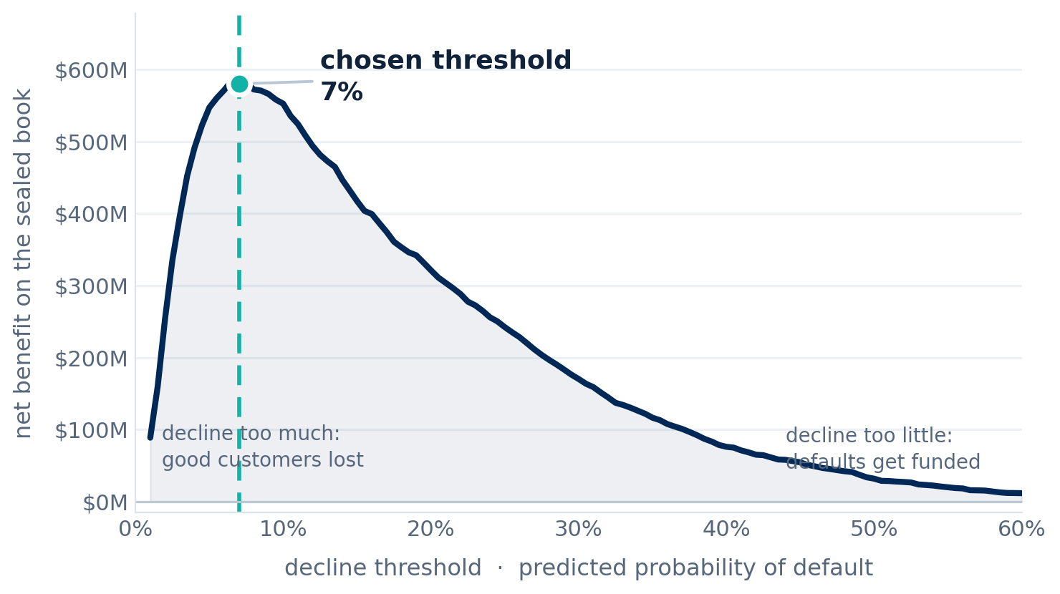
STARK FINANCIAL · CONSUMER LENDING
07
THE DECISION
The 7% cut-off is where a loan stops making money
NET BENEFIT ON THE SEALED TEST BOOK
+$578.7M
versus approving everyone, across 46,127 applications
WHY 7%, AND NOT SOME OTHER NUMBER
A good loan earns 5%. A bad one loses 65%.
5% ÷ (5% + 65%) = 7.1%
Sweeping the real profit curve over 46,127 loans lands on 7%. Two independent routes, the same answer.
63.2%
74.5%
approved at that line
of future defaults stopped
THE POINT
It is a dial. Move it and I can price the move.
Source: Kaustubh Patil analysis for Stark Financial · n = 307,511 applications · sealed test n = 46,127 · August 2026
Notes:
This is the slide that carries the argument. Say the division out loud: five over seventy is seven point one. Then say I found the same number a completely different way. If they push for a higher approval rate, the answer is yes and here is the cost.

Slide 8
STARK FINANCIAL · CONSUMER LENDING
08
EXPLAINABILITY
Every decline arrives with its reasons already attached
WHAT THE APPLICANT RECEIVES
WHERE THOSE REASONS COME FROM
“Your application was declined.
The model returns the score already broken into the factors that built it.
The main reasons were:”
Low external credit score
+2.22
1
Your external credit score is low
Amounts past due elsewhere
+0.48
2
You have amounts past due with other lenders
High utilisation of existing credit
+0.21
3
You are using a high share of your existing credit
Past-due payment history
+0.21
4
Payments elsewhere have been past due
These add up to the score exactly
72.6%
Plain language, no column names. Generated automatically for every decline.
so the four printed on the letter are the four largest pieces of this applicant’s own number, not a guess written afterwards.
WHY THIS MATTERS
Compliance is not written after the decision. It falls out of the same arithmetic that made it, so the stated reason can never drift from the real one.
Source: Kaustubh Patil analysis for Stark Financial · n = 307,511 applications · sealed test n = 46,127 · August 2026
Notes:
The regulator question is not explain the model, it is justify this decision. The bars on the right are that applicant’s actual factor contributions, and the four on the letter are simply the largest of them. Point at the bars, not the paragraph.

Slide 9
STARK FINANCIAL · CONSUMER LENDING
09
RISK REGISTER
Three limitations, each with a named control
RISK
CONTROL
Macroeconomic shift
Everyone gets riskier at once and the model does not see it coming.
Drift tripwire, monthly. Test-fired on a simulated severe recession.
TESTED, NOT PROMISED
No out-of-time validation
The data carries no dates, so the model cannot be tested against another period.
Monthly retraining plus drift monitoring until dated cohorts exist.
COMPENSATING CONTROL
Approved-population bias
JARVIS has only ever seen applicants the old process said yes to.
Thin files route to a human reviewer. Reject inference is first on the roadmap.
HUMAN IN THE LOOP
POSITION
A model whose blind spots are named and instrumented is safer than one that looks flawless.
Source: Kaustubh Patil analysis for Stark Financial · n = 307,511 applications · sealed test n = 46,127 · August 2026
Notes:
Do not rush this. Naming your own limits is what buys credibility for everything else you claimed. The tripwire being test-fired rather than merely documented is the strongest point on the slide.

Slide 10
STARK FINANCIAL · CONSUMER LENDING
10
FAIRNESS AUDIT
The audit failed, and fixing it cost almost nothing
THE DEFECT
THE FIX
Gender was a model input. That is prohibited in credit decisions regardless of how much accuracy it buys.
Retrained the identical model without gender.
0.0005
Male adverse-impact ratio
0.75
Applicants aged 20 to 35
0.62
the entire accuracy cost, in AUROC
Age effects remain and are defensible: they are risk-based, and older applicants are favoured rather than penalised.
Four-fifths screen: anything below 0.80 is flagged.
RECOMMENDATION: DEPLOY THE GENDER-FREE PIPELINE, WITH CONDITIONS
Reason codes on every decline · monthly drift monitoring · quarterly fairness re-audit · a human lane for thin files · monthly champion/challenger retraining
POSITION
I would rather find a defect in my own model than have someone else find it in production.
Source: Kaustubh Patil analysis for Stark Financial · n = 307,511 applications · sealed test n = 46,127 · August 2026
Notes:
Own this. Do not apologise for it. Finding it yourself and pricing the fix at essentially zero is the strongest governance signal in the entire review.

Slide 11
STARK FINANCIAL · CONSUMER LENDING
11
LIVE DEMONSTRATION
JARVIS, scoring an applicant you choose, right now
I am about to open the underwriting desk, type in an applicant, and let the real model decide in front of you.
The decision
The money
The reasons
probability of default, and approve or decline at the 7% line
expected loss against expected margin, for that exact loan
the same four that would appear on the applicant's letter
WHY LIVE
Nothing here is pre-recorded. It is the same model artifact validated in this deck, scoring an applicant chosen in the room.
Fallback: if the demo misbehaves, the decline letter on slide 8 is the same output from the same model, and I will talk you through that instead.
Source: Kaustubh Patil analysis for Stark Financial · n = 307,511 applications · sealed test n = 46,127 · August 2026
Notes:
Have the app open at 127.0.0.1:5000 before you arrive here. Click Thin file. Narrate while it scores. Point at the decision, then the money row, then the reasons. Sixty seconds. Do not troubleshoot live.

Slide 12
STARK FINANCIAL · CONSUMER LENDING
12
HOW IT WORKS
The model decides. The AI only writes it up.
1
2
3
4
You type
the applicant
The trained model
scores it
The arithmetic
explains it
The AI
narrates it
in the browser
probability of default
which factors, and how much
one plain-English paragraph
The AI never makes the decision, and it cannot change one.
It is handed a decision that has already been made, together with the numbers behind it, and asked to turn them into a paragraph. Unplug it and the decision, the money and the four reasons come out identical.
WHY IT IS BUILT THIS WAY
Everything auditable stays deterministic. The only non-deterministic component is the prose.
Source: Kaustubh Patil analysis for Stark Financial · n = 307,511 applications · sealed test n = 46,127 · August 2026
Notes:
This is the slide the risk officer cares about. The language model sits strictly downstream of the decision and is given the numbers as facts. If the network is down the app writes the paragraph itself and nothing else changes.

Slide 13
THE BOTTOM LINE
Deploy JARVIS, gender-free,
with four conditions.
+$578.7M
0.774
7%
0.0005
net benefit on the sealed book
against a 0.757 incumbent
the cut-off, where a loan breaks even
the price of the fairness fix
Kaustubh Patil · Stark Financial, Consumer Lending · Questions welcome
Notes:
Close on the recommendation, not on thanks. Read the four numbers, then stop talking and let the room come to you.

