Slide 1
JARVIS CAPITAL · EQUITY DESK
Can Deep Learning Beat
Our Trading Signal?
Six models · 20 years of S&P 500 data · one $1,000,000 backtest, net of costs
Kaustubh Patil · 20 August 2026
Notes:
Keep this up while people settle. One line if asked: we tested whether deep learning can replace the desk's linear signal, with a sealed four-year test and honest cost accounting. The answer is nuanced and more useful than a simple yes.

Slide 2
THE PROBLEM
The desk's signal is below target — and worse than we thought
0.4
0.6
−0.30
$474K
trailing Sharpe of the incumbent
linear signal (3-year)
the firm's Sharpe target
for deployed strategies
incumbent's 2022–25 Sharpe
net of transaction costs
costs its 159x/yr turnover
burned on $1M in 4 years
The question the CIO asked: can modern deep learning extract more signal from the same market data? The question we also answered: is the signal we already run worth its costs at all?
Notes:
Cost of getting it wrong: a signal below buy-and-hold has negative value - we pay infrastructure and trading costs for nothing. The reveal: once we charged realistic costs, the incumbent isn't just below target, it destroys value. 159x turnover means the linear signal flips positions constantly.

Slide 3
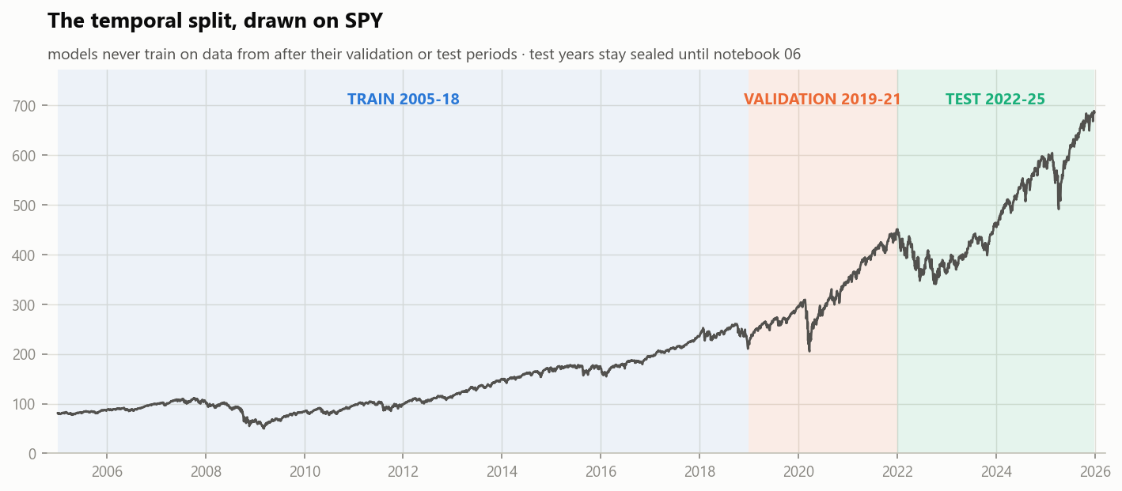
OUR APPROACH
Sealed test years, leak-proof features, one identical backtest
1
2
3
4
20 YEARS OF DATA
17 FEATURES
6 MODELS
ONE BACKTEST
48 S&P 500 stocks, 2005–2025.
VIX + rates as market context.
SPY held out as the benchmark.
Momentum, volatility, oscillators,
trend, volume, macro — hand-built,
proven leak-free by recomputation.
Linear (incumbent), 2 feedforward
nets, LSTM, 1D CNN — plus ResNet-18
reading candlestick chart images.
$1M, long/flat, 10 bps costs,
2022–25 sealed until the end.
Same engine for every signal.
Notes:
Train 2005-2018, tune 2019-2021, test 2022-2025 - strictly temporal, no shuffling across time. The scaler is fit on training years only. Notebook 02 PROVES features are leak-free: recompute them with future data deleted and they are identical. Keep this high level; details are for Q&A.

Slide 4
RESULTS · 1 OF 5
Every model, one scoreboard
Model | Dir. accuracy | Sharpe (gross) | Sharpe (net) | Max DD | Turnover/yr
Linear (incumbent) | 50.4% | 0.37 | −0.30 | −41% | 159x
Feedforward NN (selected) | 51.8% | 0.46 | 0.85 | −21% | 4.3x
LSTM (60-day) | 51.3% | 0.42 | 0.35 | −21% | 43x
1D CNN (60-day) | 49.1% | 0.32 | −0.37 | −39% | 246x
ResNet-18 chart images | 55.1% / 49.2% | AUC 0.52 / 0.49 | — | — | —
Always-long reference | 51.8% | 0.47 | — | — | —
Net of costs is the only column that matters. Three of five daily signals — including the incumbent — lose money at 10 bps. The chart-reading ResNet never beat the majority class. One model cleared the firm's 0.6 target.
Notes:
Why FFNN over LSTM despite similar accuracy? Turnover. The LSTM's 43x/yr costs 0.27 of Sharpe; the CNN's 246x is fatal. MSE separates nothing (all models sit at the predict-zero floor) - expected when predicting near-noise; directional and dollar metrics decide. ResNet: interesting experiment, majority class wins, exploratory only. Fine-tuning overfit instantly: train loss 0.03, val loss 1.5 within 4 epochs.

Slide 5
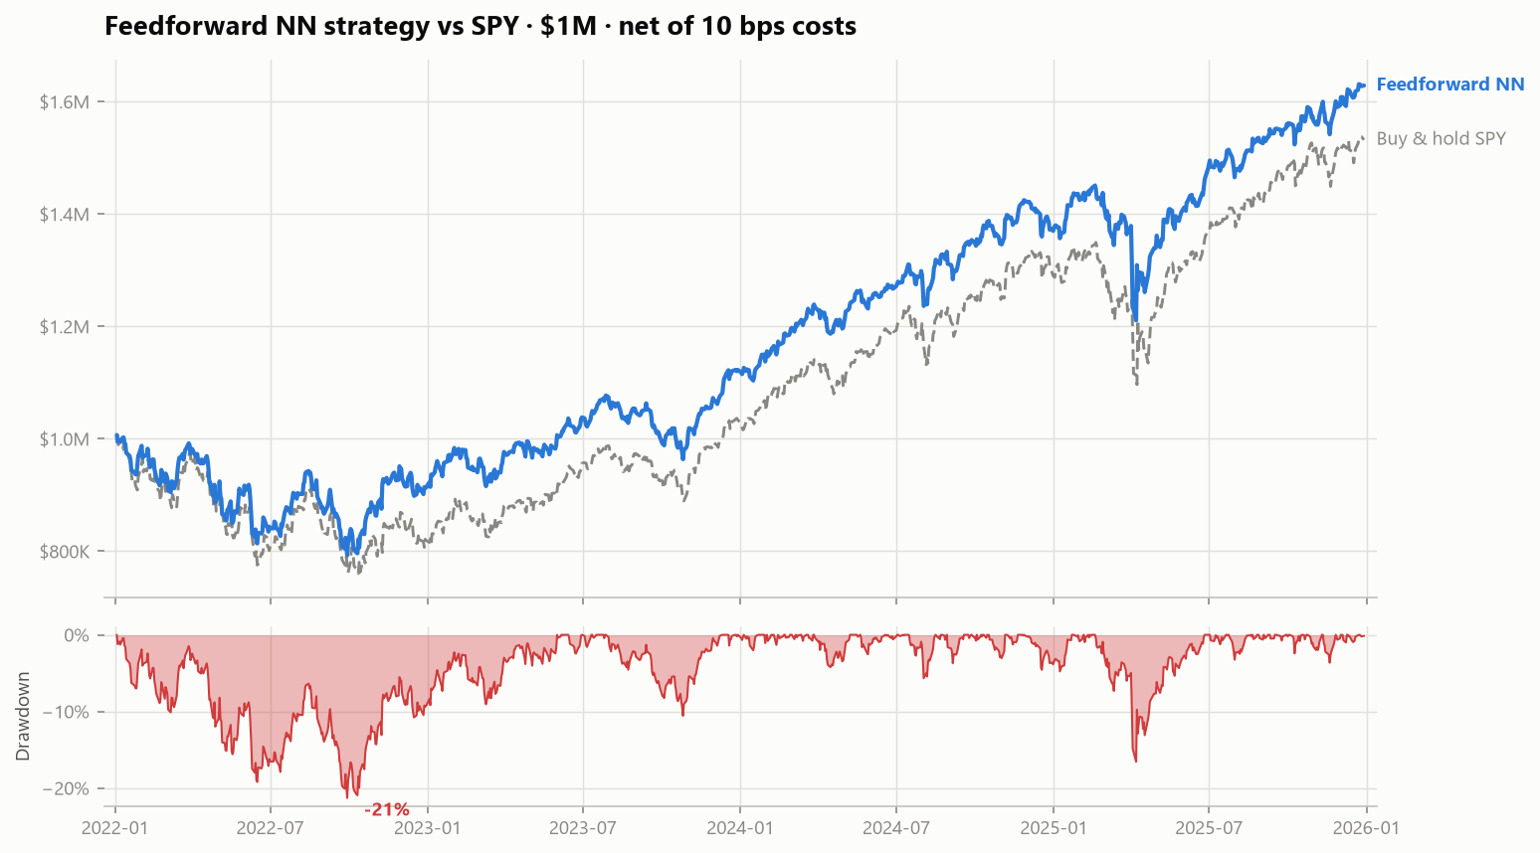
RESULTS · 2 OF 5 — THE HEADLINE
$1,000,000 → $1,627,692 net of costs
+$627,692
net P&L · 4 years
0.85
net Sharpe · target 0.6
+$96,666
vs buy-and-hold SPY
−21.3%
worst drawdown (SPY: −24.5%)
Notes:
THE most important slide - stay on it. Blue = feedforward strategy net of costs; dashed = SPY. It tracks the 2022 bear with slightly less pain, then compounds ahead. Drawdown panel below: worst episode -21.3% Jan-Sep 2022, recovered by Jun 2023. If they remember one number: +$628K on $1M, Sharpe 0.85 vs target 0.6.

Slide 6
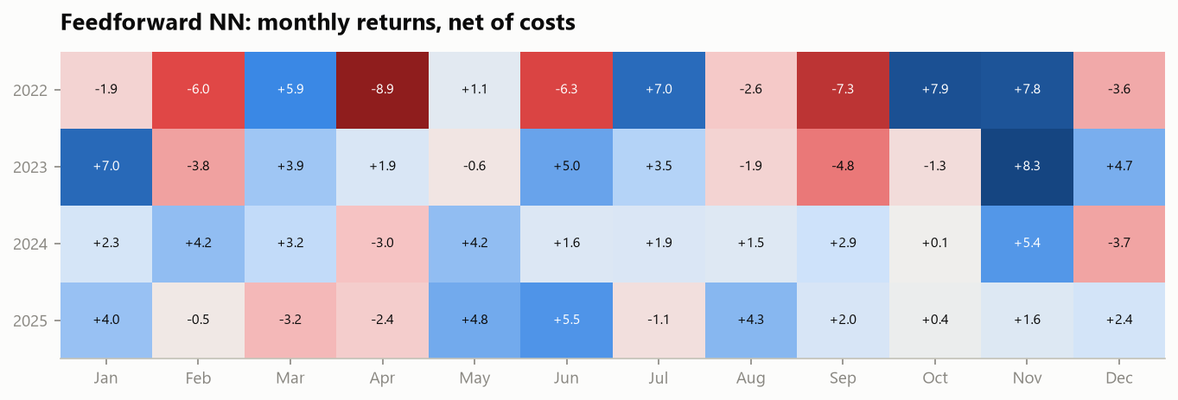
RESULTS · 3 OF 5
Forty-eight months, no smoothing
30 / 48
months positive (63%)
26 / 48
months beating SPY
+8.3%
best month · Nov 2023
−8.9%
2022 (top row) is the stress test: the strategy lost −13% while SPY lost −18%. 2023–2025 compound steadily.
worst month · Apr 2022
Notes:
The Head of Risk reads this row by row. Nothing hidden in averages: April 2022 -8.9% is the worst month, during the rate-shock bear. The pattern - red concentrated in 2022, blue after - matches the market regime, which is exactly the long-bias story on the limitations slide.

Slide 7
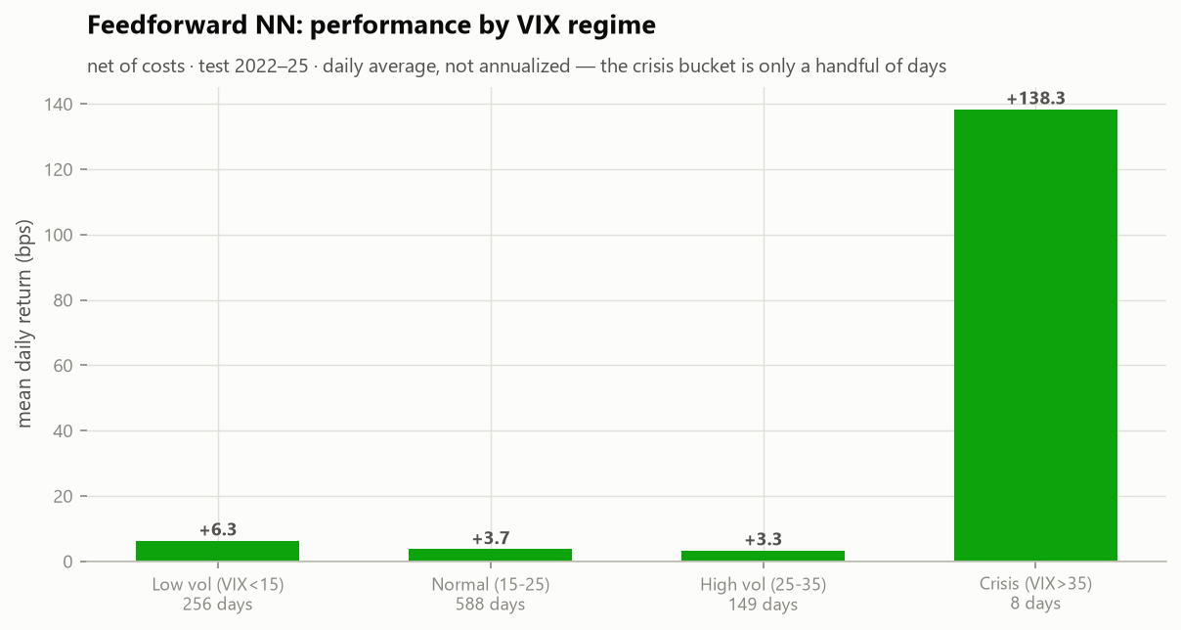
RESULTS · 4 OF 5 — RISK
Where the strategy earns — and where it would bleed
Drawdown episode | Depth | Recovery
Jan → Sep 2022 (rate shock) | −21.3% | 17 months
Feb → Apr 2025 (vol spike) | −16.6% | 4 months
Jul → Oct 2023 (drift) | −10.6% | 4.5 months
Calm-market seeking. +6.3 bps/day when VIX < 15, thinning to +3.3 in stressed markets. The crisis bucket is 8 days — statistically meaningless, honestly labeled. Proposed overlay: cut gross exposure 50% when VIX > 35.
Notes:
Anticipate: 'what happens if the market crashes next week?' Honest answer: the strategy is nearly always long, so it participates in the crash - like 2022, where it lost 21% while the market lost 25%. The VIX>35 circuit breaker is proposed but untested at scale (only 8 crisis days in the test window). That's a reason for the iterate verdict.

Slide 8
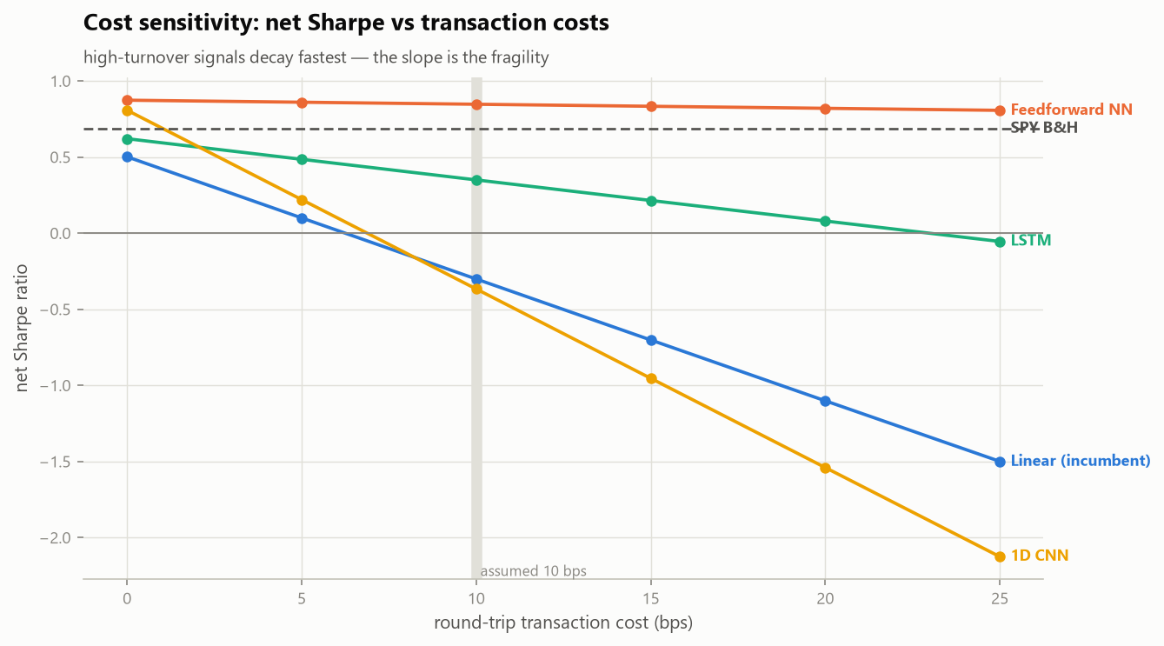
RESULTS · 5 OF 5
Turnover is destiny: the cost-sensitivity test
The flat orange line is the whole argument.
Feedforward NN: 0.87 → 0.81 Sharpe as costs rise 0 → 25 bps (turnover 4.3x/yr).
Incumbent: +0.50 → −1.50 over the same grid. Its edge was never real — it was gross-of-costs accounting.
Double our cost assumption to 20 bps and the conclusion moves by 0.03 Sharpe.
Notes:
Technical committee slide. 'Is 10 bps realistic?' For liquid large-caps at our size, 10 bps round-trip is conservative; but the point of this chart is that the answer doesn't matter for the selected model - the conclusion is invariant from 0 to 25 bps. The high-turnover models' rankings invert completely with costs, which is why gross backtests mislead.

Slide 9
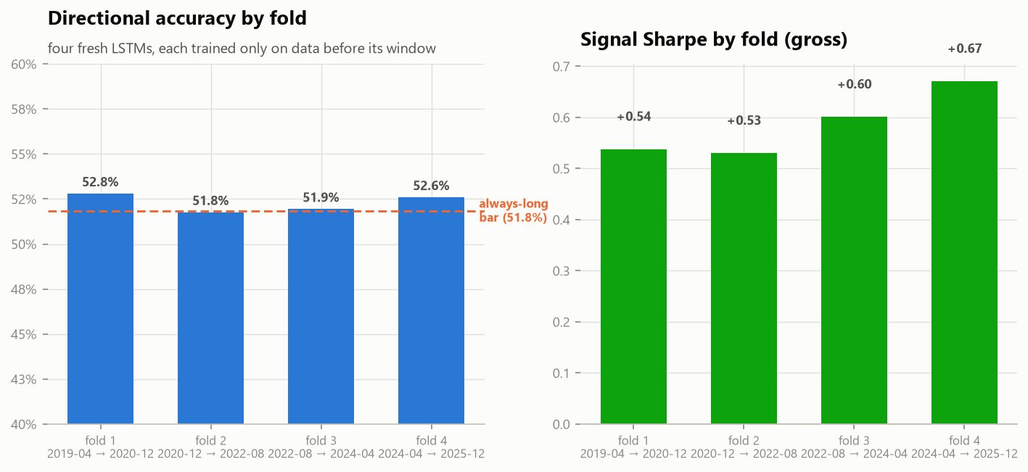
LIMITATIONS
What this model is not — said plainly
It has a learned long bias
It did not beat passive equal-weight
Holds 47.7 of 48 stocks on an average day. A 2022-style bear would be ridden down; crisis behavior is the least-tested regime (8 days).
Universe buy-and-hold scored 0.88 vs our 0.85 — the residual timing has not yet proven standalone alpha.
It sees only prices
Survivorship caveat
No earnings, news, or fundamentals. Structural breaks degrade it silently — hence PSI monitoring and monthly retraining.
Universe drawn from current S&P constituents — flatters all strategies and benchmarks equally; relative results stand.
Notes:
Walk-forward chart at the bottom is the counterweight: four fresh models, four eras, dir-accuracy 52.3% +/- 0.5% and gross Sharpe 0.59 +/- 0.07 - the signal family is stable across regimes, it just hasn't proven it beats passive. 'How do we know it's not overfit?' - early stopping on a separate validation era, sealed test, walk-forward, and the model is 13k parameters, tiny.

Slide 10
RECOMMENDATION
Iterate — with two actions today
1 · RETIRE THE INCUMBENT
The linear signal is value-destroying net of costs (−0.30 Sharpe, −$271K on $1M). Every scenario tested says stop trading it.
2 · DO NOT FUND THE NEW MODEL YET
0.85 net Sharpe beats the target — but not passive equal-weight (0.88), and its long bias is untested in a bear regime.
3 · FOUR-WEEK ITERATION PLAN
Cost-aware training objective · volatility-scaled sizing · FFNN+LSTM ensemble · bear-regime walk-forward on 2008 · then re-present.
An honest iterate, delivered with evidence, protects the desk better than an oversold deploy.
Notes:
'What would you do with 4 more weeks?' - exactly the plan on screen. 'How quickly to production if iteration succeeds?' - the pipeline already persists the scaler, weights, and monitoring thresholds; a nightly batch is ~2 weeks of engineering after sign-off. Close: retiring the incumbent is immediately accretive: it saves ~$118K/yr in trading costs alone.

Slide 11
APPENDIX · Q&A BACKUP
Pre-answered: the questions we expect
'How did you prevent look-ahead bias?'
'Is performance stable across folds?'
Features proven identical when future data is deleted (nb 02) · temporal splits · scaler fit on train only · costs charged on every position change.
Walk-forward: dir-acc 52.3% ± 0.5%, gross Sharpe 0.59 ± 0.07 over four fresh retrains spanning 2019–2025.
'What is the retraining cadence?'
'Why not the chart-image model?'
Monthly champion/challenger; PSI > 0.2 on any feature triggers revalidation; 63-day dir-acc < 50% alerts; −15% drawdown escalates.
ResNet-18 never beat the majority class: AUC 0.52 frozen, 0.49 fine-tuned — even ignoring the cutoff, it cannot rank charts by what happens next. Grad-CAM shows it attends to sensible regions, but 5-day drift dominates chart geometry. Most expensive signal per unit of accuracy — exploratory only.
'Dollar value of retiring the incumbent?'
'Is the model correlated with existing books?'
It lost $271K over 4 years while paying $474K in costs — stopping it is worth ~$118K/yr in costs alone before any alpha.
It is ~99% long the same large-cap universe — assume high correlation with any long equity book; it diversifies timing, not exposure.
Notes:
Do not present this slide - it exists so no committee question finds us unprepared. Additional backup lives in the notebooks: Grad-CAM overlays (nb 05), CNN filter visualizations (nb 04), IC analysis (nb 02).

