Slide 1
Sorting Algorithms

Slide 2
Sorting
Sorting is a process that organizes a collection of data into either ascending or descending order.
An internal sort requires that the collection of data fit entirely in the computer’s main memory.
We can use an external sort when the collection of data cannot fit in the computer’s main memory all at once but must reside in secondary storage such as on a disk.
We will analyze only internal sorting algorithms.
Any significant amount of computer output is generally arranged in some sorted order so that it can be interpreted.
Sorting also has indirect uses. An initial sort of the data can significantly enhance the performance of an algorithm.
Majority of programming projects use a sort somewhere, and in many cases, the sorting cost determines the running time.
A comparison-based sorting algorithm makes ordering decisions only on the basis of comparisons.

Slide 3
Sorting Algorithms
There are many sorting algorithms, such as:
  Selection Sort
  Insertion Sort
  Bubble Sort
  Merge Sort
  Quick Sort
The first three are the foundations for faster and more efficient algorithms.

Slide 4
Selection Sort
The list is divided into two sublists, sorted and unsorted, which are divided by an imaginary wall.
We find the smallest element from the unsorted sublist and swap it with the element at the beginning of the unsorted data.
After each selection and swapping, the imaginary wall between the two sublists move one element ahead, increasing the number of sorted elements and decreasing the number of unsorted ones.
Each time we move one element from the unsorted sublist to the sorted sublist, we say that we have completed a sort pass.
A list of n elements requires n-1 passes to completely rearrange the data.

Slide 5
Sorted
Unsorted
23 | 78 | 45 | 8 | 32 | 56
8 | 78 | 45 | 23 | 32 | 56
8 | 23 | 45 | 78 | 32 | 56
8 | 23 | 32 | 78 | 45 | 56
8 | 23 | 32 | 45 | 78 | 56
8 | 23 | 32 | 45 | 56 | 78
Original List
After pass 1
After pass 2
After pass 3
After pass 4
After pass 5

Slide 6
Insertion Sort
Insertion sort is a simple sorting algorithm that is appropriate for small inputs.
  Most common sorting technique used by card players.
The list is divided into two parts: sorted and unsorted.
In each pass, the first element of the unsorted part is picked up, transferred to the sorted sublist, and inserted at the appropriate place.
A list of n elements will take at most n-1 passes to sort the data.

Slide 7
Sorted
Unsorted
23 | 78 | 45 | 8 | 32 | 56
23 | 78 | 45 | 8 | 32 | 56
23 | 45 | 78 | 8 | 32 | 56
8 | 23 | 45 | 78 | 32 | 56
8 | 23 | 32 | 45 | 78 | 56
8 | 23 | 32 | 45 | 56 | 78
Original List
After pass 1
After pass 2
After pass 3
After pass 4
After pass 5

Slide 8
Bubble Sort
The list is divided into two sublists: sorted and unsorted.
The smallest element is bubbled from the unsorted list and moved to the sorted sublist.
After that, the wall moves one element ahead, increasing the number of sorted elements and decreasing the number of unsorted ones.
Each time an element moves from the unsorted part to the sorted part one sort pass is completed.
Given a list of n elements, bubble sort requires up to n-1 passes to sort the data.

Slide 9
Bubble Sort
23 | 78 | 45 | 8 | 32 | 56
8 | 23 | 78 | 45 | 32 | 56
8 | 23 | 32 | 78 | 45 | 56
8 | 23 | 32 | 45 | 78 | 56
8 | 23 | 32 | 45 | 56 | 78
Original List
After pass 1
After pass 2
After pass 3
After pass 4

Slide 10
Mergesort
Mergesort algorithm is one of two important divide-and-conquer sorting algorithms (the other one is quicksort).
It is a recursive algorithm.
  Divides the list into halves,
  Sort each halve separately, and
  Then merge the sorted halves into one sorted array.

Slide 11
Mergesort - Example
6 | 3 | 9 | 1 | 5 | 4 | 7 | 2
divide
6 | 3 | 9 | 1
5 | 4 | 7 | 2
divide
divide
6 | 3
9 | 1
5 | 4
7 | 2
divide
divide
divide
divide
6
3
9
1
5
4
7
2
merge
merge
merge
merge
3 | 6
1 | 9
4 | 5
2 | 7
merge
merge
1 | 3 | 6 | 9
2 | 4 | 5 | 7
merge
1 | 2 | 3 | 4 | 5 | 7 | 8 | 9
CENG 213 Data Structures

Slide 12
Quicksort
Like mergesort, Quicksort is also based on
the divide-and-conquer paradigm.
But it uses this technique in a somewhat opposite manner,
as all the hard work is done before the recursive calls.
It works as follows:
  First, it partitions an array into two parts,
  Then, it sorts the parts independently,
  Finally, it combines the sorted subsequences by
  a simple concatenation.

Slide 13
Quicksort (cont.)
The quick-sort algorithm consists of the following three steps:
1. Divide: Partition the list.
  To partition the list, we first choose some element from the list for which we hope about half the elements will come before and half after. Call this element the pivot.
  Then we partition the elements so that all those with values less than the pivot come in one sublist and all those with greater values come in another.
2. Recursion: Recursively sort the sublists separately.
3. Conquer: Put the sorted sublists together.

Slide 14
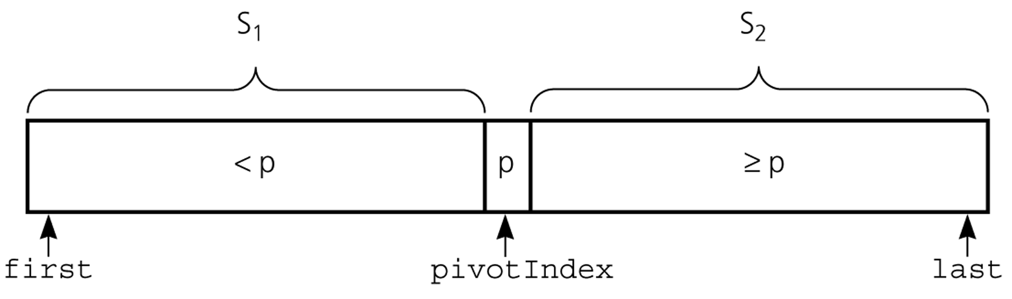
Partition
Partitioning places the pivot in its correct place position within the array.
Arranging the array elements around the pivot p generates two smaller sorting problems.
  sort the left section of the array, and sort the right section of the array.
  when these two smaller sorting problems are solved recursively, our bigger sorting problem is solved.
CENG 213 Data Structures

Slide 15
Partition – Choosing the pivot
First, we have to select a pivot element among the elements of the given array, and we put this pivot into the first location of the array before partitioning.
Which array item should be selected as pivot?
  Somehow we have to select a pivot, and we hope that we will get a good partitioning.
  If the items in the array arranged randomly, we choose a pivot randomly.
  We can choose the first or last element as a pivot (it may not give a good partitioning).
  We can use different techniques to select the pivot.

Slide 16
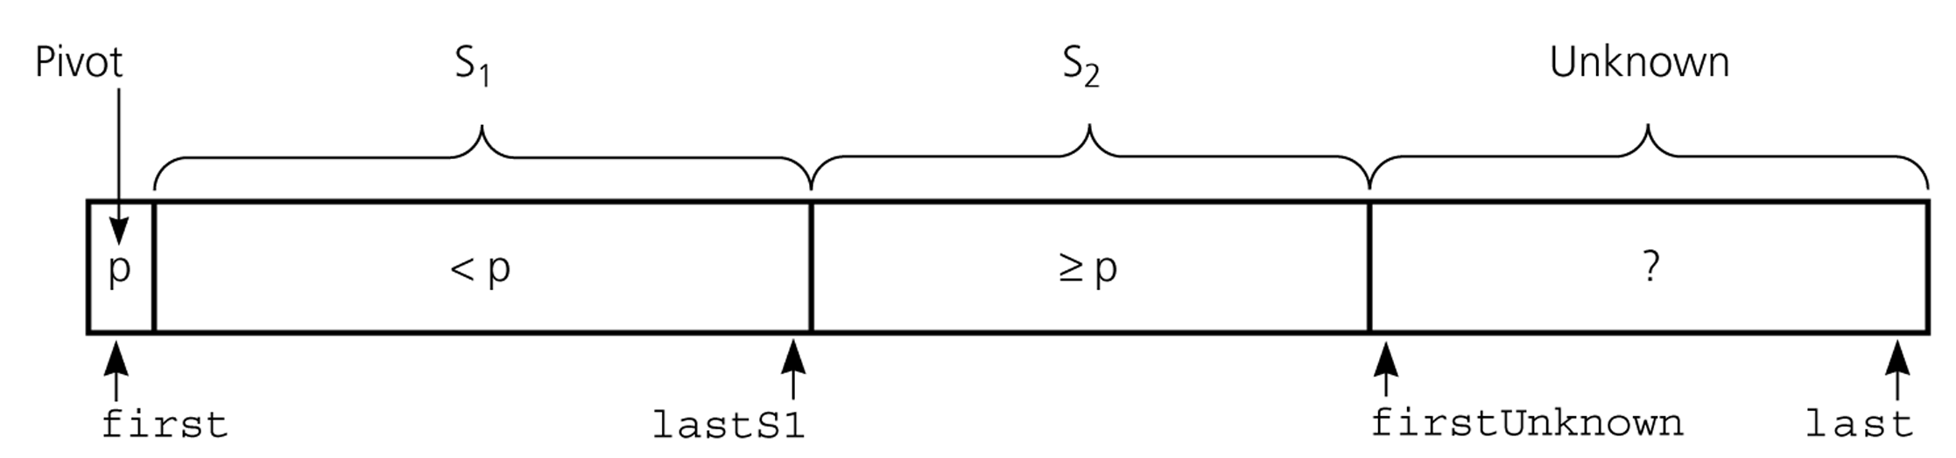
Partition Function (cont.)
Invariant for the partition algorithm

Slide 17
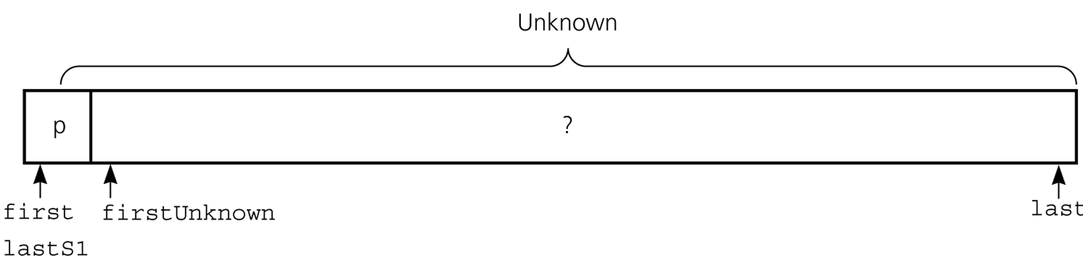
Partition Function (cont.)
Initial state of the array

Slide 18
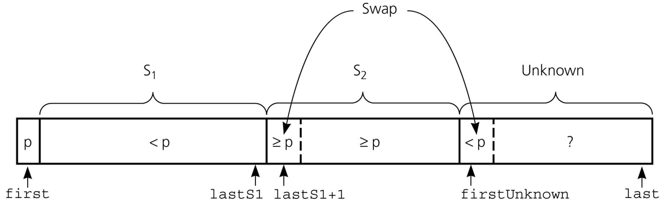
Partition Function (cont.)
Moving theArray[firstUnknown] into S₁ by swapping it with
theArray[lastS1+1] and by incrementing both lastS1 and firstUnknown.

Slide 19
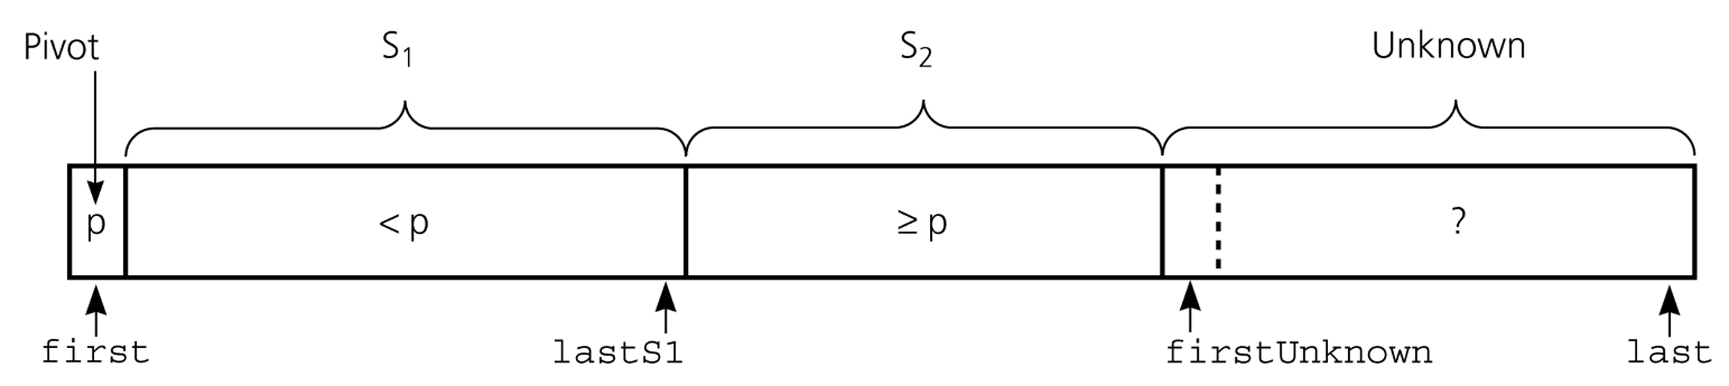
Partition Function (cont.)
Moving theArray[firstUnknown] into S₂ by incrementing firstUnknown.

Slide 20
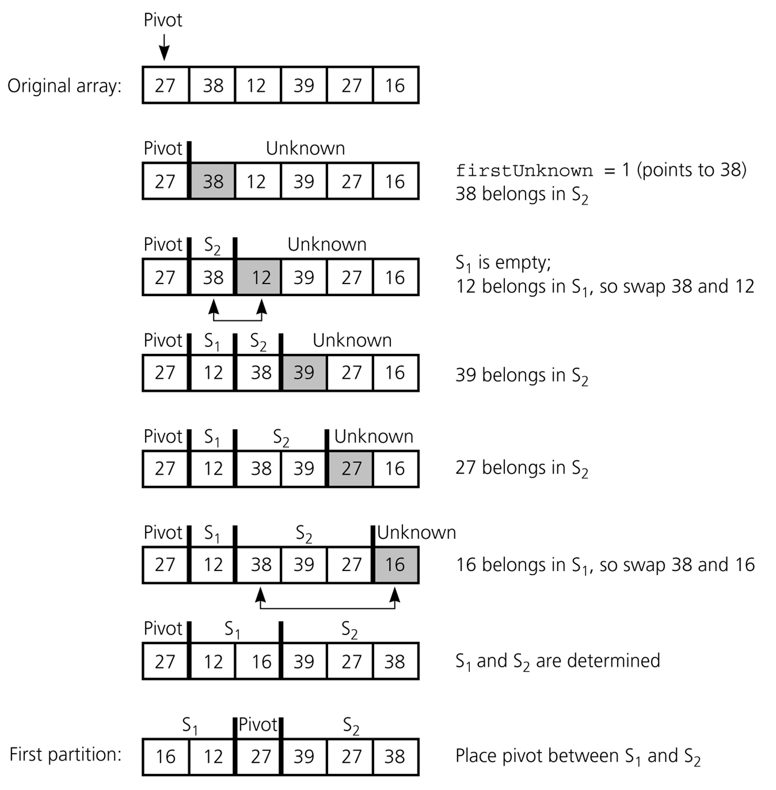
Partition Function (cont.)
Developing the first
partition of an array
when the pivot is the
first item

Slide 21
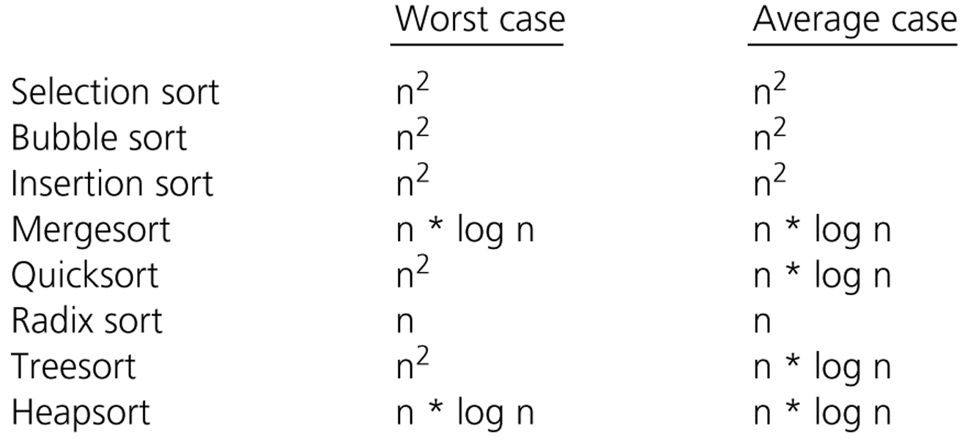
Comparison of Sorting Algorithms

Slide 22
Thank you

