Slide 1
NOVA
Excellence Redefined Daily

Slide 2
Introduction
1.1 Project Overview
NOVA is a comprehensive mock university website developed as a demonstration of contemporary web development practices, responsive design methodologies, and user-centered interface design principles. The project encompasses the complete development lifecycle, from requirements analysis and system design through implementation, usability testing, and evaluation.
The NOVA platform integrates multiple functional modules including student admission portal, course directory, faculty information system, event management, and institutional news within a cohesive, accessible, and responsive interface suitable for diverse user demographics and device types.
1.2 Problem Statement
Many existing university websites suffer from poor information architecture, inconsistent user experience across devices, accessibility issues, and outdated design paradigms. These deficiencies create barriers for prospective students, current students, faculty, and other stakeholders attempting to navigate institutional information. There is a demonstrable need for a modern university website that prioritizes user experience, incorporates accessibility standards, and employs responsive design principles to serve an increasingly mobile-first user base.

Slide 3
Project Objectives
To design a visually engaging, emotionally resonant, and user-friendly graphical user interface for an academic web platform, incorporating fundamental design principles such as alignment, contrast, spacing, typography hierarchy, and visual consistency across all pages and components.
To develop and integrate a functional backend infrastructure that supports dynamic data handling, form submissions, and content management - enabling the platform to operate beyond a static front-end system and simulate the behavior of a production-grade institutional website.
To iteratively evaluate and refine the user interface and experience following backend integration, in accordance with the Agile Software Development Life Cycle — ensuring that each development sprint produces measurable improvements in usability, performance, and design coherence.

Slide 4
Scope of the Project
This project encompasses:
1. Frontend Development: HTML5, CSS3, and JavaScript .
2. Functional Modules: Student admission portal, course catalogue, faculty directory, event management, news system.
3. Accessibility Features: WCAG 2.1 Level AA compliance.
4. Usability Evaluation: User testing with feedback collection and analysis

Slide 5
Methodology
Nova was developed following a GUI-first methodology - a deliberate inversion of the typical development sequence in which backend logic precedes visual design. In this project, all implementation decisions were anchored by interface and experience goals established at the outset, ensuring that technical execution consistently served design intent.

Slide 6
Agile SDLC Approach
The project adopted an Agile-inspired development model. Each phase produced a discrete, reviewable deliverable rather than deferring all evaluation to the end. This allowed design and implementation decisions to be validated incrementally, with findings from one phase informing the next. Peer feedback and self-review checkpoints were embedded throughout to catch usability and consistency issues early.

Slide 7
Phase 1 — GUI Design and Wire-framing
The project began with a structured design phase before a single line of code was written. Primary user flows were identified - browsing academic programs, navigating the admissions process, exploring campus life, and submitting the application form and layout wireframes were sketched. this phase: the deep forest-green and warm gold color palette, the pairing of a serif display typeface with a geometric sans-serif for body text, and the recurring page template (hero banner → ticker bar → content sections → CTA banner → footer) were all established before implementation began. A CSS custom property sheet was drafted to encode all color tokens globally, ensuring the design system would remain consistent across the entire site.

Slide 8
Phase 2 — Core HTML/CSS Implementation
With the visual system defined, structural implementation began using semantic HTML5. Every page was built using appropriate semantic elements — <header>, <nav>, <main>, <section>, <article>, and <footer> — to ensure logical document structure and support for assistive technologies. CSS3 Flexbox and Grid were used throughout to construct responsive layouts, with each component designed to reflow gracefully from desktop to tablet to mobile viewports. The shared navbar and footer HTML was replicated identically across all 17 pages to enforce structural consistency, and the global CSS variable sheet defined in Phase 1 was applied site-wide so that color and spacing changes could propagate instantly. Key pages completed in this phase included the Home page, About Us, Admission portal, Academic Calendar, and all four Program detail pages.

Slide 9
Phase 3 — JavaScript Interactivity
Once the static structure was in place, vanilla JavaScript was layered in to introduce client-side interactivity without introducing any external dependencies. The key components implemented in this phase were: a hamburger toggle for the mobile navigation menu; dropdown hover menus on the desktop navbar; an Intersection Observer-driven animated counter that counts up enrollment, faculty, alumni, and employment statistics when the relevant section scrolls into view; a horizontally scrolling marquee/ticker bar used as a visual separator across multiple pages; client-side form validation on both the Contact page form and the five-step Apply Now application form; and dynamic step-progression logic for the multi-step application flow, including visual state management for completed, active, and upcoming steps. All JavaScript was written in vanilla ES6+ and encapsulated to prevent scope conflicts between pages.

Slide 10
Phase 4 — Testing, Validation, and Deployment
The final phase focused on cross-device testing, accessibility validation, and live deployment. The site was tested across Chrome, Firefox, Safari, and Edge on desktop, and on mobile viewports via browser DevTools and physical devices. Each page was manually reviewed for layout breakpoints, navigation behavior, and interactive component reliability at varying screen widths. Accessibility compliance was checked against WCAG 2.1 guidelines, with particular attention to color contrast ratios between the dark navy backgrounds and body text, semantic label associations on form fields, and logical focus order for keyboard navigation. The completed site was deployed to GitHub Pages, providing a publicly accessible live URL (gargee1989.github.io/Nova/) with no build tools or server configuration required.

Slide 11
Tech Stack
1. HTML5 provided the semantic document structure for all 17 pages. Semantic elements were used throughout to convey meaningful page structure to both browsers and assistive technologies, and to maintain a logical content hierarchy independent of visual styling. 2. CSS3 handles all visual styling, layout, and animation. Flexbox was used for one-dimensional alignment tasks such as navbar items, card rows, and footer columns, while CSS Grid was applied for two-dimensional layouts including the programs grid, alumni card matrix, and department contact grid. CSS custom properties (variables) define the full color palette globally, enabling site-wide visual consistency and making design iteration efficient. Keyframe animations and CSS transitions provide hover state feedback and smooth visual interactions without JavaScript. 3. JavaScript was used exclusively for client-side interactivity. DOM manipulation powered the mobile navigation toggle and dropdown menus; the Intersection Observer API drove the scroll-triggered animated counters; form validation logic provided real-time user feedback on the Apply Now and Contact forms; and dynamic rendering managed the five-step application stepper’s progress state. No server-side logic, build tooling, or package management was used at any point in the project. 4. GitHub Pages served as the deployment platform. The static nature of the project made GitHub Pages an ideal host - no build pipeline, no server configuration, and free public hosting directly from the project repository.

Slide 12
Results
The developed academic web platform successfully achieved the intended design objectives by delivering a visually engaging, emotionally appealing, and user-friendly graphical user interface. The entire frontend was built using HTML, CSS, and vanilla JavaScript without relying on any external frameworks, demonstrating a strong understanding of core web technologies. Throughout the development process, fundamental design principles such as alignment, contrast, spacing, typography hierarchy, and visual consistency were carefully applied across all pages and interface components. As a result, the platform provides a clean and organized layout, intuitive navigation, responsive user interactions, and a cohesive visual identity. These design choices contribute to improved usability, accessibility and overall user satisfaction, making the platform both functional and aesthetically appealing for its intended academic audience.

Slide 13
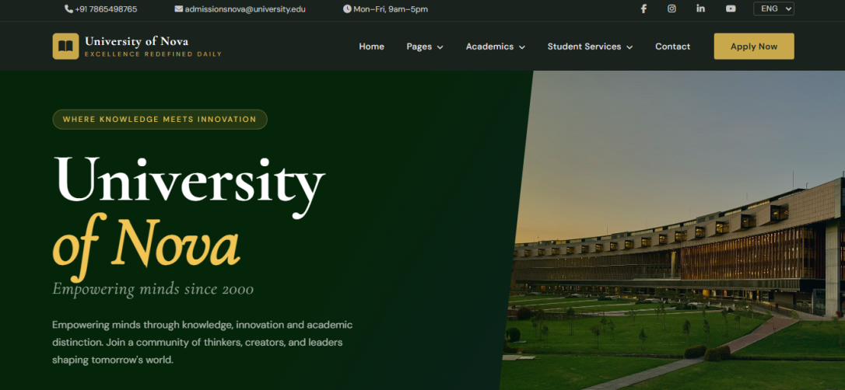
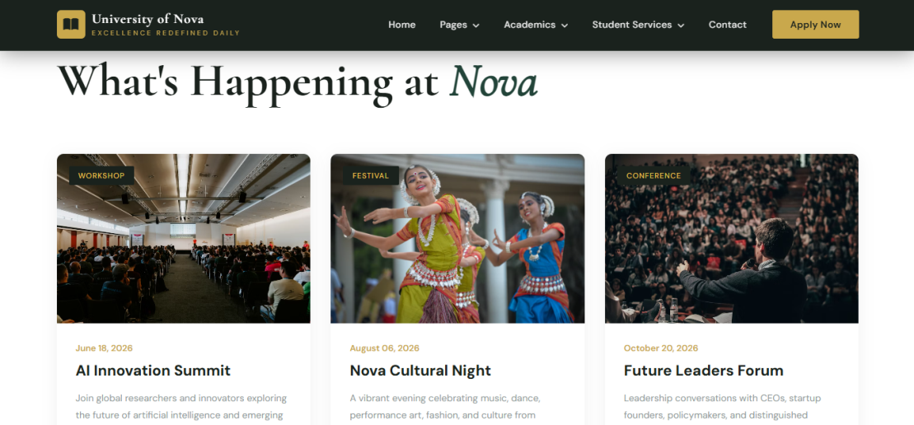
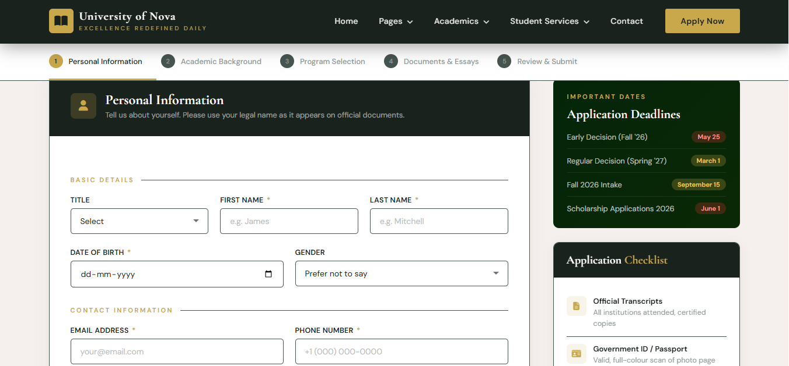
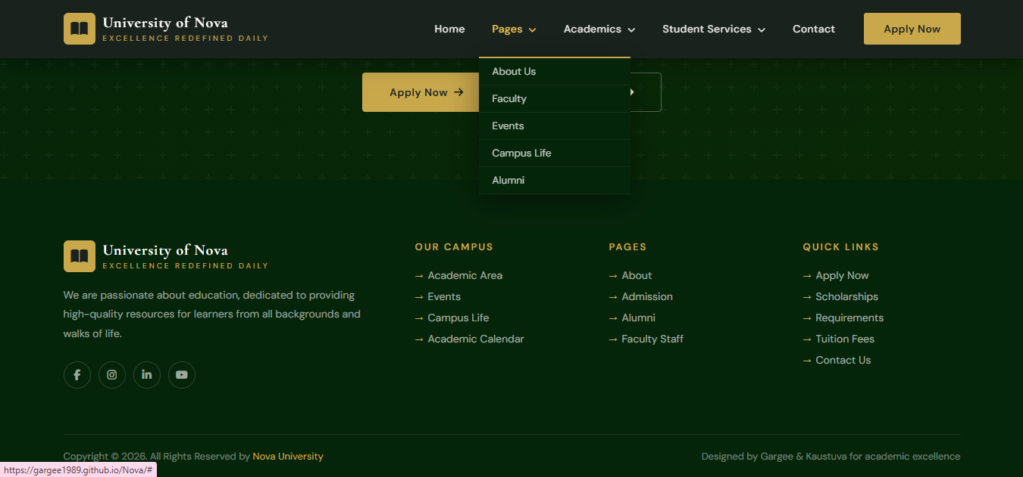
Visit: (gargee1989.github.io/Nova/)

Slide 14
Future Scope
1. Backend Integration.
2. User Authentication & Portal System.
3. Database-Driven Content.
4. Search Functionality.
5. Progressive Web Application (PWA) Conversion.
6. API Integrations.

Slide 15
Thank you!

