Slide 1
Unit-3A Differential Equations of First Order 2130002 – Advanced Engineering Mathematics

Slide 2
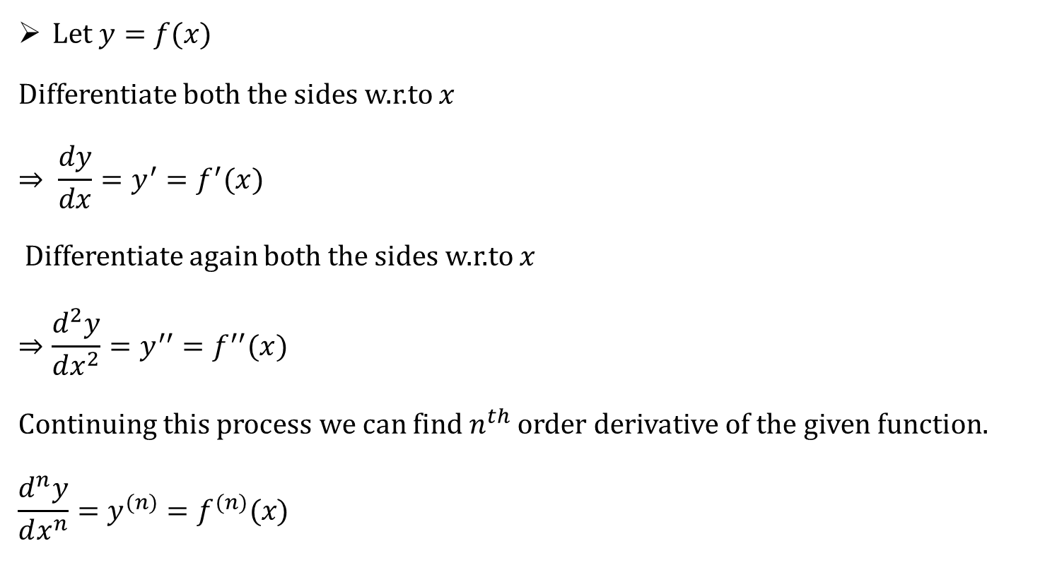
Introduction
Let $y=f(x)$
Differentiate both the sides w.r.to $x$
$$⇒ {\frac{dy}{dx}=y}^{′}=f^{′}(x)$$
Differentiate again both the sides w.r.to $x$
$$⇒{\frac{d^{2}y}{dx^{2}}=y}^{′′}=f^{′′}(x)$$
Continuing this process we can find $n^{th}$ order derivative of the given function.
$${\frac{d^{n}y}{dx^{n}}=y}^{(n)}=f^{(n)}(x)$$

Slide 3
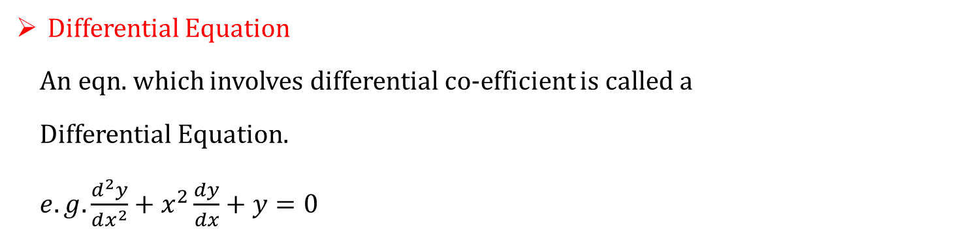
Definitions
Differential Equation
An eqn. which involves differential co-efficient is called a
Differential Equation.
$e.g. \frac{d^{2}y}{dx^{2}}+x^{2}\frac{dy}{dx}+y=0$
Types of Differential Equations
Ordinary Differential Equation
Partial Differential Equation

Slide 4
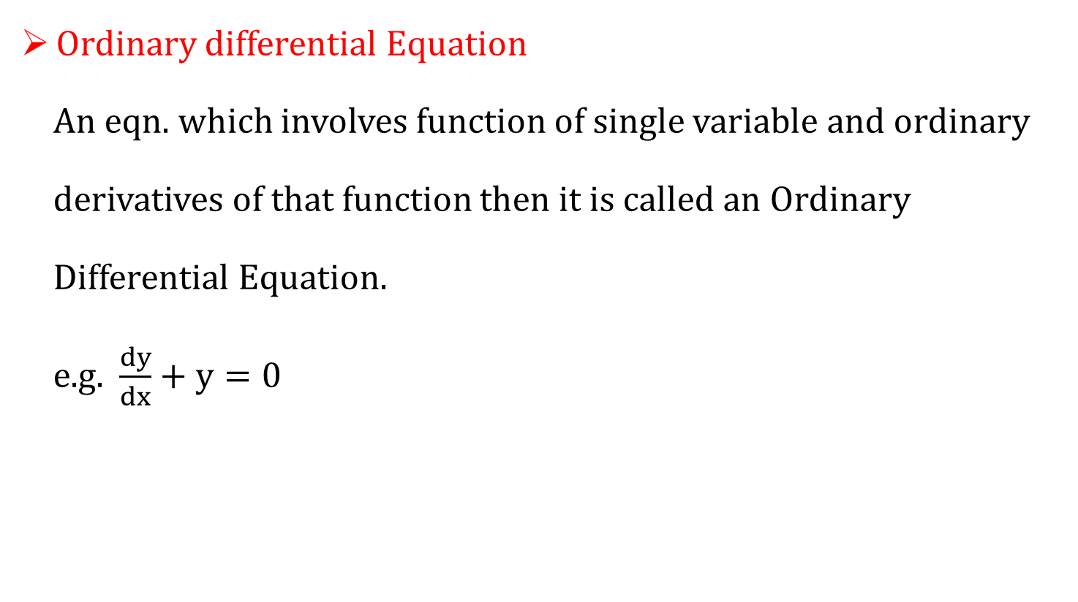
Types of Differential Equations
Ordinary differential Equation
An eqn. which involves function of single variable and ordinary
derivatives of that function then it is called an Ordinary
Differential Equation.
e.g. $\frac{dy}{dx}+y=0$

Slide 5
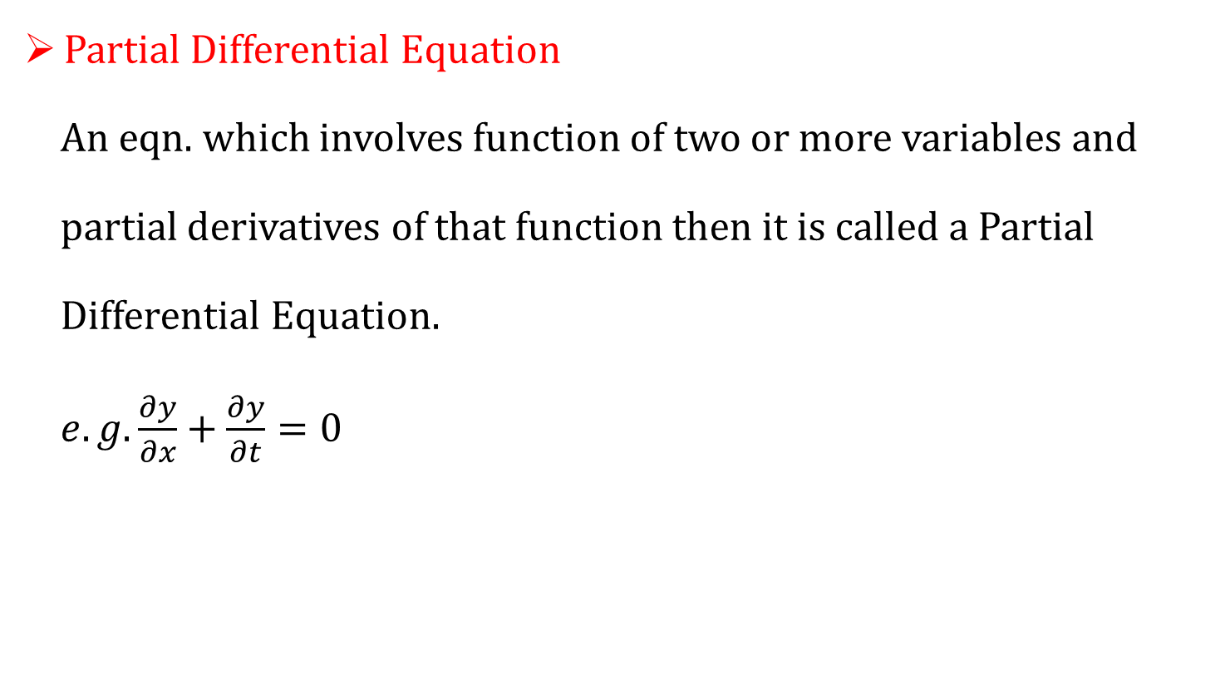
Types of Differential Equations
Partial Differential Equation
An eqn. which involves function of two or more variables and
partial derivatives of that function then it is called a Partial
Differential Equation.
$e.g. \frac{∂y}{∂x}+\frac{∂y}{∂t}=0$

Slide 6

Order of DE
Order of DE
The order of highest derivative which appeared in a differential
equation is “Order of D.E”.
$e.g. {\left(\frac{dy}{dx}\right)}^{2}+\frac{dy}{dx}+5y=0$ has order 1.

Slide 7
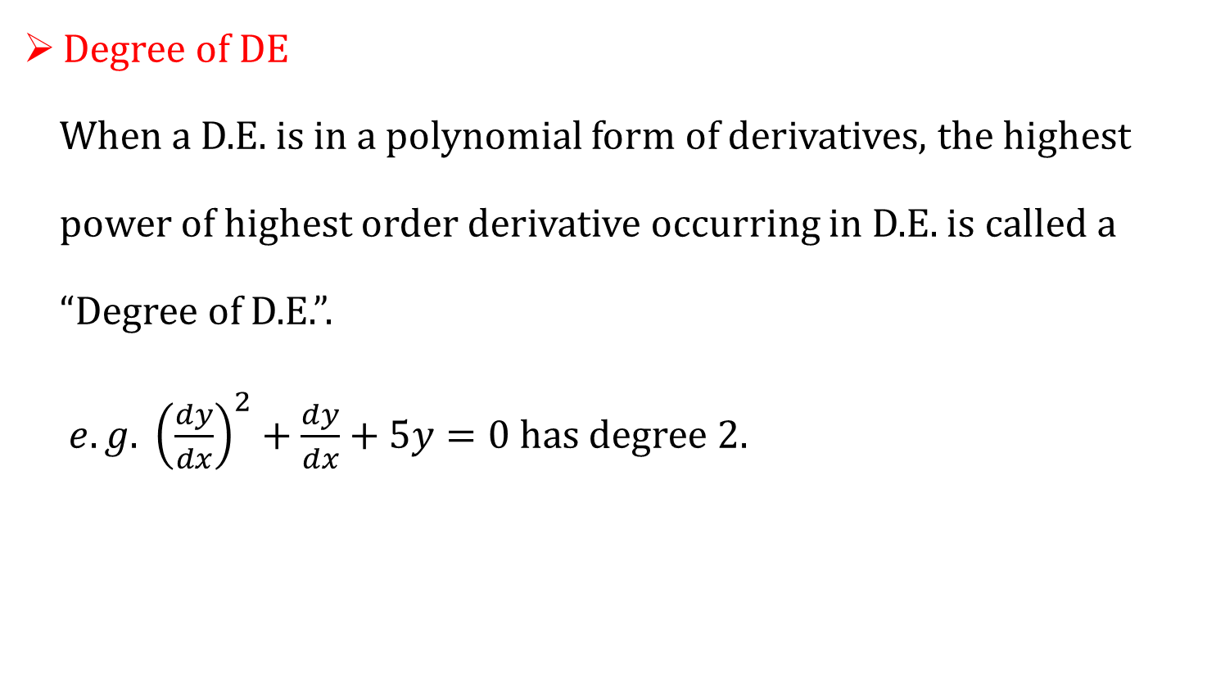
Degree of DE
Degree of DE
When a D.E. is in a polynomial form of derivatives, the highest
power of highest order derivative occurring in D.E. is called a
“Degree of D.E.”.
$e.g. {\left(\frac{dy}{dx}\right)}^{2}+\frac{dy}{dx}+5y=0$ has degree 2.

Slide 8
M-1 Examples on Order and Degree

Slide 9
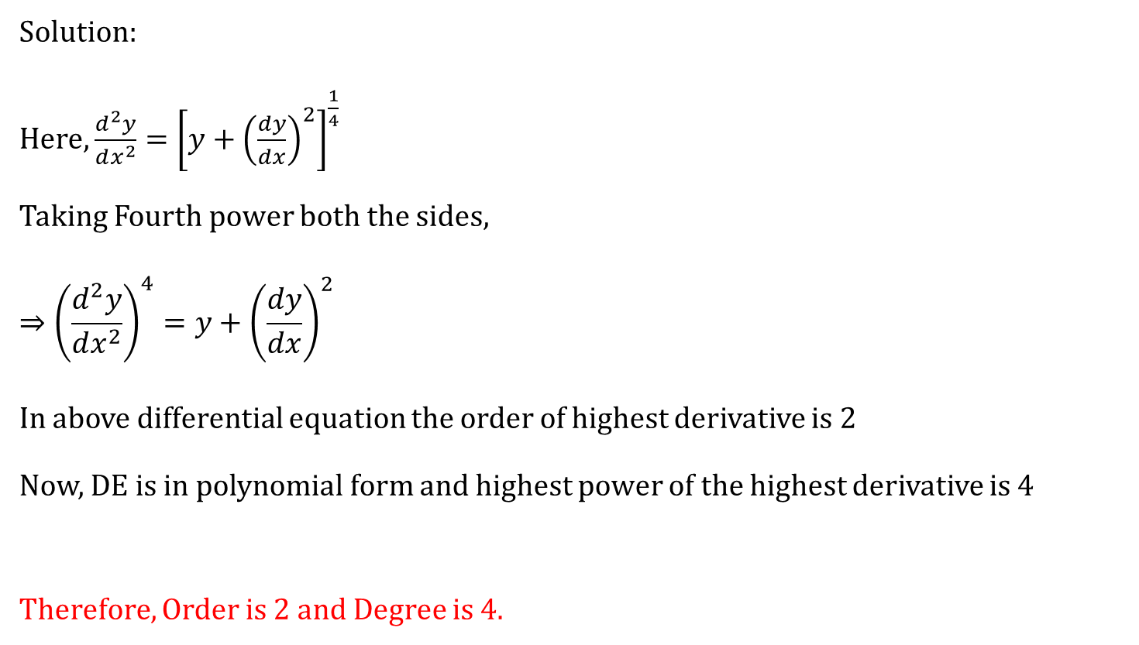
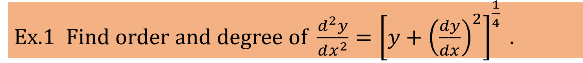
Ex.1 Find order and degree of $\frac{d^{2}y}{dx^{2}}={\left[y+{\left(\frac{dy}{dx}\right)}^{2}\right]}^{\frac{1}{4}} .$
Solution:
Here, $\frac{d^{2}y}{dx^{2}}={\left[y+{\left(\frac{dy}{dx}\right)}^{2}\right]}^{\frac{1}{4}}$
Taking Fourth power both the sides,
$$⇒{\left(\frac{d^{2}y}{dx^{2}}\right)}^{4}=y+{\left(\frac{dy}{dx}\right)}^{2}$$
In above differential equation the order of highest derivative is $2$
Now, DE is in polynomial form and highest power of the highest derivative is 4
Therefore, Order is 2 and Degree is 4.

Slide 10
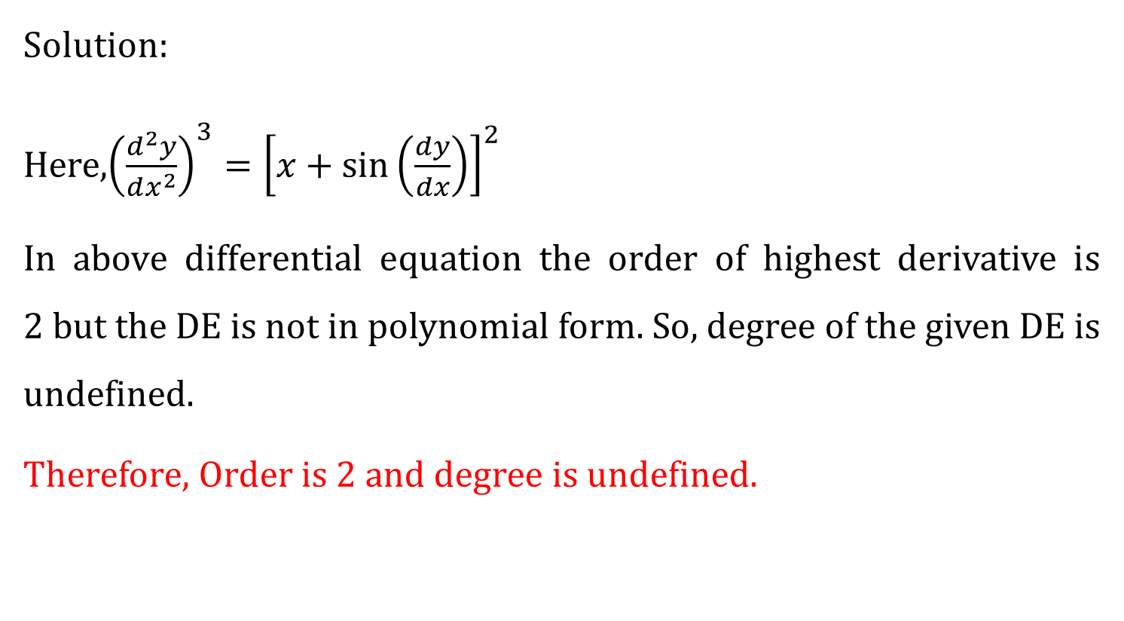
$$Ex 3 Find order and degree of {\left(\frac{d^{2}y}{dx^{2}}\right)}^{3}={\left[x+\sin\left(\frac{dy}{dx}\right)\right]}^{2}.$$
Solution:
Here,${\left(\frac{d^{2}y}{dx^{2}}\right)}^{3}={\left[x+\sin\left(\frac{dy}{dx}\right)\right]}^{2}$
In above differential equation the order of highest derivative is $2$but the DE is not in polynomial form. So, degree of the given DE is undefined.
Therefore, Order is 2 and degree is undefined.

Slide 11
Types of solution
General solution
A solution of a differential equation in which the number of
arbitrary constants is equal to the order of the differential
equation, is called the General solution or complete integral or
complete primitive.
Particular solution
The solution obtained from the general solution by giving a particular
value to the arbitrary constants is called a particular solution.

Slide 12
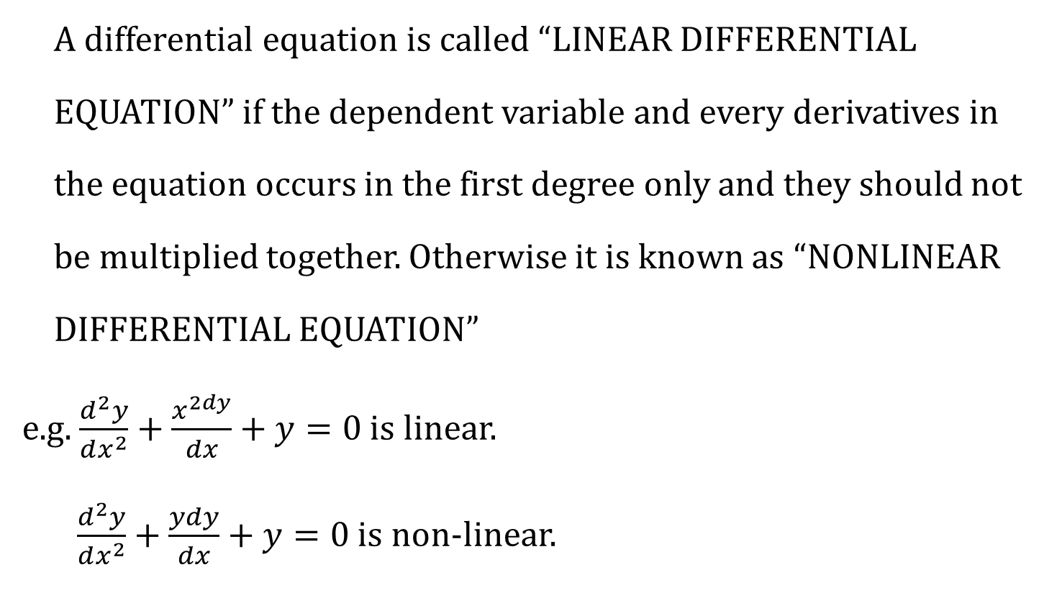
Linear and Nonlinear DE
A differential equation is called “LINEAR DIFFERENTIAL
EQUATION” if the dependent variable and every derivatives in
the equation occurs in the first degree only and they should not
be multiplied together. Otherwise it is known as “NONLINEAR
DIFFERENTIAL EQUATION”
e.g. $\frac{d^{2}y}{dx^{2}}+\frac{x^{2dy}}{dx}+y=0$ is linear.
$\frac{d^{2}y}{dx^{2}}+\frac{ydy}{dx}+y=0$ is non-linear.

Slide 13
Types of First Order and First Degree DE
Variable Separable Equation
Homogeneous Differential Equation
Linear(Leibnitz’s) Differential Equation
Bernoulli’s Equation
Exact Differential Equation

Slide 14
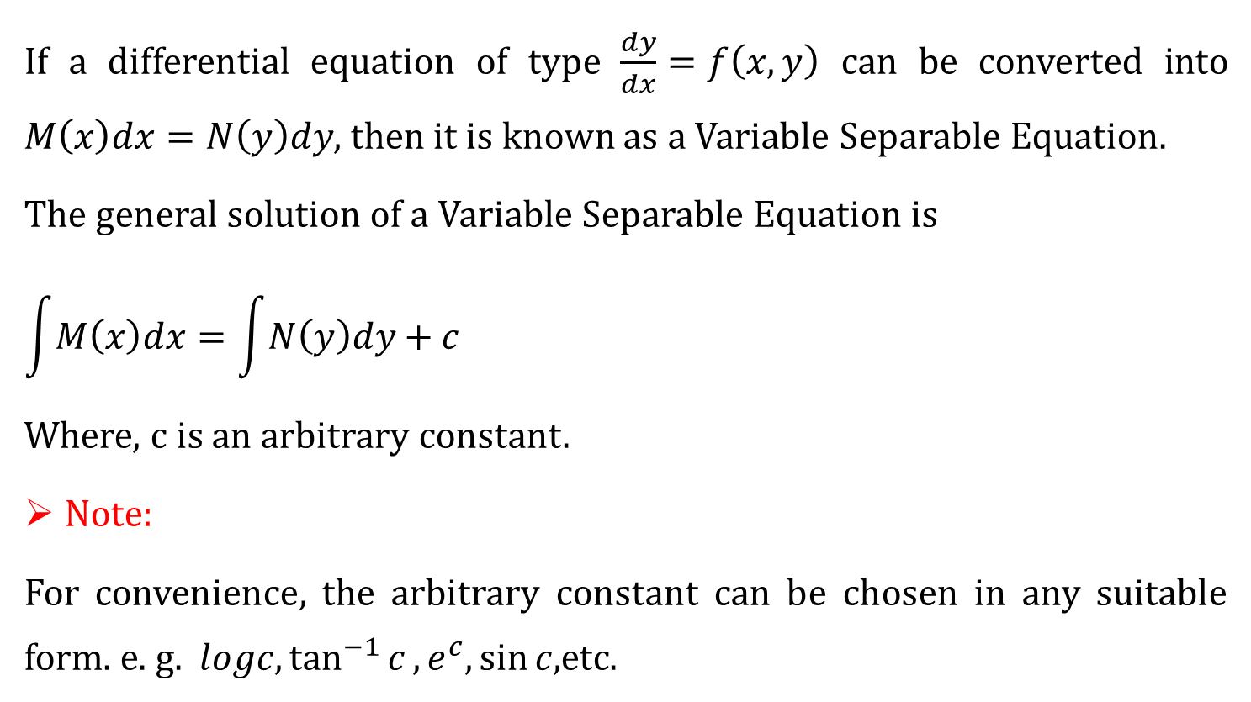
Variable Separable Method
If a differential equation of type $\frac{dy}{dx}=f\left(x,y\right)$ can be converted into $M\left(x\right)dx=N\left(y\right)dy$, then it is known as a Variable Separable Equation.
The general solution of a Variable Separable Equation is
$$\int{M\left(x\right)dx}=\int{N\left(y\right)dy}+c$$
Where, c is an arbitrary constant.
Note:
For convenience, the arbitrary constant can be chosen in any suitable form. e. g. $logc,\tan^{−1}{c},e^{c},\sin{c,}$etc.

Slide 15
M-2 Examples on Variable Separable DE

Slide 16

$Ex.1 Solve 9 y y^{′}+4 x=0$
Solution:
Here, $9 y y^{′}+4 x=0$
$$⇒9y\frac{dy}{dx}=−4x$$
$$⇒9y dy=−4x dx$$
Integrate both the sides,
$$⇒9\int{y}dy=−4\int{x}dx$$

Slide 17

$Ex.1 Solve 9 y y^′+4 x=0$
$$⇒\frac{9y^{2}}{2}=−\frac{4x^{2}}{2}+c^{′}$$
$$⇒9y^{2}=−4x^{2}+2c^{′}$$
$⇒9y^{2}+4x^{2}=c$ $(∵c=2c′)$

Slide 18

$$Ex.3 Solve xy^{′}+y=0 ;y\left(2\right)=−2$$
Solution: Here, $xy^{′}+y=0$
$$⇒x\frac{dy}{dx}+y=0$$
$$⇒x dy=−y dx$$
$$⇒\frac{1}{y} dy=−\frac{1}{x} dx$$
Integrate both the sides,
$$⇒\log{y}=−\log{x}+\log{c} ⇒\log{y}+\log{x}=\log{c}$$
$⇒\log{xy}=\log{c} ⇒xy=c$

Slide 19

$$Ex.3 Solve xy^{′}+y=0 ;y\left(2\right)=−2$$
Now, $y\left(2\right)=−2$
Here,
$$xy=c$$
$$⇒\left(2\right)\left(−2\right)=c$$
$$⇒−4=c$$
Therefore, the solution is
$$xy=−4$$

Slide 20

$$Ex.8 Solve xy\frac{dy}{dx}=1+x+y+xy .$$
Solution:
Here, $xy\frac{dy}{dx}=1+x+y+xy$
$$⇒xy\frac{dy}{dx}=1+x+y\left(1+x\right)$$
$$⇒xy\frac{dy}{dx}=\left(1+x\right)\left(1+y\right)$$
$$⇒\frac{y}{1+y} dy=\frac{1+x}{x} dx$$

Slide 21
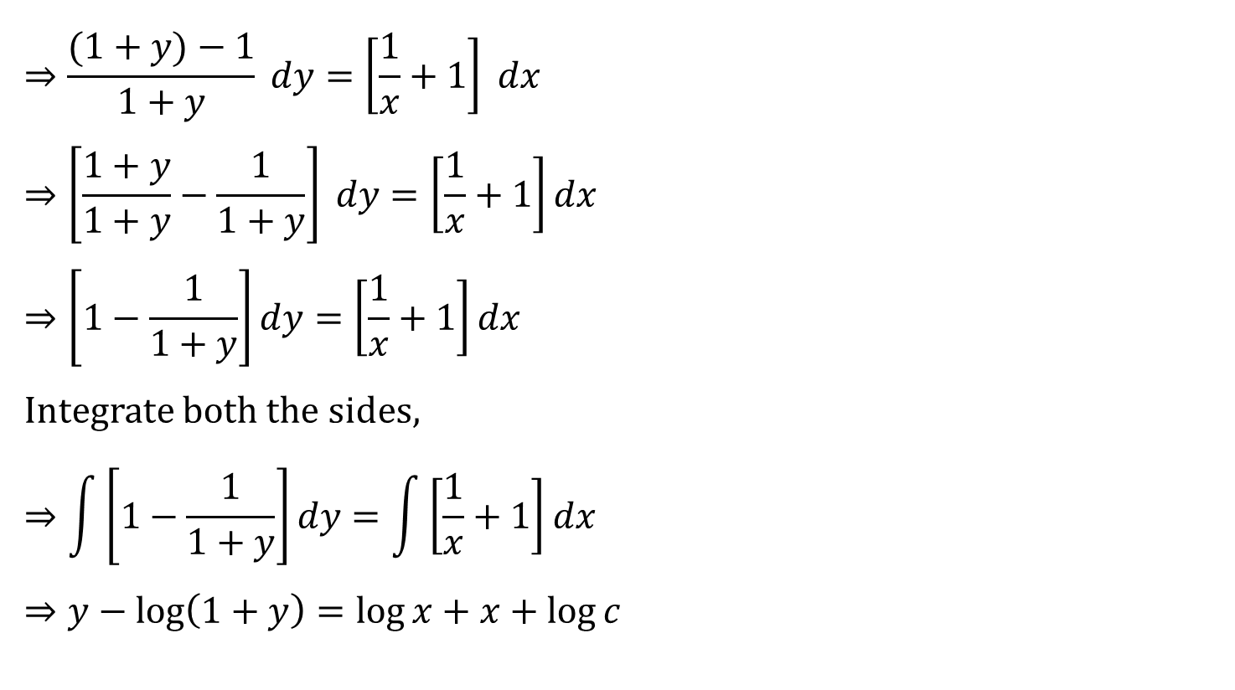
$$Ex.8 Solve xy\frac{dy}{dx}=1+x+y+xy .$$
$$⇒\frac{(1+y)−1}{1+y} dy=\left[\frac{1}{x}+1\right] dx$$
$$⇒\left[\frac{1+y}{1+y}−\frac{1}{1+y}\right] dy=\left[\frac{1}{x}+1\right]dx$$
$$⇒\left[1−\frac{1}{1+y}\right]dy=\left[\frac{1}{x}+1\right]dx$$
Integrate both the sides,
$$⇒\int{\left[1−\frac{1}{1+y}\right]}dy=\int{\left[\frac{1}{x}+1\right]}dx$$
$$⇒y−\log\left(1+y\right)=\log{x}+x+\log{c}$$

Slide 22

Reducible to variable separable Eq.
If a differential equation of type $\frac{dy}{dx}=f\left(x,y\right)$ can be converted into $\frac{dy}{dx}=φ\left(\frac{y}{x}\right)$ then it can be converted into variable separable equation by taking $y=vx$ & $\frac{dy}{dx}=x\frac{dv}{dx}+v$.

Slide 23

$$Ex.13 Solve \frac{dy}{dx}=\frac{y}{x}+\tan\left(\frac{y}{x}\right).$$
Solution:
Here, $\frac{dy}{dx}=\frac{y}{x}+\tan\left(\frac{y}{x}\right) (1)$
Let, $\frac{y}{x}=v$
Differentiate above equation both the sides, w.r.to $x$
$$⇒\frac{x\frac{dy}{dx}−y}{x^{2}}=\frac{dv}{dx}$$

Slide 24

Ex.13 Solve $\frac{dy}{dx}=\frac{y}{x}+\tan\left(\frac{y}{x}\right)$
$$⇒x\frac{dy}{dx}−y=x^{2}\frac{dv}{dx}$$
Dividing above equation both the sides by $x$
$$⇒\frac{dy}{dx}−\frac{y}{x}=x\frac{dv}{dx}$$
Therefore, by eq. $\left(1\right)$
$$\frac{dy}{dx}=\frac{y}{x}+\tan\left(\frac{y}{x}\right) ⇒ \frac{dy}{dx}−\frac{y}{x}=\tan\left(\frac{y}{x}\right)$$
$$⇒x\frac{dv}{dx} =\tan{v}$$

Slide 25

Ex.13 Solve $\frac{dy}{dx}=\frac{y}{x}+\tan\left(\frac{y}{x}\right)$
$$⇒\frac{1}{\tan{v}}dv=\frac{1}{x}dx$$
Integrate both the sides,
$$⇒\int{\frac{1}{\tan{v}}}dv=\int{\frac{1}{x}}dx$$
$$⇒\int{\cot{v}dv=\int{\frac{1}{x}}dx}$$
$$⇒\log{\sin{v}}=\log{x}+\log{c}$$
$$⇒\sin{v}=xc ⇒\sin{\frac{y}{x}}=xc \left(∵v=\frac{y}{x}\right)$$

Slide 26
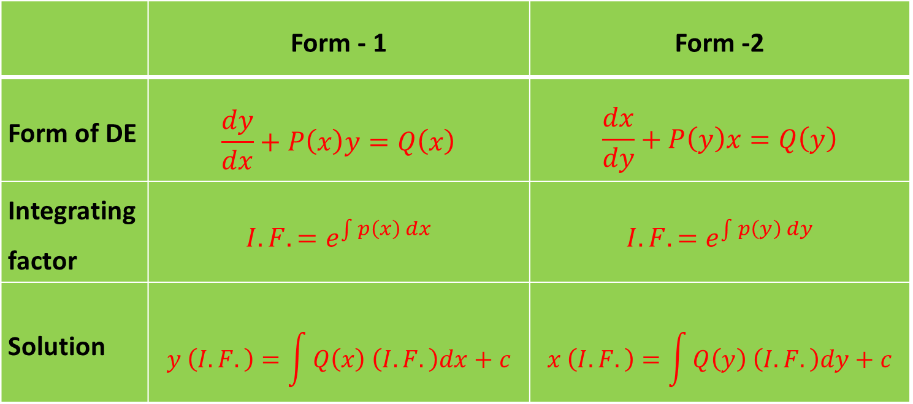
Leibnitz’s (linear) Equation
 | Form - 1 | Form -2
Form of DE | $$\frac{dy}{dx}+P\left(x\right)y=Q\left(x\right)$$ | $$\frac{dx}{dy}+P\left(y\right)x=Q\left(y\right)$$
Integrating factor | $$I.F.=e^{\int{p\left(x\right)dx}}$$ | $$I.F.=e^{\int{p\left(y\right)dy}}$$
Solution | $$y \left(I.F.\right)=\int{Q\left(x\right) \left(I.F.\right)dx}+c$$ | $$x \left(I.F.\right)=\int{Q\left(y\right) \left(I.F.\right)dy}+c$$

Slide 27
M-3 Examples on Liebnitz’s DE

Slide 28

$Ex.1 Solve y^{′}+\operatorname{ysin}{x}=e^{\cos{x}}$
Solution:
$$Here,y^{′}+\operatorname{ysin}{x}=e^{\cos{x}}$$
Comparing it with $y^{′}+P\left(x\right)y=Q(x)$
We have,
$$P\left(x\right)=\sin{x } and Q(x)\text{=}e^{\cos{x}}$$
Now, $\int{p(x)dx}=\int{\sin{x dx }}$
$=−cos⁡x$

Slide 29

$Ex.1 Solve { y}^{′}+\operatorname{ysin}{x}=e^{\cos{x}}$
I.F.$=$ $e^{\int{p(x)dx}}$
$=e^{−\cos{x} }$
The general solution is,
$$y\left(I.F.\right)=\int{Q\left(x\right) \left(I.F.\right)dx} +c$$
$$⇒ye^{−\cos{x} }=\int{e^{\cos{x}}∙e^{−\cos{x} }dx} +c$$
$⇒$ $ye^{−\cos{x} }=\int{1 dx} +c$
$⇒ye^{−\cos{x} }$ $=x+c$

Slide 30

$$Ex.4 Solve\left(x+1\right)\frac{dy}{dx}−y={\left(x+1\right)}^{2}e^{3x}$$
Solution:
$$Here, \left(x+1\right)\frac{dy}{dx}−y={\left(x+1\right)}^{2}e^{3x}$$
Dividing it by $\left(x+1\right)$
$$\frac{dy}{dx}−\frac{1}{x+1}y=\left(x+1\right)e^{3x}$$
Comparing it with $\frac{dy}{dx}+P\left(x\right)y=Q(x)$
We have,
$$P\left(x\right)=−\frac{1}{x+1} and Q\left(x\right)=\left(x+1\right)e^{3x}$$

Slide 31

$$Ex.4 Solve\left(x+1\right)\frac{dy}{dx}−y={\left(x+1\right)}^{2}e^{3x}$$
$Now, \int{p(x)dx}=\int{−\frac{1}{x+1}}$ $dx$
$=−\log\left(x+1\right)=\log{{\left(x+1\right)}^{−1}}$
I.F.$=$ $e^{\int{p(x)dx}}$
$=$ $e^{\log{{(x+1)}^{(−1)}}}$
$=\frac{1}{x+1}$

Slide 32

$$Ex.4 Solve \left(x+1\right)\frac{dy}{dx}−y={\left(x+1\right)}^{2}e^{3x}$$
The general solution is,
$$y\left(I.F.\right)=\int{Q\left(x\right) \left(I.F.\right)dx} +c$$
$$⇒y\left(\frac{1}{x+1}\right)=\int{\left(x+1\right)e^{3x}∙\left(\frac{1}{x+1}\right)dx} +c$$
$$⇒ y\left(\frac{1}{x+1}\right)=\int{e^{3x}dx}+c$$
$$⇒ y\left(\frac{1}{x+1}\right)=\frac{e^{3x}}{3}+c$$

Slide 33
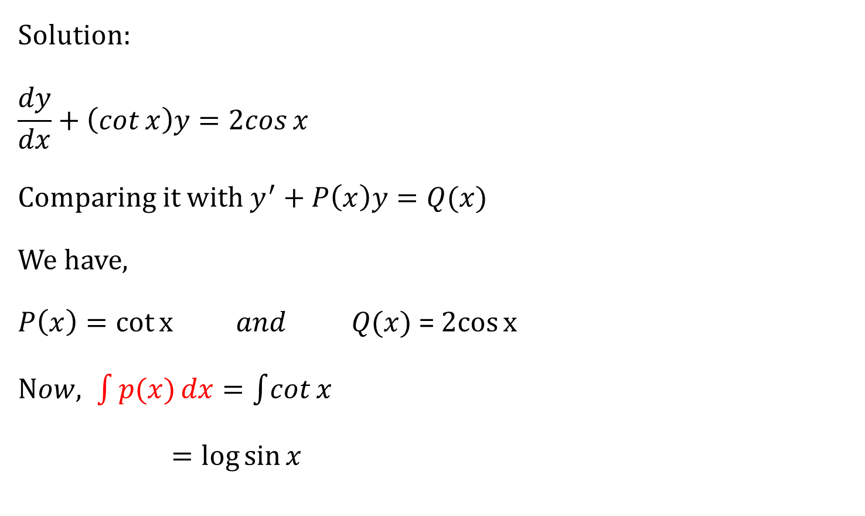
$$Ex.7 Solve \frac{dy}{dx}+\left(\cot{x}\right)y=2cos{x}$$
Solution:
$$\frac{dy}{dx}+\left(\cot{x}\right)y=2cos{x}$$
Comparing it with $y^{′}+P\left(x\right)y=Q(x)$
We have,
$P\left(x\right)=\cot{x} and Q(x)$ = $2cos{x}$
$Now, \int{p(x)dx}=\int{\cot{x}}$
$=\log{\sin{x}}$

Slide 34

$$Ex.7 Solve \frac{dy}{dx}+\left(\cot{x}\right)y=2cos{x}$$
I.F.$=$ $e^{\int{p(x)dx}}$
$=e^{\log{\sin{x}}}$
$=\sin{x}$
The general solution is,
$$y\left(I.F.\right)=\int{Q\left(x\right) \left(I.F.\right)dx} +c$$
$$⇒y\sin{x}=\int{2cos{x}∙\sin{x}dx} +c$$

Slide 35

$$Ex.7 Solve \frac{dy}{dx}+\left(\cot{x}\right)y=2cos{x}$$
$$⇒ y\sin{x}=\int{\sin{2x}dx}+c$$
$$⇒y\sin{x}=−\frac{cos2x}{2}+c$$

Slide 36

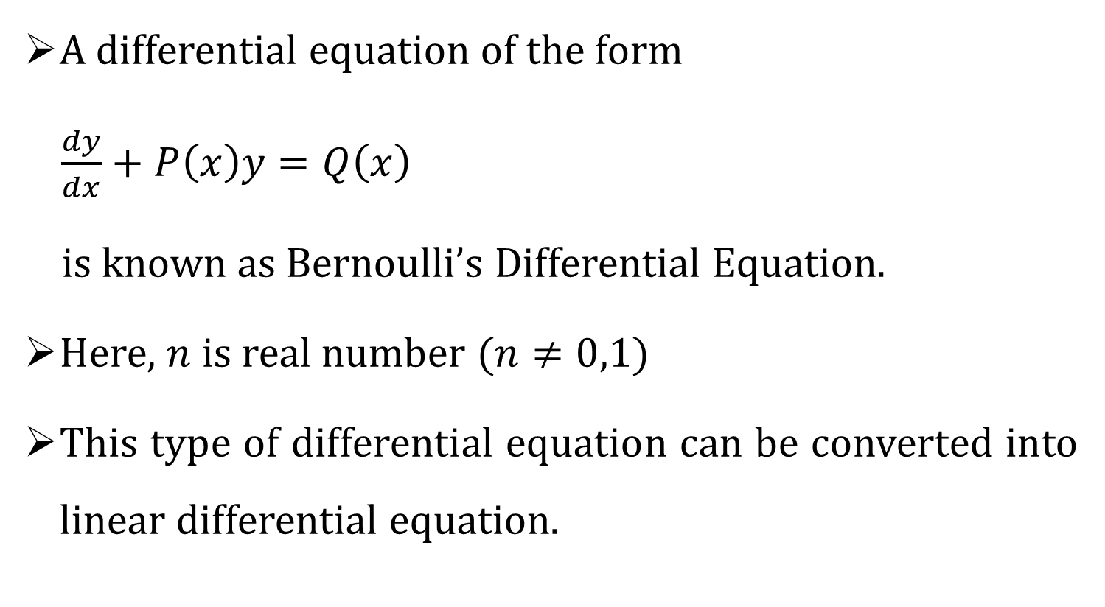
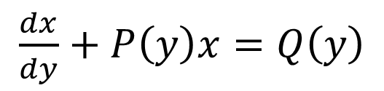

Bernoulli’s Differential Equation
A differential equation of the form
$\frac{dy}{dx}+P\left(x\right)y=Q\left(x\right)$
is known as Bernoulli’s Differential Equation.
Here, $n$ is real number $(n≠0,1)$
This type of differential equation can be converted into linear differential equation.
$$y^{n}$$
$\frac{dx}{dy}+P\left(y\right)x=Q\left(y\right)$
$$x^{n}$$
OR

Slide 37

Process to reduce the Bernoulli’s DE into Linear DE
Case-1
$$\frac{dy}{dx}+P\left(x\right)y=Q\left(x\right)y^{n} (1)$$
Dividing both sides of equation $(1)$ by$y^{n}$,
$$⇒y^{−n}\frac{dy}{dx}+P\left(x\right)y^{1−n}=Q\left(x\right) \left(2\right)$$
Let $y^{1−n}=v$

Slide 38
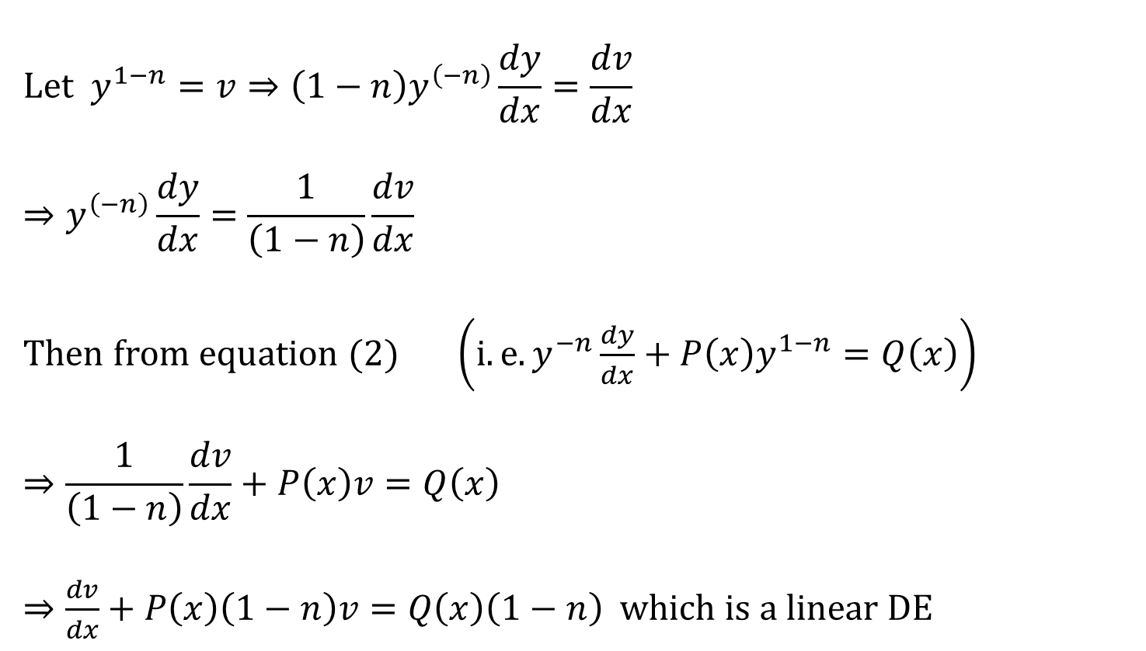
Process to reduce the Bernoulli’s DE into Linear DE
$$\text{Let} y^{1−n}=v⇒{\left(1−n\right)y}^{\left(−n\right)}\frac{dy}{dx}=\frac{dv}{dx}$$
$$⇒y^{\left(−n\right)}\frac{dy}{dx}=\frac{1}{\left(1−n\right)}\frac{dv}{dx}$$
Then from equation $(2)$ $\left(i.e.y^{−n}\frac{dy}{dx}+P\left(x\right)y^{1−n}=Q\left(x\right)\right)$
$$⇒\frac{1}{\left(1−n\right)}\frac{dv}{dx}+P\left(x\right)v=Q\left(x\right)$$
$⇒\frac{dv}{dx}+P\left(x\right)\left(1−n\right)v=Q\left(x\right)\left(1−n\right)$ which is a linear DE

Slide 39

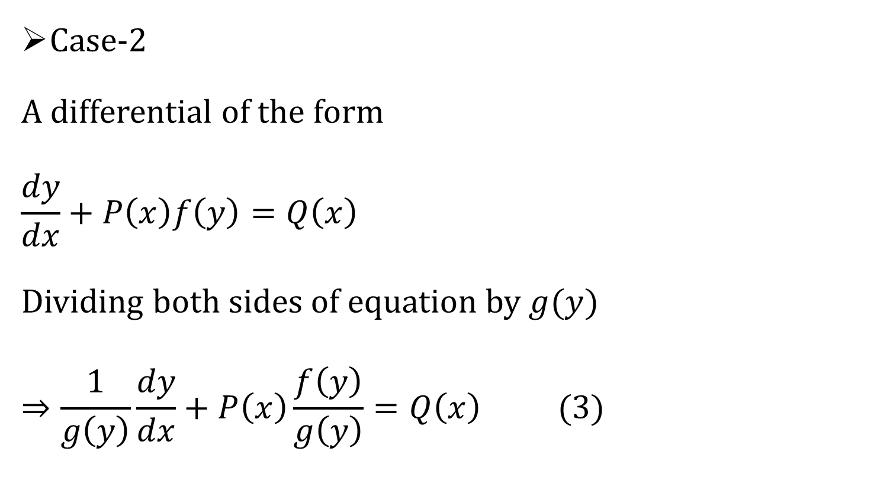
Process to reduce the Bernoulli’s DE into Linear DE
Case-2
A differential of the form
$$\frac{dy}{dx}+P\left(x\right)f\left(y\right)=Q\left(x\right)$$
Dividing both sides of equation by $g(y)$
$$⇒\frac{1}{g\left(y\right)}\frac{dy}{dx}+P\left(x\right)\frac{f\left(y\right)}{g\left(y\right)}=Q\left(x\right) (3)$$
$$g\left(y\right)$$

Slide 40

Process to reduce the Bernoulli’s DE into Linear DE
Let $\frac{f\left(y\right)}{g\left(y\right)}=v$
Differentiate with respect to $x$ both the sides,
Equation $(3)$ becomes Linear Differential equation.

Slide 41
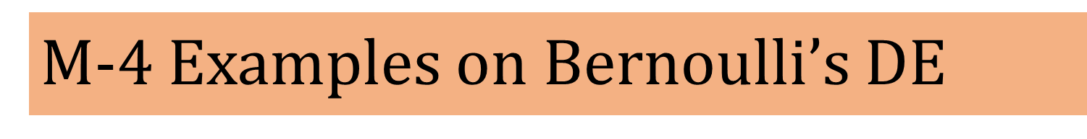
M-4 Examples on Bernoulli’s D$E$

Slide 42


Ex.3 $Solve \frac{dy}{dx}+\frac{y}{x}=x^{2}y^{6}$
Solution:
$$\frac{dy}{dx}+\frac{y}{x}=x^{2}y^{6} (1)$$
Divide the above equation both the sides by $y^{6}$
$$⇒\frac{1}{y^{6}}\frac{dy}{dx}+\frac{y}{xy^{6}}=x^{2}$$
$$⇒y^{−6}\frac{dy}{dx}+ \frac{1}{x}=x^{2} (2)$$
$$y^{−5}$$

Slide 43

Ex.3 $Solve \frac{dy}{dx}+\frac{y}{x}=x^{2}y^{6}$
Let $y^{−5}=v$
$$⇒−5y^{−6}\frac{dy}{dx}=\frac{dv}{dx}$$
$$⇒y^{−6}\frac{dy}{dx}=−\frac{1}{5}\frac{dv}{dx}$$
Now, from equation $(2)$ $\left(i.e.y^{−6}\frac{dy}{dx}+\frac{y^{−5}}{x}=x^{2}\right)$
$$−\frac{1}{5}\frac{dv}{dx}+\frac{v}{x}=x^{2}$$

Slide 44
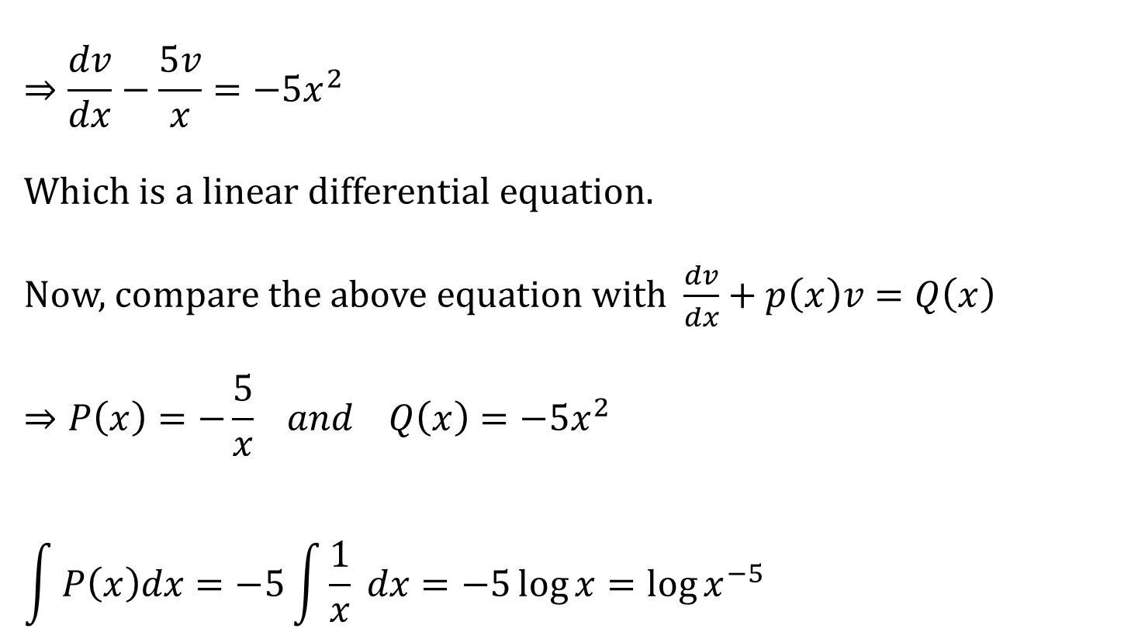
$$Ex.3 Solve \frac{dy}{dx}+\frac{y}{x}=x^{2}y^{6}$$
$$⇒\frac{dv}{dx}−\frac{5v}{x}=−5x^{2}$$
Which is a linear differential equation.
Now, compare the above equation with $\frac{dv}{dx}+p\left(x\right)v=Q\left(x\right)$
$$⇒P\left(x\right)=−\frac{5}{x} and Q\left(x\right)=−5x^{2}$$
$$\int{P\left(x\right)dx}=−5\int{\frac{1}{x}} dx=−5\log{x}={\log{x}}^{−5}$$

Slide 45

Ex.3 $Solve \frac{dy}{dx}+\frac{y}{x}=x^{2}y^{6}$
$$I.F.=e^{\int{Pdx}}$$
$$=e^{{\log{x}}^{−5}}$$
$$=x^{−5}$$
The general solution is,
$$v\left(I.F.\right)=\int{Q\left(x\right) \left(I.F.\right)dx}+c$$
$$⇒vx^{−5}=\int{−5x^{2} \left(x^{−5}\right)dx+c}$$
$$⇒vx^{−5}=−5\int{x^{−3} dx+c}$$

Slide 46

Ex.3 $Solve \frac{dy}{dx}+\frac{y}{x}=x^{2}y^{6}$
$$⇒vx^{−5}=−5\int{x^{−3} dx+c}$$
$$⇒vx^{−5}=\frac{ 5x^{−2}}{2}+c$$
$$⇒y^{−5}x^{−5}=\frac{ 5x^{−2}}{2}+c$$
Which is required solution.

Slide 47

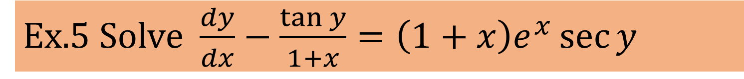
Ex.5 Solve $\frac{dy}{dx}−\frac{\tan{y}}{1+x}=\left(1+x\right)e^{x}\sec{y}$
Solution:
$\frac{dy}{dx}−\frac{\tan{y}}{1+x}=\left(1+x\right)e^{x}{\sec{y}} (1)$
Divide both the sides by $\sec{y}$
$$⇒\cos{y}\frac{dy}{dx}−\cos{y} \frac{\tan{y}}{1+x}=\left(1+x\right)e^{x}$$
$$⇒\cos{y}\frac{dy}{dx}−\frac{\sin{y}}{1+x}=\left(1+x\right)e^{x} (2)$$

Slide 48
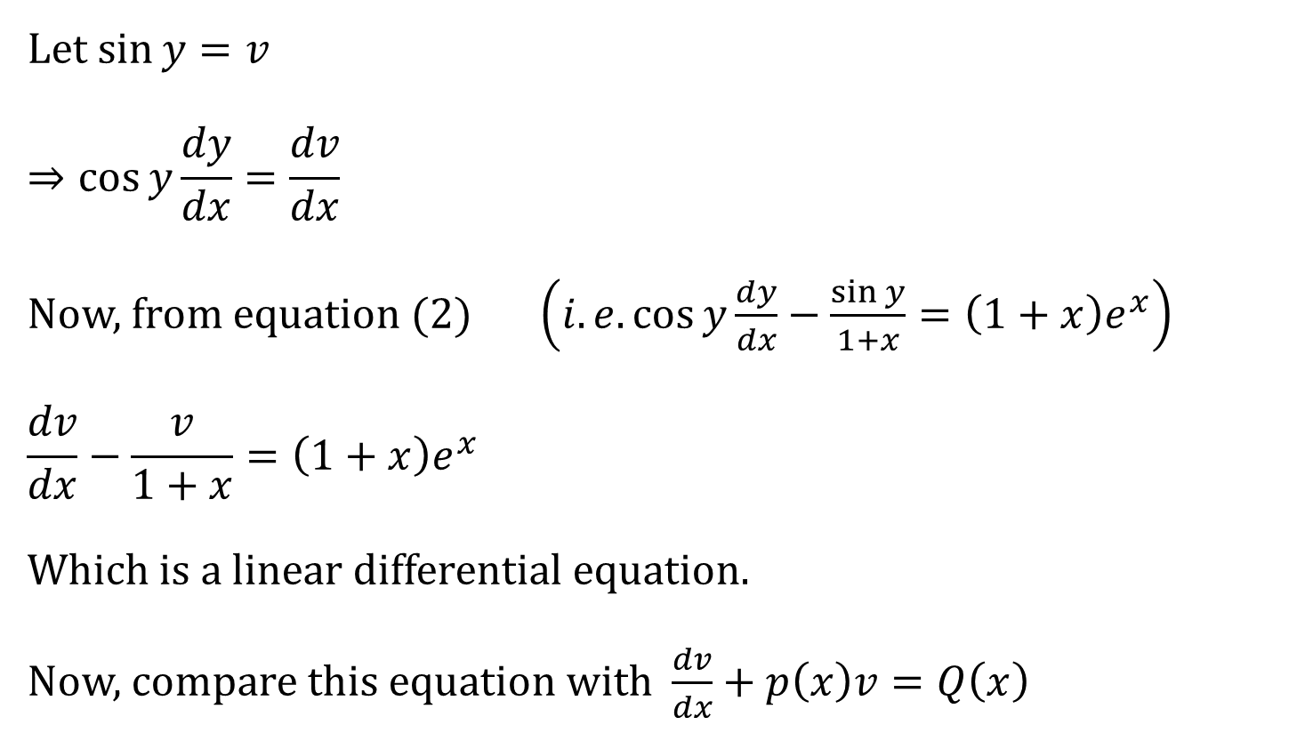
Ex.5 Solve $\frac{dy}{dx}−\frac{\tan{y}}{1+x}=\left(1+x\right)e^{x}\sec{y}$
Let $\sin{y}=v$
$$⇒\cos{y}\frac{dy}{dx}=\frac{dv}{dx}$$
Now, from equation $(2)$ $\left(i.e.\cos{y}\frac{dy}{dx}−\frac{\sin{y}}{1+x}=\left(1+x\right)e^{x}\right)$
$$\frac{dv}{dx}−\frac{v}{1+x}=\left(1+x\right)e^{x}$$
Which is a linear differential equation.
Now, compare this equation with $\frac{dv}{dx}+p\left(x\right)v=Q\left(x\right)$

Slide 49


Ex.5 Solve $\frac{dy}{dx}−\frac{\tan{y}}{1+x}=\left(1+x\right)e^{x}\sec{y}$
$$⇒P\left(x\right)=−\frac{1}{1+x} and Q\left(x\right)=\left(1+x\right)e^{x}$$
$$\int{P(x)}dx=−\int{\frac{1}{1+x}}dx$$
$=−\log\left(1+x\right)$
$={\log\left(1+x\right)}^{−1}$
I.F.=$e^{\int{P dx}}={e^{\log\left(1+x\right)}}^{−1}$ $=\frac{1}{1+x}$

Slide 50

Ex.5 Solve $\frac{dy}{dx}−\frac{\tan{y}}{1+x}=\left(1+x\right)e^{x}\sec{y}$
The general solution is,
$$v\left(I.F.\right)=\int{Q\left(x\right) \left(I.F.\right)dx}+c$$
$$⇒\frac{v}{1+x}=\int{\left(1+x\right)e^{x}\frac{1}{1+x}}dx+c$$
$$⇒\frac{\sin{y}}{1+x}=e^{x}+c$$
Which is required solution.

Slide 51

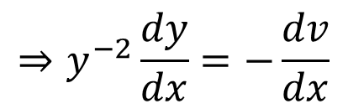
Ex.7 $Solve\frac{dy}{dx}−2 y tan⁡x=y^{2}\tan^{2}{x}$
Solution:
$$\frac{dy}{dx}−2 y\tan{x}=y^{2}\tan^{2}{x} (1)$$
Divide both the sides by $y^{2}$
$$⇒y^{−2}\frac{dy}{dx}−2y^{−1}tan{x}=\tan^{2}{x} (2)$$
Let $y^{−1}=v$
$$⇒−y^{−2}\frac{dy}{dx}=\frac{dv}{dx}$$
$$⇒y^{−2}\frac{dy}{dx}=−\frac{dv}{dx}$$

Slide 52
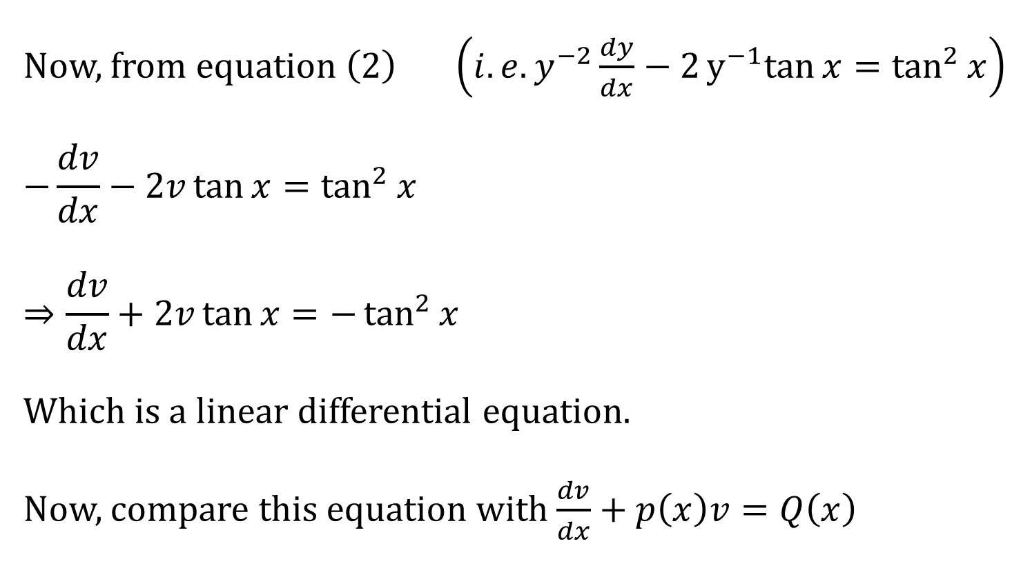
Ex.7 $Solve\frac{dy}{dx}−2 y tan⁡x=y^{2}\tan^{2}{x}$
Now, from equation $\left(2\right)$ $\left(i.e.y^{−2}\frac{dy}{dx}−2y^{−1}tan{x}=\tan^{2}{x}\right)$
$$−\frac{dv}{dx}−2v\tan{x}=\tan^{2}{x}$$
$$⇒\frac{dv}{dx}+2v\tan{x}=−\tan^{2}{x}$$
Which is a linear differential equation.
Now, compare this equation with $\frac{dv}{dx}+p\left(x\right)v=Q\left(x\right)$

Slide 53

Ex.7 $Solve\frac{dy}{dx}−2 y tan⁡x=y^{2}\tan^{2}{x}$
$$⇒P\left(x\right)=2\tan{x} and Q\left(x\right)=−\tan^{2}{x}$$
Now, $\int{P\left(x\right)}dx=2\int{\tan{x}}dx$
$=2\log{\sec{x}}$
$=\log{\sec^{2}{x}}$
$$I.F.=e^{\int{P dx}}$$
$${=e}^{\log{\sec^{2}{x }}}$$
$=\sec^{2}{x}$

Slide 54


Ex.7 $Solve\frac{dy}{dx}−2 y tan⁡x=y^{2}\tan^{2}{x}$
The general solution is,
$$v\left(I.F.\right)=\int{Q\left(x\right) \left(I.F.\right)dx}+c$$
$$v\sec^{2}{x}=−\int{\tan^{2}{x}}\sec^{2}{x} dx+c$$
$$v\sec^{2}{x}=−\frac{\tan^{3}{x}}{3}+c$$
$$\frac{\sec^{2}{x}}{y}=−\frac{\tan^{3}{x}}{3}+c$$
$$\left(∵\int{f^{n}\left(x\right)f^{′}\left(x\right)}dx=\frac{f^{n+1}\left(x\right)}{n+1} \right)$$

Slide 55


Exact Differential Equation
A differential equation of the form $M\left(x,y\right)dx+N\left(x,y\right)dy=0$ is said to be Exact Differential Equation if it can be derived from its primitive by direct differential without any further transformation such as elimination etc.
Necessary and Sufficient Condition:
$\frac{∂M}{∂y}=\frac{∂N}{∂x}$
The general solution of Exact Differential Equation is
$$\int_{y=constant}{M\left(x,y\right)dx}+\int{\left(terms of N free from x\right)dy}=c$$
$$where 1^{st} order partial derivative of$$
$$M \& N must exist at all points of f(x,y)$$

Slide 56
M-5 Examples on Exact DE

Slide 57

$$Ex.1 Solve \left(x^{3}+3xy^{2}\right)dx+\left(y^{3}+3x^{2}y\right)dy=0$$
Solution:
Compare the given equation with $M\left(x,y\right)dx+N\left(x,y\right)dy=0$
Therefore, we get that
$$M=x^{3}+3xy^{2} and N=y^{3}+3x^{2}y$$
Now, differentiate $M$ and $N$ w.r.to $y$ and $x$ respectively.
$$⇒\frac{∂M}{∂y}=6xy and \frac{∂N}{∂x}=6xy$$
$$⇒\frac{∂M}{∂y}=\frac{∂N}{∂x}$$

Slide 58

$$Ex.1 Solve \left(x^{3}+3xy^{2}\right)dx+\left(y^{3}+3x^{2}y\right)dy=0$$
Therefore, the given differential equation is Exact.
The general solution is
$$\int_{y=constant}{M\left(x,y\right)dx}+\int{\left(terms of N free from x\right)dy}=c$$
$$⇒\int_{y=constant}{\left(x^{3}+3xy^{2}\right)dx}+\int{y^{3}dy}=c$$
$$⇒\frac{x^{4}}{4}+\frac{3x^{2}y^{2}}{2}+\frac{y^{4}}{4}=c$$

Slide 59

Ex.8 Solve $\frac{dy}{dx}+\frac{y\cos{x}+\sin{y}+y}{\sin{x}+x\cos{y}+x}=0$
Solution:
Here,
$$\frac{dy}{dx}=−\frac{y\cos{x}+\sin{y}+y}{\sin{x}+x\cos{y}+x}$$
$$⇒\left(\sin{x}+x\cos{y}+x\right)dy=−\left(y\cos{x}+\sin{y}+y\right)dx$$
$$⇒\left(y\cos{x}+\sin{y}+y\right)dx+\left(\sin{x}+x\cos{y}+x\right)dy=0$$
Compare the given equation with $M\left(x,y\right)dx+N\left(x,y\right)dy=0$
$$M=y\cos{x}+\sin{y}+y and N=\sin{x}+x\cos{y}+x$$

Slide 60

Ex.8 Solve $\frac{dy}{dx}+\frac{y\cos{x}+\sin{y}+y}{\sin{x}+x\cos{y}+x}=0$
Here,
$$M=y\cos{x}+\sin{y}+y and N=\sin{x}+x\cos{y}+x$$
Now, differentiate $M$ and $N$ w.r.to $y$ and $x$ respectively.
$$⇒\frac{∂M}{∂y}=\cos{x}+\cos{y}+1 and \frac{∂N}{∂x}=\cos{x}+\cos{y}+1$$
$$⇒\frac{∂M}{∂y}=\frac{∂N}{∂x}$$
Therefore, the given differential equation is Exact.

Slide 61

Ex.8 Solve $\frac{dy}{dx}+\frac{y\cos{x}+\sin{y}+y}{\sin{x}+x\cos{y}+x}=0$
The general solution is
$$⇒\int_{y=constant}{M\left(x,y\right)dx}+\int{\left(terms of N free from x\right)dy}=c$$
$$⇒\int_{y=constant}{(y\cos{x}+\sin{y}+y) dx}=c$$
$$⇒y\sin{x}+x\sin{y}+yx=c$$

Slide 62

Ex.10 Solve $(y^{2}e^{xy^{2}}+4x^{3})dx+\left(2xye^{xy^{2}}−3y^{2}\right)dy=0$
Solution:
Compare the given equation with $M\left(x,y\right)dx+N\left(x,y\right)dy=0$
Therefore, we get that
$$M=y^{2}e^{xy^{2}}+4x^{3} and N=2xye^{xy^{2}}−3y^{2}$$
Now, differentiate $M$ and $N$ w.r.to $y$ and $x$ respectively.
$$⇒\frac{∂M}{∂y}=2ye^{xy^{2}}+2xy^{3}e^{xy^{2}} and \frac{∂N}{∂x}=2ye^{xy^{2}}+2xy^{3}e^{xy^{2}}$$
$$⇒\frac{∂M}{∂y}=\frac{∂N}{∂x}$$

Slide 63


Ex.10 Solve $(y^{2}e^{xy^{2}}+4x^{3})dx+\left(2xye^{xy^{2}}−3y^{2}\right)dy=0$
Therefore, the given differential equation is Exact.
The general solution is
$$⇒\int_{y=constant}{M\left(x,y\right)dx}+\int{\left(terms of N free from x\right)dy}=c$$
$$⇒\int_{y=constant}{(y^{2}e^{xy^{2}}+4x^{3}) dx}−3\int{\left(y^{2}\right)dy}=c$$
$$⇒\frac{y^{2}e^{xy^{2}}}{y^{2}}+x^{4}−y^{3}=c$$
$$⇒e^{xy^{2}}+x^{4}−y^{3}=c$$

Slide 64

Non Exact Differential Equation
A differential equation which is not exact differential equation is known as Non-Exact Differential Equation.
i.e. $\frac{∂M}{∂y}≠\frac{∂N}{∂x}$
We reduce the non-exact differential equation into exact differential equation by multiplying it with I.F.

Slide 65








Standard rules for finding I.F.
Condition | Type of equation | I.F.
$$\frac{1}{Mx+Ny}$$
$$Mx+Ny≠0$$
Homogeneous
Non
Homogeneous
$$\frac{1}{Mx−Ny}$$
$$Mx−Ny≠0$$
$$\frac{1}{N}\left(\frac{∂M}{∂y}−\frac{∂N}{∂x}\right)=f\left(x\right)$$
-
$$I.F.=e^{\int{f\left(x\right)dx}}$$
$$\frac{1}{M}\left(\frac{∂N}{∂x}−\frac{∂M}{∂y}\right)=g\left(y\right)$$
-
$$I.F.=e^{\int{g\left(y\right)dy}}$$

Slide 66

Non Exact Differential Equation
Now , multiply I.F. with the given differential equation to get new M and N.
Therefore, the general solution is
$$\int_{y=constant}{M dx}+\int{\left(terms of N free from x\right)dy}=c$$
Where, c is any constant.

Slide 67

Homogeneous Differential Equation
Homogeneous DE
A differential equation is called homogeneous differential equation if each term has same degree.
E.g. $(xy−2y^{2})dx−(x^{2}−3xy) dy=0$
Here, each term is of degree 2
Therefore, this diff. equation is homogeneous.

Slide 68

Non-Homogeneous Differential Equation
When the function is not homogeneous, it is called non-homogeneous function.
E.g. $(x^{2}y−2y^{2})dx−(x^{2}−3xy^{2}) dy=0$
Here, each term doesn’t have same degree
Therefore, this diff. equation is Non-homogeneous.

Slide 69
M-6 Examples on Non-Exact DE

Slide 70

Ex.2 Solve $(x^{2}y−2xy^{2})dx−\left(x^{3}−3x^{2}y\right)dy=0 .$
Solution:
Compare the given equation with $M\left(x,y\right)dx+N\left(x,y\right)dy=0$
Therefore, we get that
$$M=x^{2}y−2xy^{2} and N=−x^{3}+3x^{2}y$$
Now, differentiate $M$ and $N$ w.r.to $y$ and $x$ respectively.
$$⇒\frac{∂M}{∂y}=x^{2}−4xy and \frac{∂N}{∂x}=−3x^{2}+6xy$$
$$⇒\frac{∂M}{∂y}≠\frac{∂N}{∂x}$$

Slide 71

Ex.2 Solve $(x^{2}y−2xy^{2})dx−\left(x^{3}−3x^{2}y\right)dy=0 .$
Here, the given differential equation is homogenous as each term is of order 3.
Therefore, $I.F.=\frac{1}{Mx+Ny}$
$=\frac{1}{{(x}^{2}y−2xy^{2})x+{(−x}^{3}+3x^{2}y)y}$
$=\frac{1}{x^{3}y−2x^{2}y^{2}−x^{3}y+3x^{2}y^{2}}$
$=\frac{1}{x^{2}y^{2}}$

Slide 72

Ex.2 Solve $(x^{2}y−2xy^{2})dx−\left(x^{3}−3x^{2}y\right)dy=0 .$
Now, multiply I.F. with the given differential equation to reduce it into exact form.
$$\frac{1}{x^{2}y^{2}}(x^{2}y−2xy^{2})dx−\frac{1}{x^{2}y^{2}}\left(x^{3}−3x^{2}y\right)dy=0$$
$$\left(\frac{1}{y}−\frac{2}{x}\right)dx−\left(\frac{x}{y^{2}}−\frac{3}{y}\right)dy=0$$
Therefore, $M=\frac{1}{y}−\frac{2}{x} and N=−\frac{x}{y^{2}}+\frac{3}{y}$

Slide 73

Ex.2 Solve $(x^{2}y−2xy^{2})dx−\left(x^{3}−3x^{2}y\right)dy=0 .$
Therefore, the given differential equation is Exact.
The general solution is
$$⇒\int_{y=constant}{M\left(x,y\right)dx}+\int{\left(terms of N free from x\right)dy}=c$$
$$⇒\int_{y=constant}{\left(\frac{1}{y}−\frac{2}{x}\right) dx}+\int{\frac{3}{y}dy}=c$$
$$⇒\frac{1}{y}x−2\log{x}+3\log{y}=c$$

Slide 74

Ex.5 Solve $\left(x^{2}y^{2}+2\right)ydx+\left(2−x^{2}y^{2}\right)xdy=0 .$
Solution:
Compare the given equation with $M\left(x,y\right)dx+N\left(x,y\right)dy=0$
Therefore, we get that
$$M=x^{2}y^{3}+2y and N=2x−x^{3}y^{2}$$
Now, differentiate $M$ and $N$ w.r.to $y$ and $x$ respectively.
$$⇒\frac{∂M}{∂y}=3y^{2}x^{2}+2 and \frac{∂N}{∂x}=2−3x^{2}y^{2}$$
$$⇒\frac{∂M}{∂y}≠\frac{∂N}{∂x}$$

Slide 75

Ex.5 Solve $\left(x^{2}y^{2}+2\right)ydx+\left(2−x^{2}y^{2}\right)xdy=0 .$
Here, the given differential equation is non-homogenous and it is of the form $f\left(x,y\right)y dx+g\left(x,y\right)x dy=0$
Therefore, $I.F.=\frac{1}{Mx−Ny}$
$=\frac{1}{(x^{2}y^{3}+2y)x−(2x−x^{3}y^{2})y}$
$=\frac{1}{x^{3}y^{3}+2xy−2xy+x^{3}y^{3}}$
$=\frac{1}{2x^{3}y^{3}}$

Slide 76

Ex.5 Solve $\left(x^{2}y^{2}+2\right)ydx+\left(2−x^{2}y^{2}\right)xdy=0 .$
Now, multiply I.F. with the given differential equation to reduce it into exact form.
$$\frac{1}{2x^{3}y^{3}}\left(x^{2}y^{3}+2y\right)dx+\frac{1}{2x^{3}y^{3}}(2x−x^{3}y^{2})dy=0$$
$$\left(\frac{1}{2x}+\frac{1}{x^{3}y^{2}}\right)dx+\left(\frac{1}{{x^{2}y}^{3}}−\frac{1}{2y}\right)dy=0$$
Therefore, $M=\frac{1}{2x}+\frac{1}{x^{3}y^{2}} and N=\frac{1}{{x^{2}y}^{3}}−\frac{1}{2y}$

Slide 77

Ex.5 Solve $\left(x^{2}y^{2}+2\right)ydx+\left(2−x^{2}y^{2}\right)xdy=0 .$
Therefore, the given differential equation is Exact.
The general solution is
$$⇒\int_{y=constant}{M\left(x,y\right)dx}+\int{\left(terms of N free from x\right)dy}=c$$
$$⇒\int_{y=constant}{\left(\frac{1}{2x}+\frac{1}{x^{3}y^{2}}\right) dx}−\frac{1}{2}\int{\frac{1}{y}dy}=c$$
$⇒\frac{1}{2}log{x}−\frac{1}{{2x}^{2}y^{2}}−\frac{1}{2}\log{y}=c$ $⇒\log{\frac{x}{y}−\frac{1}{x^{2}y^{2}}=2c}$

Slide 78


Ex.9 Solve $\left(x^{2}{+y}^{2}+3\right)dx−2xydy=0 .$
Solution:
Compare the given equation with $M\left(x,y\right)dx+N\left(x,y\right)dy=0$
Therefore, we get that
$$M=x^{2}{+y}^{2}+3 and N=−2xy$$
Now, differentiate $M$ and $N$ w.r.to $y$ and $x$ respectively.
$$⇒\frac{∂M}{∂y}=2y and \frac{∂N}{∂x}=−2y$$
$$⇒\frac{∂M}{∂y}≠\frac{∂N}{∂x}$$

Slide 79

Ex.9 Solve $\left(x^{2}{+y}^{2}+3\right)dx−2xydy=0 .$
Here, the given differential equation is non-homogenous.
Here, $\frac{1}{N}\left(\frac{∂M}{∂y}−\frac{∂N}{∂x}\right)=−\frac{1}{2xy}(2y+2y)$
$=−\frac{4y}{2xy}$
$=−\frac{2}{x}=f(x)$
Therefore, $I.F.=e^{\int{f\left(x\right)}dx}$
$=e^{−\int{\frac{2}{x}dx}}=e^{−2\log{x}}=e^{{\log{x}}^{−2}}=x^{−2}$

Slide 80

Ex.9 Solve $\left(x^{2}{+y}^{2}+3\right)dx−2xydy=0 .$
Now, multiply I.F. with the given differential equation to reduce it into exact form.
$$x^{−2}\left(x^{2}{+y}^{2}+3\right) dx+x^{−2}\left(−2xy\right) dy=0$$
$$\left(1+x^{−2}y^{2}+3x^{−2}\right) dx−2x^{−1}y dy=0$$
Therefore, $M=1+x^{−2}y^{2}+3x^{−2}and N=−2x^{−1}y$
Therefore, the given differential equation is Exact.

Slide 81

Ex.9 Solve $\left(x^{2}{+y}^{2}+3\right)dx−2xydy=0 .$
The general solution is
$$⇒\int_{y=constant}{M\left(x,y\right)dx}+\int{\left(terms of N free from x\right)dy}=c$$
$$⇒\int_{y=constant}{\left(1+x^{−2}y^{2}+3x^{−2}\right) dx}=c$$
$$⇒x−\frac{y^{2}}{x}−\frac{3}{x}=c ⇒x^{2}−y^{2}−3=cx$$

Slide 82

Ex.10 $Solve \left(3x^{2}y^{4}+2xy\right)dx$ $+\left(2x^{3}y^{3}−x^{2}\right)dy=0 .$
Solution:
Compare the given equation with $M\left(x,y\right)dx+N\left(x,y\right)dy=0$
Therefore, we get that
$$M=3x^{2}y^{4}+2xy and N=2x^{3}y^{3}−x^{2}$$
Now, differentiate $M$ and $N$ w.r.to $y$ and $x$ respectively.
$$⇒\frac{∂M}{∂y}=12x^{2}y^{3}+2x and \frac{∂N}{∂x}=6x^{2}y^{3}−2x$$
$$⇒\frac{∂M}{∂y}≠\frac{∂N}{∂x}$$

Slide 83

Ex.10 $Solve \left(3x^{2}y^{4}+2xy\right)dx$ $+\left(2x^{3}y^{3}−x^{2}\right)dy=0 .$
Here, the given differential equation is non-homogenous.
Here, $\frac{1}{M}\left(\frac{∂N}{∂x}−\frac{∂M}{∂y}\right)=\frac{1}{\left(3x^{2}y^{4}+2xy\right)}(6x^{2}y^{3}−2x−12x^{2}y^{3}−2x)$
$=\frac{−6x^{2}y^{3}−4x}{\left(3x^{2}y^{4}+2xy\right)}$
$==\frac{−2x(3xy^{3}+2)}{xy\left(3xy^{3}+2\right)}=−\frac{2}{y}=g(y)$
Therefore, $I.F.=e^{\int{g\left(y\right)}dy}$
$=e^{−\int{\frac{2}{y}dy}}=e^{−2\log{y}}=e^{{\log{y}}^{−2}}=y^{−2}$

Slide 84

Ex.10 $Solve \left(3x^{2}y^{4}+2xy\right)dx$ $+\left(2x^{3}y^{3}−x^{2}\right)dy=0 .$
Now, multiply I.F. with the given differential equation to reduce it into exact form.
$$y^{−2}\left(3x^{2}y^{4}+2xy\right) dx+y^{−2}\left(2x^{3}y^{3}−x^{2}\right) dy=0$$
$$\left(3x^{2}y^{2}+2xy^{−1}\right) dx+(2x^{3}y−x^{2}y^{−2}) dy=0$$
Therefore, $M=3x^{2}y^{2}+2xy^{−1} and N=2x^{3}y−x^{2}y^{−2}$
Now, the given differential equation is Exact.

Slide 85

Ex.10 $Solve \left(3x^{2}y^{4}+2xy\right)dx$ $+\left(2x^{3}y^{3}−x^{2}\right)dy=0 .$
The general solution is
$$⇒\int_{y=constant}{M\left(x,y\right)dx}+\int{\left(terms of N free from x\right)dy}=c$$
$$⇒\int_{y=constant}{\left(3x^{2}y^{2}+2xy^{−1}\right) dx}=c$$
$$⇒x^{3}y^{2}+\frac{x^{2}}{y}=c$$

Slide 86
Orthogonal Trajectory
Trajectory
A Curve which cuts every member of a given family of curves according to some definite rule is called trajectory.
Orthogonal Trajectory
A curve which cuts every member of a given family at right angles is a called an Orthogonal Trajectory.

Slide 87


Method for finding Orthogonal trajectory of $f\left(x,y,c\right)=0$
Differentiate $f\left(x,y,c\right)=0…\left(1\right)$ w.r.t. x.
Eliminate $c$ by using $eq^{n} …\left(1\right)$ and its derivative.
Replace $\frac{dy}{dx}$ by $−\frac{dx}{dy}$. This will give you differential equation of the orthogonal trajectories.
Solve the differential equation to get the equation of the orthogonal trajectories.

Slide 88
M-7 Examples on Orthogonal Trajectory

Slide 89

Ex.1 Find orthogonal trajectories of $y=x^{2}+c .$
Solution:
Here, $y=x^{2}+c$
Now, differentiate both the sides w.r.to $x$
$$⇒\frac{dy}{dx}=2x$$
$$⇒−\frac{dx}{dy}=2x \left(∵\text{Replac}\text{ing} \frac{dy}{dx} \text{by} −\frac{dx}{dy}\right)$$
$$⇒\frac{1}{x} dx=−2dy$$

Slide 90

Ex.1 Find orthogonal trajectories of $y=x^{2}+c .$
$$⇒\frac{1}{x} dx=−2dy$$
Integrate both the sides,
$$⇒\log{x}=−2y+c$$
$$⇒\log{x}+2y=c$$

Slide 91


Method for finding Orthogonal trajectory of $f\left(r,θ,c\right)=0$
Differentiate$f\left(r,θ,c\right)=0…\left(1\right)$ w.r.t. $θ$.
Eliminate c by using eqn …(1) and its derivative
Replace $\frac{dr}{dθ}$ by $−r^{2}\frac{dθ}{dr}$. This will give you differential eqn of the orthogonal trajectories.
Solve the differential equation to get the equation of the orthogonal trajectories.

Slide 92

Ex.4 Find Orthogonal trajectories of $r^{n}=a^{n}{\cos{nθ}}.$
Solution:
Here, $r^{n}=a^{n}\cos{nθ} (1)$
Differentiate both the sides w.r.to $θ$
$$⇒nr^{n−1}\frac{dr}{dθ}=−na^{n}\sin{nθ}$$
$$⇒r^{n−1}\frac{dr}{dθ}=−\frac{r^{n}}{\cos{nθ}}\sin{nθ} \left(∵By eq^{n}\left(1\right), a^{n}=\frac{r^{n}}{\cos{nθ}}\right)$$
$$⇒\frac{1}{r}\frac{dr}{dθ}=−\tan{nθ}$$

Slide 93

Ex.4 Find Orthogonal trajectories of $r^{n}=a^{n}{\cos{nθ}}.$
$$⇒\frac{1}{r}\frac{dr}{dθ}=−\tan{nθ}$$
$$⇒−r\frac{dθ}{dr}=−\tan{nθ} \left(\text{Replacing} \frac{dr}{dθ} \text{by} −r^{2}\frac{dθ}{dr}\right)$$
$$⇒\cot{nθ}dθ=\frac{1}{r} dr$$
$$⇒\frac{\log{\sin{nθ}}}{n}=\log{r}+\log{c}$$
$$⇒\log{\sin{nθ}}=n\log{rc} ⇒\sin{nθ}={\left(rc\right)}^{n} ⇒r^{n}=c^{n}\sin{nθ}$$

