Slide 1
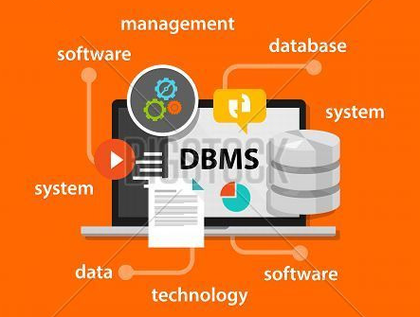

Unit – 1 Introductory concepts of DBMS
Prof. Firoz Sherasiya
 9879879861
→ firoz.sherasiya@darshan.ac.in
Database Management System (2130703) Darshan Institute of Engineering & Technology

Slide 2
Topics to be covered
Introduction of DBMS (Basic terms)
Applications of DBMS
Purpose (Advantages) of Database
Three levels ANSI SPARC Database System
Mappings and Data Independence
Database users and DBA
Database System Architecture

Slide 3
What is Database Management System (DBMS)?
Data - Fact that can be recorded or stored
e.g. Person Name, Age, Gender and Weight etc.
Database - Collection of logically related data
e.g. Books Database in Library, Student Database in University etc.
Management - Manipulation, Searching and Security of data
e.g. Viewing result in GTU website, Searching exam papers in GTU website
System - Programs or tools used to manage database
e.g. SQL Server Studio Express, Oracle 11g
DBMS - A Database Management System is a software for creating and managing databases. It provides a systematic way to create, retrieve, update and manage data.
e.g. MS SQL Server 2014, Oracle 11g, My SQL, MS Access, dBase etc.

Slide 4
Applications of DBMS
DBMS is computerized record-keeping system.
So where it is required to store data at there DBMS can be used.
E-Commerce (Flikart, Amazon, Shopclues, eBay etc.)
Online Television Streaming (Hotstar, Amazon Prime etc.)
Social Media (WhatsApp, Facebook, Twitter, LinkedIn etc.)
Banking & Insurance
Airline & Railway
Universities and Colleges/Schools
Human Resource Department
Hospitals and Medical Stores
Government Organizations
Write down any five applications of DBMS other than above.

Slide 5

Advantages of DBMS
Reduce data redundancy (duplication)
Computer
Civil
EmpName | Address | Mob | Subject
Nilesh Gambhva | Rajkot | 1234 | CPU
EmpName | Address | Mob | Subject
Nilesh Gambhva | Rajkot | 1234 | CPU
Database management system can remove such data redundancy by storing data centrally.
Same data is stored at four different places
EmpName | Address | Mob | Subject
Nilesh Gambhva | Rajkot | 1234 | CPU
EmpName | Address | Mob | Subject
Nilesh Gambhva | Rajkot | 1234 | CPU
Electrical
Mechanical

Slide 6
Advantages of DBMS (cont…)
Remove data inconsistency
Computer
Civil
EmpName | Address | Mob | Subject
Nilesh Gambhva | Rajkot | 1234 | CPU
EmpName | Address | Mob | Subject
Nilesh Gambhva | Rajkot | 1234 | CPU
678
Same data having different state (values)
Database management system can keep data in consistent state.
Mobile no is changed
EmpName | Address | Mob | Subject
Nilesh Gambhva | Rajkot | 1234 | CPU
EmpName | Address | Mob | Subject
Nilesh Gambhva | Rajkot | 1234 | CPU
678
Electrical
Mechanical

Slide 7
Advantages of DBMS
Data Isolation
EmpName | Address | Mob | Subject
Nilesh Gambhva | Rajkot | 1234 | CPU
File 1
EmpName | Salary | Load
Nilesh Gambhva | 50000 | 20
File 2
EmpName | Teaching | Knowledge | Discipline
Nilesh Gambhva | Good | V Good | Excellent
File 3
Data are scattered in various files
Files may be in different formats
Difficult to retrieve the appropriate data
Database management system allow us to access (retrieve) appropriate data easily.

Slide 8

Advantages of DBMS
Guaranteed Atomicity (Either transaction execute 0% or 100%)
Sum of both account before transfer is 3000
Person A
Account A
Bal : 2000
Transfer 500
Person B
Account B
Bal : 1000
Step 1 : Debit 500 from Account A
Step 2 : Credit 500 into Account B
Sum of both account is 2500
So Inconsistent
Sum of both account
after transfer is 3000

Slide 9
Advantages of DBMS
Allow to implement integrity constraints
EmpName | Address | MobileNo | Subject
Nilesh Gambhva | Rajkot | 9898052340 | CPU
Must contain exact 10 digits
StudentName | SPI | BackLogs
Jay Patel | 8 | 0
Must between 0 and 10
Database management system allow us to implement such rules in our database.

Slide 10

Advantages of DBMS (cont…)
Sharing of data among multiple users
Computer
Civil
EmpName | Address | Mob | Subject
Nilesh Gambhva | Rajkot | 1234 | CPU
EmpName | Address | Mob | Subject
Nilesh Gambhva | Rajkot | 1234 | CPU
Want to access
Want to access
Database management system allows more than one user to access same data simultaneously.
EmpName | Address | Mob | Subject
Nilesh Gambhva | Rajkot | 1234 | CPU
EmpName | Address | Mob | Subject
Nilesh Gambhva | Rajkot | 1234 | CPU
Electrical
Mechanical

Slide 11

Advantages of DBMS
Restricting unauthorized access to data
Wants to access
EmpName | Address | Mob | Subject
Nilesh Gambhva | Rajkot | 1234 | CPU
EmpName | Salary | Load
Nilesh Gambhva | 50000 | 20
Marwadi
Wants to access
EmpName | Teaching | Knowledge | Discipline
Nilesh Gambhva | Good | V Good | Excellent
Darshan/Firoz
Database management system prevents unauthorized user to access data.

Slide 12
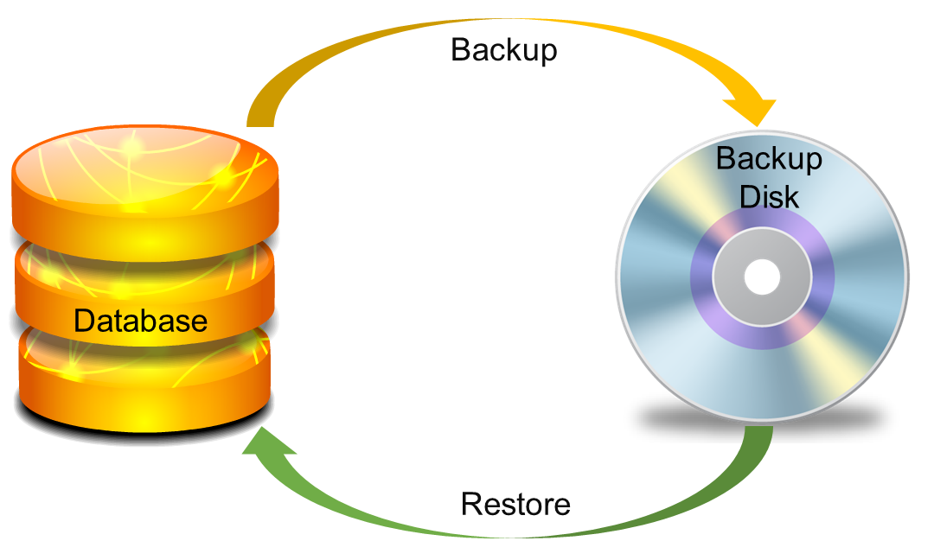
Advantages of DBMS
Providing backup and recovery services

Slide 13
Advantages of DBMS (Summary)
Reduce data redundancy (duplication)
Same data is stored at two different places
Remove data inconsistency
Same data having different state (values)
Data Isolation
Data are scattered in different files
Each file may have different formats
Difficult to retrieve proper data
Guaranteed Atomicity
Either transaction executes 0% or 100%

Slide 14
Advantages of DBMS (cont…)
Allow to implement integrity constraints
Rules such as do not allow to store amount less than Rs. 0 in balance.
Sharing of data among multiple users
More than one users can access same data at same time
Restricting unauthorized access to data
User can only access data which is authorized to him/her
Providing backup and recovery services
Can take regular auto or manual backup and use it to recover database if it corrupts.

Slide 15
Basic Terms
Data
Data is raw, unorganized facts that need to be processed.
Example: Marks of subjects
DBMS – 85/100, DS – 80/100, EEM – 75/100.
Information
When data is processed, organized, structured or presented in a given context so as to make it useful, it is called information.
Example: Percentage
Percentage = (DBMS + DS + EEM) / 3
(85 + 80 + 75) / 3 = 80%

Slide 16
Basic Terms (cont…)
Metadata
Metadata is data about data.
Data such as table name, column name, data type, authorized user and user access privileges for any table is called metadata for that table.
Table Name – Faculty
Column Name – EmpName, Address, Mob, Subject, Salary
Datatype – Varchar, Decimal
Access Privileges – Read, Write (Update)
Faculty
EmpName | Address | Mob | Subject | Salary
Nilesh Gambhva | Rajkot | 1234 | CPU | 50000

Slide 17
Basic Terms (cont…)
Data dictionary
Data dictionary is an information repository which contains metadata.
It is usually a part of the system catalog.
Data warehouse
Data warehouse is an information repository which stored data.
It is design to facilitate reporting and analysis.
Table Name – Faculty
Column Name – EmpName, Address, Mob, Subject, Salary
Datatype – Varchar, Decimal
Access Privileges – Read, Write (Update)
Why both the things are stored at different place???
Faculty
EmpName | Address | Mob | Subject | Salary
Nilesh Gambhva | Rajkot | 1234 | CPU | 50000
Data
Metadata

Slide 18
Basic Terms (cont…)
Field
A field is a character or group of characters that have a specific meaning.
It is also called a data item. It is represented in the database by a value.
For Example EmpName, Address, Mob, Subject, Salary are all fields for Employee Database.
Record
A record is a collection of logically related fields.
For examples, collection of fields (EmpName, Address, Mob, Subject & Salary) forms a record for employee.
Faculty
EmpName | Address | Mob | Subject | Salary
Nilesh Gambhva | Rajkot | 1234 | CPU | 50000

Slide 19
3 Levels ANSI SPARC Database System
User 1
User 2
User 3
How data are viewed by each users?
View 1
View 2
View 3
View
Level
What data are stored and
What relationships exist?
Conceptual
Level
Logical
Level
How the data are actually stored on storage devices?
Internal
Level
Physical
Level
Database

Slide 20

Mapping
Want to access some data
View 1
View 2
View 3
Request
Conceptual
Level
Process of transforming requests and results between the three levels is called mapping
Internal
Level
Result
Database

Slide 21
Types of Mapping
Want to access some data
View 1
View 2
View 3
External/Conceptual
Mapping
Which objects on the conceptual level correspond to the objects requested on a particular user's external view
Several mapping
Conceptual
Level
Conceptual/Internal
Mapping
Internal
Level
How conceptual records and fields stored
One mapping
Database

Slide 22
Data Independence
Want to access some data
View 1
View 2
View 3
Allows to change conceptual schema without affecting the existing external schema.
Required whenever the logical structure of the database is altered.
Difficult to achieve
Conceptual
Level
Logical Data Independence
Internal
Level
Physical Data Independence
Allows changing in physical storage devices without change in the conceptual view or external view.
Required to improve performance.
Easy to achieve
Ability to modify a schema definition in one level without affecting a schema definition in the next higher level.
Database

Slide 23
Types of database users
Naive Users (End Users)
Unsophisticated users who have zero knowledge of database system
User interacts to database via sophisticated software or tools
e.g. Clerk in Bank
Application Programmers
Programmers who write software using tools such as Java, .Net, PHP etc…
e.g. Software Developers
Sophisticated Users
Interact with database system without using application program
Use query tools like SQL
e.g. Analyst
Specialized Users (DBA)
User write specialized database applications program
Use administration tools
e.g. Database Administrator

Slide 24
Role of DBA (Database Administrator)
Schema Definition
defines the logical schema of the database.
Storage Structure and Access Method Definition
decides how the data is to be represented in the database & how to access it.
Defining Security and Integrity Constraints
decides various security and integrity constraints.
Granting of Authorization for Data Access
determines which user needs access to which part of the database.

Slide 25
Role of DBA (Database Administrator)
Liaison with Users
provide necessary data to user.
Assisting Application Programmer
provides assistance to application programmers to develop application programs.
Monitoring Performance
ensures that better performance is maintained by making change in physical or logical schema if required.
Backup and Recovery
backing up the database on some storage devices such as DVD, CD or Magnetic Tape or remote servers and recover system in case of failures, such as flood or virus attack from this backup.

Slide 26
Database System Architecture
naive users
application programmer
sophisticated
users
database administrator
uses
write
uses
uses
application
interfaces
application
program
query
tool
administration tool
translates DML statements into low level instructions that the query evaluation engine understands
Interprets DDL statements into a set of tables containing metadata
compiler and linker
DML queries
DDL interpreter
Executes low level instructions generated by DML compiler.
deal with execution of DDL and DML statements
application program object code
DML compiler and organizer
query evaluation engine
query processor
buffer manager
file manager
authorization and integrity manager
transaction manager
Manages allocation of space on disk storage
storage manager
Fetches data from disk storage to memory for being used
Preserves atomicity and controls concurrency
provides interface between low-level data stored and application program and queries
Checks the authority of users to access data and integrity constraints
To provide faster access to data items
indices
data dictionary
disk storage
To store user data
data
statistical data
To store statistical information about the data
To store metadata

