Slide 1


Unit – 2 Relational Model
Prof. Firoz Sherasiya
 9879879861
→ firoz.sherasiya@darshan.ac.in
Database Management System (2130703) Darshan Institute of Engineering & Technology

Slide 2
Topics to be covered
Structure of relational databases
Domains
Relations
Relational algebra – fundamental operators and syntax
Relational algebra queries
Tuple relational calculus

Slide 3
Basic Terms
Table / Relation???
Attributes???
Columns???
RollNo | Name | Branch | Semester | SPI
101 | Raju | CE | 3 | 8
102 | Mitesh | CE | 3 | 7
103 | Mayur | CE | 3 | 6
104 | Nilesh | CE | 3 | 9
105 | Hitesh | CE | 3 | 7
106 | Tarun | CE | 3 | 8
Tuples OR Records???
Cardinality = No of Tuples (6)
Degree = No of Attributes (5)
Domain = Set of all possible values for a specific attributes.

Slide 4
Keys
Super Key
A super key is a set of one or more attributes whose values uniquely identifies each record within a relation.
Super Key (EnrollNo)
Super Key (RollNo, Branch, Semester)
EnrollNo
RollNo
Name
Branch
Semester
SPI
BackLog
140540107001
101
Jatin
CE
3
8
0
140540107002
102
Meet
CE
3
7
0
140540106001
101
Ram
CI
3
8
0
140540106002
102
Jatin
CI
3
6
1
130540107001
101
Priya
CE
5
8
0
130540107002
102
Meet
CE
5
7
1
130540106001
101
Samir
CI
5
7
1

Slide 5
Keys
Candidate Key
A candidate is a subset of a super key.
A candidate key is a single attribute or the least combination of attribute that uniquely identifies each record in the table.
The least combination of fields distinguishes a candidate key from a super key.
Candidate key is a super key for which no proper subset is a super key.

Slide 6

Keys
What is the difference between
super key and candidate key??
Candidate Key
Candidate Key (EnrollNo)
Candidate Key
(RollNo, Branch, Semester)
EnrollNo
RollNo
Name
Branch
Semester
SPI
BackLog
140540107001
101
Jatin
CE
3
8
0
140540107002
102
Meet
CE
3
7
0
140540106001
101
Ram
CI
3
8
0
140540106002
102
Jatin
CI
3
6
1
130540107001
101
Priya
CE
5
8
0
130540107002
102
Meet
CE
5
7
1
130540106001
101
Samir
CI
5
7
1

Slide 7
Keys
Super Key V/S Candidate Key
EnrollNo alone works as a super key??
Answer is Yes
So (EnrollNo, Branch) is super key but not candidate key.
Super Key
(EnrollNo, Branch)
EnrollNo
RollNo
Name
Branch
Semester
SPI
BackLog
140540107001
101
Jatin
CE
3
8
0
140540107002
102
Meet
CE
3
7
0
140540106001
101
Ram
CI
3
8
0
140540106002
102
Jatin
CI
3
6
1
130540107001
101
Priya
CE
5
8
0
130540107002
102
Meet
CE
5
7
1
130540106001
101
Samir
CI
5
7
1

Slide 8
Keys
Super Key V/S Candidate Key
Super Key
(RollNo, Branch, Semester)
RollNo and Branch alone works as a super key??
Answer is No
EnrollNo
RollNo
Name
Branch
Semester
SPI
BackLog
140540107001
101
Jatin
CE
3
8
0
140540107002
102
Meet
CE
3
7
0
140540106001
101
Ram
CI
3
8
0
140540106002
102
Jatin
CI
3
6
1
130540107001
101
Priya
CE
5
8
0
130540107002
102
Meet
CE
5
7
1
130540106001
101
Samir
CI
5
7
1

Slide 9
Keys
Super Key V/S Candidate Key
Super Key
(RollNo, Branch, Semester)
RollNo and Semester alone works as a super key??
Answer is No
EnrollNo
RollNo
Name
Branch
Semester
SPI
BackLog
140540107001
101
Jatin
CE
3
8
0
140540107002
102
Meet
CE
3
7
0
140540106001
101
Ram
CI
3
8
0
140540106002
102
Jatin
CI
3
6
1
130540107001
101
Priya
CE
5
8
0
130540107002
102
Meet
CE
5
7
1
130540106001
101
Samir
CI
5
7
1

Slide 10
Keys
Super Key V/S Candidate Key
Branch and Semester alone works as a super key??
Answer is No
So (EnrollNo, Branch, Semester) is super key as well as candidate key.
Super Key
(RollNo, Branch, Semester)
EnrollNo
RollNo
Name
Branch
Semester
SPI
BackLog
140540107001
101
Jatin
CE
3
8
0
140540107002
102
Meet
CE
3
7
0
140540106001
101
Ram
CI
3
8
0
140540106002
102
Jatin
CI
3
6
1
130540107001
101
Priya
CE
5
8
0
130540107002
102
Meet
CE
5
7
1
130540106001
101
Samir
CI
5
7
1

Slide 11
Keys
Primary Key
A Primary key is a candidate key that is chosen by database designer to identify tuples uniquely in a relation.
Primary Key
Candidate Key (EnrollNo)
Candidate Key (RollNo, Branch, Semester)
EnrollNo | RollNo | Name | Branch | Semester | SPI | BackLog
140540107001 | 101 | Jatin | CE | 3 | 8 | 0
140540107002 | 102 | Meet | CE | 3 | 7 | 0
140540106001 | 101 | Ram | CI | 3 | 8 | 0
140540106002 | 102 | Jatin | CI | 3 | 6 | 1
130540107001 | 101 | Priya | CE | 5 | 8 | 0
130540107002 | 102 | Meet | CE | 5 | 7 | 1
130540106001 | 101 | Samir | CI | 5 | 7 | 1

Slide 12
Keys
Alternate Key
An Alternate key is a candidate key that is not chosen by database designer to identify tuples uniquely in a relation.
Alternate Key
Candidate Key (EnrollNo)
Candidate Key (RollNo, Branch, Semester)
EnrollNo | RollNo | Name | Branch | Semester | SPI | BackLog
140540107001 | 101 | Jatin | CE | 3 | 8 | 0
140540107002 | 102 | Meet | CE | 3 | 7 | 0
140540106001 | 101 | Ram | CI | 3 | 8 | 0
140540106002 | 102 | Jatin | CI | 3 | 6 | 1
130540107001 | 101 | Priya | CE | 5 | 8 | 0
130540107002 | 102 | Meet | CE | 5 | 7 | 1
130540106001 | 101 | Samir | CI | 5 | 7 | 1

Slide 13
Keys
Primary Key V/S Alternate Key
Primary Key (EnrollNo)
Alternate Key (RollNo, Branch, Semester)
EnrollNo | RollNo | Name | Branch | Semester | SPI | BackLog
140540107001 | 101 | Jatin | CE | 3 | 8 | 0
140540107002 | 102 | Meet | CE | 3 | 7 | 0
140540106001 | 101 | Ram | CI | 3 | 8 | 0
140540106002 | 102 | Jatin | CI | 3 | 6 | 1
130540107001 | 101 | Priya | CE | 5 | 8 | 0
130540107002 | 102 | Meet | CE | 5 | 7 | 1
130540106001 | 101 | Samir | CI | 5 | 7 | 1

Slide 14
Keys
Foreign key
A foreign key is a set of one or more attributes whose values are derived from the primary key attribute of another relation.

Slide 15
Basic Operations
Selection
Projection
Cross Product / Cartesian Product
Division
Renaming
Joins
Natural Join / Inner Join
Outer Join
Left Outer Join
Right Outer Join
Full Outer Join

Slide 16
Basic Operations
Set Operators
Union
Intersection
Minus / Set-difference

Slide 17
Selection operator
Symbol: σ (Sigma)
Notation: σ _{condition}(Relation)
Operation: Selects tuples from a relation that satisfy a given condition.
Operators: =, ?, <, >, <=,>=, Λ (AND), ∨ (OR)

Slide 18
Selection operator
Example: Display the detail of students belongs to “CE” branch.
RollNo | Name | Branch | SPI
101 | Raj | CE | 8
102 | Meet | ME | 9
103 | Harsh | EE | 8
104 | Punit | CE | 9
Student
σ _{Branch=‘CE’} (Student)
RollNo | Name | Branch | SPI
101 | Raj | CE | 8
104 | Punit | CE | 9
Output

Slide 19
Selection operator
Exercise:
RollNo | Name | Branch | SPI
101 | Raj | CE | 8
102 | Meet | ME | 9
103 | Harsh | EE | 8
104 | Punit | CE | 9
Student
Display the detail of students whose rollno is less than 104.
Display the detail of students having SPI more than 8.
Display the detail of students belongs to “CE” branch having SPI more than 8.
Display the detail of students belongs to “CE” or “ME” branch.

Slide 20
Projection operator
Symbol: ∏ (Pi)
Notation: ∏ _{attribute set} (Relation)
Operation: Selects specified attributes of a relation.

Slide 21
Projection operator
Example: Display rollno, name and branch of all students.
RollNo | Name | Branch | SPI
101 | Raj | CE | 8
102 | Meet | ME | 9
103 | Harsh | EE | 8
104 | Punit | CE | 9
Student
∏ _{RollNo, Name, Branch} (Student)
RollNo | Name | Branch
101 | Raj | CE
102 | Meet | ME
103 | Harsh | EE
104 | Punit | CE
Output

Slide 22
Projection operator
Exercise:
RollNo | Name | Branch | SPI
101 | Raj | CE | 8
102 | Meet | ME | 9
103 | Harsh | EE | 8
104 | Punit | CE | 9
Student
Display rollno, name and SPI of all students.
Display name and SPI of all students.

Slide 23
Combined Projection & Selection Operation
Example: Display rollno, name & branch of “CE” branch students.
RollNo | Name | Branch | SPI
101 | Raj | CE | 8
102 | Meet | ME | 9
103 | Harsh | EE | 8
104 | Punit | CE | 9
Student
∏ _{RollNo, Name, Branch} (σ _{Branch=‘CE’} (Student) )
1
2
RollNo | Name | Branch | SPI
101 | Raj | CE | 8
104 | Punit | CE | 9
Output-1
RollNo | Name | Branch
101 | Raj | CE
104 | Punit | CE
Output-2

Slide 24
Combined Projection & Selection Operation
Example: Display rollno and name of “CE” branch students.
RollNo | Name | Branch | SPI
101 | Raj | CE | 8
102 | Meet | ME | 9
103 | Harsh | EE | 8
104 | Punit | CE | 9
Student
∏ _{RollNo, Name} (σ _{Branch=‘CE’} (Student) )
1
2
RollNo | Name | Branch | SPI
101 | Raj | CE | 8
104 | Punit | CE | 9
Output-1
RollNo | Name
101 | Raj
104 | Punit
Can we use selection left side and projection right side??
Output-2

Slide 25
Combined Projection & Selection Operation
Example: Display rollno and name of “CE” branch students.
RollNo | Name | Branch | SPI
101 | Raj | CE | 8
102 | Meet | ME | 9
103 | Harsh | EE | 8
104 | Punit | CE | 9
Student
σ _{Branch=‘CE’} (∏ _{RollNo, Name}(Student) )
1
2
RollNo | Name
101 | Raj
102 | Meet
103 | Harsh
104 | Punit
Where is branch column to check condition??
Output-1
So we can’t use selection left side and projection right side.

Slide 26
Combined Projection & Selection Operation
Exercise:
RollNo | Name | Branch | SPI
101 | Raj | CE | 8
102 | Meet | ME | 9
103 | Harsh | EE | 8
104 | Punit | CE | 9
Student
Display rollno, name and SPI of all students belongs to “CE” branch.
List the name of students with their branch whose SPI is more than 8 and belongs to “CE” branch.
List the name of students belongs to either “CE” or “ME” branch with their branch and SPI.

Slide 27
Exercise
Display the name of faculties belong to CE branch and having salary more than 25000.
Display the name of all CE and ME branch’s faulty.
List the name of faculty with their salary who belongs to CE or ME branch having salary more than 35000.
Display the name of faculty along with their branch name whose salary between 25000 and 50000.
FacultyID | Name | Branch | Salary
101 | B. M. Patel | CE | 25000
102 | A. M. Shah | ME | 35000
103 | J. B. Katara | EE | 18000
104 | H. N. Shukla | CE | 50000
105 | V. K. Vyas | ME | 45000
Faculty

Slide 28
Cartesian Product / Cross Product
Symbol: X (Cross)
Notation: Relation1 X Relation2
Operation: It will multiply each tuples of Relation1 to each tuples of Relation2.
Attributes of Resultant Relation = Attributes of R1 + Attributes of R2
Tuples of Resultant Relation = Attributes of R1 * Attributes of R2
If both relations have some attribute having same name, it can be distinguished by combing relation-name.attribute-name.

Slide 29
Cartesian Product / Cross Product
Example:
RollNo | Name | Branch
101 | Raj | CE
102 | Meet | ME
RollNo | SPI
101 | 8
103 | 9
Student
Result
Student.RollNo | Name | Branch | Result.RollNo | SPI
101 | Raj | CE | 101 | 8
101 | Raj | CE | 103 | 9
102 | Meet | ME | 101 | 8
102 | Meet | ME | 103 | 9
Student X Result
Inconsistent Records

Slide 30
Natural Join
Symbol:
Notation: Relation1 Relation2
Operation: Natural join will retrieve information (consistent data) from multiple relations.
It performs Cartesian product
Then it finds consistent tuples and inconsistent tuples are deleted
Then it deletes duplicate attributes
Steps

Slide 31
Natural Join
Operation:
Step 1 : It performs Cartesian product
RollNo | Name | Branch
101 | Raj | CE
102 | Meet | ME
RollNo | SPI
101 | 8
103 | 9
Student
Result
Student.RollNo | Name | Branch | Result.RollNo | SPI
101 | Raj | CE | 101 | 8
101 | Raj | CE | 103 | 9
102 | Meet | ME | 101 | 8
102 | Meet | ME | 103 | 9
Step 1

Slide 32
Natural Join
Operation:
Step 2 : Finds consistent tuples and inconsistent tuples are deleted
RollNo | Name | Branch
101 | Raj | CE
102 | Meet | ME
RollNo | SPI
101 | 8
103 | 9
Student
Result
Student.RollNo | Name | Branch | Result.RollNo | SPI
101 | Raj | CE | 101 | 8
101 | Raj | CE | 103 | 9
102 | Meet | ME | 101 | 8
102 | Meet | ME | 103 | 9
Step 2
Inconsistent Records

Slide 33
Natural Join
Operation:
Step 2 : Finds consistent tuples and inconsistent tuples are deleted
RollNo | Name | Branch
101 | Raj | CE
102 | Meet | ME
RollNo | SPI
101 | 8
103 | 9
Student
Result
Student.RollNo | Name | Branch | Result.RollNo | SPI
101 | Raj | CE | 101 | 8
Step 2

Slide 34
Natural Join
Operation:
Step 3 : Delete duplicate attributes
RollNo | Name | Branch
101 | Raj | CE
102 | Meet | ME
RollNo | SPI
101 | 8
103 | 9
Student
Result
RollNo | Name | Branch | SPI
101 | Raj | CE | 8
Step 3
Note:- To perform natural join there must be one common column between two relations.

Slide 35
Exercise of Natural Join
Student_Personal (Rno, Sname, Address, City, Mobile)
Department (Did, Dname)
Student_Academic (Rno, Did, SPI, CPI, Backlog)
Student_Project_Guide (Rno, ProjectName, Fid)
Faculty (Fid, Fname, Subject, Did, Salary)
List the name of students with their department name and SPI of all student belongs to “CE” department
Display the name of students with their project name whose guide is “A. J. Shah”.
List the name of students with their department name having backlog 0.
List the name of faculties with their department name and salary having salary more than 25000 and belongs to “CE” department.

Slide 36
Exercise of Natural Join
Student_Personal (Rno, Sname, Address, City, Mobile)
Department (Did, Dname)
Student_Academic (Rno, Did, SPI, CPI, Backlog)
Student_Project_Guide (Rno, ProjectName, Fid)
Faculty (Fid, Fname, Subject, Did, Salary)
Display the name of students with their project name of all “CE” department’s students whose guide is “M. N. Patel”.
Display the name of faculties with their department name who belongs to “CE” department and tough “CPU” subject having salary more than 25000.
List the name of students with their department name doing project “Hackathon” under guide “A. V. Bala”.
List the name of all faculties of “CE” and “ME” department whose salary is more than 50000.

Slide 37



Outer Join
Operation: In natural join some records are missing if we want that missing records than we have to use outer join.
Types: Three types of Outer Join
Left Outer Join
Right Outer Join
Full Outer Join

Slide 38
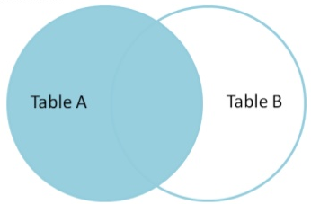
Left Outer Join
Left Outer Join: Display all the tuples of the left relation even through there is no matching tuple in the right relation.
For such kind of tuples having no matching, the attributes of right relation will be padded with null in resultant relation.
Example:
Student
Result
RollNo | Name | Branch
101 | Raj | CE
102 | Meet | ME
RollNo | SPI
101 | 8
103 | 9
Input
RollNo | Name | Branch | SPI
101 | Raj | CE | 8
102 | Meet | ME | Null
Student Result

Slide 39
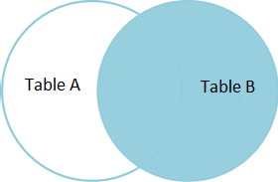
Right Outer Join
Right Outer Join: Right outer join returns all the tuples of right relation even through there is no matching tuple in the left relation.
For such kind of tuples having no matching, the attributes of left relation will be padded with null in resultant relation.
Example:
Student
Result
RollNo | Name | Branch
101 | Raj | CE
102 | Meet | ME
RollNo | SPI
101 | 8
103 | 9
Input
RollNo | Name | Branch | SPI
101 | Raj | CE | 8
103 | Null | Null | 9
Student Result

Slide 40
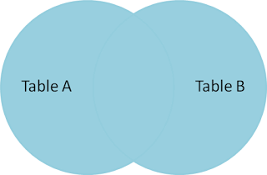
Full Outer Join
Full Outer Join: The full outer join returns all the tuples of both of the relations. It also pads null values whenever required.
For such kind of tuples having no matching, it will be padded with null in resultant relation.
Example:
Student
Result
RollNo | Name | Branch
101 | Raj | CE
102 | Meet | ME
RollNo | SPI
101 | 8
103 | 9
Input
RollNo | Name | Branch | SPI
101 | Raj | CE | 8
102 | Meet | ME | Null
103 | Null | Null | 9
Student Result

Slide 41

Set Operators
Condition to perform operation: All of these operations take two input relations, which must be union - compatible:
Both relations have same (equal) number of columns
RollNo | Name | Branch | SPI
101 | Raj | CE | 8
102 | Meet | CE | 7
103 | Neel | ME | 9
EmpNo | Name | Branch
101 | Patel | CE
102 | Shah | CE
103 | Ghosh | EE
RollNo | Name | Branch | SPI
101 | Raj | CE | 8
102 | Meet | CE | 7
103 | Neel | ME | 9
EmpNo | Name | Branch | Exp
101 | Raj | CE | 8
102 | Meet | CE | 1
103 | Ghosh | EE | 9

Slide 42
Set Operators
Operation: All of these operations take two input relations, which must be union - compatible:
Attributes domain must be compatible OR
Corresponding fields have the same type
RollNo | Name | Branch | SPI
101 | Raj | CE | 8
102 | Meet | CE | 7
103 | Neel | ME | 9
EmpNo | Name | Branch | Subject
101 | Raj | CE | DBMS
102 | Meet | CE | DS
103 | Ghosh | EE | EEM
RollNo | Name | Branch | SPI
101 | Raj | CE | 8
102 | Meet | CE | 7
103 | Neel | ME | 9
EmpNo | Name | Branch | Exp
101 | Raj | CE | 8
102 | Meet | CE | 1
103 | Ghosh | EE | 9

Slide 43
Set Operators
Exercise: Check whether following tables are compatible or not
A: (First_name (char), Last_name(char), Date_of_Birth(date))
B: (FName(char), LName(char), PhoneNumber(number))
(Not compatible) Both table have 3 attributes but third attributes datatype is different.
A: (First_name (char), Last_name(char), Date_of_Birth(date))
B: (FName(char), LName(char), DOB(date))
(Compatible) Both table have 3 attributes and of same date type.

Slide 44
Set Operators
Person (SSN, Name, Address, Hobby)
Professor (Id, Name, Office, Phone)
are not union compatible.
But
∏ _{Name} (Person) and ∏ _{Name} (Professor)
are union compatible.

Slide 45
Set Operators
Types of set operators
Union
Intersect (Intersection)
Minus (Set Difference)

Slide 46
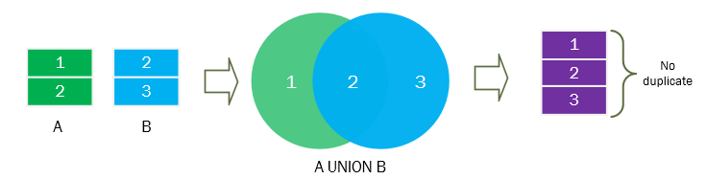
Union Operator
Symbol: U
Notation: Relation1 U Relation2
Operation: Combine the records from two or more sets (tables) in to a single set (table), without duplicates.
Customer
Raj
Suresh
Meet
Employee
Meet
Suresh
Manoj
Customer U Employee
Manoj
Meet
Raj
Suresh

Slide 47
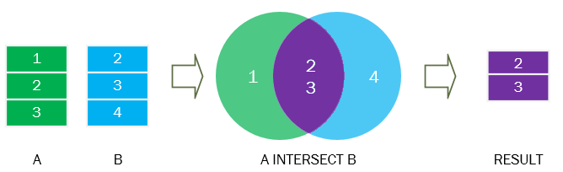
Intersect Operator
Symbol: ∩
Notation: Relation1 ∩ Relation2
Operation: Returns the records which are common from both relations.
Customer
Raj
Suresh
Meet
Employee
Meet
Suresh
Manoj
Customer ∩ Employee
Meet
Suresh

Slide 48
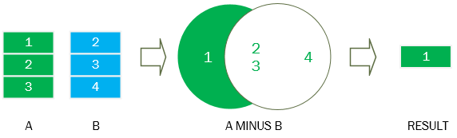
Minus Operator
Symbol: −
Notation: Relation1 − Relation2
Operation: Returns all the records from first (left) relation that are not contained in the second relation.
Customer
Raj
Suresh
Meet
Employee
Meet
Suresh
Manoj
Customer - Employee
Raj
Employee - Customer
Manoj

Slide 49
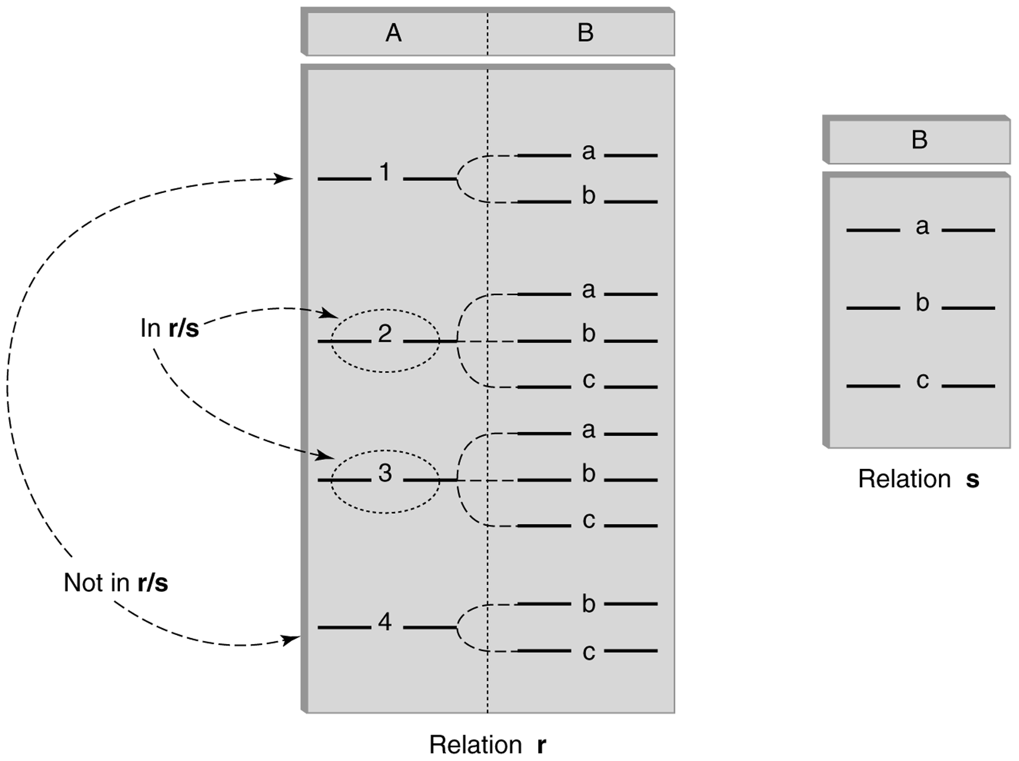
Division Operator
Symbol: ÷
Notation: Relation1 ÷ Relation2
Operation: Produce the tuples in Relation1, that match all tuples in Relation2.

Slide 50
Division Operator Examples
B1
B2
B3
A
A/B1
A/B2
A/B3

Slide 51
Division Operator Examples
Rno | Name | Technology
101 | Raj | .NET
101 | Raj | iPhone
102 | Meet | .NET
102 | Meet | PHP
102 | Meet | iPhone
102 | Meet | Android
103 | Vijay | PHP
104 | Jay | .NET
104 | Jay | PHP
104 | Jay | iPhone
104 | Jay | Android
TID | Technology
1 | .NET
2 | PHP
3 | iPhone
4 | Android
Student
Project
Name
Meet
Jay
Output
∏ _{Name, Technology} (Student) ÷ ∏ _{Technology}(Project)

Slide 52
Rename Operator
Symbol: ρ (Rho)
Notation: ρA (X1,X2….Xn) (Relation)
Operation: It is used to rename a relation or attributes.

Slide 53
Rename Operator
Example: Student
Find out maximum CPI from student table.
∏_{CPI} (Student) — ∏_{A.CPI} (σ _{A.CPI<B.CPI} (ρ_{A} (Student) X ρ_{B} (Student)))
Rno | Name | CPI
101 | Raj | 8
102 | Meet | 9
103 | Suresh | 7

Slide 54
Rename Operator
Example: Student
ρ_{A} (Student) X ρ_{B} (Student)
Rno | Name | CPI
101 | Raj | 8
102 | Meet | 9
103 | Suresh | 7
A.Rno | A.Name | A.CPI | B.Rno | B.Name | B.CPI
101 | Raj | 8 | 101 | Raj | 8
101 | Raj | 8 | 102 | Meet | 9
101 | Raj | 8 | 103 | Suresh | 7
102 | Meet | 9 | 101 | Raj | 8
102 | Meet | 9 | 102 | Meet | 9
102 | Meet | 9 | 103 | Suresh | 7
103 | Suresh | 7 | 101 | Raj | 8
103 | Suresh | 7 | 102 | Meet | 9
103 | Suresh | 7 | 103 | Suresh | 7

Slide 55
Rename Operator
Example: Student
σ _{A.CPI<B.CPI} (ρ_{A} (Student) X ρ_{B} (Student))
A.Rno | A.Name | A.CPI | B.Rno | B.Name | B.CPI
101 | Raj | 8 | 101 | Raj | 8
101 | Raj | 8 | 102 | Meet | 9
101 | Raj | 8 | 103 | Suresh | 7
102 | Meet | 9 | 101 | Raj | 8
102 | Meet | 9 | 102 | Meet | 9
102 | Meet | 9 | 103 | Suresh | 7
103 | Suresh | 7 | 101 | Raj | 8
103 | Suresh | 7 | 102 | Meet | 9
103 | Suresh | 7 | 103 | Suresh | 7

Slide 56
Rename Operator
Example: Student
σ _{A.CPI<B.CPI} (ρ_{A} (Student) X ρ_{B} (Student))
A.Rno | A.Name | A.CPI | B.Rno | B.Name | B.CPI
101 | Raj | 8 | 101 | Raj | 8
101 | Raj | 8 | 102 | Meet | 9
101 | Raj | 8 | 103 | Suresh | 7
102 | Meet | 9 | 101 | Raj | 8
102 | Meet | 9 | 102 | Meet | 9
102 | Meet | 9 | 103 | Suresh | 7
103 | Suresh | 7 | 101 | Raj | 8
103 | Suresh | 7 | 102 | Meet | 9
103 | Suresh | 7 | 103 | Suresh | 7

Slide 57
Rename Operator
Example: Student
σ _{A.CPI<B.CPI} (ρ_{A} (Student) X ρ_{B} (Student))
A.Rno | A.Name | A.CPI | B.Rno | B.Name | B.CPI
101 | Raj | 8 | 102 | Meet | 9
103 | Suresh | 7 | 101 | Raj | 8
103 | Suresh | 7 | 102 | Meet | 9

Slide 58
Rename Operator
Example: Student
∏_{A.CPI} (σ _{A.CPI<B.CPI} (ρ_{A} (Student) X ρ_{B} (Student)))
A.Rno | A.Name | A.CPI | B.Rno | B.Name | B.CPI
101 | Raj | 8 | 102 | Meet | 9
103 | Suresh | 7 | 101 | Raj | 8
103 | Suresh | 7 | 102 | Meet | 9

Slide 59
Rename Operator
Example: Student
∏_{A.CPI} (σ _{A.CPI<B.CPI} (ρ_{A} (Student) X ρ_{B} (Student)))
A.CPI
8
7

Slide 60
Rename Operator
Example: Student
∏_{CPI} (Student) ─ ∏_{A.CPI} (σ _{A.CPI<B.CPI} (ρ_{A} (Student) X ρ_{B} (Student)))
CPI
8
9
7
A.CPI
8
7
CPI
9
—
=

Slide 61
Aggregate Functions
Symbol: g or G
Notation: g function-name (column) (Relation)
Operation: It takes a more than one value as input and returns a single value as output (result).
Sum, Max, Min, Avg, Count

Slide 62
Aggregate Functions (sum)
Example: Student
Example: Find out sum of all students CPI.
G _{sum(CPI)} (Student)
Rno | Name | Branch | Semester | CPI
101 | Ramesh | CE | 3 | 9
102 | Mahesh | EC | 3 | 8
103 | Suresh | ME | 4 | 7
104 | Amit | EE | 4 | 8
105 | Anita | CE | 4 | 8
106 | Reeta | ME | 3 | 7
107 | Rohit | EE | 4 | 9
108 | Chetan | CE | 3 | 8
109 | Rakesh | CE | 4 | 9
sum
73

Slide 63
Aggregate Functions (max, min)
Example: Student
Example: Find out maximum & minimum CPI.
G _{max(CPI), min(CPI)} (Student)
Rno | Name | Branch | Semester | CPI
101 | Ramesh | CE | 3 | 9
102 | Mahesh | EC | 3 | 8
103 | Suresh | ME | 4 | 7
104 | Amit | EE | 4 | 8
105 | Anita | CE | 4 | 8
106 | Reeta | ME | 3 | 7
107 | Rohit | EE | 4 | 9
108 | Chetan | CE | 3 | 8
109 | Rakesh | CE | 4 | 9
max | min
9 | 7

Slide 64
Aggregate Functions (count)
Example: Student
Example: Count the number of students.
G _{count(Rno)} (Student)
Rno | Name | Branch | Semester | CPI
101 | Ramesh | CE | 3 | 9
102 | Mahesh | EC | 3 | 8
103 | Suresh | ME | 4 | 7
104 | Amit | EE | 4 | 8
105 | Anita | CE | 4 | 8
106 | Reeta | ME | 3 | 7
107 | Rohit | EE | 4 | 9
108 | Chetan | CE | 3 | 8
109 | Rakesh | CE | 4 | 9
count
9

Slide 65
Exercise
Employee (person-name, street, city)
Works (person-name, company-name, salary)
Company (company-name, city)
Managers (person-name, manager-name)
Find the names of all employees who work for “First Bank Corporation”.
Find the names and cities of residence of all employees who work for “First Bank Corporation”.
Find the names, street address, and cities of residence of all employees who work for First Bank Corporation and earn more than $10,000 per annum.
Find the names of all employees in this database who live in the same city as the company for which they work.

Slide 66
Exercise
Employee (person-name, street, city)
Works (person-name, company-name, salary)
Company (company-name, city)
Managers (person-name, manager-name)
Find the names of all employees in this database who do not work for First Bank Corporation.
Find the names of all employees working in “TCS” who earn more than 25000 and less than 40000.
Find the name of employee whose manager is “Ajay Pate” and salary is more than 50000.
Display the name of employee with street, city, company name, salary and manager name staying in “Rajkot” and working in “Ahmedabad”.

