Slide 1

Unit – 2 Boolean Algebra and Mapping Methods
Hardik Doshi
 99789 11553
→ hardik.doshi@darshan.ac.in
Digital Electronics (2131004) Darshan Institute of Engineering & Technology

Slide 2
Topics to be covered
Boolean Algebra
Karnaugh Maps
Variable Entered Maps
Realizing Logic Function with Gates
Combinational Design Examples

Slide 3
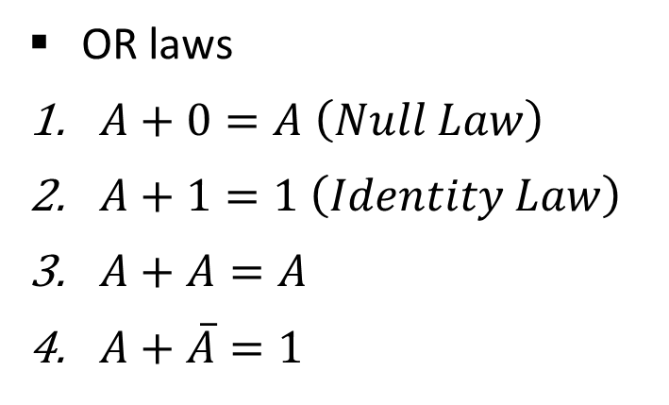
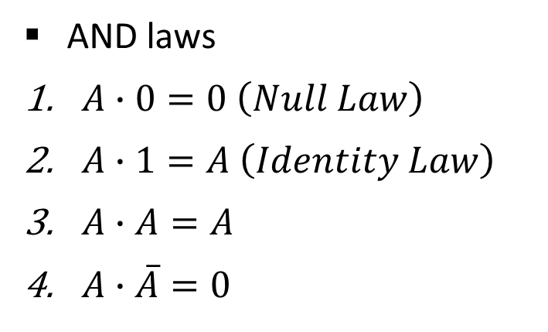
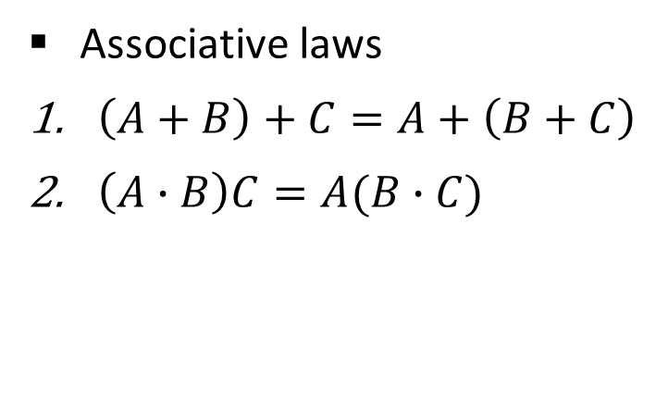
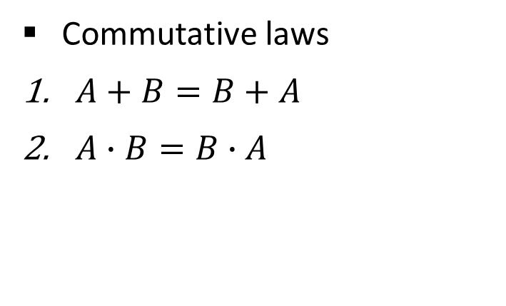
Boolean Algebra
AND laws
$A∙0=0 \left(Null Law\right)$
$A∙1=A \left(Identity Law\right)$
$A∙A=A$
$A∙\overline{A}=0$
OR laws
$A+0=A \left(Null Law\right)$
$A+1=1 \left(Identity Law\right)$
$A+A=A$
$A+\overline{A}=1$
Commutative laws
$A+B=B+A$
$A∙B=B∙A$
Associative laws
$\left(A+B\right)+C=A+\left(B+C\right)$
$\left(A∙B\right)C=A(B∙C)$

Slide 4
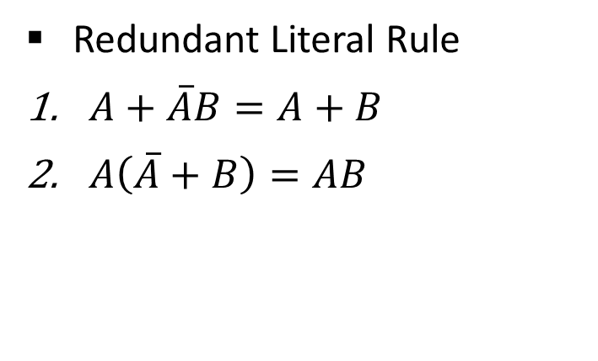
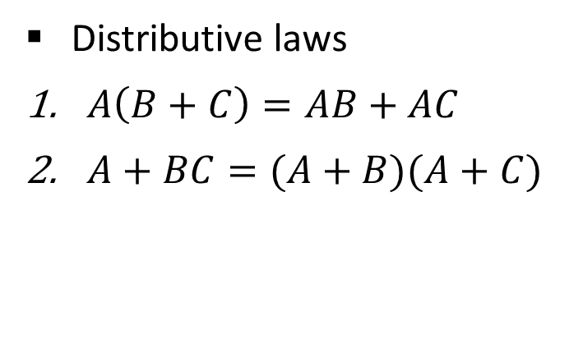
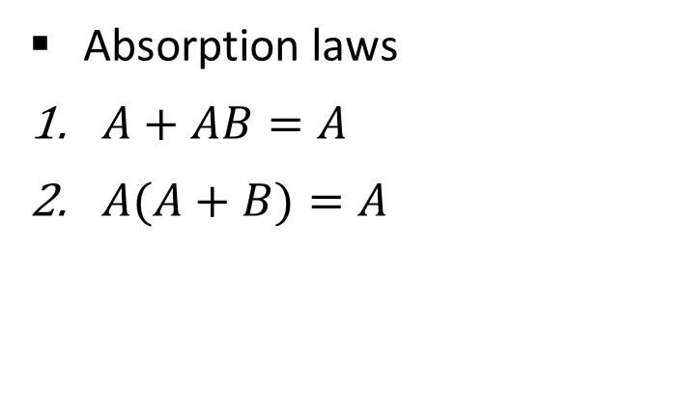

Boolean Algebra
Distributive laws
$A\left(B+C\right)=AB+AC$
$A+BC=(A+B)(A+C)$
Redundant Literal Rule
$A+\overline{A}B=A+B$
$A\left(\overline{A}+B\right)=AB$
Idempotent laws
$A∙A=A$
$A+A=A$
Absorption laws
$A+AB=A$
$A(A+B)=A$

Slide 5
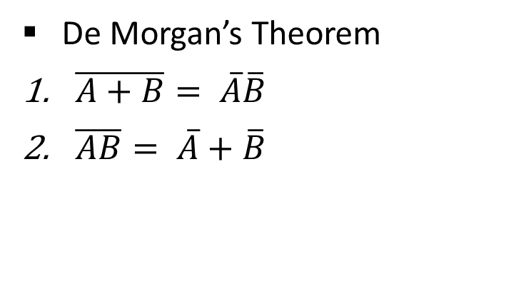
Boolean Algebra
De Morgan’s Theorem
$\overline{A+B}= \overline{A}\overline{B}$
$\overline{AB}= \overline{A}+\overline{B}$

Slide 6







Reducing Boolean Expression
Reduce the expression $f=A+B[AC+\left(B+\overline{C}\right)D]$
$$f=A+B[AC+\left(B+\overline{C}\right)D]$$
$$f=A+B[AC+BD+\overline{C}D]$$
$$f=A+BAC+BBD+B\overline{C}D$$
$$f=A+ABC+BD+B\overline{C}D$$
$$f=A(1+BC)+BD(1+\overline{C})$$
$$f=A+BD$$

Slide 7








Reducing Boolean Expression
Reduce the expression $f=A[B+\overline{C}(\overline{AB+A\overline{C}})]$
$$f=A[B+\overline{C}(\overline{AB+A\overline{C}})]$$
$$f=A[B+\overline{C}(\overline{AB}\overline{A\overline{C}})]$$
$$f=A[B+\overline{C}(\overline{A}+\overline{B})(\overline{A}+C)]$$
$$f=A[B+\overline{C}(\overline{A}\overline{A}+\overline{A}C+\overline{B}\overline{A}+\overline{B}C)]$$
$$f=A[B+\overline{C}\overline{A}+\overline{C}\overline{A}C+\overline{C}\overline{B}\overline{A}+\overline{C}\overline{B}C)]$$
$$f=A[B+\overline{C}\overline{A}+0+\overline{C}\overline{B}\overline{A}+0]$$
$$f=AB+A\overline{C}\overline{A}+A\overline{C}\overline{B}\overline{A}$$
$$f=AB+0+0$$
$$f=AB$$

Slide 8



Exercise
$f=\left(\overline{A+\overline{BC}}\right)(A\overline{B}+ABC)$
$f=(B+BC)(B+\overline{B}C)(B+D)$
Show that $AB+A\overline{B}C+B\overline{C}=AC+B\overline{C}$
$$f=0$$
$$f=B$$

Slide 9

Boolean functions & representation
Sum-of-products (SOP) form (Disjunctive Normal Form)
$$f(A,B,C)=(A\overline{B}+\overline{B}C)$$
Products-of-sums (POS) form (Conjunctive Normal Form)
$$f(A,B,C)=(\overline{A}+\overline{B})(B+C)$$

Slide 10

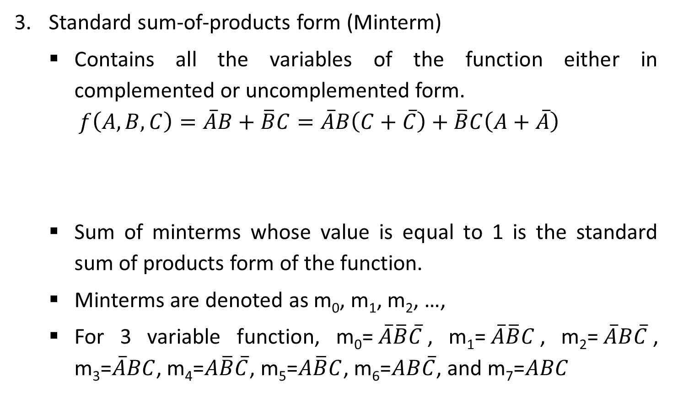
Boolean functions & representation
Standard sum-of-products form (Minterm)
Contains all the variables of the function either in complemented or uncomplemented form.
$$f\left(A,B,C\right)=\overline{A}B+\overline{B}C=\overline{A}B\left(C+\overline{C}\right)+\overline{B}C\left(A+\overline{A}\right)$$
Sum of minterms whose value is equal to 1 is the standard sum of products form of the function.
Minterms are denoted as m₀, m₁, m₂, …,
For 3 variable function, m₀=$\overline{A}\overline{B}\overline{C}$, m₁=$\overline{A}\overline{B}C$, m₂=$\overline{A}B\overline{C}$, m₃=$\overline{A}BC$, m₄=$A\overline{B}\overline{C}$, m₅=$A\overline{B}C$, m₆=$AB\overline{C}$, and m₇=$ABC$
$$=\overline{A}BC+\overline{A}B\overline{C}+A\overline{B}C+\overline{A}\overline{B}C$$
Minterm

Slide 11

Boolean functions & representation
Standard sum-of-products form (Minterm)
Canonical SOP form is shown by the sum of minterms for which the function equals 1.
f(A,B,C) = m₁ + m₂ + m₃ + m₅
Or
f(A,B,C) = $\sum{m}$(1,2,3,5)

Slide 12
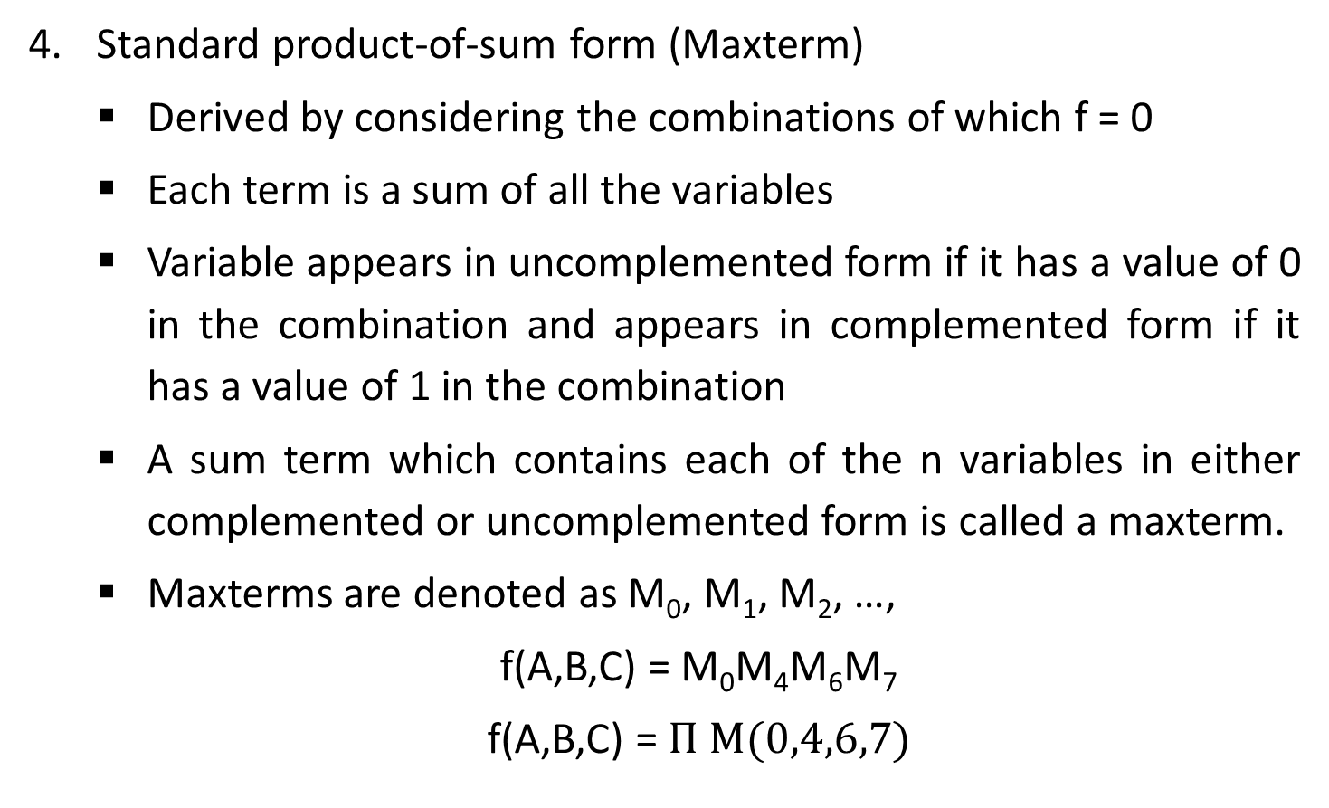
Boolean functions & representation
Standard product-of-sum form (Maxterm)
Derived by considering the combinations of which f = 0
Each term is a sum of all the variables
Variable appears in uncomplemented form if it has a value of 0 in the combination and appears in complemented form if it has a value of 1 in the combination
A sum term which contains each of the n variables in either complemented or uncomplemented form is called a maxterm.
Maxterms are denoted as M₀, M₁, M₂, …,
f(A,B,C) = M₀M₄M₆M₇
f(A,B,C) = $Π M(0,4,6,7)$

Slide 13
Introduction to K-Maps
Simplification of Boolean functions leads to simpler (and usually faster) digital circuits.
Simplifying Boolean functions using identities is time-consuming and error-prone.
This special section presents an easy, systematic method for reducing Boolean expressions.

Slide 14
Karnaugh Maps (K-Maps)
A K-Map is a matrix consisting of rows and columns that represent the output values of a Boolean function.
The output values placed in each cell are derived from the minterms of a Boolean function.
A minterm is a product term that contains all of the function’s variables exactly once, either complemented or not complemented.

Slide 15



Standard Sum-Of-Products Form
In order to apply K-map method, a function should be expressed in standard sum-of-product form.
For 3 variable function,
$$f\left(A,B,C\right)=\overline{A}B+\overline{B}C$$
$$=\overline{A}B\left(C+\overline{C}\right)+\overline{B}C\left(A+\overline{A}\right)$$
$$=\overline{A}BC+\overline{A}B\overline{C}+A\overline{B}C+\overline{A}\overline{B}C$$

Slide 16
2 – Variable K-Map
The two variables A and B have four possible combinations that can be represented by the map as follows
A
0
1
B
A | B | Minterm
0 | 0 | m₀ = A’B’
0 | 1 | m₁ = A’B
1 | 0 | m₂ = AB’
1 | 1 | m₃ = AB
0
2
0
1
3
1

Slide 17
3 – Variable K-Map
The three variables A, B and C have eight possible combinations that can be represented by the map as follows
A | B | C | Minterm
0 | 0 | 0 | m₀ = A’B’C’
0 | 0 | 1 | m₁ = A’B’C
0 | 1 | 0 | m₂ = A’BC’
0 | 1 | 1 | m₃ = A’BC
1 | 0 | 0 | m₄ = AB’C’
1 | 0 | 1 | m₅ = AB’C
1 | 1 | 0 | m₆ = ABC’
1 | 1 | 1 | m₇ = ABC
AB
00
01
11
10
C
0
2
6
4
0
1
3
7
5
1
Minterm Number

Slide 18
4 – Variable K-Map
The four variables A, B, C and D have sixteen possible combinations that can be represented by the map as follows
A | B | C | D | Minterm
0 | 0 | 0 | 0 | m₀ = A’B’C’D’
0 | 0 | 0 | 1 | m₁ = A’B’C’D
0 | 0 | 1 | 0 | m₂ = A’B’CD’
0 | 0 | 1 | 1 | m₃ = A’B’CD
0 | 1 | 0 | 0 | m₄ = A’BC’D’
0 | 1 | 0 | 1 | m₅ = A’BC’D
0 | 1 | 1 | 0 | m₆ = A’BCD’
0 | 1 | 1 | 1 | m₇ = A’BCD
A | B | C | D | Minterm
1 | 0 | 0 | 0 | m₈ = AB’C’D’
1 | 0 | 0 | 1 | m₉ = AB’C’D
1 | 0 | 1 | 0 | m₁₀ = AB’CD’
1 | 0 | 1 | 1 | m₁₁ = AB’CD
1 | 1 | 0 | 0 | m₁₂ = ABC’D’
1 | 1 | 0 | 1 | m₁₃ = ABC’D
1 | 1 | 1 | 0 | m₁₄ = ABCD’
1 | 1 | 1 | 1 | m₁₅ = ABCD

Slide 19
4 – Variable K-Map
AB
00
01
11
10
CD
0
4
12
8
00
1
5
13
9
01
3
7
15
11
11
2
6
14
10
10

Slide 20
Function plotting in K-Map
Consider function
F = AB + A’B
A
0
1
B
0
2
0
0
0
1
3
1
1
1

Slide 21

Reduce Boolean Expression
Consider the function:
$$f\left(A,B,C\right)=A^{′}B^{′}C+A^{′}BC+AB^{′}C+ABC$$
Its K-Map is given below.
What is the largest group of 1’s that is a power of 2?
AB
00
01
11
10
C
0
2
6
4
0
1
3
7
5
1
1
1
1
1

Slide 22

Reduce Boolean Expression
This grouping tells us that changes in the variables A and B have no influence upon the value of the function: They are irrelevant.
This means that the function,
$$f\left(A,B,C\right)=A^{′}B^{′}C+A^{′}BC+AB^{′}C+ABC$$
reduces to $f\left(A,B,C\right)=C$
AB
00
01
11
10
C
0
2
6
4
0
1
3
7
5
1
1
1
1
1

Slide 23



Examples
$$f=AB^{′}C+A^{′}B′C$$
$$f=ABC′D+ABCD+A^{′}BC^{′}D+A^{′}BCD$$
AB
AB
00
01
11
10
00
01
11
10
C
CD
0
4
12
8
0
00
1
5
13
9
1
1
01
1
1
1
3
7
15
11
$$f=B^{′}C$$
11
1
1
2
6
14
10
10
$$f=BD$$

Slide 24


Examples
$$f=ABC^{′}D+AB^{′}C^{′}D^{′}+AB^{′}CD^{′}+A^{′}B^{′}CD^{′}+A^{′}B^{′}C^{′}D′$$
AB
00
01
11
10
CD
0
4
12
8
00
1
1
1
5
13
9
01
1
3
7
15
11
11
2
6
14
10
10
1
1
$$f=ABC^{′}D$$
$${+ B}^{′}D^{′}$$

Slide 25



Examples
$$f=A^{′}BC^{′}D+A^{′}B^{′}C^{′}D+A^{′}B^{′}C^{′}D′$$
AB
00
01
11
10
CD
0
4
12
8
00
1
1
5
13
9
01
1
1
3
7
15
11
11
2
6
14
10
10
$$f=A^{′}B^{′}C^{′}$$
$$+ A^{′}C^{′}D$$

Slide 26
Important Note
Redundant grouping does not lead to minimization of Boolean function.
1 in the K-Map indicates minterms, rest others are treated as 0 and considered as maxterms.

Slide 27
Don’t care conditions
Suppose we are given a problem of implementing a circuit to generate a logical 1 when a 2, 7, or 15 appears on a four-variable input.
A logical 0 should be generated when 0, 1, 4, 5, 6, 9, 10, 13 or 14 appears.
The input conditions for the numbers 3, 8, 11 and 12 never occur in the system. This means we don’t care whether inputs generate logical 1 or logical 0.
Don’t care combinations are denoted by ‘x’ in K-Map which can be used for the making groups.
The above example can be represented as

Slide 28


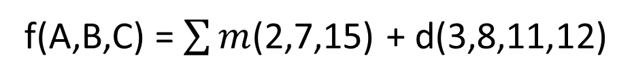
Examples
f(A,B,C) = $\sum{m}$(2,7,15) + d(3,8,11,12)
AB
00
01
11
10
CD
0
4
12
8
00
x
x
1
5
13
9
01
3
7
15
11
11
x
1
1
x
2
6
14
10
10
1
$$f=CD$$
$$+ A^{′}B^{′}C$$

Slide 29
Tabulation Method of Reduction
Also known as Quine-McCluskey procedure
Procedure consists of two main steps
Eliminate as many terms as possible using logical adjacencies. The resulting terms will be prime implicants.
Select the appropriate prime implicants to minimize the final expression.

Slide 30

Tabulation Method of Reduction
Consider function
$$F=ABC^{′}D+AB^{′}C^{′}D^{′}+AB^{′}CD^{′}+A^{′}B^{′}CD^{′}+A^{′}B^{′}C^{′}D′$$
Separate Terms based on number of complemented variables
Eliminate the terms using logical adjacencies until terms are reduced
Number of Complemented Variables | Terms
0 | -
1 | ABC’D
2 | AB’CD’
3 | AB’C’D’
 | A’B’CD’
4 | A’B’C’D’
Original Terms | Reduced Terms
ABC’D | ABC’D
AB’CD’ + AB’C’D’ | AB’D’
AB’CD’ + A’B’CD’ | B’CD’
AB’C’D’ + A’B’C’D’ | B’C’D’
A’B’CD’ + A’B’C’D’ | A’B’D’

Slide 31

Tabulation Method of Reduction
Removing additional logical adjacencies
Original Terms | Reduced Terms
ABC’D | ABC’D
AB’CD’ + AB’C’D’ | AB’D’
AB’CD’ + A’B’CD’ | B’CD’
AB’C’D’ + A’B’C’D’ | B’C’D’
A’B’CD’ + A’B’C’D’ | A’B’D’
Original Terms | Reduced Terms
ABC’D | ABC’D
AB’D’ + A’B’D’ | B’D’
B’CD’ + B’C’D’ | B’D’
$$F=ABC^{′}D+B^{′}D′$$

Slide 32

Exercise
Reduce the function to simplest form using tabulation method
$$F=A^{′}BC^{′}D^{′}+A^{′}BC^{′}D+ABC^{′}D^{′}+ABC^{′}D+AB^{′}C^{′}D+ABCD^{′}+A^{′}BCD+A^{′}B^{′}C^{′}D′$$

Slide 33
Variable-Entered Maps
Variable-entered map can be used to plot an n-variable problem on n – 1 variable map
Possible to reduce the map dimension by two or three in some cases
Advantage of using VEM occurs in design problems involving multiplexers

Slide 34
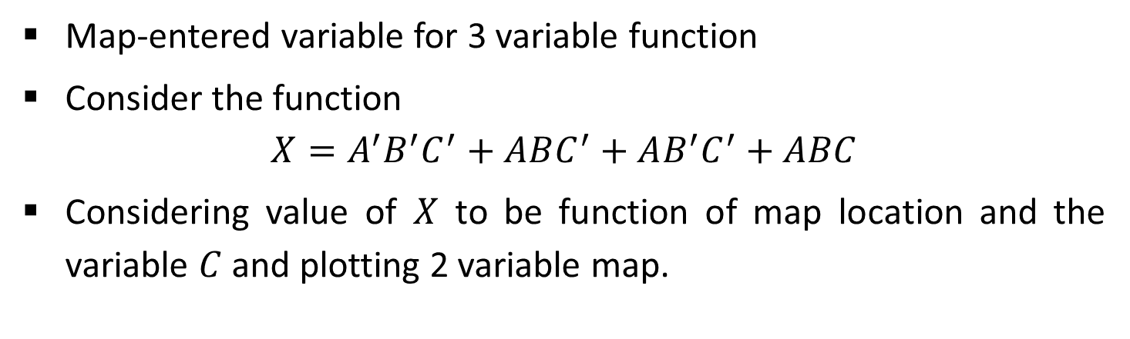
Plotting Variable-Entered Map
Map-entered variable for 3 variable function
Consider the function
$$X=A^{′}B^{′}C^{′}+ABC^{′}+AB^{′}C^{′}+ABC$$
Considering value of $X$ to be function of map location and the variable $C$ and plotting 2 variable map.
A
A
0
1
0
1
B
B
X=1 if C’=1
X=1 if C’=1
0
0
C’
C’
X=1 if C’=1 or if C = 1
1
X=0
1
0
C + C’

Slide 35
Reducing Expressions with VEM
Choose groups of similar terms to cover all nonzero terms appearing in the map except “don’t care” terms.
Rest complete process is similar to K-Map

Slide 36



Reducing Expressions with VEM
$$f=AB^{′}CD+A^{′}BC^{′}D+AB^{′}CD^{′}+ABC^{′}D+A^{′}B^{′}C^{′}D$$
AB
00
01
11
10
C
0
D
D
D
D
1
D+D’
$$f=A^{′}C^{′}D$$
$$+ BC′D$$
$$+ AB^{′}C$$

Slide 37





Reducing Expressions with VEM
$$f=A^{′}B^{′}C^{′}D+A^{′}BC^{′}D^{′}+A^{′}BC^{′}D+AB^{′}C^{′}D′+AB^{′}CD^{′}+AB^{′}CD+ABCD′$$
AB
00
01
11
10
C
D
D’
D’
0
D+D’
D’
D’
1
D+D’
$$f=A^{′}C^{′}D$$
$$+ A^{′}BC′$$
$$+ ACD′$$
$$+ AB′D′$$
$$+ AB^{′}C$$

Slide 38

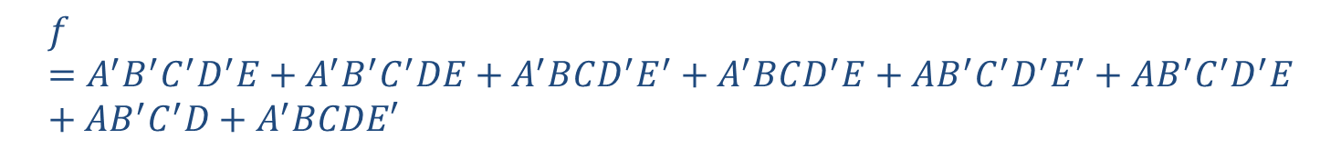



Reducing Expressions with VEM
$$f=A^{′}B^{′}C^{′}D^{′}E+A^{′}B^{′}C^{′}DE+A^{′}BCD^{′}E^{′}+A^{′}BCD^{′}E+AB^{′}C^{′}D^{′}E^{′}+AB^{′}C^{′}D^{′}E+AB^{′}C^{′}D+A^{′}BCDE′$$
AB
00
01
11
10
CD
E
E+E’
00
E’
$$f=B^{′}C^{′}E$$
$$+ AB^{′}C′$$
$$+ A^{′}BCD^{′}$$
$$+ A^{′}BCE′$$
01
E
E+E’
11
E’
E+E’
10
E’

Slide 39
Realizing Logic Function with Gates
Implement AB’ + C’D using AND, OR & Invert Gates
A
B
C
D

Slide 40
Converting AND/OR/Invert Logic to NAND/NOR Logic
Draw the circuit in AOI logic.
If NAND hardware is chosen, add a circle at the output of each AND gate and at the inputs to all the OR gates.
If NOR hardware is chosen, add a circle at the output of each OR gate and at the inputs to all the AND gates.
Add or subtract an inverter on each line that received a circle in steps 2 or 3 so that the polarity of signals on those lines remains unchanged from that of the original diagram.
Replace bubbled OR by NAND and bubbled AND by NOR.
Eliminate double inversions.

Slide 41
Converting AND/OR/Invert Logic to NAND/NOR Logic
Implement the following AOI logic using a) NAND logic and b) NOR logic

Slide 42
Converting AND/OR/Invert Logic to NAND/NOR Logic
a) NAND logic
Put a circle at the output of each AND gate and at the inputs to all OR gates

Slide 43
Converting AND/OR/Invert Logic to NAND/NOR Logic
a) NAND logic
Add an inverter to each of the lines that received only one circle at input so that polarity remains unchanged.

Slide 44
Converting AND/OR/Invert Logic to NAND/NOR Logic
a) NAND logic
Replace bubbled OR gates and NOT gates by NAND gates.

Slide 45
Converting AND/OR/Invert Logic to NAND/NOR Logic
(b) NOR Logic
Implementation is same as NAND logic except operation carried out at AND gate is to be carried out for OR gate and vice versa.

