Slide 1

Unit – 7 Asynchronous State Machines
Hardik Doshi
 99789 11553
→ hardik.doshi@darshan.ac.in
Digital Electronics (2131004) Darshan Institute of Engineering & Technology

Slide 2
Topics to be covered
The Fundamental-Mode Model
Problems of Asynchronous Circuits

Slide 3
Fundamental-Mode Model
Asynchronous circuit
X
Z
Y

Slide 4
Fundamental-Mode Model
Feedback variable z
Ideal delay circuit
Δt
Excitation variable
Fundamental-mode model for the above circuit
X
Z
Y
XY
XY
00
01
11
10
00
01
11
10
z
z
a
c
e
g
a
c
e
g
0
0
0
1
0
0
0
0
1
0
b
d
f
h
b
d
f
h
1
0
0
1
1
1
0
0
1
1
Stable State
Z

Slide 5
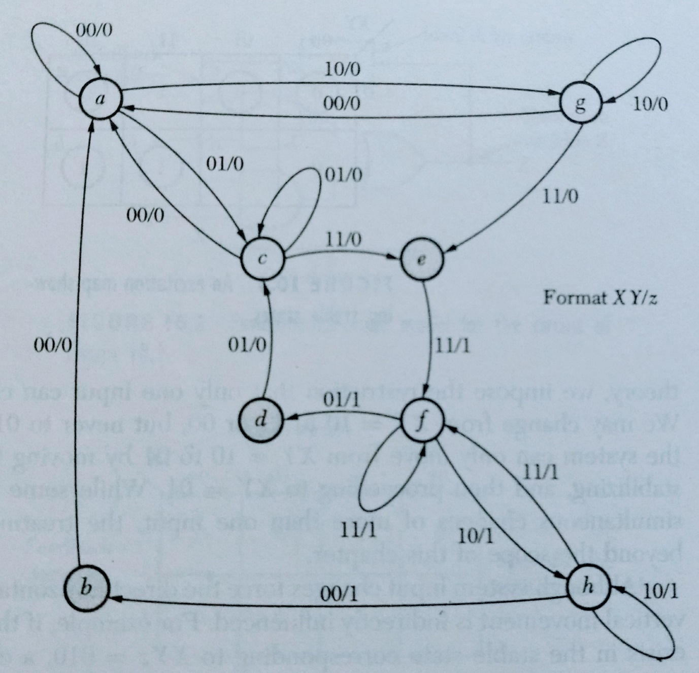
Fundamental-Mode Model

Slide 6
Problems of Asynchronous Circuits
AB
00
01
11
10
Oscillation Problem
If the system is in state a, a change of input from B = 0 to B = 1 sends the system to state c.
State c is a transient state, and thus the excitation variable X changes to 1.
x
a
c
e
g
0
0
1
0
1
b
d
f
h
1
1
0
0
1
A short time later x changes to 1, moving the system to state d. This state is also a transient state changing X back to 0, followed by a change in x to 0.
The system now oscillates between states c and d.
Of course, this type of situation can be used to advantage in a clock circuit by adding a delaying network to control the delay time Δt to create the desired oscillation frequency.
In most systems, the oscillation is unacceptable, and the situation depicted by states c and d of the map must be avoided.

Slide 7
Problems of Asynchronous Circuits
Critical Race
This situation can occur only when two or more feedback variables are present in the system.
This system has two external inputs, A and B, and two excitation variables, X and Y, that are fed back to the input of the circuit.
A
X
B
Y
Δt
y
Δt
x

Slide 8
Problems of Asynchronous Circuits
AB
One critical race occurs if the system starts in state e and input B changes from 1 to 0.
The excitation variables begin to switch from XY = 00 toward XY = 11.
Due to unequal propagation delays, one of the excitation variables will reach a value of 1 while the other has not changed from a value of 0.
If the condition XY = 10 is reached, the system moves to stable state d.
If the condition XY = 01 is reached rather than 10, the system moves to stable state b.
The final stable state reached from this input condition depends on the relative switching speeds of variables X and Y. This situation is referred to as a critical race.
00
01
11
10
xy
a
e
i
m
00
11
00
11
11
b
f
j
n
01
01
11
11
00
c
g
k
o
11
10
11
11
10
d
h
l
p
10
10
00
11
10

