Slide 1

Unit – 9 Programmable Logic Devices
Hardik Doshi
 99789 11553
→ hardik.doshi@darshan.ac.in
Digital Electronics (2131004) Darshan Institute of Engineering & Technology

Slide 2
Topics to be covered
Introduction to Programmable Logic Devices
Read-Only Memory
Programmable Logic Arrays (PLA)
Programmable Array Logic (PAL)

Slide 3
Programmable Logic Devices(PLDs)
A programmable logic device is an IC that is user configurable and is capable of implementing logic functions.
It is an LSI chip that contains a ‘regular’ structure and allows the designer to customize it for any specific application.
Advantages over fixed function ICs
Low development cost
Less space requirement
Less power requirement
High reliability
Easy circuit testing
Easy design modification
High design security

Slide 4
Read-Only Memory (ROM)
A read-only memory (ROM) is essentially a memory device in which permanent binary information is stored.
The binary information must be specified by the designer and is then embedded in the unit to form the required interconnection pattern.
Once the pattern is established, it stays within the unit when the power is turned off and on again.
A ROM which can be programmed is called a PROM. The process of entering information in a ROM is known as programming.
ROMs are used to store information which is of fixed type, such as tables for various functions, fixed data and instructions.
ROMs can be used for designing combinational logic circuits.

Slide 5
Read-Only Memory
Advantages of using a ROM as a PLD
Ease of design since no simplification or minimization of logic function is required
Designs can be changed, modified easily
Faster than discrete MSI/SSI circuit
Cost is reduced
Disadvantages of ROM based circuits
Non-utilization of complete circuit
Increased power requirement
Enormous increase in size with increase in number of input variables

Slide 6
ROM Organization
2^{k} x n
ROM
k inputs (address)
n outputs (data)
k inputs – provide address for the memory
n outputs – data bits of the stored word selected by address
k address input lines specify 2^{k} words
ROM does not have data inputs because it does not have write operation.

Slide 7
ROM Organization
Internal logic of 32 x 8 ROM
0
1
I₀
2
3
I₁
5 x 32 decoder
•
I₂
•
•
I₃
28
I₄
29
30
31
A₇
A₆
A₅
A₄
A₃
A₂
A₁
A₀

Slide 8
32 x 8 ROM
Consider, for example, a 32 x 8 ROM.
The unit consists of 32 words of 8 bits each.
There are five input lines that form the binary numbers from 0 through 31 for the address.
The five inputs are decoded into 32 distinct outputs by means of a 5 x 32 decoder.
Each output of the decoder represents a memory address.

Slide 9
32 x 8 ROM
The 32 outputs of the decoder are connected to each of the 8 OR gates.
Each OR gate must be considered as having 32 inputs.
Since each OR gate has 32 input connections and there are 8 OR gates, the ROM contains 32 x 8 = 256 internal connections.
In general, a 2^{k} x n ROM will have an internal k x 2^{k} decoder and n OR gates.
Each OR gate has 2^{k} inputs, which are connected to each of the outputs of the decoder.

Slide 10
Types of ROM
Mask programmable read-only memory (MROM)
Programmable read-only memory (PROM)
Erasable read-only memory (EPROM)
Electrically erasable and programmable read-only memory (EEPROM or E²PROM)

Slide 11
Exercise
Implement following functions using ROM.
F1 = ∑ m(1, 3, 4, 6) F2 = ∑ m(2, 4, 5, 7)
F3 = ∑ m(0, 1, 5, 7) F4 = ∑ m(1, 2, 3, 4)
A₂ | A₁ | A₀ | F₁ | F₂ | F₃ | F₄
0 | 0 | 0 | 0 | 0 | 1 | 0
0 | 0 | 1 | 1 | 0 | 1 | 1
0 | 1 | 0 | 0 | 1 | 0 | 1
0 | 1 | 1 | 1 | 0 | 0 | 1
1 | 0 | 0 | 1 | 1 | 0 | 1
1 | 0 | 1 | 0 | 1 | 1 | 0
1 | 1 | 0 | 1 | 0 | 0 | 0
1 | 1 | 1 | 0 | 1 | 1 | 0
F₁
A₀
F₂
A₁
8 x 4
ROM
F₃
A₂
F₄

Slide 12
Programmable Array Logic
Programmable array logic (a registered trade mark of Monolithic Memories) is a particular family of programmable logic devices (PLDs) that is widely used and available from a number of manufacturers.
The PAL circuits consist of a set of AND gates whose inputs can be programmed and whose outputs are connected to an OR gate, i.e. the inputs to the OR gate are hard-wired.
The PAL is easier to program as only the AND gates are programmable.

Slide 13
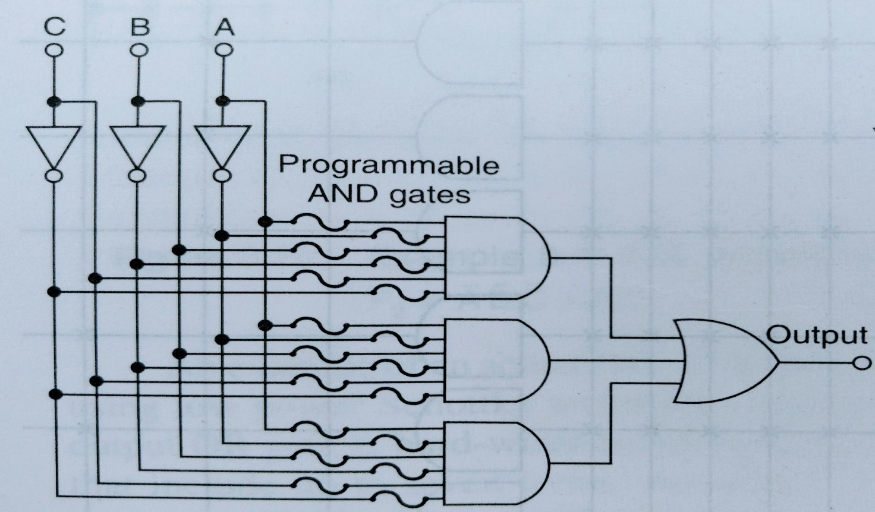
PAL
The fuse symbols represent fusible links that can be burned open using equipment similar to a PROM programmer.
Note that every input variable and its complement can be left either connected or disconnected from every AND gate.

Slide 14
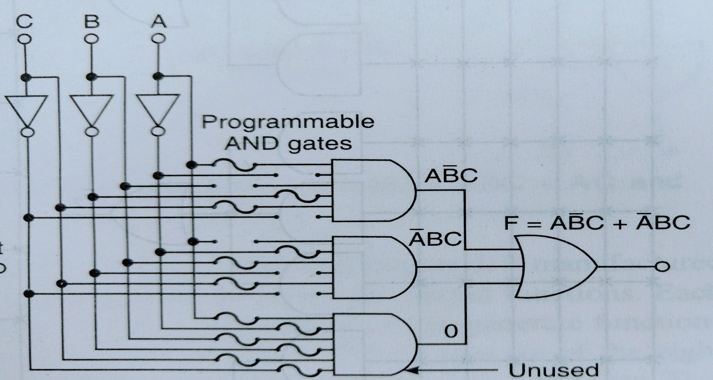
PAL
Figure shows how the circuit is programmed to implement F = A’BC + AB’C.
All input variables and their complements are left connected to the unused AND gate, whose output is, therefore, AA’BB’CC’ = 0.
The 0 has no affect on the output of the OR gate.

Slide 15
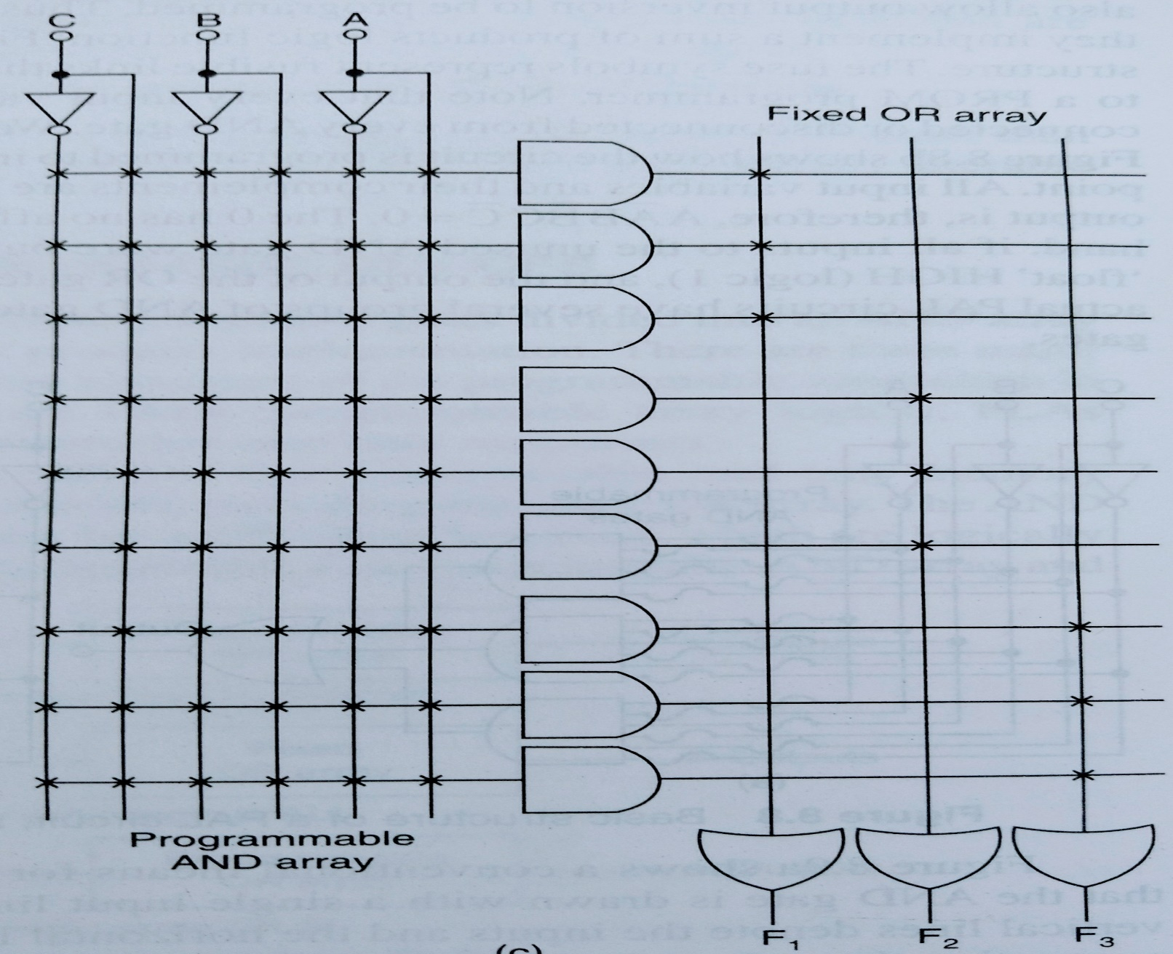
PAL

Slide 16
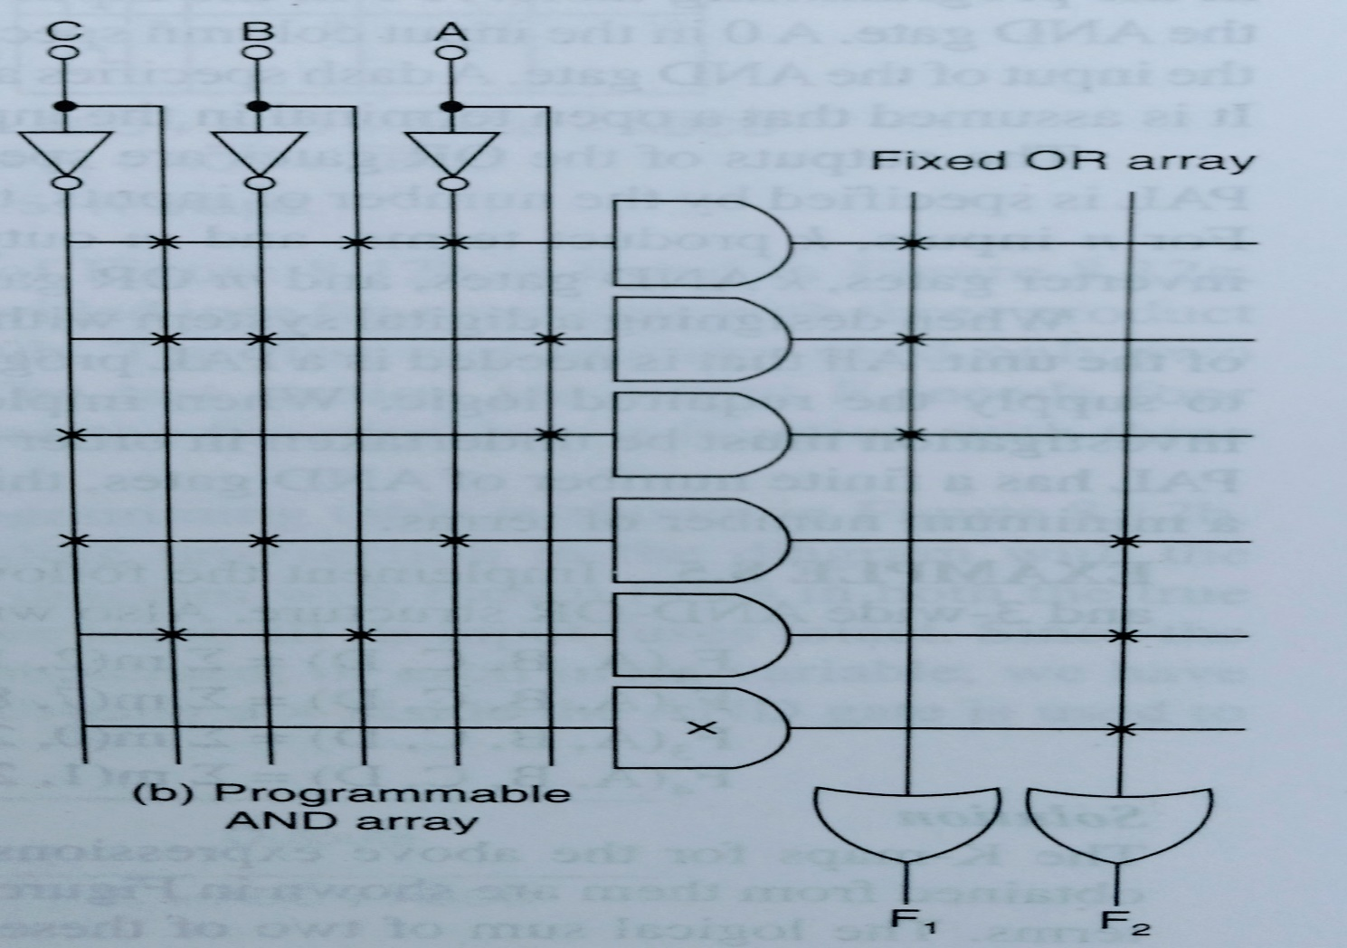
PAL Exercise
Implement following functions using PAL.
F1 = A’BC + AC’ + AB’C F2 = A’B’C’ + BC

Slide 17
Programmable Logic Array
The PLA combines the characteristics of the PROM and the PAL by providing both a programmable OR array and a programmable AND array, i.e. in a PLA both AND gates and OR gates have fuses at the inputs.
A third set of fuses in the output inverters allows the output function to be inverted if required.

Slide 18
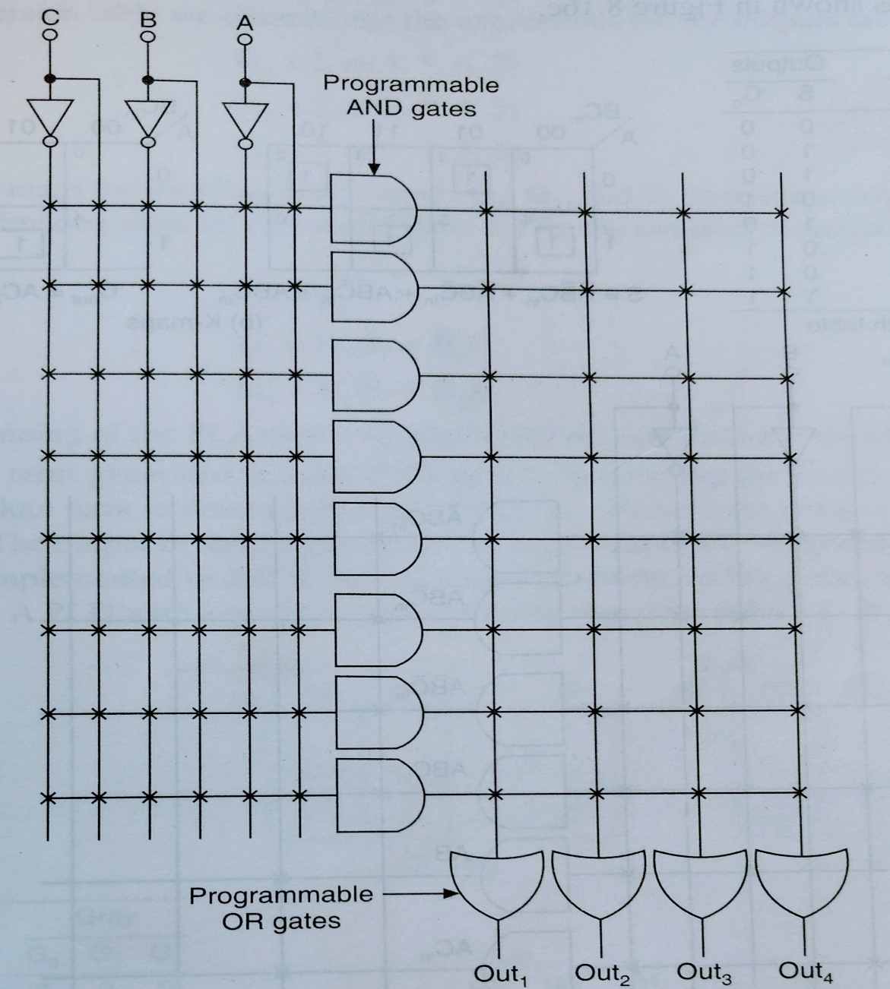
PLA
3-input 4-output PLA

Slide 19
RAM v/s ROM
 | RAM | ROM
Data | The data is not permanent but it can be altered any number of times. | The data is permanent. It can be altered but only a limited number of times that too at slow speed.
Speed | It is a high-speed memory. | It is much slower than the RAM.
CPU Interaction | The CPU can access the data stored on it. | The CPU can not access the data stored on it. In order to do so, the data is first copied to the RAM.
Size and Capacity | Large size with higher capacity. | Small size with less capacity.
Usage | Primary memory (DRAM DIMM modules), CPU Cache (SRAM). | Firmware like BIOS or UEFI. RFID tags, microcontrollers, medical devices, and at places where a small and permanent memory solution is required.
Cost | It doesn’t come cheap. | Way cheaper than RAM.

