Slide 1
Flip-Flop Applications
Notes:
Flip-Flop Applications
Digital Electronics TM
3.1 Flip-Flops and Latches
Project Lead The Way, Inc.
Copyright 2009

Slide 2
Flip-Flop Applications
This presentation will provide an overview of the following flip-flop applications:
  Event Detect
  Data Synchronizer
  Frequency Divider
  Shift Register
Additional flip-flop applications will be covered in future lessons:
  Asynchronous {Ripple} Counters (Unit 3.2)
  Synchronous {Parallel} Counters (Unit 3.3)
  State Machines (Unit 3.4)
Notes:
Introductory Slide / Overview of Presentation
Flip-Flop Applications
Digital Electronics TM
3.1 Flip-Flops and Latches
Project Lead The Way, Inc.
Copyright 2009

Slide 3
Event Detector
An event detector circuit is one that is capable of detecting and holding a signal until the event that changed the signal can be addressed.
For example, door sensors on a home burglar alarm system use an event detector circuit. Once someone opens the door, the alarm will sound until the system is turned off.
If it were not for the event detection circuit, the alarm would only be on when the door was open. Thus, someone could quickly open the door, enter the house, and close the door. In this situation the alarm would only sound for the brief time that the door was actually open.
Notes:
Description of what an event detector circuit is used for. Ask the students to think of other applications.
Flip-Flop Applications
Digital Electronics TM
3.1 Flip-Flops and Latches
Project Lead The Way, Inc.
Copyright 2009

Slide 4
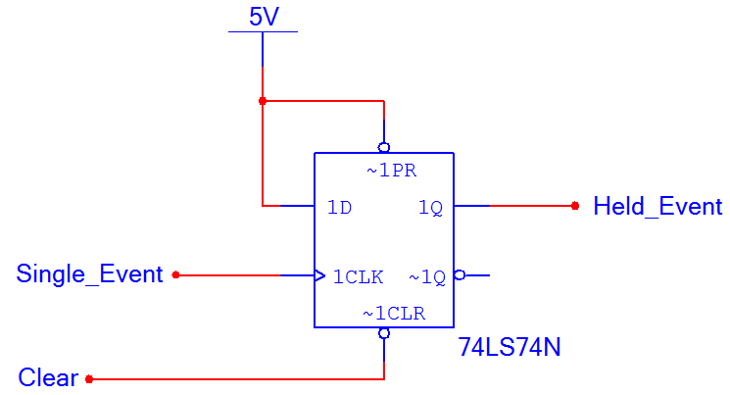
Event Detect: Circuit
Notes:
Event detector circuit with a D flip-flop.
Flip-Flop Applications
Digital Electronics TM
3.1 Flip-Flops and Latches
Project Lead The Way, Inc.
Copyright 2009

Slide 5
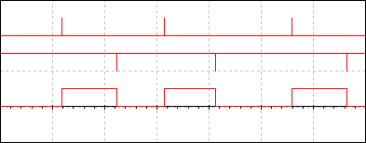
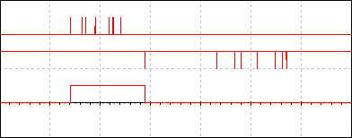
Event Detect
Single_Event
Clear
Event
Held
Event
Cleared
Held_Event
Case #1
Single_Event
Multiple Events
Only the 1st event is held.
Clear
Multiple Clears
Only the 1st event does anything.
Held_Event
Case #2
Notes:
Simulation of the Event Detector circuit.
The top timing diagram (Case #1) shows that when the Single_Event signal changes (0-to-1), the event is held by the output signal Held_Event until it is cleared.
The bottom timing diagram (Case #2) shows that when multiple events occur, only the first is held. The same is true with multiple clears.
Flip-Flop Applications
Digital Electronics TM
3.1 Flip-Flops and Latches
Project Lead The Way, Inc.
Copyright 2009

Slide 6
Data Synchronizer
Normally, timing is not a concern with combinational logic. However, due to gate delays, the outputs of combinational logic can change at different times. This can lead to potential timing problems. Take a look at the combinational logic circuit shown below. Because functions A, B, & C have different circuit complexity, they change logic levels at different times.
To solve this problem, a data synchronizer circuit can be added to the outputs.
C
B
A
.
.
.
Combinational
Logic
Circuit
Inputs
Notes:
Description of what a data synchronizer circuit is used for.
Flip-Flop Applications
Digital Electronics TM
3.1 Flip-Flops and Latches
Project Lead The Way, Inc.
Copyright 2009

Slide 7
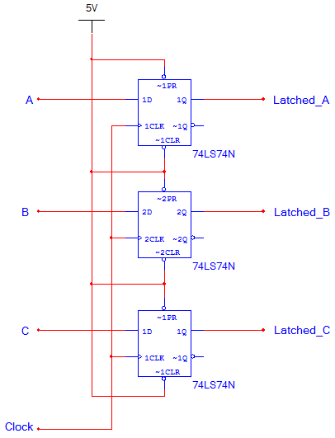
Data Synchronizer: Circuit
Notes:
Data synchronizer circuit with a D flip-flop.
Flip-Flop Applications
Digital Electronics TM
3.1 Flip-Flops and Latches
Project Lead The Way, Inc.
Copyright 2009

Slide 8
Data Synchronizer: Timing
Latched_A
Latched_B
Latched_C
A
B
C
Clock
 | The signal can be a zero or a one, depending on the previous latched values.
Notes:
Timing diagram for the data synchronizer circuit.
Flip-Flop Applications
Digital Electronics TM
3.1 Flip-Flops and Latches
Project Lead The Way, Inc.
Copyright 2009

Slide 9
Frequency Divider
As the name implies, a frequency divider is a circuit the produces a digital output signal that is half the frequency of the input.
The frequency divider is used extensively in the design of asynchronous counters.
Notes:
Description of what a data synchronizer circuit is used for.
Flip-Flop Applications
Digital Electronics TM
3.1 Flip-Flops and Latches
Project Lead The Way, Inc.
Copyright 2009

Slide 10
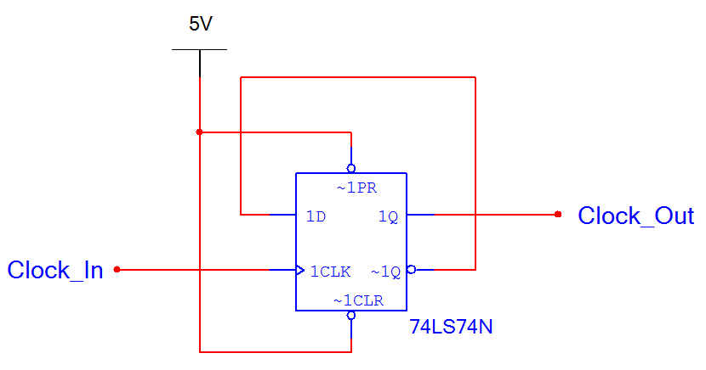
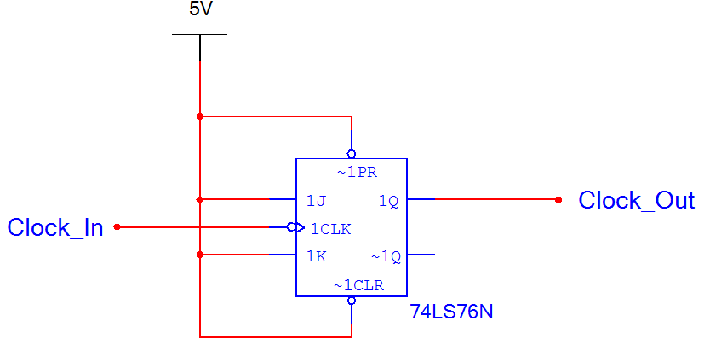
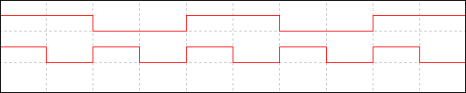
Frequency Divider: Circuit
D Version
J/K Version
Clock_Out
Clock_In
Notes:
Timing diagram for the frequency divider (divide-by-two circuit). Note that this circuit can be implemented with both the D and J/K flip-flops.
Flip-Flop Applications
Digital Electronics TM
3.1 Flip-Flops and Latches
Project Lead The Way, Inc.
Copyright 2009

Slide 11
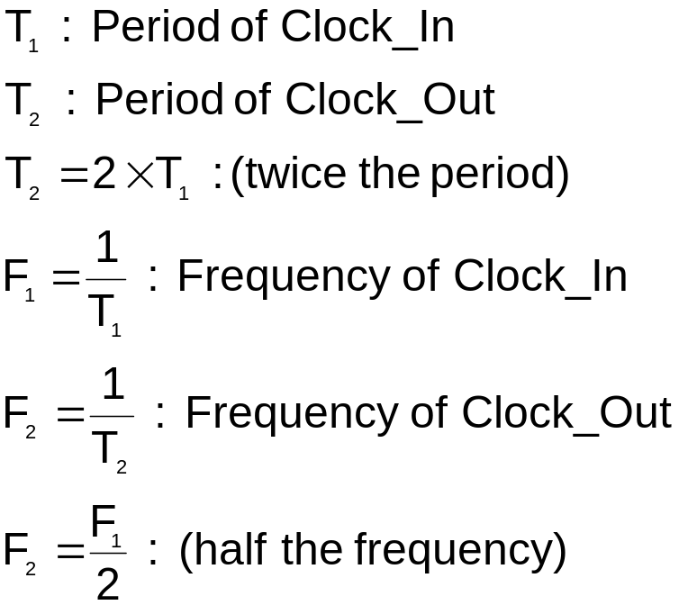
Frequency Divider: Timing
T₂
Clock_Out
Clock_In
T₁
The period of Clock_Out is twice the period of Clock_In.
Since the period is twice, the frequency is divided in half.
Notes:
Detailed view of the period and frequency of the input/output signals for the divide-by-two circuit.
Flip-Flop Applications
Digital Electronics TM
3.1 Flip-Flops and Latches
Project Lead The Way, Inc.
Copyright 2009

Slide 12
Shift Register
A shift register is a group of flip-flops (typically 4 or 8) that are arranged so that the values stored in the flip-flops are shifted from one flip-flop to the next for every clock.
Shift registers are used extensively in logic circuits to control digital displays.
A classic example is numbers being typed into a calculator. As the numbers are entered, the digits shift to the left one position. This shifting is controlled by a shift register.
Notes:
Description of what a shift register circuit is used for. Ask the students to think of other applications.
Flip-Flop Applications
Digital Electronics TM
3.1 Flip-Flops and Latches
Project Lead The Way, Inc.
Copyright 2009

Slide 13
Shift Register
Serial In / Serial Out
Left-to-Right
Data In
Data Out
Serial In / Serial Out
Right-to-Left
Data Out
Data In
Data In
Parallel In / Serial Out
Data Out
Serial In / Parallel Out
Data In
Data Out
Notes:
The four most common types of shift registers. Some textbooks also discuss the parallel in / parallel out shift register. Some people, including this writer, don’t consider this a shift register because nothing is being shifted.
Flip-Flop Applications
Digital Electronics TM
3.1 Flip-Flops and Latches
Project Lead The Way, Inc.
Copyright 2009

Slide 14
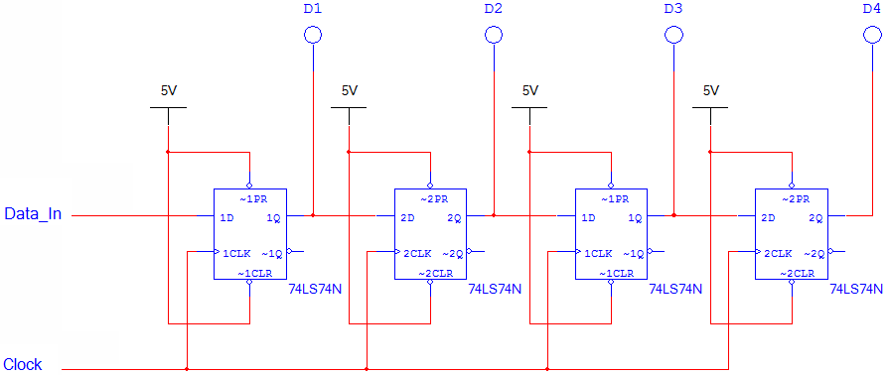
Shift Register: Circuit (D)
Notes:
A Serial In / Parallel Out shift register with D flip-flops.
Flip-Flop Applications
Digital Electronics TM
3.1 Flip-Flops and Latches
Project Lead The Way, Inc.
Copyright 2009

Slide 15
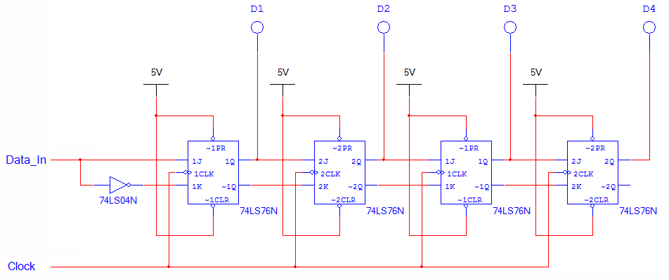
Shift Register: Circuit (J/K)
Notes:
A Serial In / Parallel Out shift register with J/K flip-flops.
Flip-Flop Applications
Digital Electronics TM
3.1 Flip-Flops and Latches
Project Lead The Way, Inc.
Copyright 2009

Slide 16
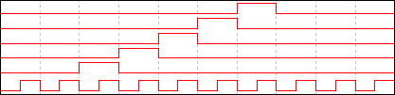
Shift Register: Timing
D3
D2
D1
D0
Data_In
Clock
Notes:
Time diagram for the proceeding Serial In / Parallel Out shift registers.
Flip-Flop Applications
Digital Electronics TM
3.1 Flip-Flops and Latches
Project Lead The Way, Inc.
Copyright 2009

Slide 17
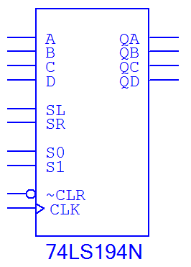
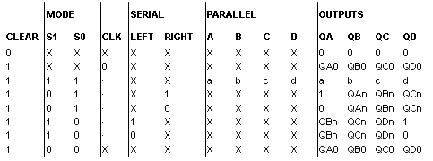
MSI Shift Register
74LS194 (4-bit Bi-Directional Universal Shift Register)
Parallel Outputs
&
Serial Outputs
Parallel Inputs
Serial Inputs
Mode Control
Clear & Clock
Notes:
Overview of commonly used MSI Shift Registers. This IC is very common because is can be used to implement a
Serial In / Serial Out, a Parallel In / Serial Out, and Serial In / Parallel Out shift register.
Flip-Flop Applications
Digital Electronics TM
3.1 Flip-Flops and Latches
Project Lead The Way, Inc.
Copyright 2009

Slide 18
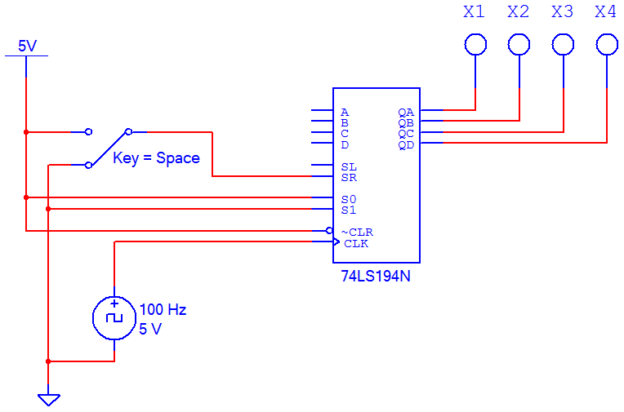
74LS194 Shift Register: Circuit
Notes:
Design example of a In / Parallel Out shift register using a 74LS194 IC.
Flip-Flop Applications
Digital Electronics TM
3.1 Flip-Flops and Latches
Project Lead The Way, Inc.
Copyright 2009

Slide 19
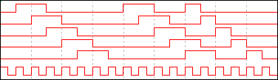
74LS194 Shift Register: Timing
Data_In
X1
X2
X3
X4
Clock
Notes:
Time diagram for the preceding Serial In / Parallel Out shift register.
Flip-Flop Applications
Digital Electronics TM
3.1 Flip-Flops and Latches
Project Lead The Way, Inc.
Copyright 2009

