Slide 1


Unit-2 Theory of Production and Cost
Engineering Economics and Management (2130004)
Prof. Vijay M. Shekhat
vijay.shekhat@darshan.ac.in
+91 9727235778
Computer Engineering Darshan Institute of Engineering & Technology

Slide 2
Outlines
Theory of Production
Production Function, Meaning
Factors of Production (Meaning and Characteristics of Land, Labour, Capital and Entrepreneur)
Law of Variable Proportions and Law of Returns To Scale
Cost
Meaning
Short Run & Long Run Cost
Fixed Cost, Variable Cost, Total Cost, Average Cost, Marginal Cost and Opportunity Cost
Break Even Analysis
Meaning, Explanation, Numerical

Slide 3
Theory of Production
Production theory is the economic process of producing outputs from the inputs.
Inputs
Transformation
Outputs
Land
Labor
Capital
Entrepreneur
Economic Process
Goods
Services

Slide 4
Production Definition
Adam Smith
Production is a creation of physical assets.
Alfred Marshal
Production is a creation of utilities.
Philip Kotler
Production is a creation of bundle of satisfaction.

Slide 5
Three Aspects to Production Processes
The quantity of the good or service produced.
The form of the good or service created.
The distribution of the good or service produced.

Slide 6
Utility
"Utility" is referring to the total satisfaction received from consuming a good or service.
Type of Utility
Transforms the form of raw materials into marketable goods.
Log of wood converted into a chair
Form Utility
Products of rural areas fetch higher price in urban areas.
Fruits, vegetables, etc.
Place Utility
Production in a peak season with low price is stored and marketed in slack season at higher price.
Onion
Time Utility
Possession Utility
Transfer ownership in a product through buying and selling deals.
Buy and resell

Slide 7
Measurement of Utility
Cardinal Utility Concept
Ordinal Utility Concept

Slide 8
1. Cardinal Utility Concept
It believes that utility is cardinal or quantitative like other mathematical variables (height, weight, etc…)
Measuring unit of utility is utils.
For Example:
Individual gains 20 utils from ice-cream and 10 utils from coffee.
Number of difficulties involved in measurement of utility.
Changes in consumer’s moods, Tastes, Preferences etc…

Slide 9
2. Ordinal Utility Concept
According to this concept, utility cannot be measured numerically, it can only be ranked as 1, 2, 3, and so on.
For instance, an individual prefers ice-cream than coffee,
which implies that utility of ice-cream is given rank 1 and coffee as rank 2.
It meets the theoretical requirements of consumer behavior analysis.

Slide 10
Factors of Production
Land
Labor
Capital
Entrepreneur

Slide 11

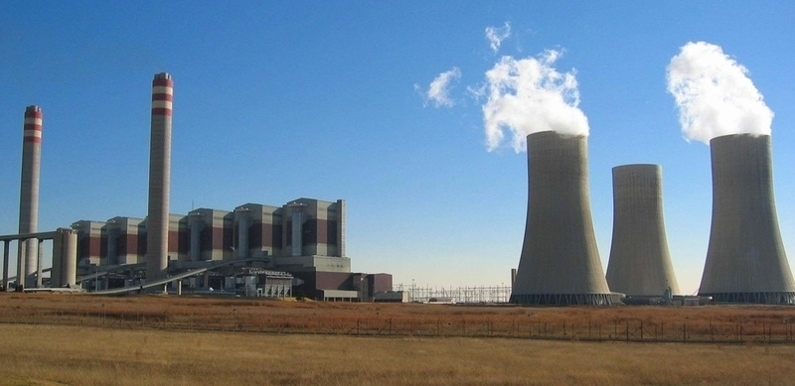
1. Land
Land is the economic resource encompassing natural resources found within the economy.
This resource includes timber, land, fisheries, farms and other similar natural resources.
Land is a limited resource for any economies.
http://www.charteredclub.com
http://www.ikon.mn

Slide 12

2. Labor
Labor represents the human capital available to transform raw materials or natural resources into consumer goods.
Human capital includes all individuals capable of working in the economy and providing various services to other individuals or businesses.
http://marketbusinessnews.com

Slide 13

3. Capital
Capital has two economic definitions as a factor of production.
Capital can represent the financial resources companies use to purchase natural resources, land and other capital goods.
Capital also represents the major physical assets individuals and companies use when producing goods or services.
These assets include buildings, production facilities, equipment, vehicles and other similar items.
http://marketbusinessnews.com

Slide 14

4. Entrepreneur
Entrepreneur is a person who sets up a business and takes financial risks in the hope of profit.
Entrepreneurs usually have an idea for creating a valuable good or service.
http://marketbusinessnews.com

Slide 15
Production Function
Production function relates physical output of a production process to physical inputs.
It is a mathematical function that relates output with the number of inputs.
Production function Q = F(K, L)
Q = quantity of output, K = capital, and L = labor
For Example
Simple Production Function: Q = K + L
Cobb-Douglas Production Function: Q = K^{0.5} x L^{0.5}
Leontief Production Function: Q = Min(K, L)

Slide 16
The Law of Variable Proportions
The law of variable proportions states that
“As the quantity of one factor is increased, keeping the other factors fixed, the marginal product of that factor will eventually decline”.
This law describes the input-output relation when the output is increased by varying the quantity of only one input.
In the short run, some factors of production are fixed.
Like, Capital, Land etc…
While some other factors are variable.
Like, Labor, Raw Materials etc…
The short run Production Function describes relation between the quantity of variable factor and the quantity of commodity produced.

Slide 17
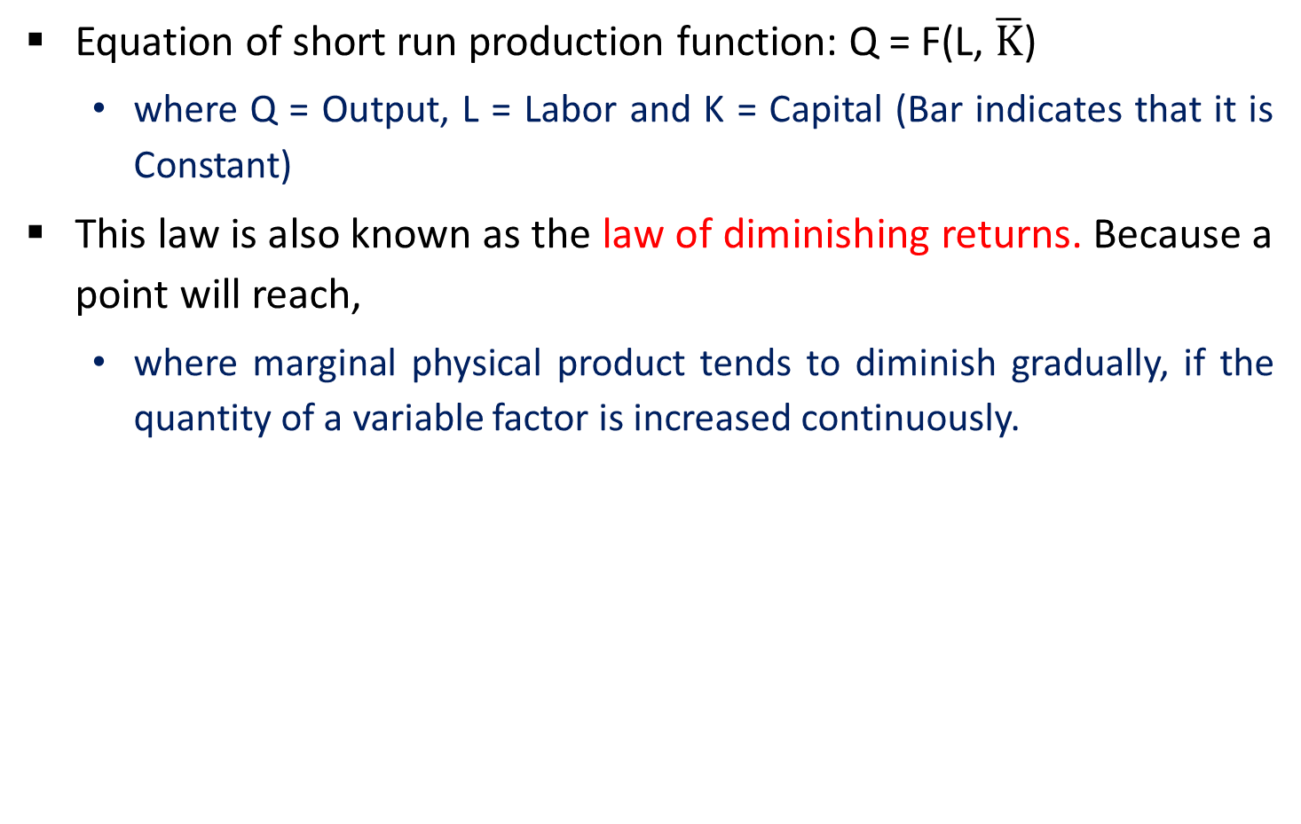
Cont…
Equation of short run production function: Q = F(L, $\overline{K}$)
where Q = Output, L = Labor and K = Capital (Bar indicates that it is Constant)
This law is also known as the law of diminishing returns. Because a point will reach,
where marginal physical product tends to diminish gradually, if the quantity of a variable factor is increased continuously.

Slide 18
Assumptions of the Law of Variable Proportions
Only one factor is variable while others are held constant.
All units of the variable factor are homogeneous.
There is no change in technology.
It is possible to vary the proportions in which different inputs are combined.
It assumes a short-run situation.
The product is measured in physical units.
i.e., in quintals, tones, etc…

Slide 19
Example
No. of Workers | Total Product | Average Product | Marginal Product | Stage
1 | 8 | 8 | 8 | Stage – I Increasing Returns
2 | 20 | 10 | 12
3 | 36 | 12 | 16
4 | 48 | 12 | 12 | Stage – II Diminishing Returns
5 | 55 | 11 | 7
6 | 60 | 10 | 5
7 | 60 | 8.6 | 0 | Stage – III Negative Marginal Returns
8 | 56 | 7 | -4

Slide 20
Stages of Law of Variable Proportions
Increasing Returns
Diminishing Returns
Negative Marginal Returns

Slide 21
1. Increasing Returns
It becomes cheaper to produce the additional output.
Thus the producer will always expand through this stage.
Causes
Fixed factor is used more intensively and production increases rapidly.
Division of labor and specialization.
The fixed factors are indivisible which means that they must be used in a fixed minimum size.

Slide 22
2. Diminishing Returns
This is the only stage in which production is feasible and profitable.
In this stage the marginal productivity of labor, though positive, is diminishing but is non-negative.
Causes
The distortion (disfigurement) in the combination of factors.
Control and supervision become difficult.
There may be shortage of trained labor or raw material.

Slide 23
3. Negative Marginal Returns
It clearly shows loss so no business operate in this stage.
The Best Stage
Stage-II is best because it utilizes resources very well.

Slide 24
Cont…
C
B
TP
TP, AP, MP
Inflection Point
Stage II
Stage III
A
Stage I
D
E
F
AP
Units of Variable Factor
MP

Slide 25
The Law of Returns to Scale
Describes the relationship between outputs and scale of inputs in the long-run when all the inputs are increased in the same proportion.
In the words of Prof. Roger Miller
“Returns to scale refer to the relationship between changes in output and proportionate changes in all factors of production”
As demand, increases the firm increases its scale of production.

Slide 26
Assumptions of the Law of Returns to Scale
All factors (inputs) are variable but enterprise is fixed.
A worker works with given tools and implements.
Technological changes are absent.
There is perfect competition.
The product is measured in quantities.

Slide 27
Example
Unit | Scale of Production | Total Returns | Marginal Returns | Stage
1 | 1 worker + 2 acres Land | 8 | 8 | I Increasing Returns
2 | 2 worker + 4 acres Land | 17 | 9
3 | 3 worker + 6 acres Land | 27 | 10
4 | 4 worker + 8 acres Land | 38 | 11 | II Constant Returns
5 | 5 worker + 10 acres Land | 49 | 11
6 | 6 worker + 12acres Land | 59 | 10 | III Diminishing Returns
7 | 7 worker + 14 acres Land | 68 | 9
8 | 8 worker + 16 acres Land | 76 | 8

Slide 28
Cont…
Marginal
Returns
Constant
Returns
C
D
Diminishing
Returns
Increasing
Returns
R
S
Scale of Production

Slide 29
Stages of Law of Returns to Scale
Increasing Returns to Scale
Constant Returns to Scale
Diminishing Returns to Scale

Slide 30
1. Increasing Returns to Scale
Increase in to­tal output is more than proportional to the increase in all inputs.
Causes
Indivisibility of Factors
Specialization and Division of Labor
Internal Economies
External Economies

Slide 31
2. Constant Returns to Scale
Increase in total output is in exact proportion to the increase in inputs.
Causes
Internal Economies and Diseconomies
External Economies and Diseconomies
Divisible Factors

Slide 32
3. Diminishing Returns to Scale
Increase in output is less than proportional to the increase in inputs.
Causes
Indivisible factors may become inefficient and less productive.
Produce problems of supervision and coordination.
Large management creates difficulties of control and rigidities.
Higher prices or Diminishing productivities of the factors.
Demand for skilled labor, land, capital, etc. rises.

Slide 33
Cost
An amount that has to be paid or given up in order to get something.
In business, cost is usually a monetary valuation of
Effort
Material
Resources
Time and Utilities Consumed
Risks Incurred
Opportunity Forgone in Production and Delivery of a Good or Service.

Slide 34
Classification of Cost
Classification of Cost on the Basis of
Service Tenure
Cost Behaviour to Production Volume
Changes in Total Costs in Relation to Certain Specified Volume
Other Important Costs
Long Run Costs
Fixed Cost / Indirect Costs / Overheads
Total Cost
Opportunity Cost
Short Run Costs
Average Cost
Implicit Cost
Variable Cost
Marginal Cost
Sunk Cost

Slide 35
On the basis of Service Tenure
Long Run Costs
Long run costs are accumulated when firms change production levels over time in response to expected economic profits or losses.
In the long run there are no fixed factors of production.
The land, labor, capital goods, and entrepreneurship all vary to reach the long run cost of producing a good or service.
The long run is a planning and implementation stage for producers.
They analyze the current and projected state of the market in order to make production decisions.

Slide 36
Cont...
Short Run Costs
Short run costs are accumulated in real time throughout the production process.
Fixed costs have no impact of short run costs, only variable costs and revenues affect the short run production.
The short run costs increase or decrease based on variable cost as well as the rate of production.
If a firm manages its short run costs well over time, it will be more likely to succeed in reaching the desired long run costs and goals.

Slide 37
On the basis of Cost Behaviour to Production Volume
Fixed Cost / Indirect Costs / Overheads
In economics, fixed costs are business expenses that are not dependent on the level of goods or services produced.
They tend to be time-related, such as salaries or rents being paid per month, and are often referred to as overhead costs.
Total Fixed Cost: Total cost for all fixed inputs of the firm per time is called total fixed cost.
For example firm taking land on lease Rs. 1 lack per month and borrowed money on interest Rs. 2oooo per month. So total fixed cost per month is Rs. 120000 per month.

Slide 38
Cont…
Variable Cost
Variable costs are costs that change in proportion to the good or service that a business produces.
For example Assume a business produces clothing. A variable cost of this product would be the direct material, i.e., cloth, and the direct labor.
Total Variable Cost: Total variable cost is calculated by adding variable cost of all variable inputs. It is varies with output.
 | 1 Garment | 2 Garment | 3 Garment
Cloth (Direct Materials) | 10 ft. | 20 ft. | 30 ft.
Labor (Direct Labor) | 5 hrs | 10 hrs | 15 hrs

Slide 39
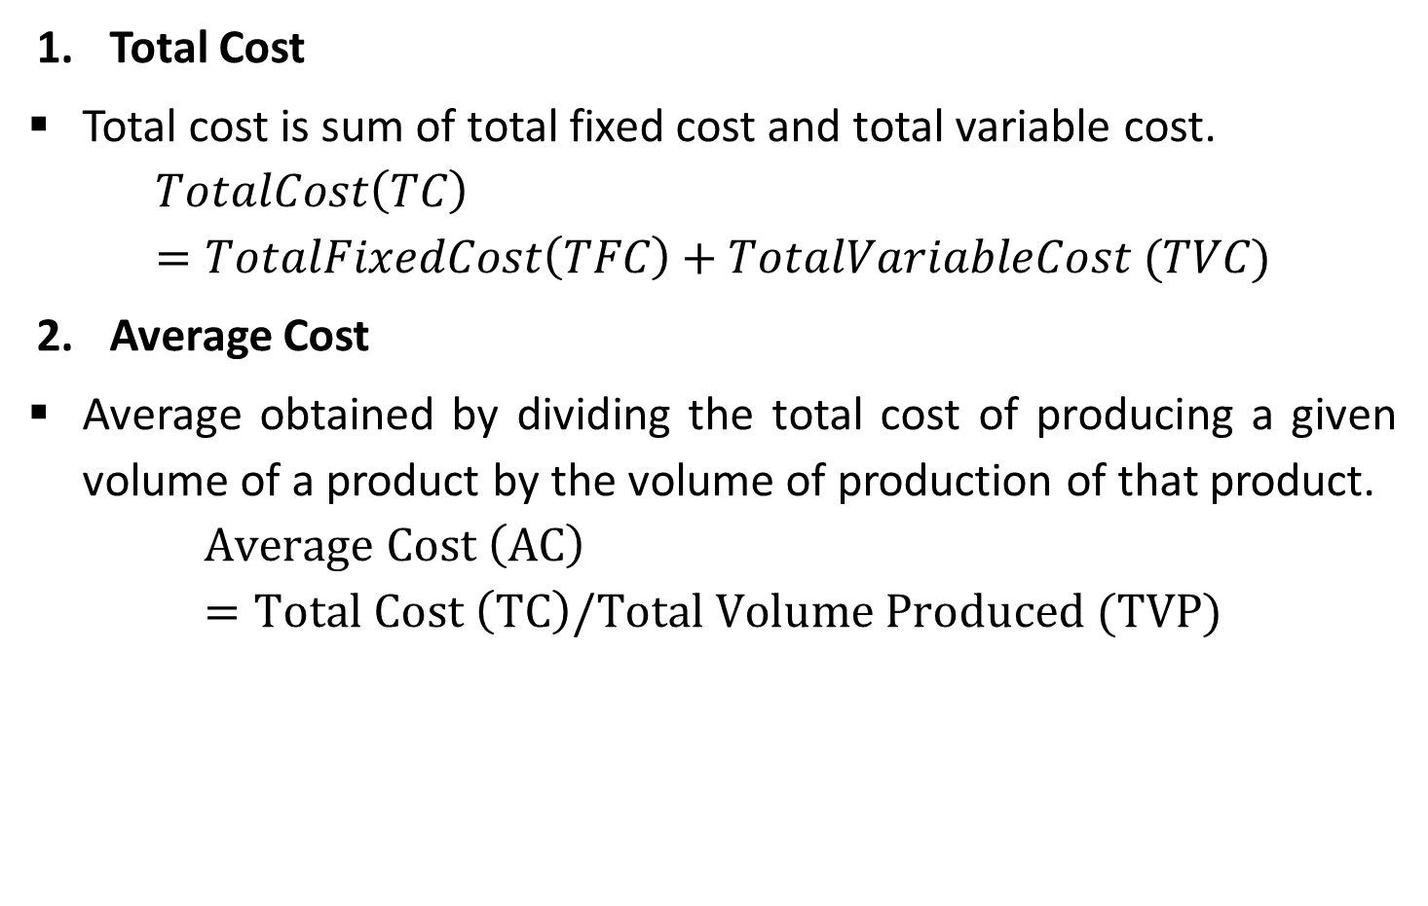
On the basis of Changes in Total Costs in Relation to Certain Specified Volume
Total Cost
Total cost is sum of total fixed cost and total variable cost.
$$TotalCost\left(TC\right)=TotalFixedCost\left(TFC\right)+TotalVariableCost (TVC)$$
Average Cost
Average obtained by dividing the total cost of producing a given volume of a product by the volume of production of that product.
$$Average Cost \left(AC\right)=Total Cost \left(TC\right)/Total Volume Produced (TVP)$$

Slide 40
Cont…
Marginal Cost
The benefit of mass production can be seen in marginal cost.
If V1 volume of product is manufactured in X1 cost and it requires X2 cost for producing V1 + 1 volume then the marginal cost of production is X2 – X1 with reference to production volume V1.
For example if 1000 toy is manufactured in Rs. 50000 and 1001 toy requires Rs. 50030 then the marginal cost is 30.

Slide 41
Other Important Costs
Opportunity Cost
For example if you have Rs. 50000 to invest and have two option share market and real estate.
If you selected share market and got Rs, 4000 return in one year.
At the same time if you invest it in real estate then it will give Rs. 5000 return
Then you have to forget Rs. 1000 due to not selecting real estate.
This 1000 is called Opportunity Cost.
In real practice if alternative (X) is selected from a set of competing alternatives (X, Y), then the corresponding investment in the selected alternative is not available for any other purpose.

Slide 42
Cont…
Implicit Cost
The implicit cost is to be understood with reference to the explicit cost.
The explicit cost is certain and fixed like 10% interest on bonds indicates 10% explicit cost.
If the bonds are issued today at Rs. 92 which are repayable after 1 year with its face value of Rs. 100 then Rs. 8 will become the implicit cost.
The implicit cost in percentage will be 11.5% i.e. Rs. 92/ Rs. 8.

Slide 43
Cont…
Sunk Cost
Sunk costs are such cash outflows incurred currently which cannot be reversed at later stage.
Examples are the government stamps duty or registration fee or consultancy fee or project report fee etc.
After incurring such expenses, if business is not started then such fees cannot be recovered.

Slide 44
Break-Even Analysis
The main objective of break-even analysis is to find the cut-off production volume from where a firm will make profit.

Slide 45
Assumptions of Break-Even Analysis
All costs can be separated into fixed and variable components.
Fixed costs will remain constant at all volumes of output.
Variable costs will fluctuate in direct proportion to volume of output.
Selling price will remain constant.
Product-mix will remain unchanged.
No opening or closing stock.
Productivity per worker will remain unchanged.
There will be no change in the general price level.

Slide 46
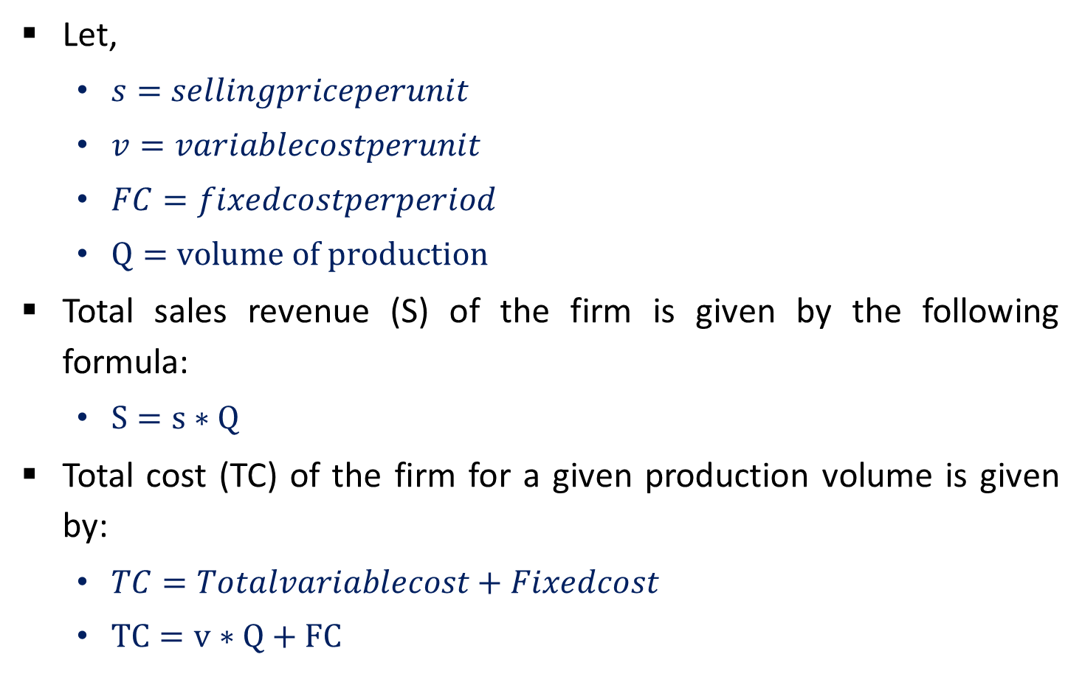
Break-Even Analysis Equation
Let,
$s=sellingpriceperunit$
$v=variablecostperunit$
$FC=fixedcostperperiod$
$Q=volume of production$
Total sales revenue (S) of the firm is given by the following formula:
$S=s∗Q$
Total cost (TC) of the firm for a given production volume is given by:
$TC=Totalvariablecost+Fixedcost$
$TC=v∗Q+FC$

Slide 47
Break-Even Analysis Graphical Representation
Sales (S)
Sales
Profit
Loss
Total Cost (TC)
Break-even
Sales
Variable Cost (VC)
Fixed Cost (FC)
BEP (Q*)
Production quantity

Slide 48
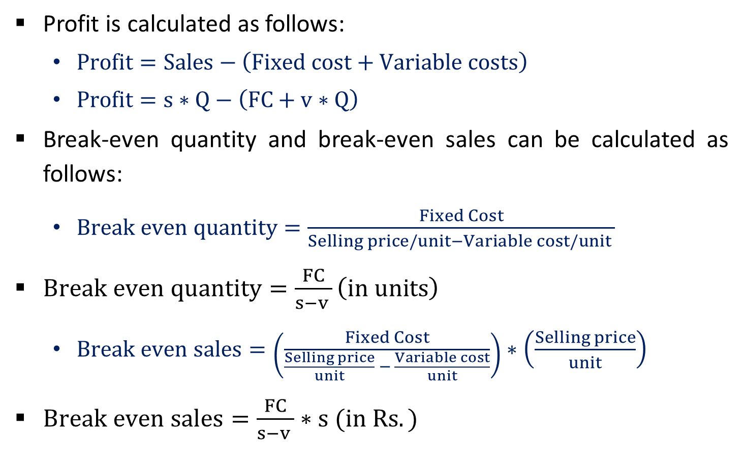
Break-Even Analysis
Profit is calculated as follows:
$Profit=Sales−\left(Fixed cost+Variable costs\right)$
$Profit=s∗Q−\left(FC+v∗Q\right)$
Break-even quantity and break-even sales can be calculated as follows:
$Break even quantity=\frac{Fixed Cost}{Selling price/unit−Variable cost/unit }$
$Break even quantity=\frac{FC}{s−v }\left(in units\right)$
$Break even sales=\left(\frac{Fixed Cost}{\frac{Selling price}{unit} − \frac{Variable cost}{unit}}\right)∗\left(\frac{Selling price}{unit}\right)$
$Break even sales=\frac{FC}{s−v }∗s (in Rs.)$

Slide 49
Limitation of Break-Even Analysis
In practice, it may not be possible to achieve a clear-cut division of costs into fixed and variable types.
It should be noted that fixed costs tend to vary beyond a certain level of activity.
In practice variable costs vary with the volume of output, but not necessarily in direct proportions.
The assumption that selling price remains unchanged gives a straight revenue line which may not be true.
In practice may product mix will not remain unchanged.
Distribution of fixed cost over a variety of products poses a problem.

Slide 50
Cont…
It assumes that the business conditions may not change which is not true.
Assumption no change in opening and closing stock of finished product, this is not true in practice.
Capital employed is an important determinant of the profitability of a concern which break-even analysis does not take into consideration.

Slide 51
Application of Break-Even Analysis
Determination of selling price which will give the desired profits.
Fixation of sales volume to cover a given return on capital employed.
Forecasting costs and profit as a result of change in volume.
Gives suggestions for shift in sales mix.
Inter-firm comparison of profitability.
Determination of costs and revenue at various levels of output.
It is an aid in management decision-making, forecasting, long-term planning and maintaining profitability.
It reveals business strength and profit earning capacity of a concern without much difficulty and effort.

Slide 52

Contribution
The contribution is the difference between the sales and the variable cost.
$Contribution=Sales−Variable costs$
$\frac{Contribution}{unit}=Selling price/unit−Variable cost/unit$

Slide 53
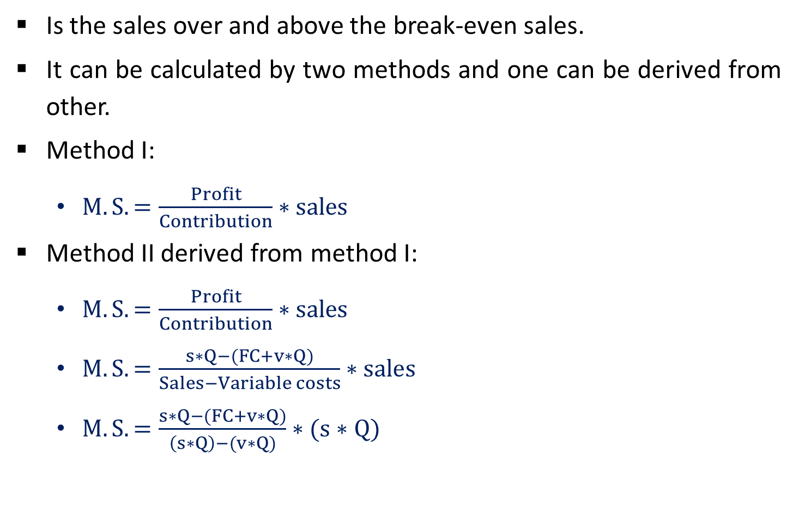
Margin of Safety (M.S.)
Is the sales over and above the break-even sales.
It can be calculated by two methods and one can be derived from other.
Method I:
$M.S.=\frac{Profit}{Contribution}∗sales$
Method II derived from method I:
$M.S.=\frac{Profit}{Contribution}∗sales$
$M.S.=\frac{s∗Q−(FC+v∗Q)}{Sales−Variable costs}∗sales$
$M.S.=\frac{s∗Q−(FC+v∗Q)}{\left(s∗Q\right)−(v∗Q)}∗(s∗Q)$

Slide 54

Cont…
$M.S.=\frac{(s∗Q−v∗Q−FC)}{\left(s∗Q\right)−(v∗Q)}∗(s∗Q)$
$M.S.=\frac{(s∗Q−v∗Q)−(FC)}{\left(s∗Q\right)−(v∗Q)}∗(s∗Q)$
$M.S.=\left(s∗Q\right)−\frac{FC}{s−v}∗s$
$M.S.=Sales−Break even sales$
Now M.S. as a percent of sales:
$M.S.as a percent of sales=\frac{M.S.}{Sales}∗100$

Slide 55
Margin of Safety (M.S.) Example 1
Alpha Associates has the following details:
Fixed cost = Rs. 20,00,000
Variable cost per unit = Rs. 100
Selling price per unit = Rs. 200
Find
The break-even sales quantity
The break-even sales
If the actual product quantity is 60,000, find
contribution;
margin of safety by all methods and
margin of safety as a percent of sales.

Slide 56
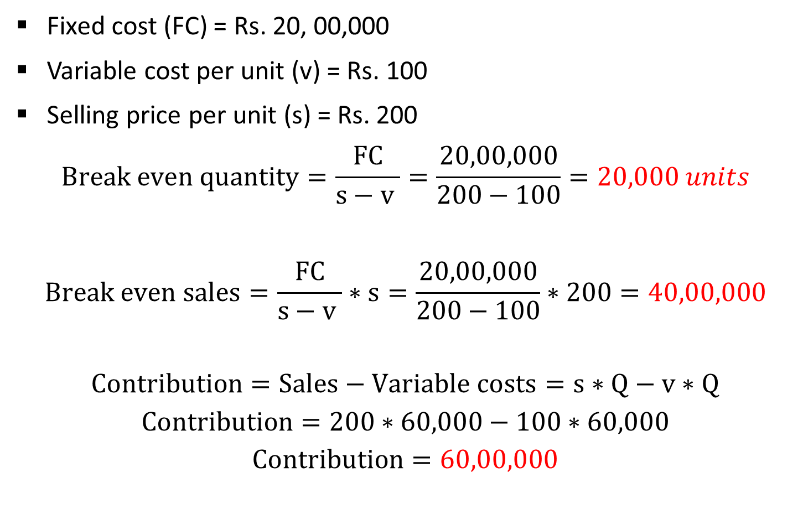
Cont…
Fixed cost (FC) = Rs. 20, 00,000
Variable cost per unit (v) = Rs. 100
Selling price per unit (s) = Rs. 200
$$Break even quantity=\frac{FC}{s−v }=\frac{20,00,000}{200−100}=20,000 units$$
$$Break even sales=\frac{FC}{s−v }∗s=\frac{20,00,000}{200−100}∗200=40,00,000$$
$$Contribution=Sales−Variable costs=s∗Q−v∗Q$$
$$Contribution=200∗60,000−100∗60,000$$
$$Contribution=60,00,000$$

Slide 57
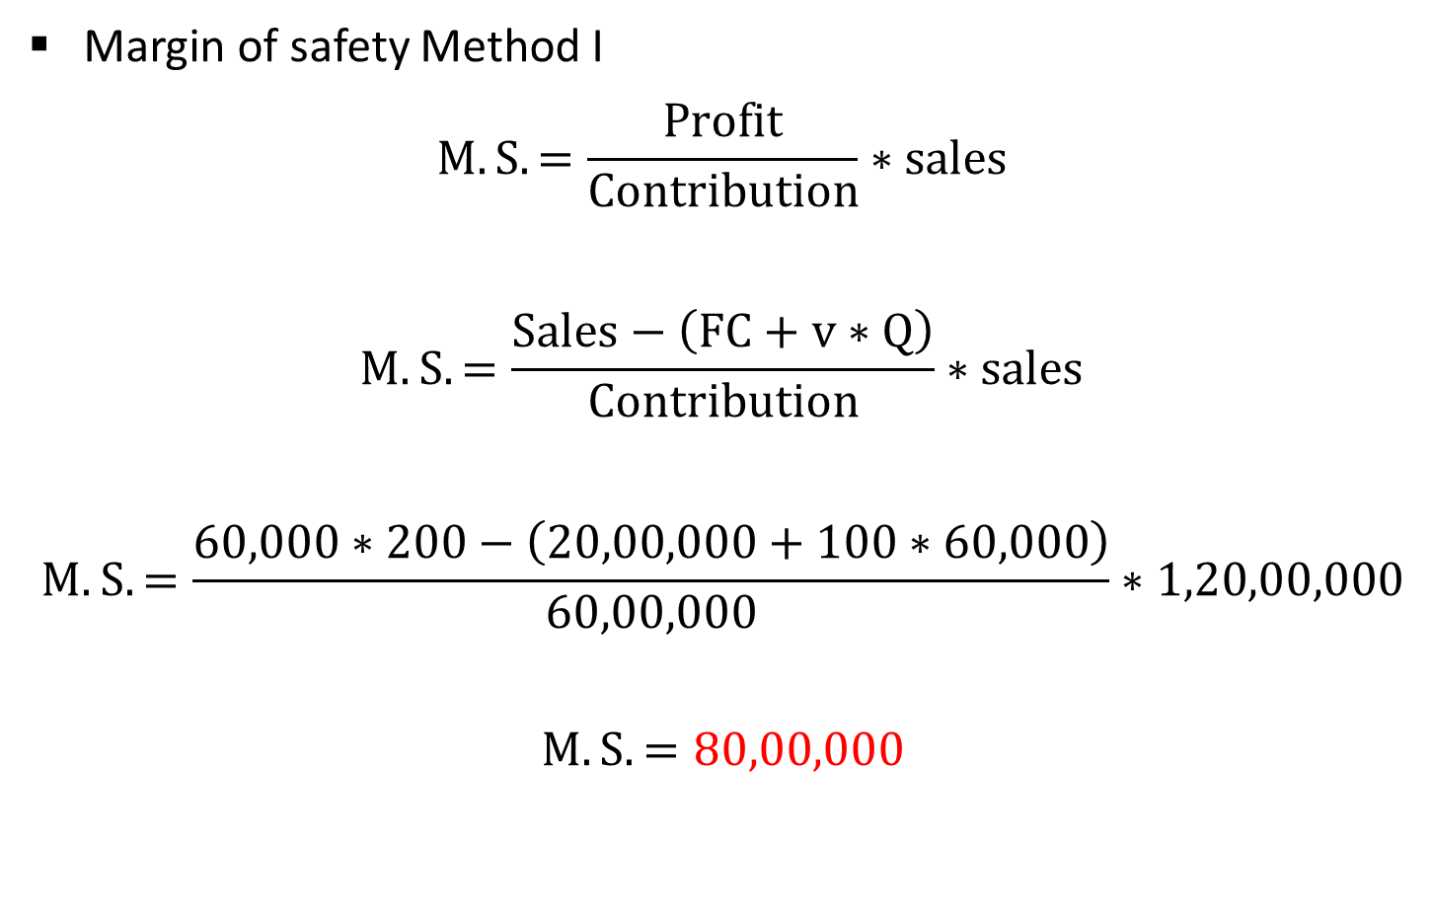
Cont…
Margin of safety Method I
$$M.S.=\frac{Profit}{Contribution}∗sales$$
$$M.S.=\frac{Sales−\left(FC+v∗Q\right)}{Contribution}∗sales$$
$$M.S.=\frac{60,000∗200−\left(20,00,000+100∗60,000\right)}{60,00,000}∗1,20,00,000$$
$$M.S.=80,00,000$$

Slide 58
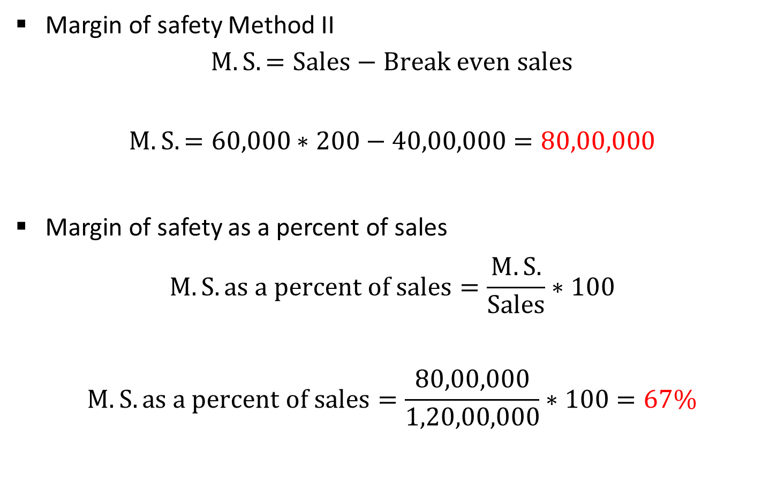
Cont…
Margin of safety Method II
$$M.S.=Sales−Break even sales$$
$$M.S.=60,000∗200−40,00,000=80,00,000$$
Margin of safety as a percent of sales
$$M.S.as a percent of sales=\frac{M.S.}{Sales}∗100$$
$$M.S.as a percent of sales=\frac{80,00,000}{1,20,00,000}∗100=67\%$$

Slide 59
Margin of Safety (M.S.) Example 2
ABC Associates has the following details:
Fixed cost = Rs. 30,00,000
Variable cost per unit = Rs. 200
Selling price per unit = Rs. 350
Find
The break-even sales quantity
The break-even sales
If the actual product quantity is 80,000, find
contribution;
margin of safety by all methods and
margin of safety as a percent of sales.

Slide 60
Thank You

