Slide 1


Unit-3 Markets and National Income
Engineering Economics and Management (2130004)
Prof. Vijay M. Shekhat
vijay.shekhat@darshan.ac.in
+91 9727235778
Computer Engineering Darshan Institute of Engineering & Technology

Slide 2
Outlines
Markets
Meaning
Types of Market and their Characteristics
Perfect Competition, Monopoly, Monopolistic Completion and Oligopoly
National Income
Meaning
Stock and Flow Concept
NI at Current Price and Constant Price
GNP, GDP, NNP, NDP
Personal and Disposal Income

Slide 3






Introduction to Market
Market is a means by which the exchange of goods and services takes place as a result of buyers and sellers being in contact with one another.
Source: http://www.10best.com
Contact can be directly or through intermediating agents.
Now a day market also become online.

Slide 4
Meaning of Market
Prof. R. Chapman
“The term market refers not necessarily to a place but always to a commodity and the buyer, and seller who are in direct competition with one another”
Prof. Benham
“A market means any area over which buyers and sellers are in close touch with one another, either directly or through dealers that the price obtainable in one part of the market on the prices paid on the other parts”
Philip Kotler
“Market means a combination of actual and potential (probable) users”

Slide 5
Types of Market
Perfect Competition
Monopoly
Market Types
Monopolistic Competition
Oligopoly

Slide 6
1. Perfect Competition Market
Market with large number of buyers and sellers.
The individual buyer or seller cannot influence the price.
The quantity picked up by individual buyers is negligible hence he is not in a position to dictate his terms.
The quantity supplied by individual seller is negligible hence he is not in a position to dictate his terms.
This market is considered to be unrealistic but it is still of special interest for imaginary and theoretical reasons.

Slide 7
Characteristics of Perfect Competition Market
large number of buyers and sellers.
No barriers for entry.
Perfect mobility for factors of production allows free long term adjustment to changing market condition.
Perfect knowledge of price, utility, quality and production methods to buyers and sellers.
Zero transaction cost in making an exchange of goods.
Homogeneous products.
Non-increasing returns to scale.
Property rights determine what may be sold and what are the rights of a buyer.
Rational buyers who are capable to make reasonable purchases.

Slide 8
2. Monopoly Market
The term monopoly is a combination of two Greek terms, mono means single and poly means seller.
Monopoly refers to a market with a single seller.
Seller has full power to set prices So he is price maker and not price taker.
Buyers are in a weaker bargaining position in a monopoly market.

Slide 9
Characteristics of Monopoly Market
Single seller in a market.
No substitutes So buyers have to buy that product only.
High entry barriers for seller.
Seller is Price Maker.
Price Discrimination happens when a firm charges a different price to different groups of buyers for an identical good or service.
10% discount for students.
Generation of super normal profit.

Slide 10

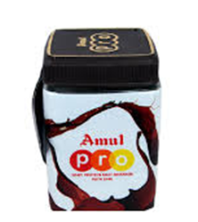
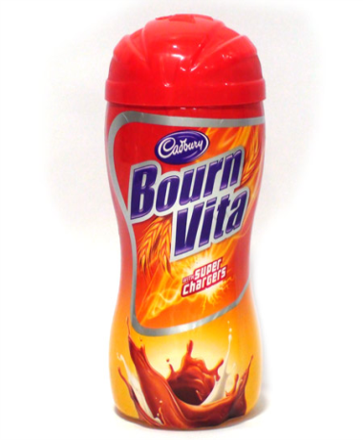
3. Monopolistic Market
The perfect competition and the monopoly are the extreme state of market structure which is unrealistic in real world.
Monopolistic market is formed by a high number of firms.
Each seller will be considered as a monopoly due to differentiation in product.
But the whole market is considered as competitive because the degree of differentiation is not high.
For Example:

Slide 11
Characteristics of Monopolistic Competition Market
Large number of buyers.
Large number of sellers, but less than the perfect competition.
Product differentiation, where the concept of the homogeneous products of perfect competition is changed to close substitutes.
Less entry barrier.
Need of Huge advertisement budget otherwise close substitute will replace market.
Price sensitive as it is highly elastic, where minor change in price will divert the buyer to other substitute.
Concept of group or chain in which a minor union may formed through group companies, or chain shops, or franchises etc.

Slide 12
4. Oligopoly (ઓલીગોપોલી) Market
Total market demand is shared among few giant sellers.
For e.g.
Hero, Honda, Bajaj in two wheeler market .
Each seller enjoys a defined market share in the total demand.
One seller enjoying huge market share, is termed as market leader.
If there are only two sellers, it is a special case of oligopoly known as Duopoly.

Slide 13
Characteristics of Oligopoly Market
Number of firms are few.
Interdependence where the action of one firm can affect the action of the other firms.
Profit maximization.
Ability to set price: price maker rather than price takers.
Entry barriers are high.
Examaple: Government licenses, patents, access to expensive and complex technology, and strategic actions by current firms designed to discourage or destroy emerging firms.
Long run profit: High barriers of entry prevent sideline firms from entering market to capture excess profits.

Slide 14
Cont…
Product differentiation: Product may be homogeneous (steel) or differentiated (automobiles).
Perfect knowledge: Have perfect knowledge of their own cost and demand functions but their inter-firm information may be incomplete.
Non-Price Competition.

Slide 15

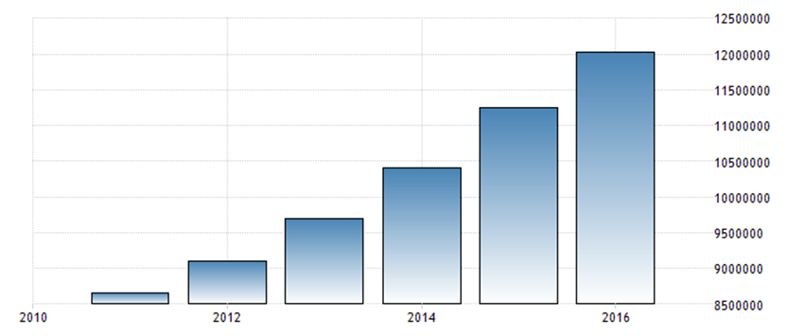
National Income (NI)
Source: http://iasdreamz.com
INR Tens of Million
INDIA GROSS NATIONAL INCOME
Source: https://tradingeconomics.com

Slide 16
Cont…
Alfred Marshall
The labour and capital of country acting on its national resources produce annually a certain net aggregate of commodities, material and immaterial including services of all kind. This is the true national income or revenue of the country.
A. C. Pigou
The national dividend is that part of the objective income of the public, including income received from abroad, which can be measured in money.
C. Rangarajan & Bakul Dholakia
National income is the aggregate income value of the annual flow of final goods and services in the national economy.

Slide 17
Stock and Flow Concept of NI
A flow is any quantity which is measured over a period of time.
Example: Income is a flow.
A stock is any quantity which is measured at a single instant in time.
Example: 10 Acres land
The amount of orange juice I drink in a month is a flow.
The amount of orange juice I have right now is a stock.

Slide 18
Relationship between stock of wealth and flow of income
Stock is useable for the generation of the flow of income.
The change in value of stock during the holding period occurs due to following reasons:
Generation of flow of income will be added to stock for the next period of time.
Depreciation on fixed assets will reduce value of stock of wealth
It should be noted that period-end increase in the value of stock arise from the following two sources:
Periodic recurring operating income.
One time capital gains between two points of time. Example: price of land is increase by two lacs.

Slide 19
NI at Current Price
NI is calculated by using current market price for measurement of factor cost.
It Includes fluctuation due to inflation.
It is also known as monetary income.
It does not give true picture of economic growth.
In India NI data compilation is done by Central Statistical Organization (CSO) located in Delhi.

Slide 20
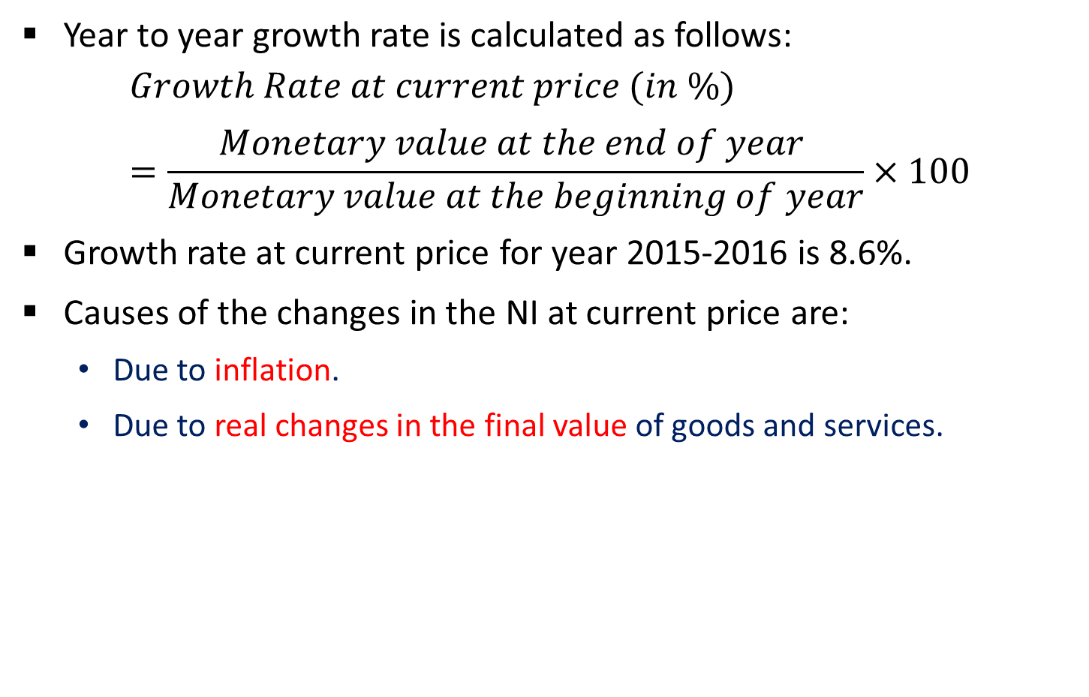
Cont…
Year to year growth rate is calculated as follows:
$$Growth Rate at current price (in \%)=\frac{Monetary value at the end of year }{Monetary value at the beginning of year}×100$$
Growth rate at current price for year 2015-2016 is 8.6%.
Causes of the changes in the NI at current price are:
Due to inflation.
Due to real changes in the final value of goods and services.

Slide 21
NI at Constant Price
NI is calculated by using some base year’s market price for measurement of factor cost.
In India current base year is 2011-2012. And before this 2004-2005 was considered as base year.
It is not affected due to inflation.
It is also describe as real income.
It gives true picture of economic growth of a country.

Slide 22
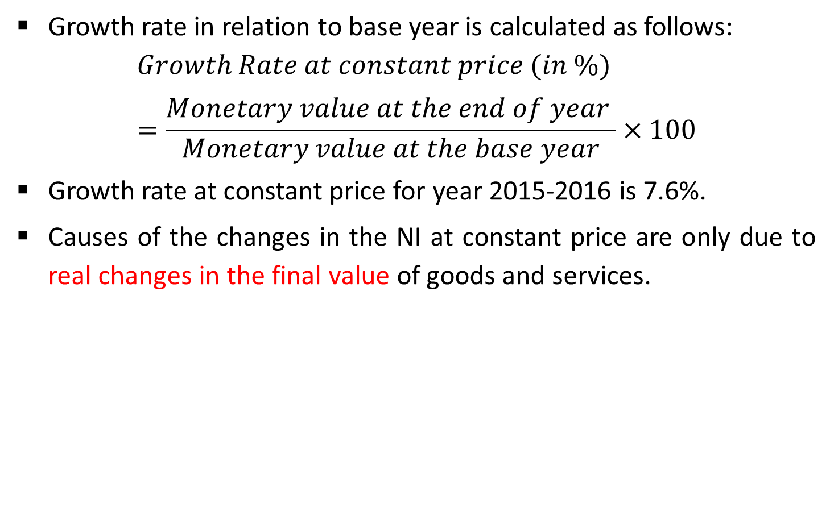
Cont…
Growth rate in relation to base year is calculated as follows:
$$Growth Rate at constant price (in \%)=\frac{Monetary value at the end of year }{Monetary value at the base year}×100$$
Growth rate at constant price for year 2015-2016 is 7.6%.
Causes of the changes in the NI at constant price are only due to real changes in the final value of goods and services.

Slide 23
Gross National Product (GNP)
GNP is the value of all finished goods and services produced in a country in a year by its nationals.
GNP is a broad measure of a nation's total economic activity.
It includes income earned by NRI and companies abroad.
It does not include income earned by foreigners within the country.
It Includes manufactured goods and services provided.
It Includes depreciation and indirect business taxes like sales tax.

Slide 24
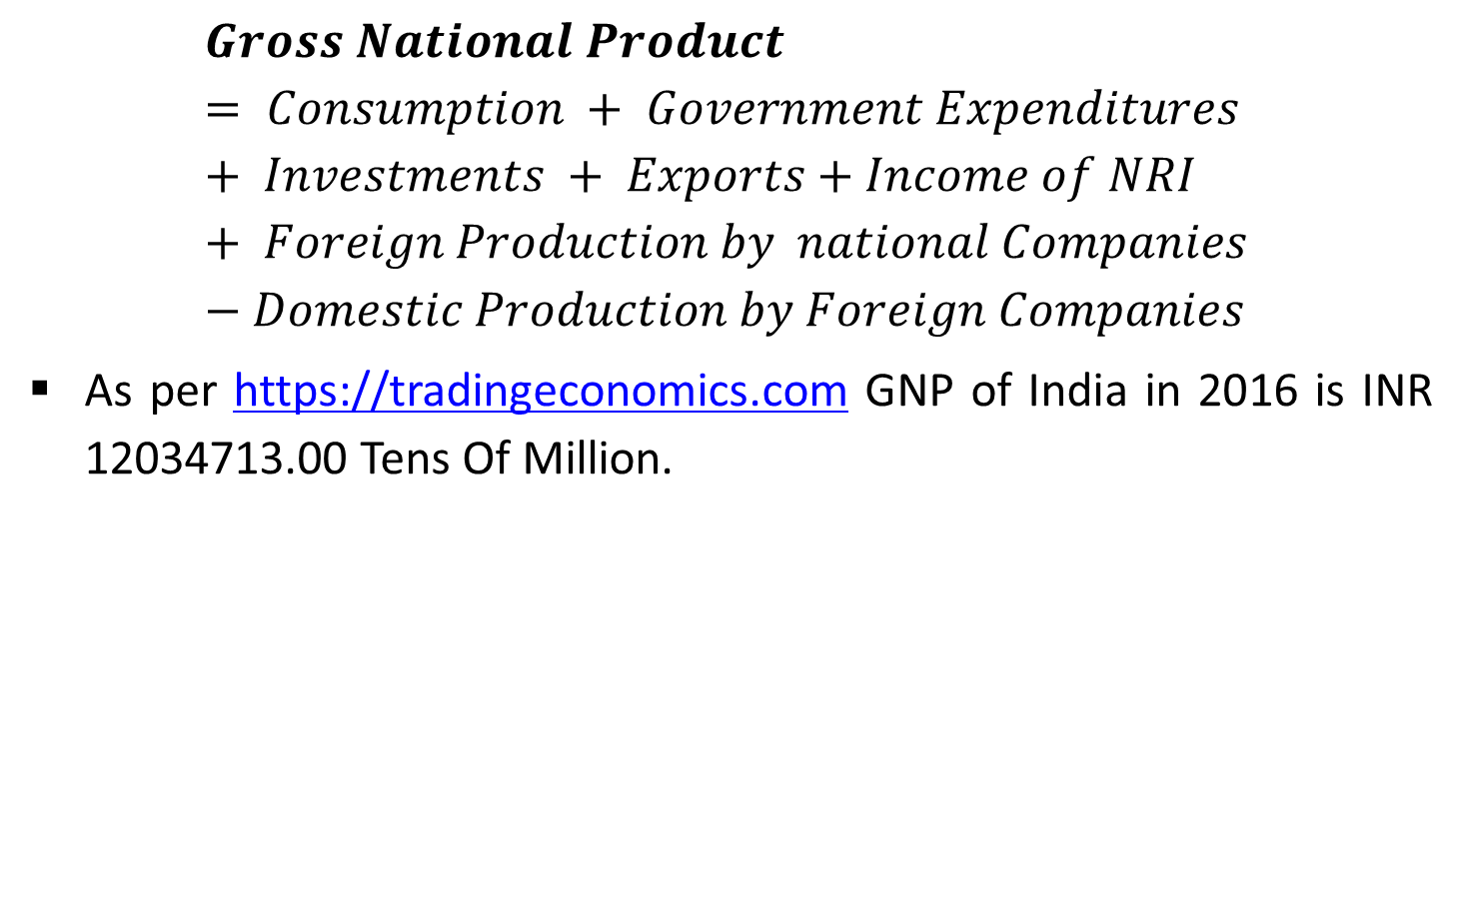
Cont…
$$Gross National Product= Consumption + Government Expenditures + Investments + Exports+Income of NRI + Foreign Production by national Companies −Domestic Production by Foreign Companies$$
As per https://tradingeconomics.com GNP of India in 2016 is INR 12034713.00 Tens Of Million.

Slide 25
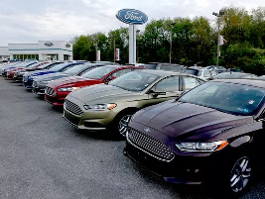


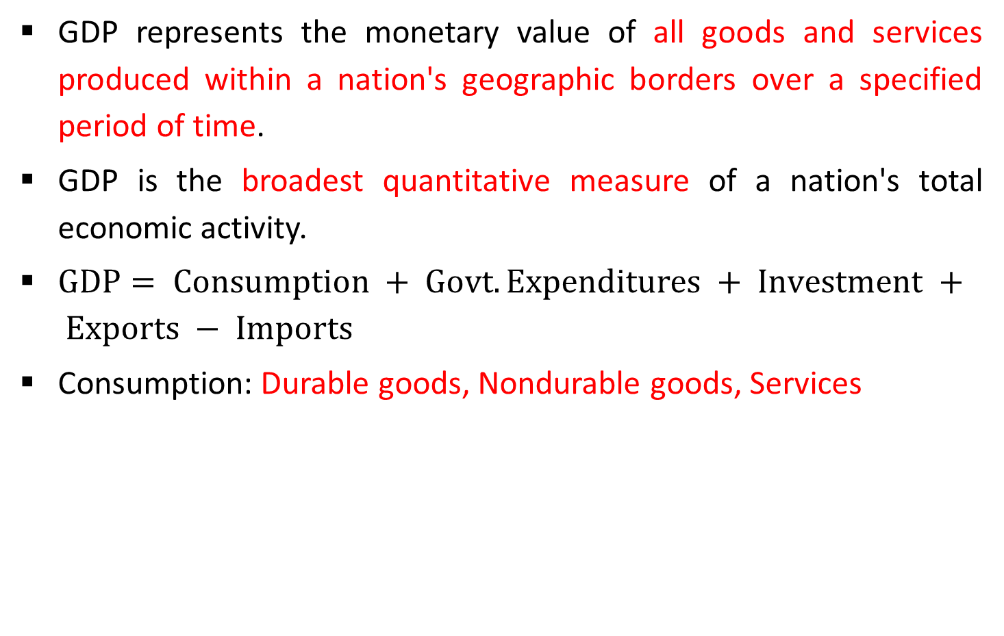
Gross Domestic Products (GDP)
GDP represents the monetary value of all goods and services produced within a nation's geographic borders over a specified period of time.
GDP is the broadest quantitative measure of a nation's total economic activity.
$GDP= Consumption + Govt. Expenditures + Investment + Exports − Imports$
Consumption: Durable goods, Nondurable goods, Services
Source: https://www.usatoday.com
Source: https://www.bizbuysell.com
Source: http://www.serviceworld.net.in

Slide 26
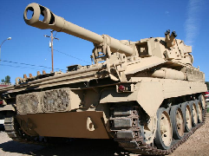
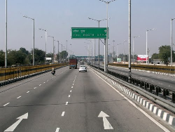



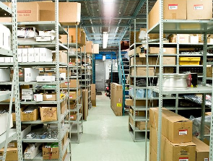
Cont…
Government Expenditures: Defense, Roads, Schools
Investment Spending On: Commercial, Residential, Business inventories
Source: http://www.ceetak.com
Source: http://meinhardtindia.com
Source: http://mysuperbrain.com
Source: http://www.cgarchitect.com
Source: https://stimulrealty.com
Source: http://www.mountainjobs.com

Slide 27
Cont…
Net Exports: Exports are added to GDP
Net Imports: Imports are deducted from GDP
As per https://tradingeconomics.com GDP of India in 2016 is 2263.52 billion USD.

Slide 28

Net National Product (NNP)
NNP is the monetary value of finished goods and services produced by a country's citizens, whether overseas or resident, in the time period being measured.
$$NNP = GNP−Depreciation on Gross Capital Investment$$

Slide 29

Net Domestic Product (NDP)
NDP is an annual measure of the economic output of a nation that is adjusted to account for depreciation.
Calculated by subtracting depreciation from the gross domestic product (GDP).
$$NDP = GDP−Depreciation on Gross Capital Investment$$

Slide 30
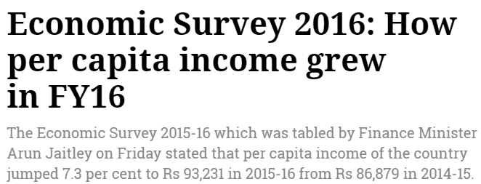

Per Capita National Income
The per capita income indicates a share of every Indian citizen in the total national income.
$$Per capital Income \left(in Rs.\right)= \frac{Total NI during a period}{Total number of citizens in a country}$$
Source: http://www.financialexpress.com

Slide 31

Personal Income (PI)
PI refers to all of the income collectively received by all of the individuals or households in a country.
Disposable Income OR Disposable Personal Income (DPI).
$$DPI=PI−Income tax paid$$

Slide 32
Thank You

