Slide 1


Unit-4 Basic Economic Problems
Engineering Economics and Management (2130004)
Prof. Vijay M. Shekhat
vijay.shekhat@darshan.ac.in
+91 9727235778
Computer Engineering Darshan Institute of Engineering & Technology

Slide 2
Outlines
Basic Economic Problems
Poverty
Meaning
Absolute and Relative Poverty
Causes and Remedies
Unemployment
Meaning
Types
Causes and Remedies
Inflation
Meaning
Types
Causes and Measures to Control

Slide 3
Basic Economic Problems
Poverty
Unemployment
Inflation

Slide 4
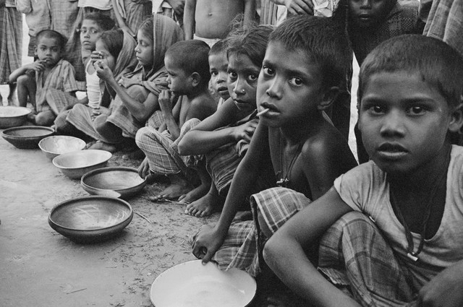

Poverty
Source: http://helpfightpoverty.weebly.com
Source: http://refe99.com

Slide 5



What is Poverty?
Poverty is about not having enough money to meet basic needs including,
Food
Clothing
Shelter
Source: http://www.comicoast.com
Source: http://www.clipartpanda.com
Source: https://www.farmers.com/

Slide 6
Concepts of Poverty
There are two concepts of poverty
Absolute Poverty
Relative Poverty

Slide 7

Absolute Poverty
Refers to a condition where a person does not have the minimum amount of income needed to meet the minimum requirements for one or more basic living needs over an extended period of time.
Source: http://www.scienceinpublic.com.au

Slide 8
Absolute Poverty in India
Earlier, India used to define the poverty line based on a method defined by a task force in 1979.
It was based on expenditure for buying food worth 2,400 calories in rural, and 2,100 calories in urban areas.
In 2011, the Suresh Tendulkar Committee defined the poverty line on the basis of monthly spending on food, education, health, electricity and transport.
According to them, a person who spends less than Rs. 27.2 in rural and Rs. 33.3 in urban areas a day are living below the poverty line(BPL).

Slide 9
Cont…
This has been criticized for fixing the poverty line too low.
According to a committee headed by former Reserve Bank governor C Rangarajan, people living on less than Rs. 32 a day in rural areas and Rs. 47 a day in urban areas is poor.

Slide 10
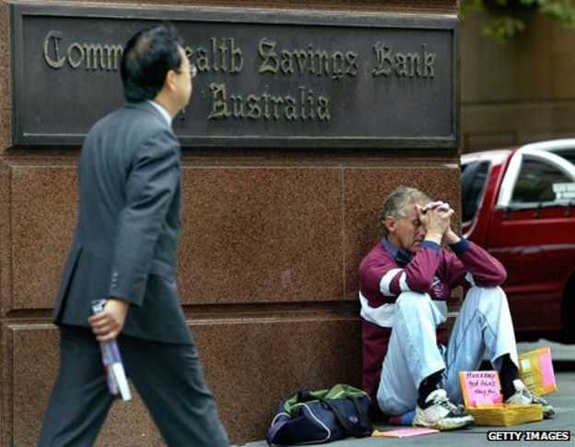
Relative Poverty
It is condition in which people lack the minimum amount of income needed in order to maintain the average standard of living in the society in which they live.
Source: http://www.bbc.com

Slide 11
Relative Poverty Example
It is obvious that A is poorest person while D is richest person.
However, Relative poverty may be assessed on the basis of some standard level of income.
If Rs. 20000, per month is considered as standard level of income then A, B, & C are considered relatively poor.
If Rs. 10000, per month is considered as standard level of income then only A is considered relatively poor.
Person | Income
A | 5000
B | 10000
C | 15000
D | 20000

Slide 12
Causes of Poverty
Low rate of economic growth.
Economic inequalities.
Benefits of public investment have accrued more to the upper layer of the society.
Unemployment and underemployment.
Inflationary price rice.
Faster population growth amongst the poor.
Low level of literacy amongst the poor.
Inadequacies of anti poverty programs.
Corruption.
Natural calamity.

Slide 13
Measures to Reduce Poverty
Rapid economic growth . – GDP
Reducing economic inequalities. – Progressive Income Tax
Employment oriented planning. – Make in India
Adoption of appropriate pattern of production. – Drip Irrigation
Control of inflation and price stability. – Reduction of import duty on essential commodities
Removal of illiteracy. – Right to free primary education
Population control. – Family planning
Special program of poverty eradication
Self-Employment program- Gram Rozgar Yojana
Wage-Employment program- Mahatma Gandhi NREGA
Social security program- Aam Aadmi Bima Yojana

Slide 14
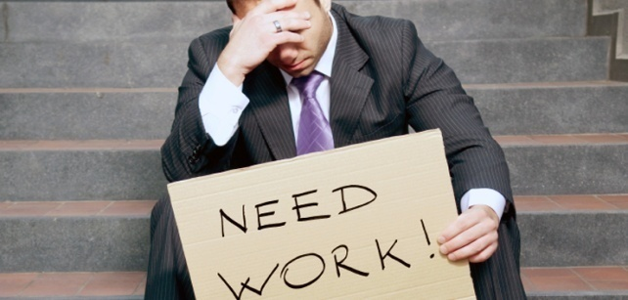
Unemployment
Source: https://www.stlucianewsonline.com

Slide 15
What is Unemployment?
Unemployment refers to a situation in which a person is jobless though
He is able to work,
He is willing to work,
He is ready to accept the current wage rate, &
He is in search of job.

Slide 16
Active labour force
Unemployment is a concept which is connected with only active labour force in the country
Active labour force is age group 15-60 year.
Housewives, physically handicapped, old person and children etc. are not Included in active labour force.

Slide 17
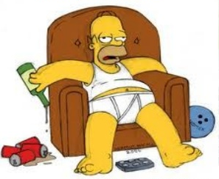
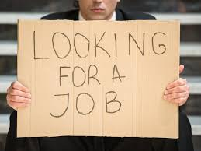
Voluntary and Involuntary Unemployment
Voluntarily Unemployed
Person choose not to work because his expected salary is higher than the usual salary.
Involuntarily Unemployed
Person is willing to work at the usual salary yet he is unemployed.
Source: https://anshupriyagoswamy.wordpress.com
Source: http://pechtellaw.com

Slide 18
Dimensions of Unemployment
Economic
It indicates unutilized or underutilized manpower.
We cannot get desired increases in production and national income.
Social
He starts support to any activity to oppose the existing economic and social system.
Psychological
He cannot live life with self-respect.
Become mentally frustrated.

Slide 19
Types of Unemployment
Cyclical Unemployment.
Frictional Unemployment.
Structural unemployment.
Seasonal unemployment.

Slide 20
Cyclical Unemployment
This type of unemployment increases during a recession and decreases during boom.
Businessman are unwilling to spend money on salaries when they believe consumers are not buying their products.
For e.g. an automobile worker may be laid off during a recession, when people are buying fewer cars.
When people buy fewer cars, businessman don't need many workers to meet the consumer demand.
As the demand for cars decreases, so does the demand for automobile workers.
As the economy strengthens, and consumers start to spend more money on goods (e.g. cars), the unemployed worker will probably be rehired.

Slide 21
Frictional Unemployment
It is always presence in the economy, resulting from temporary transitions made by workers and employers.
It is caused because, unemployed workers may not always take the first job offer they receive because of the wages and necessary skills.
This type of unemployment is also caused by failing firms, poor job performance, or outdated skills.
This may also be caused by workers who will quit their jobs in order to move to different parts of the country.
Frictional unemployment can be seen as a transaction cost of trying to find a new job.
It is the result of not having perfect information of available jobs.

Slide 22
Structural unemployment
The Structural Unemployment is the situation when the jobs are available, and also the workers are willing to work, but they don’t have the required job skills suitable for the vacant positions.
It occurs due to the change in the demand for specific types of worker because of the fundamental shifts in the economy.
Advances in technology and changes in market conditions often turn many skills outdated.
For e.g. with the rise of computers, many jobs in manual book keeping have been replaced by highly efficient software users.
Workers need to acquire new skills in order to obtain such jobs.

Slide 23
Seasonal unemployment
Worker of seasonal business will get employment in season only and in off season they are unemployed.
Example – workers of mango farm.

Slide 24
Causes of Unemployment
Slow rate of economic growth.
Preference to capital centric techniques of production. – Buying new machine instead of increasing workers.
Defective education system. – Not giving industry ready students.
Absence of skill development opportunities. – Shortage of skill development training providers.
Lack of man-power planning. – Imbalance in skill and requirement.
Immobility of labour. – Home-sickness.
Rapid growth of population.

Slide 25
Remedies to Resolve Unemployment
Accelerating economic growth rate.
Change in pattern of investment.
Employment oriented planning.
Role of employment agencies (Information of available jobs).
Appropriate labour policy.
Encouragement to self employment.
Reform of education system.
Population control.

Slide 26
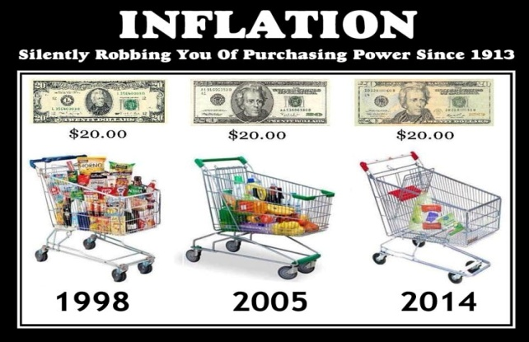
Inflation
Source: http://1077thejewel.com

Slide 27
Inflation
Inflation is defined as a continuous increase in the general level of prices for goods and services.
It is measured as an annual percentage increase.
As inflation rises, every rupee you own buys a smaller percentage of a good or service.
The value of a rupee does not stay constant during inflation.

Slide 28
Inflation Example
The value of a rupee is observed in terms of purchasing power.
Real goods or services that money can buy.
When inflation goes up, there is a decline in the purchasing power of money.
For e.g. if the inflation rate is 10% annually, then goods costs RS 100 will be costing RS 110 in next year.

Slide 29
Types of Inflation
Types of Inflation
Based on Causes
Based on Degree of Rise in Price
Demand-pull inflation
Cost-push inflation
Creeping inflation
Walking inflation
Currency inflation
Credit inflation
Running inflation
Hyper inflation
Deficit-induced inflation

Slide 30
Demand-pull inflation
Demand-pull inflation results from strong consumer demand.
Many individuals purchasing the same good will cause the price to increase.
When such an event happens to a whole economy for all types of goods, it is called demand-pull inflation.
Causes
Additional Demand
Increase in Price level
Demand-pull Inflation
Growing economy.
Expectation of inflation.
Technological innovation.
Overexpansion of the money supply.

Slide 31
Cost-push inflation
Cost push inflation is inflation caused by an increase in prices of inputs like labour, raw material, etc.
The increased price of the factors of production leads to a decreased supply of these goods.
While the demand remains constant, the prices of commodities increase causing a rise in the overall price level. This is known as cost push inflation.
Increased cost of raw materials
Increase in Price level
Cost-push Inflation

Slide 32
Cont…
Causes
Salary increases.
Government regulation and taxation.
Shift in exchange rates.
Natural disasters.

Slide 33
Currency inflation
A situation in which more money becomes available without an increase in production and services, causing prices to rise.
This type of infla­tion is caused by the printing of cur­rency notes.

Slide 34
Credit inflation
Being profit-making institutions, commercial banks sanction more loans and advances to the public than what the economy needs.
Such credit expansion leads to a rise in price level.

Slide 35
Deficit-induced inflation
The budget of the government reflects a deficit when expenditure exceeds revenue.
To meet this gap, the government may ask the central bank to print additional money.
Due to pumping of additional money price rise, this is called the deficit-induced inflation.

Slide 36
Creeping inflation
Circumstance where the inflation of a nation increases gradually, but continually, over time.
This tends to be a typical pattern for many nations.
Although the increase is relatively small (less than 3%) in the short-term, as it continues over time the effect will become greater and greater.

Slide 37
Walking/Moderate inflation
When prices rise moderately and the annual inflation rate is a single digit (3% - 10%), it is called walking or trotting inflation.
Inflation at this rate is a warning signal for the government to control it before it turns into running inflation.

Slide 38
Running inflation
When prices rise rapidly like the running horse at a rate of 10% - 20% per annum, it is called running inflation.
Its control requires strong monetary and fiscal measures, otherwise it leads to hyperinflation.

Slide 39
Hyper/ Galloping inflation
When prices rises 20% to 100% per annum or even more, it is called galloping or hyperinflation.
Such a situation brings a total collapse of the monetary system because of the continuous fall in the purchasing power of money.

Slide 40
Causes of Inflation
Demand Side Factors
Increase in money supply.
Increase in government spending through deficit financing.
Expansionary monetary policy will increase money supply..
Bouyant economy and expansion of private sector capital projects.
Existence of parallel black money economy.
Repayment of public debt.
Income from exports.

Slide 41
Cont…
Supply Side Factors
Shortage of factor of production (inputs).
Labour instability.
Producers give more preference to product which gives more profit as compare to basic product.
Price rise in the international inputs.
Artificial scarcity.
Natural calamities.

Slide 42
Cont…
Perceptual Factors
Expected salary rise will increase current consumption and price rise.
Due to expectation of getting higher price in future supplier will restrict the supply.
Due to expectation of rise in price in future producer will buy more row material.

Slide 43
Measures to Control Inflation
Monetary measures
Credit Control.
Issue of New Currency must be stopped or limited .
Increase in Bank Rate.
Increase in Cash Reserve Ratio (CRR).
Increase in Statutory Liquidity Ratio (SLR).
Withdraw liquid funds from economy through Open Market Operations (OMO).

Slide 44
Cont…
Fiscal Measures
Reduction in public Expenditure.
Increased taxation.
Tax incentives on savings and investments.
Extension of repayment of public debt.
Other Measures
Price control.
Rationing
Increase Production

Slide 45
Thank You

