Slide 1


UNIT-4 Objects and Classes
C++ is Very Easy to Understand
I Love C++ Language
Rupesh G. Vaishnav
rupesh.vaishnav@darshan.ac.in
94280-37452
Computer Engineering Darshan Institute of Engineering & Technology

Slide 2
Outline
Weightage: 15%
Basics of Object and Class in C++
Private and Public Members
Static data and Function Members
Constructors and their types
Destructors
Operator Overloading
Type Conversion

Slide 3



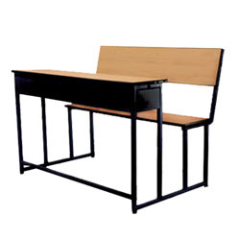


What is an Object?
Pen
Board
Laptop
Bench
Projector
Bike
Physical objects…

Slide 4
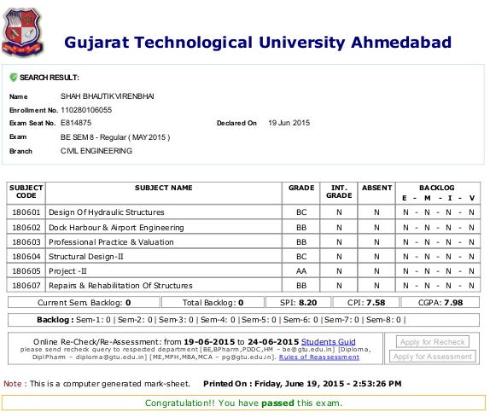

What is an Object? (Cont…)
Result
Bank Account
Logical objects…

Slide 5


Attributes and Operations of an Object
Object: Person
Object: Car
Object: Account
Attributes:
Name
Age
Weight
Attributes:
Company
Color
Fueltype
Attributes:
AccountNo
HolderName
AccountType
Methods :
Eat
Sleep
Walk
Methods :
Start
Drive
Stop
Methods :
Deposit
Withdraw
Transfer
List 2 objects with its attributes and operations

Slide 6
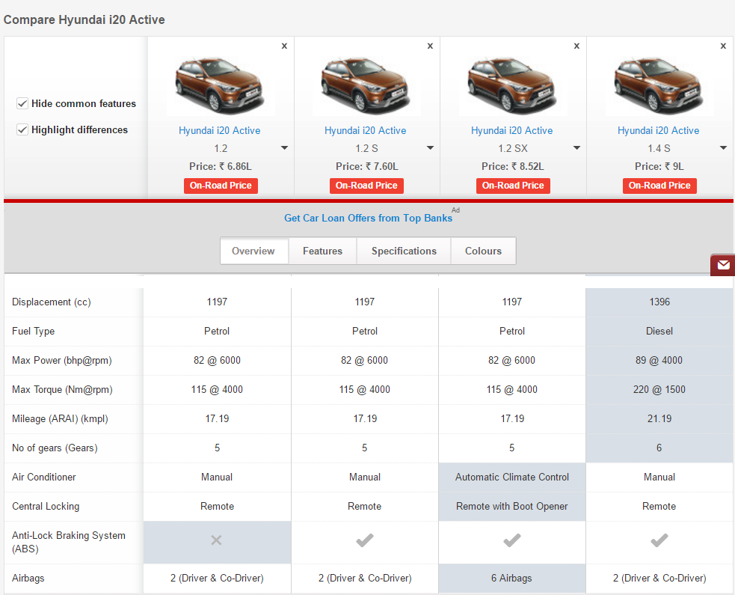

Slide 7





Class Car
Honda City
Hyundai i20
Sumo Grand
Mercedes E class
Swift Dzire

Slide 8

CAR
CLASS: CAR
Properties (Describe)
Company
Model
Color
Mfg. Year
Price
Fuel Type
Mileage
Gear Type
Power Steering
Anti-Lock braking system
Methods (Functions)
Start
Drive
Park
On_break
On_lock
On_turn
Notes:
Describe car Properties: Make, Model, Color, Year, Price
Actions Start, Drive, Park
Thing happens to a car Events On_Strart(Turn on head light),On_Parked, On_Brake
These are backbone of object oriented programming

Slide 9
Class in C++
A class is a blueprint or template that describes the object.
A class specifies the attributes and methods of objects.
Example:
class employee
{
// data members and member functions
}a;
In above syntax class name is employee, and a is object of that class.

Slide 10
Object in C++
An object is an instance of a class
An object is a variable of type class
Notes:
An object, as you might remember
from Chapter 1, is a particular instance of a class, and a class defines how data is stored
and used

Slide 11
Program Class, Object
Write a C++ program to create class Test having data members mark and spi.
Create member functions SetData() and DisplayData()to demonstrate class and objects.

Slide 12
Program
#include <iostream>
using namespace std;
class Test
{
private:
int mark;
float spi;
public:
void SetData()
{
mark = 70;
spi = 6.5;
}
void DisplayData()
{
cout << "Mark= "<<mark<<endl;
cout << "spi= "<<spi;
}
} ;
int main()
{
Test o1;
o1.SetData();
o1.DisplayData();
return 0;
}
Executes statements and return to calling function
Calling member function. Control jumps to definition of DisplayData()
Calling member function. Control jumps to definition of SetData()
Starting point of a Program
Creates an object o1 of type Test
Notes:
Executes statements and return to calling function

Slide 13
Keyword Private and Public
Private
Public

Slide 14
Public Members
The public keyword makes data and functions public.
Public members of the class are accessible by any program from anywhere.
Class members that allow manipulating or accessing the class data are made public.
Notes:
Here, data1 and data2 are private members where as function1() and function2() are public members.
If you try to access private data from outside of the class, compiler throws error. This feature in OOP is known as data hiding.

Slide 15
Private Members
Private members of the class can be accessed within the class and from member functions of the class.
They cannot be accessed outside the class or from other programs, not even from inherited class.
If you try to access private data from outside of the class, compiler throws error.
This feature in OOP is known as Data hiding / Encapsulation.
If any other access modifier is not specified then member default acts as Private member.

Slide 16
Data Hiding in Classes
CLASS
No entry to
Private area
Private Area
X
Data
Functions
Public Area
Entry allowed to
Public area
Data
Functions

Slide 17
Example Class in C++
class Test
{
private:
int data1;
float data2;
public:
void function1()
{
data1 = 2;
}
float function2()
{
data2 = 3.5;
return data2;
}
};
By Default the members of a class are private.
private is a Keyword
Private data and functions can be written here
public is a Keyword
Public data and functions can be written here

Slide 18
Program
Write a C++ program to create class Car having data members Company and Top_Speed.
Create member functions SetData() and DisplayData() and create two objects of class Car.

Slide 19
class Car
{
private:
char company[20];
int top_speed;
public:
void SetData(){
cout<<"Enter Company:";
cin>>company;
cout<<"Enter top speed:";
cin>>top_speed;
}
void DisplayData()
{
cout << "\nCompany:"<<company;
cout << "\tTop Speed:"<<top_speed;
}
} ;
Program
int main()
{
Car o1;
o1.SetData();
o1.DisplayData();
return 0;
}

Slide 20
Program
Write a C++ program to create class Employee having data members Emp_Name, Salary, Age.
Create member functions SetData() and DisplayData().
Create two objects of class Employee

Slide 21
Program (Function with arguments)
class Employee
{
private:
char name[10];
int salary,age;
public:
void SetData()
{
cin>>name>>salary>>age;
}
void DisplayData()
{
cout << “Name= "<<name<<endl;
cout << “salary= "<<salary<<endl;
cout << “age= "<<age;
}
} ;
int main()
{
Employee o1;
o1.SetData();
o1.DisplayData();
return 0;
}

Slide 22
Function definition outside the class
Syntax:
Return-type class-name :: function-name(argument declaration)
{
Function body;
}
The membership label class-name:: tells the compiler that the function belongs to class
Example:
void Test :: SetData(int i,int j)
{
mark = i;
spi = j;
}
Notes:
Return-type class-name :: function-name(argument declaration)
{
}

Slide 23
Program
class Test
{
private:
int mark;
float spi;
public:
void SetData(int,float);
void DisplayData();
};
void Test :: SetData(int i,float j){
mark = i;
spi = j;
}
void Test :: DisplayData()
{
cout << "Mark= "<<mark;
cout << “\nspi= "<<spi;
}
int main()
{
Test o1;
o1.SetData(70,6.5);
o1.DisplayData();
return 0;
}
The membership label Test:: tells the compiler that the SetData() and DisplayData() belongs to Test class

Slide 24
Program
Define class Time with members hour, minute and second. Also define function to setTime() to initialize the members, print() to display time. Demonstrate class Time for two objects.

Slide 25
Program
#include<iostream>
using namespace std;
class Time
{
private :
int hour, minute, second;
public :
void setTime(int h, int m, int s);
void print();
};

Slide 26
Program
void Time::setTime(int h, int m, int s)
{
hour=h;
minute=m;
second=s;
}
void Time::print()
{
cout<<"hours=\n"<<hour;
cout<<"minutes=\n"<<minute;
cout<<"seconds=\n"<<second;
}

Slide 27
Program
int main()
{
int h,m,s;
Time t1;
cout<<"Enter hours="; cin>>h;
cout<<"Enter minutes="; cin>>m;
cout<<"Enter seconds="; cin>>s;
t1.setTime(h,m,s);
t1.print();
return 0;
}

Slide 28
Program
Define class Rectangle with members width and height. Also define function to set_values() to initialize the members, area() to calculate area. Demonstrate class Rectangle for two objects.

Slide 29
class Rectangle
{
int width, height;
public:
void set_values (int,int);
int area(){
return width*height;
}
};
void Rectangle::set_values (int x, int y){
width = x; height = y;
}
Program
int main(){
Rectangle rect;
rect.set_values(3,4);
cout << "area: " << rect.area();
return 0;
}

Slide 30
Program
Define class Employee with members age and salary.
Also define function to setdata() to initialize the members.
Define function displaydata() to display data.
Demonstrate class Employee for two objects.
int main(){
Employee yash,raj;
yash.setData(23,1500);
yash.displaydata();
raj.setData(27,1800);
raj. displaydata();
return 0;
}

Slide 31
Program
class Employee{
private :
int age; int salary;
public :
void setData(int , int);
void addData(Employee,Employee);
void displaydata();
};
void Employee::setData(int x, int y){
age=x;
salary=y;
}
void Employee::displaydata(){
cout<<"age="<<age<<endl;
cout<<"salary="<<salary<<endl;
}

Slide 32
Program Passing and Returning an Object
Define class Time with members hour, minute and second. Also define function to getTime() to initialize the members, printTime() to display time and addTime() to add two time objects. Demonstrate class Time.
1. Passing object as argument
2. Returning object

Slide 33
Program passing object as argument
class Time
{
int hour, minute, second;
public :
void getTime(){
cout<<"\nEnter hours:";cin>>hour;
cout<<"Enter Minutes:";cin>>minute;
cout<<"Enter Seconds:";cin>>second;
}
void printTime(){
cout<<"\nhour:"<<hour;
cout<<"\tminute:"<<minute;
cout<<"\tsecond:"<<second;
}
void addTime(Time t1, Time t2){
hour = t1.hour + t2.hour;
minute = t1.minute + t2.minute;
second = t1.second + t2.second;
}
};

Slide 34
Program passing object as argument
int main()
{
Time t1,t2,t3;
t1.getTime();
t1.printTime();
t2.getTime();
t2.printTime();
t3.addTime(t1,t2);
cout<<"\nafter adding two objects";
t3.printTime();
return 0;
}

Slide 35
Program returning object
class Time{
int hour, minute, second;
public :
void getTime(){
cout<<"\nEnter hours:";cin>>hour;
cout<<"Enter Minutes:";cin>>minute;
}
void printTime(){
cout<<"\nhour:"<<hour;
cout<<"\tminute:"<<minute;
}
Time addTime(Time t1, Time t2){
Time t4;
t4.hour = t1.hour + t2.hour;
t4.minute = t1.minute + t2.minute;
return t4;
}
};

Slide 36
Program #7 returning object
int main()
{
Time t1,t2,t3,ans;
t1.getTime();
t1.printTime();
t2.getTime();
t2.printTime();
ans=t3.addTime(t1,t2);
cout<<"\nafter adding two objects";
ans.printTime();
return 0;
}

Slide 37
Nesting Member functions
A member function of a class can be called by an object of that class using dot operator.
A member function can be also called by another member function of same class.
This is known as nesting of member functions.
void set_values (int x, int y)
{
width = x;
height = y;
printdata();
}

Slide 38
Program
Define class Rectangle with member width,height. Also define function to setvalue(), displayvalue(). Demonstrate nested member functions.

Slide 39
Program
class rectangle{
int w,h;
public:
void setvalue(int ww,int hh)
{
w=ww;
h=hh;
displayvalue();
}
void displayvalue()
{
cout<<"width="<<w;
cout<<"\theigth="<<h;
}
};
int main(){
rectangle r1;
r1.setvalue(5,6);
r1.displayvalue();
return 0;
}

Slide 40
Memory allocation of objects
The member functions are created and placed in the memory space only once when they are defined as part of a class specification.
No separate space is allocated for member functions when the objects are created.
Only space for member variable is allocated separately for each object because, the member variables will hold different data values for different objects.

Slide 41
Memory allocation of objects(Cont…)
Common for all objects
Member function 1
Member function 2
Memory created when, Functions defined
Object 1
Object 2
Object 3
Member variable 1
Member variable 1
Member variable 1
Member variable 2
Member variable 2
Member variable 2
Memory created when Object created

Slide 42
class Account
{
int Account_no,Balance;
char Account_type[10];
public:
void setdata(int an,char at[],int bal)
{
cin>>an;cin>>at;cin>>bal;
}
void printdata(){
cout<<an;cout<<at;cout<<bal;
}
};
Object | A1
Account No | 101
Account Type | Current
Balance | 3400
Object | A2
Account No | 102
Account Type | Saving
Balance | 150
Object | A3
Account No | 103
Account Type | Current
Balance | 7900
int main(){
Account A1,A2,A3;
A1.setdata(101,“Current“,3400);
A2.setdata(102,“Saving“,150);
A3.setdata(103,“Current“,7900);
return 0;
}

Slide 43
Static Data Members
Data members of the class which are shared by all objects are known as static data members.
Only one copy of a static variable is maintained by the class and it is common for all objects.
Static members are declared inside the class and defined outside the class.
It is initialized to zero when the first object of its class is created.
you cannot initialize a static member variable inside the class declaration.
It is visible only within the class but its lifetime is the entire program.
Static members are generally used to maintain values common to the entire class.
Notes:
you cannot initialize a static member variable inside the class declaration.

Slide 44
Program
class item
{
int number;
static int count;// static variable declaration
public:
void getdata(int a){
number = a;
count++;
}
void getcount(){
cout<<"\nvalue of count: "<<count;
}
};
int item :: count; // static variable definition

Slide 45
Program
int main()
{
item a,b,c;
a.getdata(100);
a.getcount();
b.getdata(200);
a.getcount();
c.getdata(300);
a.getcount();
return 0;
}
Object a
Object b
Object c
100
200
300
count
2
1
3
0
Output:
value of count: 1
value of count: 2
value of count: 3

Slide 46
Program #10 Static Data member
int main() {
shared x, y;
x.set(1, 1);
x.show();
y.set(2, 2);
y.show();
x.show();
return 0;
}
class shared {
static int a;
int b;
public:
void set(int i, int j) {a=i; b=j;}
void show();
} ;
int shared::a;
void shared::show()
{
cout << "This is static a: " << a;
cout << "\nThis is non-static b: " << b; cout << "\n";
}
static variable a declared inside class but, storage is not allocated
variable a redeclared outside the class using scope resolution operator.
Storage for the variable will be allocated
Notes:
class shared {
static int a;
int b;
public:
void set(int i, int j) {a=i; b=j;}
void show();
} ;
int shared::a; // define a
void shared::show()
{
cout << "This is static a: " << a;
cout << "\nThis is non-static b: " << b; cout << "\n";
}
int main()
{
shared x, y;
x.set(1, 1); // set a to 1
x.show();
y.set(2, 2); // change a to 2
y.show(); x.show(); /* Here, a has been changed for both x and y because a is shared by both objects. */
return 0;
}

Slide 47
Static Member Functions
Static member functions can be invoked using class name, not object.
They can access only static members of the class.
They cannot be virtual.
They cannot be declared as constant or volatile.
A static member function can be called, even when a class is not instantiated.
There cannot be static and non-static version of the same function.
A static member function does not have this pointer.

Slide 48
Program#10 Static Member function
class item
{
int number;
static int count;// static variable declaration
public:
void getdata(int a){
number = a;
count++;
}
static void getcount(){
cout<<”value of count: “<<count;
}
};
int item :: count; // static variable definition

Slide 49
Program
int main()
{
item a,b,c;
a.getdata(100);
item::getcount();
b.getdata(200);
item::getcount();
c.getdata(300);
item::getcount();
return 0;
}
Output:
value of count: 1
value of count: 2
value of count: 3

Slide 50
Friend Function
A friend function is a function which is declared using friend keyword.
Friend Function is mechanism built in C++ programming to access private or protected data from non-member functions.
It is not a member of the class.
Friend function cannot access the member names directly.
Notes:
One of the important concepts of OOP is data hiding.
i.e., a non-member function cannot access an object's private or protected data.

Slide 51
Friend Function (Cont…)
Friend function can be declared either in public or private part of the class.
It is not a member of the class so it cannot be called using the object.
Usually, it has the objects as arguments.
Syntax:
class ABC
{
public:
……………………………………………
friend void xyz(argument/s); //declaration
……………………………………………
};

Slide 52
Program
class numbers {
int num1, num2;
public:
void setdata(int a, int b);
friend int add(numbers N);
};
void numbers :: setdata(int a, int b){
num1=a;
num2=b;
}
int add(numbers N){
return (N.num1+N.num2);
}
int main()
{
numbers N1;
N1.setdata(10,20);
cout<<”Sum = ”<<add(N1);
return 0;
}

Slide 53
Program
class Box {
double width;
public:
friend void printWidth( Box );
void setWidth( double wid );
};
void Box::setWidth( double wid ) {
width = wid;
}
void printWidth(Box b) {
cout << "Width of box : " << b.width;
}
int main( ) {
Box box;
box.setWidth(10.0);
printWidth( box );
return 0;
}

Slide 54
class base
{
int val1,val2;
public:
void get(){
cout<<"Enter two values:";
cin>>val1>>val2;
}
friend float mean(base ob);
};
float mean(base ob){
return float(ob.val1+ob.val2)/2;
}
int main(){
base obj;
obj.get();
cout<<"\n Mean value is : "<<mean(obj);
}
Program

Slide 55
Member function, friend to another class
class X {
………………………………………
int f();
};
class Y{
………………………………………
friend int X :: f();
};
Member functions of one class can be made friend function of another class.
The function f is a member of class X and a friend of class Y.
Notes:
We can declare all the member functions of one class as the friend functions of another class.
In such cases, the class is called a friend class, like class X is the friend class of class Z

Slide 56
class B; //forward declaration
class ABC {
private:
int numA;
public:
void setdata(){
numA=10;
}
friend int add(ABC, XYZ);
};
class XYZ {
private:
int numB;
public:
void setdata(){
numB=25;
}
friend int add(ABC , XYZ);
};
int add(ABC objA, XYZ objB){
return (objA.numA + objB.numB);
}
int main(){
ABC objA; XYZ objB;
objA.setdata(); objB.setdata();
cout<<"Sum: "<< add(objA, objB);
}

Slide 57
class Square; // forward declaration
class Rectangle
{
int width=5, height=6;
public:
friend void display(Rectangle , Square );
};
class Square
{
int side=9;
public:
friend void display(Rectangle , Square );
};
void display(Rectangle r, Square s)
{
cout<<"Rectangle:"<< r.width * r.height;
cout<<"Square:"<< s.side * s.side;
}

Slide 58
int main () {
Rectangle rec;
Square sq;
display(rec,sq);
return 0;
}

Slide 59
Program (GTU JAN’16)
Write a program to find out sum of two private data members x and y of two classes A and B using a common friend function. Assume that the prototype for both the classes will be void sum (A, B);
Program (GTU JUN’16)
Create two classes X and Y containing private variables x and y respectively. Using a common friend function, perform multiplication operation between x and y.

Slide 60
Constructor
A constructor is a “special” member function which has same name as class name and being called when object of class is created.
A constructor executed automatically whenever object is created. i.e. not by calling explicitly to a function.
A constructor is used to initialize the objects of class as soon as the object is created.
Syntax:
class class_name{
....
public:
class_name(){
....
}
};
Constructor
Notes:
Cube Example

Slide 61
Constructor (Cont…)
class Rectangle
{
int width,height;
public:
Rectangle(){
width=5;
height=6;
cout<<”Constructor Called”;
}
};
int main()
{
Rectangle r1;
return 0;
}

Slide 62
Properties of Constructor
Constructor should be declared in public section because private constructor cannot be invoked outside the class so they are useless.
Constructors do not have return types and they cannot return values, not even void.
Constructors cannot be inherited, even though a derived class can call the base class constructor.
Constructors cannot be virtual.
They make implicit calls to the operators new and delete when memory allocation is required.

Slide 63
Types of Constructors
Default constructor
Parameterized constructor
Copy constructor

Slide 64
1) Default Constructor
Default constructor is the one which invokes by default when object of the class is created.
It is generally used to initialize the default value of the data members.
It is also called no argument constructor.
class integer{
int m,n;
public:
integer(){
m=n=10;
}
};
int main()
{
integer i1;
}
Object i1
m
n
10
10

Slide 65
Program Constructor
class Area
{
private:
int length, breadth;
public:
Area(){
length=5;
breadth=2;
}
void Calculate(){
cout<<"\narea="<<length * breadth;
}
};
int main(){
Area A1;
A1.Calculate();
Area A2;
A2.Calculate();
return 0;
}
A1
A2
length
breadth
length
breadth
5
2
5
2

Slide 66
2) Parameterized Constructor
Constructors that can take arguments are called parameterized constructors.
Sometimes it is necessary to initialize the various data elements of different objects with different values when they are created.
We can achieve this objective by passing arguments to the constructor function when the objects are created.

Slide 67
Parameterized Constructor (Cont…)
class integer
{
int m,n;
public:
integer(int x,int y){ //Parameterized Constructor
m=x;
n=y;
cout<<“Constructor Called“;
}
};
int main()
{
integer i1(5,6);
}
i1
m
n
5
6

Slide 68
Program Parameterized Constructor
Create a class Distance having data members feet and inch. Create parameterized constructor to initialize members feet and inch.

Slide 69
3) Copy Constructor
A copy constructor is used to declare and initialize an object from another object using an object as argument.
For example:
integer(integer &i); //declaration
integer I2(I1); //copy object
OR interger I2=I1; //copy object
Constructor which accepts a reference to its own class as a parameter is called copy constructor.
Notes:
These are special type of Constructors, and is used to copy values of data members of one object into other object.

Slide 70
Copy Constructor (Cont…)
class integer
{
int m, n;
public:
integer(int x,int y){
m=x;
n=y;
cout<<“Constructor Called“;
}
integer(integer &x){
m = x.m;
n = x.n;
cout<<“Copy Constructor Called“;
}
};
int main()
{
integer i1(5,6);
integer i2(i1);
}
i1
i1 or x
m
n
5
6
i2
m
n
5
6

Slide 71
Program Types of Constructor
class rectangle{
int length, width;
public:
rectangle(){ // Default constructor
length=0;
width=0;
}
rectangle(int x, int y){// Parameterized constructor
length = x;
width = y;
}
rectangle(rectangle &_r){ // Copy constructor
length = _r.length;
width = _r.width;
}
};
This is constructor overloading

Slide 72
Program Types of Constructor (Cont…)
int main()
{
rectangle r1; // Invokes default constructor
rectangle r2(10,20); // Invokes parameterized constructor
rectangle r3(r2); // Invokes copy constructor
}

Slide 73
Destructor
Destructor is used to destroy the objects that have been created by a constructor.
The syntax for destructor is same as that for the constructor, the class name is used for the name of destructor, with a tilde (~) sign as prefix to it.
Destructor never takes any argument nor it returns any value nor it has return type.
Destructor is invoked automatically by the complier upon exit from the program.
Destructor should be declared in the public section.

Slide 74
Destructor Example-1
class rectangle
{
int length, width;
public:
rectangle(){ //Constructor
length=0;
width=0;
cout<<”Constructor Called”;
}
~rectangle() //Destructor
{
cout<<”Destructor Called”;
}
// other functions for reading, writing and processing can be written here
};
int main()
{
rectangle x;
// default constructor is called
}

Slide 75
Destructor Example-2
int main( )
{
Marks m1;
Marks m2;
return 0;
}
class Marks{
public:
int maths;
int science;
//constructor
Marks() {
cout << "Inside Constructor"<<endl;
cout << "C++ Object created"<<endl;
}
//Destructor
~Marks() {
cout << "Inside Destructor"<<endl;
cout << "C++ Object destructed"<<endl;
}
};

Slide 76
Operator Overloading
int a=5, b=10,c;
c = a + b;
Operator + performs addition of integer operands a, b
class time
{
int hour, minute;
};
Operator + performs addition of objects of type time t1,t2
time t1,t2,t3;
t3 = t1 + t2;
string str1=“Hello”,str2=“Good Day”;
str1 + str2;
Operator + concatenates two strings str1,str2

Slide 77
Operator Overloading
Specifying more than one definition for an operator in the same scope, is called operator overloading.
You overload operators by creating operator functions.
Syntax:
return-type operator operator-symbol(argument-list)
{
// operations
}
Keyword
substitute the operator
Example:
void operator + (arguments);
int operator - (arguments);
class-name operator / (arguments);
float operator * (arguments);
Notes:
To define an additional task to an operator , we must specify what it means in relation to class to which operator is applied. This is done with the help of special function is called operator function
C++ allows you to specify more than one definition for a function name or an operator in the same scope, which is called function overloading and operator overloading respectively.
We can give special meaning to any operators in which program it is implemented.

Slide 78
Overloading Binary operator +
int main()
{
complex c1(4,6),c2(7,9);
complex c3;
c3 = c1 + c2;
c1.disp(); c2.disp();
c3.disp(); return 0;
}
class complex{
int real,imag;
public:
complex(){
real=0; imag=0;}
complex(int x,int y){
real=x; imag=y;}
void disp(){
cout<<"\nreal value="<<real<<endl;
cout<<"imag value="<<imag<<endl;}
complex operator + (complex);
};
complex complex::operator + (complex c){
complex tmp;
tmp.real = real + c.real;
tmp.imag = imag + c.imag;
return tmp;
}
Similar to function call
c3=c1.operator +(c2);

Slide 79
Overloading Binary operator ==
class complex{
int r,i;
public:
complex(){
r=i=0;}
complex(int x,int y){
r=x;
i=y;}
void display(){
cout<<"\nreal="<<r<<endl;
cout<<"imag="<<i<<endl;}
int operator==(complex);
};
int main()
{
complex c1(5,3),c2(5,3);
if(c1==c2)
cout<<"objects are equal";
else
cout<<"objects are not equal";
return 0;
}
int complex::operator ==(complex c){
if(r=c.r && i==c.i)
return 1;
else
return 0;}

Slide 80
Create a class coordinate containing x, y and z private variables. Perform operations for incrementing, adding and comparing object(s) by overloading + +, + = and = = operators respectively. Define necessary functions to set and display the variables.

Slide 81
Overloading Unary operator −−
int main()
{
space s1(5,4,3);
s1.display();
--s1;
s1.display();
return 0;
}
class space {
int x,y,z;
public:
space(){
x=y=z=0;}
space(int a, int b,int c){
x=a; y=b; z=c; }
void display(){
cout<<"\nx="<<x<<",y="<<y<<",z="<<z;
}
void operator--();
};
void space::operator--() {
x--;
y--;
z--;
}

Slide 82
Overloading Unary operator −
int main()
{
space s1(5,4,3);
s1.display();
-s1;
s1.display();
return 0;
}
class space {
int x,y,z;
public:
space(){
x=y=z=0;}
space(int a, int b,int c){
x=a; y=b; z=c; }
void display(){
cout<<"\nx="<<x<<",y="<<y<<",z="<<z;
}
void operator-();
};
void space::operator--() {
x=-x;
y=-y;
z=-z;
}

Slide 83
Overloading Binary operator +
class complex{...
complex operator + (complex);
};
complex complex::operator + (complex c){
complex tmp;
tmp.real = real + c.real;
tmp.imag = imag + c.imag;
return tmp;
}
class complex{...
friend complex operator+(complex , complex);
};
friend complex operator +(complex c1,complex c2){
complex tmp;
tmp.real = c1.real + c2.real;
tmp.imag = c1.imag + c2.imag;
return tmp;}

Slide 84
Overloading Binary operator using friend function
int main(){
complex c1(3,5);
complex c2(4,9);
complex c3;
c3=c1+c2;
c3.disp();
return 0;
}
class complex{
int r, i;
public:
complex (){
r=i=0;}
complex(int x, int y) {
r=x; i=y;}
void disp(){
cout<<"\nThe value of real="<<r<<endl;
cout<<"The value of imag="<<i;}
friend complex operator+(complex , complex);
};
friend complex operator +(complex c1,complex c2){
complex tmp;
tmp.r=c1.r+c2.r; tmp.i=c1.i+c2.i;
return tmp;
}

Slide 85
Operator Overloading
Operator overloading is compile time polymorphism.
You can overload most of the built-in operators available in C++.
+ | - | * | / | % | ^
& | | | ~ | ! | , | =
< | > | <= | >= | ++ | --
<< | >> | == | != | && | ||
+= | -= | /= | %= | ^= | &=
|= | *= | <<= | >>= | [] | ()
-> | ->* | new | new [] | delete | delete []
Operator overloading provides mechanism to perform operations on user defined data type as well.

Slide 86
Rules for operator overloading
Only existing operator can be overloaded.
The overloaded operator must have at least one operand that is user defined type.
We cannot change the basic meaning and syntax of an operator.
We cannot use friend function to overload certain operators.
Unary operators, overloaded by means of a member function, take no explicit arguments and return no explicit value.
But, those overloaded by means of a friend function, take one reference argument.
Binary operators overloaded through a member function take one explicit argument and those which are overloaded through a friend function take two explicit arguments.

Slide 87
Rules for operator overloading (Cont…)
When using binary operators overloaded through a member function, the left hand operand must be an object of the relevant class.
We cannot overload following operators.
Operator | Name
. and .* | Class member access operator
:: | Scope Resolution Operator
sizeof() | Size Operator
?: | Conditional Operator

Slide 88
Type Conversion
int a;
float b = 10.54;
a = 10;
float is converted to integer automatically by complier.
basic to basic type conversion.
a = b;
integer
(Basic)
float
(Basic)
Time t1;
int m;
m = t1;
class type will not be converted to basic type OR basic type will not be converted class type automatically.
t1 = m;
integer
(Basic)
Time
(Class)
Time
(Basic)
integer
(Class)

Slide 89
Type Conversion
C++ provides mechanism to perform automatic type conversion if all variable are of basic type.
For user defined data type programmers have to convert it by using constructor or by using casting operator.
Three type of situation arise in user defined data type conversion.
Basic type to Class type
Class type to Basic type
Class type to Class type

Slide 90
(1) Basic to class type conversion
Basic to class type can be achieved using constructor.
class sample
{
int a;
public:
sample(){}
sample(int x){
a=x;
}
void disp(){
cout<<"The value of a="<<a;
}
};
int main()
{
int m=10;
sample s;
s = m;
s.disp();
return 0;
}

Slide 91
(2) Class to basic type conversion
The Class type to Basic type conversion is done using casting operator function.
The casting operator function should satisfy the following conditions.
It must be a class member.
It must not specify a return type.
It must not have any arguments.
Syntax:
operator destinationtype()
{
....
return
}

Slide 92
Example Class to basic type conversion
class vector{
int a[5];
public:
vector(){
for(int i=0;i<5;i++)
a[i] = i*2;
}
operator int();
};
sample:: operator int() {
int sum=0;
for(int i=0;i<5;i++)
sum = sum + a[i];
return sum;}
int main()
{
vector v;
int len;
len = v;
cout<<“Length of V="<<len;
return 0;
}

Slide 93
(3) Class type to Class type
It can be achieved by two ways
Using constructor
Using casting operator function

Slide 94
class stock2 ;
class stock1{
int code , item ;
float price ;
public :
stock1 ( int a , int b , int c ) {
code = a ; item = b ; price = c ;
}
void disp () {
cout << " code " << code << " \n " ;
cout << " items " << item << " \n " ;
cout << " price per item Rs. " << price << " \n " ;
}
int getcode (){ return code; }
int getitem (){ return item ; }
int getprice (){ return price ; }
operator float () {
return ( item*price ) ;
}
};

Slide 95
class stock2{
int code ;
float val ;
public :
stock2 () {
code = 0; val = 0 ;
}
stock2( int x , float y ){
code = x ; val = y ;
}
void disp () {
cout << " code " << code << " \n " ;
cout << " total value Rs. " << val << " \n " ;
}
stock2( stock1 p ) {
code = p.getcode() ;
val = p.getitem() * p.getprice() ;
}
};

Slide 96
int main()
{
stock1 i1 ( 101 , 10 ,125.0 ) ;
stock2 i2 ;
float tot_val = i1;
i2 = i1 ;
cout << " Stock Details : Stock 1 type " << " \n " ;
i1.disp ();
cout << " Stock Value " << " - " ;
cout << tot_val << " \n " ;
cout << " Stock Details : Stock 2 type " << " \n " ;
i2.disp () ;
return 0 ;
}

Slide 97

?

