Slide 1
Unit-1 Computer Arithmetic 2140706 – Numerical & Statistical Methods

Slide 2
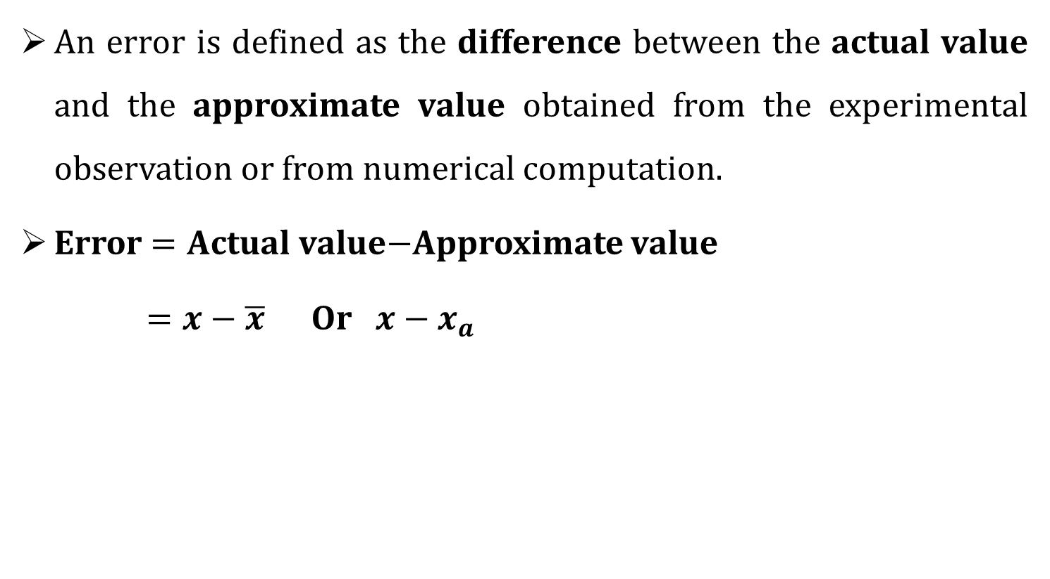
Errors
An error is defined as the difference between the actual value and the approximate value obtained from the experimental observation or from numerical computation.
Error $=A$ctual value$−$Approximate value
$=x−\overline{x}$ Or $x−x_{a}$

Slide 3
Types of Errors
Relative error
Percentage error
Absolute error

Slide 4

Absolute error
If $x$ is the true value of a quantity and $\overline{x}$ is its approximate value, then Absolute error is denoted by $E_{a}$.
$$E_{a}=\left|Exact value−Approximate value\right|$$
$$E_{a}=\left|x− \overline{x}\right|$$

Slide 5

Relative error
The relative error is defined by
$$E_{r}=\left|\frac{Exact value−Approximate value}{Exact value}\right|$$
$$E_{r}=\left|\frac{x−\overline{x}}{x}\right|$$

Slide 6


Percentage error
The percentage error is
$$E_{p}=E_{r}×100$$
$$E_{p}=\left|\frac{Exact value−Approximate value}{Exact value}\right|×100\%$$
$$E_{p}=\left|\frac{X−\overline{X}}{X}\right|×100\%$$
$$\left(∵E_{r}=\left|\frac{X−\overline{X}}{X}\right|\right)$$

Slide 7
Sources of Errors
Truncation error
Inherent error
Rounding-off error

Slide 8
Inherent error
The errors which are already Present in the statement of problem before its solution is obtained.
Such are either due to the given data being approximated or due to limitation of mathematical measurements.

Slide 9
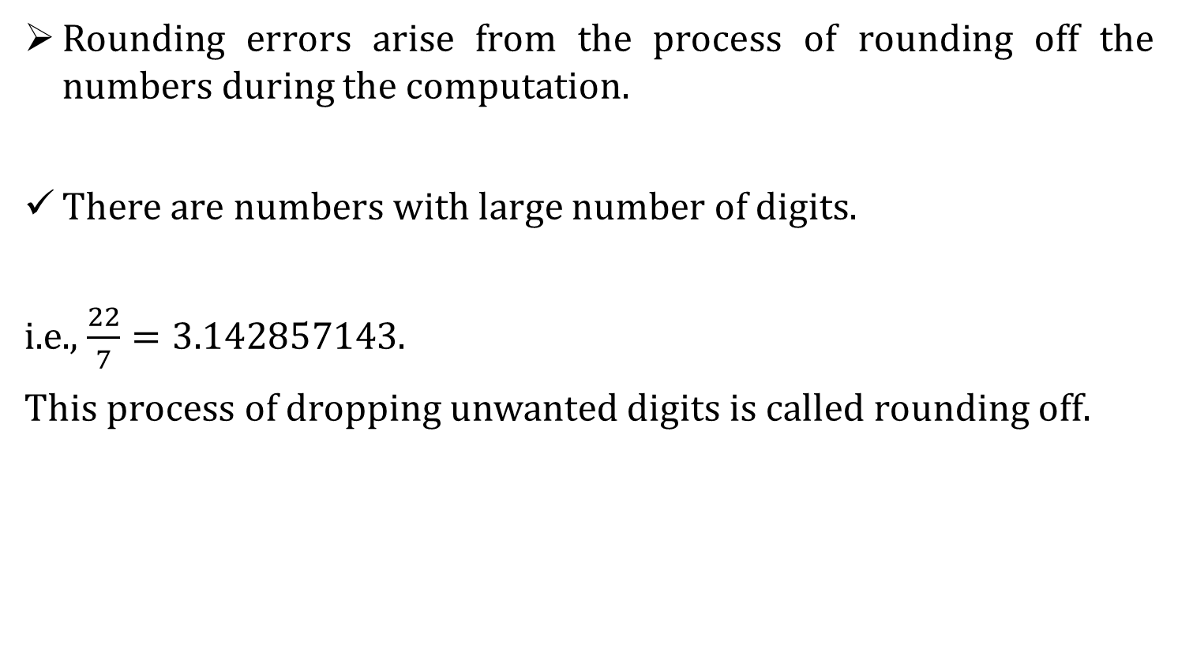
Rounding-off error
Rounding errors arise from the process of rounding off the numbers during the computation.
There are numbers with large number of digits.
i.e., $\frac{22}{7}=3.142857143$.
This process of dropping unwanted digits is called rounding off.

Slide 10
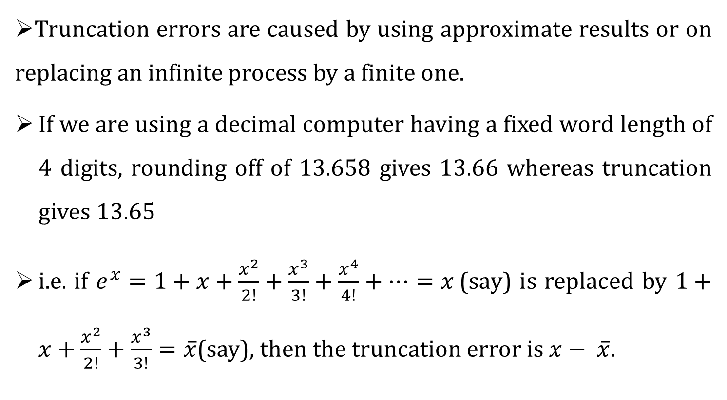
Truncation error
Truncation errors are caused by using approximate results or on replacing an infinite process by a finite one.
If we are using a decimal computer having a fixed word length of 4 digits, rounding off of 13.658 gives 13.66 whereas truncation gives 13.65
i.e. if $e^{x}=1+x+\frac{x^{2}}{2!}+\frac{x^{3}}{3!}+\frac{x^{4}}{4!}+⋯=x$(say) is replaced by $1+x+\frac{x^{2}}{2!}+\frac{x^{3}}{3!}=\overline{x}$(say), then the truncation error is $x− \overline{x}.$

Slide 11
Significant Figures
The digits used to express a number are called significant numbers.
All nonzero digits are considered as significant, e.g., 9345, 123.9 have four significant figures.
All zeros between two nonzero digits are significant, e.g., 10011, 120.03 have 5 significant figures.
Leading zeros are not significant, e.g., 0.0012, 0.13 have two significant figures.

Slide 12
Accuracy and Precision
(June-2016)
The concept of accuracy and precision are closely related to significant digits. They are related as follows:
Accuracy refers to how closely a computed or measured value agree with true value.
Precision refers to how closely individually computed or measured value agree with each other.

Slide 13
Accuracy and Precision
Low accuracy Low precision
Low accuracy High precision
High accuracy High precision
High accuracy Low precision

Slide 14


Example-3
Find error and relative error in the following cases:
$$\left(a\right) x=3.141592, \overline{x}=3.14$$
Solution:
$$\left(a\right) x=3.141592, \overline{x}=3.14$$
Absolute error: $E_{a}=\left|x−\overline{x}\right|$
$$=\left|3.141592−3.14 \right|$$
$$=0.001592$$
Relative error: $E_{r}=\left|\frac{x−\overline{x}}{x}\right|$
$$=\left|\frac{3.141592−3.14}{3.141592}\right|$$
$$=0.0005067$$
$$=5.067∗{10}^{−4}$$

Slide 15
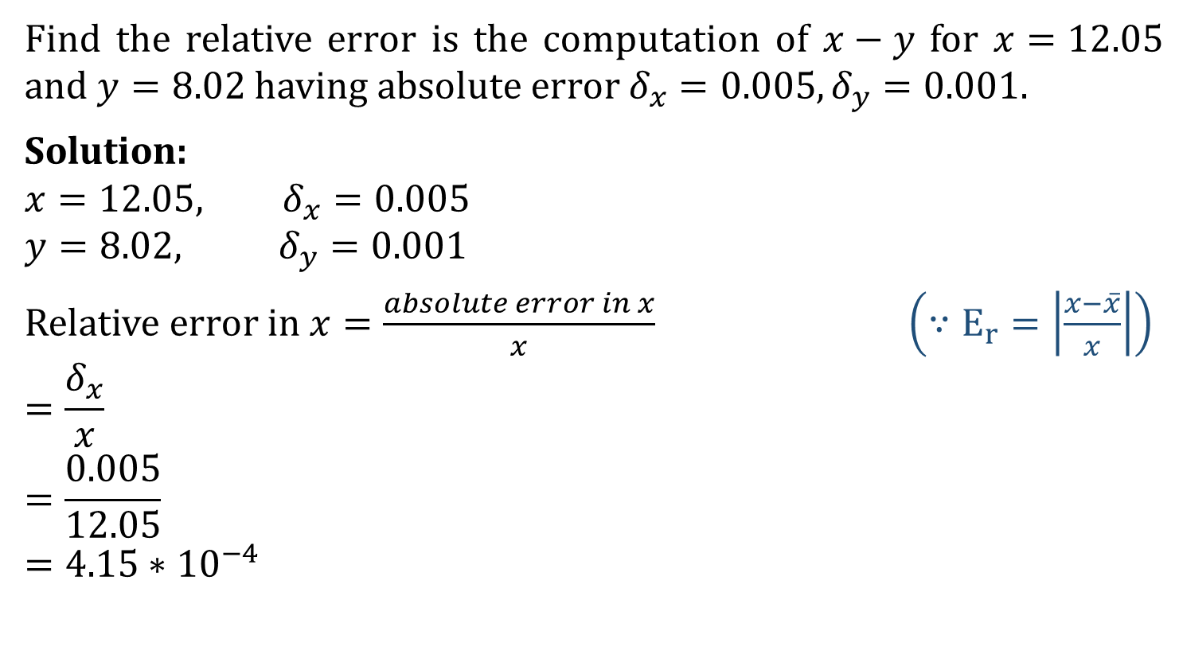
Example-4
Find the relative error is the computation of $x−y$ for $x=12.05$ and $y=8.02$ having absolute error $δ_{x}=0.005,δ_{y}=0.001.$
Solution:
$$x=12.05, δ_{x}=0.005$$
$$y=8.02, δ_{y}=0.001$$
Relative error in $x=\frac{absolute error in x}{x}$ $\left(∵E_{r}=\left|\frac{x−\overline{x}}{x}\right|\right)$
$$=\frac{δ_{x}}{x}$$
$$=\frac{0.005}{12.05}$$
$$=4.15∗{10}^{−4}$$

Slide 16

Relative error in y$=\frac{absolute error in x}{y}$
$$=\frac{δ_{y}}{y}$$
$$=\frac{0.001}{8.02}$$
$$=1.25∗{10}^{−4}$$
Relative error in $x−y=4.15∗{10}^{−4}−1.25∗{10}^{−4}$
$$=2.903∗{10}^{−4}$$

Slide 17
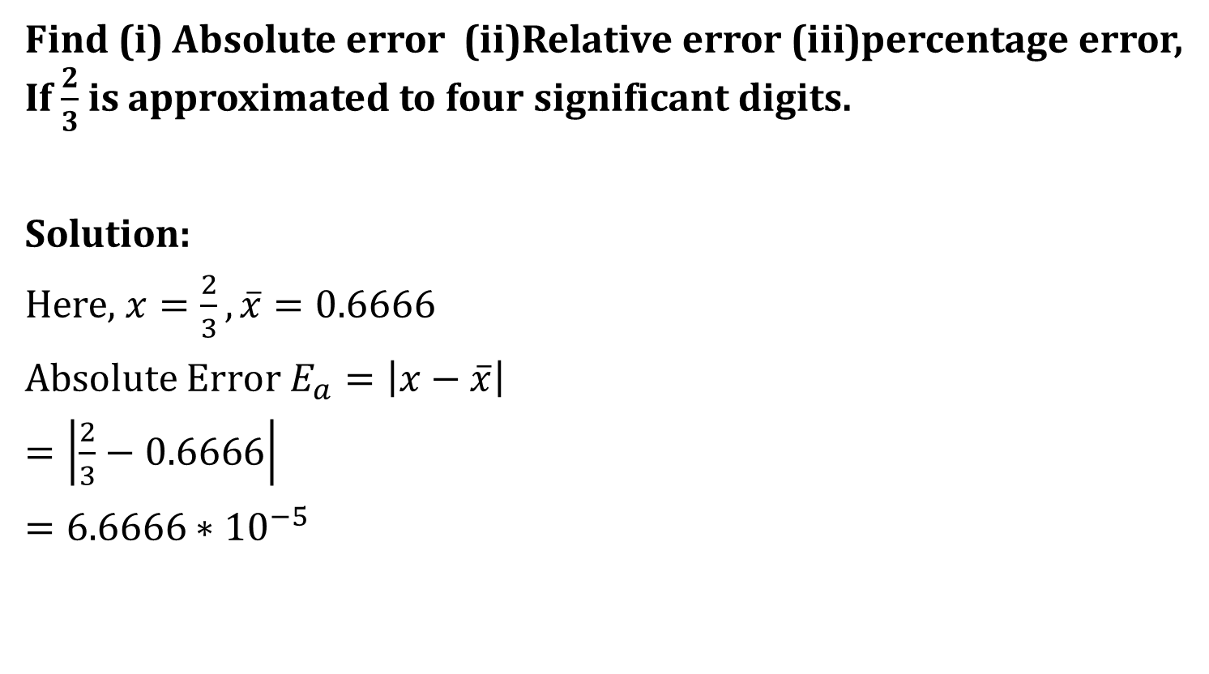
Example-5
Find (i) Absolute error (ii)Relative error (iii)percentage error, If $\frac{2}{3}$ is approximated to four significant digits.
Solution:
Here, $x=\frac{2}{3}, \overline{x}=0.6666$
Absolute Error $E_{a}=\left|x−\overline{x}\right|$
$=\left|\frac{2}{3}−0.6666\right|$
$=6.6666∗{10}^{−5}$

Slide 18

Relative error:
$E_{r}=\left|\frac{x−\overline{x}}{x}\right|$
$$=\left|\frac{\frac{2}{3}−0.6666}{\frac{2}{3}}\right|$$
$$=0.1∗{10}^{−3}$$
Percentage error:
$E_{p}=\left|\frac{x−\overline{x}}{x}\right|∗100\%$
$$=0.01$$

Slide 19
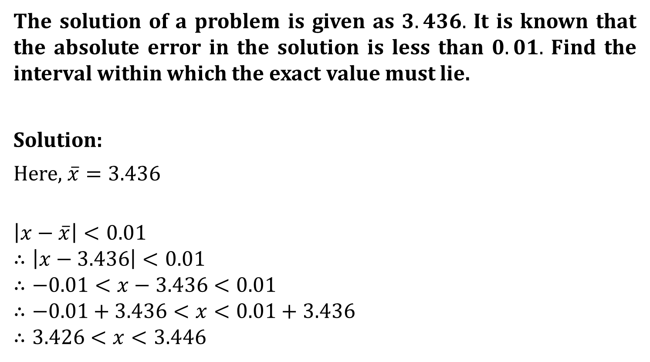
Example-9
The solution of a problem is given as $3.436.$ It is known that the absolute error in the solution is less than $0.01.$ Find the interval within which the exact value must lie.
Solution:
Here, $\overline{x}=3.436$
$$\left|x−\overline{x}\right|<0.01$$
$$∴\left|x−3.436\right|<0.01$$
$$∴−0.01<x−3.436<0.01$$
$$∴−0.01+3.436<x<0.01+3.436$$
$$∴3.426<x<3.446$$

Slide 20
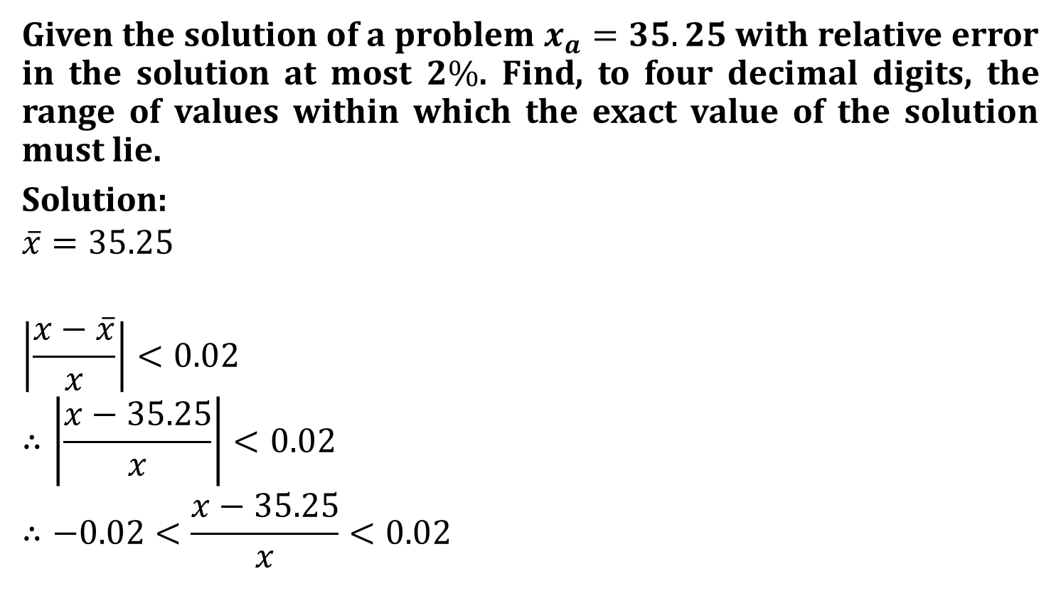
Example-12
Given the solution of a problem $x_{a}=35.25$ with relative error in the solution at most $2\%$. Find, to four decimal digits, the range of values within which the exact value of the solution must lie.
Solution:
$$\overline{x}=35.25$$
$$\left|\frac{x−\overline{x}}{x}\right|<0.02$$
$$∴\left|\frac{x−35.25}{x}\right|<0.02$$
$$∴−0.02<\frac{x−35.25}{x}<0.02$$

Slide 21

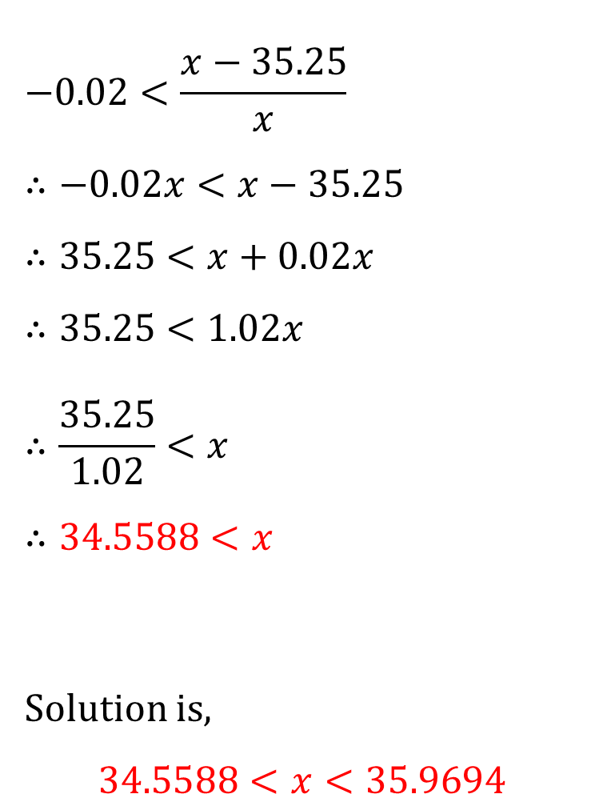
$$−0.02<\frac{x−35.25}{x}$$
$$∴−0.02x<x−35.25$$
$$∴35.25<x+0.02x$$
$$∴35.25<1.02x$$
$$∴\frac{35.25}{1.02}<x$$
$$∴34.5588<x$$
Solution is,
$$34.5588<x<35.9694$$
$$\frac{x−35.25}{x}<0.02$$
$$∴x−35.25<0.02x$$
$$∴x−0.02x<35.25$$
$$∴0.98x<35.25$$
$$∴x<\frac{35.25}{0.98}$$
$$∴x<35.9694$$

Slide 22
Mathematical Modelling
Mathematical Modelling is the method of translating the problems from real life systems into conformable and manageable mathematical expressions whose analytical consideration determines an insight and orientation for solving a problem and provides us with a technique for better development of the system.
Mathematical models are used in various fields including natural sciences, engineering and social sciences.

Slide 23
Steps of problem solving:
1. Data Analysis:
In this phase problem is analyzed and required data is collected for modelling.
2. Designing of Mathematical model:
In this phase, the structure of the solution like objective of the model, bounds of the system, performance measures, etc. is defined.

Slide 24
3. Computer simulation and post processing or graphic result:
By inputting required data, we get the result in form of data or graph using mathematical model by computer simulation software.
4. Validation/Verification:
During validation phase, Mathematical model’s result is verified.
5. Implementation:
We can implement model of problem in real world.

Slide 25
Data Analysis
Desigining of
Mathematical model
Computer simulation and post processing or numeric or graphic result
validation/verification
Implementation
This is the whole view of whole process leading from a problem to its solution by scientific computation.

Slide 26
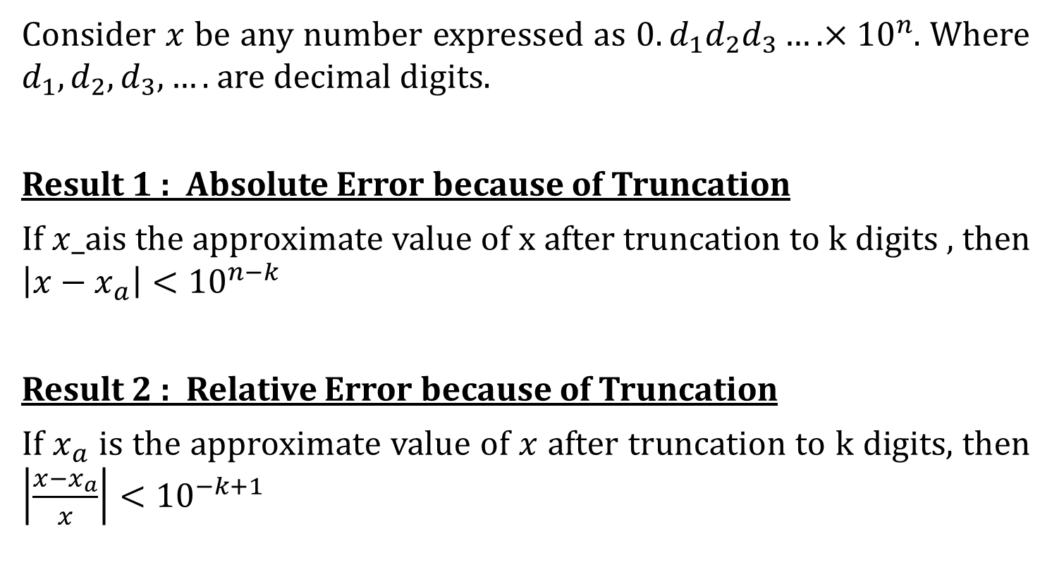
Important Results
Consider $x$ be any number expressed as $0.d_{1}d_{2}d_{3}….×{10}^{n}$. Where $d_{1},d_{2},d_{3},….$are decimal digits.
Result 1 : Absolute Error because of Truncation
If $x$_ais the approximate value of x after truncation to k digits , then $\left|x−x_{a}\right|<{10}^{n−k}$
Result 2 : Relative Error because of Truncation
If $x_{a}$ is the approximate value of $x$ after truncation to k digits, then $\left|\frac{x−x_{a}}{x}\right|<{10}^{−k+1}$

Slide 27
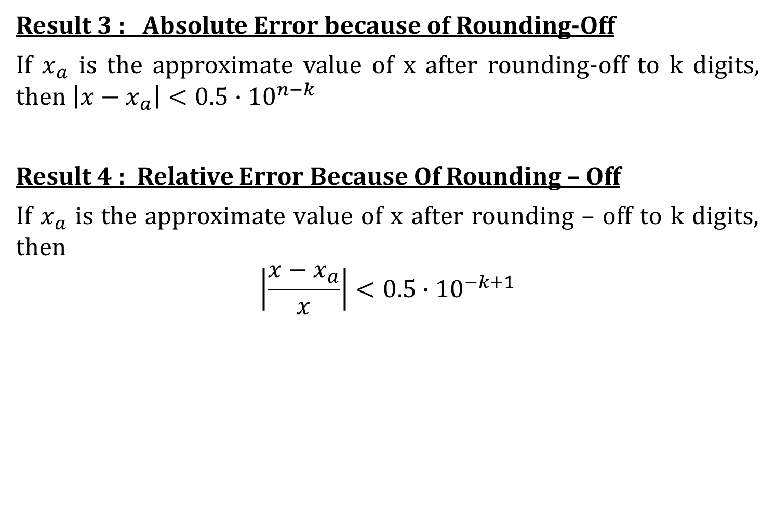
Result 3 : Absolute Error because of Rounding-Off
If $x_{a}$ is the approximate value of x after rounding-off to k digits, then $\left|x−x_{a}\right|<0.5∙{10}^{n−k}$
Result 4 : Relative Error Because Of Rounding – Off
If $x_{a}$ is the approximate value of x after rounding – off to k digits, then
$$\left|\frac{x−x_{a}}{x}\right|<0.5∙{10}^{−k+1}$$

