Slide 1
Unit-3 Linear Algebric Equation 2140706 – Numerical & Statistical Methods

Slide 2
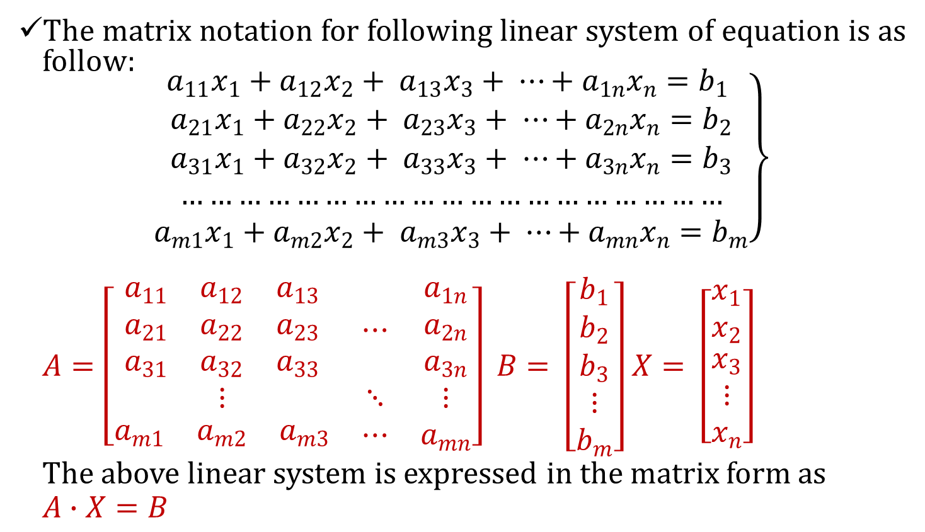
Matrix Equation
The matrix notation for following linear system of equation is as follow:
$$\left.\begin{aligned}a_{11}x_{1}+a_{12}x_{2}+ a_{13}x_{3}+ ⋯+a_{1n}x_{n}=b_{1} \\ a_{21}x_{1}+a_{22}x_{2}+ a_{23}x_{3}+ ⋯+a_{2n}x_{n}=b_{2} \\ a_{31}x_{1}+a_{32}x_{2}+ a_{33}x_{3}+ ⋯+a_{3n}x_{n}=b_{3} \\ ………………………………………………… \\ a_{m1}x_{1}+a_{m2}x_{2}+ a_{m3}x_{3}+ ⋯+a_{mn}x_{n}=b_{m}\end{aligned}\right\}$$
$A=\left[\begin{matrix}\begin{matrix}a_{11} & a_{12} & a_{13} \\ a_{21} & a_{22} & a_{23} \\ a_{31} & a_{32} & a_{33}\end{matrix} & ⋯ & \begin{matrix}a_{1n} \\ a_{2n} \\ a_{3n}\end{matrix} \\ ⋮ & ⋱ & ⋮ \\ \begin{matrix}a_{m1} & a_{m2} & a_{m3}\end{matrix} & ⋯ & a_{mn}\end{matrix}\right]$ $B= \left[\begin{matrix}b_{1} \\ b_{2} \\ \begin{matrix}b_{3} \\ ⋮ \\ b_{m}\end{matrix}\end{matrix}\right]$ $X= \left[\begin{matrix}x_{1} \\ x_{2} \\ \begin{matrix}x_{3} \\ ⋮ \\ x_{n}\end{matrix}\end{matrix}\right]$
The above linear system is expressed in the matrix form as
$$A∙X=B$$

Slide 3
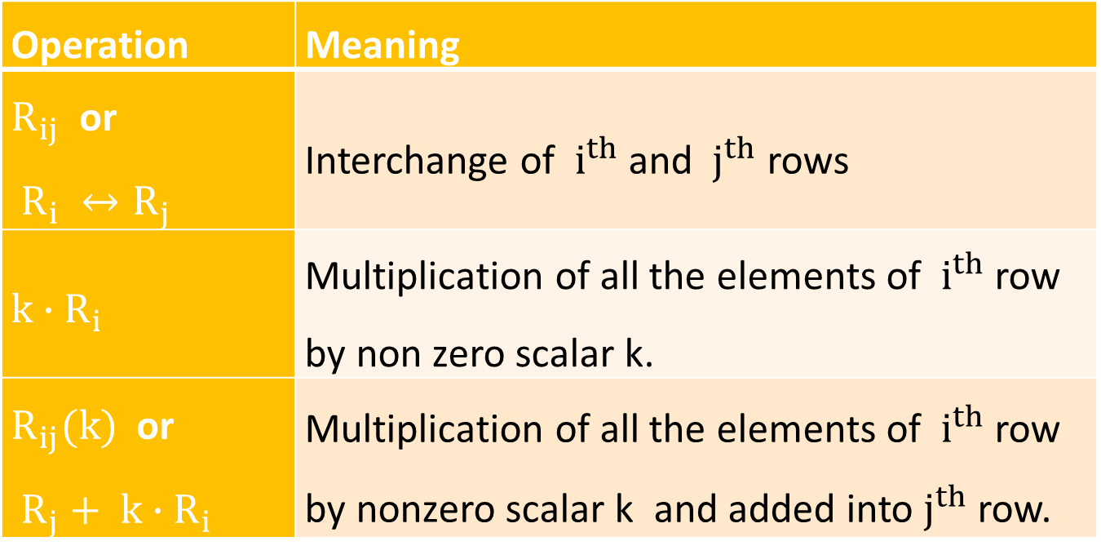
Elementary Transformation or Operation on a Matrix
Operation | Meaning
$R_{ij}$ or $R_{i} ↔R_{j}$ | Interchange of $i^{th}$ and $j^{th}$ rows
$${k∙R}_{i}$$ | Multiplication of all the elements of $i^{th}$ row by non zero scalar k.
$R_{ij}(k)$ or $R_{j}+ k∙R_{i}$ | Multiplication of all the elements of $i^{th}$ row by nonzero scalar k and added into $j^{th}$ row.

Slide 4
Row Echelon Form of Matrix
To convert the matrix into row echelon form follow the following steps:
Every zero row of the matrix occurs below the non zero rows.
Arrange all the rows in strictly decreasing order.
Make all the entries zero below the leading (first non zero entry of the row) element of 1st row.
Repeat step-3 for each row.

Slide 5
Reduced Row Echelon Form of Matrix
To convert the matrix into reduced row echelon form follow the following steps:
Convert given matrix into row echelon form.
Make all leading elements 1(one).
Make all the entries zero above the leading element 1(one) of each row.

Slide 6
Numerical Methods For Solution Of A Linear Equation
Direct Methods
Iterative Methods
Direct Methods
This method produce the exact solution after a finite number of steps but are subject to errors due to round-off and other factors.
We will discuss two direct methods :
Gauss Elimination method
Gauss-Jordan method

Slide 7
Indirect Method(Iterative Method)
In this method, an approximation to the true solution is assumed initially to start method. By applying the method repeatedly, better and better approximations are obtained. For large systems, iterative methods are faster than direct methods and round-off error are also smaller.
Gauss seidel method
Gauss jacobi method

Slide 8
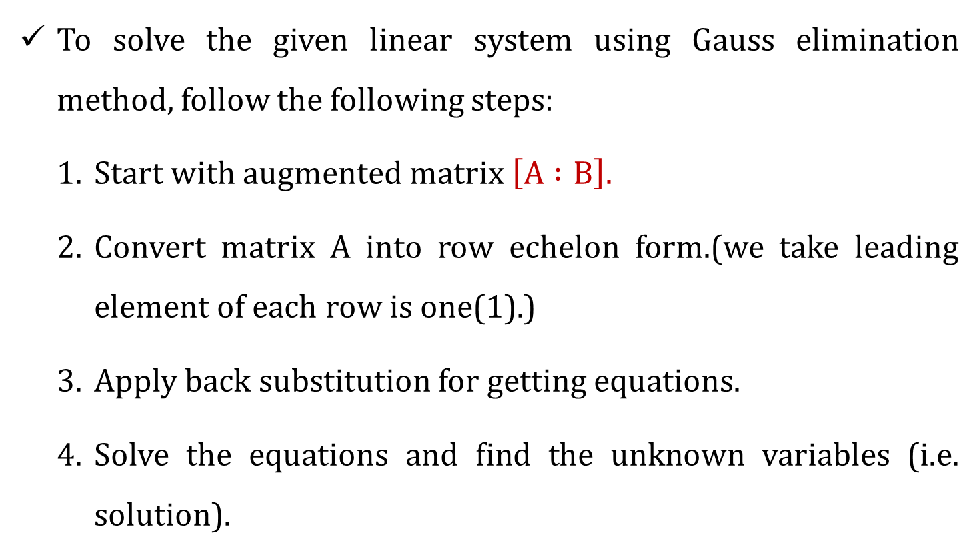
Gauss Elimination Method
To solve the given linear system using Gauss elimination method, follow the following steps:
Start with augmented matrix $\left[A :B\right].$
Convert matrix $A$ into row echelon form.(we take leading element of each row is one(1).)
Apply back substitution for getting equations.
Solve the equations and find the unknown variables (i.e. solution).

Slide 9



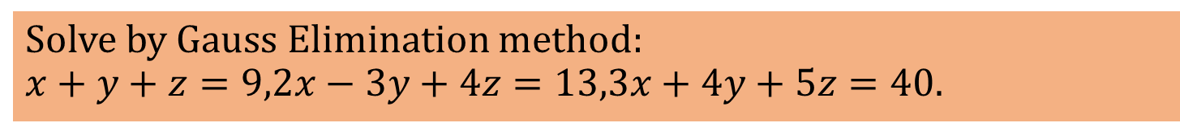



Solve by Gauss Elimination method: $$x+y+z=9,2x−3y+4z=13,3x+4y+5z=40.$$
Solution:-
By Augmented matrix,
$$\left[\begin{matrix}1 & 1 & \begin{matrix}1 & \begin{matrix}: & 9\end{matrix}\end{matrix} \\ 2 & −3 & \begin{matrix}4 & \begin{matrix}: & 13\end{matrix}\end{matrix} \\ 3 & 4 & \begin{matrix}5 & \begin{matrix}: & 40\end{matrix}\end{matrix}\end{matrix}\right]$$
$\sim \left[\begin{aligned}1 1 1 : 9 \\ \\ \end{aligned}\right]$
We have to make zero to these three elements.
$$1 1 1 : 9$$
$$R_{12}\left(−2\right)$$
$$0 −5 2 :−5$$
$$R_{13}\left(−3\right)$$
$$0 1 2 : 13$$
($∵R_{13}\left(−3\right)$ means multiply row 1 by $−3$ and add it into row 3)
($∵R_{12}\left(−2\right)$ means multiply row 1 by $−2$ and add it into row 2)

Slide 10




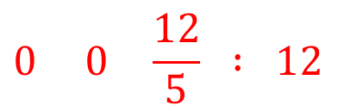

$$\sim \left[\begin{matrix} & 1 & \begin{matrix}1 & \begin{matrix}: & 9\end{matrix}\end{matrix} \\ & & \begin{matrix} & \end{matrix} \\ & & \begin{matrix} & \begin{matrix} & \begin{aligned} \\ \end{aligned}\end{matrix}\end{matrix}\end{matrix}\right]$$
Now, solving equations by back-substitution
$$∴\frac{12}{5}z=12$$
$$∴ z=5$$
$$∴−5y+2z=−5$$
$$∴ −5y+10=−5$$
$$∴ y=3$$
$$1 1 1 : 9$$
Now, these three elements are zeros
$$\begin{aligned}R_{23}\left(\frac{1}{5}\right) \\ \end{aligned}$$
$$0 −5 2 :−5$$
$$0 0 \frac{12}{5} : 12$$
$$∴ x+y+z=9$$
$$∴ x+3+5=9$$
$$∴ x=1$$
$$Answer : \left(x,y,z\right)=\left(1,3,5\right)$$

Slide 11



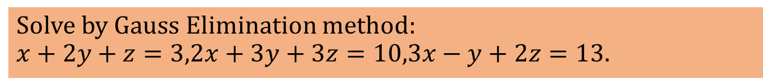



Solve by Gauss Elimination method: $$x+2y+z=3,2x+3y+3z=10,3x−y+2z=13.$$
Solution:-
By Augmented matrix,
$$\left[\begin{matrix}1 & 2 & \begin{matrix}1 & \begin{matrix}: & 3\end{matrix}\end{matrix} \\ 2 & 3 & \begin{matrix}3 & \begin{matrix}: & 10\end{matrix}\end{matrix} \\ 3 & −1 & \begin{matrix}2 & \begin{matrix}: & 13\end{matrix}\end{matrix}\end{matrix}\right]$$
$\sim \left[\begin{aligned}1 1 1 : 9 \\ \\ \end{aligned}\right]$
We have to make zero to these three elements.
$$1 2 1 : 3$$
$$R_{12}\left(−2\right)$$
$$0 −1 1 : 4$$
$$R_{13}\left(−3\right)$$
$$0 −7 1 : 4$$
($∵R_{13}\left(−3\right)$ means multiply row 1 by $−3$ and add it into row 3)
($∵R_{12}\left(−2\right)$ means multiply row 1 by $−2$ and add it into row 2)

Slide 12
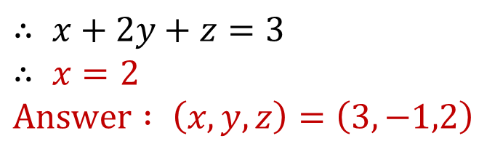





$$\sim \left[\begin{matrix} & 1 & \begin{matrix}1 & \begin{matrix}: & 9\end{matrix}\end{matrix} \\ & & \begin{matrix} & \end{matrix} \\ & & \begin{matrix} & \begin{matrix} & \begin{aligned} \\ \end{aligned}\end{matrix}\end{matrix}\end{matrix}\right]$$
Now, solving equations by back-substitution
$$∴−8z=−24$$
$$∴ z=3$$
$$∴−y+z=4$$
$$∴ y=−1$$
$$1 2 1 : 3$$
Now, these three elements are zeros
$$\begin{aligned}R_{23}\left(−7\right) \\ \end{aligned}$$
$$0 −1 1 : 4$$
$$0 0−8 : −24$$
$$∴ x+2y+z=3$$
$$∴ x=2$$
$$Answer : \left(x,y,z\right)=\left(3,−1,2\right)$$

Slide 13
Gauss Elimination Method With Partial Pivoting
To solve the given linear system using Gauss elimination method with partial pivoting, follow the following steps:
Find largest absolute value(pivot element) in first column.
Make the pivot element row to first row.
Eliminate x₁ below the pivot element.
Again find pivot element in 2nd and 3rd row.
Make the pivot element row to second row.
Eliminate x₂ below the pivot element.
Apply back substitution for getting equations.
Solve the equations and find the unknown variables (i.e. solution).

Slide 14


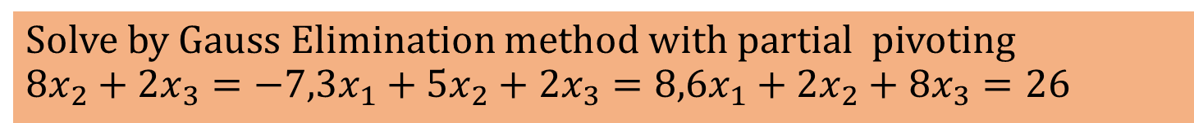



Solve by Gauss Elimination method with partial pivoting $$8x_{2}+2x_{3}=−7,3x_{1}+5x_{2}+2x_{3}=8,6x_{1}+2x_{2}+8x_{3}=26$$
Solution:-
By Augmented matrix,
$\left[\begin{matrix}0 & 8 & \begin{matrix} 2 & \begin{matrix}: & −7\end{matrix}\end{matrix} \\ 3 & 5 & \begin{matrix}2 & \begin{matrix}: & 8\end{matrix}\end{matrix} \\ 6 & 2 & \begin{matrix}8 & \begin{matrix}: & 26\end{matrix}\end{matrix}\end{matrix}\right]$
$$\sim \left[\begin{aligned}\begin{aligned}\begin{matrix} & & \begin{matrix} & \end{matrix} \\ & & \begin{matrix} & \end{matrix} \\ & & \begin{matrix} & \begin{matrix} & \end{matrix}\end{matrix}\end{matrix} \\ \end{aligned} \\ \end{aligned}\right]$$
Find Largest absolute value in first column and make that row into first row
$$6 2 8 : 26$$
$$R_{1}↔R_{3}$$
$$3 5 2 : 8$$
$$0 8 2 : −7$$
Make these two elements to zero

Slide 15

$$\sim \left[\begin{matrix}6 & 2 & \begin{matrix}8 & \begin{matrix}: & 26\end{matrix}\end{matrix} \\ 3 & 5 & \begin{matrix}2 & \begin{matrix}: & 8\end{matrix}\end{matrix} \\ 0 & 8 & \begin{matrix} 2 & \begin{matrix}: & −7\end{matrix}\end{matrix}\end{matrix}\right]$$
$\sim \left[\begin{matrix}6 & 2 & \begin{matrix}8 & \begin{matrix}: & 26\end{matrix}\end{matrix} \\ 0 & 4 & \begin{matrix}−2 & \begin{matrix}: & −5\end{matrix}\end{matrix} \\ 0 & 8 & \begin{matrix}2 & \begin{matrix}: & −7\end{matrix}\end{matrix}\end{matrix}\right] \begin{aligned}R_{12}\left(−\frac{1}{2}\right) \\ \end{aligned}$
$$\sim \left[\begin{matrix}6 & 2 & \begin{matrix}8 & \begin{matrix}: & 26\end{matrix}\end{matrix} \\ 0 & 8 & \begin{matrix}2 & \begin{matrix}: & −7\end{matrix}\end{matrix} \\ 0 & 4 & \begin{matrix}−2 & \begin{matrix}: & −5\end{matrix}\end{matrix}\end{matrix}\right] R_{2}↔R_{3}$$
Find Largest absolute value in second column in 2nd and 3rd row and interchange accordingly.

Slide 16
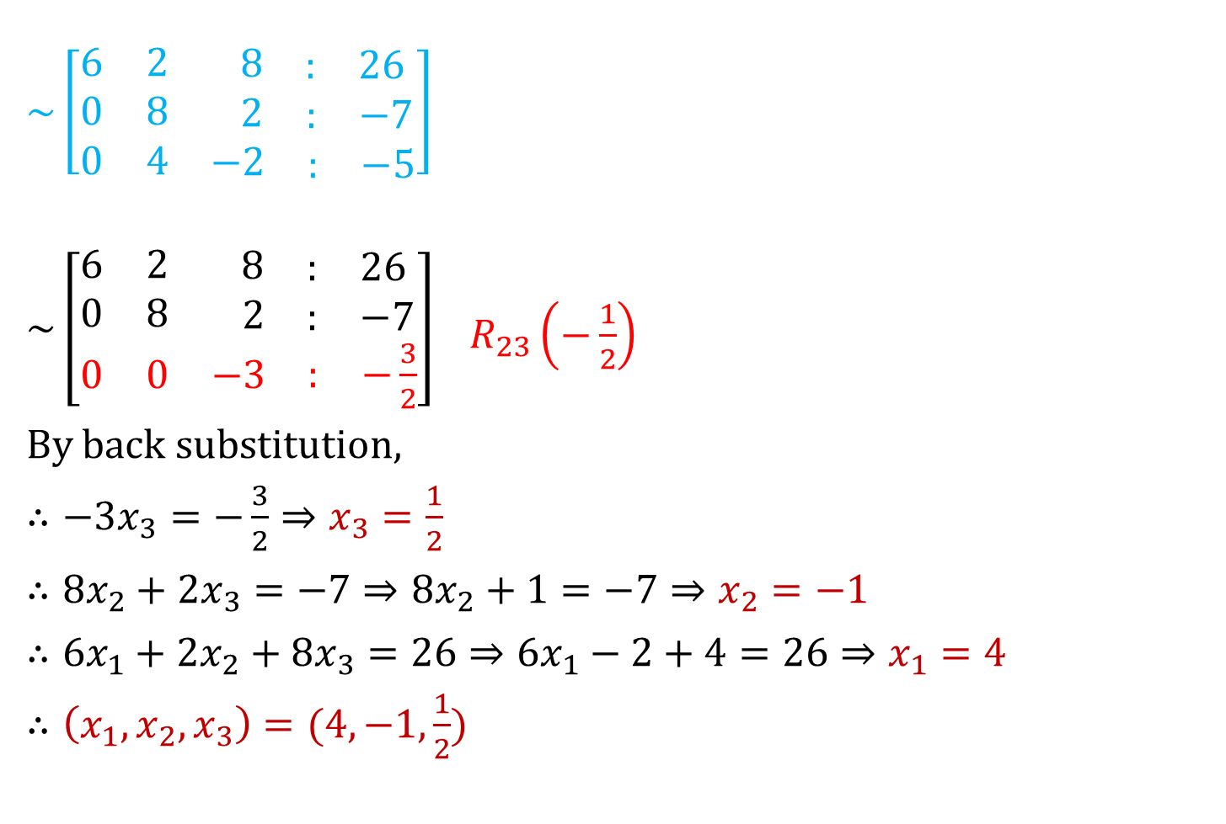
$$\sim \left[\begin{matrix}6 & 2 & \begin{matrix}8 & \begin{matrix}: & 26\end{matrix}\end{matrix} \\ 0 & 8 & \begin{matrix}2 & \begin{matrix}: & −7\end{matrix}\end{matrix} \\ 0 & 4 & \begin{matrix}−2 & \begin{matrix}: & −5\end{matrix}\end{matrix}\end{matrix}\right]$$
$\sim \left[\begin{matrix}6 & 2 & \begin{matrix}8 & \begin{matrix}: & 26\end{matrix}\end{matrix} \\ 0 & 8 & \begin{matrix} 2 & \begin{matrix}: & −7\end{matrix}\end{matrix} \\ 0 & 0 & \begin{matrix}−3 & \begin{matrix}: & −\frac{3}{2}\end{matrix}\end{matrix}\end{matrix}\right] \begin{aligned} \\ R_{23}\left(−\frac{1}{2}\right)\end{aligned}$
By back substitution,
$∴−3x_{3}=−\frac{3}{2}⇒x_{3}=\frac{1}{2}$
$∴8x_{2}+2x_{3}=−7⇒8x_{2}+1=−7⇒x_{2}=−1$
$∴6x_{1}+2x_{2}+8x_{3}=26⇒6x_{1}−2+4=26⇒x_{1}=4$
$∴\left(x_{1},x_{2},x_{3}\right)=(4,−1,\frac{1}{2})$

Slide 17
Gauss-Jordan Method
This method is modification of the gauss elimination method. This method solves a given system of equation by transforming the coefficient matrix into unit matrix.
Steps to solve Gauss-Jordan method:
Write the matrix form of the system of equations.
Write the augmented matrix.
Reduce the coefficient matrix to unit matrix by applying elementary row transformations to the augmented matrix.
Write the corresponding linear system of equations to obtain the solution.

Slide 18
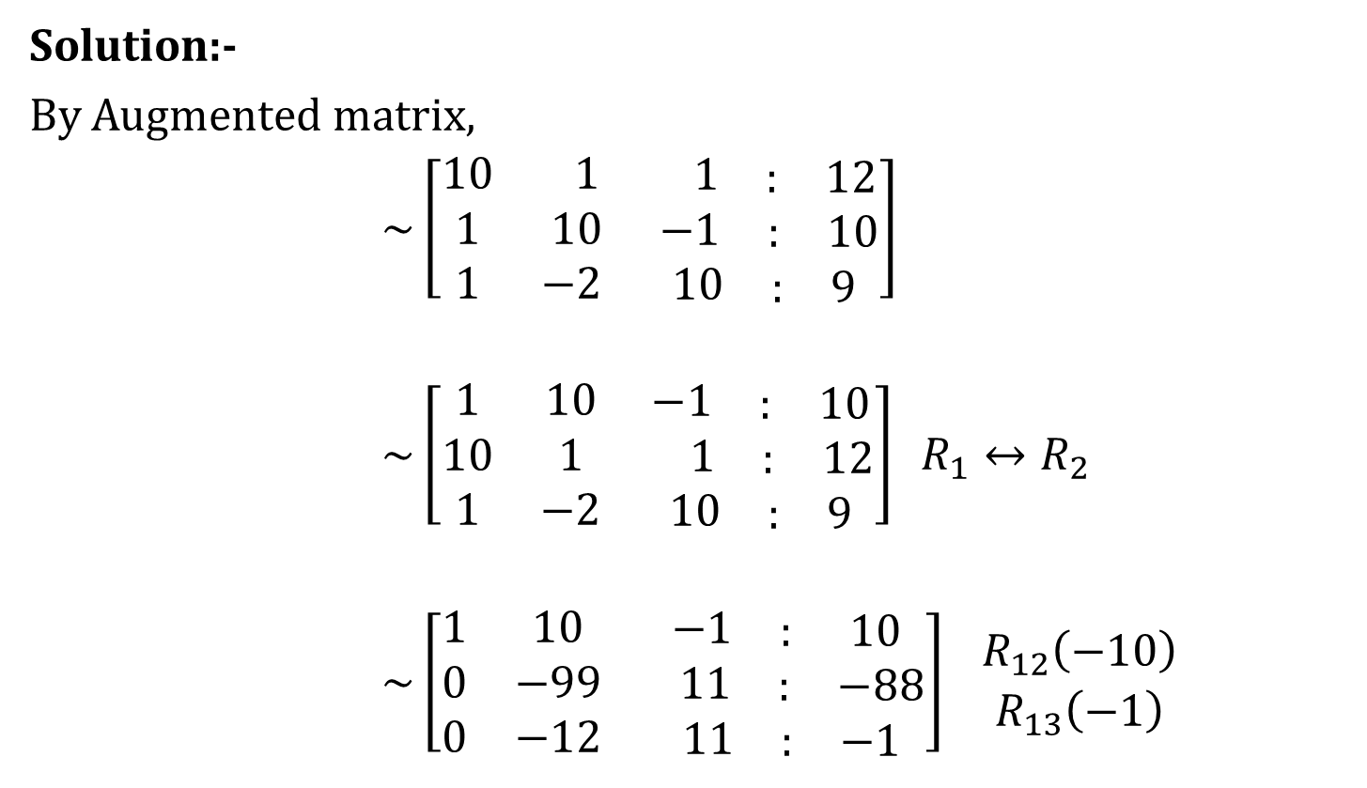
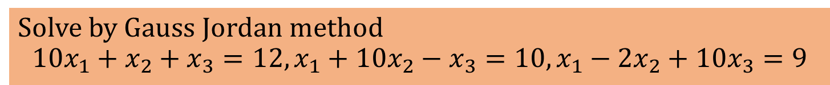
Solve by Gauss Jordan method $$10x_{1}+x_{2}+x_{3}=12,x_{1}+10x_{2}−x_{3}=10,x_{1}−2x_{2}+10x_{3}=9$$
Solution:-
By Augmented matrix,
$\sim \left[\begin{matrix}10 & 1 & \begin{matrix} 1 & \begin{matrix}: & 12\end{matrix}\end{matrix} \\ 1 & 10 & \begin{matrix} −1 & \begin{matrix}: & 10\end{matrix}\end{matrix} \\ 1 & −2 & \begin{matrix}10 & \begin{matrix}: & 9\end{matrix}\end{matrix}\end{matrix}\right]$
$\sim \left[\begin{matrix}1 & 10 & \begin{matrix}−1 & \begin{matrix}: & 10\end{matrix}\end{matrix} \\ 10 & 1 & \begin{matrix}1 & \begin{matrix}: & 12\end{matrix}\end{matrix} \\ 1 & −2 & \begin{matrix}10 & \begin{matrix}: & 9\end{matrix}\end{matrix}\end{matrix}\right] R_{1}↔R_{2}$
$\sim \left[\begin{matrix}1 & 10 & \begin{matrix}−1 & \begin{matrix}: & 10\end{matrix}\end{matrix} \\ 0 & −99 & \begin{matrix} 11 & \begin{matrix}: & −88\end{matrix}\end{matrix} \\ 0 & −12 & \begin{matrix} 11 & \begin{matrix}: & −1\end{matrix}\end{matrix}\end{matrix}\right] \begin{aligned}R_{12}\left(−10\right) \\ R_{13}\left(−1\right)\end{aligned}$

Slide 19

$\sim \left[\begin{matrix}1 & 10 & \begin{matrix} −1 & \begin{matrix}: & 10\end{matrix}\end{matrix} \\ 0 & 1 & \begin{matrix}−\frac{1}{9} & \begin{matrix}: & \frac{8}{9}\end{matrix}\end{matrix} \\ 0 & −12 & \begin{matrix} 11 & \begin{matrix}: & −1\end{matrix}\end{matrix}\end{matrix}\right] \begin{aligned}R_{2}\left(−\frac{1}{99}\right) \\ \end{aligned}$
$\sim \left[\begin{matrix}1 & 0 & \begin{matrix} \frac{1}{9} & \begin{matrix}: & \frac{10}{9}\end{matrix}\end{matrix} \\ 0 & 1 & \begin{matrix}−\frac{1}{9} & \begin{matrix}: & \frac{8}{9}\end{matrix}\end{matrix} \\ 0 & 0 & \begin{matrix} \frac{87}{9} & \begin{matrix}: & \frac{87}{9}\end{matrix}\end{matrix}\end{matrix}\right] \begin{aligned}R_{21}\left(−10\right) \\ R_{23}\left(12\right)\end{aligned}$
$\sim \left[\begin{matrix}1 & 0 & \begin{matrix} \frac{1}{9} & \begin{matrix}: & \frac{10}{9}\end{matrix}\end{matrix} \\ 0 & 1 & \begin{matrix}−\frac{1}{9} & \begin{matrix}: & \frac{8}{9}\end{matrix}\end{matrix} \\ 0 & 0 & \begin{matrix} 1 & \begin{matrix}: & 1\end{matrix}\end{matrix}\end{matrix}\right] \begin{aligned} \\ R_{3}\left(\frac{9}{87}\right)\end{aligned}$

Slide 20

$$\sim \left[\begin{matrix}1 & 0 & \begin{matrix}0 & \begin{matrix}: & 1\end{matrix}\end{matrix} \\ 0 & 1 & \begin{matrix}0 & \begin{matrix}: & 1\end{matrix}\end{matrix} \\ 0 & 0 & \begin{matrix}1 & \begin{matrix}: & 1\end{matrix}\end{matrix}\end{matrix}\right] \begin{aligned}R_{31}\left(−\frac{1}{9}\right) \\ R_{32}\left(\frac{1}{9}\right)\end{aligned}$$
By back substitution,
$$∴\left(x,y,z\right)=(1,1,1)$$

Slide 21
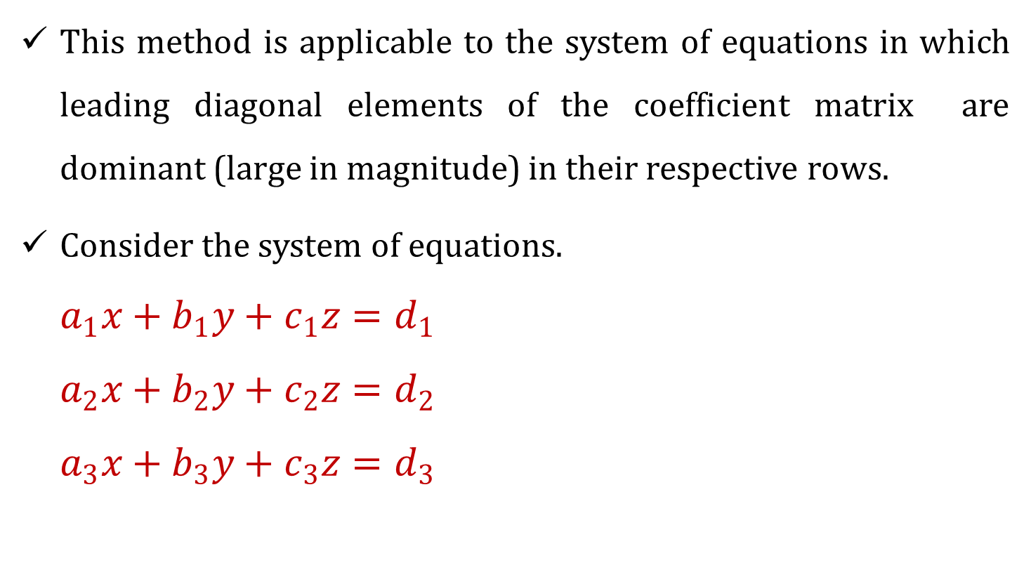
Gauss Jacobi Method
This method is applicable to the system of equations in which leading diagonal elements of the coefficient matrix are dominant (large in magnitude) in their respective rows.
Consider the system of equations.
$$a_{1}x+b_{1}y+c_{1}z=d_{1}$$
$$a_{2}x+b_{2}y+c_{2}z=d_{2}$$
$$a_{3}x+b_{3}y+c_{3}z=d_{3}$$

Slide 22
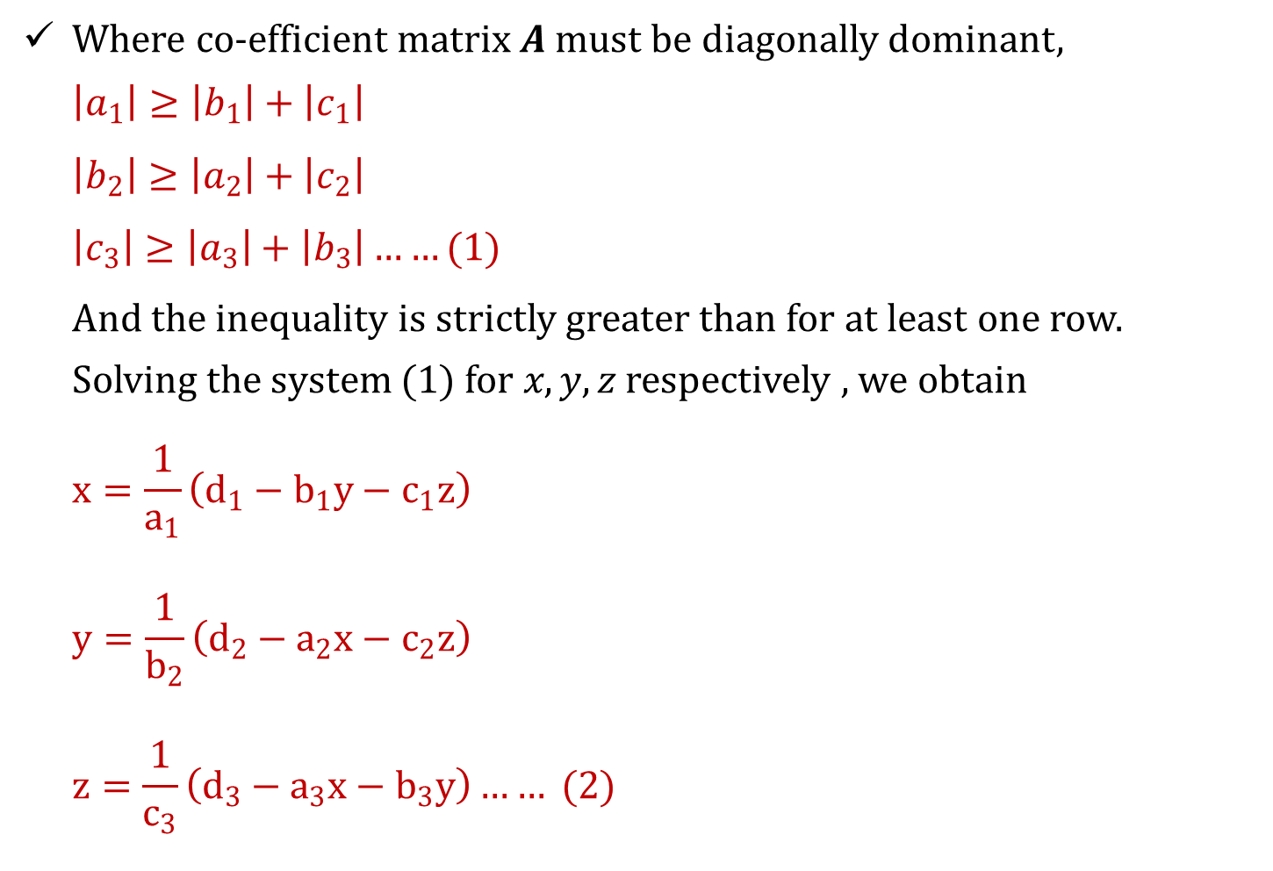
Where co-efficient matrix $A$ must be diagonally dominant,
$$\left|a_{1}\right|≥\left|b_{1}\right|+\left|c_{1}\right|$$
$$\left|b_{2}\right|≥\left|a_{2}\right|+\left|c_{2}\right|$$
$$\left|c_{3}\right|≥\left|a_{3}\right|+\left|b_{3}\right|……(1)$$
And the inequality is strictly greater than for at least one row.
Solving the system $(1)$ for $x,y,z$ respectively , we obtain
$$x=\frac{1}{a_{1}}\left(d_{1}−b_{1}y−c_{1}z\right)$$
$$y=\frac{1}{b_{2}}\left(d_{2}−a_{2}x−c_{2}z\right)$$
$$z=\frac{1}{c_{3}}\left(d_{3}−a_{3}x−b_{3}y\right)…… (2)$$

Slide 23
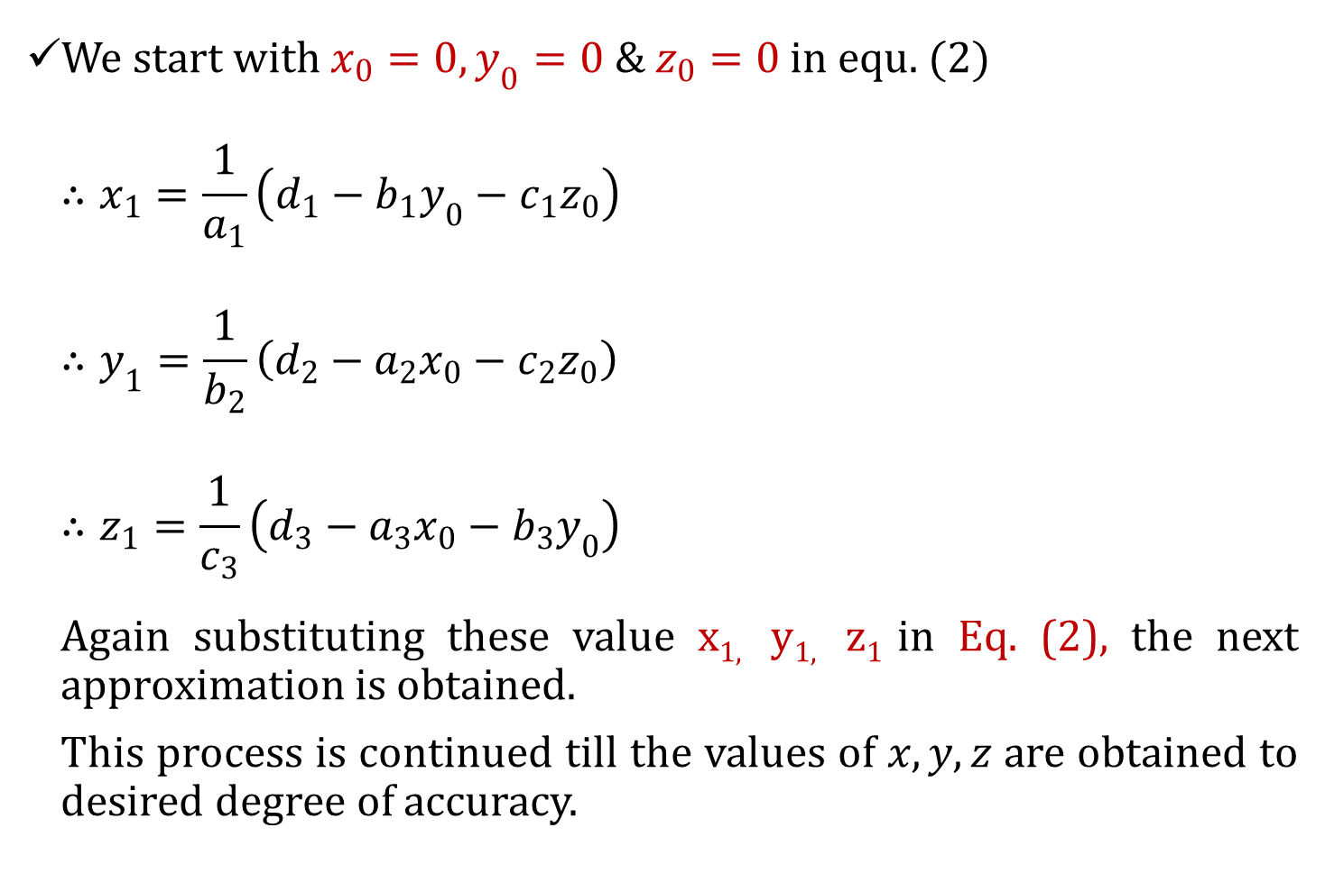
We start with $x_{0}=0,y_{0}=0 \& z_{0}=0$in equ. $(2)$
$$∴x_{1}=\frac{1}{a_{1}}\left(d_{1}−b_{1}y_{0}−c_{1}z_{0}\right)$$
$$∴y_{1}=\frac{1}{b_{2}}\left(d_{2}−a_{2}x_{0}−c_{2}z_{0}\right)$$
$$∴z_{1}=\frac{1}{c_{3}}\left(d_{3}−a_{3}x_{0}−b_{3}y_{0}\right)$$
Again substituting these value x_{1,} y_{1,} z₁ in Eq. (2), the next approximation is obtained.
This process is continued till the values of $x,y,z$ are obtained to desired degree of accuracy.

Slide 24
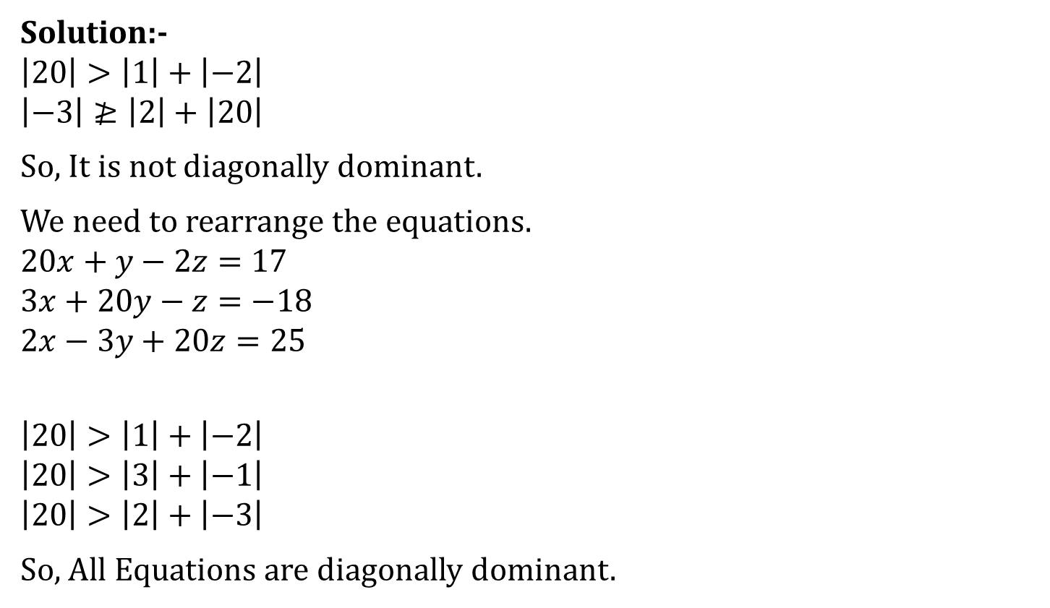
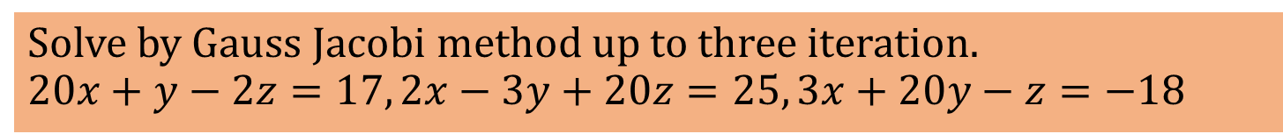
Solve by Gauss Jacobi method up to three iteration. $$20x+y−2z=17, 2x−3y+20z=25, 3x+20y−z=−18$$
Solution:-
$$\left|20\right|>\left|1\right|+\left|−2\right|$$
$$\left|−3\right|≱\left|2\right|+\left|20\right|$$
So, It is not diagonally dominant.
We need to rearrange the equations.
$$20x+y−2z=17$$
$$3x+20y−z=−18$$
$$2x−3y+20z=25$$
$$\left|20\right|>\left|1\right|+\left|−2\right|$$
$$\left|20\right|>\left|3\right|+\left|−1\right|$$
$$\left|20\right|>\left|2\right|+\left|−3\right|$$
So, All Equations are diagonally dominant.

Slide 25
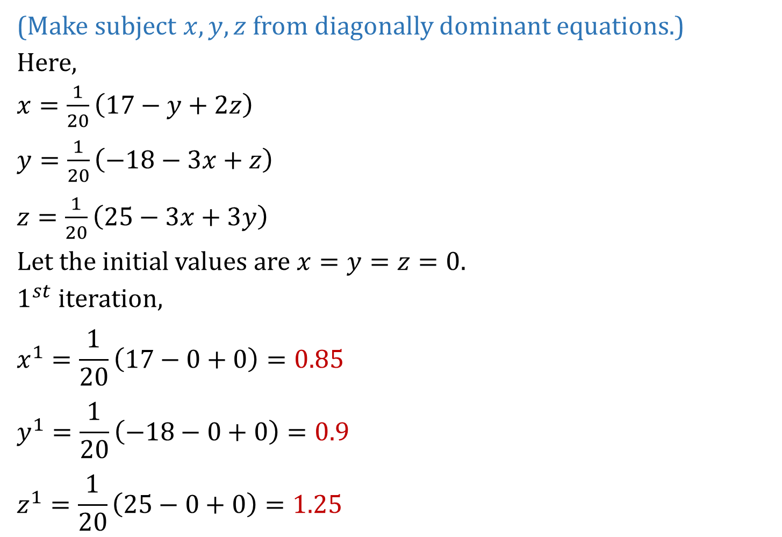
(Make subject $x,y,z$ from diagonally dominant equations.)
Here,
$x=\frac{1}{20}\left(17−y+2z\right)$
$y=\frac{1}{20}\left(−18−3x+z\right)$
$z=\frac{1}{20}\left(25−3x+3y\right)$
Let the initial values are $x=y=z=0.$
$1^{st}$ iteration,
$$x^{1}=\frac{1}{20}\left(17−0+0\right)=0.85$$
$$y^{1}=\frac{1}{20}\left(−18−0+0\right)=0.9$$
$$z^{1}=\frac{1}{20}\left(25−0+0\right)=1.25$$

Slide 26
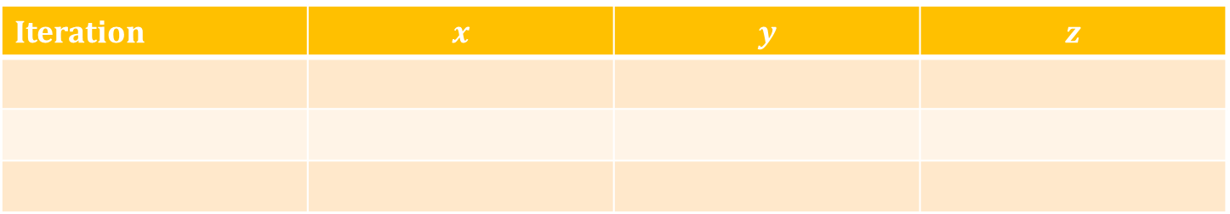
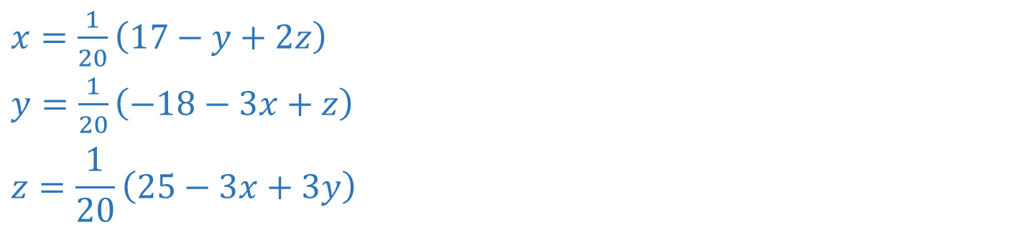
$x=\frac{1}{20}\left(17−y+2z\right)$
$y=\frac{1}{20}\left(−18−3x+z\right)$
$$z=\frac{1}{20}\left(25−3x+3y\right)$$
Iteration | $$x$$ | $$y$$ | $$z$$
1
0.85
1.00
1.25
2
1.02
-0.97
1.03
3
1.00
-1.00
1.00
Ans: $\left(x,y,z\right)=(1,−1,1)$

Slide 27
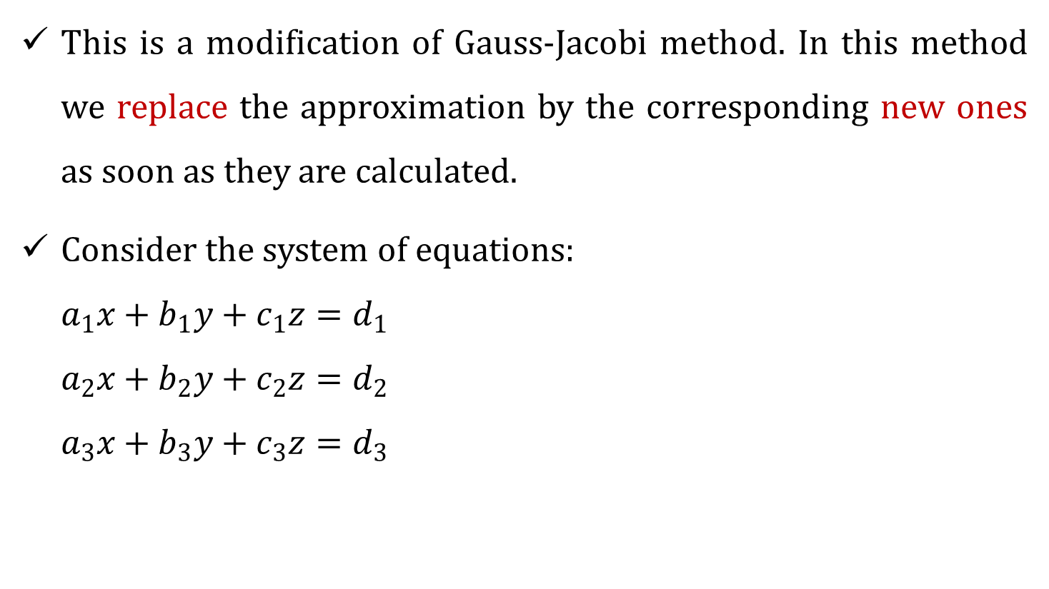
Gauss Seidel Method
This is a modification of Gauss-Jacobi method. In this method we replace the approximation by the corresponding new ones as soon as they are calculated.
Consider the system of equations:
$$a_{1}x+b_{1}y+c_{1}z=d_{1}$$
$$a_{2}x+b_{2}y+c_{2}z=d_{2}$$
$$a_{3}x+b_{3}y+c_{3}z=d_{3}$$

Slide 28
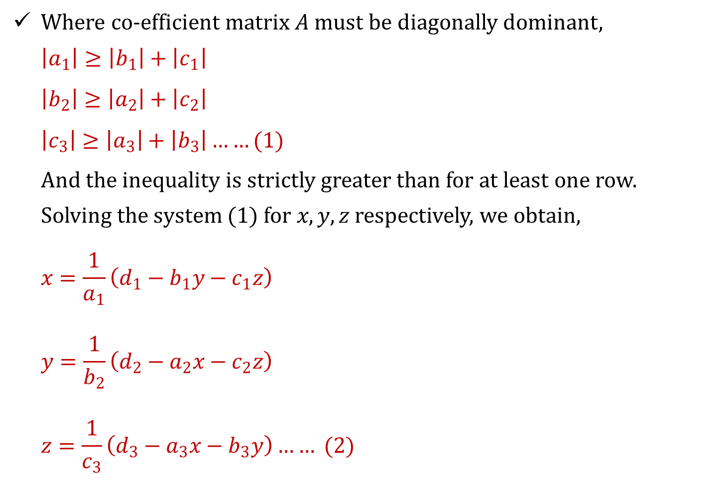
Where co-efficient matrix $A$ must be diagonally dominant,
$$\left|a_{1}\right|≥\left|b_{1}\right|+\left|c_{1}\right|$$
$$\left|b_{2}\right|≥\left|a_{2}\right|+\left|c_{2}\right|$$
$\left|c_{3}\right|≥\left|a_{3}\right|+\left|b_{3}\right|……(1)$
And the inequality is strictly greater than for at least one row.
Solving the system $(1)$ for $x,y,z$ respectively, we obtain,
$$x=\frac{1}{a_{1}}\left(d_{1}−b_{1}y−c_{1}z\right)$$
$$y=\frac{1}{b_{2}}\left(d_{2}−a_{2}x−c_{2}z\right)$$
$$z=\frac{1}{c_{3}}\left(d_{3}−a_{3}x−b_{3}y\right)…… (2)$$

Slide 29
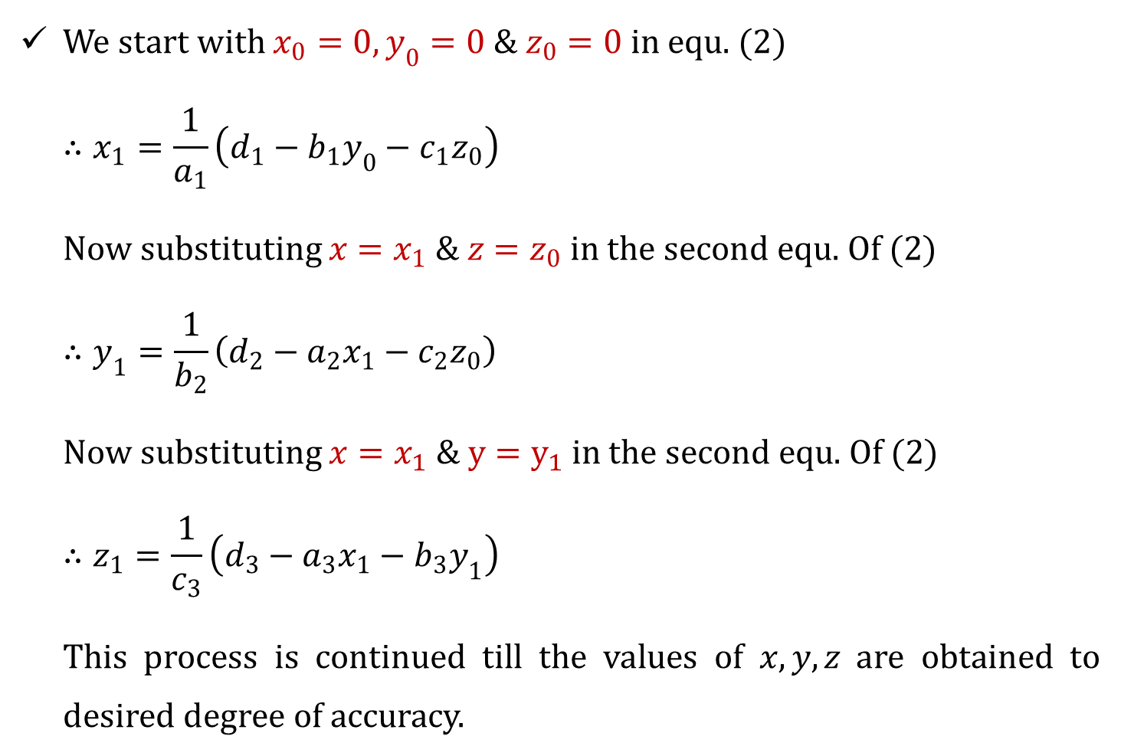
We start with $x_{0}=0,y_{0}=0 \& z_{0}=0$in equ. $(2)$
$$∴x_{1}=\frac{1}{a_{1}}\left(d_{1}−b_{1}y_{0}−c_{1}z_{0}\right)$$
Now substituting $x=x_{1} \& z=z_{0}$ in the second equ. Of $(2)$
$$∴y_{1}=\frac{1}{b_{2}}\left(d_{2}−a_{2}x_{1}−c_{2}z_{0}\right)$$
Now substituting $x=x_{1} \& y=y_{1}$ in the second equ. Of $(2)$
$$∴z_{1}=\frac{1}{c_{3}}\left(d_{3}−a_{3}x_{1}−b_{3}y_{1}\right)$$
This process is continued till the values of $x,y,z$ are obtained to desired degree of accuracy.

Slide 30
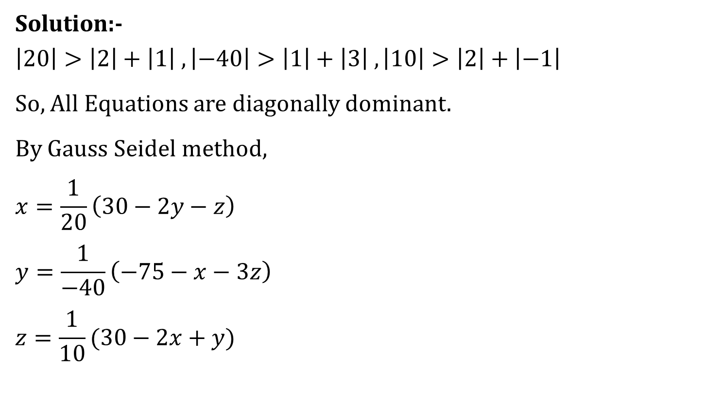
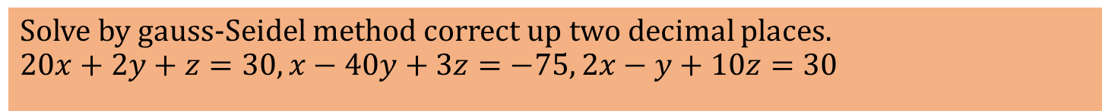
Solve by gauss-Seidel method correct up two decimal places. $$20x+2y+z=30, x−40y+3z=−75, 2x−y+10z=30$$
Solution:-
$$\left|20\right|>\left|2\right|+\left|1\right| ,\left|−40\right|>\left|1\right|+\left|3\right| ,\left|10\right|>\left|2\right|+\left|−1\right|$$
So, All Equations are diagonally dominant.
By Gauss Seidel method,
$$x=\frac{1}{20}\left(30−2y−z\right)$$
$$y=\frac{1}{−40}\left(−75−x−3z\right)$$
$$z=\frac{1}{10}(30−2x+y)$$

Slide 31
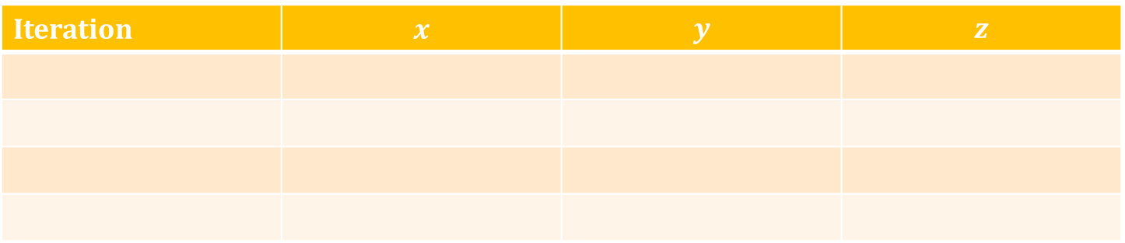

Let the initial values are $x_{1}=x_{2}=x_{3}=0.$
$$x=\frac{1}{20}\left(30−2y−z\right)=\frac{1}{20}\left(30−0−0\right)=1.5$$
$$y=\frac{1}{−40}\left(−75−x−3z\right)=\frac{1}{−40}\left(−75−1.5−0\right)=1.91$$
$$z=\frac{1}{10}\left(30−2x+y\right)=\frac{1}{10}\left(30−2\left(1.5\right)+1.91\right)=2.89$$
In $3^{rd} \& 4^{th}$ iteration all values are almost same.
So,$\left(x,y,z\right)=(1.14, 2.13, 2.99)$
Iteration | $$x$$ | $$y$$ | $$z$$
1
1.5
1.91
2.89
2
1.16
2.12
2.98
3
1.14
2.13
2.99
4
1.14
2.13
2.99

