Slide 1
Unit-5 Numerical Integration 2140706 – Numerical & Statistical Methods

Slide 2
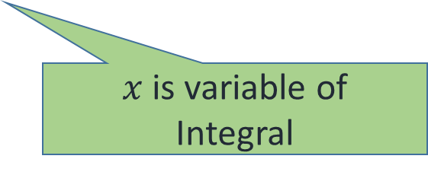

What is Integration ?
Integration is process of evaluating an indefinite integral or definite integral.
$$\int_{a}^{b}{ f\left(x\right)} dx$$
Integral Sign
$x$ is variable of
Integral
Integrand

Slide 3

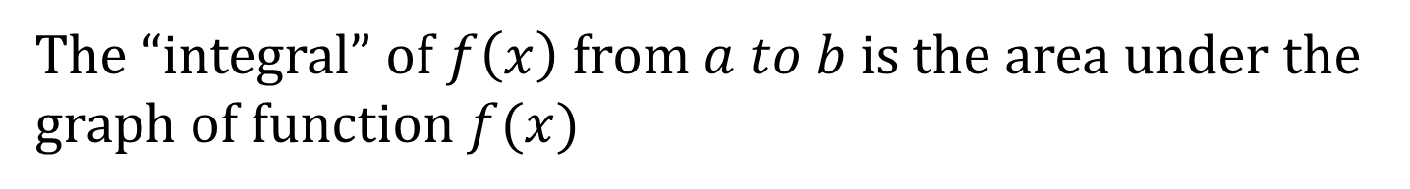



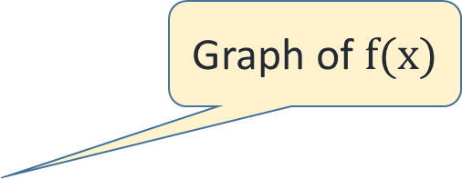
Graphical representation of Integral
$$Y$$
Graph of $f(x)$
$$a$$
$$b$$
$$X$$
The “integral” of $f\left(x\right)$ from $a to b$ is the area under the graph of function $f(x)$

Slide 4
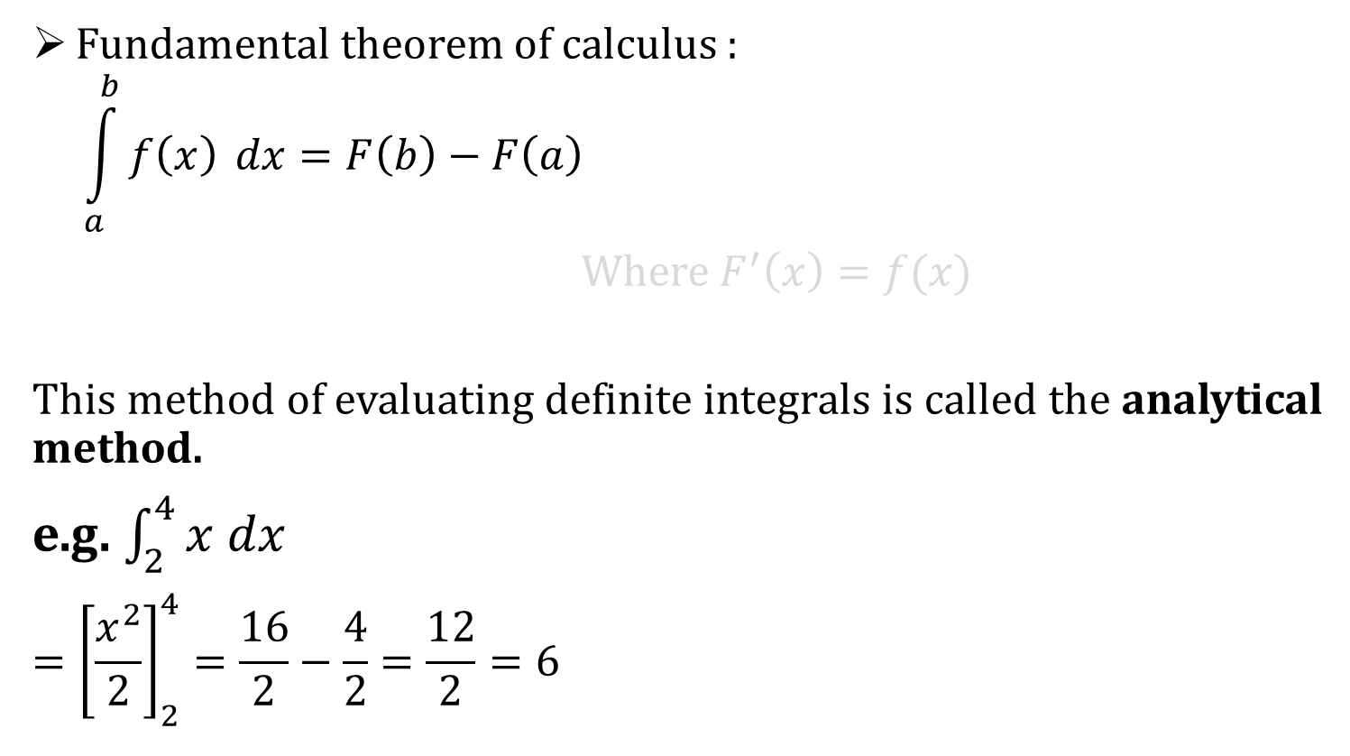
Integration
Fundamental theorem of calculus :
$$\int_{a}^{b}{f\left(x\right)} dx=F\left(b\right)−F\left(a\right)$$
Where $F^{′}\left(x\right)=f(x)$
This method of evaluating definite integrals is called the analytical method.
e.g. $\int_{2}^{4}{x dx}$
$$={\left[\frac{x^{2}}{2}\right]}_{2}^{4}=\frac{16}{2}−\frac{4}{2}=\frac{12}{2}=6$$

Slide 5
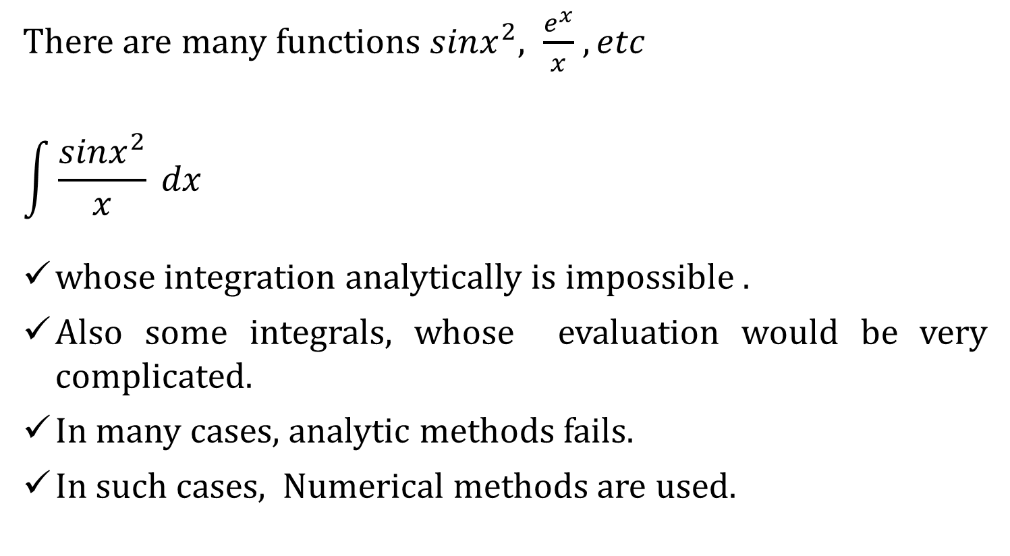
Why Numerical Integration ?
There are many functions $sinx^{2}, \frac{e^{x}}{x}$ $, etc$
$$\int{\frac{sinx^{2}}{x}} dx$$
whose integration analytically is impossible .
Also some integrals, whose evaluation would be very complicated.
In many cases, analytic methods fails.
In such cases, Numerical methods are used.
Solve it, if you can

Slide 6






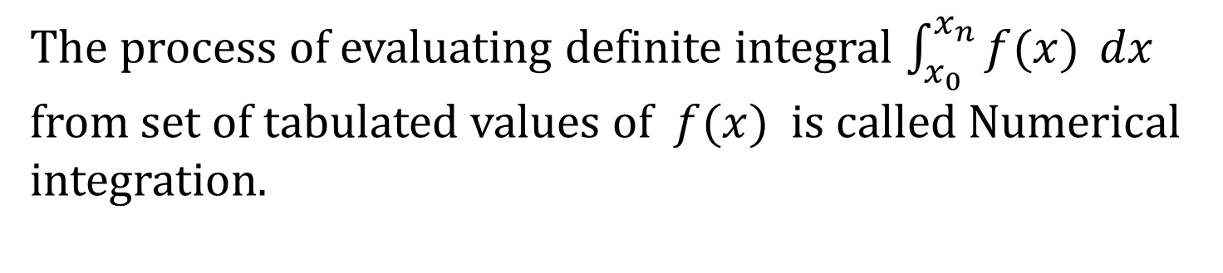








Numerical Integration
Consider the observation table
$$x$$
$$x_{0}$$
$$x_{1}$$
$$x_{2}$$
$$x_{3}$$
$$x_{n−1}$$
$$x_{n}$$
$$y=f(x)$$
$$y_{0}$$
$$y_{1}$$
$$y_{2}$$
$$y_{3}$$
$$y_{n−1}$$
$$y_{n}$$
The process of evaluating definite integral $\int_{x_{0}}^{x_{n}}{f(x)} dx$ from set of tabulated values of $f(x)$ is called Numerical integration.

Slide 7
Methods of Numerical integration
Trapezoidal Rule
Simpson’s 1/3 Rule
Simpson’s 3/8 Rule
Weddle’s Rule

Slide 8
Trapezoidal Rule
$$Y$$
“Trapezoid” approximation with one subinterval
$$a$$
$$b$$
$$X$$
One interval trapezoidal rule

Slide 9



Trapezoidal Rule
$$Y$$
“Trapezoid” approximation with two subinterval
$$x_{0}$$
$$x_{1}$$
$$x_{2}$$
$$X$$
Two interval trapezoidal rule

Slide 10




Trapezoidal Rule
$$Y$$
“Trapezoid” approximation with three subinterval
$$a$$
$$b$$
$$c$$
$$d$$
$$X$$
Three interval trapezoidal rule

Slide 11
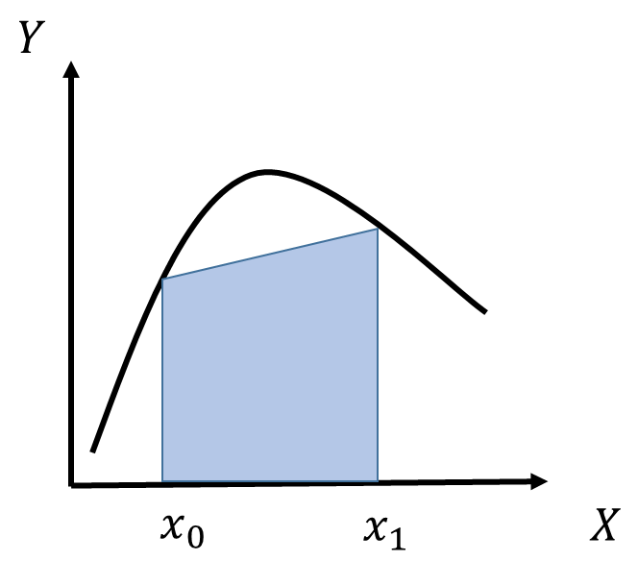
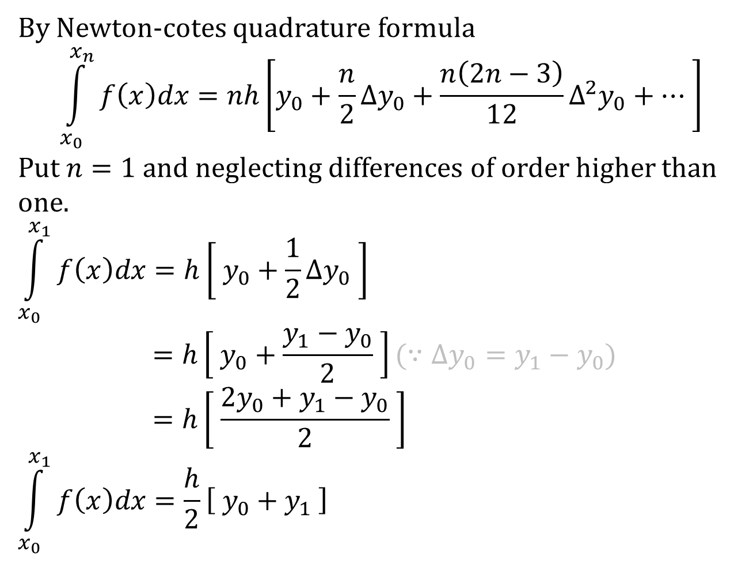
Derive Trapezoidal rule.
By Newton-cotes quadrature formula
$$\int_{x_{0}}^{x_{n}}{f\left(x\right)dx}=nh\left[y_{0}+\frac{n}{2}Δy_{0}+\frac{n\left(2n−3\right)}{12}Δ^{2}y_{0}+… \right]$$
Put $n=1$ and neglecting differences of order higher than one.
$$\int_{x_{0}}^{x_{1}}{f\left(x\right)dx}=h\left[ y_{0}+\frac{1}{2}Δy_{0} \right]$$
$$=h\left[ y_{0}+\frac{y_{1}−y_{0}}{2} \right](∵Δy_{0}=y_{1}−y_{0})$$
$$=h\left[ \frac{{{2y}_{0}+y}_{1}−y_{0}}{2} \right]$$
$$\int_{x_{0}}^{x_{1}}{f\left(x\right)dx}=\frac{h}{2}\left[ y_{0}+y_{1} \right]$$

Slide 12
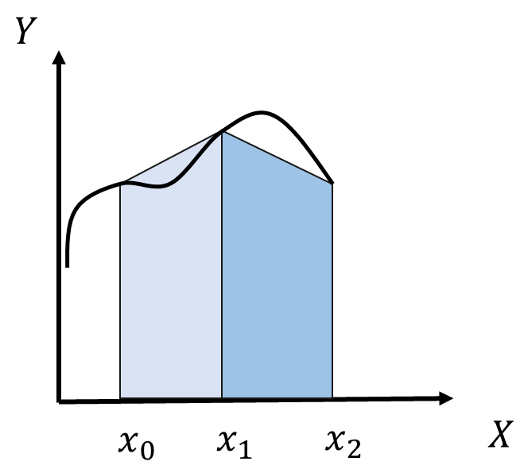
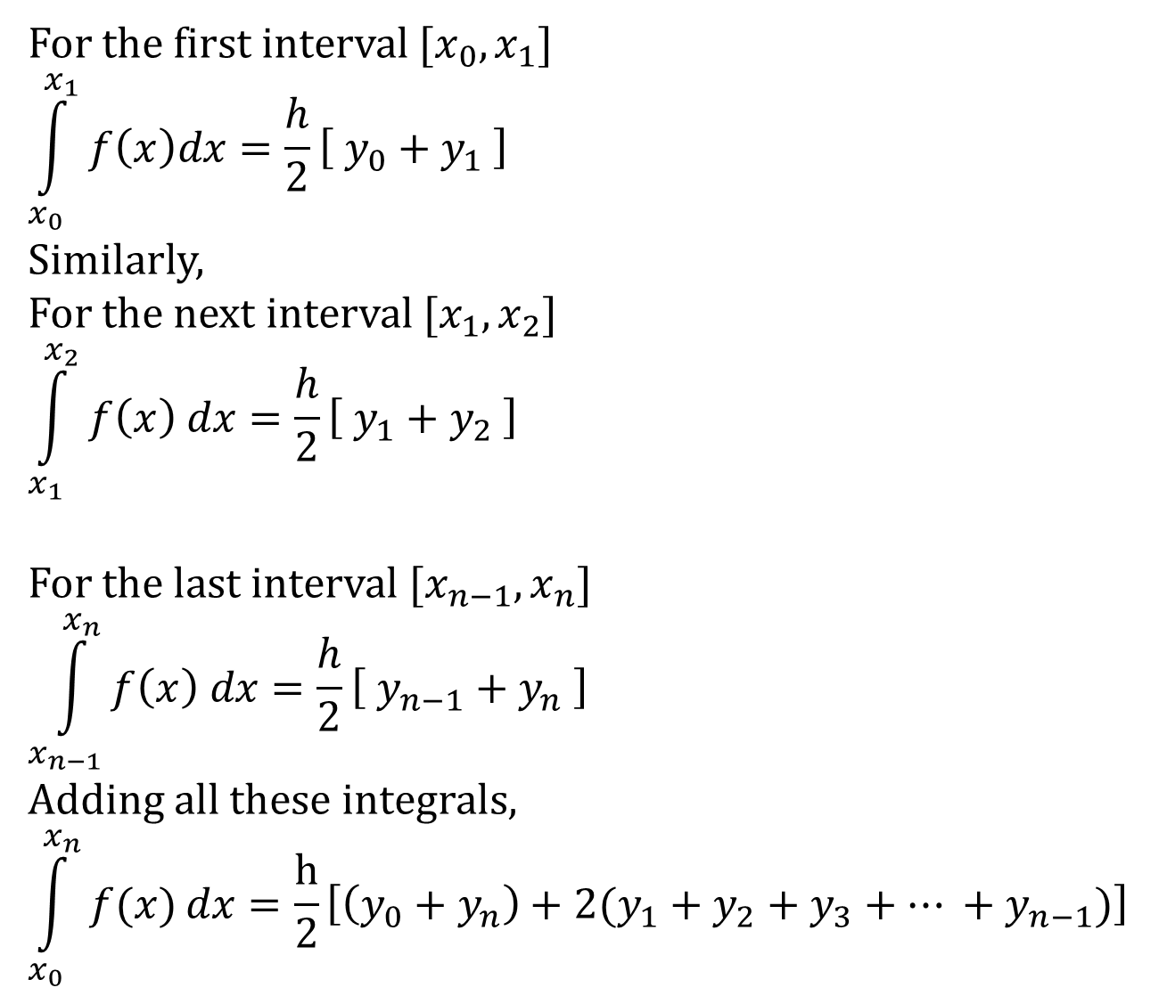
For the first interval $[x_{0},x_{1}]$
$$\int_{x_{0}}^{x_{1}}{f\left(x\right)dx}=\frac{h}{2}\left[ y_{0}+y_{1} \right]$$
Similarly,
For the next interval $[x_{1},x_{2}]$
$$\int_{x_{1}}^{x_{2}}{f\left(x\right) dx}=\frac{h}{2}\left[ y_{1}+y_{2} \right]$$
For the last interval $[x_{n−1},x_{n}]$
$$\int_{x_{n−1}}^{x_{n}}{f\left(x\right) dx}=\frac{h}{2}\left[ y_{n−1}+y_{n} \right]$$
Adding all these integrals,
$$\int_{x_{0}}^{x_{n}}{f(x)}dx=\frac{h}{2}\left[\left(y_{0}+y_{n}\right)+2(y_{1}+y_{2}+y_{3}+… +y_{n−1})\right]$$

Slide 13










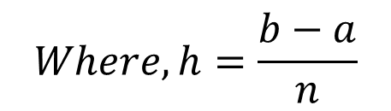




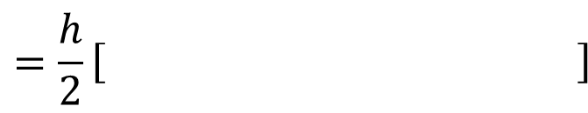




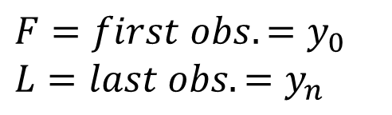



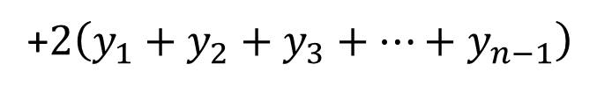
Trapezoidal Rule
Consider the observation table
$$x$$
$$x_{0}$$
$$x_{1}$$
$$x_{2}$$
$$x_{3}$$
$$x_{n−1}$$
$$x_{n}$$
Formula :
$$\int_{a}^{b}{f\left(x\right)} dx$$
$$y$$
$$y_{0}$$
$$y_{1}$$
$$y_{2}$$
$$y_{3}$$
$$y_{n−1}$$
$$y_{n}$$
$$=\frac{h}{2}\left[ \right]$$
$$\left(F+L\right)$$
$$+2\left(rest of all\right)$$
$$= \frac{h}{2}$$
$$\left(y_{0}+y_{n}\right)$$
+$2\left(y_{1}+y_{2}+y_{3}+…+y_{n−1}\right)$
$$F=first obs. =y_{0}$$
$$L=last obs. =y_{n}$$
$x_{n}=x_{0}+nh$
$$Where, h=\frac{b−a}{n}$$
$n is no of sub−intervals.$

Slide 14
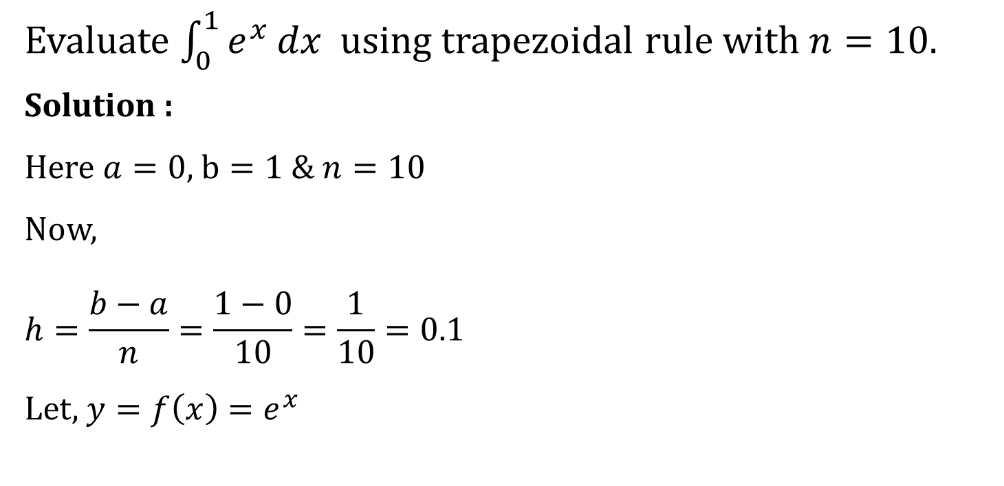
Example
Evaluate $\int_{0}^{1}{e^{x}}dx$ using trapezoidal rule with $n=10.$
Solution :
Here $a=0$, $b=1$ & $n=10$
Now,
$$h=\frac{b−a}{n}=\frac{1−0}{10}=\frac{1}{10}=0.1$$
Let, $y=f\left(x\right)=e^{x}$

Slide 15


































$$x$$
$$0$$
$$0.1$$
$$0.2$$
$$0.3$$
$$0.4$$
$$y$$
$$1$$
$$1.1052$$
$$1.2214$$
1.3499
$$1.4918$$
$$0.5$$
$$0.6$$
$$0.7$$
$$0.8$$
$$0.9$$
$$1.0$$
$$1.6487$$
$$1.8221$$
$$2.0138$$
$$2.2255$$
$$2.4596$$
$$2.7183$$
$$y\left(x\right)=e^{x}⟹y\left(0\right)=e^{0}=1$$
$$y\left(0.5\right)=e^{0.5}=1.6487$$
$$y\left(0.1\right)=e^{0.1}=1.1052$$
$$y\left(0.6\right)=e^{0.6}=1.8221$$
$$y\left(0.2\right)=e^{0.2}=1.2214$$
$$y\left(0.7\right)=e^{0.7}=2.0138$$
$$y\left(0.3\right)=e^{0.3}=1.3499$$
$$y\left(0.8\right)=e^{0.8}=2.2255$$
$$y\left(0.9\right)=e^{0.9}=2.4596$$
$$y\left(0.4\right)=e^{0.4}=1.4918$$
$$y\left(1.0\right)=e^{1.0}=2.7183$$

Slide 16










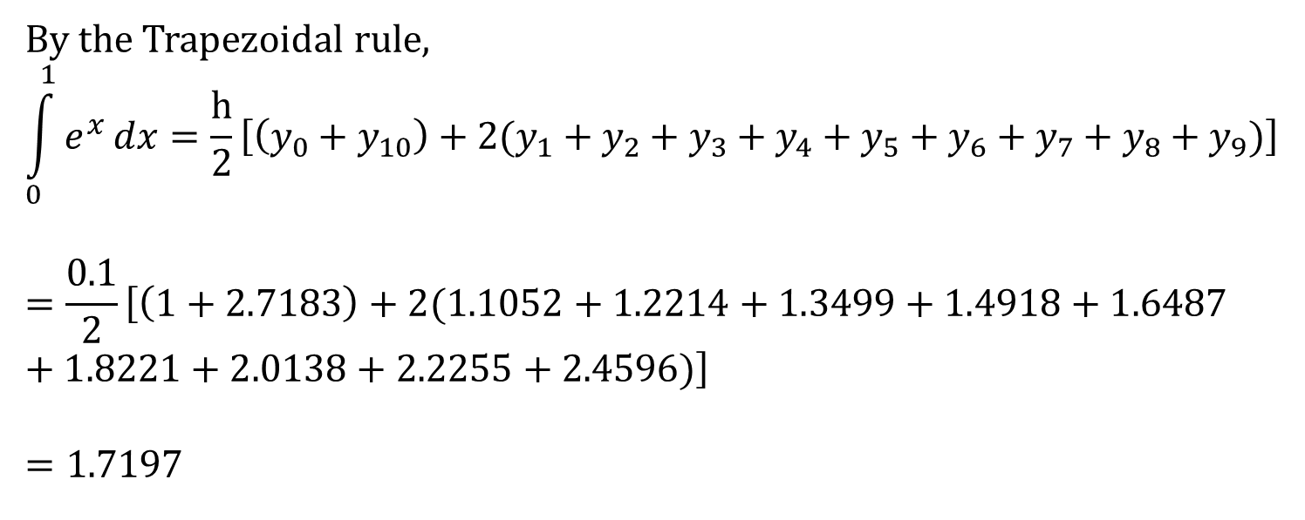














$$x$$
$$0$$
$$0.1$$
$$0.2$$
$$0.3$$
$$0.4$$
$$y$$
$$y_{0}=1$$
$$y_{1}=1.1052$$
$$y_{2}=1.2214$$
$$y_{3}=1.3499$$
$$y_{4}=1.4918$$
$$0.5$$
$$0.6$$
$$0.7$$
$$0.8$$
$$0.9$$
$$1.0$$
$$y_{5}=1.6487$$
$$y_{6}=1.8221$$
$$y_{7}= 2.0138$$
$$y_{8}=2.2255$$
$$y_{9}=2.4596$$
$$y_{10}=2.7183$$
By the Trapezoidal rule,
$$\int_{0}^{1}{e^{x}}dx=\frac{h}{2}\left[\left(y_{0}+y_{10}\right)+2(y_{1}+y_{2}+y_{3}+y_{4}+y_{5}+y_{6}+y_{7}+y_{8}+y_{9})\right]$$
$$=\frac{0.1}{2}\left[\left(1+2.7183\right)+2(1.1052+1.2214+1.3499+1.4918+1.6487+1.8221+2.0138+2.2255+2.4596)\right]$$
$$=1.7197$$

Slide 17
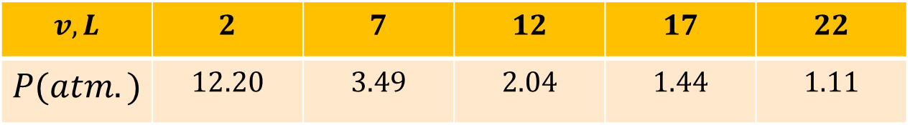

Example
Find the work done on the gas as it is compressed from
$v_{1}=22L to v_{2}=2L$ by using Trapezoidal rule.
Use $w=−\int_{v_{1}}^{v_{2}}{Pdv}$
Solution :
Here $v_{1}=22 , v_{2}=2$ & $h=5$
$$w=−\int_{v_{1}}^{v_{2}}{Pdv}=−\int_{22}^{2}{Pdv=\int_{2}^{22}{Pdv}}$$
$$v,L$$ | $$2$$ | $$7$$ | $$12$$ | $$17$$ | $$22$$
$$P(atm.)$$ | $$12.20$$ | $$3.49$$ | $$2.04$$ | $$1.44$$ | $$1.11$$

Slide 18
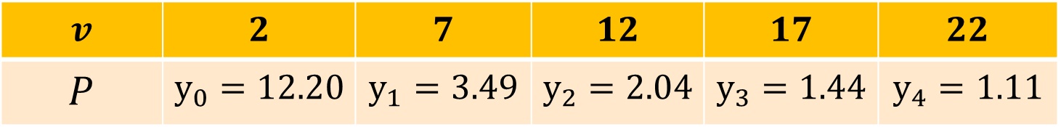
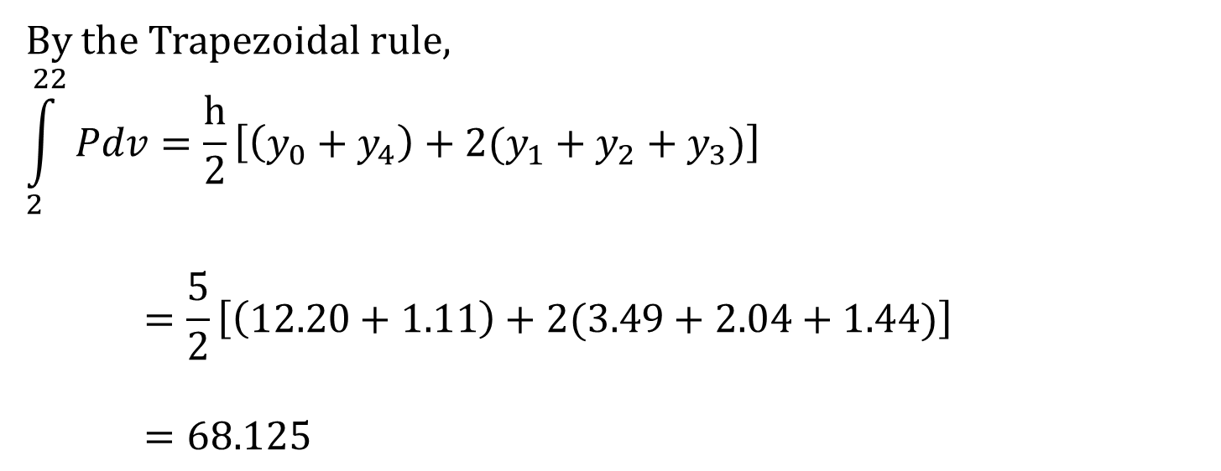
$$v$$ | $$2$$ | $$7$$ | $$12$$ | $$17$$ | $$22$$
$$P$$ | $$y_{0}=12.20$$ | $$y_{1}=3.49$$ | $$y_{2}=2.04$$ | $$y_{3}=1.44$$ | $$y_{4}=1.11$$
By the Trapezoidal rule,
$$\int_{2}^{22}{Pdv}=\frac{h}{2}\left[\left(y_{0}+y_{4}\right)+2(y_{1}+y_{2}+y_{3})\right]$$
$$=\frac{5}{2}\left[\left(12.20+1.11\right)+2(3.49+2.04+1.44)\right]$$
$$=68.125$$

Slide 19
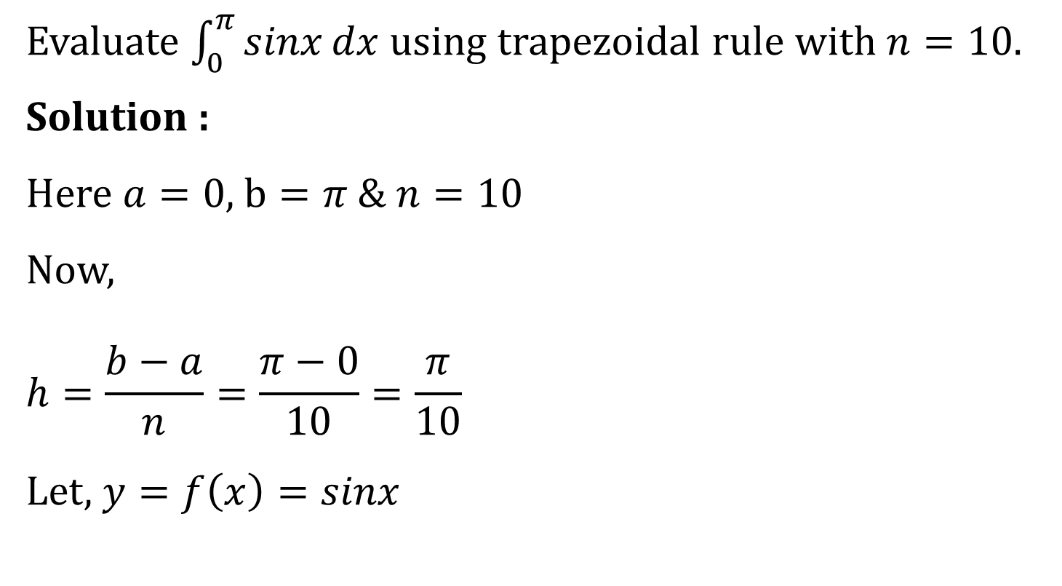
Example
Evaluate $\int_{0}^{π}{sinx}dx$using trapezoidal rule with $n=10.$
Solution :
Here $a=0$, $b=π$ & $n=10$
Now,
$$h=\frac{b−a}{n}=\frac{π−0}{10}=\frac{π}{10}$$
Let, $y=f\left(x\right)=sinx$

Slide 20
























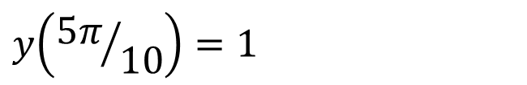








$$x$$
$$0$$
$$π/10$$
$$2π/10$$
$$3π/10$$
$$4π/10$$
$$y$$
$$0$$
$$0.3090$$
$$0.5878$$
$$0.8090$$
$$0.9511$$
$$5π/10$$
$$6π/10$$
$$7π/10$$
$$8π/10$$
$$9π/10$$
$$10π/10$$
$$1.0000$$
$$0.9511$$
$$0.8090$$
$$0.5878$$
$$0.3090$$
$$0$$
$$y\left(x\right)=\sin{x}⟹y\left(0\right)=\sin{0}=0$$
$$y\left({5π}/{10}\right)=1$$
$$y\left(π/{10}\right)=\sin{π/{10}}=0.3090$$
$$y\left({6π}/{10}\right)=0.9511$$
$$y\left({2π}/{10}\right)=\sin{{2π}/{10}}=0.5878$$
$$y\left({7π}/{10}\right)=0.8090$$
$$y\left({8π}/{10}\right)=0.5878$$
$$y\left({3π}/{10}\right)=\sin{{3π}/{10}}=0.8090$$
$$y\left({9π}/{10}\right)=0.3090$$
$$y\left({4π}/{10}\right)=\sin{{4π}/{10}}=0.9511$$
$$y\left({10π}/{10}\right)=0$$

Slide 21
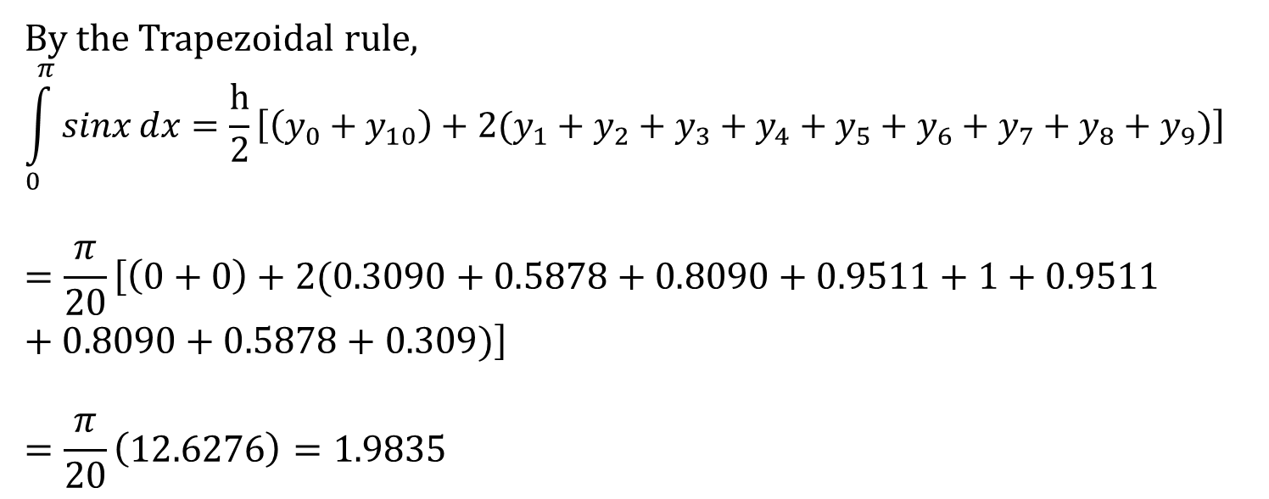
$$x$$
$$0$$
$$π/10$$
$$2π/10$$
$$3π/10$$
$$4π/10$$
$$y$$
$$0$$
$$0.3090$$
$$0.5878$$
$$0.8090$$
$$0.9511$$
$$5π/10$$
$$6π/10$$
$$7π/10$$
$$8π/10$$
$$9π/10$$
$$10π/10$$
$$1.0000$$
$$0.9511$$
$$0.8090$$
$$0.5878$$
$$0.3090$$
$$0$$
By the Trapezoidal rule,
$$\int_{0}^{π}{sinx}dx=\frac{h}{2}\left[\left(y_{0}+y_{10}\right)+2(y_{1}+y_{2}+y_{3}+y_{4}+y_{5}+y_{6}+y_{7}+y_{8}+y_{9})\right]$$
$$=\frac{π}{20}\left[\left(0+0\right)+2(0.3090+0.5878+0.8090+0.9511+1+0.9511+0.8090+0.5878+0.309)\right]$$
$$=\frac{π}{20}\left(12.6276\right)=1.9835$$

Slide 22
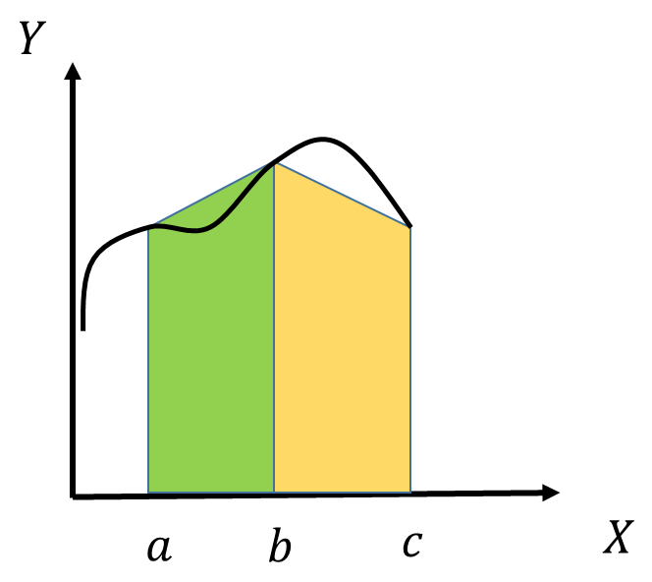
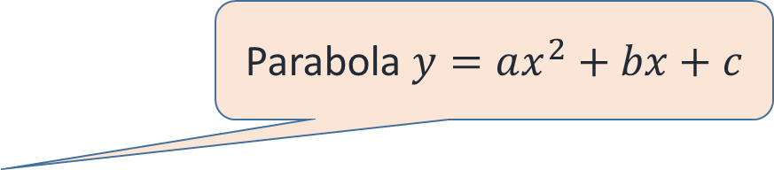

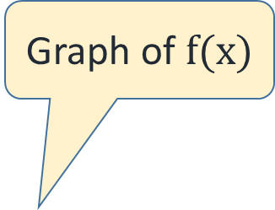




Simpson’s 1/3 Rule
Graph of $f(x)$
$$Y$$
Parabola $y=ax^{2}+bx+c$
$$a$$
$$b$$
$$c$$
$$X$$
Trapezoidal rule fit two points ,
Here Parabola is fitted through three points

Slide 23






Simpson’s 1/3 Rule
$$Y$$
Graph of $f(x)$
Parabola
0
$$a$$
$$b$$
$$c$$
$$d$$
$$e$$
$$X$$
For Simpson’s rule , $n$ should be multiple of two

Slide 24
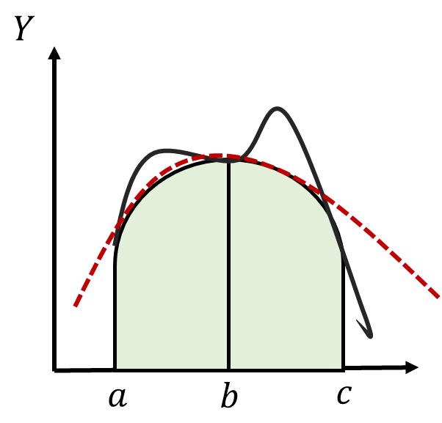
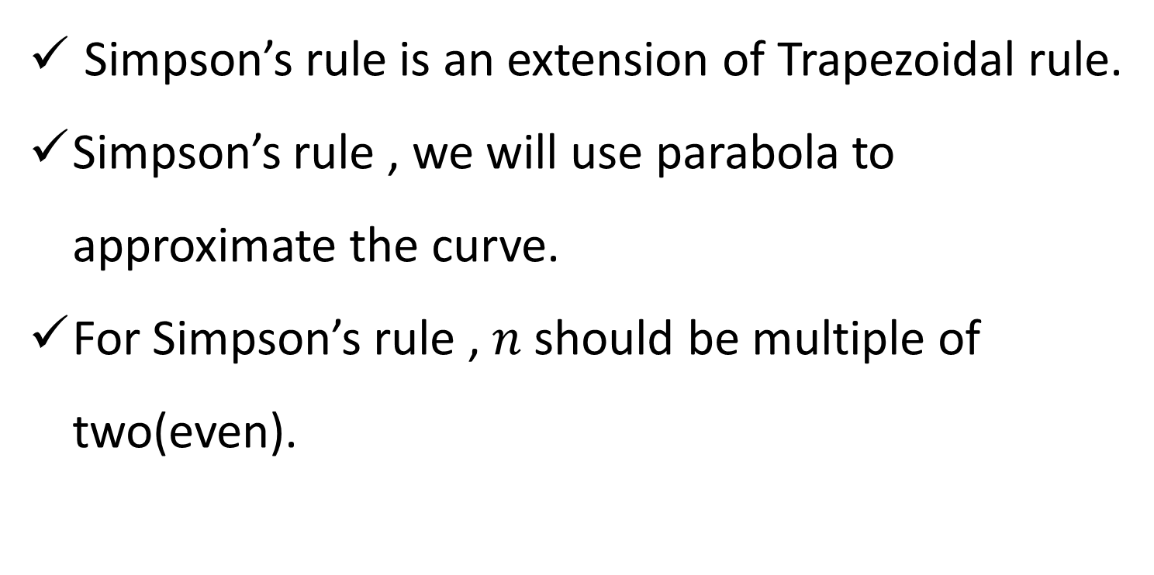
Simpson’s 1/3 Rule
Simpson’s rule is an extension of Trapezoidal rule.
Simpson’s rule , we will use parabola to approximate the curve.
For Simpson’s rule , $n$ should be multiple of two(even).

Slide 25
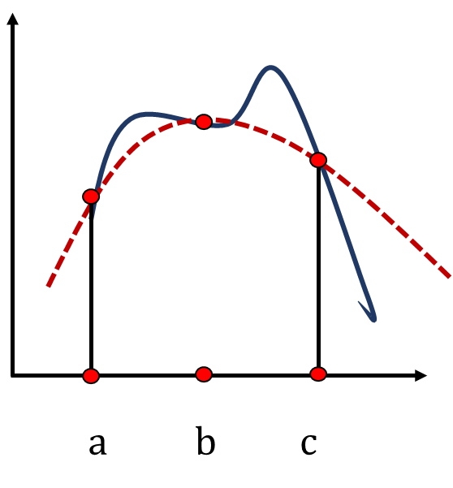
Simpson’s 1/3 Rule
The no. of ordinates ( y values ) is odd.
The accuracy can be improved by increasing n(subinterval)
Integration is approximated by second order polynomial (quadratic).

Slide 26


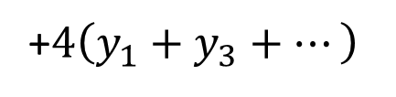

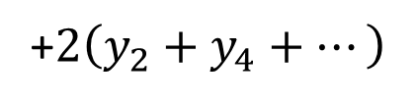







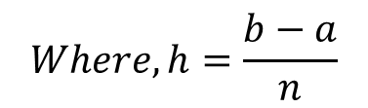








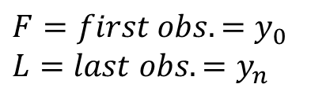



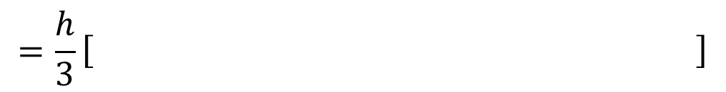


Simpson’s 1/3 Rule
Consider the observation table
$$x$$
$$x_{0}$$
$$x_{1}$$
$$x_{2}$$
$$x_{3}$$
$$x_{4}$$
$$x_{n−1}$$
$$x_{n}$$
$$y$$
$$y_{0}$$
$$y_{1}$$
$$y_{2}$$
$$y_{3}$$
$$y_{4}$$
$$y_{n−1}$$
$$y_{n}$$
$$\int_{a}^{b}{f\left(x\right)} dx$$
$$=\frac{h}{3}\left[ \right]$$
$$\left(F+L\right)$$
$$+4\left(odd obs.\right)$$
$$+2\left(even obs.\right)$$
$$= \frac{h}{3}$$
$$\left(y_{0}+y_{n}\right)$$
+$4\left(y_{1}+y_{3}+…\right)$
+$2\left(y_{2}+y_{4}+…\right)$
$$Where, h=\frac{b−a}{n}$$
$$F=first obs. =y_{0}$$
$$L=last obs. =y_{n}$$
$n is no of sub−intervals.$

Slide 27
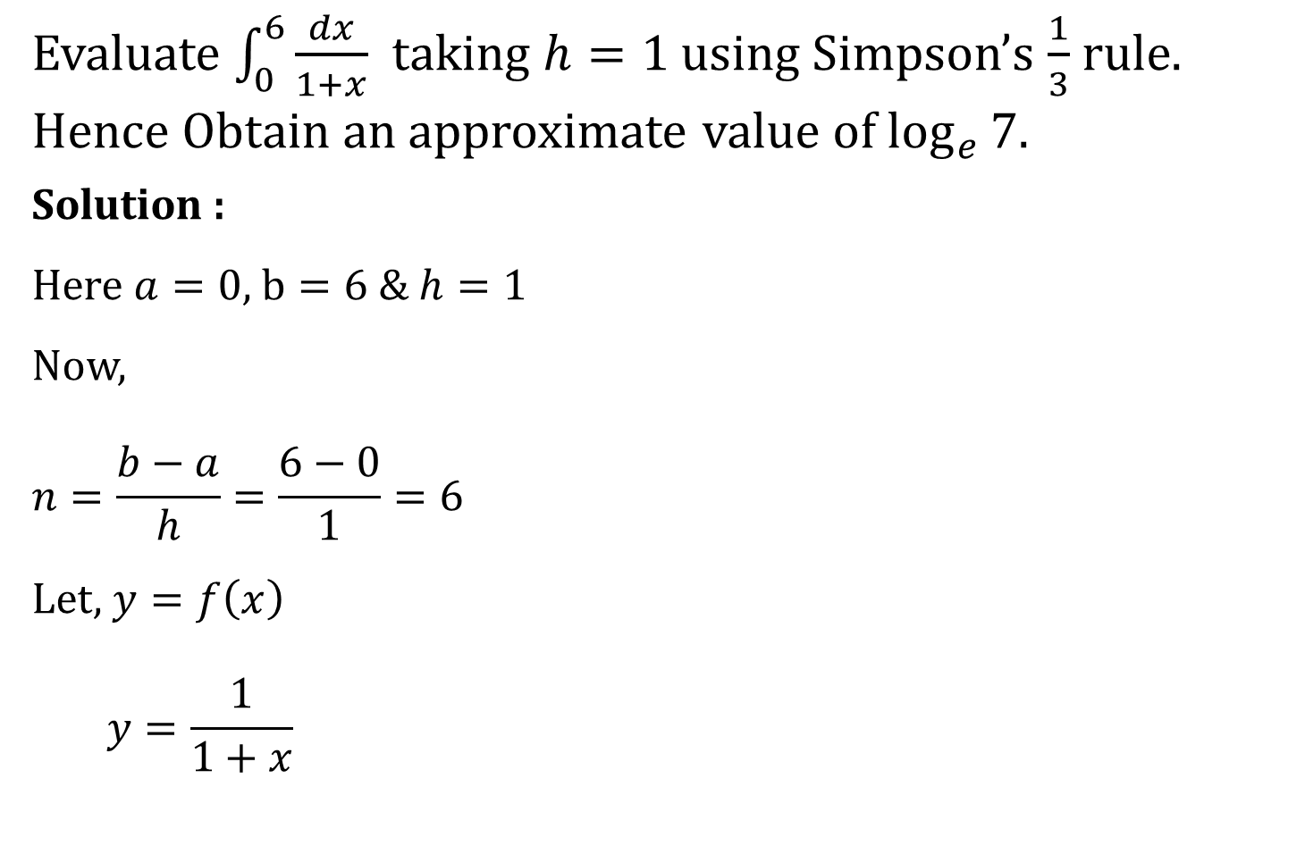
Example 1
Evaluate $\int_{0}^{6}{\frac{dx}{1+x}}$ taking $h=1$ using Simpson’s $\frac{1}{3}$ rule. Hence Obtain an approximate value of $\log_{e}{7}$.
Solution :
Here $a=0$, $b=6$ & $h=1$
Now,
$$n=\frac{b−a}{h}=\frac{6−0}{1}=6$$
Let, $y=f\left(x\right)$
$$y=\frac{1}{1+x}$$

Slide 28



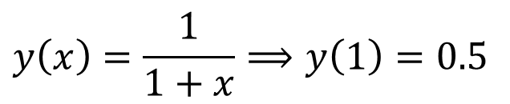
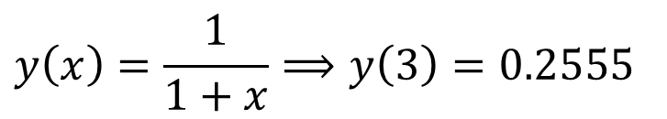



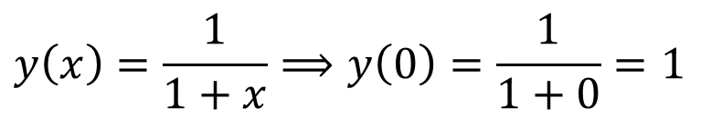

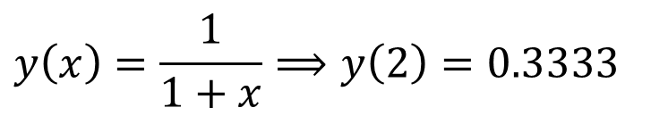


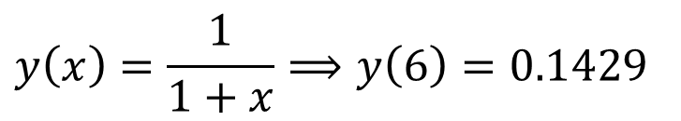


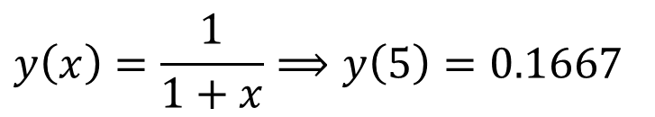





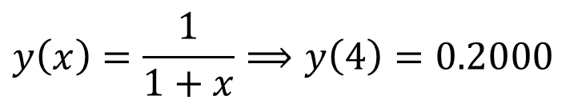
$$x$$
$$0$$
$$1$$
$$2$$
$$3$$
$$4$$
$$5$$
$$6$$
$$y$$
$$1$$
$$0.5$$
$$0.3333$$
$$0.2555$$
$$0.2000$$
$$0.1667$$
$$0.1429$$
$$y\left(x\right)=\frac{1}{1+x}⟹y\left(0\right)=\frac{1}{1+0}=1$$
$$y\left(x\right)=\frac{1}{1+x}⟹y\left(1\right)=0.5$$
$$y\left(x\right)=\frac{1}{1+x}⟹y\left(2\right)=0.3333$$
$$y\left(x\right)=\frac{1}{1+x}⟹y\left(3\right)=0.2555$$
$$y\left(x\right)=\frac{1}{1+x}⟹y\left(4\right)=0.2000$$
$$y\left(x\right)=\frac{1}{1+x}⟹y\left(5\right)=0.1667$$
$$y\left(x\right)=\frac{1}{1+x}⟹y\left(6\right)=0.1429$$

Slide 29









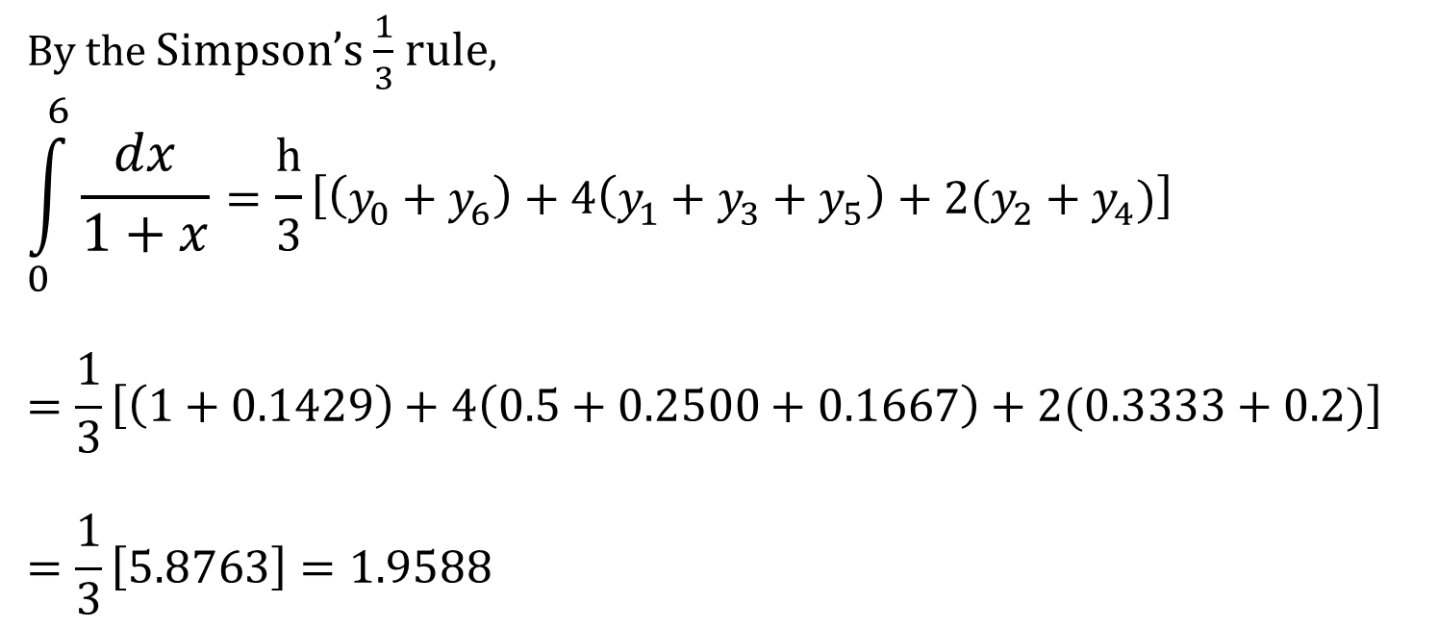














$$x$$
$$0$$
$$1$$
$$2$$
$$3$$
$$4$$
$$5$$
$$6$$
$$y$$
$$1$$
$$0.5$$
$$0.3333$$
$$0.2500$$
$$0.2000$$
$$0.1667$$
$$0.1429$$
$$y_{0}$$
$$y_{1}$$
$$y_{2}$$
$$y_{3}$$
$$y_{4}$$
$$y_{5}$$
$$y_{6}$$
By the Simpson’s $\frac{1}{3}$ rule,
$$\int_{0}^{6}{\frac{dx}{1+x}}=\frac{h}{3}\left[\left(y_{0}+y_{6}\right)+4\left(y_{1}+y_{3}+y_{5}\right)+2(y_{2}+y_{4})\right]$$
$$=\frac{1}{3}\left[\left(1+0.1429\right)+4\left(0.5+0.2500+0.1667\right)+2(0.3333+0.2)\right]$$
$$=\frac{1}{3}\left[5.8763\right]=1.9588$$

Slide 30
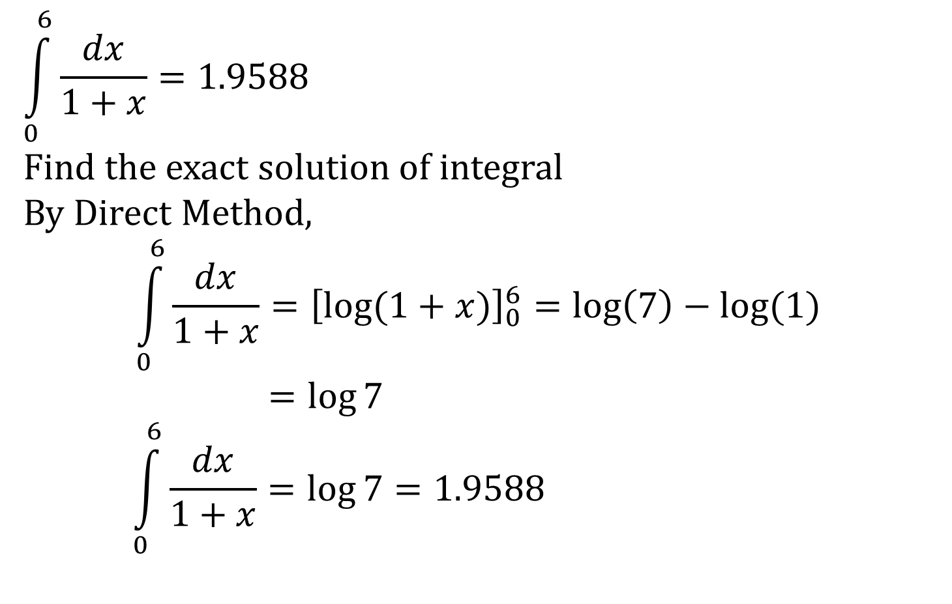
Example
$$\int_{0}^{6}{\frac{dx}{1+x}}=1.9588$$
Find the exact solution of integral
By Direct Method,
$$\int_{0}^{6}{\frac{dx}{1+x}={\left[\log{(1+x)}\right]}_{0}^{6}=\log\left(7\right)−\log{(1)}}$$
$$=\log{7}$$
$$\int_{0}^{6}{\frac{dx}{1+x}=\log{7}}=1.9588$$

Slide 31
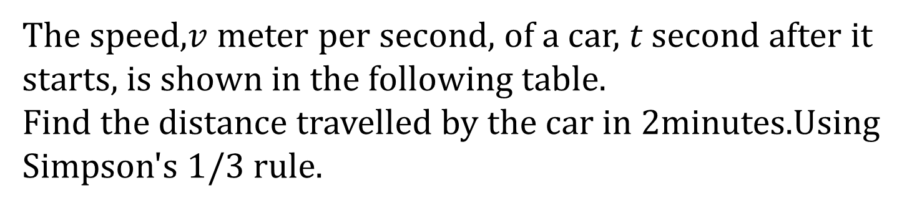
Example 5
The speed,$v$ meter per second, of a car, $t$ second after it starts, is shown in the following table.
Find the distance travelled by the car in $2$minutes.Using Simpson's $1/3$ rule.
T (time) | 0 | 12 | 24 | 36 | 48 | 60 | 72 | 84 | 96 | 108 | 120
V (Speed) | 0 | 3.6 | 10.08 | 18.90 | 21.6 | 18.54 | 10.26 | 4.5 | 4.5 | 5.4 | 9

Slide 32

Example 5
Let $s$(meters) distance be travelled in $t$(seconds).
$$\frac{ds}{dt}=v$$
$$\int{ds}=\int{v dt}$$
$$s=\int{v dt}$$
The distance travelled in $2$ minute, i.e.$120$ seconds is
$$s=\int_{0}^{120}{v dt}$$

Slide 33












t | 0 | 12 | 24 | 36 | 48 | 60 | 72 | 84 | 96 | 108 | 120
v | 0 | 3.6 | 10.08 | 18.90 | 21.6 | 18.54 | 10.26 | 4.5 | 4.5 | 5.4 | 9
$$y_{0}$$
$$y_{1}$$
$$y_{2}$$
$$y_{3}$$
$$y_{4}$$
$$y_{5}$$
$$y_{6}$$
$$y_{7}$$
$$y_{8}$$
$$y_{9}$$
$$y_{10}$$
By using Simpson's $1/3$ rule,
$s=\int_{0}^{120}{v dt}$
$$=\frac{h}{3}\left[\left(y_{0}+y_{10}\right)+4\left(y_{1}+y_{3}+y_{5}+y_{7}+y_{9}\right)+2(y_{2}+y_{4}+y_{6}+y_{8})\right]$$
$$=\frac{12}{3}[\left(0+9\right)+4\left(3.6+18.9+18.54+4.5+5.4\right)+2(10.08+21.6+10.26+4.5)]$$
$=\frac{12}{3}(9+203.76+92.88)$ $=\frac{12}{3}(305.64)$ $=1222.56$ metres

Slide 34

Example 8
Evaluate $\int_{−2}^{6}{{\left(1+x^{2}\right)}^{\frac{3}{2}} dx}$using Simpson’s $\frac{1}{3}$ rule with taking six subintervals. Use four digits after decimal points for calculation.
Solution :
Here $a=−2$, $b=6$ & $n=6$
Now,
$$h=\frac{b−a}{n}=\frac{6+2}{6}=\frac{8}{6}=\frac{4}{3}≠1.3333$$
Let, $y=f\left(x\right)={\left(1+x^{2}\right)}^{\frac{3}{2}}$

Slide 35



















$$x$$
$$−2$$
$$−2/3$$
$$2/3$$
$$2$$
$$10/3$$
$$14/3$$
$$6$$
$$y$$
$$11.1803$$
$$1.7360$$
$$1.7360$$
$$11.1803$$
$$42.1479$$
$$108.7094$$
$$225.0622$$
$$y\left(x\right)={\left(1+x^{2}\right)}^{\frac{3}{2}}⟹y\left(−2\right)={\left(1+0\right)}^{\frac{3}{2}}=11.1803$$
$$y\left(x\right)={\left(1+x^{2}\right)}^{\frac{3}{2}}⟹y\left(−2/3\right)=1.7360$$
$$y\left(2/3\right)=1.7360$$
$$y\left(2\right)=11.1803$$
$$y\left(10/3\right)=42.1479$$
$$y\left(14/3\right)=108.7094$$
$$y\left(6\right)=225.0622$$

Slide 36










$$x$$
$$−2$$
$$−2/3$$
$$2/3$$
$$2$$
$$10/3$$
$$14/3$$
$$6$$
$$y$$
$$11.1803$$
$$1.7360$$
$$1.7360$$
$$11.1803$$
$$42.1479$$
$$108.7094$$
$$225.0622$$
$$y_{0}$$
$$y_{1}$$
$$y_{2}$$
$$y_{3}$$
$$y_{4}$$
$$y_{5}$$
$$y_{6}$$
By the Simpson’s $\frac{1}{3}$ rule,
$$\int_{0}^{1}{e^{x}}dx=\frac{h}{3}\left[\left(y_{0}+y_{6}\right)+4\left(y_{1}+y_{3}+y_{5}\right)+2(y_{2}+y_{4})\right]$$
$$=\frac{4}{9}\left[\left(11.1803+225.0622\right)+4\left(1.736+11.1803+108.7094\right)+2(1.736+42.1479)\right]$$
$$=\frac{4}{9}\left(810.5131\right)=360.2280$$

Slide 37









Simpson’s 3/8 Rule
Consider the observation table
$$x$$
$$x_{0}$$
$$x_{1}$$
$$x_{2}$$
$$x_{3}$$
$$x_{4}$$
$$x_{n−1}$$
$$x_{n}$$
$$y$$
$$y_{0}$$
$$y_{1}$$
$$y_{2}$$
$$y_{3}$$
$$y_{4}$$
$$y_{n−1}$$
$$y_{n}$$
$$\int_{a}^{b}{f\left(x\right)} dx$$
$$=\frac{3h}{8}\left[ \right]$$
$$\left(F+L\right)$$
$$+2\left(Multiple of 3\right)$$
$$+3\left(Not Multiple of 3\right)$$
$$= \frac{3h}{8}$$
$$\left(y_{0}+y_{n}\right)$$
+$2\left(y_{3}+y_{6}+…\right)$
+$3\left(y_{1}+y_{2}+y_{4}…\right)$
$$Where, h=\frac{b−a}{n}$$
$$F=first obs. =y_{0}$$
$$L=last obs. =y_{n}$$
$n is no of sub−intervals.$

Slide 38
Simpson’s 3/8 Rule
a
b
c
d
a
b
c
Simpson’s 3/8 Rule
Simpson’s 1/3 Rule

Slide 39


Error bounds in Simpson's 3/8 rule
If $f^{4}(x)$ is continuous in $[a,b]$ then the error in Simpson's $3/8$ rule is
$\left|error\right|≤ \frac{\left(b−a\right)}{80}h^{4} \left|f^{4}(M)\right|$
Constant
Where $\left|f^{4}(M)\right|$ is the largest value of $\left|f^{4}(x)\right|$ in $\left[a,b\right].$

Slide 40

Example 2
Evaluate $\int_{0}^{3}{\frac{dx}{1+x}}$ taking $n=6$ using Simpson’s $3/8$ rule. Hence Obtain an approximate value of $\log_{e}{2}$.Estimate the bound of error involved in the process.
Solution :
Here $a=0$, $b=3$ & $n=6$
Now,
$$h=\frac{b−a}{n}=\frac{3−0}{6}=0.5$$
Let, $y=f\left(x\right)=\frac{1}{1+x}$

Slide 41


















$$x$$
$$0$$
$$0.5$$
$$1$$
$$1.5$$
$$2$$
$$2.5$$
$$3$$
$$y$$
1
$$0.6667$$
$$0.5000$$
$$0.4000$$
$$0.3333$$
$$0.2857$$
$$0.2500$$
$$y\left(x\right)=\frac{1}{1+x}⟹y\left(0\right)=\frac{1}{1+0}=1$$
$$y\left(x\right)=\frac{1}{1+x}⟹y\left(0.5\right)=0.6667$$
$$y\left(x\right)=\frac{1}{1+x}⟹y\left(1\right)=0.5000$$
$$y\left(x\right)=\frac{1}{1+x}⟹y\left(1.5\right)=0.4000$$
$$y\left(x\right)=\frac{1}{1+x}⟹y\left(2\right)=0.3333$$
$$y\left(x\right)=\frac{1}{1+x}⟹y\left(2.5\right)=0.2857$$
$$y\left(x\right)=\frac{1}{1+x}⟹y\left(3\right)=0.2500$$

Slide 42

$$x$$
$$0$$
$$0.5$$
$$1$$
$$1.5$$
$$2$$
$$2.5$$
$$3$$
$$y$$
1
$$0.6667$$
$$0.5000$$
$$0.4000$$
$$0.3333$$
$$0.2857$$
$$0.2500$$
$$y_{0}$$
$$y_{1}$$
$$y_{2}$$
$$y_{3}$$
$$y_{4}$$
$$y_{5}$$
$$y_{6}$$
By the Simpson’s $\frac{1}{3}$ rule,
$$\int_{0}^{3}{\frac{dx}{1+x}}=\frac{3h}{8}\left[\left(y_{0}+y_{6}\right)+2\left(y_{3}\right)+3(y_{1}+y_{2}+y_{4}+y_{5})\right]$$
$$=\frac{3(0.5)}{8}\left[\left(1+0.25\right)+2\left(0.4\right)+3(0.5+0.3333+0.2857+0.6667)\right]$$
$$=1.3888$$

Slide 43

Example
$$\int_{0}^{3}{\frac{dx}{1+x}}≈1.3888………(1)$$
Find the exact value of integral
By Direct Method,
$$\int_{0}^{3}{\frac{dx}{1+x}={\left[\log{(1+x)}\right]}_{0}^{3}=\log\left(4\right)−\log{(1)}}$$
$$=\log{{\left(2\right)}^{2}}=2\log{2}………(2)$$
Using Equation (1) & (2)
$$2\log{2}=1.3888⇒\log{2}=0.6944$$

Slide 44

Error bound :
$$f\left(x\right)=\frac{1}{1+x}$$
$$⇒f^{′}\left(x\right)=\frac{−1}{{\left(1+x\right)}^{2}}$$
$$⇒f^{′′}\left(x\right)=\frac{2}{{\left(1+x\right)}^{3}}$$
$$⇒f^{′′′}\left(x\right)=\frac{−6}{{\left(1+x\right)}^{4}}$$
$$⇒f^{iv}\left(x\right)=\frac{24}{{\left(1+x\right)}^{5}}$$
When $x⟶increase⇒f\left(x\right)⟶decrease$
Max. value of $f^{iv}$ in $\left[0,3\right]$ is
$$M=max\left|f^{iv}(0)\right|=24$$
$$\left(\begin{aligned}max\left|f^{iv}\left(x\right)\right|=max⁡\{f^{iv}\left(0\right), f^{iv}\left(1\right), f^{iv}\left(2\right),f^{iv}(3)\} \\ =\max{ \{24, 0.75, 0.0988,0.0234\}}\end{aligned}\right)$$

Slide 45

Error bound :
$$f\left(x\right)=\frac{1}{1+x}⇒f^{′}\left(x\right)=\frac{−1}{{\left(1+x\right)}^{2}}=f^{′′}\left(x\right)=\frac{2}{{\left(1+x\right)}^{3}}$$
$$⇒f^{′′′}\left(x\right)=\frac{−6}{{\left(1+x\right)}^{4}}⇒f^{iv}\left(x\right)=\frac{24}{{\left(1+x\right)}^{5}}$$
When $x⟶increase⇒f\left(x\right)⟶decrease$
Max. value of $f^{iv}$ in $\left[0,3\right]$ is
$$M=max\left|f^{iv}(0)\right|=24$$
$$\left(\begin{aligned}max\left|f^{iv}\left(x\right)\right|=max⁡\{f^{iv}\left(0\right), f^{iv}\left(1\right), f^{iv}\left(2\right),f^{iv}(3)\} \\ =\max{\{24, 0.75, 0.0988,0.0234\}}\end{aligned}\right)$$
Hence, upper bound is 24 for $\left|f^{iv}(0)\right|$
$$\left|Error\right|≤\frac{b−a}{80}h^{4}M≤\frac{\left(3−0\right)\left(0.5\right)\left(24\right)}{80}≈0.0563$$

Slide 46

Example
Evaluate $\int_{4}^{5.2}{\log{x}} dx$ using Simpson’s $3/8$ rule.
Solution:
Let$y=f\left(x\right)=\log{x}$
Let $n=6⇒h=\frac{b−a}{n}=\frac{5.2−4}{6}=0.2$
x | 4 | 4.2 | 4.4 | 4.6 | 4.8 | 5.0 | 5.2
y | 1.3863 | 1.4351 | 1.4816 | 1.5261 | 1.5686 | 1.6094 | 1.6487

Slide 47


By Simpson's 3/8 rule,
$$\int_{4}^{5.2}{\log{x dx}=\frac{3h}{8}\left(\left(y_{0}+y_{6}\right)+2\left(y_{3}\right)+3\left(y_{1}+y_{2}+y_{4}+y_{5}\right)\right)}$$
$$=\frac{3\left(0.2\right)}{8}\left(\left(1.3863+1.6487\right)+2\left(1.5261\right)+3\left(1.4351+1.4816+1.5686+1.6094\right)\right)$$
$$=1.8278$$

Slide 48

Example
Evaluate $\int_{0}^{π}{sinx}dx$using Simpson’s $3/8$ rule with
$$n=10.$$
Solution :
Here $a=0$, $b=π$ & $n=10$
Now,
$$h=\frac{b−a}{n}=\frac{π−0}{10}=\frac{π}{10}$$
Let, $y=f\left(x\right)=sinx$

Slide 49
$$x$$
$$0$$
$$π/10$$
$$2π/10$$
$$3π/10$$
$$4π/10$$
$$y$$
$$0$$
$$0.3090$$
$$0.5878$$
$$0.8090$$
$$0.9511$$
$$5π/10$$
$$6π/10$$
$$7π/10$$
$$8π/10$$
$$9π/10$$
$$10π/10$$
$$1.0000$$
$$0.9511$$
$$0.8090$$
$$0.5878$$
$$0.3090$$
$$0$$
$$y\left(x\right)=\sin{x}⟹y\left(0\right)=\sin{0}=0$$
$$y\left({5π}/{10}\right)=1$$
$$y\left(π/{10}\right)=\sin{π/{10}}=0.3090$$
$$y\left({6π}/{10}\right)=0.9511$$
$$y\left({2π}/{10}\right)=\sin{{2π}/{10}}=0.5878$$
$$y\left({7π}/{10}\right)=0.8090$$
$$y\left({8π}/{10}\right)=0.5878$$
$$y\left({3π}/{10}\right)=\sin{{3π}/{10}}=0.8090$$
$$y\left({9π}/{10}\right)=0.3090$$
$$y\left({4π}/{10}\right)=\sin{{4π}/{10}}=0.9511$$
$$y\left({10π}/{10}\right)=0$$

Slide 50


By Simpson's 3/8 rule,
$$\int_{0}^{π}{sinx}dx=\frac{3h}{8}\left[\left(y_{0}+y_{10}\right)+2(y_{3}+y_{6}+y_{9})+3(y_{1}+y_{2}+y_{4}+y_{5}+y_{7}+y_{8})\right]$$
$$=\frac{3π}{80}\left[\left(0+0\right)+2\left(0.8090+0.9511+0.3090\right)+3(0.3090+0.5878+0.9511+1.0000+0.8090+0.5878)\right]$$
$$=1.9877$$

Slide 51




Weddle’s rule
$$\int_{a}^{b}{f(x)} dx=\frac{3h}{10}[\left( y_{0}+y_{n} \right)$$
$$+(5y_{1}+y_{2}+6y_{3}+y_{4}+5y_{5})$$
$$+(2y_{6}+5y_{7}+y_{8}+6y_{9}+y_{10}+5y_{11})$$
$$+(2y_{n−6}+5y_{n−5}+y_{n−4}+{6y}_{n−3}+y_{n−2}+{5y}_{n−1})$$
$$Where, h=\frac{b−a}{n}$$
How to remember it easily ?
We remember it to make formula.

Slide 52






Weddle’s rule
$$\int_{a}^{b}{f(x)} dx=$$
$$\frac{3h}{10}$$
$$[\left( y_{0}+y_{n} \right)$$
$$+(5y_{1}+y_{2}+6y_{3}+y_{4}+5y_{5})$$
$$+(2y_{6}+5y_{7}+y_{8}+6y_{9}+y_{10}+5y_{11})$$
$+(2y_{n−6}+5y_{n−5}+y_{n−4}+{6y}_{n−3}+y_{n−2}+{5y}_{n−1})$]
$$Take n=12.$$
$$Take n=6.$$
$$Where, h=\frac{b−a}{n}$$
$$keep it mind.$$

Slide 53

Example -1
Consider the following tabular values.
Determine the area bounded by the given curve and $X$-axis between$x=25$ to $x=25.6$ by Weddle's rule.
Solution :
Here $a=25$, $b=25.6$ & $h=0.1$
X | 25 | 25.1 | 25.2 | 25.3 | 25.4 | 25.5 | 25.6
F(x) | 3.205 | 3.217 | 3.232 | 3.245 | 3.256 | 3.268 | 3.28

Slide 54








X | 25 | 25.1 | 25.2 | 25.3 | 25.4 | 25.5 | 25.6
F(x) | 3.205 | 3.217 | 3.232 | 3.245 | 3.256 | 3.268 | 3.28
$$y_{0}$$
$$y_{1}$$
$$y_{2}$$
$$y_{3}$$
$$y_{4}$$
$$y_{5}$$
$$y_{6}$$
By Weddle's rule,
$$\int_{25}^{25.6}{f\left(x\right) dx}=\frac{3h}{10}\left[\left(y_{0}+y_{6}\right)+({5y}_{1}+y_{2}+6y_{3}+y_{4}+5y_{5})\right]$$
$$=\frac{3(0.1)}{10}[\left(3.205+3.28\right)+\left(5\left(3.217\right)+3.232+6\left(3.245\right)+3.256+5\left(3.268\right)\right]$$
$$=0.03\left(64.868\right)=1.9460$$
$$\int_{25}^{25.6}{f\left(x\right) dx}=1.9460$$

