Slide 1
Unit-6 Ordinary Differential Equation 2140706 – Numerical & Statistical Methods

Slide 2

Taylor Series
Taylor’s series expansion
If $\frac{dy}{dx}=f(x,y)$ and $y\left(x_{0}\right)=y_{0}$, then
$$y\left(x\right)=y_{0}+\frac{(x−x_{0})}{1!}y_{0}^{′}+\frac{{\left(x−x_{0}\right)}^{2}}{2!}y_{0}^{′′}+…$$
Putting $x=x_{1}=x_{0}+h$
$$⇒ x−x_{0}=h$$
$$∴ y\left(x_{1}\right)=y\left(x_{0}+h\right)= y_{0}+\frac{h}{1!} y_{0}^{′}+\frac{h^{2}}{2!} y_{0}^{′′}+…$$
So, $y\left(x_{1}\right)=y_{1}=y_{0}+\frac{h}{1!} {y_{0}}^{′}+\frac{h^{2}}{2!}{y_{0}}^{′′}+…$

Slide 3
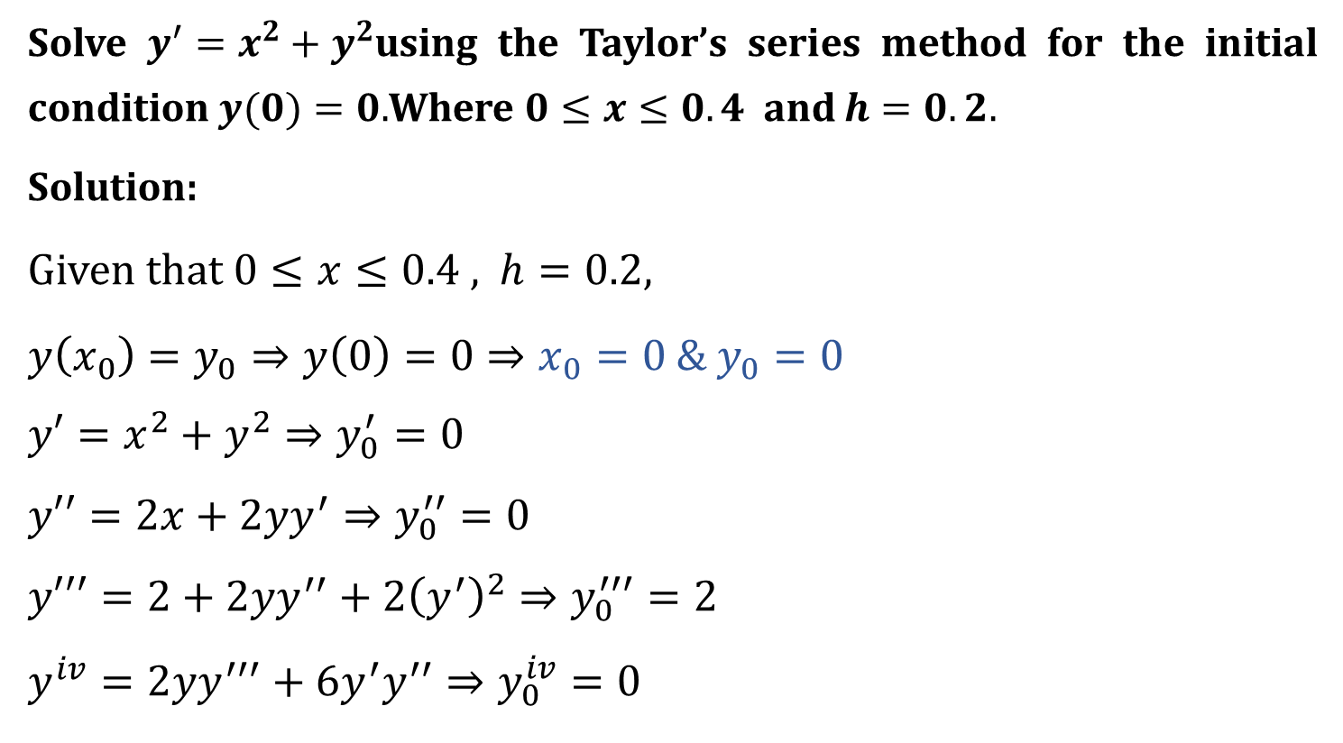
Example
Solve $y^{′}=x^{2}+y^{2}$using the Taylor’s series method for the initial condition $y(0)=0.$Where $0≤x≤0.4$and $h=0.2.$
Solution:
Given that $0≤x≤0.4$ , $h=0.2,$
$y\left(x_{0}\right)=y_{0}⇒y\left(0\right)=0⇒x_{0}=0$ &$y_{0}=0$
$$y′=x^{2}+y^{2}⇒y_{0}^{′}=0$$
$$y′′=2x+2yy^{′}⇒y_{0}^{′′}=0$$
$$y′′′=2+2yy^{′′}+2{\left(y^{′}\right)}^{2}⇒y_{0}^{′′′}=2$$
$$y^{iv}=2yy^{′′′}+6y^{′}y^{′′}⇒y_{0}^{iv}=0$$

Slide 4
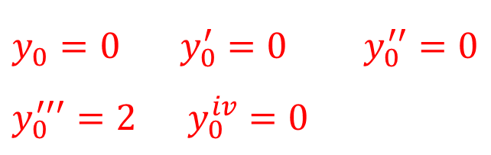
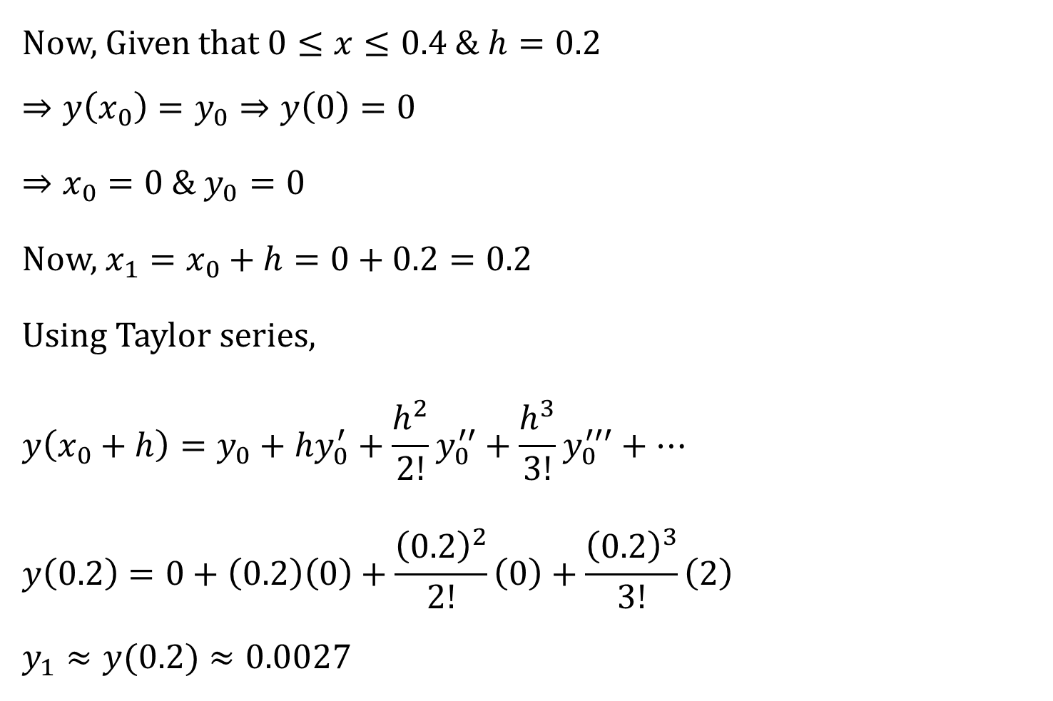
Now, Given that $0≤x≤0.4$ & $h=0.2$
$$⇒y\left(x_{0}\right)=y_{0}⇒y\left(0\right)=0$$
$⇒x_{0}=0$ & $y_{0}=0$
Now, $x_{1}=x_{0}+h=0+0.2=0.2$
Using Taylor series,
$$y\left(x_{0}+h\right)=y_{0}+hy_{0}^{′}+\frac{h^{2}}{2!}y_{0}^{′′}+\frac{h^{3}}{3!}y_{0}^{′′′}+…$$
$$y\left(0.2\right)=0+\left(0.2\right)\left(0\right)+\frac{{\left(0.2\right)}^{2}}{2!}\left(0\right)+\frac{{\left(0.2\right)}^{3}}{3!}\left(2\right)$$
$$y_{1}≈y(0.2)≈0.0027$$
$$y_{0}=0 y_{0}^{′}=0 y_{0}^{′′}=0$$
$$y_{0}^{′′′}=2 y_{0}^{iv}=0$$

Slide 5

Now, $x=x_{1}=0.2 \& y=y_{1}=0.0027$
$y′=x^{2}+y^{2}⇒y_{1}^{′}=0$.04
$$y′′=2x+2yy^{′}⇒y_{1}^{′′}=0.4002$$
$$y′′′=2+2yy^{′′}+2{\left(y^{′}\right)}^{2}⇒y_{1}^{′′′}=2.0054$$
$$y^{iv}=2yy^{′′′}+6y^{′}y^{′′}⇒y_{1}^{iv}=0.1069$$

Slide 6
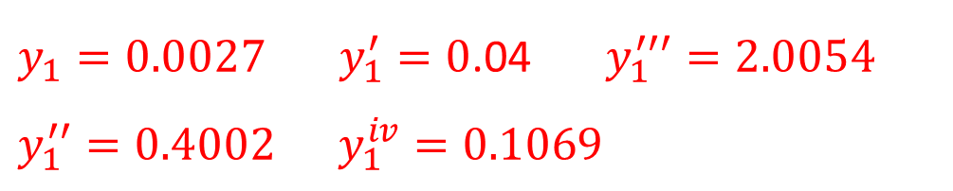

$y_{1}=0.0027 y_{1}^{′}=0$.04 $y_{1}^{′′′}=2.0054$
$$y_{1}^{′′}=0.4002 y_{1}^{iv}=0.1069$$
$$x_{2}=x_{1}+h=0.2+0.2=0.4$$
$$y\left(x_{2}\right)=y\left(x_{1}+h\right)=y_{1}+hy_{1}^{′}+\frac{h^{2}}{2!}y_{1}^{′′}+\frac{h^{3}}{3!}y_{1}^{′′′}+\frac{h^{4}}{4!}y_{1}^{iv}$$
$$y\left(0.4\right)=\left(0.0027\right)+\left(0.2\right)\left(0.04\right)+\frac{{\left(0.2\right)}^{2}}{2!}\left(0.4002\right)$$
$$+\frac{{\left(0.2\right)}^{3}}{3!}\left(2.0054\right)+\frac{{\left(0.2\right)}^{4}}{4!}\left(0.1069\right)$$
$$≈0.0214$$

Slide 7
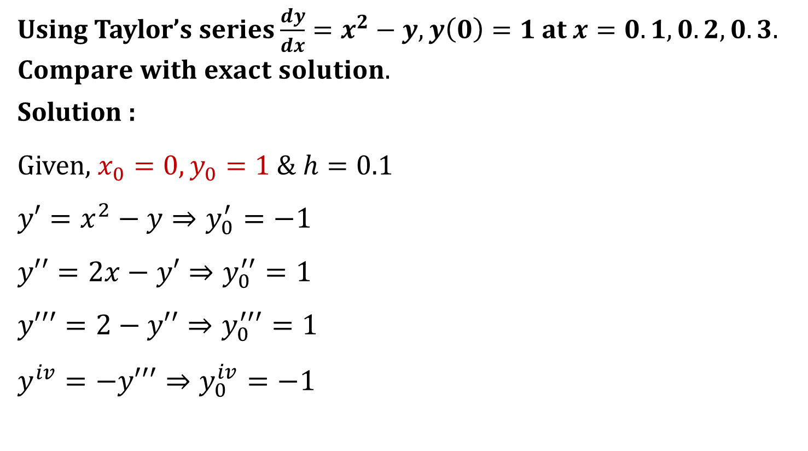
Example
Using Taylor’s series $\frac{dy}{dx}=x^{2}−y, y\left(0\right)=1$ at $x=0.1,0.2,0.3.$
$$Compare with exact solution.$$
Solution :
Given, $x_{0}=0, y_{0}=1 \& h=0.1$
$$y′=x^{2}−y⇒y_{0}^{′}=−1$$
$$y′′=2x−y′⇒y_{0}^{′′}=1$$
$$y′′′=2−y′′⇒y_{0}^{′′′}=1$$
$$y^{iv}=−y′′′⇒y_{0}^{iv}=−1$$

Slide 8
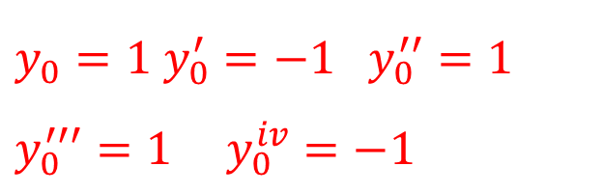

Putting these values in taylor’s series
$$y\left(x_{0}+h\right)=y_{0}+hy_{0}^{′}+\frac{h^{2}}{2!}y_{0}^{′′}+\frac{h^{3}}{3!}y_{0}^{′′′}+…$$
$$y(0.1)=1+\left(0.1\right)\left(−1\right)+\frac{{\left(0.1\right)}^{2}}{2!}\left(1\right)+\frac{{\left(0.1\right)}^{3}}{3!}\left(1\right)+\frac{{\left(0.1\right)}^{4}}{4!}\left(−1\right)$$
$$∴y\left(0.1\right)≈0.9052$$
$$y_{0}=1 y_{0}^{′}=−1 y_{0}^{′′}=1$$
$$y_{0}^{′′′}=1 y_{0}^{iv}=−1$$

Slide 9




Now for exact solution
$\frac{dy}{dx}+ =$
Compare with $\frac{dy}{dx}+ =$
$$∴P\left(x\right)=1, Q\left(x\right)=x^{2}$$
$$I.F.=e^{\int{p\left(x\right)dx}}$$
$$=e^{\int{1dx}}$$
$$=e^{x}$$
y
$$x^{2}$$
$$P\left(x\right)y$$
$$Q(x)$$

Slide 10
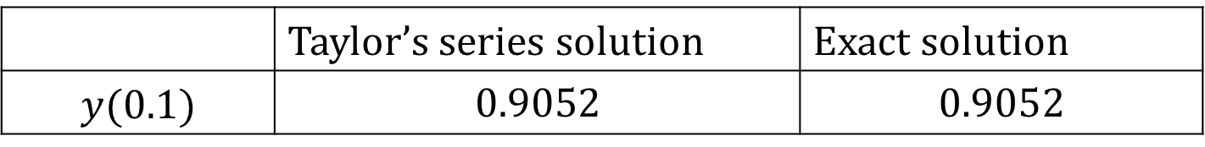

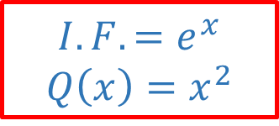
General solution
$y\left(I.F.\right)=\int{Q\left(x\right) I.F. dx}+c$
$∴y.e^{x}=\int{x^{2}e^{x} dx+c}$
$y.e^{x}=x^{2}e^{x}−2xe^{x}+2e^{x}+c \left(∵\int{uv=uv_{1}−u^{′}v_{2}+u^{′′}v_{3}… }\right)$
$$∴y(x)=x^{2}−2x+2+ce^{−x}$$
Now, $y\left(0\right)=1$
$$∴y\left(0\right)=0−0+2+c=1⇒c=−1$$
So, $y(x)=x^{2}−2x+2−e^{−x}$
$$y\left(0.1\right)=0.9052$$
$$I.F.=e^{x}$$
$$Q\left(x\right)=x^{2}$$
Initial Condition
Exact solution
 | Taylor’s series solution | Exact solution
$$y(0.1)$$ | $$0.9052$$ | $$0.9052$$

Slide 11
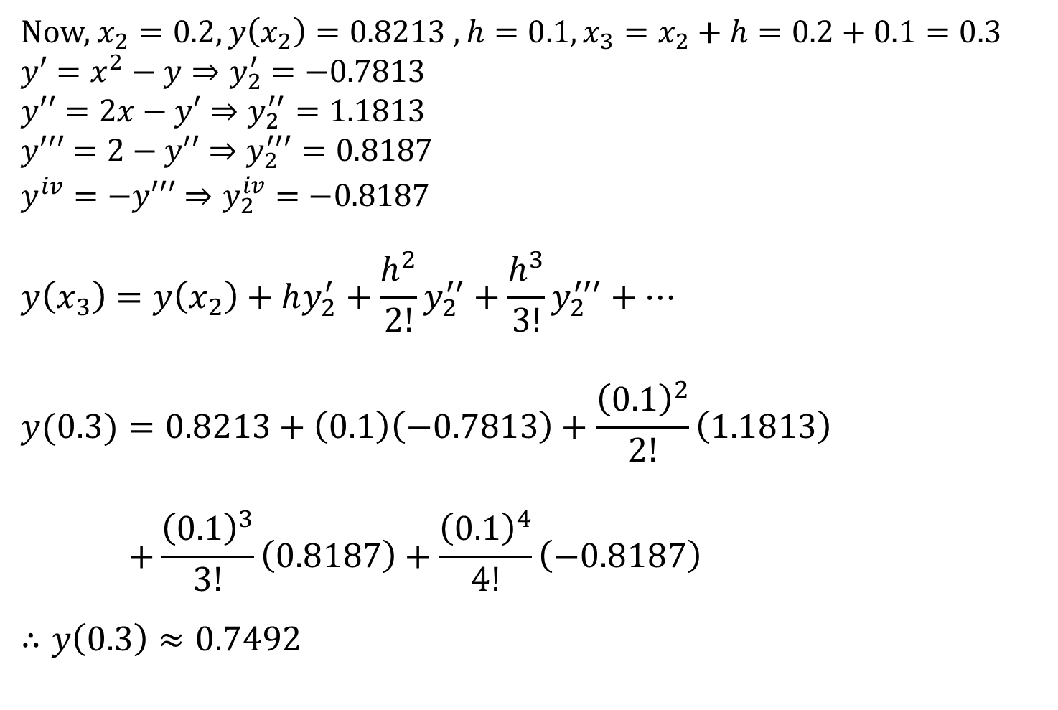
Now, $x_{2}=0.2, y\left(x_{2}\right)=0.8213 , h=0.1, x_{3}=x_{2}+h=0.2+0.1=0.3$
$$y′=x^{2}−y⇒y_{2}^{′}=−0.7813$$
$$y′′=2x−y′⇒y_{2}^{′′}=1.1813$$
$$y′′′=2−y′′⇒y_{2}^{′′′}=0.8187$$
$$y^{iv}=−y′′′⇒y_{2}^{iv}=−0.8187$$
$$y\left(x_{3}\right)=y\left(x_{2}\right)+hy_{2}^{′}+\frac{h^{2}}{2!}y_{2}^{′′}+\frac{h^{3}}{3!}y_{2}^{′′′}+…$$
$$y(0.3)=0.8213+\left(0.1\right)\left(−0.7813\right)+\frac{{\left(0.1\right)}^{2}}{2!}\left(1.1813\right)$$
$$+\frac{{\left(0.1\right)}^{3}}{3!}\left(0.8187\right)+\frac{{\left(0.1\right)}^{4}}{4!}\left(−0.8187\right)$$
$$∴y\left(0.3\right)≈0.7492$$

Slide 12
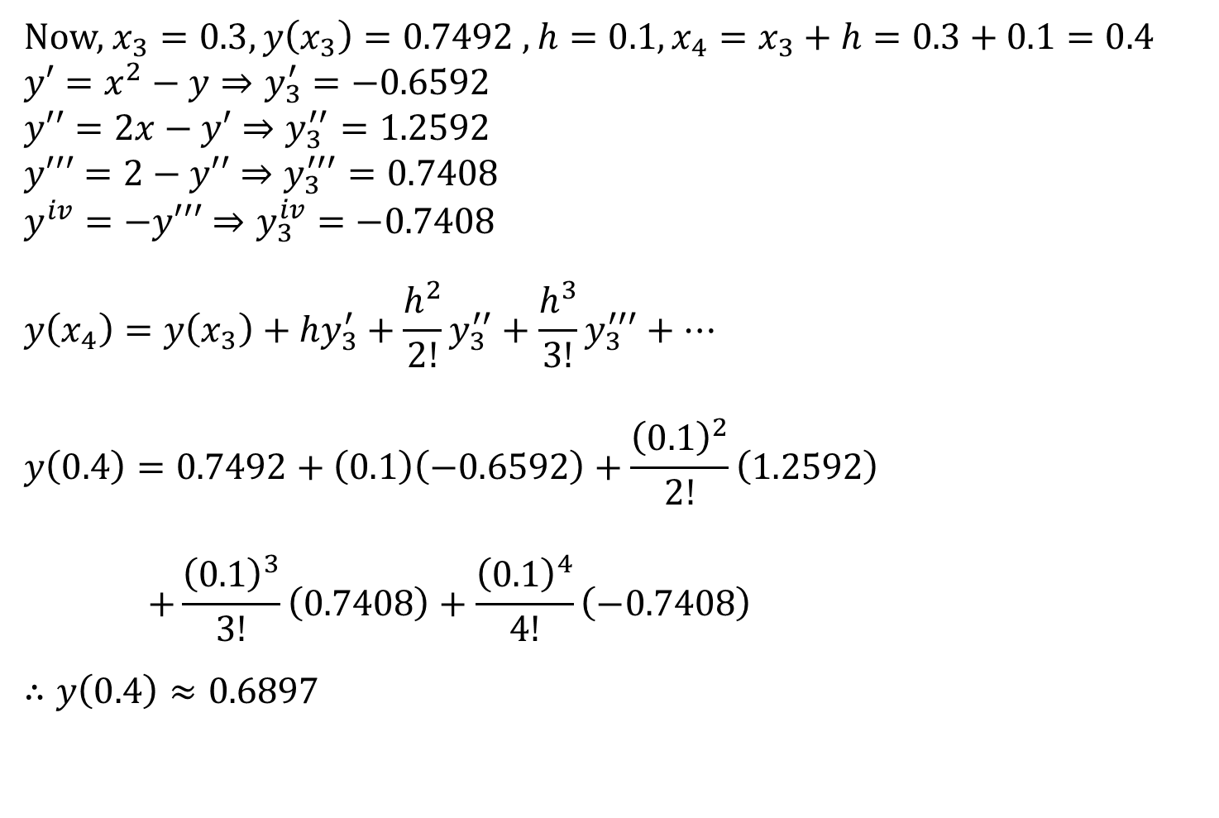
Now, $x_{3}=0.3, y\left(x_{3}\right)=0.7492 , h=0.1, x_{4}=x_{3}+h=0.3+0.1=0.4$
$$y′=x^{2}−y⇒y_{3}^{′}=−0.6592$$
$$y′′=2x−y′⇒y_{3}^{′′}=1.2592$$
$$y′′′=2−y′′⇒y_{3}^{′′′}=0.7408$$
$$y^{iv}=−y′′′⇒y_{3}^{iv}=−0.7408$$
$$y\left(x_{4}\right)=y\left(x_{3}\right)+hy_{3}^{′}+\frac{h^{2}}{2!}y_{3}^{′′}+\frac{h^{3}}{3!}y_{3}^{′′′}+…$$
$$y\left(0.4\right)=0.7492+\left(0.1\right)\left(−0.6592\right)+\frac{{\left(0.1\right)}^{2}}{2!}\left(1.2592\right)$$
$$+\frac{{\left(0.1\right)}^{3}}{3!}\left(0.7408\right)+\frac{{\left(0.1\right)}^{4}}{4!}\left(−0.7408\right)$$
$$∴y\left(0.4\right)≈0.6897$$

Slide 13

Euler’s Method (RK 1st order method)
If $\frac{dy}{dx}=f\left(x,y\right) and y\left(x_{0}\right)=y_{0}$ ,then
$$y_{n+1}=y_{n}+h \left[f\left(x_{n},y_{n}\right)\right] ; n=0,1,2,…$$
$$Where, x_{n}=x_{0}+nh ; n=1,2,3,…$$

Slide 14
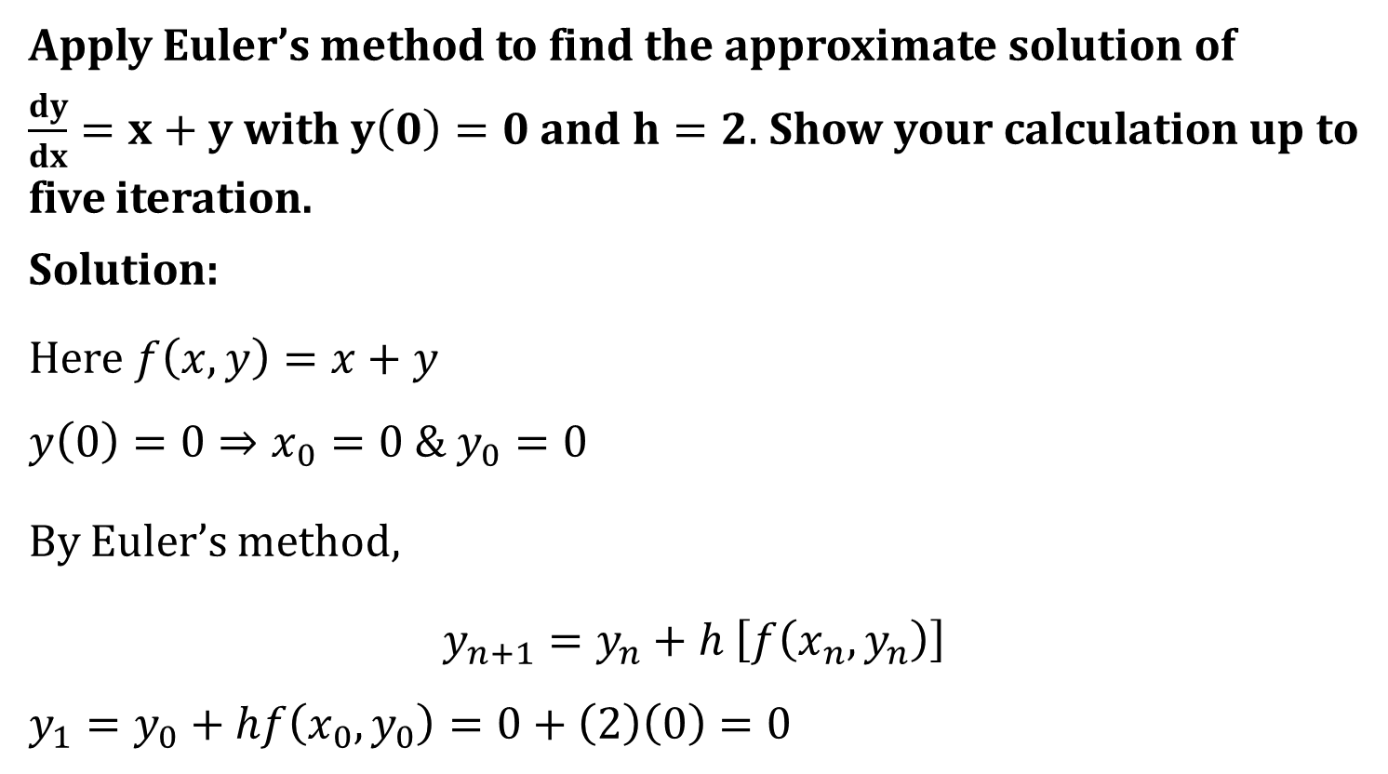
Example-2
Apply Euler’s method to find the approximate solution of
$\frac{dy}{dx}=x+y$ with $y\left(0\right)=0$and $h=2.$ Show your calculation up to five iteration.
Solution:
Here $f\left(x,y\right)=x+y$
$$y\left(0\right)=0⇒x_{0}=0 \& y_{0}=0$$
By Euler’s method,
$y_{n+1}=y_{n}+h \left[f\left(x_{n},y_{n}\right)\right]$
$$y_{1}=y_{0}+hf\left(x_{0},y_{0}\right)=0+\left(2\right)\left(0\right)=0$$

Slide 15


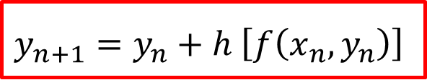





n
$x_{n}$
$$y_{n}$$
$$f(x_{n},y_{n})$$
$$y_{n+1}$$
0
0
0
0
0
0
1
4
2
2
4
2
4
8
20
3
6
20
26
72
4
8
72
80
$$y_{5}=232$$
$f\left(x_{n},y_{n}\right)=x_{n}+y_{n}$
$y_{n+1}=y_{n}+h \left[f\left(x_{n},y_{n}\right)\right]$
$$x_{n+1}=x_{n}+h$$

Slide 16
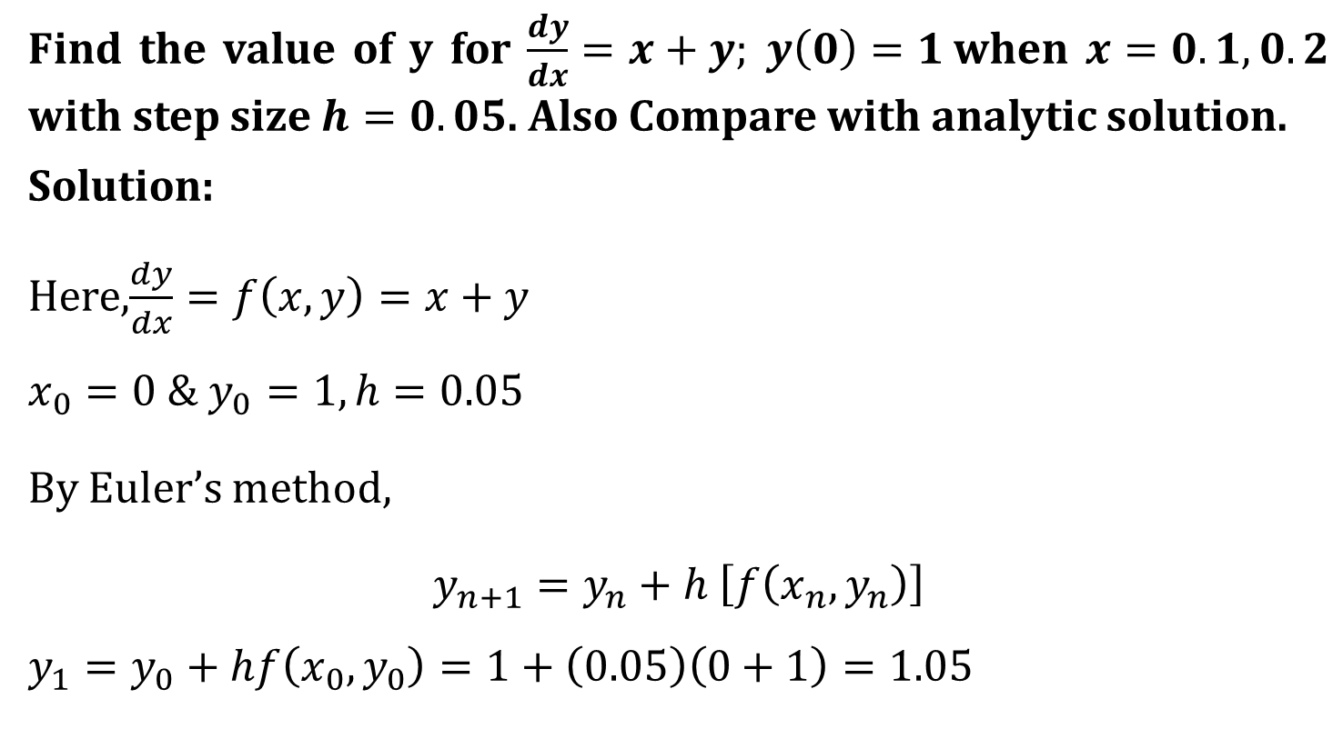
Example-4
Find the value of y for $\frac{dy}{dx}=x+y; y\left(0\right)=1$when $x=0.1,0.2$ with step size $h=0.05$. Also Compare with analytic solution.
Solution:
Here,$\frac{dy}{dx}=f\left(x,y\right)=x+y$
$$x_{0}=0 \& y_{0}=1, h=0.05$$
By Euler’s method,
$y_{n+1}=y_{n}+h \left[f\left(x_{n},y_{n}\right)\right]$
$$y_{1}=y_{0}+hf\left(x_{0},y_{0}\right)=1+\left(0.05\right)\left(0+1\right)=1.05$$

Slide 17
n
$x_{n}$
$$y_{n}$$
$$f(x_{n},y_{n})$$
$$y_{n+1}$$
0
0
1
1
1.05
1
0.05
1.05
1.1
1.1050
2
0.1
1.1050
1.2050
1.1653
3
0.15
1.1653
1.3153
1.2311
4
0.2
1.2311
$f\left(x_{n},y_{n}\right)=x_{n}+y_{n}$
$y_{n+1}=y_{n}+h \left[f\left(x_{n},y_{n}\right)\right]$
$$x_{n+1}=x_{n}+h$$

Slide 18




Now for exact solution
$\frac{dy}{dx}− =$
Compare with $\frac{dy}{dx}+ =$
$$∴P\left(x\right)=−1, Q\left(x\right)=x$$
$$I.F.=e^{\int{p\left(x\right)dx}}$$
$$=e^{\int{−1dx}}$$
$$=e^{−x}$$
y
$$x$$
$$P\left(x\right)y$$
$$Q(x)$$

Slide 19
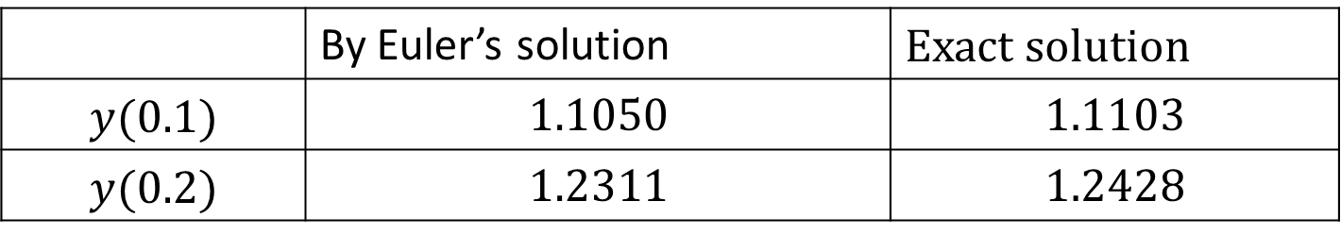

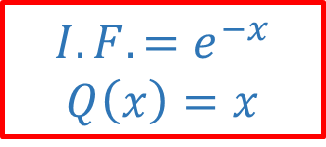
General solution
$y\left(I.F.\right)=\int{Q\left(x\right)I .F dx}+c$
$∴y.e^{−x}=\int{xe^{−x} dx+c}$
$y.e^{−x}=x(−e^{−x})−e^{−x}+c \left(∵\int{uv=uv_{1}−u^{′}v_{2}+u^{′′}v_{3}… }\right)$
$$∴y(x)=−x−1+ce^{x}$$
Now, $y\left(0\right)=1$
$$∴y\left(0\right)=−0−1+ce^{0}=1⇒c=2$$
So, $y(x)=−x−1+2e^{x}$
$$y\left(0.1\right)=1.1103$$
$$I.F.=e^{−x}$$
$$Q\left(x\right)=x$$
Initial Condition
Exact solution
 | By Euler’s solution | Exact solution
$$y(0.1)$$ | $$1.1050$$ | $$1.1103$$
$$y(0.2)$$ | $$1.2311$$ | $$1.2428$$

Slide 20
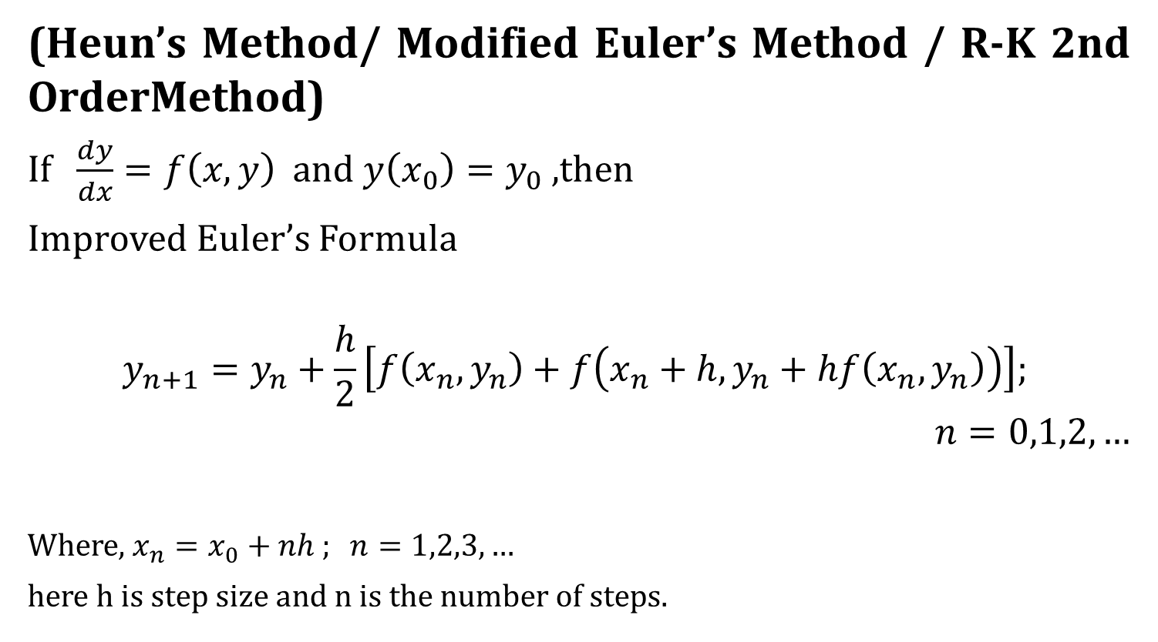
Improved Euler’s Method
(Heun’s Method/ Modified Euler’s Method / R-K 2nd OrderMethod)
If $\frac{dy}{dx}=f\left(x,y\right)$ and $y\left(x_{0}\right)=y_{0}$,then
Improved Euler’s Formula
$$y_{n+1}=y_{n}+\frac{h}{2}\left[f\left(x_{n},y_{n}\right)+f\left(x_{n}+h,y_{n}+hf\left(x_{n},y_{n}\right)\right)\right];$$
$$n=0,1,2,…$$
Where, $x_{n}=x_{0}+nh ; n=1,2,3,…$
here h is step size and n is the number of steps.

Slide 21
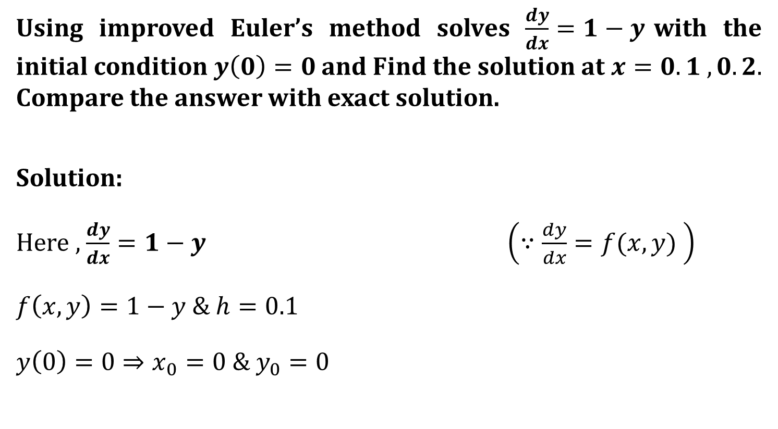
Example-1
Using improved Euler’s method solves $\frac{dy}{dx}=1−y$with the initial condition $y\left(0\right)=0$and Find the solution at $x=0.1 ,0.2.$ Compare the answer with exact solution.
Solution:
Here , $\frac{dy}{dx}=1−y \left(∵\frac{dy}{dx}=f(x,y) \right)$
$f\left(x,y\right)=1−y$ & $h=0.1$
$y\left(0\right)=0⇒x_{0}=0 \& y_{0}=0$

Slide 22
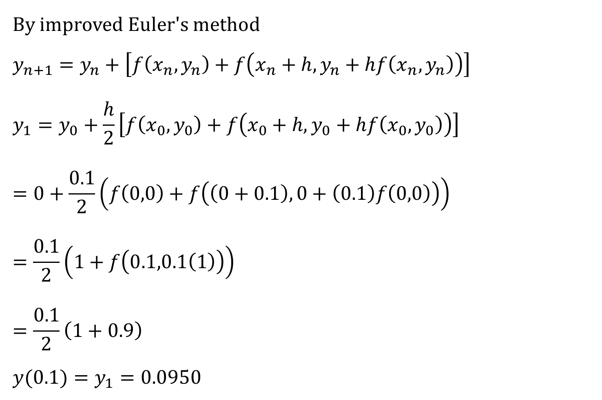
By improved Euler's method
$$y_{n+1}=y_{n}+\left[f\left(x_{n},y_{n}\right)+f\left(x_{n}+h,y_{n}+hf\left(x_{n},y_{n}\right)\right)\right]$$
$$y_{1}=y_{0}+\frac{h}{2}\left[f\left(x_{0},y_{0}\right)+f\left(x_{0}+h, y_{0}+hf\left(x_{0},y_{0}\right)\right)\right]$$
$$=0+\frac{0.1}{2}\left(f\left(0,0\right)+f\left(\left(0+0.1\right), 0+\left(0.1\right)f\left(0,0\right)\right)\right)$$
$$=\frac{0.1}{2}\left(1+f\left(0.1,0.1\left(1\right)\right)\right)$$
$$=\frac{0.1}{2}\left(1+0.9\right)$$
$${y(0.1)=y}_{1}=0.0950$$

Slide 23









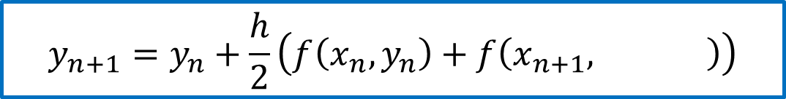




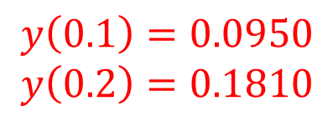













We have $h=0.1, x_{0}=0, y_{0}=0$
Improved Euler’s formula:
$$f\left(x,y\right)=1−y$$
$$x_{n+1}=x_{n}+h$$
Euler’s formula:- $y_{n+1}^{(0)}=y_{n}+h f(x_{n}, y_{n})$
$$y_{n+1}=y_{n}+\frac{h}{2}\left(f\left(x_{n},y_{n}\right)+f\left(x_{n+1}, \right)\right)$$
$${ y}_{n+1}^{\left(0\right)}$$
n
$$x_{n}$$
$$y_{n}$$
$$f(x_{n},y_{n})$$
$$x_{n+1}$$
$$y_{n+1}^{(0)}$$
$$f\left(x_{n+1},y_{n+1}^{(0)}\right)$$
$$y_{n+1}$$
$$0$$
$$0.1$$
$$0.0950$$
0
$$0$$
$$1$$
$$0.1$$
$$0.1$$
$$0.9$$
$$0.0950$$
1
$$0.9050$$
$$0.2$$
$$0.1855$$
$$0.8145$$
$$0.1810$$
$$y\left(0.1\right)=0.0950$$
$$y\left(0.2\right)=0.1810$$

Slide 24


Exact solution:
$$\frac{dy}{dx}=1−y$$
$$\frac{dy}{dx}+y=1$$
Now, $P(x)=1 \& Q(x)=1$
$$I.F.=e^{\int{p\left(x\right)dx}}=e^{\int{1dx}}=e^{x}$$
General solution,
$y\left(I.F.\right)=\int{Q(x)\left(I.F.\right)dx+c}$
$y.e^{x}=\int{e^{x}dx}+c$
$$y e^{x}=e^{x}+c$$
$$y=1+ce^{−x}$$
$y\left(0\right)=0$ Initial condition
So,$0=1+ce^{0}$
$$∴0=1+c$$
$$∴c=−1$$
$$∴y=e^{x}−1$$
$y\left(0.1\right)=0.0952$ &
$$y\left(0.2\right)=0.1813$$

Slide 25
Comparison of approximate value with exact solution are given in following table:
x | By improved Euler method | Exact solution
0.1 | 0.0950 | 0.0952
0.2 | 0.1810 | 0.1813

Slide 26

Example-4
Use Runge-kutta second order method to find the approximate value of $y\left(0.2\right)$ given that $\frac{dy}{dx}=x−y^{2}$ & $y\left(0\right)=1$ (take h=0.1).

Slide 27

















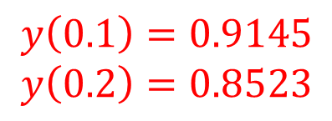






We have $h=0.1, x_{0}=0, y_{0}=1$
Improved Euler’s formula:
$$f\left(x,y\right)=x−y^{2}$$
$$x_{n+1}=x_{n}+h$$
Euler’s formula:- $y_{n+1}^{(0)}=y_{n}+h f(x_{n}, y_{n})$
$$y_{n+1}=y_{n}+\frac{h}{2}\left(f\left(x_{n},y_{n}\right)+f\left(x_{n+1}, \right)\right)$$
$${ y}_{n+1}^{\left(0\right)}$$
n
$$x_{n}$$
$$y_{n}$$
$$x_{n+1}$$
$$y_{n+1}^{(0)}$$
$$f\left(x_{n+1},y_{n+1}^{(0)}\right)$$
$$y_{n+1}$$
$$f(x_{n},y_{n})$$
0
$$0$$
$$−1$$
$$0.1$$
$$0.9$$
$$0.9145$$
$$1$$
$$−0.71$$
$$0.9154$$
1
$$0.1$$
$$−0.7363$$
$$0.2$$
$$0.8409$$
$$−0.5071$$
$$0.8523$$
$$y\left(0.1\right)=0.9145$$
$$y\left(0.2\right)=0.8523$$

Slide 28

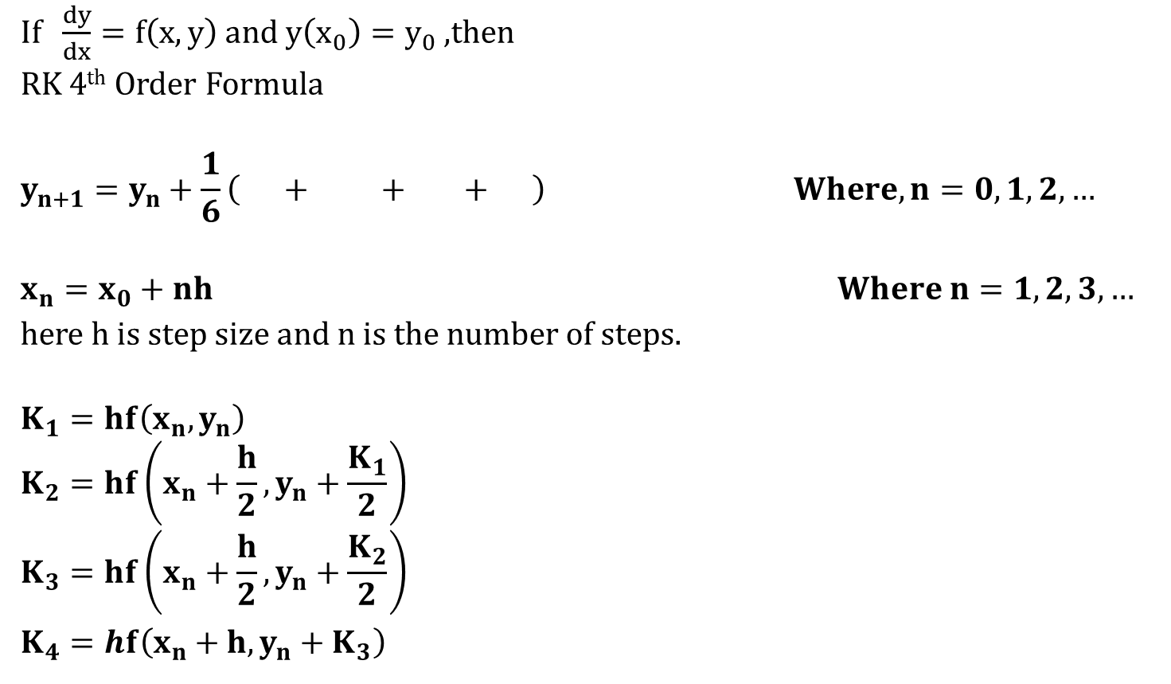



Runge Kutta 4th Order Method
If $\frac{dy}{dx}=f\left(x,y\right) and y\left(x_{0}\right)=y_{0}$ ,then
RK 4th Order Formula
$$y_{n+1}=y_{n}+\frac{1}{6}\left( + + + \right) Where, n=0,1,2,…$$
$$x_{n}=x_{0}+nh Where n=1,2,3,…$$
here h is step size and n is the number of steps.
$$K_{1}=hf\left(x_{n},y_{n}\right)$$
$$K_{2}=hf\left(x_{n}+\frac{h}{2},y_{n}+\frac{K_{1}}{2}\right)$$
$$K_{3}=hf\left(x_{n}+\frac{h}{2},y_{n}+\frac{K_{2}}{2}\right)$$
$K_{4}=hf\left(x_{n}+h,y_{n}+K_{3}\right)$
$$K_{1}$$
$$2K_{2}$$
$$2K_{3}$$
$$K_{4}$$

Slide 29
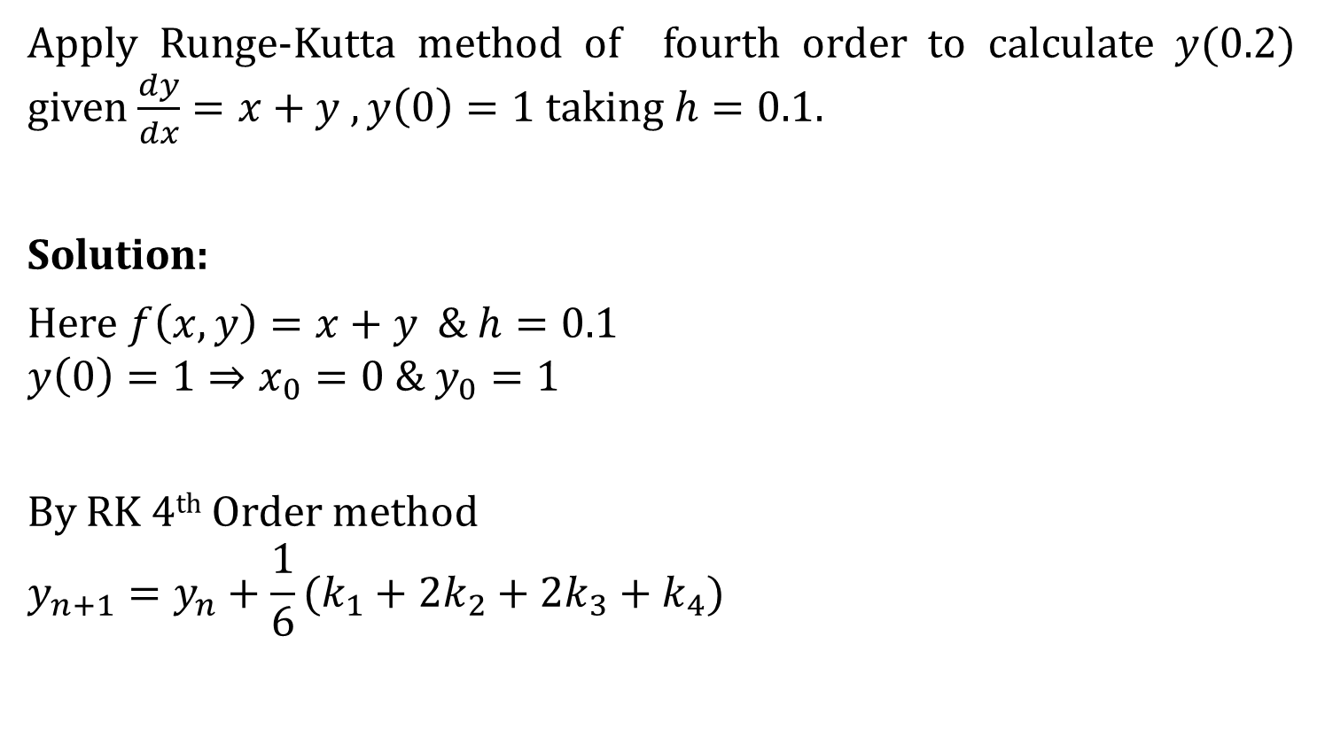
Example-2
Apply Runge-Kutta method of fourth order to calculate $y(0.2)$ given $\frac{dy}{dx}=x+y ,y\left(0\right)=1$ taking $h=0.1.$
Solution:
Here $f\left(x,y\right)=x+y \& h=0.1$
$$y\left(0\right)=1⇒x_{0}=0 \& y_{0}=1$$
By RK 4th Order method
$$y_{n+1}=y_{n}+\frac{1}{6}(k_{1}+2k_{2}+2k_{3}+k_{4})$$

Slide 30


Let, $n=0$
$$y_{1}=y_{0}+\frac{1}{6}\left(k_{1}+2k_{2}+2k_{3}+k_{4}\right)………(1)$$
$$k_{1}=hf\left(x_{0},y_{0}\right)$$
$$=\left(0.1\right)f\left(0,1\right)$$
$$=\left(0.1\right)\left(1\right)$$
$$∴k_{1}=0.1$$
$$k_{2}=hf\left(x_{0}+\frac{h}{2}, y_{0}+\frac{k_{1}}{2}\right)$$
$$=\left(0.1\right)f\left(0.05,1.05\right)$$
$$=\left(0.1\right)\left(1.100\right)$$
$$∴k_{2}=0.11$$
$$f\left(x,y\right)=x+y$$

Slide 31
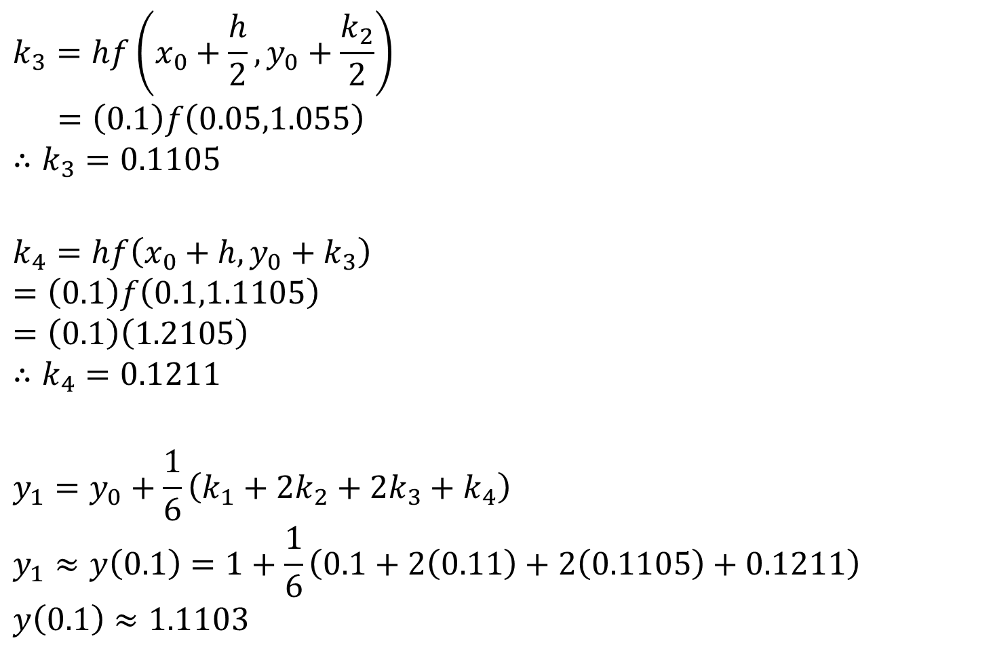
$$k_{3}=hf\left(x_{0}+\frac{h}{2},y_{0}+\frac{k_{2}}{2}\right)$$
$$=\left(0.1\right)f\left(0.05,1.055\right)$$
$$∴k_{3}=0.1105$$
$$k_{4}=hf\left(x_{0}+h, y_{0}+k_{3}\right)$$
$$=\left(0.1\right)f\left(0.1,1.1105\right)$$
$$=\left(0.1\right)\left(1.2105\right)$$
$$∴k_{4}=0.1211$$
$$y_{1}=y_{0}+\frac{1}{6}\left(k_{1}+2k_{2}+2k_{3}+k_{4}\right)$$
$$y_{1}≈y\left(0.1\right)=1+\frac{1}{6}\left(0.1+2\left(0.11\right)+2\left(0.1105\right)+0.1211\right)$$
$$y\left(0.1\right)≈1.1103$$
$$f\left(x,y\right)=x+y$$

Slide 32

When $n=1$
$$y_{2}=y_{1}+\frac{1}{6}\left(k_{1}+2k_{2}+2k_{3}+k_{4}\right)$$
Where $k_{1}=hf\left(x_{1},y_{1}\right)$
$$=\left(0.1\right)f\left(0.1,1.1103\right)$$
$$=\left(0.1\right)\left(1.2103\right)$$
$$∴k_{1}=0.1210$$
$$k_{2}=hf\left(x_{1}+\frac{h}{2}, y_{1}+\frac{k_{1}}{2}\right)$$
$$=\left(0.1\right)f\left(0.15,1.1708\right)$$
$$=\left(0.1\right)\left(1.3208\right)$$
$$k_{2}=0.1321$$
$$f\left(x,y\right)=x+y$$

Slide 33

$$k_{3}=hf\left(x_{1}+\frac{h}{2},y_{1}+\frac{k_{2}}{2}\right)$$
$$=\left(0.1\right)f\left(0.15,1.1764\right)$$
$$=(0.1)(1.3264)$$
$$=0.1326$$
$$k_{4}=hf\left(x_{1}+h, y_{1}+k_{3}\right)$$
$$=\left(0.1\right)f\left(0.2,1.2429\right)$$
$$=\left(0.1\right)\left(1.4429\right)$$
$$=0.1443$$
$$f\left(x,y\right)=x+y$$

Slide 34

Now,
$$y_{2}=y_{1}+\frac{1}{6}\left(k_{1}+2k_{2}+2k_{3}+k_{4}\right)$$
$$y_{2}=y\left(0.2\right)=1.1103+\frac{1}{6}\left(0.1210+0.2642+0.2652+0.1443\right)$$
$$y\left(0.2\right)≈1.2428$$

Slide 35
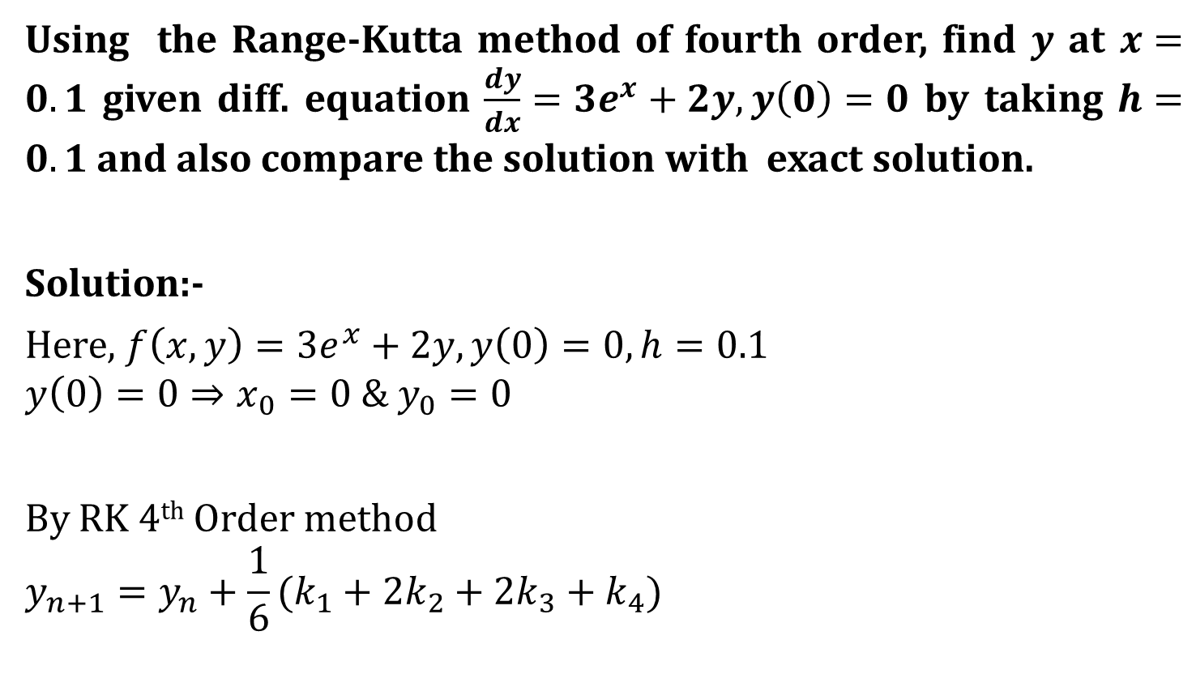
Example-8
Using the Range-Kutta method of fourth order, find $y$ at $x=0.1$ given diff. equation $\frac{dy}{dx}=3e^{x}+2y, y\left(0\right)=0$ by taking $h=0.1$ and also compare the solution with exact solution.
Solution:-
Here, $f\left(x,y\right)=3e^{x}+2y, y\left(0\right)=0, h=0.1$
$$y\left(0\right)=0⇒x_{0}=0 \& y_{0}=0$$
By RK 4th Order method
$$y_{n+1}=y_{n}+\frac{1}{6}(k_{1}+2k_{2}+2k_{3}+k_{4})$$

Slide 36


Let, $n=0$
$$y_{1}=y_{0}+\frac{1}{6}\left(k_{1}+2k_{2}+2k_{3}+k_{4}\right)………(1)$$
$$k_{1}=hf\left(x_{0},y_{0}\right)$$
$$=\left(0.1\right)f\left(0,0\right)$$
$$=\left(0.1\right)\left(3\right)$$
$$=0.3$$
$$k_{2}=hf\left(x_{0}+\frac{h}{2}, y_{0}+\frac{k_{1}}{2}\right)$$
$$=\left(0.1\right)f\left(0.05,0.15\right)$$
$$=\left(0.1\right)\left(3.4538\right)$$
$$k_{2}=0.3454$$
$$f\left(x,y\right)=3e^{x}+2y$$

Slide 37
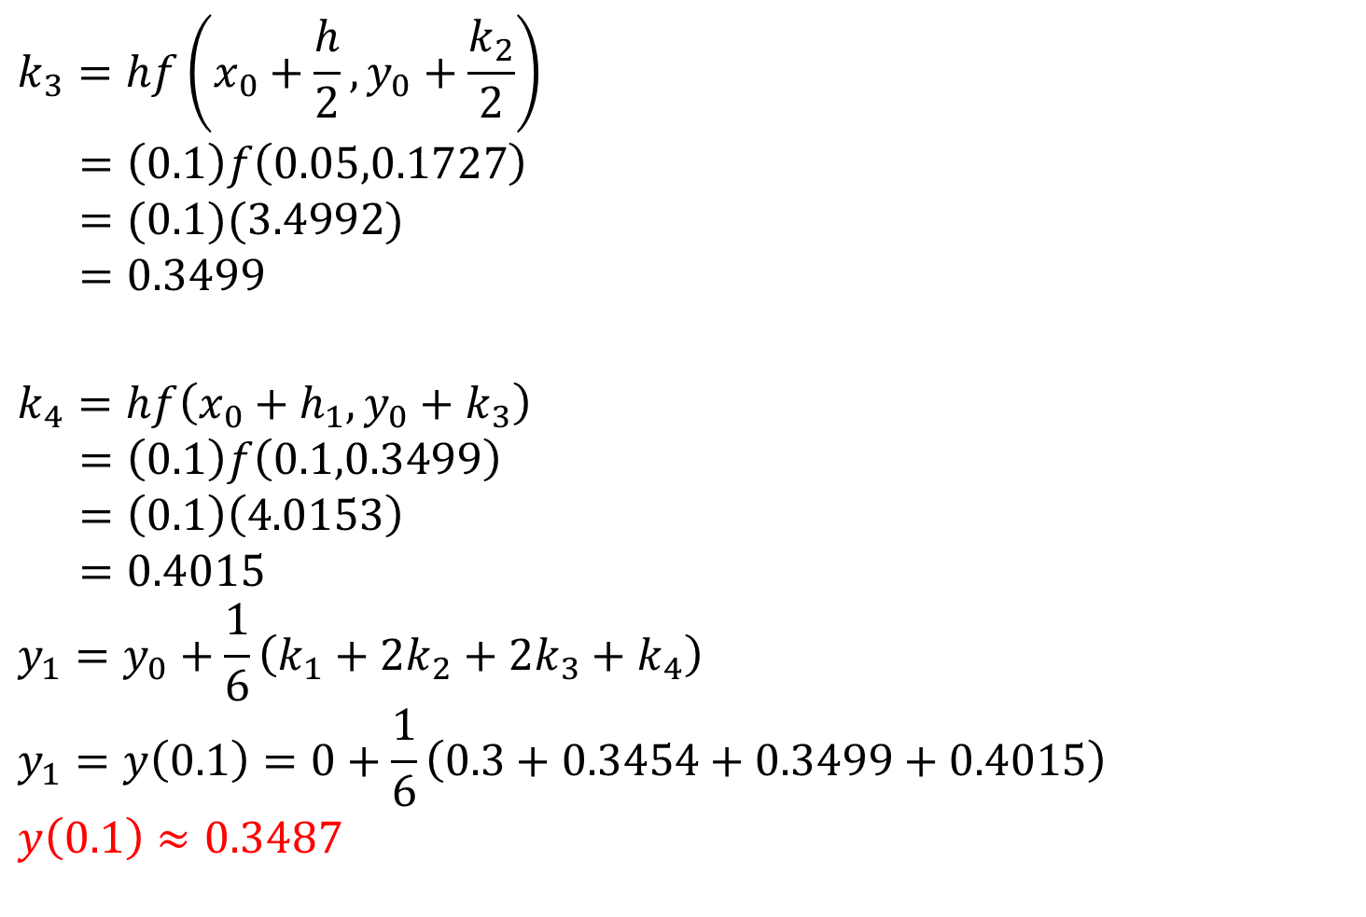
$$k_{3}=hf\left(x_{0}+\frac{h}{2},y_{0}+\frac{k_{2}}{2}\right)$$
$$=\left(0.1\right)f\left(0.05,0.1727\right)$$
$$=(0.1)(3.4992)$$
$$=0.3499$$
$$k_{4}=hf\left(x_{0}+h_{1}, y_{0}+k_{3}\right)$$
$$=\left(0.1\right)f\left(0.1,0.3499\right)$$
$$=\left(0.1\right)\left(4.0153\right)$$
$$=0.4015$$
$$y_{1}=y_{0}+\frac{1}{6}\left(k_{1}+2k_{2}+2k_{3}+k_{4}\right)$$
$$y_{1}=y\left(0.1\right)=0+\frac{1}{6}\left(0.3+0.3454+0.3499+0.4015\right)$$
$$y\left(0.1\right)≈0.3487$$
$$f\left(x,y\right)=3e^{x}+2y$$

Slide 38


Exact solution:
$$\frac{dy}{dx}=3e^{x}+2y$$
$$\frac{dy}{dx}−2y=3e^{x}$$
Now, $P(x)=−2 \& Q(x)=3e^{x}$
$$I.F.=e^{\int{p\left(x\right)dx}}=e^{−\int{2dx}}=e^{−2x}$$
General solution,
$y\left(I.F.\right)=\int{Q(x)\left(I.F.\right)dx+c}$
$y e^{−2x}=3\int{e^{−x} dx}+c$
$$y e^{−2x}=−3e^{−x}+c$$
$$y=−3e^{x}+ce^{2x}$$
$y\left(0\right)=0$ Initial condition
So,
$$y=−3e^{x}+ce^{2x}$$
$$∴0=−3+c$$
$$∴c=3$$
$$∴y=−3e^{x}+3e^{2x}$$
$$y\left(0.1\right)=0.3487$$

Slide 39

Predictor-Corrector Methods
Modified Euler’s Method (Heun’s Method)
$$y_{i+1}^{p}=y_{i}+hf\left(x_{i},y_{i}\right)$$
$$y_{i+1}^{c}=y_{i}+\frac{h}{2}\left[f\left(x_{i},y_{i}\right)+f\left(x_{i+1},y_{i+1}^{p}\right)\right]$$

Slide 40

Predictor-Corrector Methods
Adams-Bashforth Method
$$y_{k+1}^{p}=y_{k}+\frac{h}{24}\left[−9f_{k−3}+37f_{k−2}−59f_{k−1}+55f_{k}\right]$$
$$y_{k+1}^{c}=y_{k}+\frac{h}{24}\left[f_{k−2}−5f_{k−1}+19f_{k}+9f_{k+1}^{p}\right]$$

Slide 41

Example-1
Use Adam’s predictor-corrector to find $y\left(0.4\right),$ $y(0.5)$ for
$\frac{dy}{dx}=y−\frac{2x}{y},y\left(0\right)=1$
Using $y\left(0.1\right)=1.0954,y\left(0.2\right)=1.1832,y\left(0.3\right)=1.2649$
Solution:
Here given that
$y\left(0\right)=1⟹$ $x_{0}= 0 \& y_{0}=1$
$y\left(0.1\right)=1.0954⟹$ $x_{1}=0.1 \& y_{1}=1.0954$
$y\left(0.2\right)=1.1832⟹$ $x_{2}=0.2 \& y_{2}=1.1832$
$$y\left(0.3\right)=1.2649⟹x_{3}=0.3 \& y_{3}=1.2649$$

Slide 42



Now calculate $f_{0}, f_{1}, f_{2}, f_{3}$
$$f_{0}=f\left(0,1\right)=y−\frac{2x}{y}=1−\frac{2\left(0\right)}{1}=1$$
$$f_{1}=f\left(0.1,1.0954\right)=0.9129$$
$$f_{2}=f\left(0.2,1.1832\right)=0.8451$$
$$f_{3}=f\left(0.3,1.2649\right)=0.7906$$
1
$$f\left(x,y\right)=y−\frac{2x}{y}$$
$$x_{0}= 0 \& y_{0}=1$$
$$x_{1}=0.1 \& y_{1}=1.0954$$
$$x_{2}=0.2 \& y_{2}=1.1832$$
$$x_{3}=0.3 \& y_{3}=1.2649$$

Slide 43


$$f_{0}=1$$
$$f_{1}=0.9129$$
$$f_{2}=0.8451$$
$$f_{3}=0.7906$$
Using Adam‘s Predictor Method,
$$y_{k+1}^{p}=y_{k}+\frac{h}{24}\left[−9f_{k−3}+37f_{k−2}−59f_{k−1}+55f_{k}\right]$$
$k=3$
$$y_{4}^{p}=y_{3}+\frac{h}{24}[−9f_{0}+37f_{1}−59f_{2}+55f_{3}]$$
$$=1.2649+\frac{\left(0.1\right)}{24}\left[−9(1)+37(0.9129)−59(0.8451)+55(0.7906)\right]$$
$${∴y}_{4}^{p}=1.3416$$

Slide 44


$$f_{1}=0.9129$$
$$f_{2}=0.8451$$
$$f_{3}=0.7906$$
Now calculate $f_{4}^{p}$
$$f_{4}^{p}=f\left(x_{4},y_{4}^{p}\right)=f\left(0.4, 1.3416\right)=1.3416−\frac{2\left(0.4\right)}{1.3416}$$
$${∴f}_{4}^{p}=0.7453$$
Using Adam‘s Corrector Method,
$$y_{4}^{c}=y_{3}+\frac{h}{24}[{f_{1}−5f}_{2}+19f_{3}+9f_{4}^{p}]$$
$$=1.2649+\frac{0.1}{24}\left[0.9129−5(0.8451)+19\left(0.7906\right)+9(0.7453) \right]$$
$${∴y}_{4}^{c}=1.3416$$
Here,$y_{4}^{p} \& y_{4}^{c}$are almost equal .
$$y\left(0.4\right)=1.3416$$

Slide 45


$$f_{1}=0.9129$$
$$f_{2}=0.8451$$
$$f_{3}=0.7906$$
$$f_{4}=0.7453$$
Using Adam‘s Predictor Method,
$$y_{k+1}^{p}=y_{k}+\frac{h}{24}\left[−9f_{k−3}+37f_{k−2}−59f_{k−1}+55f_{k}\right]$$
$k=4$
$$y_{5}^{p}=y_{4}+\frac{h}{24}[−9f_{1}+37f_{2}−59f_{3}+55f_{4}]$$
$$=1.3416+\frac{\left(0.1\right)}{24}\left[−9(0.9129)+37(0.8451)−59(0.7906)+55(0.7453)\right]$$
$${∴y}_{5}^{p}=1.4141$$

Slide 46


$$f_{2}=0.8451$$
$$f_{3}=0.7906$$
$$f_{4}=0.7453$$
Now,
$$f_{5}^{p}=f\left(x_{5},y_{5}^{p}\right)=f\left(0.5,1.4141 \right)$$
$$∴f_{5}^{p}=0.7069$$
Using Adam‘s Corrector Method,
$$y_{5}^{c}=y_{4}+\frac{h}{24}\left[{f_{2}−5f}_{3}+19f_{4}+9f_{5}^{p}\right]$$
$$=1. 3416+\frac{0.1}{24}\left[0.8451−5(0.7906)+19\left(0.7453\right)+9(0.7069) \right]$$
$$y_{5}^{c}=1.4142$$
Here,$y_{5}^{p} \& y_{5}^{c}$are almost equal.
$$y\left(0.5\right)=1.4142$$

Slide 47

Predictor-Corrector Methods
Milne’s Method
$$y_{k+1}^{p}=y_{k−3}+\frac{4h}{3}[2f_{k−2}−f_{k−1}+2f_{k}]$$
$$y_{k+1}^{c}=y_{k−1}+\frac{h}{3}[f_{k−1}+4f_{k}+f_{k+1}^{p}]$$

Slide 48


Example-4
Use Milne’s predictor-corrector to find $y(0.4)$ for
$\frac{dy}{dx}=x+y^{2},y\left(0\right)=1$with $h=0.1$.
$$x$$ | $$Y$$ | $$f=x+y^{2}$$
$$0$$ | $$1$$ | $$1.0$$
$$0.1$$ | $$1.1$$ | $$1.31$$
$$0.2$$ | $$1.231$$ | $$1.715361$$
$$0.3$$ | $$1.4025361$$ | $$2.2671075$$
$$0.4$$ | $$?$$

Slide 49


Using Milne’s predictor Method,
$$y_{k+1}^{p}=y_{k−3}+\frac{4h}{3}[2f_{k−2}−f_{k−1}+2f_{k}]$$
$$k=3$$
$$y_{4}^{p}=y_{0}+\frac{4h}{3}[2f_{1}−f_{2}+2f_{3}]$$
$$=1.0+\frac{4\left(0.1\right)}{3}\left[2\left(1.31\right)−1.715361+2\left(2.671075\right)\right]$$
$$y_{4}^{p}=1.7251805$$

Slide 50

Using Milne’s Corrector Method,
$$y_{k+1}^{c}=y_{k−1}+\frac{h}{3}\left[f_{k−1}+4f_{k}+f_{k+1}^{p}\right]$$
$$k=3$$
$$y_{4}^{c}=y_{2}+\frac{h}{3}[f_{2}+4f_{3}+f_{4}^{p}]$$
$$\left(\begin{aligned}∵f_{4}^{p}=f\left(x_{4},y_{4}^{p}\right)=f\left(0.4, 1.7251805\right) \\ =x+y^{2}=3.3762479\end{aligned}\right)$$
$$=1.231+\frac{0.1}{3}\left[1.715361+4\left(2.2671073\right)+3.3762479\right]$$
$$y_{4}^{c}=1.703013$$

Slide 51

Now, we have to Again find $y_{4}^{c}$
Using Milne’s Corrector Method,
$$y_{k+1}^{c}=y_{k−1}+\frac{h}{3}\left[f_{k−1}+4f_{k}+f_{k+1}^{p}\right]$$
$$y_{4}^{c}=y_{2}+\frac{h}{3}[f_{2}+4f_{3}+f_{4}^{p}]$$
$$y_{4}^{c}=1.231+\frac{0.1}{3}\left[1.715361+4\left(2.2671075\right)+3.300253\right]$$
$$\left(\begin{aligned}∵f_{4}^{p}=f\left(x_{4},y_{4}^{c}\right)=f\left(0.4,1.703013\right) \\ =x+y^{2}=0.4+{\left(1.703013\right)}^{2} \\ =3.300253\end{aligned}\right)$$
$$y_{4}^{c}=1.700468$$
$$y(0.4)=1.700468$$

Slide 52
Boundary Value Problems
Finite difference method
Shooting method

Slide 53

Finite Difference method
Step1: Divide given interval in to n sub-intervals.
Step2: At each point of x, obtain difference equation using a suitable difference formula.
This will result in $(n−1)$equations with $\left(n−1\right)unknows,y_{1},y_{2},…,y_{n−1}.$
Solve these equations by using any of the standard elimination method.
Central-difference approximations
$$y_{i}^{′}=\frac{1}{2h}\left(y_{i+1}−y_{i−1}\right);i=1,2,3,4,…..$$
$$y_{i}"=\frac{1}{h^{2}}\left(y_{i+1}−2y_{i}+y_{i−1} \right);i=1,2,3,4,…..$$

Slide 54

Example-1
Solve the boundary value problem for
$y′′+y+1=0$with$y=0$when$x=0$and $y=0$when $x=1$. Using finite difference method for $h=0.25 .$
Solution:
We divide $(0,1)$ interval into four sub intervals.
Points are $\left(∵h=0.25\right)$
The boundary condition are $y_{0}=y\left(0\right)=0 \& y_{4}=y\left(1\right)=0$
$$x_{0}=0, y_{0}=0$$
$$x_{1}=0.25, y_{1}=?$$
$$x_{2}=0.5, y_{2}=?$$
$$x_{3}=0.75, y_{3}=?$$
$$x_{4}=1, y_{4}=0$$

Slide 55

Finite Difference approximation of BVP is given by $y"+y+1=0$
$$\frac{1}{h^{2}}\left(y_{i+1}−2y_{i}+y_{i−1}\right)+y_{i}+1=0$$
$$16\left(y_{i+1}−2y_{i}+y_{i−1}\right)+y_{i}+1=0……\left(1\right) \left(∵h=\frac{1}{4}\right)$$
$\left(i=1\right)$ by equation (1)
$$16\left(y_{2}−2y_{1}+y_{0}\right)+y_{1}+1=0$$
$$16y_{2}−31y_{1}+16y_{0}+1=0$$
$$16y_{2}−31y_{1}+1=0 ……\left(a\right) (∵y_{0}=0)$$

Slide 56

$(i=2)$ by equation (1)
$$16\left(y_{i+1}−2y_{i}+y_{i−1}\right)+y_{i}+1=0$$
$$16\left(y_{3}−2y_{2}+y_{1}\right)+y_{2}+1=0$$
$$16y_{3}−31y_{2}+16y_{1}+1=0……\left(b\right)$$
$\left(i=3\right)$ by equation (1)
$$16\left(y_{i+1}−2y_{i}+y_{i−1}\right)+y_{i}+1=0$$
$$16\left(y_{4}−2y_{3}+y_{2}\right)+y_{3}+1=0$$
$$16y_{4}−31y_{3}+16y_{2}+1=0$$
$$−31y_{3}+16y_{2}+1=0 ……\left(c\right) (∵y_{4}=0)$$

Slide 57

Solve Equation (a) and (b)
$$16y_{2}−31y_{1}+1=0 ……\left(a\right) ∗16$$
$$16y_{3}−31y_{2}+16y_{1}+1=0……\left(b\right) ∗31$$
$$256y_{2}−496y_{1}+16=0$$
$$496y_{3}−961y_{2}+496y_{1}+31=0$$
$$496y_{3}−705y_{2}+47=0……(d)$$

Slide 58

Solve equation (c) and (d)
$$−31y_{3}+16y_{2}+1=0 ……\left(c\right) ∗16$$
$$496y_{3}−705y_{2}+47=0……\left(d\right) ∗1$$
$$−496y_{3}+256y_{2}+16=0$$
$$496y_{3}−705y_{2}+47=0$$
$$−449y_{2}+63=0$$
$$y_{2}=\frac{−63}{−449}=0.1403$$

Slide 59

From equation (c)
$$−31y_{3}+16\left(0.1403\right)+1=0$$
$$∴y_{3}=0.1047$$
From equation (a)
$$16y_{2}−31y_{1}+1=0$$
$$16\left(0.1403\right)−31y_{1}+1=0$$
$$∴y_{1}=0.1047$$

Slide 60

Example-3
Solve boundary value problem $\frac{d^{2}y}{dx^{2}}−y=0, y\left(0\right)=0,$
$y\left(1\right)=1, h=\frac{1}{4}$ by finite difference method.
Solution:
$$h=\frac{1}{4}=0.25$$
The boundary condition are $y_{0}=y\left(0\right)=0 \& y_{4}=y\left(1\right)=1$
$$x_{0}=0, y_{0}=0$$
$$x_{1}=0.25, y_{1}=?$$
$$x_{2}=0.5, y_{2}=?$$
$$x_{3}=0.75, y_{3}=?$$
$$x_{4}=1, y_{4}=1$$

Slide 61

Finite Difference approximation of BVP is given by $y"−y=0$
$$\frac{1}{h^{2}}\left(y_{i+1}−2y_{i}+y_{i−1}\right)−y_{i}=0$$
$$16\left(y_{i+1}−2y_{i}+y_{i−1}\right)−y_{i}=0……\left(1\right)$$
$\left(i=1\right)$ by equation (1)
$$16\left(y_{2}−2y_{1}+y_{0}\right)−y_{1}=0$$
$$16y_{2}−33y_{1}+16y_{0}=0$$
$$16y_{2}−33y_{1}=0 ……\left(a\right) (∵y_{0}=0)$$

Slide 62

$$(i=2)$$
$$16\left(y_{3}−2y_{2}+y_{1}\right)−y_{2}=0$$
$$16y_{3}−33y_{2}+16y_{1}=0……\left(b\right)$$
$$\left(i=3\right)$$
$$16\left(y_{4}−2y_{3}+y_{2}\right)−y_{3}=0$$
$$16y_{4}−33y_{3}+16y_{2}=0$$
$$16−33y_{3}+16y_{2}=0 ……\left(c\right) (∵y_{4}=1)$$

Slide 63

Solving Equation (a), (b) & (c)
$$y_{1}=0.4437$$
$$y_{2}=0.2151$$
$$y_{3}=0.6999$$

Slide 64
Shooting method

Slide 65
Shooting method
Working rules for solving Problems by Shooting Method
Step1: Convert the problem into an initial-value problem.
Step2: Initialize the variables including two guesses at the initial slope.
Step3: Solve the equations with these guesses using either a one –step or a multistep method.
Step4: Interpolate from these results to find an improved value of the slopes obtained.
Step5: Repeat the process until a specified accuracy in the final function value is obtained (or until a limit to the number of iterations is applied).

Slide 66

Example-1
Using the shooting method, solve the boundary value problem:
$$y^{′′}(x)=y(x), y(0)=0 and y(1)=1.17$$
Solution:
$$y"(x)=y(x), y(0)=0,y(1)=1.17$$
Let, initial guesses for $y^{′}\left(0\right)=m$ be $m_{0}=0.8 \& m_{1}=0.9$

Slide 67

$$y"(x)=y(x), y(0)=0,y(1)=1.17$$
Let, $y^{′}\left(0\right)=m$
$$y^{′′}\left(0\right)=y\left(0\right)=0 \left(∵y^{′′}\left(x\right)=y\left(x\right)\right)$$
$$y^{′′′}\left(0\right)=y^{′}\left(0\right)=m \left(∵y^{′′′}\left(x\right)=y^{′}\left(x\right)\right)$$
$$y^{iv}\left(0\right)=y^{′′}\left(0\right)=0$$
$$y^{v}\left(0\right)=y^{′′′}\left(0\right)=m$$
$y^{vi}\left(0\right)=y^{iv}\left(0\right)=0$ and so on

Slide 68

Putting these values in Taylor series,
$$y\left(x\right)=y\left(0\right)+xy^{′}\left(0\right)+\frac{x^{2}}{2!}y^{′′}\left(0\right)+\frac{x^{3}}{3!}y^{′′′}\left(0\right)+…$$
$$=m\left(x+\frac{x^{3}}{6}+\frac{x^{5}}{120}+\frac{x^{7}}{5040}+…\right)$$
$$y\left(1\right)=m\left(1+0.1667+0.0083+0.0002+…\right)$$
$$y\left(1\right)=m\left(1.1752\right)$$
Let, initial guesses for $y^{′}\left(0\right)=m$ be $m_{0}=0.8 \& m_{1}=0.9$
For $m_{0}=0.8⇒y\left(m_{0},1\right)=0.9402$
For $m_{1}=0.9⇒y\left(m_{1},1\right)=1.0577$

Slide 69

Hence, Better approximation for m,
$m_{2}$ is given by,
$$m_{2}=m_{1}−\left(m_{1}−m_{0}\right)\left(\frac{y\left(m_{1},1\right)−y\left(1\right)}{y\left(m_{1},1\right)−y\left(m_{0},1\right)}\right)$$
$$=0.9−\left(0.9−0.8\right)\left(\frac{1.0577−1.17}{1.0577−0.9402}\right)$$
$$=0.9−\left(−0.0956\right)$$
$$m_{2}=0.9956$$

Slide 70

We solve initial value problem,
$$y^{′′}\left(x\right)=y\left(x\right), y\left(0\right)=0$$
$$y^{′}\left(0\right)=m_{2}$$
Taylor’s series, solution is given by,
$$y\left(m_{2},1\right)=m_{2}\left(1.1752\right)$$
$$y\left(m_{2},1\right)=0.9956\left(1.1752\right)$$
$$y\left(m_{2},1\right)=1.1700$$
Hence, the solution at $x=1$ is $y\left(1\right)=1.1700$
Which is same as exact value of $y\left(1\right)=1.17$

