Slide 1

Unit – 1 Introduction to Operating System
Prof. Firoz Sherasiya
 9879879861
→ firoz.sherasiya@darshan.ac.in
Operating System (2140702) Darshan Institute of Engineering & Technology

Slide 2
Topics to be covered
Definition of Operating System (OS)
Generations of Operating systems
Types of Operating Systems
OS Services
System Calls
OS structure
Concept of Virtual Machine

Slide 3
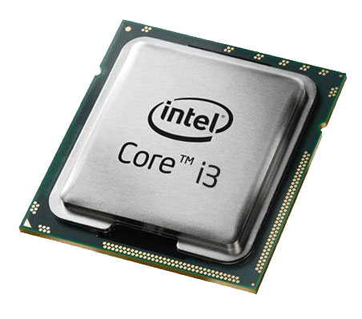
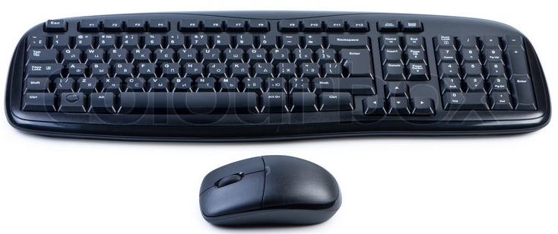
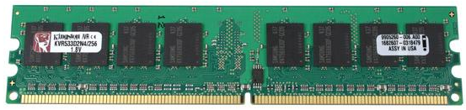
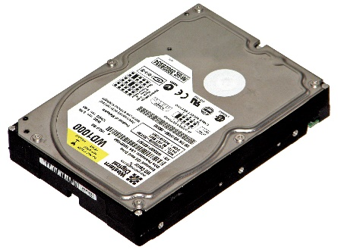

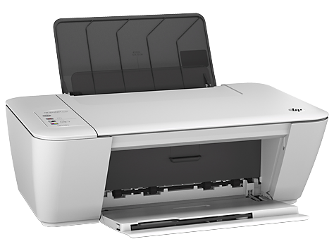
What is Operating System (OS)?
A Computer consist of various hardwares such as
Processor
RAM
Keyboard & Mouse
Hard Disk
Monitor
Printer
Who manages (controls) these hardwares???
Operating System

Slide 4
Definition of Operating System
An Operating System (OS) is a collection of software that
manages hardware resources
provides various service to the users
It acts as an intermediary between the user and the hardware.
Example: Windows 8, Linux Ubuntu, Linux Fedora, Android KitKat, Android Lollipop, Android Marshmallow, Mac etc…

Slide 5





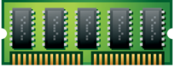
Where OS lies?
OS lies between hardware and user program
Web
browser
E-mail
reader
Music
player
User Mode
User Program
Software
Operating System
Kernel Mode
Hardware

Slide 6
Modes of operation of computer
User Mode
can execute only subset (few) of the machine instructions
less privileged (rights)
Kernel Mode
has complete access to all the hardware
can execute any instruction that a machine is capable of executing
has high privileged (rights)
Web
browser
E-mail
reader
Music
player
User
Mode
User Program
S/W
Operating System
Kernel
Mode
H/W

Slide 7
Roles of OS (OS can be viewed as)
The OS as an Extended/Virtual Machine
The OS as a Resource Manager

Slide 8
OS as Extended Machine
The architecture of a computer is difficult to program
Architecture: instruction set, memory organization, I/O, bus, etc
To do I/O work, hardware dependent work has to be done.
Example: to read from floppy or hard disk:
One has to write command and address to the disk controller and then initiate the I/O.
The disk controller will find the requested data in the disk and fetch it from disk to disk controller buffer.
One has to check the status of disk controller operation where it has finished or not.
If success, the data from disk controller buffer should be moved to main memory (to the application buffer)

Slide 9
OS as Extended Machine (Cont…)
If all user programs would do these messy details:
The program will be very difficult to write and quite long.
The program will be hardware dependent.
Therefore, an OS cares all these details and provides a nice programming interface to the applications to access the hardware.

Slide 10
OS as Resource Manager
There are lots of resources in computer system
CPU (Processor)
Memory
I/O devices such as hard disk, mouse, keyboard, printer, scanner etc.
If a computer system is used by multiple applications (or users), then they will compete for these resources.
It is the job of OS to allocate these resources to the various applications so that:
The resources are allocated fairly (equally)
The resources are protected from cross-access
Access to the resources is synchronized so that operations are correct and consistent
Deadlock are detected, resolved and avoided.

Slide 11
OS as Resource Manager (Cont…)
Resource manager – sharing/multiplexing resources in two different ways:
In time sharing/multiplexing. Example: CPU

Slide 12
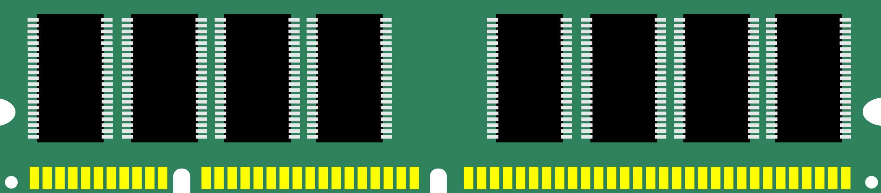
OS as Resource Manager (Cont…)
Resource manager – sharing/multiplexing resources in two different ways
In space sharing/multiplexing. Example: Memory
Process 1
Process
2
Process
3
Empty Space
Main Memory

Slide 13
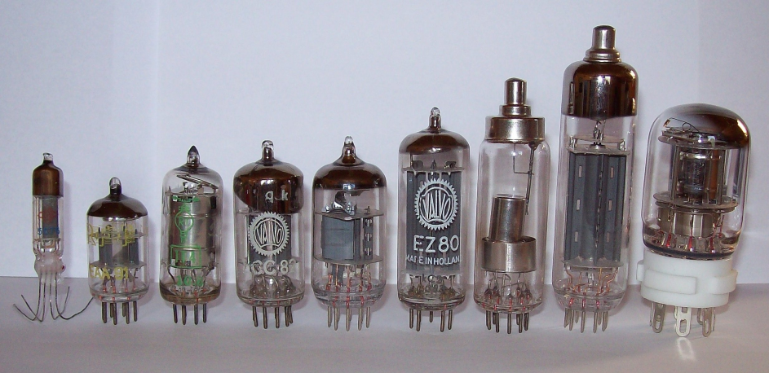
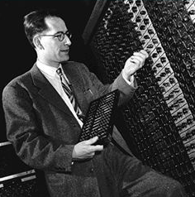
History of OS (First generation)
First generation (1945-1955)
Vacuum tubes and plug-boards are used in these systems.
Vacuum tubes
Plug board

Slide 14
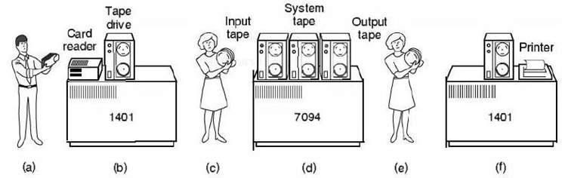
History of OS (Second generation)
Second generation (1955-1965)
Transistors are used in these systems
The machine that are produced are called mainframes.
Batch systems was used for processing.
Programmers bring cards to 1401
1401 prints output
1401 reads batch of jobs onto tape
Operator carries input tape to 7094
7094 does computing
Operator carries output tape to 1401

Slide 15
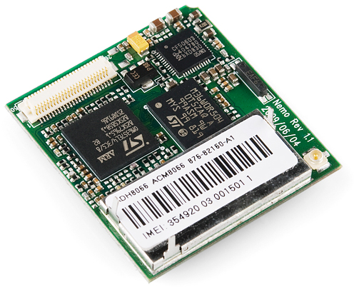
History of OS (Third generation)
Third generation (1965-1980)
Integrated circuits (IC's) are used in place of transistors in these computers.
It provides multiprogramming (the ability to have several programs in memory at once, each in its own memory partition).

Slide 16
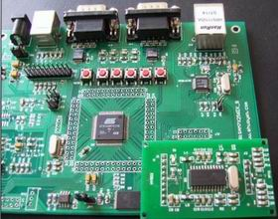
History of OS (Fourth generation)
Fourth generation (1980-present)
Personal Computers
LSI (Large Scale Integration) circuits, chips containing thousands of transistors are used in these systems.

Slide 17
OS Services / Task of OS
Program development
It provides editors and debuggers to assist (help) the programmer in creating programs.
Program execution
Following tasks need to be perform to execute a program
Instructions and data must be loaded into main memory.
I/O devices and files must be initialized.
The OS handles all these duties for the user.
Access to I/O devices
A running program may require I/O, which may involve file or an I/O device
For efficiency and protection, users cannot control I/O devices directly
Therefore, the OS controls these I/O devices and provides to program as per requirement.

Slide 18
OS Services / Task of OS
Memory management
OS manages memory hierarchy.
OS keeps the track of which part of memory area in use in use and free memory.
It allocates memory to program when they need it.
It de-allocate the memory when the program finish execution.
Controlled access to file
In case of file access, OS provides a directory hierarchy for easy access and management of file.
OS provides various file handling commands using which user can easily read, write and modify file.

Slide 19
OS Services / Task of OS
System access
In case of public system, OS controls access to the system.
It also protect data and resources from unauthorized access.
Error detection and response
An error may occur in CPU, in I/O devices or in the memory hardware.
Following are the major activities of an operating system with respect to error handling −
The OS constantly checks for possible errors.
The OS takes an appropriate action to ensure correct and consistent computing.

Slide 20
OS Services / Task of OS
Accounting
Keeping a track of which users are using how much and what kinds of computer resources can be used for accounting or simply for accumulating usage statistics.
Usage statistics is used to reconfigure the system to improve computing services.
Protection & Security
Protection involves ensuring that all accesses to system resources is controlled.
To make a system secure, the user needs to authenticate himself or herself to the system.

Slide 21
OS Services / Task of OS (Revision)
Program development
Program execution
Access to I/O devices
Memory management
Controlled access to file
System access
Error detection and response
Accounting
Protection & Security

Slide 22
Types of OS
Mainframe Operating Systems
OS found in room sized computers which are still found in major corporate data centres
They offer three kinds of services:
Batch OS – processes routine jobs without any interactive user presents i.e. claim processing in insurance
Transaction processing – handles large numbers of small processes i.e. cheque processing at banks
Timesharing – allows multiple remote users to run their jobs at once i.e. querying a database
Example: OS/390, OS/360.

Slide 23
Types of OS (Cont…)
Server Operating Systems
This OS runs on servers which are very large PC, workstations or even mainframes.
They serve multiple users at once over a network and allow the users to share hardware & software resources
It provides print services, file service or web service.
It handles the incoming requests from clients
Example: Solaris, FreeBSD, and Linux and Windows Server 200x.

Slide 24
Types of OS (Cont…)
Multiprocessor Operating Systems
A computer system consist two or more CPUs is called multiprocessor.
It is also called parallel computers, multicomputer or multiprocessor.
They need special OS or some variations on server OS with special features for communication, connectivity and consistency.
Example: Windows and Linux.

Slide 25
Types of OS (Cont…)
Personal Computer Operating Systems
The operating systems installed on our personal computer and laptops are personal OS.
Job of this OS is to provide good support to single user.
This OS is widely used for word processing, spreadsheet and internet access.
Example: Linux, Windows vista and Macintosh.

Slide 26
Types of OS (Cont…)
Handhelds Computer Operating Systems
A handheld computer or PDA (Personal Digital Assistant) is small computer that fit in a Pocket and perform small number of functions such as electronic address book, memo pad.
The OS runs on these devices are handheld OS.
These OS also provides ability to handle telephony, digital photography and other functions.
Example: Symbian OS, Palm OS.

Slide 27
Types of OS (Cont…)
Embedded Operating Systems
It runs on the computer that control devices.
It neither allow to download new software nor accept user installed software. So there is no need for protection.
This OS is installed in ATMs, printers, calculators and washing machine.
Example: QNX, VxWorks.

Slide 28
Types of OS (Cont…)
Sensor Node Operating Systems
Network of tiny sensor nodes are being developed for numerous purpose.
Each nodes are tiny computers with a CPU, RAM, ROM and one or more environmental sensors.
The OS installed in these nodes are sensor node OS.
They communicate with each other and with base station using wireless communication.
These sensor network are used to protect area of building, detect fires in forest, measure temperature
Example: TinyOS.

Slide 29
Types of OS (Cont…)
Real Time Operating Systems
These systems having Time as a key parameter.
Real time OS has well defined fixed time constraints.
Processing must be done within defined time constraints otherwise system fails.
Two types of Real Time OS:
Hard real time – missing an occasional deadline can cause any permanent damage. Many of these are found in industrial process control, car engine control system.
Soft real time – missing an occasional deadline does not cause any permanent damage. Used in digital audio, multimedia system.
Example: e-Cos.

Slide 30
Types of OS (Cont…)
Smart Card Operating Systems
Smallest OS run on smart cards which are credit card sized devices containing CPU chip.
They have limited processing power.
Some smart cards are Java oriented. ROM on smart card holds an interpreter for the JVM – small program.
These OS are installed on electronic payments cards such as debit card, credit card etc.

Slide 31
Types of OS (Revision)
Mainframe Operating Systems
Server Operating Systems
Multiprocessor Operating Systems
Personal Computer Operating Systems
Handhelds Computer Operating Systems
Embedded Operating Systems
Sensor Node Operating Systems
Real Time Operating Systems
Smart Card Operating Systems

Slide 32
System Calls
The interface between OS and user program is defined by the set of system calls that OS provides.
System calls vary from OS to OS.
Example: Unix Read System call
count=read(fd, buffer, nbytes)
fd is a file descriptor.
When a file is opened, permissions are checked.
If access is allowed, a number (fd) is returned.
Then file can be read/written.
nbytes is number of bytes to read
buffer is where read deposits (stores) the data

Slide 33
System Calls (Cont…)
Return to caller
Library
procedure
read
Trap to the kernel
5
Put code for read in register
6
10
User
space
Call to library proc
4
11
Increment SP
Call read
User
program
calling read
Push parameter onto stack
3
Push fd
2
Push &buffer
9
1
Push nbytes
Kernel
space
7
8
Dispatch
Sys call
handler

Slide 34
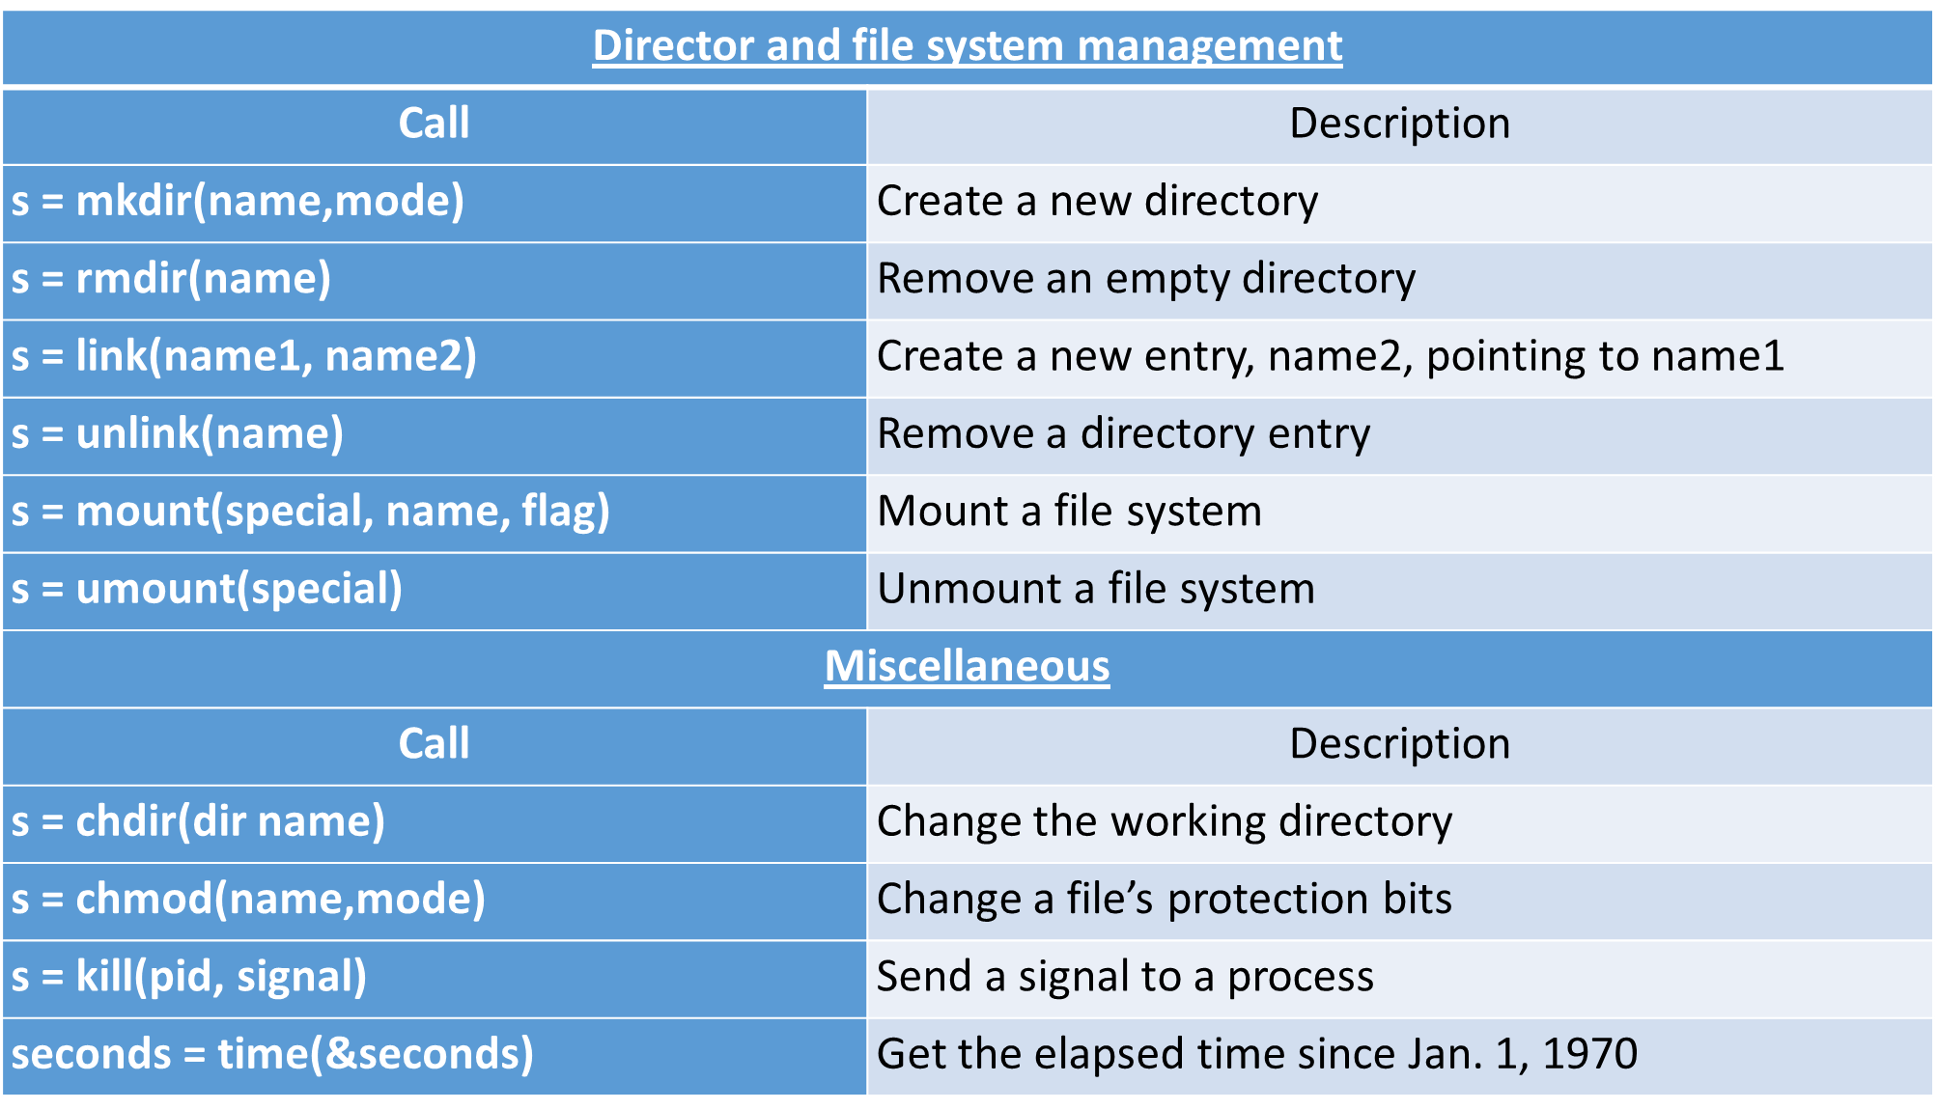
System Calls (Cont…)

Slide 35
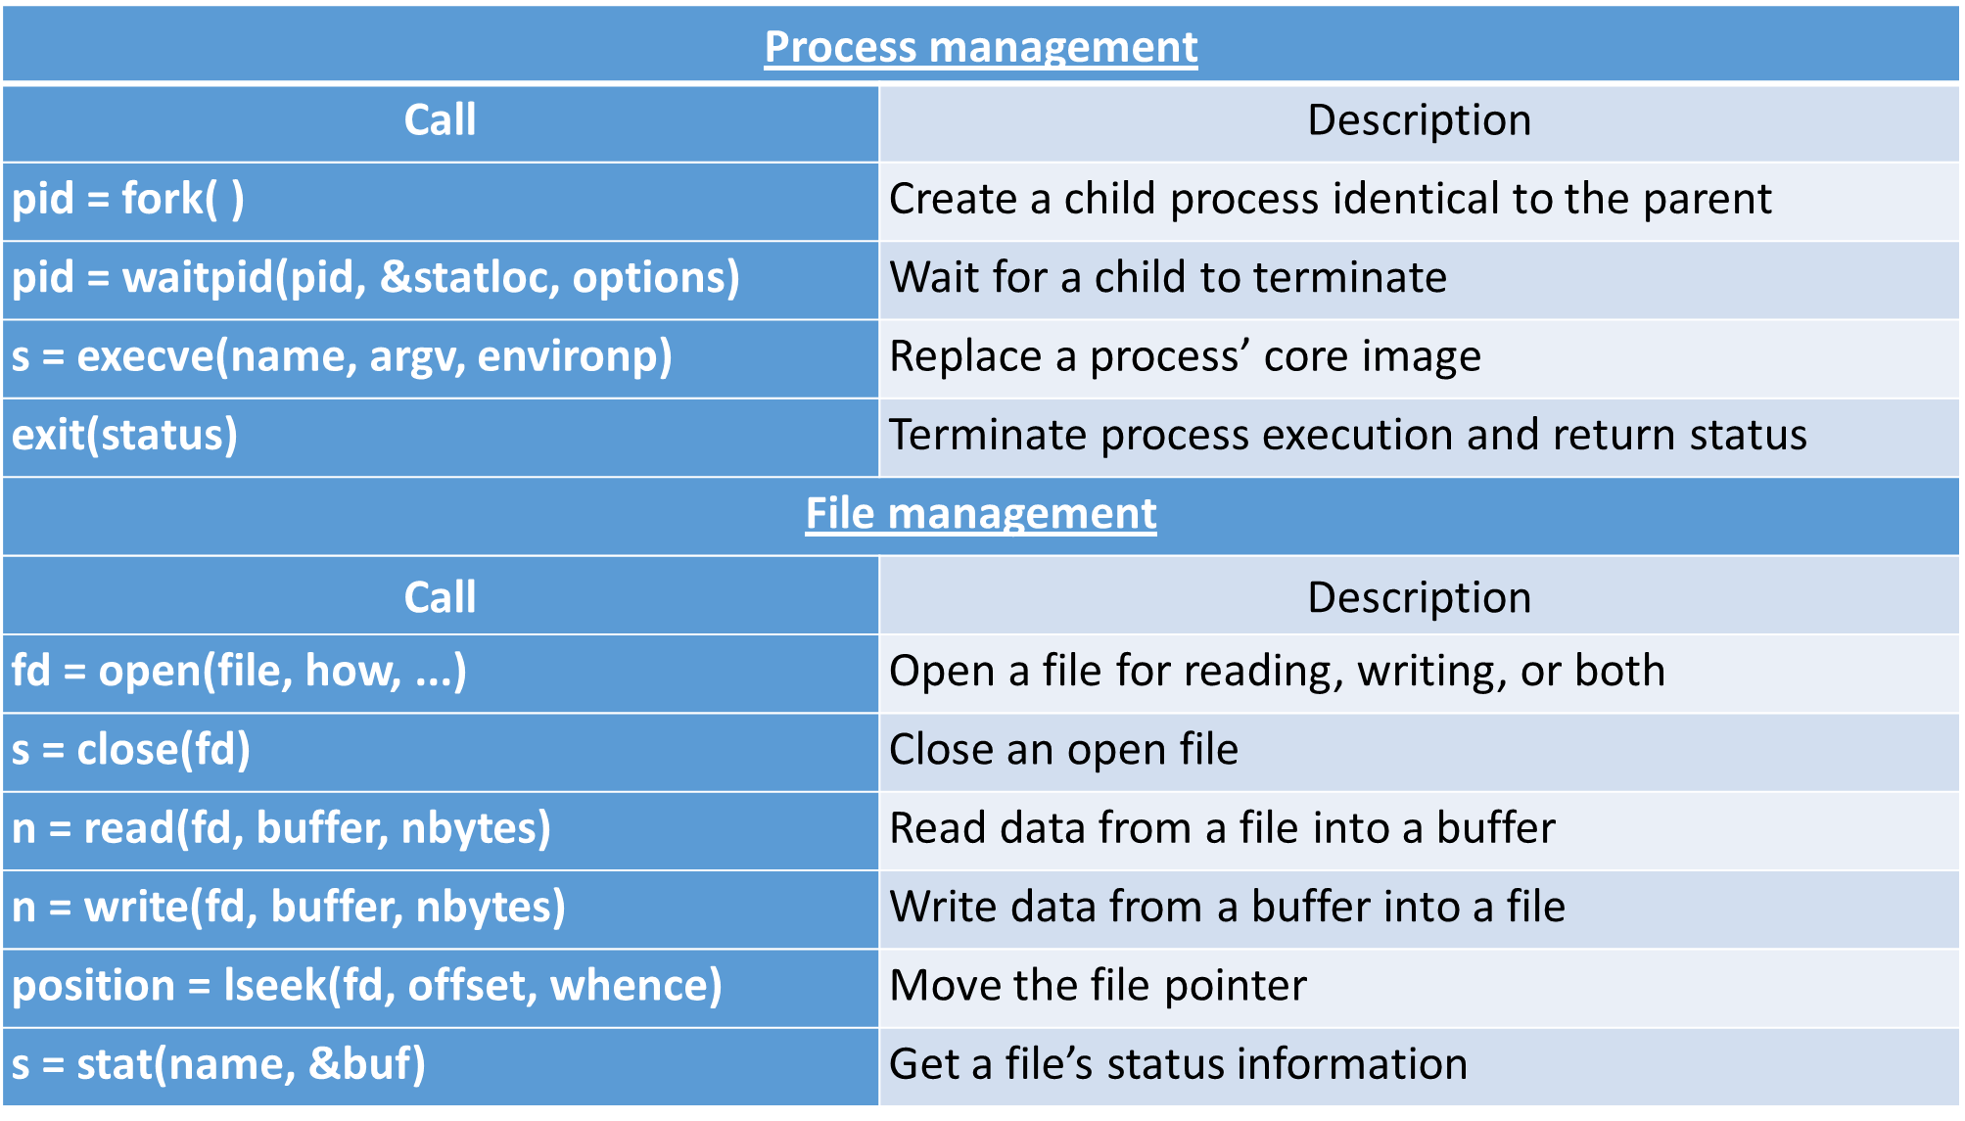
System Calls (Cont…)

Slide 36
Operating System Structures
Monolithic systems
Layered systems
Microkernel
Client-Server Model
Virtual Machines
VM/370
Virtual Machines Rediscovered
The Java Virtual Machine
Exokernels

Slide 37
Monolithic Systems
The entire OS runs as a single program in kernel mode.
OS is written as a collection of procedures, linked together into a single large executable binary program.
Each procedure has well defined interface in terms of parameter and results, and each one is free to call any other one.
A main program that invoke the requested service procedure.
A set of service procedures that carry out the system calls.
A set of utility procedures that help the service procedure.
Main
Procedure
Service
Procedures
Utility
Procedure

Slide 38
Layered Systems
In this system, the OS is organized as a hierarchy of layers.
The first system constructed in this way was THE system.

Slide 39
Architecture of THE Systems
Layer | Function | Description
5 | The operator | Operator was located.
4 | User Programs | User programs were found.
3 | Input / Output Management | Takes care of managing the I/O devices. Buffering the information.
2 | Operator-process communication | Handles communication between each process and the operator console (i.e. user).
1 | Memory and drum management | Did the memory management. Allocated space for process in main memory and on a 512K word drum used for holding parts of processes for which there was no room in memory.
0 | Processor allocation and multi-programming | Provided the basic multiprogramming of the CPU. Dealt with allocation of the processor, switching between processes when interrupts occurred or timers expired.

Slide 40
Microkernel
In layered approach, the designer have choice where to draw the kernel and user mode boundary.
It is better to put as little as possible in kernel mode because bugs in the kernel can bring down the system instantly.
The microkernel design provides high reliability by splitting OS up into small well defined modules, only one module run in kernel and rest of all run in user mode.
As each device driver runs as a user process, a bug in audio driver will cause the sound to be stop, but not crash the computer.
Example: Integrity, K42, QNX, Symbian and MINIX 3.

Slide 41
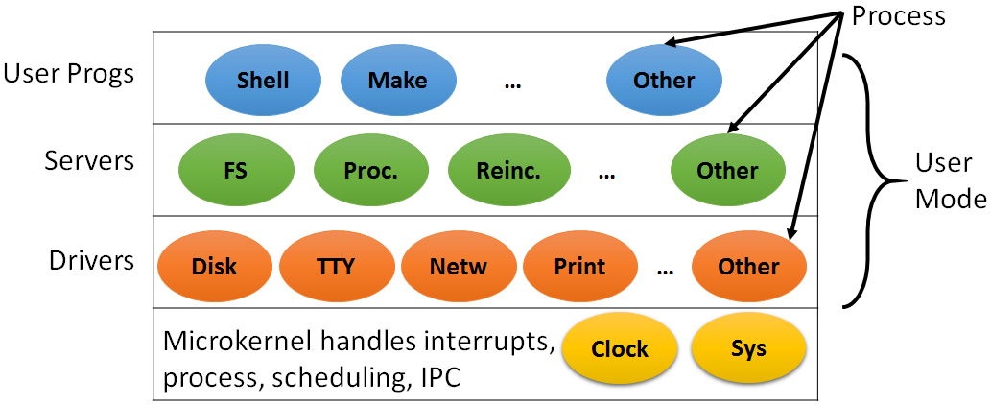
Microkernel (Cont…)
Kernel contains only
Sys (Kernel call handler)
Clock (because scheduler interact with it)

Slide 42
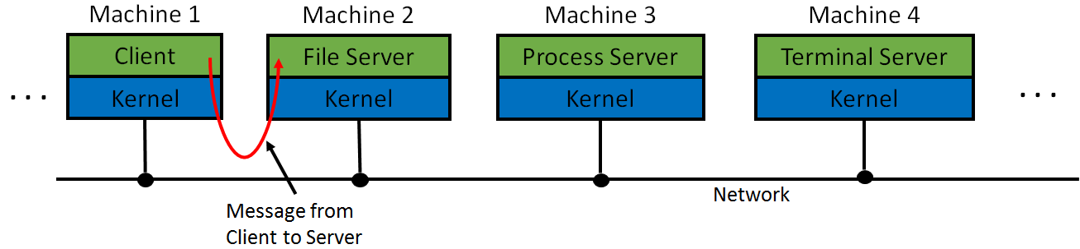
Client-Server Model
Processes in divided into in to two categories
Servers: provide services
Clients: uses services
Client and server run on different computers, connected by LAN or WAN and communicate via Message passing.
To obtain a service, a client construct a message saying what it wants and send it to server.
The server then does the work and send back the answer.

Slide 43
Virtual Machines
The initial releases of OS/360 were strictly batch systems.
But many users wanted to be able to work interactively at a terminal, so OS designers decided to write timesharing systems for it.
Types of Virtual machines are:
VM/370
Virtual Machines Rediscovered
The Java Virtual Machine

Slide 44
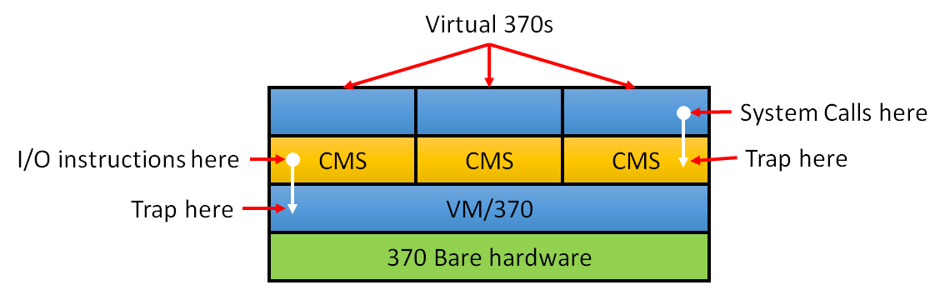
VM/370
Virtual machine monitor run on the bare hardware and does the multiprogramming.
Each virtual machine is identical to the true hardware; each one can run any OS (may be different) that will run directly on the bare hardware.
On VM/370, some run OS/360 while the others run single user interactive system called CMS (Conversational Monitor System) for interactive time sharing users.

Slide 45
VM/370 (Cont…)
When CMS program executed a system call, a call was trapped to the operating system in its own virtual machine, not on VM/370.
CMS then issued the normal hardware I/O instruction for reading its virtual disk or whatever was needed to carry out the call.
These I/O instructions were trapped by VM/370 which then performs them.

Slide 46
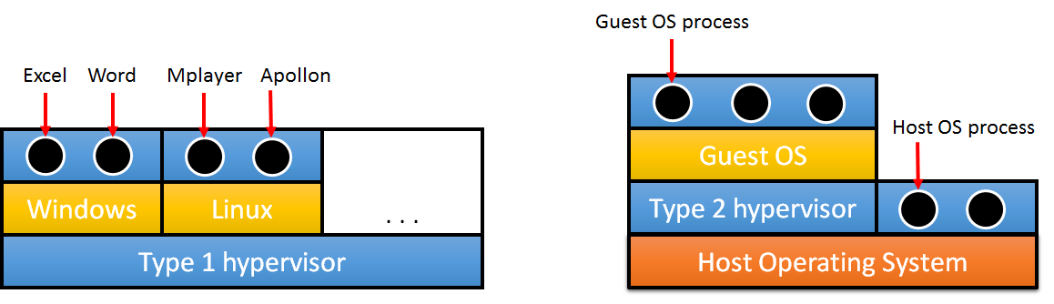
Virtual Machines Rediscovered
Companies can run their mail servers, web servers, FTP servers and other servers on the same machine without having a crash of one server bring down the rest.
Web hosting company offers virtual machines for rent, where a single physical machine can run many virtual machines; each one appears to be a complete machine.
Customers who rent a virtual machine can run any OS or software.

Slide 47
Virtual Machines Rediscovered (Cont…)
Another use of virtualization is for end users who want to be able to run two or more operating systems at the same time, say Windows and Linux.
Type 1 hypervisors runs on the bare hardware.
Type 2 hypervisors run as application programs on top of Windows, Linux, or some other operating system, known as the host operating system.

Slide 48
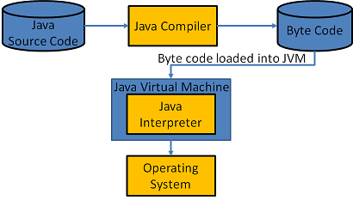
Java Virtual Machine
When Sun Microsystems invented the Java programming language, it also invented a virtual machine called the JVM (Java Virtual Machine).
The Java compiler produces code for JVM, which then typically is executed by a software JVM interpreter.
The advantage is that the JVM code can be shipped over the internet to any computer that has a JVM interpreter and run there.

Slide 49
Exokernels
Rather than cloning (copying) the actual machine, another strategy is partitioning it (giving each user a subset of the resource).
For example one virtual machine might get disk blocks 0 to 1023, the next one might get block 1024 to 2047, and so on.
Program running at the bottom layer (kernel mode) is called the exokernel.
Its job is to allocate resources to virtual machines and then continuously check to make sure no machine is trying to use somebody else’s resources.
The advantage of the exokernel scheme is that it saves a layer of mapping.

