Slide 1

Unit – 3 Interprocess Communication
Prof. Firoz Sherasiya
 9879879861
→ firoz.sherasiya@darshan.ac.in
Operating System (2140702) Darshan Institute of Engineering & Technology

Slide 2
Topics to be covered
IPC, Race Conditions, Critical Section, Mutual Exclusion
Hardware Solution
Strict Alternation
Peterson’s Solution
The Producer Consumer Problem
Semaphores
Event Counters
Monitors
Classical IPC Problems:
Reader’s & Writer Problem
Dinning Philosopher Problem
Message Passing
Barrier

Slide 3
Basic Definitions
Inter Process Communication: It is a communication between two or more processes.
Race Condition: Situation where two or more processes are reading or writing some shared data and the final result depends on who runs precisely when.
Mutual Exclusion: Way of making sure that if one process is using a shared variable or file; the other process will be excluded (stopped) from doing the same thing.
Critical Section: The part of program where the shared resource is accessed is called critical section.
A enters in critical region
A leaves critical region
Process A
B attempt to enter
B enters in critical region
B leaves critical region
Process B
T1
T2
B Blocked
T3
T4

Slide 4
Mutual exclusion with busy waiting
Mechanisms for achieving mutual exclusion with busy waiting
Disabling interrupts
Shared lock variable
Strict alteration
TSL (test and set lock) instruction
Exchange instruction
Peterson’s solution

Slide 5
Disabling interrupts
while (true)
{
< disable interrupts >;
< critical section >;
< enable interrupts >;
< remainder section>;
}
< critical section >
< remainder section>
< disable interrupts >
< enable interrupts >
Process A
Process B
T1
T3
T4

Slide 6
Disabling interrupts
Problems:
Unattractive or unwise to give user processes the power to turn off interrupts.
What if one of them did it (disable interrupt) and never turned them on (enable interrupt) again? That could be the end of the system.
If the system is a multiprocessor, with two or more CPUs, disabling interrupts affects only the CPU that executed the disable instruction. The other ones will continue running and can access the shared memory.

Slide 7
Shared lock variable
A shared variable lock having value 0 or 1.
Before entering in to critical region a process checks a shared variable lock’s value.
If the value of lock is 0 then set it to 1 before entering the critical section and enters into critical section and set it to 0 immediately after leaving the critical section.
If the value of lock is 1 then wait until it becomes 0 by some other process which is in critical section.
while (true)
{
< set shared variable to 1>;
< critical section >;
< set shared variable to 0>;
< remainder section>;
}

Slide 8
Shared lock variable
Problem:
If process P0 sees the value of lock variable 0 and before it can set it to 1 context switch occurs.
Now process P1 runs and finds value of lock variable 0, so it sets value to 1, enters critical region.
At some point of time P0 resumes, sets the value of lock variable to 1, enters critical region.
Now two processes are in their critical regions accessing the same shared memory, which violates the mutual exclusion condition.

Slide 9
Strict Alteration
Integer variable 'turn' keeps track of whose turn is to enter the critical section.
Initially turn=0. Process 0 inspects turn, finds it to be 0, and enters in its critical section.
Process 1 also finds it to be 0 and therefore sits in a loop continually testing 'turn' to see when it becomes 1.
Continuously testing a variable waiting for some event to appear is called the busy waiting.
When process 0 exit from critical region it set turn to 1 and now process 1 can find it to be 1 and enters in to critical region.
In this way both the process get alternate turn to enter in critical region.

Slide 10
Strict Alteration (Algorithm)
Process 0 while (TRUE) { while (turn != 0) /* loop */ ; critical_region(); turn = 1; noncritical_region(); } | Process 1 while (TRUE) { while (turn != 1) /* loop */ ; critical_region(); turn = 0; noncritical_region(); }
0
0
0
1
0
0
0 enters in critical region
0 leaves critical region
Process 0
1 attempt to enter
1 enters in critical region
1 leaves critical region
1 attempt to enter
Process 1
T1
T2
1 Busy Wait
T3
T4
T5
1 Busy Wait

Slide 11
Strict Alteration (Disadvantages)
Taking turns is not a good idea when one of the processes is much slower than the other.
Consider the following situation for two processes P0 and P1.
P0 leaves its critical region, set turn to 1, enters non critical region.
P1 enters and finishes its critical region, set turn to 0.
Now both P0 and P1 in non-critical region.
P0 finishes non critical region, enters critical region again, and leaves this region, set turn to 1.
P0 and P1 are now in non-critical region.
P0 finishes non critical region but cannot enter its critical region because turn = 1 and it is turn of P1 to enter the critical section.
Hence, P0 will be blocked by a process P1 which is not in critical region. This violates one of the conditions of mutual exclusion.
It wastes CPU time, so we should avoid busy waiting as much as we can.

Slide 12
TSL (Test and Set Lock) Instruction
Algorithm
enter_region: (Before entering its critical region, process calls enter_region)
TSL REGISTER,LOCK |copy lock variable to register set lock to 1
CMP REGISTER,#0 |was lock variable 0?
JNE enter_region |if it was nonzero, lock was set, so loop
RET |return to caller: critical region entered
leave_region: (When process wants to leave critical region, it calls leave_region)
MOVE LOCK,#0 |store 0 in lock variable
RET |return to caller

Slide 13
Exchange Instruction
Algorithm
enter_region: (Before entering its critical region, process calls enter_region)
MOVE REGISTER,#1 |put 1 in the register
XCHG REGISTER,LOCK |swap content of register & lock variable
CMP REGISTER,#0 |was lock variable 0?
JNE enter_region |if it was nonzero, lock was set, so loop
RET |return to caller: critical region entered
leave_region: (When process wants to leave critical region, it calls leave_region)
MOVE LOCK,#0 |store 0 in lock variable
RET |return to caller

Slide 14
Peterson’s Solution
#define FALSE 0
#define TRUE 1
#define N 2 //number of processes
int turn; //whose turn is it?
int interested[N]; //all values initially 0 (FALSE)
void enter_region(int process)
{
int other; // number of the other process
other = 1 - process; // the opposite process
interested[process] = TRUE; // this process is interested
turn = process; // set flag
while(turn == process && interested[other] == TRUE); // wait
}
void leave_region(int process)
{
interested[process] = FALSE; // process leaves critical region
}
0
1
P0
P1
P0
P1
0 | 0
1 | 0
1
0
1 | 0
1 | 1
0
1
0 | 1

Slide 15
Priority inversion problem
Priority inversion means the execution of a high priority process/thread is blocked by a lower priority process/thread.
Consider a computer with two processes, H having high priority and L having low priority.
The scheduling rules are such that H runs first then L will run.
At a certain moment, L is in critical region and H becomes ready to run (e.g. I/O operation complete).
H now begins busy waiting and waits until L will exit from critical region.
But H has highest priority than L so CPU is switched from L to H.
Now L will never be scheduled (get CPU) until H is running so L will never get chance to leave the critical region so H loops forever. This situation is called priority inversion problem.

Slide 16
Sleep and Wakeup
Peterson’s solution and solution using TSL and XCHG have the defect of requiring busy waiting.
when a processes wants to enter in its critical section , it checks to see if the entry is allowed.
If it is not allowed, the process goes into tight loop and waits (i.e., start busy waiting) until it is allowed to enter.
This approach waste CPU-time.
But we have interprocess communication primitives (the pair of sleep & wakeup).
Sleep: It is a system call that causes the caller to be blocked (suspended) until some other process wakes it up.
Wakeup: It is a system call that wakes up the process.
Both 'sleep' and 'wakeup' system calls have one parameter that represents a memory address used to match up 'sleeps' and 'wakeups' .

Slide 17
Producer Consumer problem
It is multi-process synchronization problem.
It is also known as bounded buffer problem.
This problem describes two processes producer and consumer, who share common, fixed size buffer.
Producer process
Produce some information, put it into buffer
Consumer process
Consume this information (remove it from the buffer)
Producer
Buffer
Consumer

Slide 18
What Producer Consumer problem is?
The problem is to make sure that the producer won’t try to add data (information) into the buffer if it is full and consumer won’t try to remove data (information) from the an empty buffer.
Solution for producer:
Producer either go to sleep or discard data if the buffer is full.
Once the consumer removes an item from the buffer, it notifies (wakeups)the producer to put the data into buffer.
Solution for consumer:
Consumer can go to sleep if the buffer is empty.
Once the producer puts data into buffer, it notifies (wakeups) the consumer to remove (use) data from buffer.

Slide 19
What Producer Consumer problem is?
Buffer is empty
Producer want to produce
Consumer want to consume
Buffer is full
Producer want to produce
Consumer want to consume
Buffer is partial filled
Producer want to produce
Consumer want to consume
√
X
Producer
Buffer
Consumer
X
√
√
√

Slide 20
Producer Consumer problem using Sleep & Wakeup
#define N 4
int count=0;
void producer (void)
{ int item;
while (true)
{item=produce_item();
if (count==N) sleep();
insert_item(item);
count=count+1;
if(count==1) wakeup(consumer);
}
}
count
0
1
item
Item 1
Producer
Buffer
Consumer
1
2
3
4

Slide 21
Producer Consumer problem using Sleep & Wakeup
void consumer (void)
{ int item;
while (true)
{
if (count==0) sleep();
item=remove_item();
count=count-1;
if(count==N-1) wakeup(producer);
consume_item(item);
}
}
count
0
1
item
Producer
Buffer
Consumer
1
Item 1
2
3
4

Slide 22
Problem in Sleep & Wakeup
Problem with this solution is that it contains a race condition that can lead to a deadlock.
The consumer has just read the variable Count, noticed it's zero and is just about to move inside the if block.
Just before calling sleep, the consumer is interrupted and the producer is resumed.
The producer creates an item, puts it into the buffer, and increases Count.
Because the buffer was empty prior to the last addition, the producer tries to wake up the consumer.
Unfortunately the consumer wasn't yet sleeping, and the wakeup call is lost.
When the consumer resumes, it goes to sleep and will never be awakened again. This is because the consumer is only awakened by the producer when Count is equal to 1.
The producer will loop until the buffer is full, after which it will also go to sleep.
Since both processes will sleep forever, we have run into a deadlock. This solution therefore is unsatisfactory.

Slide 23
Semaphore
A semaphore is a variable that provides an abstraction for controlling access of a shared resource by multiple processes in a parallel programming environment.
There are 2 types of semaphores:
Binary semaphores :-
Binary semaphores can take only 2 values (0/1).
Binary semaphores have 2 methods associated with it (up, down / lock, unlock).
They are used to acquire locks.
Counting semaphores :-
Counting semaphore can have possible values more than two.

Slide 24
Semaphore (cont…)
We want functions insert _item and remove_item such that the following hold:
Mutually exclusive access to buffer: At any time only one process should be executing (either insert_item or remove_item).
No buffer overflow: A process executes insert_item only when the buffer is not full (i.e., the process is blocked if the buffer is full).
No buffer underflow: A process executes remove_item only when the buffer is not empty (i.e., the process is blocked if the buffer is empty).
No busy waiting.
No producer starvation: A process does not wait forever at insert_item() provided the buffer repeatedly becomes full.
No consumer starvation: A process does not wait forever at remove_item() provided the buffer repeatedly becomes empty.

Slide 25
Producer Consumer problem using Semaphore
#define N 4
typedef int semaphore;
semaphore mutex=1;
semaphore empty=N;
semaphore full=0;
void producer (void)
{ int item;
while (true)
{
item=produce_item();
down(&empty);
down(&mutex);
insert_item(item);
up(&mutex);
up(&full);
}
}
mutex
1
1
0
empty
4
3
full
0
0
1
item
Item 1
Producer
Buffer
Consumer
1
2
3
4

Slide 26
Producer Consumer problem using Semaphore
void consumer (void)
{ int item;
while (true)
{
down(&full);
down(&mutex);
item=remove_item(item);
up(&mutex);
up(&empty);
consume_item(item);
}
}
mutex
1
0
1
1
1
0
empty
4
4
3
full
0
1
item
Producer
Buffer
Consumer
1
Item 1
2
3
4

Slide 27
Readers Writer problem
In the readers and writers problem, many competing processes are wishing to perform reading and writing operations in a database.
It is acceptable to have multiple processes reading the database at the same time, but if one process is updating (writing) the database, no other processes may have access to the database, not even readers.
P1
P2
P3
X
Read
Read
X
Write
Write
Write
X
X
DATABASE

Slide 28
Readers Writer problem
In the readers and writers problem, many competing processes are wishing to perform reading and writing operations in a database.
It is acceptable to have multiple processes reading the database at the same time, but if one process is updating (writing) the database, no other processes may have access to the database, not even readers.
P1
P2
P3
Read
Read
√
Read
√
Write
Write
X
X
DATABASE

Slide 29
Readers Writer problem
In the readers and writers problem, many competing processes are wishing to perform reading and writing operations in a database.
It is acceptable to have multiple processes reading the database at the same time, but if one process is updating (writing) the database, no other processes may have access to the database, not even readers.
Need to keep track of read of more than one process at a time
P1
P2
P3
Read
Read
√
Read
√
3
Reader_count
DATABASE

Slide 30
Readers Writer problem using Semaphore
typedef int semaphore;
semaphore mutex=1; //control access to reader count
semaphore db=1; //control access to database
int reader_count=0; //number of processes reading database

Slide 31
Readers Writer problem using Semaphore
void Reader (void)
{ while (true){
down(&mutex); //gain access to reader count
reader_count=reader_count+1; //increment reader counter
if(reader_count==1) //if this is first process to read DB
down(&db) //prevent writer process to access DB
up(&mutex) //allow other process to access reader_count
read_database();
down(&mutex); //gain access to reader count
reader_count=reader_count-1; //decrement reader counter
if(reader_count==0) //if this is last process to read DB
up(&db) //leave the control of DB, allow writer process
up(&mutex) //allow other process to access reader_count
use_read_data();} //use data read from DB (non-critical)
}

Slide 32
Readers Writer problem using Semaphore
void Writer (void)
{ while (true){
create_data(); //create data to enter into DB (non-critical)
down(&db); //gain access to DB
write_db(); //write information to DB
up(&db);} //release exclusive access to DB
}

Slide 33
Monitor
A monitor is a collection of procedures, variables, and data structures grouped together in a single module or package.
Processes can call the monitor procedures but cannot access the internal data structures.
Monitors have an important property that makes them useful for achieving mutual exclusion: only one process can be active in a monitor at any instant.

Slide 34
Producer Consumer problem using Monitor
monitor ProducerConsumer
condition full, empty;
integer count;
procedure insert (item:integer);
begin
if count=N then wait (full);
insert_item(item);
count=count+1;
if count=1 then signal (empty);
end;

Slide 35
Producer Consumer problem using Monitor
function remove:integer;
begin
if count=0 then wait (empty);
remove=remove_item;
count=count-1;
if count=N-1 then signal (full);
end;
count=0;
end monitor;

Slide 36
Producer Consumer problem using Monitor
function remove:integer;
begin
if count=0 then wait (empty);
remove=remove_item;
count=count-1;
if count=N-1 then signal (full);
end;
procedure producer;
begin
while true do
begin
item=produce_item;
ProducerConsumer.insert(item);
end;
end;
procedure consumer;
begin
while true do
begin
item=ProducerConsumer.remove;
Consume_insert(item);
end;
end;
procedure insert (item:integer);
begin
if count=N then wait (full);
insert_item(item);
count=count+1;
if count=1 then signal (empty);
end;

Slide 37
Mutex
Mutex is the short form for ‘Mutual Exclusion Object’.
A Mutex and the binary semaphore are essentially the same.
Both Mutex and the binary semaphore can take values: 0 or 1.
mutex_lock:
TSL REGISTER,MUTEX |copy Mutex to register and set Mutex to 1
CMP REGISTERS, #0 |was Mutex zero?
JZE ok |if it was zero, Mutex was unlocked, so return
CALL thread_yield | Mutex is busy; schedule another thread
JMP mutex_lock | try again later
ok: RET | return to caller; critical region entered
mutex_unlock:
MOVE MUTEX,#0 | store a 0 in Mutex
RET | return to caller

Slide 38
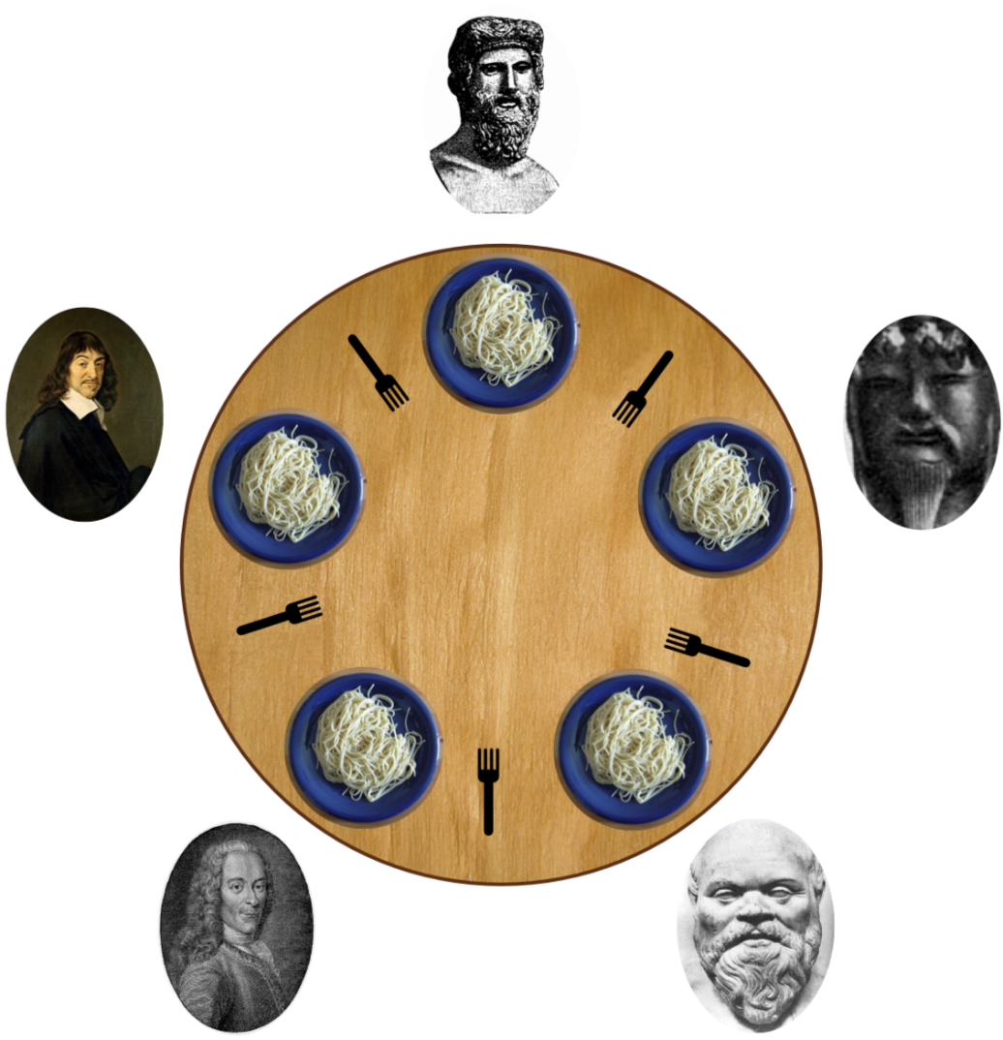
Dinning Philosopher Problem
In this problem 5 philosophers sitting at a round table doing 2 things eating and thinking.
While eating they are not thinking and while thinking they are not eating.
Each philosopher has plates that is total of 5 plates.
And there is a fork place between each pair of adjacent philosophers that is total of 5 forks.
Each philosopher needs 2 forks to eat and each philosopher can only use the forks on his immediate left and immediate right.

Slide 39
Solution to Dinning Philosopher Problem
#define N 5 //no. of philosophers
#define LEFT (i+N-1)%5 //no. of i’s left neighbor
#define RIGHT (i+1)%5 //no. of i’s left neighbor
#define THINKING 0 //Philosopher is thinking
#define HUNGRY 1 //Philosopher is trying to get forks
#define EATING 2 //Philosopher is eating
typedef int semaphore; //semaphore is special kind of int
int state[N]; //array to keep track of everyone’s state
semaphore mutex=1; //mutual exclusion for critical region
semaphore s[N]; //one semaphore per philosopher

Slide 40
Solution to Dinning Philosopher Problem
void philosopher (int i) //i: philosopher no, from 0 to N-1
{
while (true)
{
think(); //philosopher is thinking
take_forks(i); //acquire two forks or block
eat(); //eating spaghetti
put_forks(i); //put both forks back on table
}
}

Slide 41
Solution to Dinning Philosopher Problem
void take_forks (int i) //i: philosopher no, from 0 to N-1
{
down(&mutex); //enter critical region
state[i]=HUNGRY; //record fact that philosopher i is hungry
test(i); //try to acquire 2 forks
up(&mutex); //exit critical region
down(&s[i]); //block if forks were not acquired
}
void put_forks (int i) //i: philosopher no, from 0 to N-1
{
down(&mutex); //enter critical region
state[i]=THINKING; //philosopher has finished eating
test(LEFT); //see if left neighbor can now eat
test(RIGHT); // see if right neighbor can now eat
up(&mutex); // exit critical region
}

Slide 42
Solution to Dinning Philosopher Problem
void test (i) //i: philosopher no, from 0 to N-1
{
if (state[i]==HUNGRY &&
state[LEFT]!=EATING &&
state[RIGHT]!=EATING)
{
state[i]=EATING;
up (&s[i]);
}
}

Slide 43
Message Passing
This method will use two primitives
Send: It is used to send message.
Send (destination, &message)
In above syntax destination is the process to which sender want to send message and message is what the sender wants to send.
Receive: It is used to receive message.
Receive (source, &message)
In above syntax source is the process that has send message and message is what the sender has sent.

Slide 44
Producer Consumer problem using message passing
#define N 100 //number of slots in buffer
void producer (void)
{
int item;
message m; //message buffer
while (true)
{
item=produce_item(); //generate something to put in buffer
receive(consumer, &m); //wait for an empty to arrive
build_message(&m, item); //construct a message to send
send(consumer, &m); //send item to consumer
}
}

Slide 45
Producer Consumer problem using message passing
void consumer (void)
{
int item, i;
message m;
for (i=0; i<N; i++) send (producer, &m);//send N empties
while (true)
{
receive (producer, &m); //get message containing item
item=extract_item(&m); //extract item from message
send (producer, &m); //send back empty reply
consume_item (item); //do something with the item
}
}

Slide 46
Barrier
In this mechanism some application are divided into phases and have that rule that no process may proceed into the next phase until all process completed in this phase and are ready to proceed to the next phase.
This behaviour is achieved by placing barrier at the end of each phase.
When a process reaches the barrier, it is blocked until all processes have reach at the barrier.
There are four processes with a barrier.
A
B
Barrier
C
D
Time

Slide 47
Barrier
Processes A, B and D are completed and process C is still not completed so until process C will complete, process A, B and D will not start in next phase.
A
B
Barrier
C
D
Time

Slide 48
Barrier
Once process C completes all the process start in next phase.
A
B
Barrier
C
D
Time

