Slide 1

Unit – 6 I/O Management
Prof. Firoz Sherasiya
 9879879861
→ firoz.sherasiya@darshan.ac.in
Operating System (2140702) Darshan Institute of Engineering & Technology

Slide 2
Topics to be covered
Principles of I/O Hardware: I/O devices
Device controllers
Direct memory access
Principles of I/O Software: Goals of Interrupt handlers
Device drivers
Device independent I/O software
Secondary-Storage Structure: Disk structure
Disk scheduling algorithm

Slide 3
Components of I/O devices
I/O devices have two components
Mechanical component
Electronic component
The mechanical component is device itself.
Electronic component of devices is called the Device Controller.

Slide 4
Device controller
Electronic component which controls the device.
It may handle multiple devices.
There may be more than one controller per mechanical component (example: hard drive).
Controller's tasks are:
It converts serial bit stream to block of bytes
Perform error correction if necessary
Block of bytes is first assembled bit by bit in buffer inside the controller
After verification, the block has been declared to be error free, and then it can be copied to main memory

Slide 5
Memory-Mapped I/O
Each device controller has a few registers that are used for communicating with the CPU.
By writing into these registers, the OS can command the device to deliver data, accept data, switch itself on or off, or perform some action.
By reading from these registers OS can learn what the device’s status is, whether it is prepared to accept a new command and so on.
There are two ways to communicate with control registers and the device buffers:
I/O Port
Memory mapped I/O

Slide 6
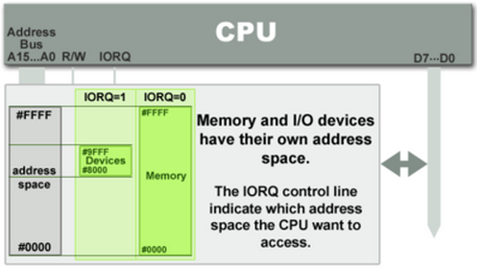
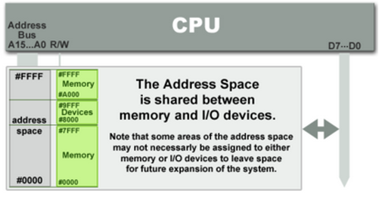
I/O Port Vs Memory Mapped I/O
I/O Port
Port mapped I/O uses a separate, dedicated address space and is accessed via a special set of instructions.
Memory mapped I/O
Memory mapped I/O is mapped into the same address space as program memory or user memory, and is accessed in the same way.

Slide 7
Direct Memory Access
Direct memory access (DMA) is a feature of computer systems that allows certain hardware subsystems to access main memory (RAM), independent of the central processing unit (CPU).
Without DMA, when the CPU is using programmed input/output, it is typically fully occupied for the entire duration of the read or write operation, and is thus unavailable to perform other work.
With DMA, the CPU first initiates the transfer, then it does other operations while the transfer is in progress, and it finally receives an interrupt from the DMA controller when the operation is done.
This feature is useful when the CPU needs to perform useful work while waiting for a relatively slow I/O data transfer.
Many hardware systems such as disk drive controllers, graphics cards, network cards and sound cards use DMA.

Slide 8
Disk read-write without a DMA
The disk controller reads the block from the drive serially, bit by bit, until the entire block is in the controller’s buffer.
Next, it computes the checksum to verify that no read errors have occurred.
Then the controller causes an interrupt, so that OS can read the block from controller’s buffer (a byte or a word at a time) by executing a loop.
After reading every single part of the block from controller device register, the operating system will store them into the main memory.
Drive
Disk
Controller
Main
Memory
CPU
Buffer
Bus

Slide 9
Disk read-write using DMA
Drive
1. CPU programs DMA controller
DMA
Controller
Disk
Controller
Main
Memory
CPU
Buffer
Address
Count
Control
Bus
Step 1: First the CPU programs the DMA controller by setting its registers so it knows what to transfer where.
It also issues a command to the disk controller telling it to read data from the disk into its internal buffer and verify the checksum.
When valid data are in the disk controller’s buffer, DMA can begin.

Slide 10
Disk read-write using DMA
Drive
1. CPU programs DMA controller
DMA
Controller
Disk
Controller
Main
Memory
CPU
Buffer
Address
2. DMA requests transfer to memory
Count
Control
Bus
Step 2: The DMA controller initiates the transfer by issuing a read request over the bus to the disk controller.
This read request looks like any other read request, and the disk controller does not know (or care) whether it came from the CPU or from a DMA controller.

Slide 11
Disk read-write using DMA
Drive
1. CPU programs DMA controller
DMA
Controller
Disk
Controller
Main
Memory
CPU
Buffer
Address
2. DMA requests transfer to memory
Count
3. Data transferred
Control
Bus
Typically, the memory address to write to is on the bus’ address lines, so when the disk controller fetches the next word from its internal buffer, it knows where to write it.
Step 3: The write to memory is another standard bus cycle.

Slide 12
Disk read-write using DMA
Drive
1. CPU programs DMA controller
DMA
Controller
Disk
Controller
Main
Memory
CPU
Buffer
4. ACK
Address
2. DMA requests transfer to memory
Count
3. Data transferred
Control
Bus
Step 4: When the write is complete, the disk controller sends an acknowledgement signal to the DMA controller, also over the bus.
The DMA controller then increments the memory address to use and decrements the byte count.
If the byte count is still greater than 0, steps 2 to 4 are repeated until it reaches 0.

Slide 13
Disk read-write using DMA
Drive
1. CPU programs DMA controller
DMA
Controller
Disk
Controller
Main
Memory
CPU
Buffer
4. ACK
Address
2. DMA requests transfer to memory
Count
3. Data transferred
Control
Bus
At that time, the DMA controller interrupts the CPU to let it know that the transfer is now complete.
When the OS starts up, it does not have to copy the disk block to memory; it is already there.

Slide 14
Modes of bus operation
The buses can be operated in two modes
Word-at-a-time mode: Here the DMA requests for the transfer of one word and gets it.
If CPU wants the bus at same time then it has to wait.
This mechanism is known as Cycle.
Block mode: Here the DMA controller tells the device to acquire the bus, issues a series of transfer and then releases the bus.
This form of the operation is called Burst mode.
It is more efficient then cycle stealing.

Slide 15
Goals of I/O Software
Device independence
It should be possible to write programs that can access any I/O devices without having to specify device in advance.
For example, a program that reads a file as input should be able to read a file on a floppy disk, on a hard disk, or on a CD-ROM, without having to modify the program for each different device.
Uniform naming
Name of file or device should be some specific string or number. It must not depend upon device in any way.
All files and devices are addressed the same way: by a path name.

Slide 16
Goals of I/O Software
Error handling
Error should be handled as close to hardware as possible.
If any controller generates error then it tries to solve that error itself. If controller can’t solve that error then device driver should handle that error, perhaps by reading all blocks again.
Many times when error occurs, error is solved in lower layer. If lower layer is not able to handle error then problem should be told to upper layer.
In many cases error recovery can be done at a lower layer without the upper layers even knowing about error.

Slide 17
Goals of I/O Software
Synchronous vs. asynchronous transfers
Most of devices are asynchronous device. CPU starts transfer and goes off to do something else until interrupt occurs.
I/O Software needs to support both the types of devices.
Buffering
Data comes in main memory cannot be stored directly.
For example data packets come from the network cannot be directly stored in physical memory.
Packets have to be put into output buffer for examining them.
Some devices have several real-time constraints, so data must be put into output buffer in advance to decouple the rate at which buffer is filled and the rate at which it is emptied, in order to avoid buffer under runs.

Slide 18
Device driver
I/O devices which are plugged with computer have some specific code for controlling them. This code is called the device driver.
Each device driver normally handles one device type, or at most one class of closely related devices.
Generally device driver is delivered along with the device by device manufacturer.
Device drivers are normally positioned below the rest of Operating System.

Slide 19
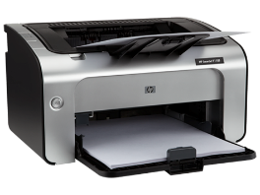
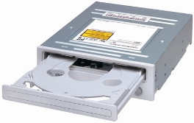
Logical positioning of device drivers
User Space
User
Programs
Rest of
Operating System
Kernel Space
Printer
Driver
CD-Rom
Driver
Printer
Controller
CD-Rom
Controller
Hardware
Device

Slide 20
Functions of device drivers
Device driver accept abstract read and write requests from device independent software.
Device driver must initialize the device if needed.
It also controls power requirement and log event.
It also checks statues of devices. If it is currently in use then queue the request for latter processing. If device is in idle state then request can be handled now.
Pluggable device can be added or removed while the computer is running. At that time the device driver inform CPU that the user has suddenly removed the device from system.

Slide 21
Device Independent I/O Software
Exact boundary between the drivers and the device independent I/O software is system dependent.
Function of device independent I/O Software
Uniform interfacing for device drivers.
Buffering.
Error Reporting.
Allocating and releasing dedicated devices.
Providing a device-independent block size.

Slide 22
Uniform interfacing for device drivers
A major issue of an OS is how to make all I/O devices and drivers look more or less the same.
One aspect of this issue is the interface between the device drivers and the rest of the OS.

Slide 23
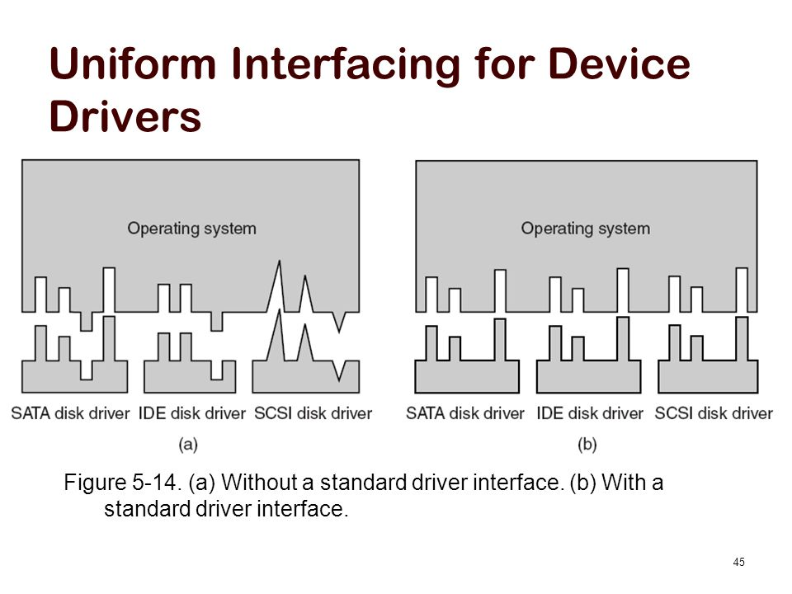
Uniform interfacing for device drivers
Figure shows situation in which each device driver has a different interface to OS, it means that interfacing each new driver requires a lot of new programming effort.

Slide 24
Uniform interfacing for device drivers
Figure shows a different design in which all drivers have the same interface.
Now it becomes much easier to plug in a new driver.

Slide 25
Buffering
Buffering is also issue, both for block and character devices.
In case of a process, which reads the data from the modem, without buffering the user process has to be started up for every incoming character.
We have four different options:
Unbuffered input
Buffering in user space
Buffering in kernel followed by user space
Double buffering in kernel space

Slide 26
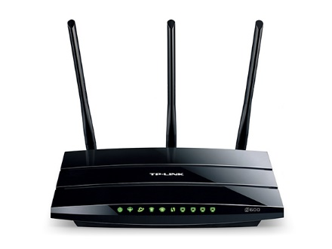
Unbuffered input
No buffer available in user space or kernel space.
Allowing a process to run many times for short runs is inefficient, so this design is not a good one.
User Space
User
Programs
Kernel Space
Modem

Slide 27
Buffering in user space
Buffer in users pace: here user process provides an n-character buffer in user space and does a read of n-characters.
User Space
Kernel Space
Modem

Slide 28
Buffering in kernel space followed by user space
Buffer inside kernel: to create the buffer inside the kernel and interrupt handler is responsible to put the character there.
User Space
Kernel Space
Modem

Slide 29
Double buffering in kernel space
Two buffers in kernel: the first buffer is used to store characters. When it is full, it is being copied to user space. During that time the second buffer is used.
In this way, two buffers take turns.
This is called double buffering scheme.
User Space
Kernel Space
Modem

Slide 30
Error Reporting
Errors are far more common in the context of I/O than in other context. When they occur, the OS must handle them as best it can.
One class of I/O errors is programming errors. These occur when a process asks for something impossible, such as writing to an input device or reading from an output device.
The action taken for these errors is, to report an error code back to the caller.
Another class of error is the class of actual I/O errors, for example trying to write a disk block that has been damaged.
In this case, driver determines what to do and if it does not know the solution then the problem may be passed to the device independent software.

Slide 31
Allocating and releasing dedicated devices
Some devices such as CD-ROM recorders can be used only by a single process at any given moment.
A mechanism for requesting and releasing dedicated devices is required.
An attempt to acquire a device that is not available blocks the caller instead of failing.
Blocked processes are put on a queue, sooner or later the requested device becomes available and the first process on the queue is allowed to acquire it and continue execution.

Slide 32
Providing a device-independent block size
Different disks may have different sector sizes.
It is up to the device independent I/O software to hide this fact and provide a uniform block size to higher layers.

Slide 33
RAID
RAID (RAID – Redundant Array of Independent Disks)
RAID is a data storage virtualization technology that combines multiple physical disk drive components into a single logical unit for the purposes of data redundancy, performance improvement, large storage capacity or all.
Data is distributed across the drives in one of several ways, referred to as RAID levels, depending on the required level of redundancy and performance.
All RAID have the property that the data are distributed over drives, to allow parallel operation.
There are 7 levels of RAID.

Slide 34
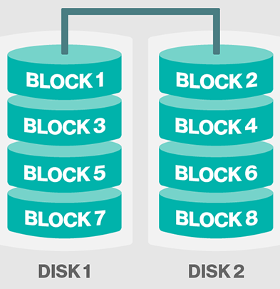
RAID 0
It splits data (file) into blocks of data.
Stripe the blocks across disks in the system.
In the diagram to the right, the odd blocks are written to disk 1 and the even blocks to disk 2.

Slide 35
RAID 0
It is easy to implement.
No parity calculation overhead is involved.
It provides good performance by spreading the load across many channels and drives.
It provides no redundancy or error detection.
Not true RAID because there is no fault tolerance. The failure of just one drive will result in all data in an array being lost.
After certain amount of drives, performance does not increase significantly.
It requires minimum 2 drives to implement.

Slide 36
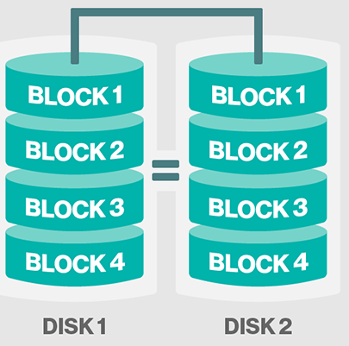
RAID 1
A complete file is stored on a single disk
A second disk contains an exact copy of the file
It provides complete redundancy of data.
Read performance can be improved
Same file data can be read in parallel
Write performance suffers
must write the data out twice

Slide 37
RAID 1
Most expensive RAID implementation.
It requires twice as much storage space.
In case a drive fails, data do not have to be rebuild, they just have to be copied to the replacement drive.
The main disadvantage is that the effective storage capacity is only half of the total drive capacity because all data get written twice.
Software RAID 1 solutions do not always allow a hot swap of a failed drive.
That means the failed drive can only be replaced after powering down the computer it is attached to.
For servers that are used simultaneously by many people, this may not be acceptable. Such systems typically use hardware controllers that do support hot swapping.

Slide 38
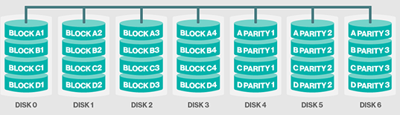
RAID 2
It stripes data at bit level (rather than block level) with dedicated Hamming-code parity.
It uses ECC (Error Correcting Code) to monitor correctness of information on disk.
A parity disk is then used to reconstruct corrupted or lost data.

Slide 39
RAID 2
Imagine splitting each byte into a pair of 4-bit nibbles, then adding Hamming code to each one to form a 7-bit word, of which bit 1, 2 and 4 were parity bits.
In this RAID level 2 each of seven drives needs synchronized in terms of arm position and rotational position, and then it would be possible to write the 7-bit Hamming coded word over the seven drives.
Here, losing one drive did not cause problem, which can be handled by Hamming code on the fly.
Big problem is performance
must have to read data plus ECC code from other disks
for a write, must have to modify data, ECC, and parity disks

Slide 40
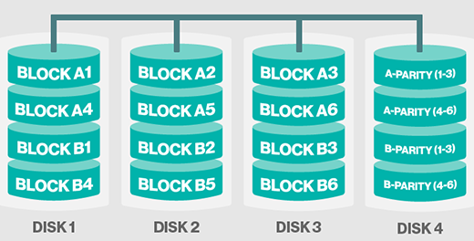
RAID 3
This technique uses striping and dedicates one drive fo storing parity information.
Here single parity bit is computed for each data word and written to a parity drive.
The embedded ECC information is used to detect errors.
As in RAID level 2 the drives must be exactly synchronized.

Slide 41
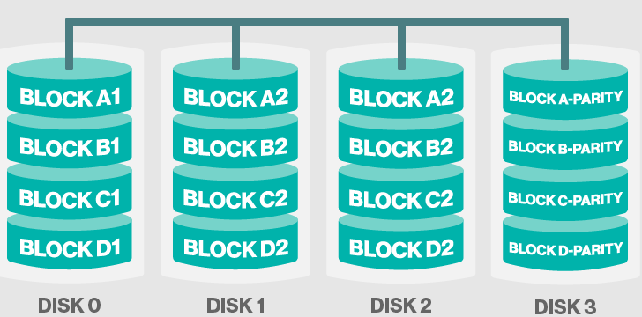
RAID 4
This level uses large stripes, which means you can read records from any single drive.
They do not require synchronization of drives.

Slide 42
RAID 4
RAID level 4 is like RAID level 0, with strip-for-strip parity written onto an extra drive, for example, if each strip is k bytes long, all strips are EXCLUSIVE ORed together, resulting in a parity strip k bytes long.
If a drive crashes, the lost bytes can be recomputed from the parity drive by reading the entire set of drives.
This design protects against the loss of a drive but performs poorly for small updates, if one sector is changed, it is necessary to read all the drives in order to recalculate the parity.
It creates heavy load on parity drive.

Slide 43
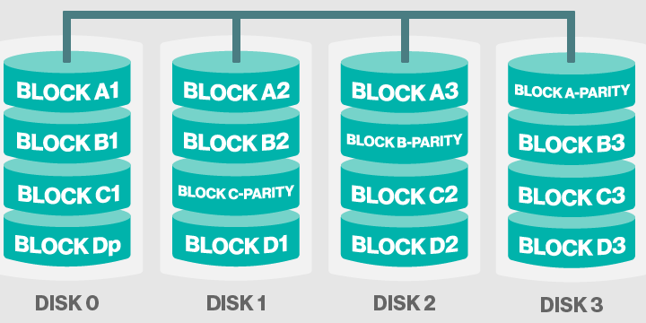
RAID 5
This level is based on block-level striping with parity.
The parity information is striped across each drive.

Slide 44
RAID 5
As with RAID level 4, there is a heavy load in the parity drive, it may become bottleneck.
This bottleneck can be eliminated in RAID level 5 by distributing the parity bits uniformly over all the drives.

Slide 45
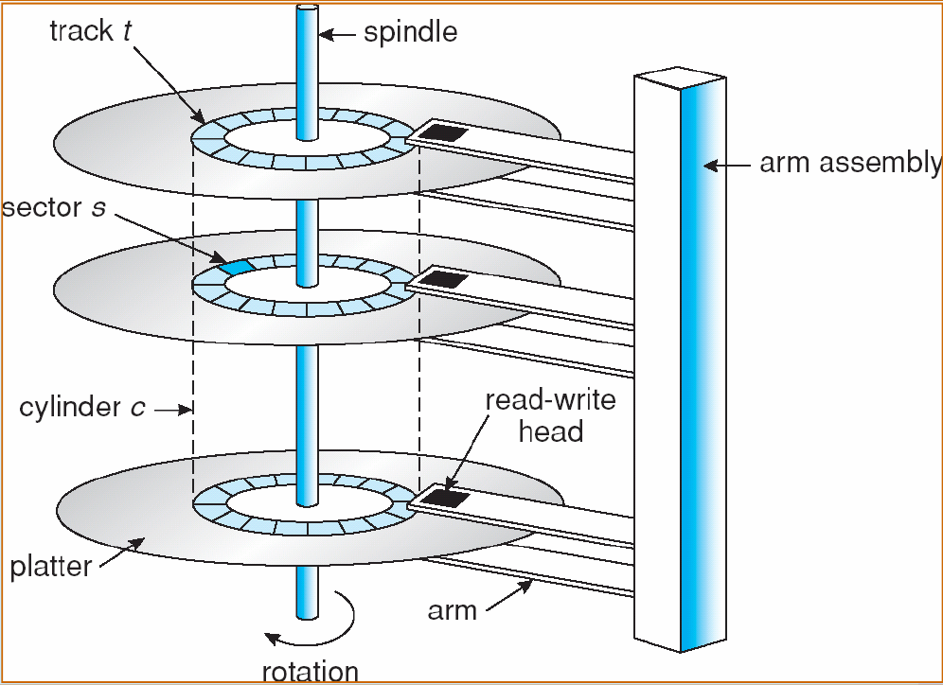
Definitions
Seek time: The time to move the arm to the proper cylinder.
Rotational delay: The time for the proper sector to rotate under the head.

Slide 46
Disk Arm Scheduling Algorithm
Various types of disk arm scheduling algorithms are available to decrease mean seek time.
FCSC (First come first serve)
SSTF (Shorted seek time first)
SCAN
C-SCAN
LOOK (Elevator)
C-LOOK

Slide 47
Example for Disk Arm Scheduling Algorithm
Consider an imaginary disk with 51 cylinders. A request comes in to read a block on cylinder 11. While the seek to cylinder 11 is in progress, new requests come in for cylinders 1, 36, 16, 34, 9, and 12, in that order.
Starting from the current head position, what is the total distance (in cylinders) that the disk arm moves to satisfy all the pending requests, for each of the following disk scheduling Algorithms?

Slide 48
FCSC (First come first serve)
Here requests are served in the order of their arrival.
Disk movement will be 11, 1, 36, 16, 34, 9 and 12.
Total cylinder movement: (11-1) + (36-1) + (36-16) + (34-16) + (34-9) + (9-12) = 111
0
1
9
12
16
34
36
50
11
1, 36, 16, 34, 9, 12
1
36
16
34
9
12

Slide 49
SSTF (Shortest seek time first)
We can minimize the disk movement by serving the request closest to the current position of the head.
Disk movement will be 11, 12, 9, 16, 1, 34, 36.
Total cylinder movement: (12-11) + (12-9) + (16-9) + (16-1) + (34-1) + (36-34) = 61
0
1
9
12
16
34
36
50
11
1, 36, 16, 34, 9, 12
12
9
16
1
34
36

Slide 50
LOOK (Elevator)
Keep moving in the same direction until there are no more outstanding requests pending in that direction, then algorithm switches the direction.
After switching the direction the arm will move to handle any request on the way. Here first go it moves in up direction then goes in down direction.
This is also called as elevator algorithm.
In the elevator algorithm, the software maintains 1 bit: the current direction bit, which takes the value either UP or DOWN.

Slide 51
LOOK (Elevator)
Disk movement will be 11, 12, 16, 34, 36, 9, 1.
Total cylinder movement: (12-11) + (16-12) + (34-16) + (36-34) + (36-9) + (9-1)=60
0
1
9
12
16
34
36
50
11
1, 36, 16, 34, 9, 12
12
16
34
36
9
1

Slide 52
C-LOOK
Keep moving in the same direction until there are no more outstanding requests pending in that direction, then algorithm switches direction.
When switching occurs the arm goes to the lowest numbered cylinder with pending requests and from there it continues moving in upward direction again.

Slide 53
C-LOOK
Disk movement will be 11, 12, 16, 34, 36, 1, 9.
Total cylinder movement: (12-11) + (16-12) + (34-16) + (36-34) +(36-1)+(9-1)=68
0
1
9
12
16
34
36
50
11
1, 36, 16, 34, 9, 12
12
16
34
36
1
9

Slide 54
SCAN
From the current position disk arm starts in up direction and moves towards the end, serving all the pending requests until end.
At that end arm direction is reversed (down) and moves towards the other end serving the pending requests on the way.

Slide 55
SCAN
Disk movement will be 11, 12, 16, 34, 36, 50, 9, 1.
Total cylinder movement: (12-11) + (16-12) + (34-16) +(36-34) +(50-36) + (50-9) + (9-1) = 88
0
1
9
12
16
34
36
50
11
1, 36, 16, 34, 9, 12
12
16
34
36
9
50
1

Slide 56
CSCAN
From the current position disk arm starts in up direction and moves towards the end, serving request until end.
At the end the arm direction is reversed (down), and arm directly goes to other end and again continues moving in upward direction.

Slide 57
CSCAN
Disk movement will be 11, 12, 16, 34, 36, 50, 0, 1,9.
Total cylinder movement: (12-11) + (16-12) + (34-16) +(36-34) +(50-36) + (50-0) + (1-0)+ (9-1) = 98
0
1
9
12
16
34
36
50
11
1, 36, 16, 34, 9, 12
12
16
34
36
0
50
1
9

Slide 58
Example for Disk Arm Scheduling Algorithm
Consider an imaginary disk with 45 cylinders. A request comes in to read a block on cylinder 20. While the seek to cylinder 20 is in progress, new requests come in for cylinders 10, 22, 20, 2, 40, 6, and 38 in that order.
Starting from the current head position, what is the total distance (in cylinders) that the disk arm moves to satisfy all the pending requests and how much seek time is needed for, for each of the disk scheduling algorithms if a seek takes 6 msec per cylinder moved?

