Slide 1

Unit – 7 File Management
Prof. Firoz Sherasiya
 9879879861
→ firoz.sherasiya@darshan.ac.in
Operating System (2140702) Darshan Institute of Engineering & Technology

Slide 2
Topics to be covered
File concept
Access methods
File types
File operation
Directory structure
File System structure
Allocation methods (contiguous, linked, indexed)
Free-space management (bit vector, linked list, grouping)
Directory implementation (linear list, hash table)

Slide 3
File
A file is a unit of storing data on a secondary storage device such as a hard disk or other external media.
Every file has a name and its data.
Operating system associates various information with files. For example the date and time of the last modified file and the size of file etc….
This information is called the file’s attributes or metadata.
The attributes varies considerably from system to system.

Slide 4
File attributes
Below attributes tell who may access it and who may not:
Protection - Who can access the file and in what way.
Password - Password needed to access the file.
Creator - ID of the person who created the file.
Owner - Current owner.

Slide 5
File attributes
Flags are bits or short fields that control or enable some specific property.
Read only flag - 0 for read/write, 1 for read only.
Hidden flag - 0 for normal, 1 for do not display the listings.
System flag - 0 for normal, 1 for system file.
Archive flag - 0 for has been backed up, 1 for needs to be backed up.
Random access flag - 0 for sequential access only, 1 for random access.
Temporary flag - 0 for normal, 1 for delete file on process exit.
Lock flag - 0 for unlocked, 1 for locked.

Slide 6
File attributes
Below attributes are only present in files whose record can be looked up using the key. They provide the information required to find the keys.
Record length - Number of bytes in a record.
Key position - Offset of the key within each record.
Key length - Number of bytes in key field.

Slide 7
File attributes
Various attributes keeps times track of when the file was created, most recently accessed and most recently modified.
Creation time - Date and time the file was created.
Time of last access - Date and time of file was last accessed.
Time of last change - Date and time of file was last changed.

Slide 8
File attributes
Various attributes keeps track of file size.
Current size - Number of bytes in the file.
Maximum size - Number of bytes the file may grow to.

Slide 9
File operations
Create
The purpose of the call is to announce that the file is coming and to set some attributes.
Delete
When the file is no longer needed, it has to be deleted to free up disk space.
Open
The purpose of the open call is to allow the system to fetch the attributes.
Close
When all accesses are finished, the attributes and disk addresses are no longer needed, so the file should be closed to free up table space.

Slide 10
File operations
Read
Data are read from file. Usually the bytes come from the current position.
Write
Data are written to the file, usually at the current position.
Append
This call is restricted form of write. It can only add data to the end of file.
Seek
For a random access files, a method is needed to specify from where to take the data.
Seek repositions the file pointer to a specific place in the file.

Slide 11
File operations
Get attributes
Processes often need to read the file attributes to do their work.
Set attributes
Some of the attributes are user settable and can be changed after the file has been created. This system call makes that possible.
Rename
It frequently happens that a user needs to change the name of an existing file. This system call makes it possible.

Slide 12
Types of files
File Type
Regular File
Directories
ASCII File
Binary File

Slide 13
Regular file Vs Directories
Regular File
Regular files are the ones that contain user information.
Regular file, as a randomly accessible sequence of bytes, has no other predefined internal structure.
Application programs are responsible for understanding the structure and content of any specific regular file.
Directories
Directories are system files for maintaining the structure of the file system.
To keep track of files, file systems normally have directories or folder.

Slide 14
Different types of files
ASCII files
ASCII file consists of line of text.
Advantage of ASCII files is that they can be displayed & printed as it is & they can be edited with ordinary text editor.
If number of programs use ASCII files for input and output, it is easy to connect the output of one program to the input of another.
C/C++/Perl/HTML files are all examples of ASCII files.

Slide 15
Different types of files
Binary Files
Binary files contain formatted information that only certain applications or processors can understand.
Binary files must be run on the appropriate software or processor before humans can read them.
Executable files, compiled programs, spreadsheets, compressed files, and graphic (image) files are all examples of binary files.

Slide 16
Different types of files
Device Files
Under Linux and UNIX each and every hardware device is treated as a file. A device file allows to accesses hardware devices so that end users do not need to get technical details about hardware.
In short, a device file (also called as a special file) is an interface for a device driver that appears in a file system as if it were an ordinary file.
This allows software to interact with the device driver using standard input/output system calls, which simplifies many tasks.

Slide 17
Different types of files
Character Special Files
It is a type of device file which talks to devices in a character by character (1 byte at a time).
Character Special files are related to input/output and use to model serial I/O devices, such as terminals, printers, and networks.
Block Special Files
It is a type of device file which talks to devices 1 block at a time (1 block = 512 bytes to 32KB).
Block special files are used to model disks, DVD/CD ROM, and memory regions etc.

Slide 18
Files access methods
Sequential File Access
In Sequential access, process could read all the bytes or records from a file in order, starting at the beginning, but could not skip around and read them out of order.
Sequential files could be rewound, however, so they could be read as often as needed.
These files were convenient when the storage medium was magnetic tape or CD-ROM.

Slide 19
Files access methods
Random File Access
Files whose bytes or records can be read in any order are called random access files.
Random access files are essentials for many applications, for example, data base systems.
Example: If an airline customer calls up and wants to reserve a seat on a particular flight, the reservation program must be able to access the record for that flight without having to read the records for thousands of other flights.

Slide 20

Directory structure
Single Level Directory system
The simplest form of directory system is having one directory containing all the files. This is some time called as root directory.
Here directory contain three files.
The advantages of this scheme are its simplicity and the ability to locate files quickly there is only one directory to look, after all.
The single level is used for simple dedicated application, but for modern user with thousands of files, it would be impossible to find anything if all files were in a single directory.

Slide 21
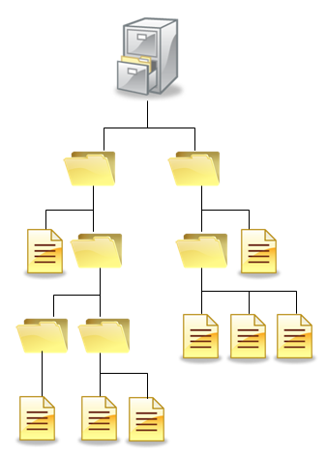
Hierarchical Directory system
In this system user can create an arbitrary number of subdirectories to organize their work.
When the file system is organized as a directory tree, some way is needed for specifying file names.
Two methods are used commonly
Absolute path name
Relative path name

Slide 22
Absolute path name
An absolute path name consisting of the path from the root directory to the file.
As an example, the path /usr /ast/mailbox means that the root directory contains a subdirectory usr, which in turn contains a subdirectory ast, which contain the file mailbox.

Slide 23
Relative path name
Relative path name is used in conjunction with the concept of the working directory.
User can designate one directory as the current working directory, in which case, all path names not beginning at the root directory are taken relative to working directory.
For example if the current working is /usr/ast, then the file whose absolute path is /usr/ast/mailbox can be referenced simply as mailbox.
Most operating systems that support a hierarchical directory system have two special entries in every directory,
“.” or “dot” refers to current directory
“..” or “dotdot” refers to parent directory

Slide 24
Directory operations
Create
A directory is created. It is empty except for dot and dotdot, which are put there automatically by the system.
Delete
A directory is deleted. Only an empty directory can be deleted.
A directory containing only dot and dotdot is considered as an empty directory.

Slide 25
Directory operations
Opendir
Directories can be read.
For example, to list all the files in a directory, a listing program opens the directory to read out the names of all the files it contains.
Before a directory can be read, it must be opened.
Closedir
When a directory has been read, it should be closed to free up space.

Slide 26
Directory operations
Readdir
This call returns the next entry in an open directory.
It was possible to read directories using the usual read system call, but that approach has the disadvantage of forcing the programmer to know and deal with the internal structure of directories.
In contrast, readdir always returns one entry in a standard format, no matter which of the possible directory structure is being used.
Rename
In many respects, directories are just like files and can be renamed the same way files can be.

Slide 27
Directory operations
Link
Linking is a technique that allows a file to appear in more than one directory.
This system call specifies an existing file and a path name, and creates a link from the existing file to the name specified by the path.
In this way, the same file may appear in multiple directories.
Unlink
A directory entry is removed.
If the file being unlinked is only present in one directory (the normal case), it is removed from the file system.
If it is present in multiple directories, only the path name specified is removed. The others remain.

Slide 28
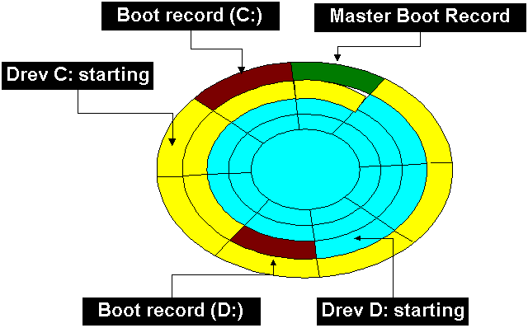
MBR (Master Boot Record)
The Master Boot Record (MBR) is the information in the first sector (sector 0) of hard disk.
It identifies how and where an operating system is located so that it can be boot (loaded) into the computer's main storage or random access memory (RAM).
It is used to boot the computer.
The end of the MBR contains the partition table which gives the starting and ending addresses of each partition

Slide 29
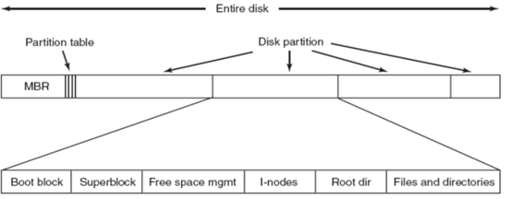
MBR (Master Boot Record)

Slide 30
File system
It is group of files and information regarding them.
The disk space allotted to file system is made up of blocks, each of which are 512 bytes.
All the blocks belonging to file system are logically divided into:
Boot block
Super block
Inode table
Data block

Slide 31
Boot block
It represent the beginning of file system.
It contains a program “bootstrap loader”.
This program is executed when we boot the machine.
All the file system contain one boot block.

Slide 32
Super block
It describe the state of file system.
How large file system is
How many maximum files it can accommodate
How many more files can be created
List of free and allocated blocks
Modification time of the file system

Slide 33
Inode table
The information related to all file (not the content) is stored in an inode table on the disk.
For each file, there is an inode entry in table.
Each entry is made up of 64 bytes and contain the detail for that file.
These details are:
Owner of file
Group to which the owner belongs
Types of file
File access permission
Date and time of last access
Date and time of last modification
Size of file
Address of blocks where the file is physically present

Slide 34
Data block
It contains actual file content.
An allocated block can belong to only one file in the file system.
This block can’t be used for storing any other file’s content unless the file to which it originally belonged is deleted.

Slide 35
File implementation
Various methods to implement files are listed below,
Contiguous Allocation
Linked List Allocation
Linked List Allocation Using A Table In Memory
I-nodes

Slide 36


Contiguous Allocation
The simplest allocation scheme is to store each file as a contiguous run of disk block.
State of the disk after files D and F have been removed

Slide 37
Contiguous Allocation
It is simple to implement because we need to keep track of only the first block and the number of blocks in the file.
Read performance is excellent because the entire file can be read from the disk in a single operation.
Only one seek is needed (to the first block).
Once the disk is filled, reusing the space requires maintaining a list of hole.
However, when a new file is to be created, it is necessary to know its final size in order to choose a hole of the correct size to place it in.

Slide 38
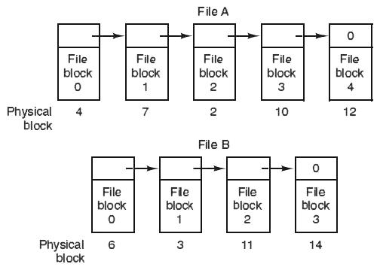
Linked List Allocation
Another method for storing files is to keep each one as a linked list of the disk blocks.
The first word of each block is used as a pointer to the next one. The rest of the block is for data.
No space is lost to disk fragmentation.
Reading a file is extremely slower than Contiguous Allocation.
Less data occupied in block.

Slide 39
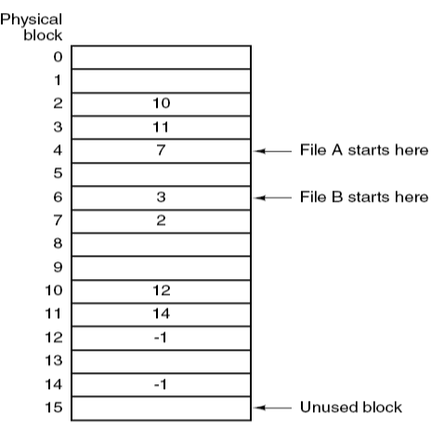
Linked List Allocation Using A Table In Memory
In this method instead of a pointer, a table in memory called file allocation table is used.
Take the pointer word from each block and put it in a table in memory.
Advantage of this method is that random access of files is faster.
The only disadvantage of this method is that the entire table should always be in the memory.

Slide 40
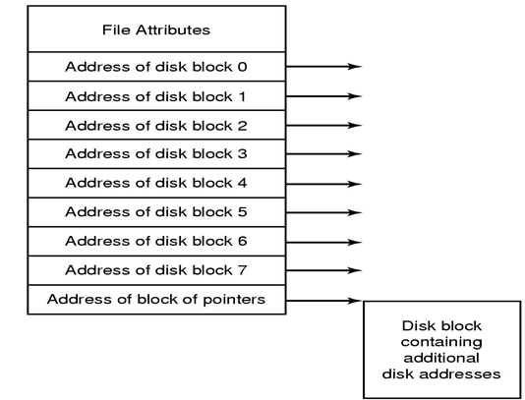
I-nodes
I-node (Index-node) is a data structure used for storing attributes and disk address of a block in memory.
A method for keeping track of which blocks belong to which file is to associate with each file a data structure called an i-node (index-node), which lists the attributes and disk addresses of the file’s blocks.
Here, only the i-node should be in the memory at all times.

Slide 41
Free-space management
Techniques to manage free space are:
bit vector
linked list
grouping

Slide 42
Bit vector
In this method free space list (block) is implemented as a bit map or bit vector.
If the block is free the bit is set to 1.
If the block is allocated the bit is set to 0.
Example:
Consider a disk, where blocks 2, 3, 4, 5, 8, 9, 10, 11, 12, 13, 17, 18, 25, 27 are free and rest of blocks are allocated.
The free space bit map would be:
Advantages
Relatively simple and efficient
Easy to get contiguous files
0 | 1 | 2 | 3 | 4 | 5 | 6 | 7 | 8 | 9 | 10 | 11 | 12 | 13 | 14 | 15 | 16 | 17 | 18 | 19 | 20 | 21 | 22 | 23 | 24 | 25 | 26 | 27
0 | 0 | 1 | 1 | 1 | 1 | 0 | 0 | 1 | 1 | 1 | 1 | 1 | 1 | 0 | 0 | 0 | 1 | 1 | 0 | 0 | 0 | 0 | 0 | 0 | 1 | 0 | 1

Slide 43
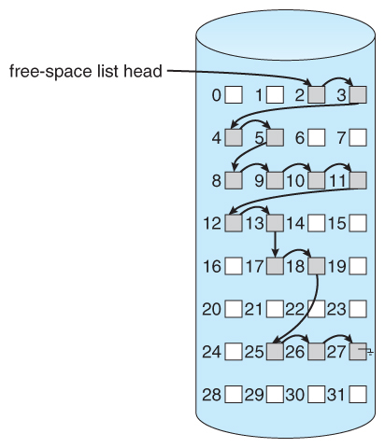
Linked list
It links all free disk blocks together.
Each block contain a pointer to next free blocks, and so on
In figure there is a pointer to block 2, as the first free block.
Block 2 would contain a pointer to block 3.
Which would point 4,5,8,9,10,11,12,13,17,18,25,26,27
Can’t get continuous space easily.
No waste of space.
Not efficient for faster access.

Slide 44
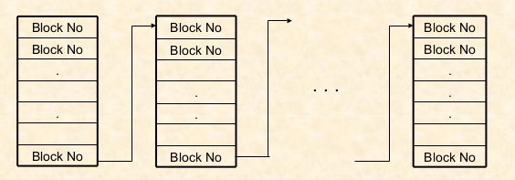
Grouping
It stores addresses of n free blocks in the first free block.
First n-1 of these block are address of free blocks.
Last block contains the pointer of another free block.
Large number of free blocks can be found quickly.

Slide 45
Directory implementation
Linear list
Linear list of file names with pointer to the data blocks
It is simple to program
It is time-consuming to execute
Hash table
It uses hash table – linear list with hash data structure
It decreases directory search time
It may cause collisions – situations where two file names hash to the same location

Slide 46
Efficiency and performance
Efficiency depends on:
Disk allocation and directory algorithms
Type of data kept in file
Example: keep a last write date or last access date
Thus whenever a file is read, a field in the directory structure must be written to.
Performance:
Keep disk cache – a separate section of RAM in the disk controller for frequently used blocks.
Some system maintain a separate section of main memory for a buffer cache.
Improve the performance of system by allocating dedicated section of memory as virtual disk or RAM disk.

Slide 47
Issues in file backup
First should the entire file system be backup or only part of it? It is usually desirable to back up only specific directories and everything in them rather than the entire file system.
It is wasteful to back up files that have no change since the previous backup which leads to the idea of incremental dumps.
Third since huge amount of data are typically dumped, it may be desirable to compress the data before writing them to tape.
It is difficult to perform a backup on an active file system.
Making backups introduces many nontechnical problems into an organization.

Slide 48
Physical dump vs Logical dump
Physical dump:
It is started at block 0 of the disk, writes all the disk blocks onto the output tape in order, and stops when it has copied the last one.
Such program is so simple that it can probably be made 100% bug free.
Main advantages of physical dumping are simplicity and great speed.
Logical dump:
It is started at one or more specified directories and recursively dumps all files and directories found there that have changed since some given base date.
In logical backup individual files can be backed up and restored as per the requirements.

Slide 49
File System Consistency
Two kinds of consistency checks can be made:
Blocks
Files

Slide 50
Block consistency
To check for block consistency, the program builds two tables, each one containing a counter for each block, initially set to 0.
keep track of how many times each block is present in a file
0 | 0 | 0 | 0 | 0 | 0 | 0 | 0 | 0
0 | 0 | 0 | 0 | 0 | 0 | 0 | 0 | 0
record how often each block is present in the free list

Slide 51
Block consistency
If the file system is consistent, each block will have a 1 either in the first table or in the second table.
0 | 1 | 0 | 0 | 1 | 1 | 1 | 0 | 1
1 | 0 | 1 | 1 | 0 | 0 | 0 | 1 | 0

Slide 52
Block consistency
Block number 2 do not occur in either table.
It will be reported as being a missing block.
The solution to missing blocks is straightforward: the file system checker just adds them to the free list.
0 | 1 | 0 | 0 | 1 | 1 | 1 | 0 | 1
1 | 0 | 0 | 1 | 0 | 0 | 0 | 1 | 0
0 | 1 | 0 | 0 | 1 | 1 | 1 | 0 | 1
1 | 0 | 1 | 1 | 0 | 0 | 0 | 1 | 0

Slide 53
Block consistency
Block number 2 occurs twice in the free list.
The solution here is also simple: rebuild the free list.
0 | 1 | 0 | 0 | 1 | 1 | 1 | 0 | 1
1 | 0 | 2 | 1 | 0 | 0 | 0 | 1 | 0
0 | 1 | 0 | 0 | 1 | 1 | 1 | 0 | 1
1 | 0 | 1 | 1 | 0 | 0 | 0 | 1 | 0

Slide 54
Block consistency
Block number 4 occurs twice in two or more files.
The appropriate action for the file system checker to take is to allocate a free block, copy the contents of block 4 into it, and insert the copy into one of the files.
0 | 1 | 0 | 0 | 2 | 1 | 1 | 0 | 1
1 | 0 | 1 | 1 | 0 | 0 | 0 | 1 | 0
0 | 1 | 0 | 0 | 1 | 1 | 1 | 1 | 1
1 | 0 | 1 | 1 | 0 | 0 | 0 | 0 | 0

