Slide 1

Unit – 8 Security
Prof. Firoz Sherasiya
 9879879861
→ firoz.sherasiya@darshan.ac.in
Operating System (2140702) Darshan Institute of Engineering & Technology

Slide 2
Topics to be covered
Design Principles of Security
Domain Protection mechanism
Access metrics mechanism
Access Control list
Trojan Horse, Trap Door, Virus and Warms program threats

Slide 3
Design Principles of Security
Principles of Least Privileges:
This principle states how the privileges are to be granted to a subject.
A subject should be given only those privileges that it requires for completing a task.
For example, if a subject requires append rights to an object then it must be given only the append rights and not the write rights.
Principles of Fail Safe Defaults:
This principle states that unless the subject is given explicit access to the object it should be denied access to that object.
This means that the default access to object is none.
All the access rights should be given explicitly granted.

Slide 4
Design Principles of Security
Principle of Economy of Mechanisms:
This principle states that security mechanism should be as simple as possible.
If design is simple there are fewer chances for errors.
The checking and testing procedure becomes simpler.
Principles of Complete Mediation:
This principle states that all the accesses to object be checked in order to ensure that they are allowed.
Whenever a subject attempts to read an object the OS mediate the action.
First it determines if the subject is allowed to access the object.
If so it provides resources for reading the object.
If the subject reattempts the read operation then it checks if the subject is still allowed to read the object and then allows for reading.

Slide 5
Design Principles of Security
Principle of Open Design:
This principle suggests that complexity doesn’t add security.
This principle states that the security of mechanism should not depend on the secrecy of its design or implementation.
Principles of Separation of Privileges:
This principle states that the access of an object should not depend only on fulfilling a single condition.
There should be multiple conditions required to grant privilege and two or more system components work together to enforce security.

Slide 6
Design Principles of Security
Principles of Least Common Mechanism
This principle states that the amount of mechanism common to and depending on multiple users should be kept to the minimum possible.
Principles of user Acceptability
This principle states that the mechanism used for protection should be acceptable to the users and should be easy to use.
Otherwise, the user may feel a burden to follow the protection mechanism.

Slide 7
Domain protection mechanism
A computer system is collections of objects and processes and these objects and processes are needed to be protected.
Each object has unique name by which it is referred and finite set of operations that processes are allowed to carry out on it.
There should be some way to prohibit processes from accessing objects that they are not authorized to.
Operations that are possible depend on the object.
Object | Operation
CPU | Execution
File | Read, Write
Semaphore | Up, Down
Tape Drive | Read, Write, Rewound

Slide 8
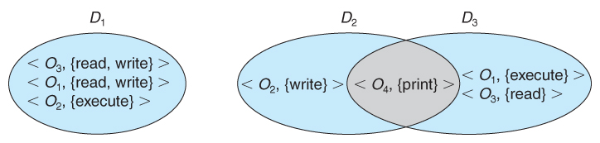
Domain structure
A protection domain specifies the resources that a process may access.
Each domain defines a set of objects and the types of operations that may be invoked on each object.
A domain is defined as a set of < object, {access right set} > pairs.
Note that some domains may be disjoint while others overlap.

Slide 9
Domain structure
The association between a process and a domain may be static or dynamic.
If the association is static, then the need-to-know principle requires a way of changing the contents of the domain dynamically.
If the association is dynamic, then there needs to be a mechanism for domain switching.

Slide 10
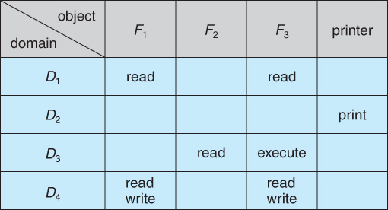
Access matrix
The model of protection can be viewed as an access matrix, in which columns represent different system resources and rows represent different protection domains.
Entries within the matrix indicate what access that domain has to that resource.
Domain switching can be easily supported under this model, simply by providing "switch" access to other domains:

Slide 11
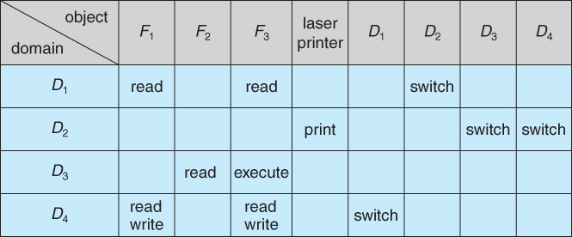
Access matrix

Slide 12
Access matrix
The ability to copy rights is denoted by an asterisk, indicating that processes in that domain have the right to copy that access within the same column, i.e. for the same object.
If the asterisk is removed from the original access right, then the right is transferred, rather than being copied.
If only the right and not the asterisk is copied, then the access right is added to the new domain, but it may not be propagated further.
That is the new domain does not also receive the right to copy the access.

Slide 13
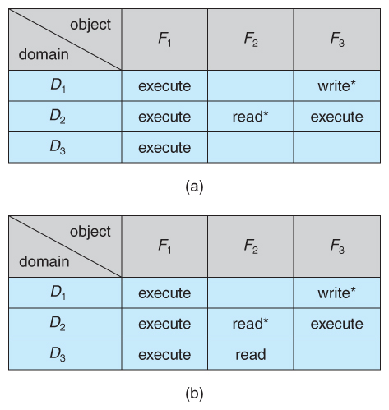
Access matrix with copy rights

Slide 14
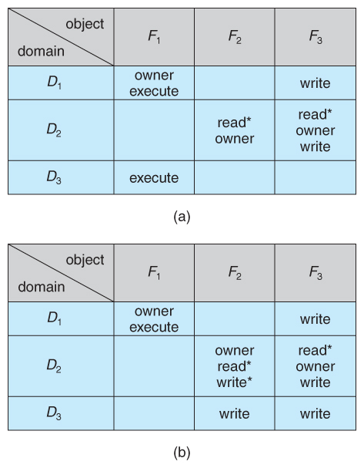
Access matrix
The owner right adds the privilege of adding new rights or removing existing ones:

Slide 15
Trojan Horse
A Trojan horse is a standalone malicious program which may give full control of infected PC to another PC.
Trojan horses may make copies of them, steal information, or harm the host computer systems.
The Trojan horse, at first glance will appear to be useful software but will actually do damage once installed or run on your computer.
Trojans are designed for different purpose like changing your desktop, adding silly active desktop icons or they can cause serious damage by deleting files and destroying information on your system.

Slide 16
Trojan Horse
Trojans are also known to create a backdoor on your computer that gives unauthorized users access to your system, possibly allowing confidential or personal information to be compromised.
Unlike viruses and worms, Trojans do not reproduce by infecting other files nor do they self-replicate. Means Trojan horse viruses differ from other computer viruses in that they are not designed to spread themselves.
Most popular Trojan horses are Netbus, Subseven, Y3K Remote Administration Tool, Back Orifice, Beast, Zeus, The Blackhole Exploit Kit, Flashback Trojan.

Slide 17
Trap Door
A trap door is a secret entry point into a program that allows someone that is aware of the trap door to gain access without going through the usual security access procedures.
We can also say that it is a method of bypassing normal authentication methods.
It is also known as back door.
Trap doors have been used legally for many years by programmers to debug and test programs.
Trap doors become threats when they are used by dishonest programmers to gain unauthorized access.
It is difficult to implement operating system controls for trap doors.
Security measures must focus on the program development and software update activities.

Slide 18
Virus
A computer virus is a computer program that can replicate itself and spread from one computer to another.
Viruses can increase their chances of spreading to other computers by infecting files on a network file system or a file system that is accessed by other computers.
A computer virus is a program or piece of code that is loaded onto your computer without your knowledge and runs against your wishes.
Viruses can also replicate themselves.
All computer viruses are manmade.

Slide 19
Worms program threats
A worm is a program which spreads usually over network connections.
Unlike a virus which attaches itself to a host program, worms always need a host program to spread.
Worms are not normally associated with one person computer systems.
They are mostly found in multi-user systems such as UNIX environments.
A classic example of a worm is Robert Morris is Internet worm 1988.

