Slide 1
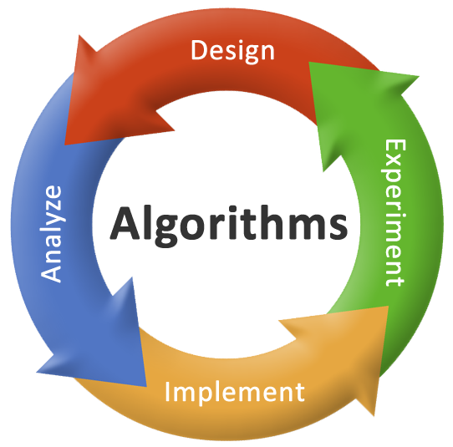

Unit – 1 Basics of Algorithms and Mathematics
Gopi Sanghani
 02822-293032
→ gopi.sanghani@darshan.ac.in
Basics of Algorithms and Mathematics Darshan Institute of Engineering & Technology

Slide 2
Topics to be Covered
What is an algorithm?
Characteristics
Types
Simple Multiplication Methods
Mathematics for Algorithmic Sets
Set Theory
Functions and Relations
Vectors and Matrices
Linear Inequalities and Linear Equations
Logic and Quantifiers

Slide 3
What is an algorithm?
Broadly an algorithm can be defined as;
A process or a set of rules to be followed to achieve desired output, especially by a computer.
A step-by-step procedure, to solve the different kinds of problems.
An unambiguous sequence of computational steps that transform the input into the output.
An algorithm is any well-defined computational procedure that takes some value, or set of values, as input and produces some value, or set of values as output.

Slide 4
Characteristics of an algorithm
Finiteness: An algorithm must always terminate after a finite number of steps.
Definiteness: Each step of an algorithm must be precisely defined.
Input: An algorithm has zero or more inputs.
Output: An algorithm must have at least one desirable output.
Effectiveness: All the operations to be performed in the algorithm must be sufficiently basic so that they can in principle be done exactly and in a finite length of time.

Slide 5
Types of Algorithm
Simple recursive algorithms
Backtracking algorithms
Divide and conquer algorithms
Dynamic programming algorithms
Greedy algorithms
Branch and bound algorithms
Brute force algorithms
Randomized algorithms

Slide 6
Simple Multiplication Example
1. American approach
2. English approach
9 8 1
9 8 1
1
2
3
4
1
2
3
4
3 9 2 4
9 8 1
2 9 4 3
1 9 6 2
1 9 6 2
2 9 4 3
9 8 1
3 9 2 4
1 2 1 0 5 5 4
1 2 1 0 5 5 4

Slide 7
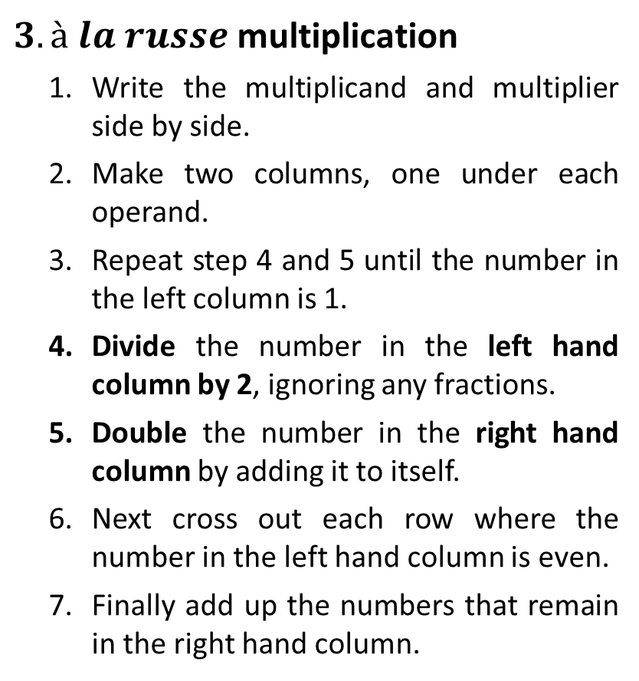
Simple Multiplication Example
$3. à$ $la russe$multiplication
Write the multiplicand and multiplier side by side.
Make two columns, one under each operand.
Repeat step 4 and 5 until the number in the left column is 1.
Divide the number in the left hand column by 2, ignoring any fractions.
Double the number in the right hand column by adding it to itself.
Next cross out each row where the number in the left hand column is even.
Finally add up the numbers that remain in the right hand column.
981
1234
1234
490
2468
245
4936
4936
122
9872
61
19744
19744
30
39488
15
78976
78976
7
157952
157952
3
315904
315904
1
631808
631808
1210554

Slide 8
Simple Multiplication Example
4. Multiplication by divide and conquer
Both the multiplicand and the multiplier must have the same number of digits and this number be a power of 2.
If not then it can be done by adding zeros on the left if necessary.

Slide 9
Simple Multiplication Example
4. Multiplication by divide and conquer
Multiply left half of the multiplicand by left half of multiplier and shift the result by no. of digits of multiplier i.e. 4.
Multiply left half of the multiplicand by right half of the multiplier, shift the result by half the number of digits of multiplier i.e. 2.
Multiply right half of the multiplicand by left half of the multiplier, shift the result by half the number of digits of multiplier i.e. 2.
Multiply right half of the multiplicand by right half of the multiplier the result is not shifted at all.
Multiplicand = 0 9 8 1
Multiplier = 1 2 3 4
Multiply | Shift | Result
(09) * (12) | 4
1
0
8
.
.
.
.
(09) * (34) | 2
3
0
6
.
.
(81) * (12) | 2
9
7
2
.
.
(81) * (34) | 0
2
7
5
4
1 2 1 0 5 5 4

Slide 10

Exercises
Multiply following values using divide and conquer method.
$4567×6543$
$31415975×8182818$

Slide 11















To multiply $3141 5975$with $0818 2818$
Multiply | Shift | Result
$$3141∗0818$$
$$8$$
$$256933800000000$$
Multiply | Shift | Result
$$31∗08$$
$$4$$
$$2480000$$
$$31∗18$$
$$2$$
$$55800$$
$$41∗08$$
$$2$$
$$32800$$
$$41∗18$$
$$0$$
$$738$$
$$2569338$$

Slide 12













To multiply $3141 5975$with $0818 2818$
Multiply | Shift | Result
$$3141∗0818$$
$$8$$
$$256933800000000$$
$$3141∗2818$$
$$4$$
$$88513380000$$
$$5975∗0818$$
$$4$$
$$48875500000$$
$$5975 ∗2818$$
$$0$$
$$16837550$$
$$257071205717550$$
Multiply | Shift | Result
$$31∗28$$
$$4$$
$$8680000$$
$$31∗18$$
$$2$$
$$55800$$
$$41∗28$$
$$2$$
$$114800$$
$$41∗18$$
$$0$$
$$738$$
$$8851338$$

Slide 13
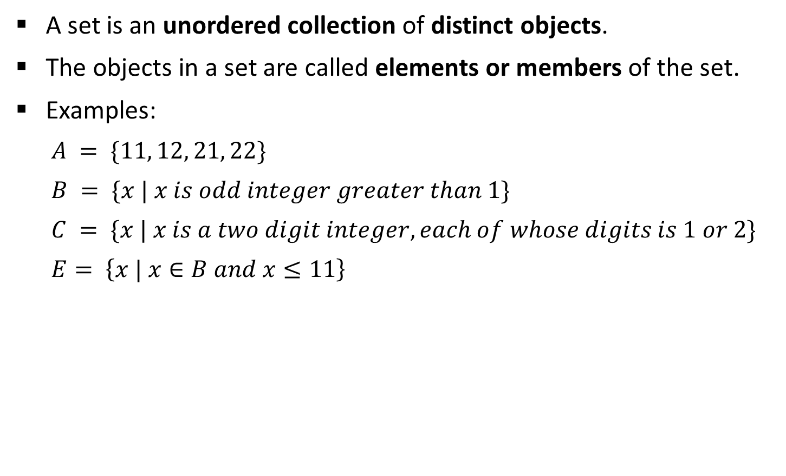
Mathematics for Algorithmic Sets
A set is an unordered collection of distinct objects.
The objects in a set are called elements or members of the set.
Examples:
$$A = \{11, 12, 21, 22\}$$
$$B = \{x | x is odd integer greater than 1\}$$
$$C = \{x | x is a two digit integer, each of whose digits is 1 or 2\}$$
$$E= \left\{x | x∈B and x≤11\right\}$$
Value notation
Property notation

Slide 14

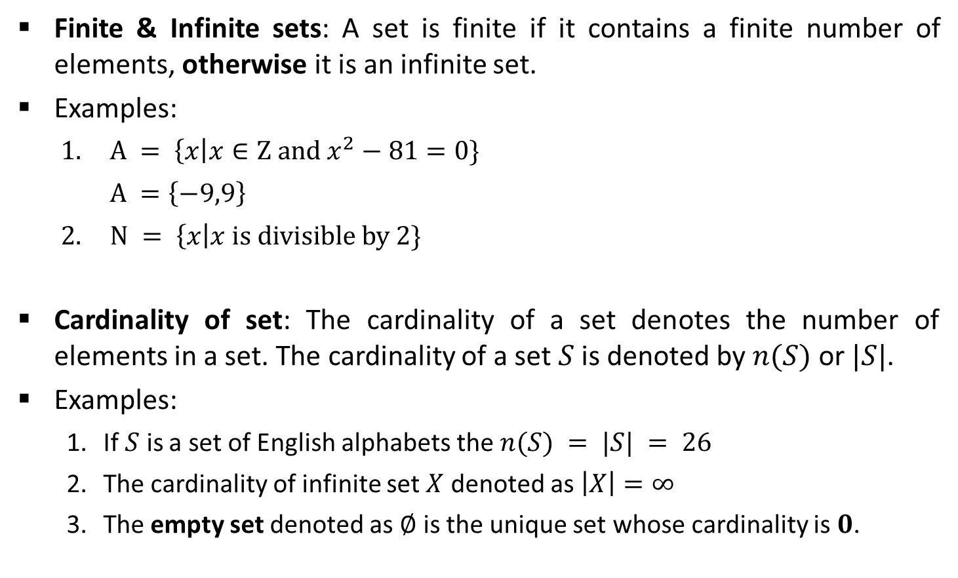

Set Theory
Finite & Infinite sets: A set is finite if it contains a finite number of elements, otherwise it is an infinite set.
Examples:
$A = \left\{x\right|x∈Z and x^{2}−81=0\}$
$$A =\left\{−9,9\right\}$$
$N = \left\{x\right|x is divisible by 2\}$
Cardinality of set: The cardinality of a set denotes the number of elements in a set. The cardinality of a set $S$ is denoted by $n(S)$ or $|S|$.
Examples:
If $S$ is a set of English alphabets the $n(S) = |S| = 26$
The cardinality of infinite set $X$ denoted as $\left|X\right|=∞$
The empty set denoted as $∅$ is the unique set whose cardinality is $0$.
Set $A$ is a finite set
Set $N$ is an infinite set

Slide 15

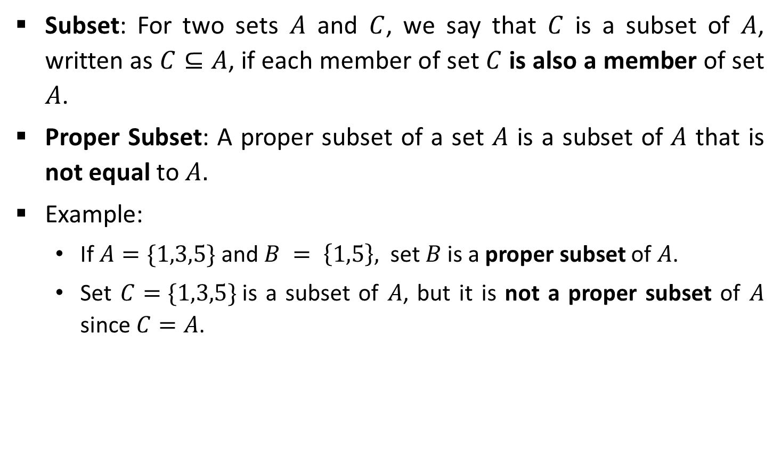

Set Theory
Subset: For two sets $A$ and $C$, we say that $C$ is a subset of $A$, written as $C⊆A$, if each member of set $C$ is also a member of set 𝐴.
Proper Subset: A proper subset of a set $A$ is a subset of $A$ that is not equal to $A.$
Example:
If $A=\{1,3,5\}$and $B = \left\{1,5\right\},$ set $B$ is a proper subset of $A$.
Set $C=\{1,3,5\}$is a subset of $A$, but it is not a proper subset of $A$ since $C=A$.
$$B\text{⊂}A$$
$$C⊆A$$
A
A=C
B

Slide 16

Set Theory
Power Set: Let $A$ be the set. The power set of $A$, written as $P(A)$, is the set of all subsets of $A$.
Example:
$A= \{0, 1\}$then the power set of $A is \{\{\}, \{0\}, \{1\}, \{0, 1\}\}$

Slide 17

Set Theory
Complement: The complement of a set $A$ is the set $A’$ that contains every element of the Universal set U but not in A.
$A′ = \{x | x ∈U and x∉A\}$
Example:
Consider $U = \{1, 3, 5, 7, 9\}$and $A = \left\{1, 5\right\}$
Then $A′= \{3, 7, 9\}$
A’
A
U

Slide 18

Set Operations
Union: The union of two different sets $A$ and $B$ is the set of all distinct elements of sets $A$ and $B$.
$A ∪ B = \{x | x ∈ A or x ∈ B\}$
Example:
Consider $A = \{1, 3, 5, 7, 9\}$and $B = \{1, 2, 3, 4, 5\}$
Then $A ∪ B = \{1, 2, 3, 4, 5, 7, 9\}$
A
B
A
B

Slide 19
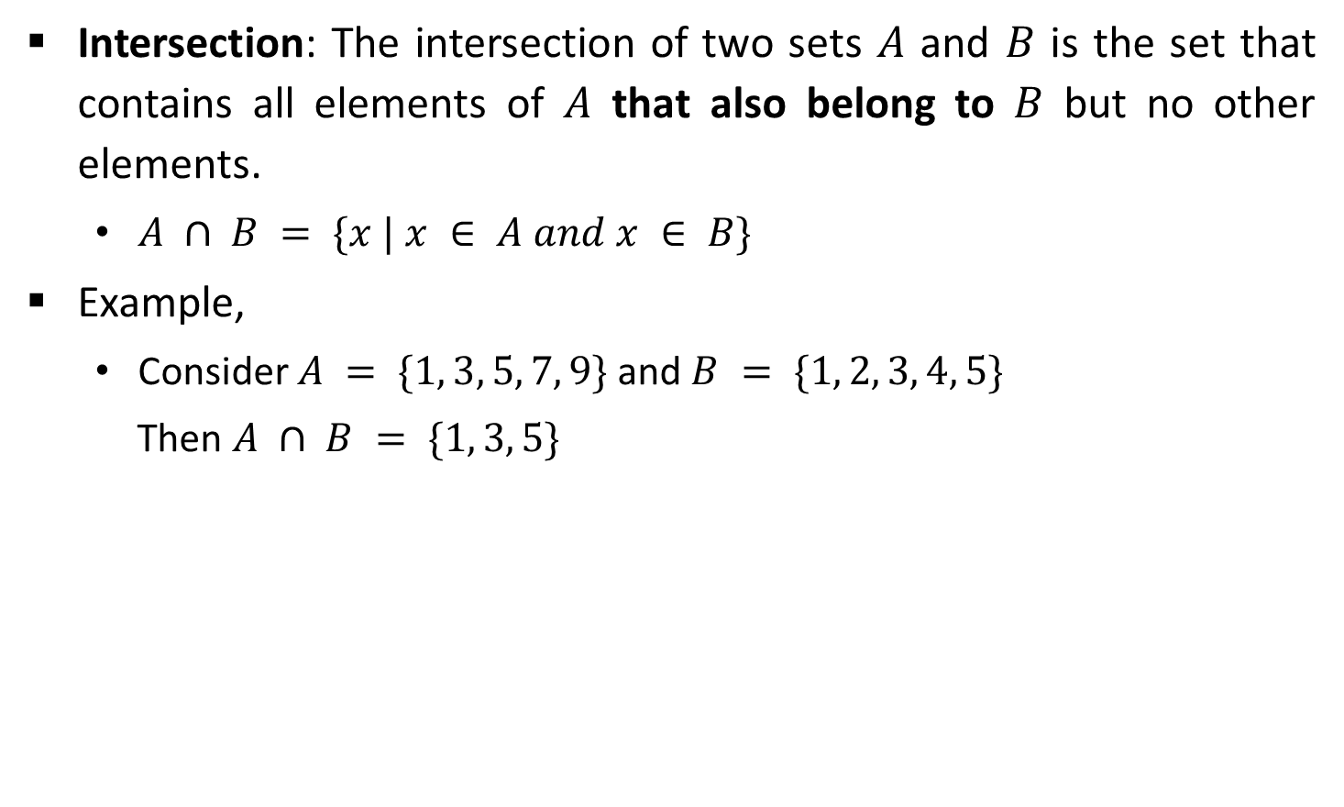
Set Operations
Intersection: The intersection of two sets $A$ and $B$ is the set that contains all elements of $A$ that also belong to $B$ but no other elements.
$A ∩ B = \{x | x ∈ A and x ∈ B\}$
Example,
Consider $A = \{1, 3, 5, 7, 9\}$and $B = \{1, 2, 3, 4, 5\}$
Then $A ∩ B = \{1, 3, 5\}$
A
B

Slide 20

Set Operations
Set Difference: The set difference $A − B$of two sets $A$ and $B$ is the set of elements that are in $A$ but not in $B$.
$A – B = \{x | x ∈ A and x ∉ B\}$
Example
Consider $A = \{1, 3, 5, 7, 9\}$and $B = \{1, 2, 3, 4, 5\}$
Then $A − B = \{7, 9\}$
A
A
B

Slide 21

Set Operations
Symmetric Difference: The symmetric difference $A ⊖ B$ of two sets $A$ and $B$ is the elements that are in $A$ but not in $B$ and the elements that are in $B$ but not in $A$.
$A ⊖ B = (A – B) ∪(B – A)$
Example
Consider, $A = \{1, 3, 5, 7, 9\}$and $B = \{1, 2, 3, 4, 5\}$
Then $A ⊖ B = \{7, 9, 2, 4\}$
A
A
B
B

Slide 22
Set Operations
Sequences: A sequence of objects is a list of objects in some order.
Example: the sequence 7, 21, 57 would be written as (7, 21, 57)
In a set the order does not matter but in a sequence it does.
Repetition is not permitted in a set but repetition is permitted in a sequence. So, (7, 7, 21, 57) is different from (7, 21, 57).
Tuples: Finite sequences are called tuples.
Examples:
(7, 21) 2-tuple or pair
(7, 21, 57) 3-tuple
(7, 21, ..., k ) k-tuple

Slide 23




Set Operations
Cartesian Product: The Cartesian product $A × B$ of two sets $A$ and $B$ is the set of all ordered pairs $(a, b)$where $a∈A$and $b∈B$.
$A×B = \{(a, b) | a ∈ A and b ∈ B\}$
Example:
$$(1, x)$$
$$(1, y)$$
$$A$$
$$\{1,2,3\}$$
$$B$$
$$\{x, y\}$$
$$(2, x)$$
$$(2, y)$$
$$(3, x)$$
$$(3, y)$$
$$A×B$$

Slide 24
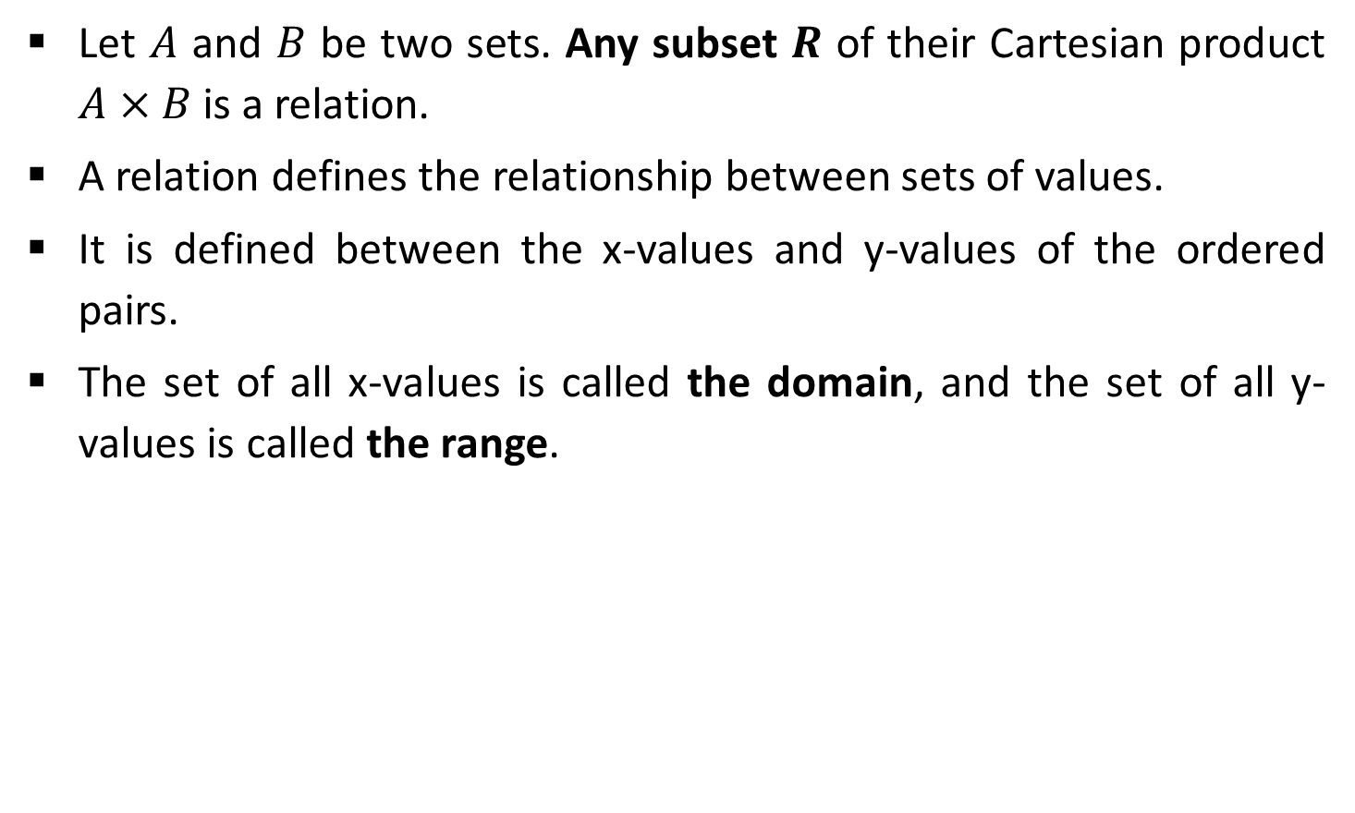
Relation
Let $A$ and $B$ be two sets. Any subset $R$ of their Cartesian product $A×B$is a relation.
A relation defines the relationship between sets of values.
It is defined between the x-values and y-values of the ordered pairs.
The set of all x-values is called the domain, and the set of all y-values is called the range.

Slide 25
Properties of the Relation
Reflexive: Let $A$ be a set, and let $R$ be a binary relation on $A$. Relation $R$ is reflexive if,
$∀x:[(x∈A)→((x, x)∈R)]$
Examples:
Consider $A =\{1, 2\}$and $R = \{(a,b) | a≤b\}$ $R = \left\{\left(1,1\right), \left(1,2\right), \left(2,2\right)\right\}$
$A = \left\{1,2,3,4\right\}, R = \{(1,1), (1,2), (2,1), (2,2), (3,4), (4,1), (4,4)\}$
Reflexive
Relation $R$ is Not Reflexive since $(3,3) ∉ R$

Slide 26
Properties of the Relation
Symmetric: A relation $R$ on a set $A$ is called symmetric if $(y, x)∈R$whenever $(x, y)∈R$, for some $x, y∈A$.
$$∀x:∀y:[((x, y)∈R)→((y, x)∈R)]$$
Examples:
$A=\{1,2,3\}$and $R=\{(a,b)|a≠b\}$ So, $R=\{(1,2),(1,3),(2,1),(2,3),(3,1),(3,2)\}$
$A = \{ 1, 2, 3\}$and $R = \{(a,b) | a ≤ b\}$ So, $R = \{(1,1), (1,2), (1,3), (2,2),(2,3),(3,3)\}$
Symmetric
Asymmetric

Slide 27

Properties of the Relation
Transitive: A relation $R$ on a set $A$, is called transitive if whenever $(x,y)∈R$and $(y,z)∈R$, then $(x,z)∈R$, for $x, y, z∈A$.
$$∀x:∀y:∀z[([(x, y)∈R]∧[(y, z)∈R])→((x, z) ∈ R)]$$
Example:
Consider $A=\{ 1, 2, 3\}$and $R=\{(a,b) | a ≤ b\}$
So, $R=\{(1,1), (1,2), (1,3), (2,2),(2,3),(3,3)\}$
Transitive

Slide 28
Equivalence Relation
Equivalence Relation declares or shows some kind of equality or equivalence.
If the relation satisfies all three properties reflexive, symmetric and transitive then it is called an Equivalence Relation.
Equality ‘=’ relation is the equivalence relation because equality proves the required conditions.
Reflexive: $x=x$ is true for all values of $x$.
Symmetric: $x=y$ and $y=x$ is true for all values of $x$ and $y$.
Transitive: if $x=y$ and $y=z$ is true for all values then we can say that $x=z$.

Slide 29

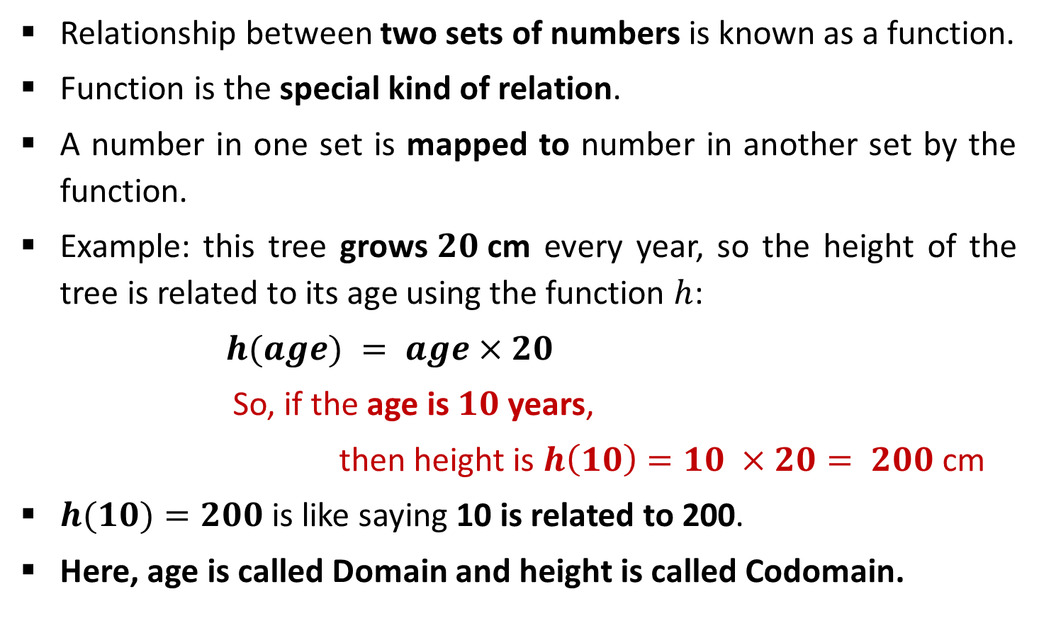
Functions
Relationship between two sets of numbers is known as a function.
Function is the special kind of relation.
A number in one set is mapped to number in another set by the function.
Example: this tree grows$20$cm every year, so the height of the tree is related to its age using the function $h$:
$$h(age) = age×20$$
So, if the age is $10$ years,
then height is $h\left(10\right)=10 ×20= 200$cm
$h(10)=200$is like saying 10 is related to 200.
Here, age is called Domain and height is called Codomain.

Slide 30


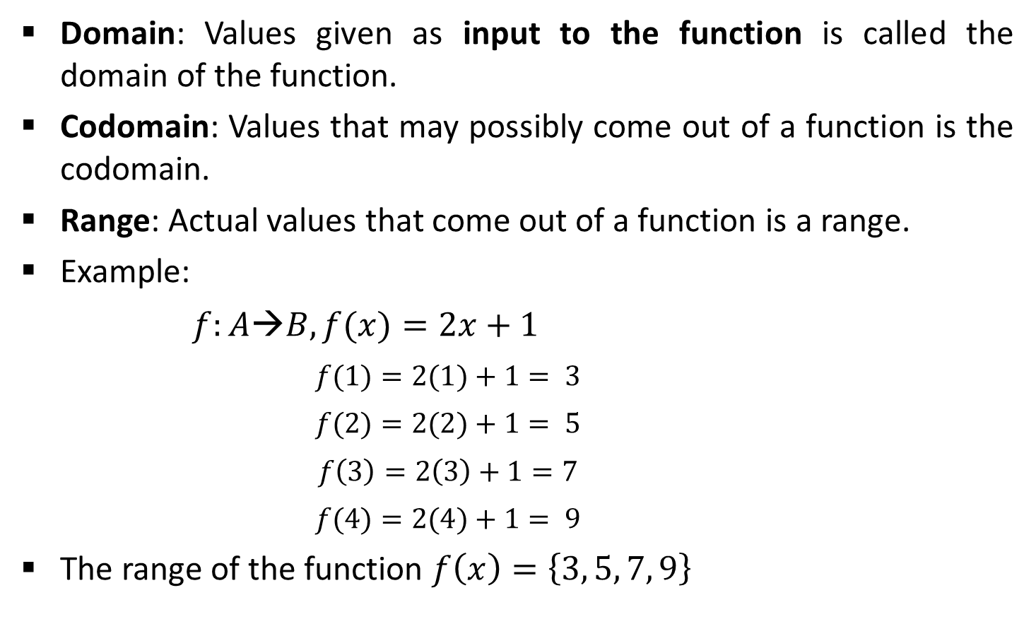



Function Notations
Domain: Values given as input to the function is called the domain of the function.
Codomain: Values that may possibly come out of a function is the codomain.
Range: Actual values that come out of a function is a range.
Example:
$$f:A→B, f(x)=2x+1$$
$$f(1)=2(1)+1= 3$$
$$f(2)=2(2)+1= 5$$
$$f\left(3\right)=2\left(3\right)+1=7$$
$$f(4)=2(4)+1= 9$$
The range of the function $f\left(x\right)=\left\{3, 5, 7, 9\right\}$
Codomain
$$1$$
2
3
4
5
6
7
8
9
10
$$1$$
Domain
$$2$$
$$3$$
$$4$$
Domain
Codomain

Slide 31
Relation & Function
Relation 1
Relation 2
Is not a function since elements of domain point to multiple elements of codomain.
Is a function since elements of domain point to only one element of codomain.
Ana
Mit
Sam
Yug
Jen
Tom
Ram
Neel
CX
CY
CZ
Ana
Yug
Ram
Mit
CX
CY
CZ
Division (Domain)
Students (Codomain)
Students (Domain)
Division (Codomain)

Slide 32





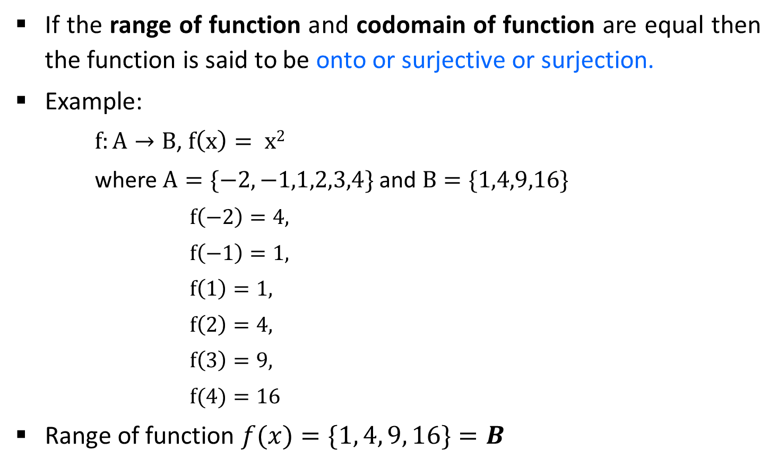







Functions
If the range of function and codomain of function are equal then the function is said to be onto or surjective or surjection.
Example:
$f:A→B$, $f\left(x\right)= x2$
where $A=\{−2,−1,1,2,3,4\}$and $B=\{1,4,9,16\}$
$$f\left(−2\right)=4,$$
$$f\left(−1\right)=1,$$
$$f\left(1\right)=1,$$
$$f\left(2\right)=4,$$
$$f\left(3\right)=9,$$
$$f(4)=16$$
Range of function $f(x)=\{1, 4, 9, 16\}=B$
Codomain
$$A$$
-$2$
$$B$$
-$1$
$$1$$
$$1$$
$$4$$
$$2$$
$$9$$
$$3$$
$$4$$
$$16$$

Slide 33











Functions
A function $f:A→B$is injective or one-to-one if there do not exist two distinct $x1$and$x2$such that $f(x1)=f(x2).$
The function $f:A →B$, $f(x)=x+1$is a one-to-one function,
where $A=\{1, 2, 3, 4\}$and $B=\{2, 3, 4, 5\}$
$$1$$
$$2$$
$$2$$
$$3$$
$$3$$
$$4$$
$$4$$
$$5$$
$$A$$
$$B$$

Slide 34

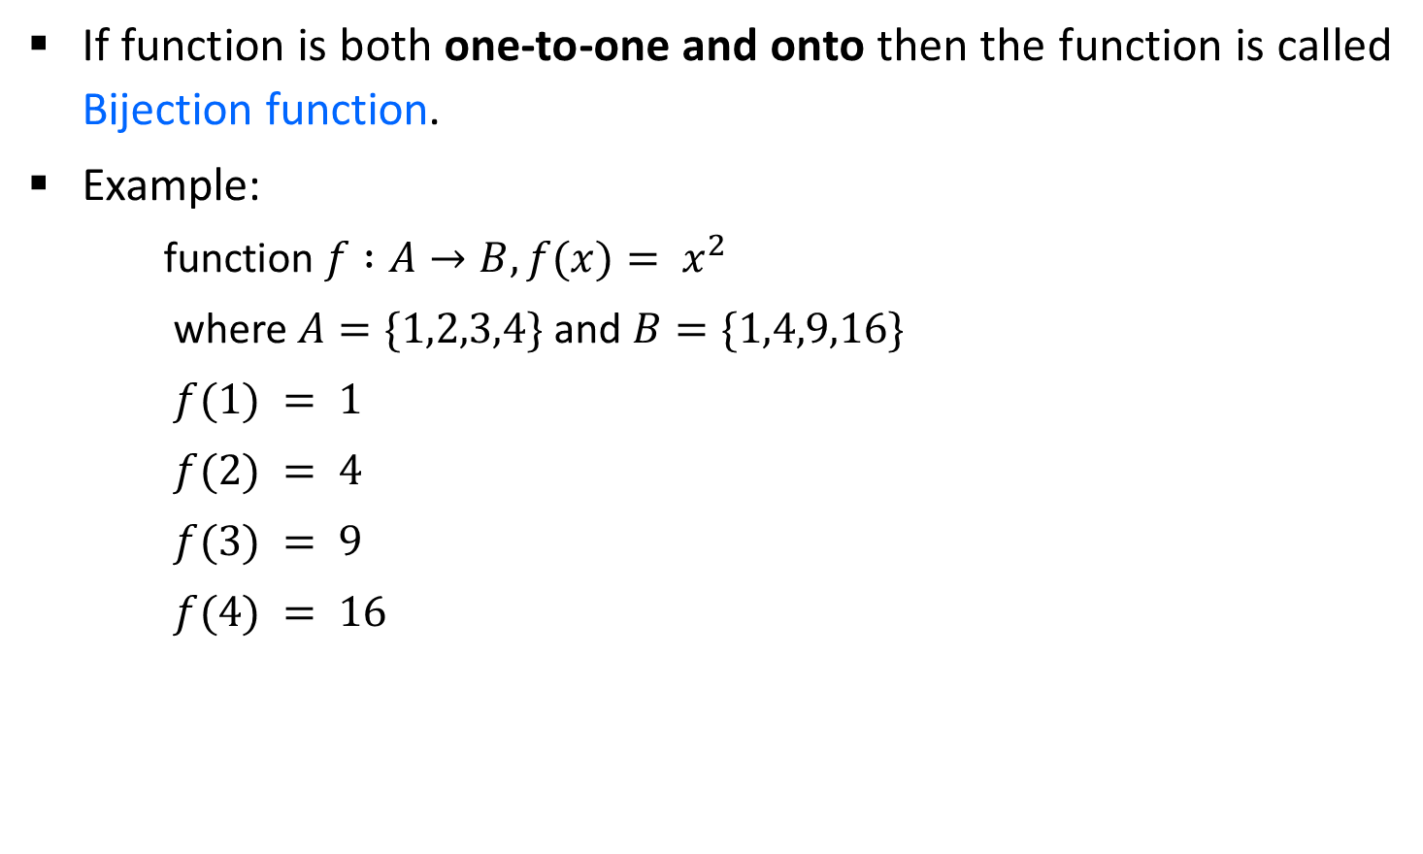

Functions
If function is both one-to-one and onto then the function is called Bijection function.
Example:
function $f :A→B, f(x)= x^{2}$
where $A=\{1,2,3,4\}$and $B=\{1,4,9,16\}$
$$f(1) = 1$$
$$f(2) = 4$$
$$f(3) = 9$$
$$f(4) = 16$$
$$A$$
$$B$$
1
1
2
4
3
9
16
4

Slide 35

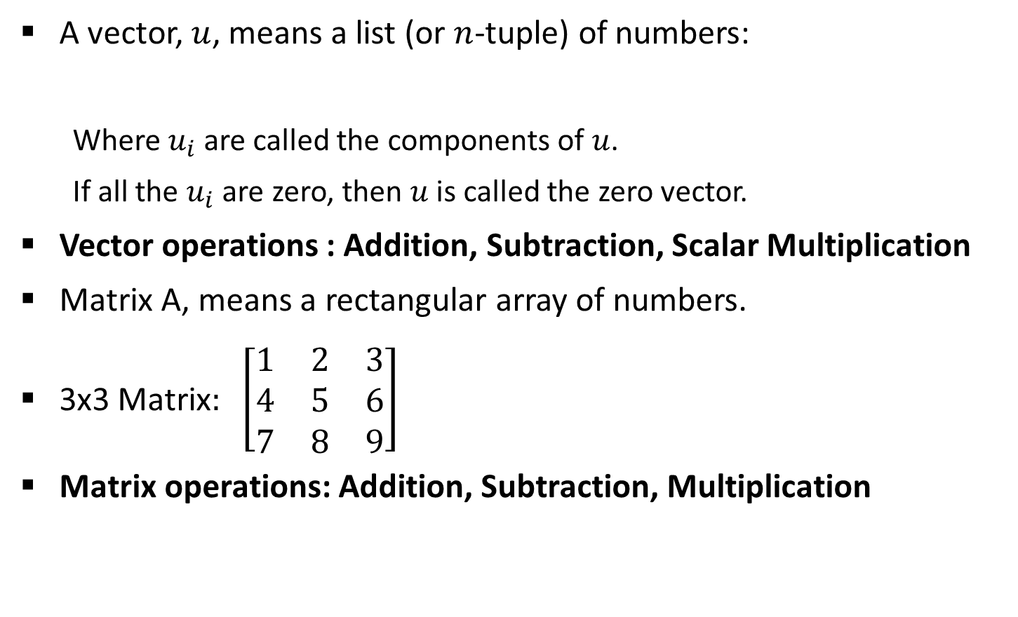
Vectors and Matrices
A vector, $u$, means a list (or $n$-tuple) of numbers:
Where$u_{i}$are called the components of $u$.
If all the $u_{i}$ are zero, then $u$ is called the zero vector.
Vector operations : Addition, Subtraction, Scalar Multiplication
Matrix A, means a rectangular array of numbers.
3x3 Matrix$: \left[\begin{matrix}1 & 2 & 3 \\ 4 & 5 & 6 \\ 7 & 8 & 9\end{matrix}\right]$
Matrix operations: Addition, Subtraction, Multiplication
$$u = (u_{1}, u_{2}, . . . , u_{n})$$

Slide 36

Linear Inequalities
Inequalities: The term inequality is applied to any statement involving one of the symbols <, >, ≤, ≥.
Examples of inequalities are:
$x≥1$
$x + y + 2z > 16$
$p2 + q2 ≤1/2$
$a2 + ab > 1$

Slide 37

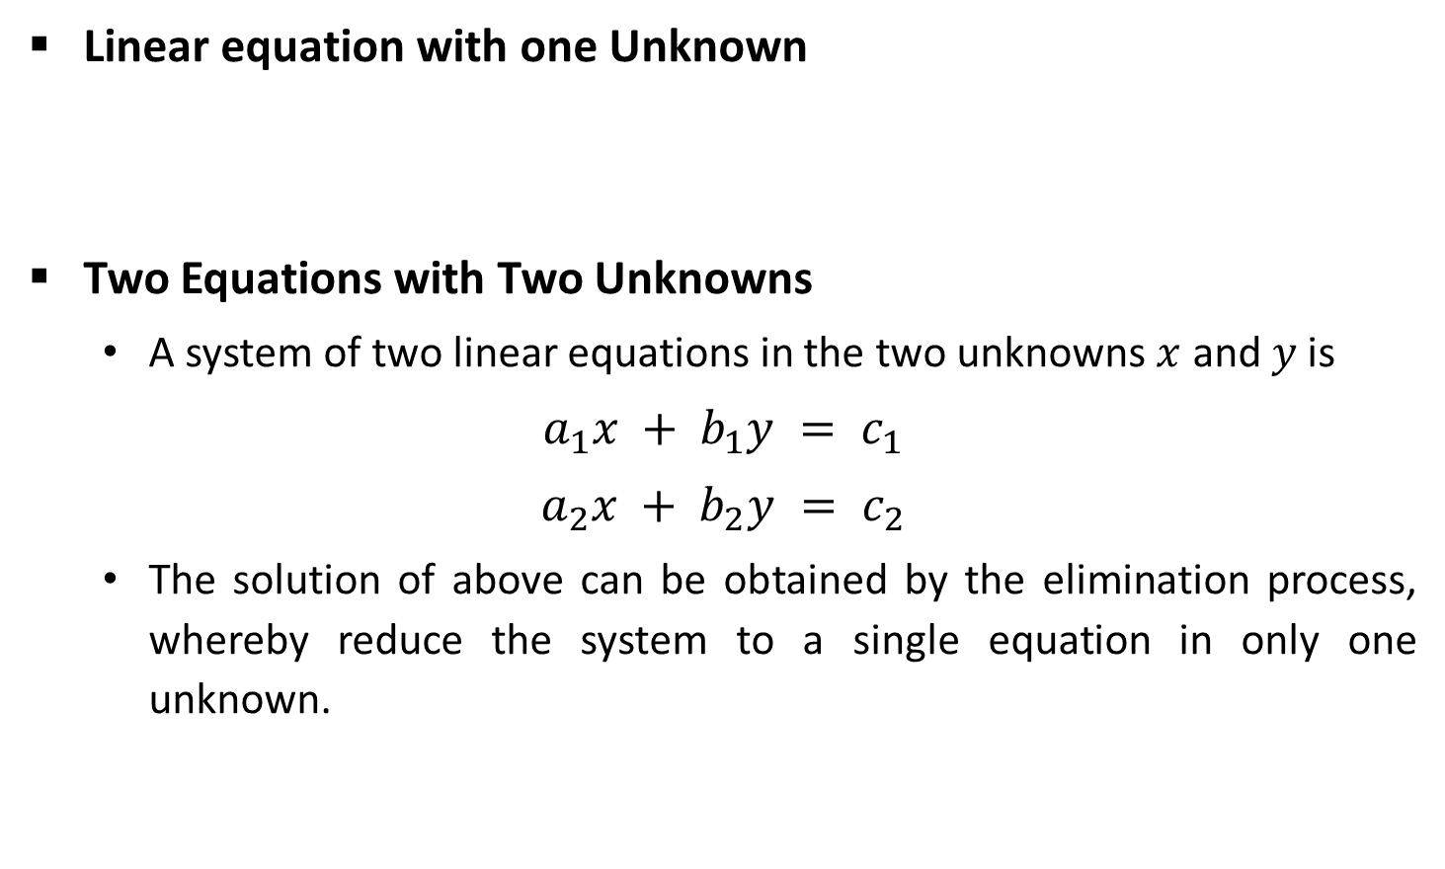

Linear Equations
Linear equation with one Unknown
Two Equations with Two Unknowns
A system of two linear equations in the two unknowns $x$ and $y$ is
$$a_{1}x + b_{1}y = c_{1}$$
$$a_{2}x + b_{2}y = c_{2}$$
The solution of above can be obtained by the elimination process, whereby reduce the system to a single equation in only one unknown.
$$x=\frac{b}{a}$$
$$ax = b$$
Solution

Slide 38
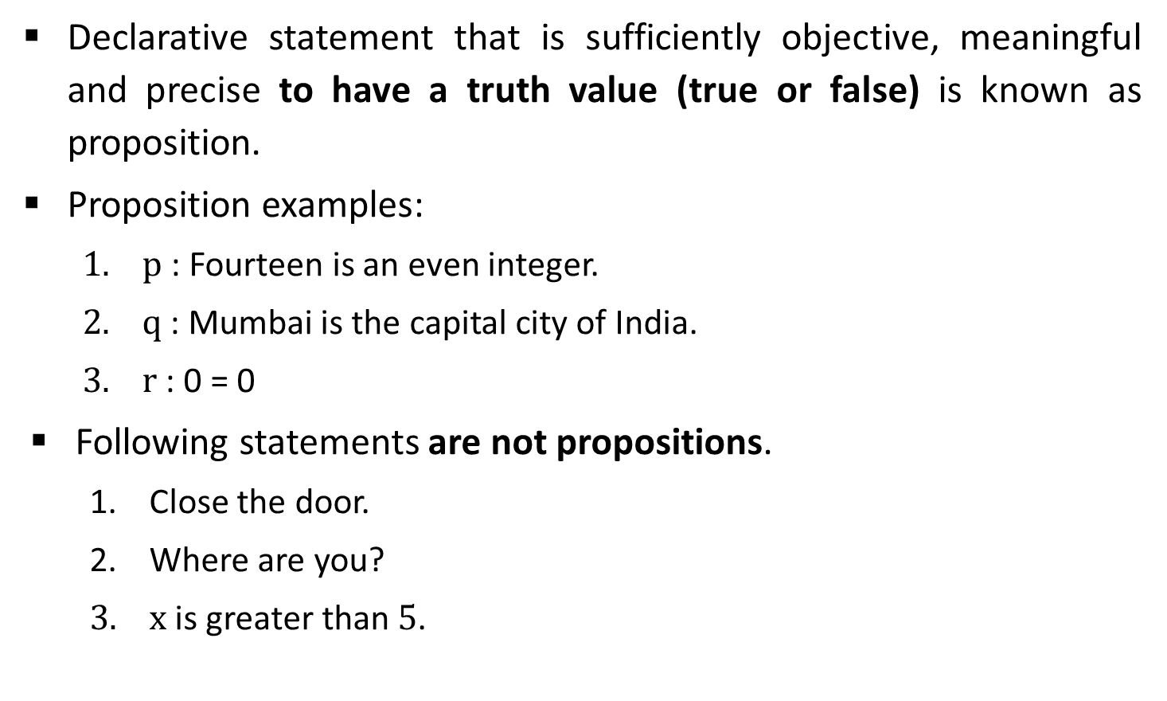
Logic
Declarative statement that is sufficiently objective, meaningful and precise to have a truth value (true or false) is known as proposition.
Proposition examples:
$p$ : Fourteen is an even integer.
$q$ : Mumbai is the capital city of India.
$r$ : 0 = 0
Following statements are not propositions.
Close the door.
Where are you?
$x$ is greater than $5$.

Slide 39
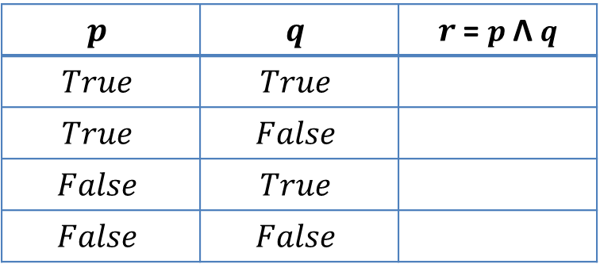

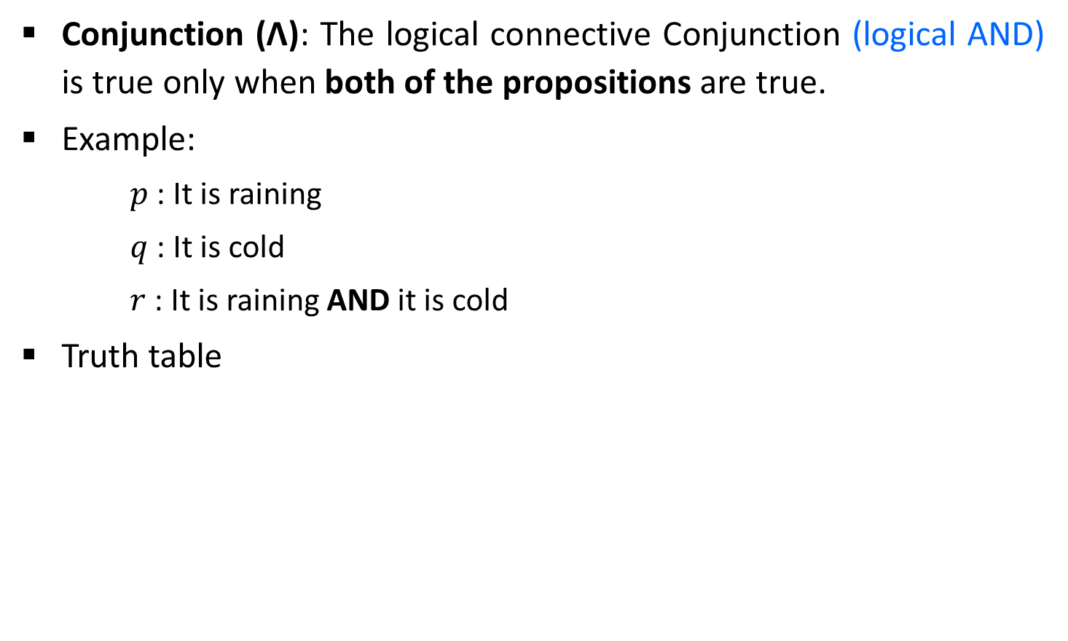



Logical Connectives
Conjunction ($\text{Ʌ}$): The logical connective Conjunction (logical AND) is true only when both of the propositions are true.
Example:
$p$ : It is raining
$q$ : It is cold
$r$ : It is raining AND it is cold
Truth table
$$p$$ | $$q$$ | $r$ = $p \text{Ʌ} q$
$$True$$ | $$True$$
$$True$$ | $$False$$
$$False$$ | $$True$$
$$False$$ | $$False$$
$$True$$
$$False$$
$$False$$
$$False$$

Slide 40
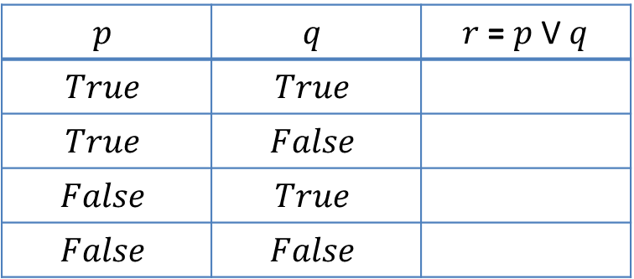





Logical Connectives
Disjunction (V): The logical disjunction, or logical OR, is true if one or both of the propositions are true.
Example:
$$p : 2+2=5$$
$$q : 1<2$$
$$r : 2+2=5 OR 1<2$$
Truth table
$$p$$ | $$q$$ | $r$ = $p$ V $q$
$$True$$ | $$True$$
$$True$$ | $$False$$
$$False$$ | $$True$$
$$False$$ | $$False$$
$$True$$
$$True$$
$$True$$
$$False$$

Slide 41






Logical Connectives
Negation (¬): $➢p$, the negation of a proposition $p$, is also a proposition.
Example:
$p$ : John studies.
$➢ p$ : John does NOT study.
Truth table
$$p$$ | $$➢ p$$
$$True$$
$$False$$
$$False$$
$$True$$

Slide 42
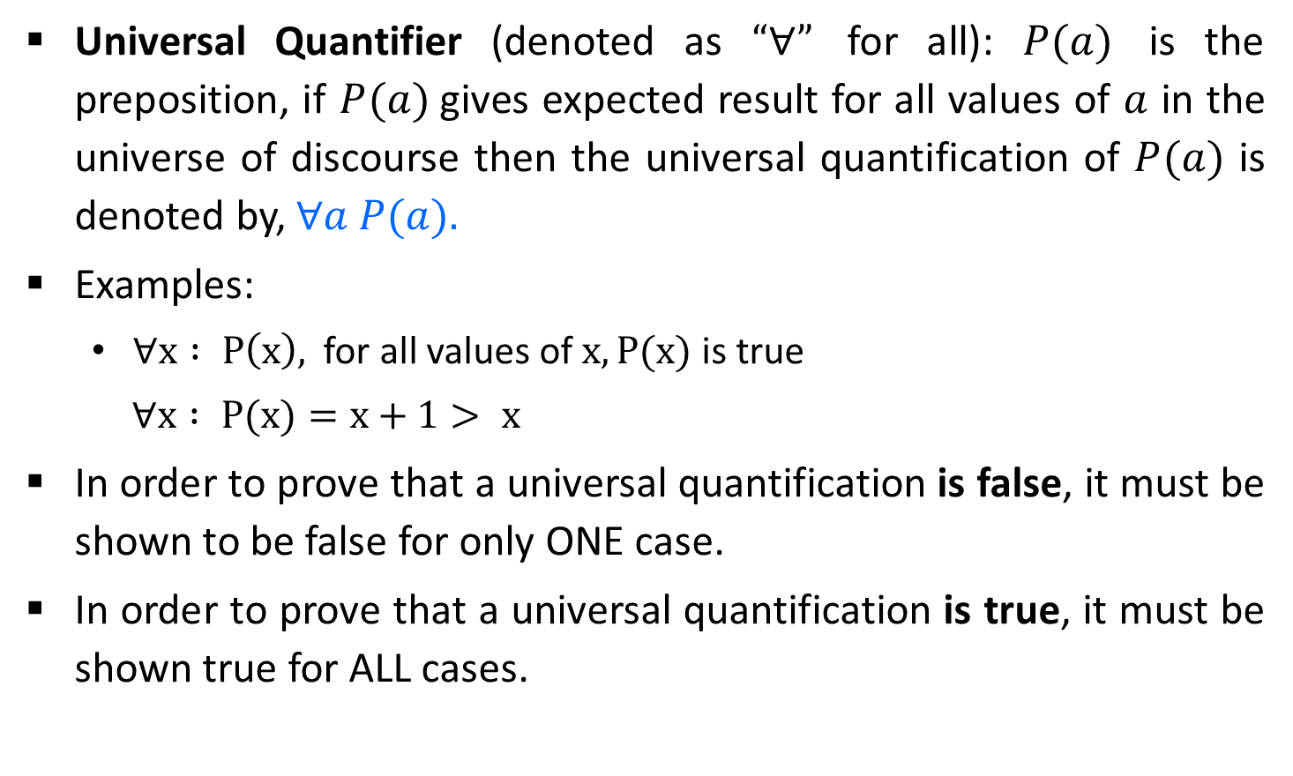
Logical Quantifiers
Universal Quantifier (denoted as $“∀”$ for all): $P(a)$ is the preposition, if $P(a)$gives expected result for all values of $a$ in the universe of discourse then the universal quantification of $P(a)$ is denoted by, $∀a P(a).$
Examples:
$∀x : P\left(x\right),$ for all values of $x, P(x)$is true
$$∀x : P(x)=x+1> x$$
In order to prove that a universal quantification is false, it must be shown to be false for only ONE case.
In order to prove that a universal quantification is true, it must be shown true for ALL cases.

Slide 43
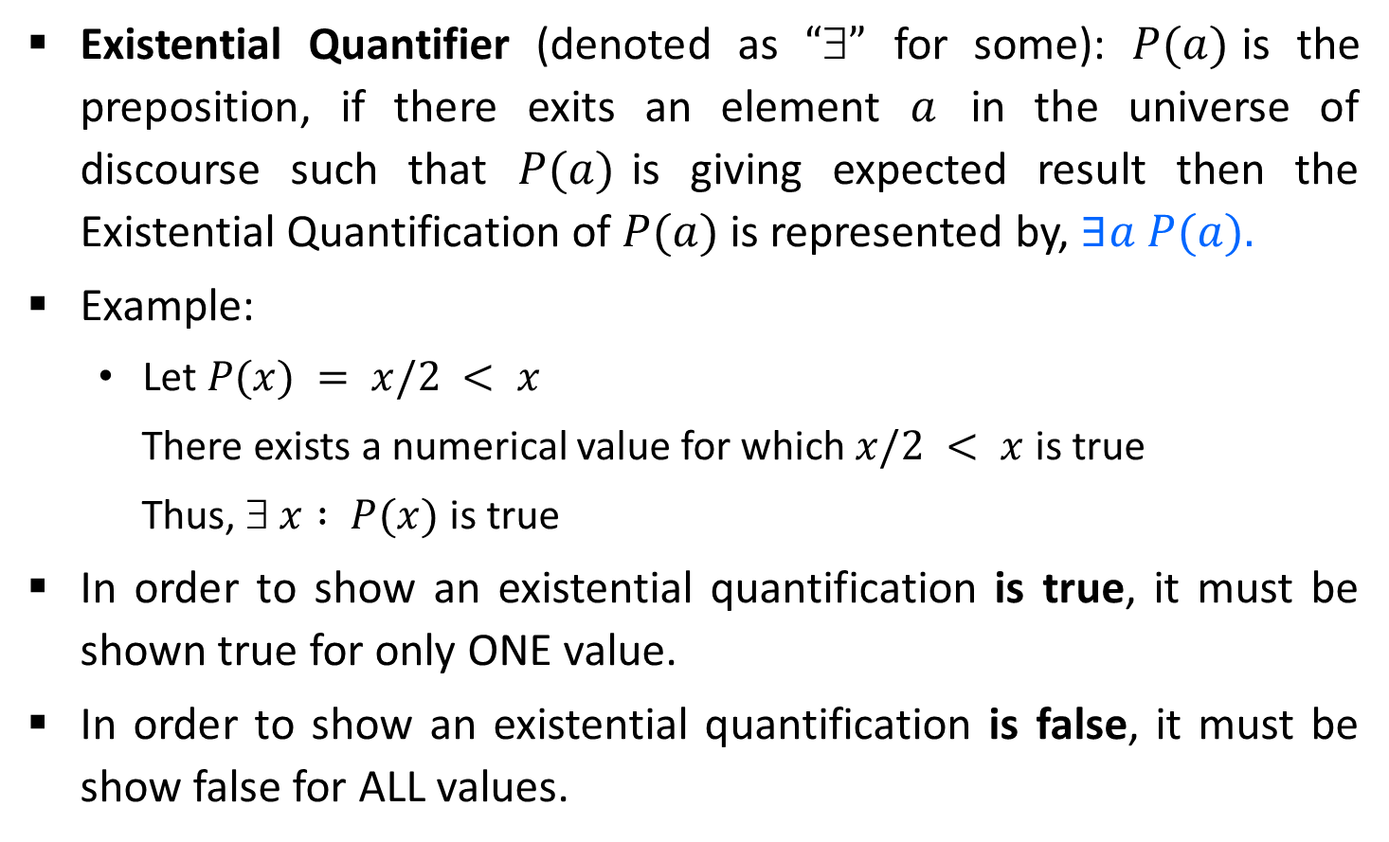
Logical Quantifiers
Existential Quantifier (denoted as $“”$ for some): $P(a)$is the preposition, if there exits an element $a$ in the universe of discourse such that $P(a)$is giving expected result then the Existential Quantification of $P(a)$ is represented by, $∃a P(a).$
Example:
Let $P(x) = x/2 < x$
There exists a numerical value for which $x/2 < x$is true
Thus, $ x : P(x)$is true
In order to show an existential quantification is true, it must be shown true for only ONE value.
In order to show an existential quantification is false, it must be show false for ALL values.

Slide 44
GTU Questions
Define the term: Quantifier
Define the term: Algorithm
What is vector? Which operations are performed on vector?
List types of algorithms.
Discuss key characteristics of algorithm.
Explain Equivalence Relation with example.

Slide 45


