Slide 1


UNIT-7 Backtracking & Branch & Bound
Prof. Rupesh G. Vaishnav
rupesh.vaishnav@darshan.ac.in
94280-37452
Analysis and Design of Algorithm (2150703) Darshan Institute of Engineering & Technology

Slide 2
Outline
Introduction
The Eight queens problem
Knapsack problem
Travelling Salesman problem
Minimax principle
Notes:
X.800 and RFC 2828
International Telecommunication Union (ITU)

Slide 3
Backtracking
It is a recursive algorithm technique
It generates state space tree for all possible solutions
It traverse state space tree in depth first order

Slide 4
The n-queens problem
K-Promising solution
A solution is called k-promising if it arranges queens such a way that they can not threat each other.
Two queens of same row or column or diagonal can threat each other.
Q
Q
Q
Q
 | Q
1 - Promising Solution
0 - Promising Solution
0 - Promising Solution
0 - Promising Solution

Slide 5
The 4-queen problem
 | 1 | 2 | 3 | 4
 | Q
 | 1 | 2 | 3 | 4
 | Q
 | Q | Q | Q
 | Q | Q | Q | Q
 | 1 | 2 | 3 | 4
 |  |  | Q
 | Q
 | Q | Q | Q | Q
 | Q | Q
1 - Promising
2 - Promising
4 – Promising
<3, 1, 4, 2>
 | 1 | 2 | 3 | 4
1 |  | Q
2 |  |  |  | Q
3 | Q
4 |  |  | Q
Above 4-promising solution can be written as
<3, 1, 4, 2>
Another possible solution is
<2, 4, 1, 3>
4 – Promising <2, 4, 1, 3>

Slide 6
N- Queen problem
Number of Queens | Possible Solutions
1 | 1
2 | 0
3 | 0
4 | 2
5 | 10
6 | 4
7 | 40
8 | 92
9 | 352
10 | 724

Slide 7
[2,4,0,0]
 | 1 | 2 | 3 | 4
1 |  | Q
2 |  |  |  | Q
3 | Q
4 |  |  | Q
Sol =
[2,4,1,0]
K =
[2,0,0,0]
1
3
[2,4,1,3]
4
2
col =
{2,4}
{2}
diag45 =
{2}
{2,3,-2}
{2,4,1}
{2,3}
diag135 =
{2,5}
{2}
{2,5,4}
procedure queens (k, col, diag45, diag135)
{sol[1..k] is k-promising,
col = {sol[i] | 1≤i≤k},
diag45 = {sol[i]–i+1 | 1≤i≤k}, and
diag135 = {sol[i]+i–1 | 1≤i≤k}}
if k = 4 then
write sol
else
for j ← 1 to 4 do
if j ∉ col and j – k ∉ diag45 and j + k ∉ diag135
then sol[k+1]← j
queens(k + 1, col U {j}, diag45 U {j - k}, diag135 U {j + k})
3- Promising
1- Promising
4- Promising
2- Promising
j = 1
j = 4
j = 2
j = 3
j = 1
J - k = 3
J - k = 2
J - k = 0
J + k = 3
J + k = 5
J - k = -1
J + k = 2

Slide 8
sol[1…8] is global array, for all solutions to the eight queens problem call queens(0, ∅, ∅, ∅)
procedure queens (k, col, diag45, diag135)
{sol[1..k] is k-promising,
col = {sol[i] | 1≤i≤k},
diag45 = {sol[i]–i+1 | 1≤i≤k}, and
diag135 = {sol[i]+i–1 | 1≤i≤k}}
if k = 8 then {an 8-promising vector is a solution}
write sol
else {explore (k+1)-promising extensions of sol }
for j ← 1 to 8 do
if j ∉ col and j – k ∉ diag45 and j + k ∉ diag135 ∉ sol[k+1] ← j
then sol[k+1]← j
{sol[1..k+1] is (k+1)-promising}
queens(k + 1, col U {j}, diag45 U {j - k}, diag135 U {j + k})

Slide 9
n-Queens State Space Tree
1
2
4
3
2
4
1
3
4
1
2
4
3
3
4
2
4
2
3
3
4
1
4
1
3
2
4
1
4
1
1
4
3
4
2
3
2
4
3
4
1
3
1
4
2
4
1
2
1

Slide 10
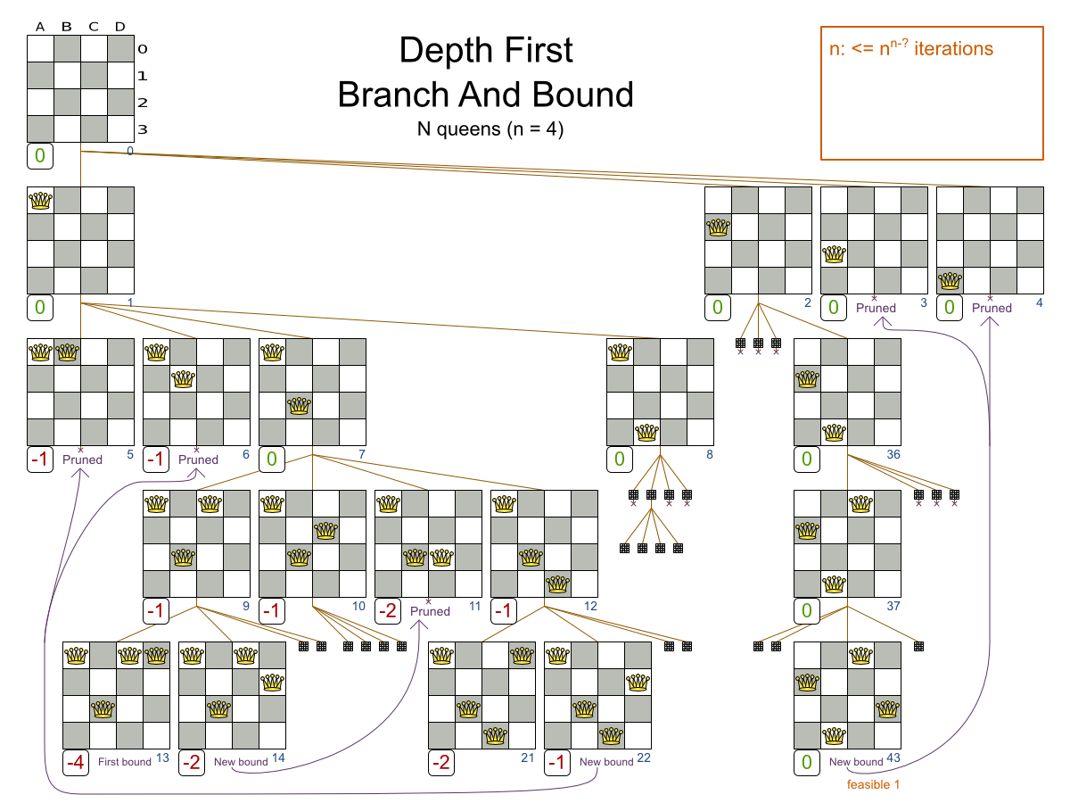

Slide 11
Knapsack Problem - BackTracking
We are given a certain number of objects and a knapsack.
Instead of supposing that we have n objects available, we shall suppose that we have n types of object, and that an adequate number of objects of each type are available.
Our aim is to fill the knapsack in a way that maximizes the value of the included objects.
We may take an object or leave behind, but we may not take fraction of an object.

Slide 12
Knapsack Problem – Cont…
Initially solution is empty.
Left of the semicolon are weights of the objects.
Right of the semicolon is the current total value of load.
Weight of objects
w = (2,3,4,5)
Corresponding value of each object
v = (3,5,6,10)
Capacity of Knapsack
W = 8
Now, apply depth first search
; 0
2 ; 3
3 ; 5
4 ; 6
5 ; 10
2,2; 6
2,3; 8
2,4; 9
2,5; 13
3,3; 10
3,4; 11
3,5; 15
4,4; 12
2,2,2; 9
2,2,3; 11
2,2,4; 12
2,3,3; 13
Store solution if optimal solution than current is found
2,2,2,2; 12

Slide 13
Knapsack Problem – Cont…
function backpack(i, r)
{Calculates the value of the best load that can be constructed using items of type i to n and whose total weight does not exceed r}
b ← 0
{Try each allowed kind of item in turn}
for k ← i to n do
if w[k] ≤ r then
b ← max(b, v[k] + backpack (k, r – w[k]))
return b

Slide 14
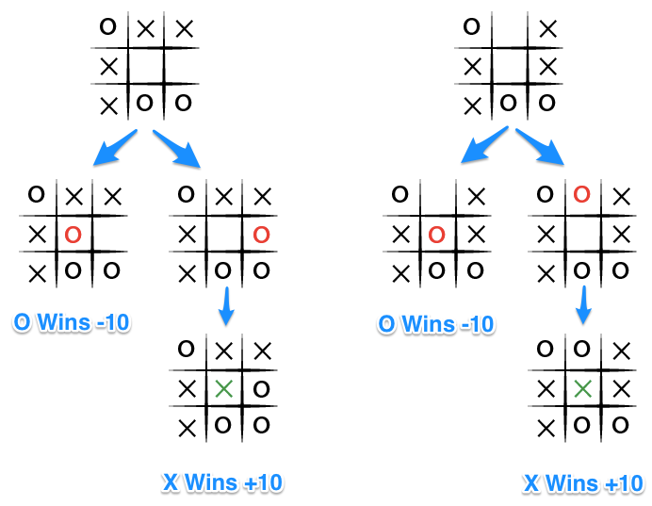
Minimax Principle
It is a decision rule that minimize the maximum loss and maximize the minimum profit(gain).

Slide 15
Minimax principle – Cont…
The key to the Minimax algorithm is a back and forth between the two players, where the player whose "turn it is" desires to pick the move with the maximum score.
In turn, the scores for each of the available moves are determined by the opposing player deciding which of its available moves has the minimum score.
And the scores for the opposing players moves are again determined by the turn-taking player trying to maximize its score and so on all the way down the move tree to an end state.

Slide 16
Minimax principle – Cont…
X | X | O
X | O
 | O
Human
Max
WIN
X | X | O
X | O | X
 | O
X | X | O
X | O
X | O
X | X | O
X | O
 | O | X
Computer
Min
WIN
WIN
X | X | O
X | O | X
O | O
X | X | O
X | O | X
 | O | O
X | X | O
X | O
O | O | X
X | X | O
X | O | O
 | O | X
Human
Max
WIN
WIN
X | X | O
X | O | X
X | O | O
X | X | O
X | O | O
X | O | X
Computer
Min

Slide 17
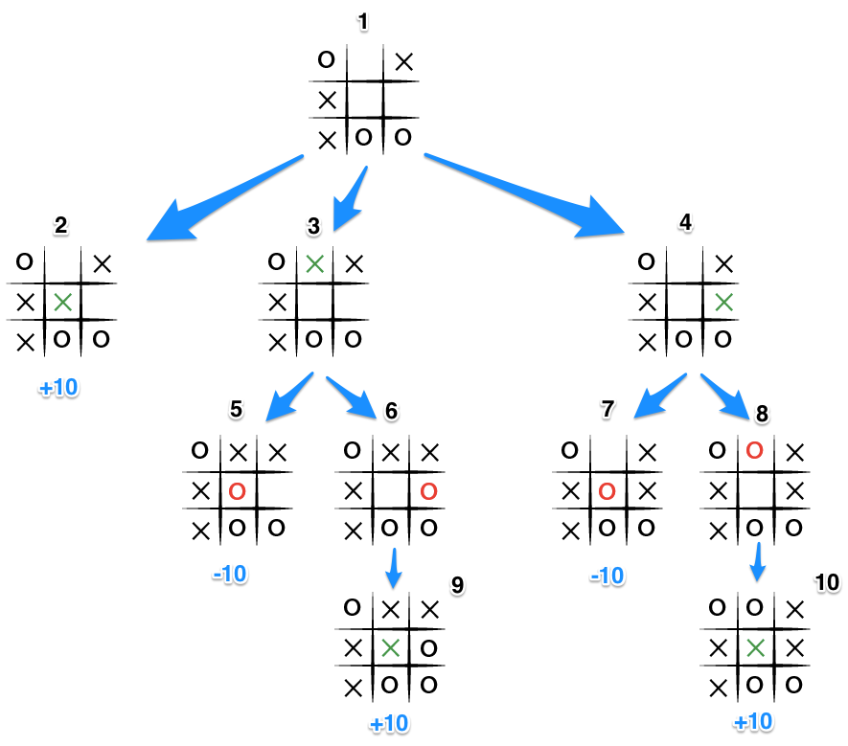

Slide 18
Travelling Salesman Problem (TSP)
Given a set of cities and distance between every pair of vertices the problem is to find the shortest possible route that visits every city once and returns to the starting city.
Suppose tour in a graph is
A-B-C-D-A
Then cost of tour
= 10 + 35 + 30 + 20
= 95
But is tour is not optimal path
A
20
10
15
D
25
30
B
C
35
Notes:
http://www.techiedelight.com/travelling-salesman-problem-using-branch-and-bound/
https://www.youtube.com/watch?v=RR7GXoWiUw4

Slide 19
TSP – Using Branch and Bound
12
Step-1: Create initial cost matrix and reduce it
A
C
11
5
4
7
3
6
10
 | A | B | C | D
A
B
C
D
B
18
D
∞
4
12
7
5
∞
∞
18
2
11
∞
∞
6
10
2
3
∞

Slide 20
Step-1 Create initial cost matrix and reduce it
Initial Cost Matrix
Reduce by
4
12
We can reduce a column if it has no zero ‘0’ element.
Reduce a column by smallest element of a row
For each column subtract smallest element from each column element
∞
7
4
Cost(A) = Total of all reductions
= 4 + 5 + 6 + 2 + 1
= 18
We can reduce a row if it has no zero ‘0’ element.
Reduce a row by smallest element of a row
For each row subtract smallest element from each row element
5
∞
∞
18
5
11
∞
∞
6
6
10
2
3
∞
2
Row Reduction
Reduced Matrix
∞
0
8
3
∞
0
7
3
0
∞
∞
13
0
∞
∞
13
Column
Reduction
5
∞
∞
0
5
∞
∞
0
8
0
1
∞
8
0
0
∞
―
―
1
―

Slide 21
Step-2 Find cost to further nodes
Minimum [Cost(A->B), Cost (A->C), Cost(A->D)]
Cost(A) = 18
A
B
C
D
Cost(A->B) =
Cost(A->C) =
Cost(A->D) =

Slide 22
Step-2 Find Cost(A->B)
Reduced Matrix
Take Reduced Matrix of Step-1
Store from Matrix M[A,B] =
Set row A and column B to ∞
Set M[B,A] = ∞
Then Reduce cost matrix
∞
∞
Cost (A->B) = Reduction + Cost(A) + M[A,B]
= 13 + 5 + 18 + 0
= 36
∞
0
7
3
∞
―
0
∞
∞
13
13
0
∞
5
∞
∞
0
―
8
0
0
∞
―
∞
Row Reduction
Reduced Matrix
∞
∞
∞
∞
∞
∞
∞
∞
∞
∞
∞
0
∞
∞
∞
0
Column
Reduction
5
∞
∞
0
0
∞
∞
0
8
∞
0
∞
3
∞
0
∞
5
―
―
―

Slide 23
Step-2 Find Cost(A->C)
Reduced Matrix
Take Reduced Matrix of Step-1
Store from Matrix M[A,C] =
Set row A and column C to ∞
Set M[C,A] = ∞
Then Reduce cost matrix
7
Cost (A->C) = Reduction + Cost(A) + M[A,C]
= 0+ 18 + 7
= 25
∞
0
∞
3
∞
∞
―
0
∞
∞
13
―
7
5
∞
∞
―
∞
0
0
0
∞
―
8
∞
―
―
―
―
Row Reduction
No Row Reduction Required
No Column Reduction Required
Column
Reduction

Slide 24
Step-2 Find Cost(A->D)
Reduced Matrix
Take Reduced Matrix of Step-1
Store from Matrix M[A,D] =
Set row A and column D to ∞
Set M[D,A] = ∞
Then Reduce cost matrix
0
7
3
―
Cost (A->D) = Reduction + Cost(A) + M[A,D]
= 5 + 18 + 3
= 26
∞
∞
∞
∞
0
∞
∞
13
3
∞
―
5
∞
∞
∞
0
5
∞
∞
0
0
∞
8
―
Row Reduction
∞
∞
∞
∞
No Column Reduction Required
0
∞
∞
∞
Column
Reduction
0
∞
∞
∞
∞
0
0
∞
―
―
―
―

Slide 25
Step-2 Find cost to further nodes
Minimum [Cost(A->B), Cost (A->C), Cost(A->D)]
Cost(A) = 18
A
B
C
D
Cost(A->B) = 36
Cost(A->C) = 25
Cost(A->D) =26

Slide 26
Step-3 Find cost to further nodes
Minimum [Cost(A->C->B), Cost (A->C->D)]
Cost(A) = 18
A
B
C
D
Cost(A->B) = 36
Cost(A->C) = 25
Cost(A->D) =26
B
D

Slide 27
Step-3 Find Cost(A->C->B)
Reduced Matrix
Cost (A->C->B) = Reduction + Cost(C) + M[C,B]
= 13+8+ 25 + ∞
= ∞
∞
∞
∞
∞
Take Reduced Matrix of Step-2
Store from Matrix M[C,B] =
Set row C and column B to ∞
Set M[B,A] = ∞
Then Reduce cost matrix
∞
∞
∞
∞
―
0
∞
∞
13
13
∞
∞
0
∞
∞
∞
∞
―
0
8
0
0
∞
8
∞
∞
Row Reduction
∞
∞
∞
∞
∞
∞
∞
0
No Column Reduction Required
Column
Reduction
∞
∞
∞
∞
0
∞
∞
∞
―
―
―
―

Slide 28
Step-3 Find Cost(A->C->D)
Reduced Matrix
Take Reduced Matrix of Step-2
Store from Matrix M[C,D] =
Set row C and column D to ∞
Set M[D,A] = ∞
Then Reduce cost matrix
∞
∞
∞
∞
Cost (A->C->D) = Reduction + Cost(C) + M[C,B]
= 0+ 25 + 0
= 25
∞
0
0
∞
∞
13
∞
∞
∞
∞
0
∞
0
∞
∞
8
Row Reduction
No Row Reduction Required
No Column Reduction Required
Column
Reduction

Slide 29
Step-4 Find cost to further nodes
Cost(A) = 18
A
B
C
D
Cost(A->B) = 36
Cost(A->C) = 25
Cost(A->D) =26
Cost(A->C->B) = ∞
B
D
Cost(A->C->D) = 25
B

Slide 30
Step-4 Find Cost(A->C->D->B)
Reduced Matrix
∞
∞
∞
∞
Take Reduced Matrix of Step-3
Store from Matrix M[D,B] =
Set row D and column B to ∞
Set M[B,A] = ∞
Then Reduce cost matrix
∞
∞
∞
0
0
∞
∞
∞
∞
∞
∞
∞
∞
∞
0
Cost (A->C->D->B) = Reduction + Cost(D) + M[D,B]
= 0+ 25 + 0
= 25
Optimal path is A->C->D->B with cost = 25
Row Reduction
No Row Reduction Required
No Column Reduction Required
Column
Reduction

Slide 31


