Slide 1

Unit – 3 Divide and Conquer Algorithm
Gopi Sanghani
 9825621471
→ gopi.sanghani@darshan.ac.in
Analysis and Design of Algorithms (2170703) Darshan Institute of Engineering & Technology

Slide 2
Topics to be covered
Introduction
Recurrence and different methods to solve recurrence
Multiplying large Integers Problem
Problem Solving using divide and conquer algorithm –
Binary Search,
Sorting (Merge Sort, Quick Sort),
Matrix Multiplication,
Exponential.

Slide 3
Recurrence equations
When analyzing an algorithm the essential last step is often to solve a recurrence equation.
A recurrence relation is an equation that recursively defines a sequence where the next term is a function of the previous terms.
Expressing F(N) as some combination of F(i) where 1 ≤ i ≤ n.

Slide 4
Methods to solve Recurrence
Substitution
Homogeneous (characteristic equation)
Inhomogeneous
Master method
Recurrence tree
Intelligent guess work
Change of variable
Range transformations

Slide 5
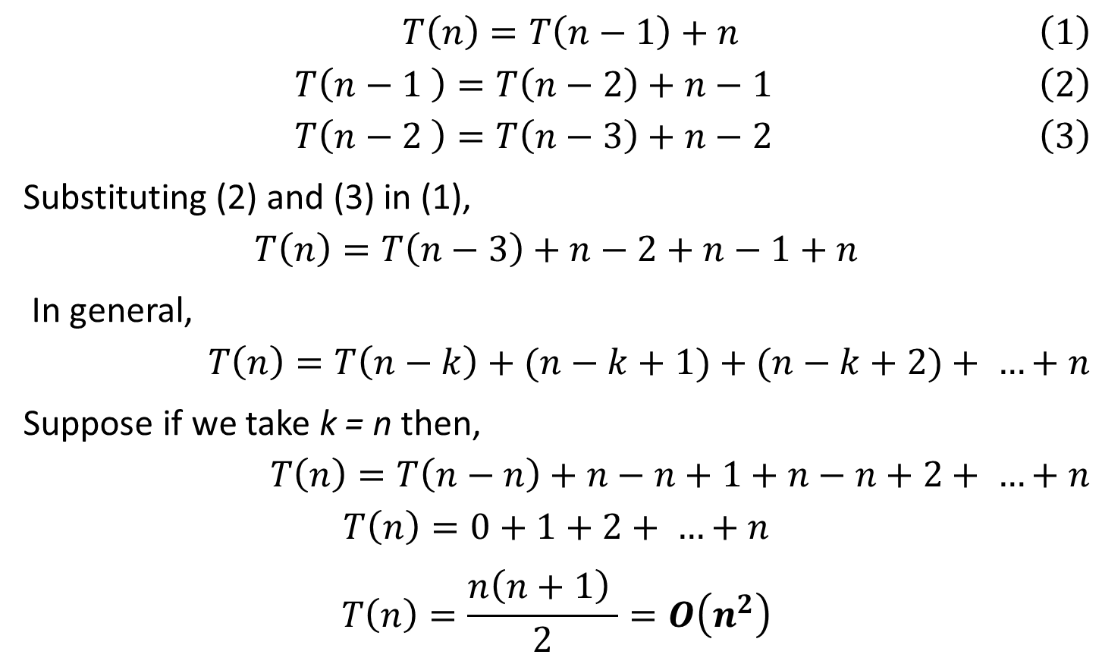
Substitution method
$$T\left(n\right)=T\left(n−1\right)+n \left(1\right)$$
$$T\left(n−1 \right)=T\left(n−2\right)+n−1 \left(2\right)$$
$$T\left(n−2 \right)=T\left(n−3\right)+n−2 \left(3\right)$$
Substituting (2) and (3) in (1),
$$T\left(n\right)=T\left(n−3\right)+n−2+n−1+n$$
In general,
$$T\left(n\right)=T\left(n−k\right)+(n−k+1)+(n−k+2)+ …+n$$
Suppose if we take k = n then,
$$T\left(n\right)=T\left(n−n\right)+n−n+1+n−n+2+ …+n$$
$$T\left(n\right)=0+1+2+ …+n$$
$$T\left(n\right)=\frac{n\left(n+1\right) }{2}=O\left(n^{2}\right)$$

Slide 6
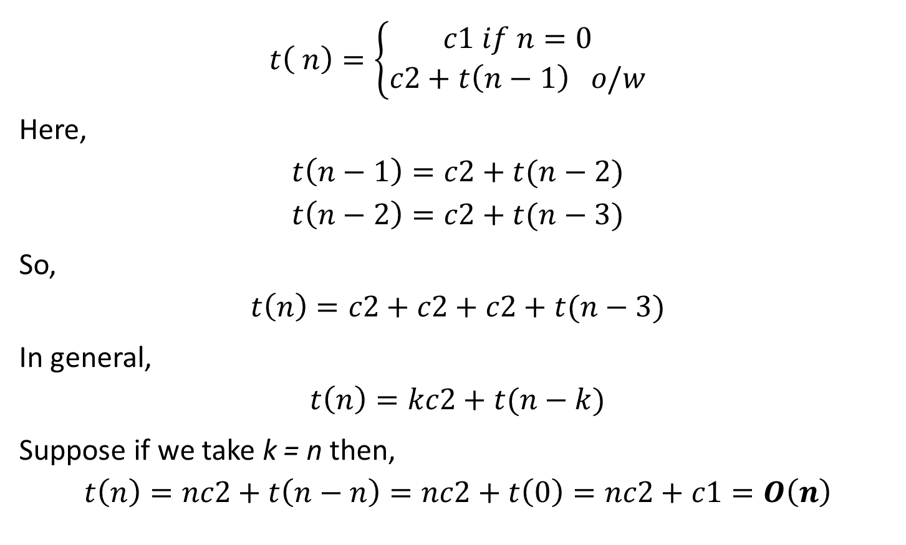
Exercise
$$t\left( n\right)=\left\{\begin{aligned}c1 if n=0 \\ c2+t\left(n−1\right) o/w\end{aligned}\right.$$
Here,
$$t\left(n−1\right)=c2+t(n−2)$$
$$t\left(n−2\right)=c2+t(n−3)$$
So,
$$t\left(n\right)=c2+c2+c2+t(n−3)$$
In general,
$$t\left(n\right)=kc2+t(n−k)$$
Suppose if we take k = n then,
$$t\left(n\right)=nc2+t\left(n−n\right)=nc2+t\left(0\right)=nc2+c1=O\left(n\right)$$

Slide 7

Exercise
Solve the following recurrence using substitution method.
$$T\left( n\right)=\left\{\begin{aligned}1 if n=0 or 1 \\ 2T\left(n−1\right) +1 o/w\end{aligned}\right.$$

Slide 8
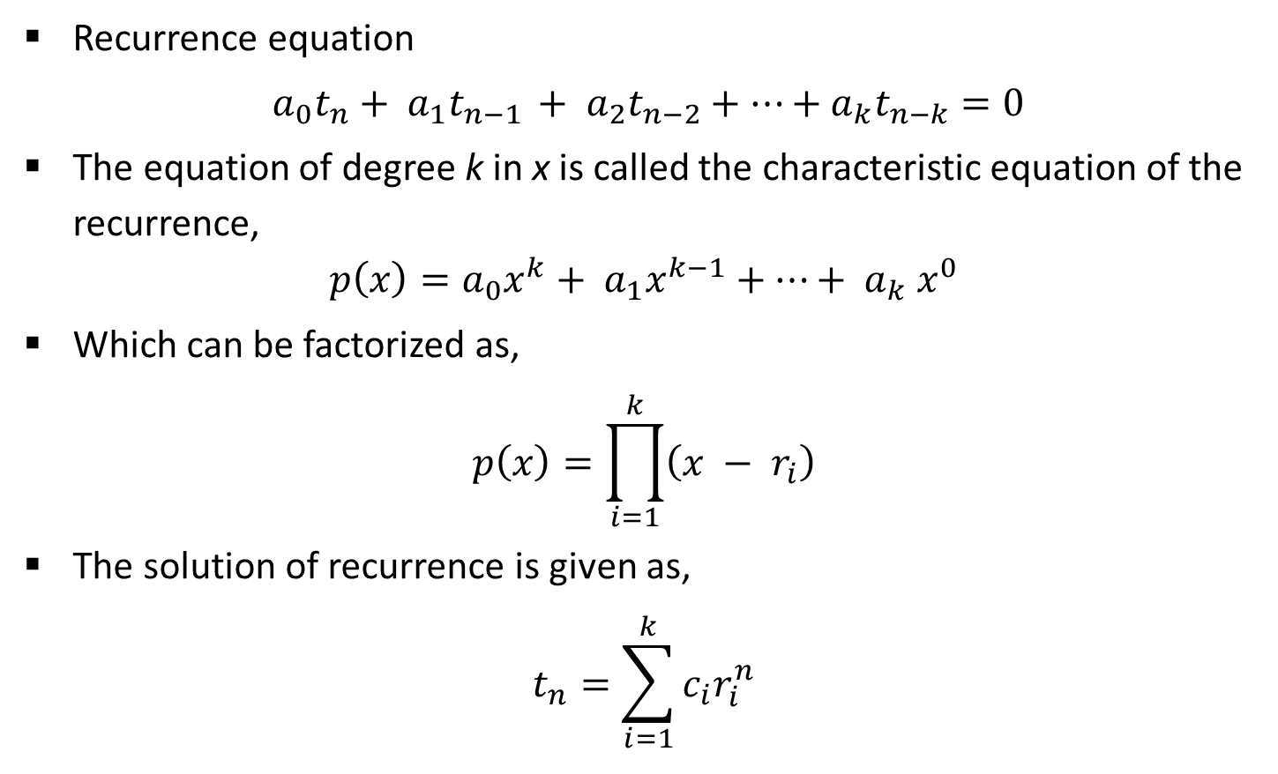
Homogeneous recurrence
Recurrence equation
$a_{0}t_{n}+ a_{1}t_{n−1 }+ a_{2}t_{n−2}+⋯+a_{k}t_{n−k}=0$
The equation of degree k in x is called the characteristic equation of the recurrence,
$$p\left(x\right)=a_{0}x^{k}+ a_{1}x^{k−1}+⋯+ a_{k} x^{0}$$
Which can be factorized as,
$$p\left(x\right)=\prod_{i=1}^{k}{\left(x − r_{i}\right)}$$
The solution of recurrence is given as,
$$t_{n}=\sum_{i=1}^{k}{c_{i}r_{i}^{n}}$$

Slide 9
Analysis: Fibonacci series
Compare Iterative and Recursive algorithm to find out Fibonacci series.
If we count all arithmetic operations at unit cost; the instructions inside for loop take constant time. The time taken by the for loop is bounded above by n times this constant, i.e. nc = Θ (n).
Iterative Algorithm for Fibonacci series
Function fibiter(n) i ← 1; j ← 0 for k ← 1 to n do j ← i + j i ← j – i return j

Slide 10
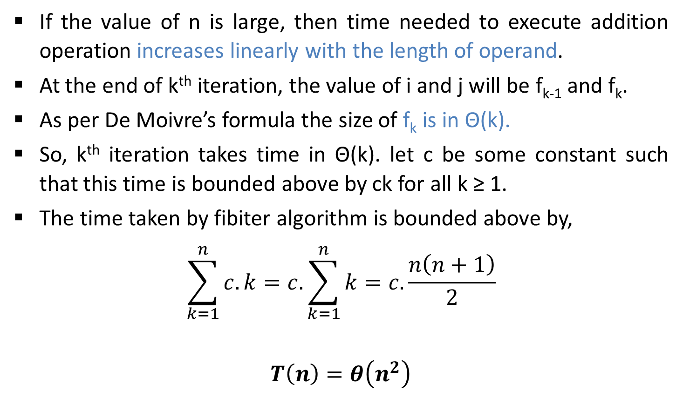
Analysis: Fibonacci series
If the value of n is large, then time needed to execute addition operation increases linearly with the length of operand.
At the end of k^{th} iteration, the value of i and j will be f_{k-1} and f_{k}.
As per De Moivre’s formula the size of f_{k} is in Θ(k).
So, k^{th} iteration takes time in Θ(k). let c be some constant such that this time is bounded above by ck for all k ≥ 1.
The time taken by fibiter algorithm is bounded above by,
$$\sum_{k=1}^{n}{c.k=c.\sum_{k=1}^{n}{k}}=c.\frac{n\left(n+1\right)}{2}$$
$$T\left(n\right)=θ\left(n^{2}\right)$$

Slide 11
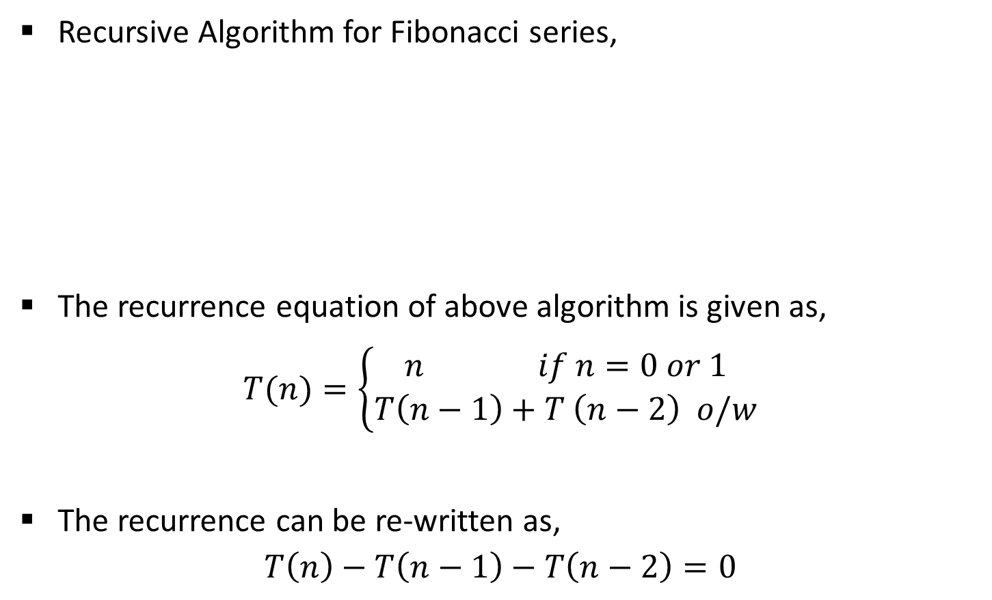
Analysis: Fibonacci series
Recursive Algorithm for Fibonacci series,
The recurrence equation of above algorithm is given as,
$$T(n)=\left\{\begin{aligned}n if n=0 or 1 \\ T\left(n−1\right)+T \left(n−2\right) o/w\end{aligned}\right.$$
The recurrence can be re-written as,
$$T\left(n\right)−T\left(n−1\right)−T\left(n−2\right)=0$$
Function fibrec(n)
if n < 2 then return n
else return fibrec (n – 1) + fibrec (n – 2)

Slide 12

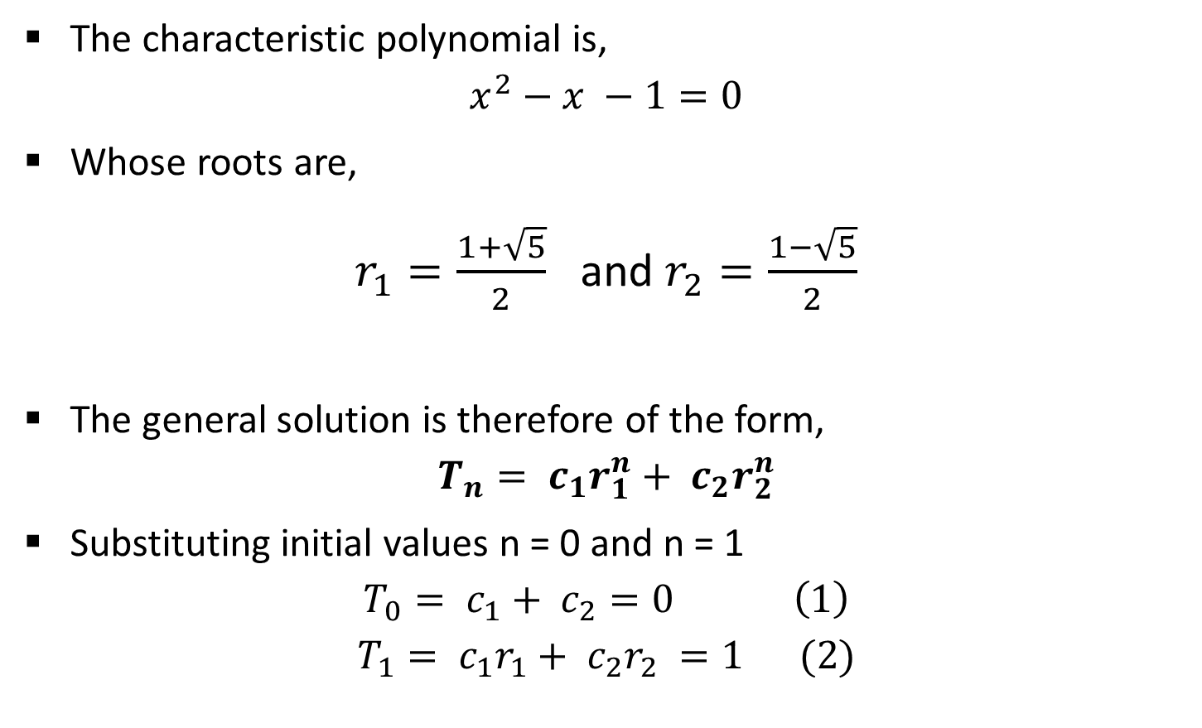

Analysis: Fibonacci series
The characteristic polynomial is,
$$x^{2}−x −1=0$$
Whose roots are,
$r_{1}=\frac{1+\sqrt{5}}{2}$ and $r_{2}=\frac{1−\sqrt{5}}{2}$
The general solution is therefore of the form,
$$T_{n}= c_{1}r_{1}^{n}+ c_{2}r_{2}^{n}$$
Substituting initial values n = 0 and n = 1
$$T_{0}= c_{1}+ c_{2}=0 \left(1\right)$$
$$T_{1}= c_{1}r_{1}+ c_{2}r_{2} =1 (2)$$
$$x =\frac{−b±\sqrt{b^{2}−4ac}}{2a}$$
$$t_{n}=\sum_{i=1}^{k}{c_{i}r_{i}^{n}}$$

Slide 13
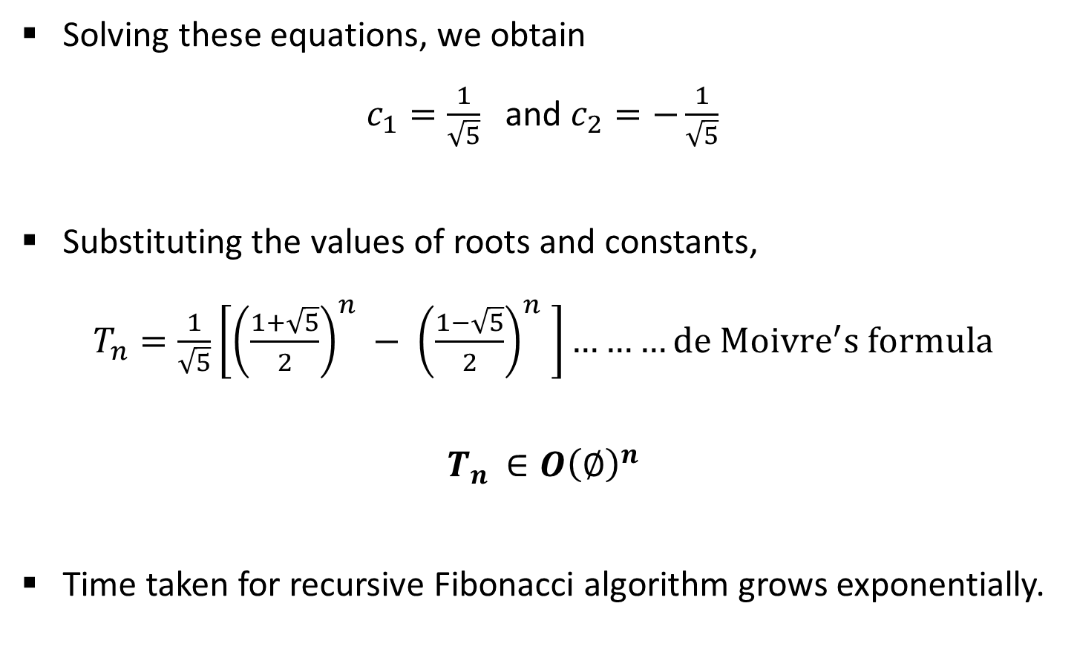
Analysis: Fibonacci series
Solving these equations, we obtain
$c_{1}=\frac{1}{\sqrt{5}}$ and $c_{2}=−\frac{1}{\sqrt{5}}$
Substituting the values of roots and constants,
$T_{n}=\frac{1}{\sqrt{5}}\left[{\left(\frac{1+\sqrt{5}}{2}\right)}^{n} − {\left(\frac{1−\sqrt{5}}{2}\right)}^{n} \right]………de {Moivre}^{′}s formula$
$$T_{n }∈O{\left(∅\right)}^{n}$$
Time taken for recursive Fibonacci algorithm grows exponentially.

Slide 14
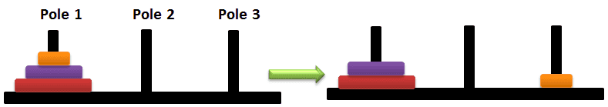

Analysis: Tower of Hanoi

Slide 15


Analysis: Tower of Hanoi

Slide 16
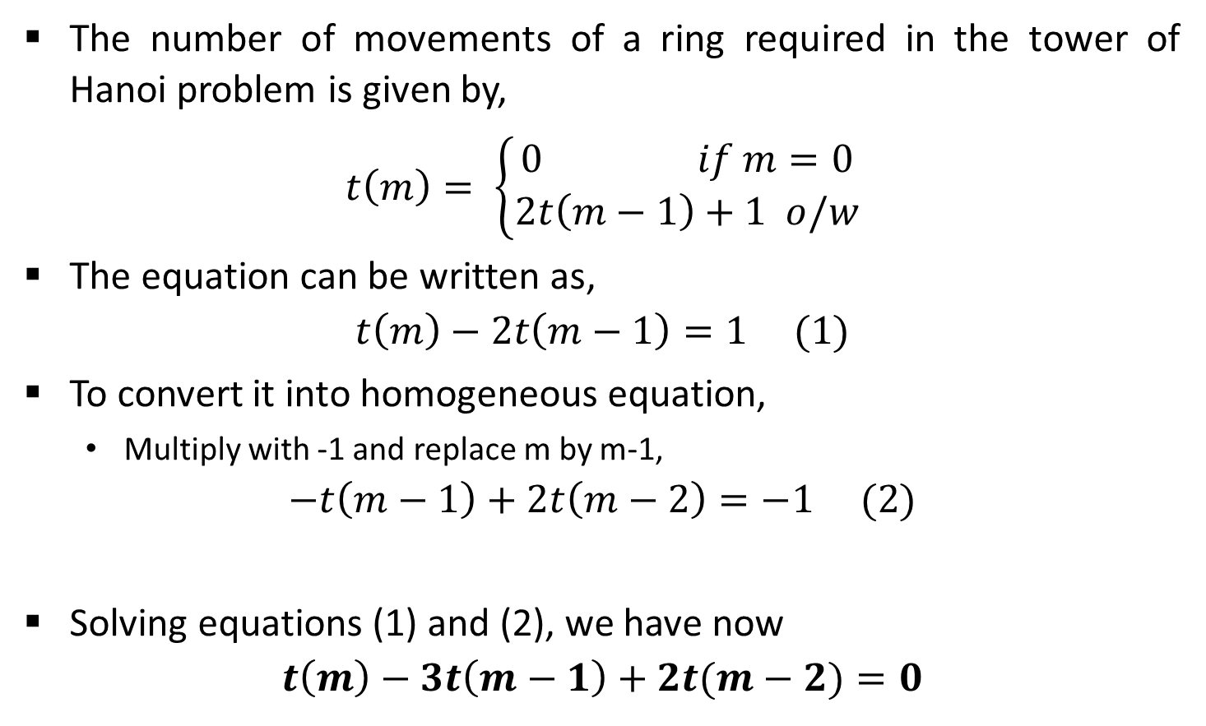
Analysis: Tower of Hanoi
The number of movements of a ring required in the tower of Hanoi problem is given by,
$$t\left(m\right)= \left\{\begin{aligned}0 if m=0 \\ 2t\left(m−1\right)+1 o/w\end{aligned}\right.$$
The equation can be written as,
$$t\left(m\right)−2t\left(m−1\right)=1 (1)$$
To convert it into homogeneous equation,
Multiply with -1 and replace m by m-1,
$$−t\left(m−1\right)+2t\left(m−2\right)=−1 (2)$$
Solving equations (1) and (2), we have now
$$t\left(m\right)−3t\left(m−1\right)+2t(m−2)=0$$
Inhomogeneous equation

Slide 17
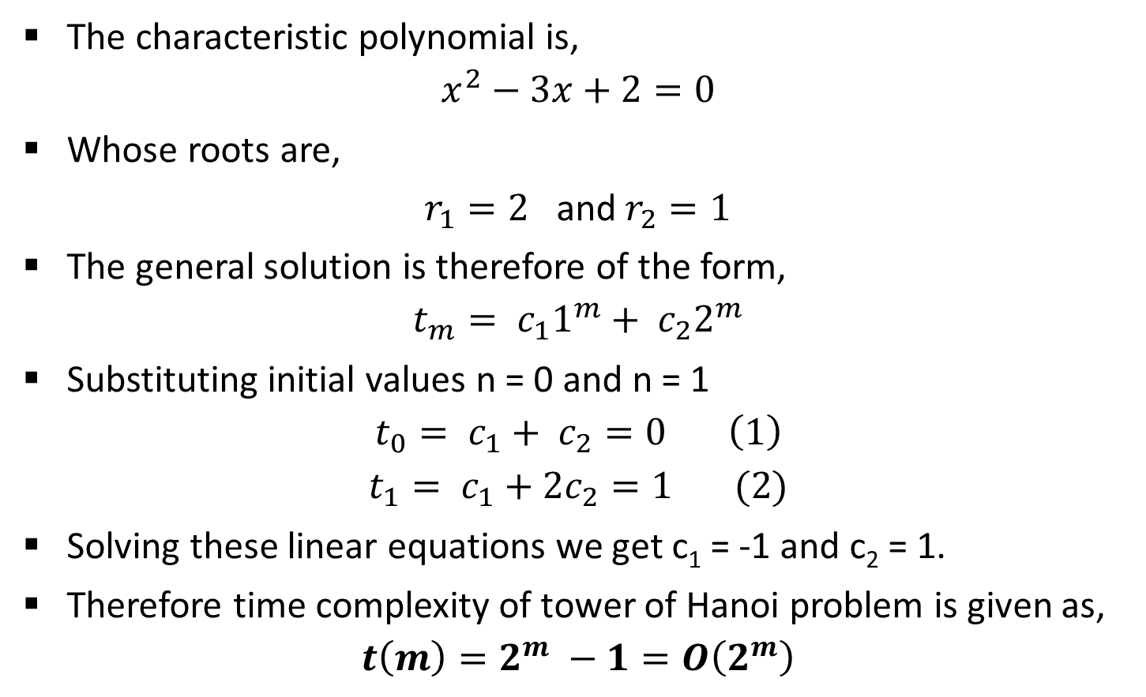
Analysis: Tower of Hanoi
The characteristic polynomial is,
$$x^{2}−3x+2=0$$
Whose roots are,
$r_{1}=2$ and $r_{2}=1$
The general solution is therefore of the form,
$$t_{m}= c_{1}1^{m}+ c_{2}2^{m}$$
Substituting initial values n = 0 and n = 1
$$t_{0}= c_{1}+ c_{2}=0 \left(1\right)$$
$$t_{1}= c_{1}+2c_{2}=1 (2)$$
Solving these linear equations we get c₁ = -1 and c₂ = 1.
Therefore time complexity of tower of Hanoi problem is given as,
$$t\left(m\right)=2^{m} −1=O\left(2^{m}\right)$$

Slide 18

Exercise
Solve the following recurrences
$t_{n}=\left\{\begin{aligned}n if n=0 or 1 \\ 5t_{n−1 }−6t_{n−2 O/W}\end{aligned}\right.$
$t_{n}=\left\{\begin{aligned}n if n=0, 1 or 2 \\ 5t_{n−1 }−8t_{n−2 }+4t_{n−3} O/W\end{aligned}\right.$

Slide 19
Mater method
The master method is a cookbook method for solving recurrences.
Suppose you have a recurrence of the form
T(n) = aT(n/b) + f(n)
This recurrence would arise in the analysis of a recursive algorithm.
When input size n is large, the problem is divided up into a sub-problems each of size n/b. Sub-problems are solved recursively and results are recombined.
The work to split the problem into sub-problems and recombine the results is f(n).
Time to divide & recombine
Number of sub-problems
Time required to solve a sub-problem

Slide 20
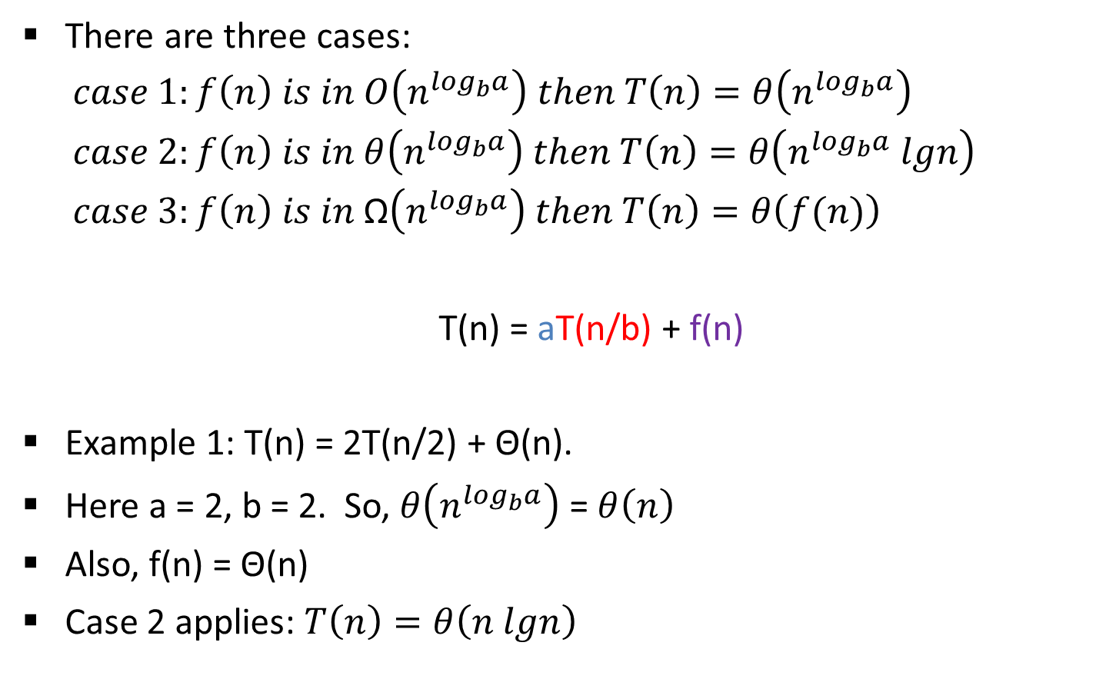
Mater method
There are three cases:
$$case 1:f\left(n\right) is in O\left(n^{\log_{b}a}\right) then T\left(n\right)=θ\left(n^{\log_{b}a}\right)$$
$$case 2:f\left(n\right) is in θ\left(n^{\log_{b}a}\right) then T\left(n\right)=θ\left(n^{\log_{b}a} lgn\right)$$
$$case 3:f\left(n\right) is in \text{Ω}\left(n^{\log_{b}a}\right) then T\left(n\right)=θ\left(f(n)\right)$$
T(n) = aT(n/b) + f(n)
Example 1: T(n) = 2T(n/2) + Θ(n).
Here a = 2, b = 2. So, $θ\left(n^{\log_{b}a}\right)$ = $θ\left(n\right)$
Also, f(n) = Θ(n)
Case 2 applies: $T\left(n\right)=θ\left(n lgn\right)$
Merge sort

Slide 21
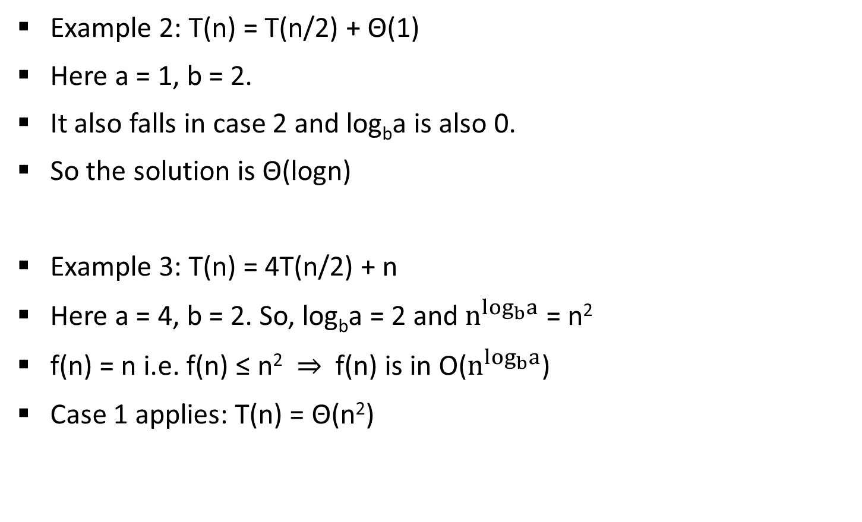
Mater method
Example 2: T(n) = T(n/2) + Θ(1)
Here a = 1, b = 2.
It also falls in case 2 and log_{b}a is also 0.
So the solution is Θ(logn)
Example 3: T(n) = 4T(n/2) + n
Here a = 4, b = 2. So, log_{b}a = 2 and $n^{\log_{b}a}$ = n²
f(n) = n i.e. f(n) ≤ n² ⇒ f(n) is in O($n^{\log_{b}a}$)
Case 1 applies: T(n) = Θ(n²)
Binary Search

Slide 22
Mater method
Example 4: T(n) = 4T(n/2) + n²
Example 5: T(n) = 4T(n/2) + n³.
Example 6: T(n) = 9T(n/3) + n (Summer 17)
Example 7: T(n) = T(2n/3) + 1 (Summer 17)

Slide 23
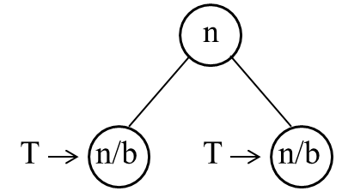
Recurrence tree method
Here while solving recurrences, we divide the problem into sub-problems of equal size.
For e.g., T(n) = a T(n/b) + f(n) where a > 1 ,b > 1 and f(n) is a given function.
F(n) is the cost of splitting or combining the sub problems.

Slide 24
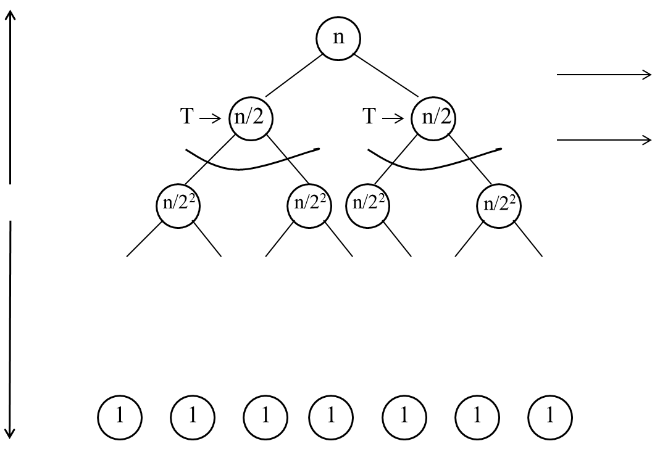
Recurrence tree method
Example 1: T(n) = 2T(n/2) + n
The recursion tree for this recurrence is :
n
n
log₂ n

Slide 25
Recurrence tree method
When we add the values across the levels of the recursion tree, we get a value of n for every level.
We have n + n + n + …… log n times
= n (1 + 1 + 1 + …… log n times)
= n (log₂ n)
= Θ (n log n)
T(n) = Θ (n log n)

Slide 26
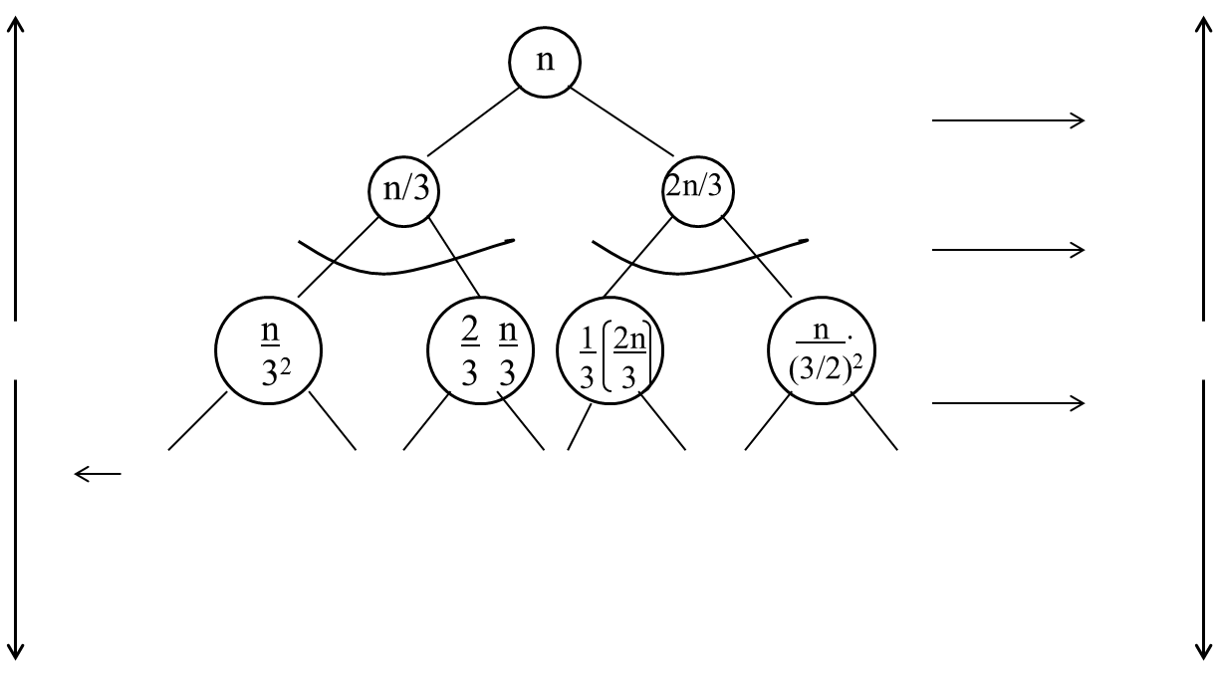
Recurrence tree method
Example 2: T(n) = T(n/3) + T(2n/3) + n
Solution: The recursion tree for the above recurrence is
n
n
log₃ n
log_{3/2} n
n

Slide 27
Recurrence tree method
Since the shortest path from the root to the leaf is
n → n/3 → n/3² → n/3³ → …. 1
we have 1 when n/3^{i} => 1
=> n = 3i
Taking log₃ on both the sides
=> log₃ n = i
When we add the values across the levels of the recursion tree , we get a value of n for every level.
Thus the height of the shorter tree is log₃ n
T(n) > n log₃ n … (A)

Slide 28
Recurrence tree method
Similarly, the longest path from root to the leaf is
n → 2/3 n → (2/3)² n → … 1
So rightmost will be the longest
when (2/3)^{k}n = 1
or n/ (3/2)^{k} = 1
=> k = log_{3/2} n
T(n) < n log_{3/2} n … (B)
Since base does not matter in asymptotic notation, from (A) and (B)
T(n) = Θ (n log₃n)

Slide 29
Recurrence tree method
Example 3: T(n) = T(n/4) + T(3n/4) + c.n
Example 4: T(n) = 3T(n/4) + c.n²
Example 5: T(n) = T(n/4) + T(n/2) + n²

Slide 30
Recurrence tree
Example 3: T(n) = T(n/4) + T(3n/4) + c.n
c.n
n/4
3n/4
1/4
(n/4)
(n/4)
3/4
1/4
(3n/4)
(3n/4)
3/4
…
Θ(1)

Slide 31
Recurrence tree
Since the shortest path from the root to the leaf is
n → n/4 → n/4² → n/4³ → …. 1
T(n) > n log₄ n … (A)
Similarly, the longest path from root to the leaf is
n → 3/4 n → (3/4)² n → … 1
T(n) < n log_{4/3}n … (B)
T(n) = Θ (n log n)

Slide 32
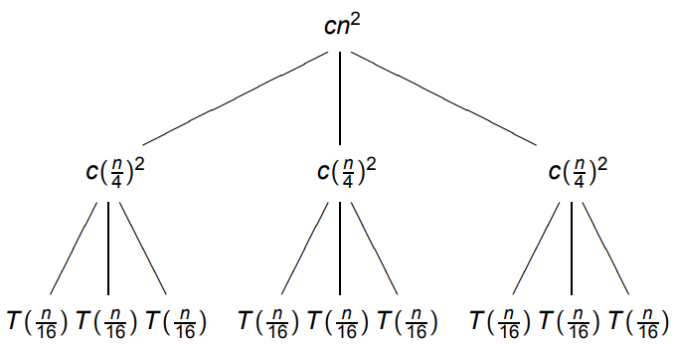
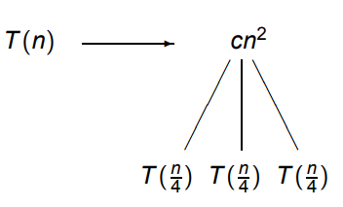
Recurrence tree
Example 4: T(n) = 3T(n/4) + c.n²

Slide 33
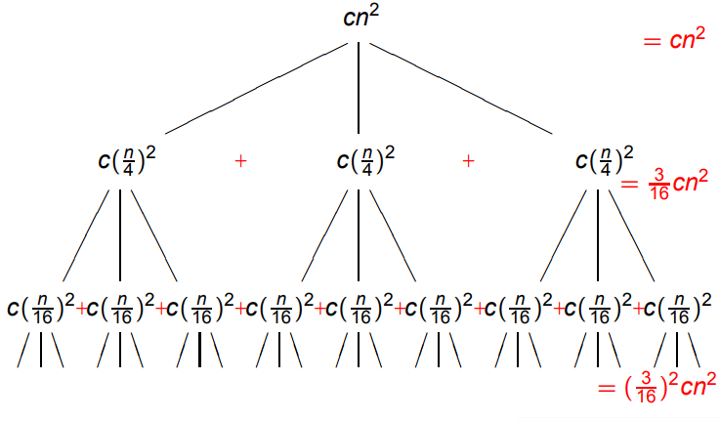
Recurrence tree

Slide 34
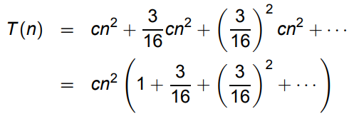
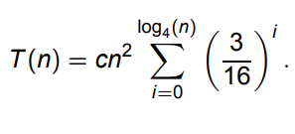
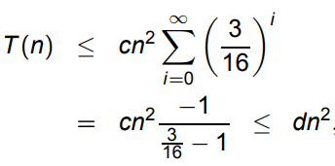
Recurrence tree
Summing up the cost,
= Θ(n²)

Slide 35
Recurrence tree
Example 5: T(n) = T(n/4) + T(n/2) + n²
n²
(n/4)²
(n/2)²
(n/16)²
(n/8)²
(n/8)²
(n/4)²
…
…
Θ(1)
Total =
= Θ(n²)

Slide 36
Divide & conquer (D&C) Technique
Many useful algorithms are recursive in structure: to solve a given problem, they call themselves recursively one or more times.
These algorithms typically follow a divide-and-conquer approach:
The divide-and-conquer approach involves three steps at each level of the recursion:
Divide: Break the problem into several sub problems that are similar to the original problem but smaller in size.
Conquer: Solve the sub problems recursively, and if the sub problem sizes are small enough, just solve the sub problems in a straightforward manner.
Combine: Combine these solutions to create a solution to the original problem.

Slide 37
D&C: general template
Consider an arbitrary problem.
Let adhoc be a basic simple algorithm capable of solving the problem efficiently for small instances.
But its performance on large instances is of no concern.
General template for D & C algorithm
function DC(x)
if x is sufficiently small or simple then return adhoc(x)
decompose x into smaller instances x₁ , x₂, …, x_{l}
for i = 1 to l do y_{i} ← DC(x_{i})
recombine the Y_{i} 's to obtain a solution y for x
return y

Slide 38
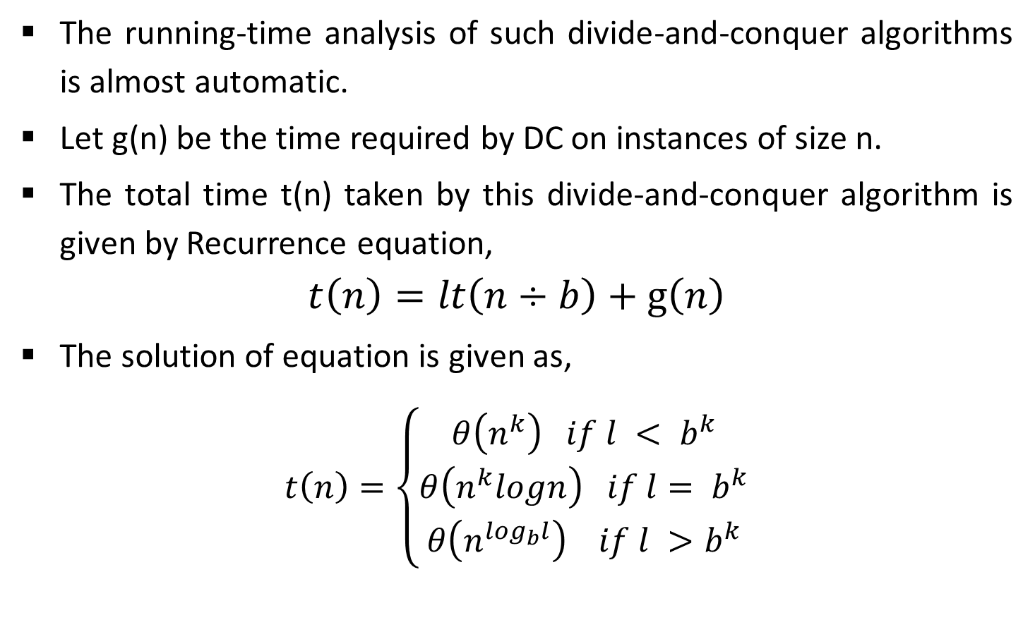
D&C: general template
The running-time analysis of such divide-and-conquer algorithms is almost automatic.
Let g(n) be the time required by DC on instances of size n.
The total time t(n) taken by this divide-and-conquer algorithm is given by Recurrence equation,
$$t\left(n\right)=lt\left(n÷b\right)+g\left(n\right)$$
The solution of equation is given as,
$$t\left(n\right)=\left\{\begin{aligned}θ\left(n^{k}\right) if l < b^{k} \\ θ\left(n^{k}logn\right) if l= b^{k} \\ θ\left(n^{\log_{b}l}\right) if l >b^{k}\end{aligned}\right.$$
T(n) = aT(n/b) + f(n)

Slide 39
Multiplying large Integers Problem
Multiplying two n digit large integers using divide and conquer method.
Multiplication of 981 by 1234.
Convert them into same length nos.
Then we split each operand into two parts:
0981 gives rise to w = 09 and x = 81, and 1234 to y = 12 and z = 34.
We can write, 981 = 10²w + x and 1234 = 10²y + z.
Therefore, the required product can be computed as
981 x 1234 = (10²w + x) * (10²y + z)
= 10⁴w*y + 10²(w*z + x*y) + x*z
= 1080000 + 127800 + 2754
= 1210554.

Slide 40
Multiplying large Integers Problem
The above procedure still needs four half-size multiplications:
w*y, w*z, x*y and x*z.
No need to compute both w*z and x*y;
Consider the product
r = (w + x) * (y + z) = w*y + (w*z + x*y) + x*z.
After only one multiplication, we obtain the sum of all three terms needed to calculate the desired product.

Slide 41
Multiplying large Integers Problem
This suggests proceeding as follows.
p = w*y = 09 * 12 =108
q = x*z = 81 * 34 = 2754
r = (w + x) * (y + z) = 90 * 46 = 4140
Finally
10⁴w*y + 10²(w*z + x*y) + x*z
981 x 1234 = 10⁴p + 10² (r - p - q) + q
= 1080000 + 127800 + 2754
= 1210554.
w = 09
x = 81
y = 12
z = 34
r = (w*y + (w*z + x*y) + x*z)

Slide 42
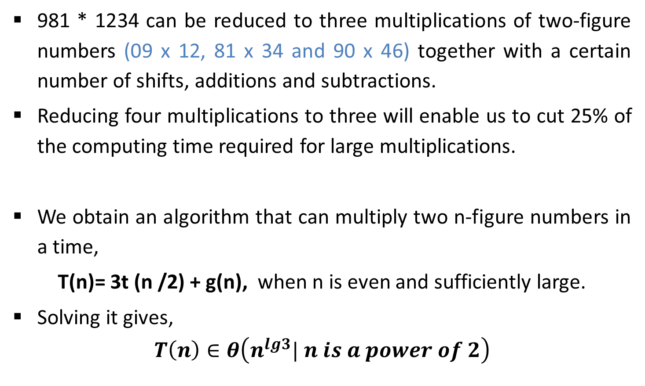
Multiplying large Integers Problem
981 * 1234 can be reduced to three multiplications of two-figure numbers (09 x 12, 81 x 34 and 90 x 46) together with a certain number of shifts, additions and subtractions.
Reducing four multiplications to three will enable us to cut 25% of the computing time required for large multiplications.
We obtain an algorithm that can multiply two n-figure numbers in a time,
T(n)= 3t (n /2) + g(n), when n is even and sufficiently large.
Solving it gives,
$$T\left(n\right)∈θ\left(n^{lg3}| n is a power of 2\right)$$

Slide 43
Multiplying large Integers Problem
Example: Multiply 8114 with 7622 using divide & conquer method.
Let
p = w*y = 81 * 76 = 6156
q = x*z = 14 * 22 = 308
r = (w + x) * (y + z) = 95 * 98 = 9310
8114 * 7622 = 10⁴p + 10² (r - p - q) + q
= 61560000+284600+308
=61844908
w = 81
x = 14
y = 76
z = 22

Slide 44
Binary search
Binary Search is an extremely well-known instance of divide-and-conquer approach.
Let T[1 . . . n] be an array of increasing sorted order; that is T [i] ≤ T [j] whenever 1 ≤ i ≤ j ≤ n.
Let x be some number. The problem consists of finding x in the array T if it is there.
If x is not in the array, then we want to find the position where it might be inserted.

Slide 45
Binary search : Example
Input: sorted array of integer keys. X=7.
[ 0 ]
[ 1 ]
[ 2 ]
[ 3 ]
[ 4 ]
[ 5 ]
[ 6 ]
3
6
7
11
32
33
53
[ 0 ]
[ 1 ]
[ 2 ]
[ 3 ]
[ 4 ]
[ 5 ]
[ 6 ]
3
6
7
11
32
33
53
Find approximate midpoint

Slide 46
Binary search : Example
[ 0 ]
[ 1 ]
[ 2 ]
[ 3 ]
[ 4 ]
[ 5 ]
[ 6 ]
X = 7
3
6
7
11
32
33
53
Is 7 = midpoint key? NO.
Is 7 < midpoint key? YES.
[ 0 ]
[ 1 ]
[ 2 ]
[ 3 ]
[ 4 ]
[ 5 ]
[ 6 ]
3
6
7
11
32
33
53
Search for the target in the area before midpoint.

Slide 47
Binary search : Example
[ 0 ]
[ 1 ]
[ 2 ]
[ 3 ]
[ 4 ]
[ 5 ]
[ 6 ]
X = 7
3
6
7
11
32
33
53
Find approximate midpoint
[ 0 ]
[ 1 ]
[ 2 ]
[ 3 ]
[ 4 ]
[ 5 ]
[ 6 ]
3
6
7
11
32
33
53
X = key of midpoint? NO.
X < key of midpoint? NO.
X > key of midpoint? YES.

Slide 48
Binary search : Example
[ 0 ]
[ 1 ]
[ 2 ]
[ 3 ]
[ 4 ]
[ 5 ]
[ 6 ]
X = 7
3
6
7
11
32
33
53
Search for the X in the area after midpoint.
[ 0 ]
[ 1 ]
[ 2 ]
[ 3 ]
[ 4 ]
[ 5 ]
[ 6 ]
3
6
7
11
32
33
53
Find approximate midpoint.
Is X = midpoint key? YES.

Slide 49
Binary search
Binary search algorithm – Iterative
Function biniter ( T[1,…,n], x )
if x > T[n] then return n+1
i ← 1; j ← n
while i < j do
k ← (i + j ) ÷ 2
if x ≤ T [k] then j ← k
else i ← k + 1
return i

Slide 50
Binary search
Binary search algorithm – Recursive
Function binsearch ( T[1,…,n], x )
if n = 0 or x > T[n] then return n + 1
else return binrec ( T[1,…,n], x )
Function binrec( T[i,…,j], x )
if i = j then return i
k ← (i + j) ÷ 2
if x ≤ T [k] then return binrec( T[i,…,k], x )
else return binrec( T[k + 1,…,j], x )

Slide 51
Binary search
Analysis
Let t(n) be the time required for a call on binrec( T[i,…,j], x ), where n = j – i + 1 is the number of elements still under consideration in the search.
The recurrence equation is given as,
t(n) = t(n/2) + Θ(1)
Comparing this to the general template for divide and conquer algorithm, a = 1, b = 2 and c = 0.
So, t(n) Є Θ(lg n)
The complexity of binrec is Θ (log n).
T(n) = aT(n/b) + f(n)

Slide 52
Merge sort
Original Sequence
Sorted Sequence
18
26
32
6
43
15
9
1
18
26
32
6
43
15
9
1
1
6
9
15
18
26
32
43
43
15
9
1
18
26
32
6
43
15
9
1
18
26
32
6
6
26
32
6
18
26
32
18
1
9
15
43
1
9
15
43
18
26
43
15
9
1
18
26
32
6
43
15
9
1
32
6
18
26
6
32
15
43
18
26
6
32
15
43
1
9
1
9
18
26
32
1
15
18
26
32
6
43
15
9
1
18
26
6
43
9
26
32
6
43
15
9
9
1
18
32
6
43
1
15
18
26
32
6
43
15
9
1
18
26
32
6
43
15
9
1

Slide 53
Merge sort
Example: sort given numbers into descending order using merge sort.
38, 27, 43, 3, 9, 82, 10, 67, 71, 54, 97

Slide 54
Merge sort
Algorithm for merging two sorted U and V arrays into array T
Procedure merge(U[1,…,m+1],V[1,…,n+1],T[1,…,m+n])
i, j ← 1
U[m+1], V[n+1] ← ∞
for k ← 1 to m + n do
if U[i] < V[j]
then T[k] ← U[i] ; i ← i + 1
else T[k] ← V[j] ; j ← j + 1

Slide 55
Merge sort
Algorithm merge sort
Procedure mergesort(T[1,…,n])
if n is sufficiently small then insert(T)
else
array U[1,…,1+n/2],V[1,…,1+n/2]
U[1,…,n/2] ← T[1,…,n/2]
V[1,…,n/2] ← T[n/2+1,…,n]
mergesort(U[1,…,n/2])
mergesort(V[1,…,n/2])
merge(U, V, T)

Slide 56


Merge sort
Analysis
Let T(n) be the time taken by this algorithm to sort an array of n elements.
Separating T into U & V takes linear time; merge (U, V, T) also takes linear time.
T(n)=T(n/2)+ T(n/2)+g(n) where g(n) ϵ Θ(n).
T(n) = 2t(n/2)+ Θ (n)
Applying the general case, l=2, b=2, k=1
Since l = b^{k} the second case applies which yields t(n) ϵ Θ(nlogn).
Time complexity of merge sort is Θ (nlogn).
$$t\left(n\right)=lt\left(n÷b\right)+g\left(n\right)$$
$$t\left(n\right)=\left\{\begin{aligned}θ\left(n^{k}\right) if l < b^{k} \\ θ\left(n^{k}logn\right) if l= b^{k} \\ θ\left(n^{\log_{b}l}\right) if l >b^{k}\end{aligned}\right.$$

Slide 57
Quick sort
Quick sort works by partitioning the array to be sorted. Each Partition is internally sorted recursively.
As a first step, this algorithm chooses one element of an array as a pivot or a key element.
The array is then partitioned on either side of the pivot.
Elements are moved so that those greater than the pivot are shifted to its right whereas the others are shifted to its left.

Slide 58
Quick sort
Two pointers low and up are initialized to the lower and upper bounds of the sub array.
Up pointer will be decremented and low pointer will be incremented as per following condition.
1. Increase low pointer until T[low] > pivot.
2. Decrease up pointer until T[up] ≤ pivot.
3. If low < up then interchange T[low] with T[up].
4. If up ≤ low then interchange T[up] with T[i].

Slide 59
Quick sort: Example
Increase low pointer until T[low] > pivot.
Decrease up pointer until T[up] ≤ pivot.
If low < up then interchange T[low] with T[up].
If up ≤ low then interchange T[up] with T[pivot].
T[low] =
10
20
Pivot = 40
pivot = 40
40
20
10
80
60
50
7
30
100
[0] [1] [2] [3] [4] [5] [6] [7] [8]
low
up

Slide 60
Quick sort: Example
Increase low pointer until T[low] > pivot.
Decrease up pointer until T[up] ≤ pivot.
If low < up then interchange T[low] with T[up].
If up ≤ low then interchange T[up] with T[pivot].
T[low] = 10
80
Pivot = 40
pivot = 40
40
20
10
80
60
50
7
30
100
[0] [1] [2] [3] [4] [5] [6] [7] [8]
low
up

Slide 61
Quick sort: Example
Increase low pointer until T[low] > pivot.
Decrease up pointer until T[up] ≤ pivot.
If low < up then interchange T[low] with T[up].
If up ≤ low then interchange T[up] with T[pivot].
T[up] = 100
30
Pivot = 40
pivot = 40
40
20
10
80
60
50
7
30
100
[0] [1] [2] [3] [4] [5] [6] [7] [8]
low
up

Slide 62
Quick sort: Example
Increase low pointer until T[low] > pivot.
Decrease up pointer until T[up] ≤ pivot.
If low < up then interchange T[low] with T[up].
If up ≤ low then interchange T[up] with T[pivot].
T[low]
T[up] = 30
Pivot = 40
40
20
10
80
30
60
50
7
30
80
100
[0] [1] [2] [3] [4] [5] [6] [7] [8]
low
up

Slide 63
Quick sort: Example
T[low] = 30
60
Increase low pointer until T[low] > pivot.
Decrease up pointer until T[up] ≤ pivot.
If low < up then interchange T[low] with T[up].
If up ≤ low then interchange T[up] with T[pivot].
Pivot = 40
T[up] = 7
40
20
10
80
30
60
50
7
30
pivot = 40
80
100
[0] [1] [2] [3] [4] [5] [6] [7] [8]
low
up

Slide 64
Quick sort: Example
7
T[low] =
50
Increase low pointer until T[low] > pivot.
Decrease up pointer until T[up] ≤ pivot.
If low < up then interchange T[low] with T[up].
If up ≤ low then interchange T[up] with T[pivot].
Pivot = 40
T[up] = 50
T[up] = 7
40
20
10
80
30
60
7
50
60
7
30
pivot = 40
80
100
[0] [1] [2] [3] [4] [5] [6] [7] [8]
low
up

Slide 65
Quick sort: Example
T[low] = 30
7
50
Increase low pointer until T[low] > pivot.
Decrease up pointer until T[up] ≤ pivot.
If low < up then interchange T[low] with T[up].
If up ≤ low then interchange T[up] with T[pivot].
Pivot = 40
T[up] = 7
40
7
20
10
80
30
60
7
40
50
60
7
30
pivot = 40
80
100
[0] [1] [2] [3] [4] [5] [6] [7] [8]
low
5
up
4

Slide 66
Quick sort: Example
7
20
10
30
40
50
60
80
100
[0] [1] [2] [3] [4] [5] [6] [7] [8]
data <= [pivot]
data > [pivot]

Slide 67
Quick sort: Example
Example: sort following array in ascending order using quick sort algorithm.
5, 3, 8, 9, 1, 7, 0, 2, 6, 4
3, 1, 4, 1, 5, 9, 2, 6, 5, 3, 5, 8, 9 (HW)
9, 7, 5, 11, 12, 2, 14, 3, 10, 6 (HW)

Slide 68
Quick sort Algorithm
Procedure quicksort(T[i,…,j])
{Sorts subarray T[i,…,j] into ascending order}
if j – i is sufficiently small then insert (T[i,…,j])
else
pivot(T[i,…,j],l)
quicksort(T[i,…, l - 1])
quicksort(T[l+1,…,j]
For small arrays insertion sort is faster than quick sort. So, switch to insertion sort when sub-array size becomes smaller.

Slide 69
Quick sort Algorithm
Procedure pivot(T[i,…,j]; var l)
p ← T[i]
K ← i; l ← j+1
Repeat k ← k+1 until T[k] > p or k ≥ j
Repeat l ← l-1 until T[l] ≤ p
While k < l do
Swap T[k] and T[l]
Repeat k ← k+1 until T[k] > p
Repeat l ← l-1 until T[l] ≤ p
Swap T[i] and T[l]

Slide 70
Quick sort: Example
3, 1, 4, 1, 5, 9, 2, 6, 5, 3, 5, 8, 9
3
1
4
1
5
9
2
6
5
3
5
8
9
L
U
Pivot
While k < l do
Swap T[k] and T[l]
Repeat k ← k+1 until T[k] > p
Repeat l ← l-1 until T[l] ≤ p Swap T[i] and T[l]

Slide 71
Quick sort: Example
3, 1, 4, 1, 5, 9, 2, 6, 5, 3, 5, 8, 9
3
1
3
1
5
9
2
6
5
4
5
8
9
L
U
Pivot
While k < l do
Swap T[k] and T[l]
Repeat k ← k+1 until T[k] > p
Repeat l ← l-1 until T[l] ≤ p Swap T[i] and T[l]

Slide 72
Quick sort: Example
3, 1, 4, 1, 5, 9, 2, 6, 5, 3, 5, 8, 9
3
1
3
1
2
9
5
6
5
4
5
8
9
L
U
Pivot
While k < l do
Swap T[k] and T[l]
Repeat k ← k+1 until T[k] > p
Repeat l ← l-1 until T[l] ≤ p Swap T[i] and T[l]

Slide 73
Quick sort: Example
3, 1, 4, 1, 5, 9, 2, 6, 5, 3, 5, 8, 9
Smaller
Larger
2
1
3
1
3
9
5
6
5
4
5
8
9
U
L
Pivot
While k < l do
Swap T[k] and T[l]
Repeat k ← k+1 until T[k] > p
Repeat l ← l-1 until T[l] ≤ p Swap T[i] and T[l]

Slide 74
Quick sort: Example
3, 1, 4, 1, 5, 9, 2, 6, 5, 3, 5, 8, 9
1
1
2
3
3
9
5
6
5
4
5
8
9
L
U
Pivot
While k < l do
Swap T[k] and T[l]
Repeat k ← k+1 until T[k] > p
Repeat l ← l-1 until T[l] ≤ p Swap T[i] and T[l]

Slide 75
Quick sort: Example
3, 1, 4, 1, 5, 9, 2, 6, 5, 3, 5, 8, 9
1
1
2
3
3
8
5
6
5
4
5
9
9
if j – i is sufficiently small then insert (T[i,…,j])

Slide 76
Quick sort: Example
3, 1, 4, 1, 5, 9, 2, 6, 5, 3, 5, 8, 9
1
1
2
3
3
4
5
5
5
6
8
9
9

Slide 77
Quick sort
Analysis
Worst Case
Running time of quick sort depends on whether the partitioning is balanced or unbalanced.
And this in turn depends on which element is chosen as key or pivot element.
The worst case behavior for quick sort occurs when the partitioning routine produces one sub problem with n-1 elements and one with 0 elements.
In this case recurrence will be,
T(n)=T(n-1)+T(0)+Θ(n)
T(n)=T(n-1)+ Θ (n)
T(n)= Θ (n²)

Slide 78
Quick sort
Best Case
Occurs when partition produces sub problems each of size n/2.
Recurrence equation:
T(n)=2T(n/2)+ Θ(n)
l = 2, b = 2, k = 1, so l = b^{k}
T(n)= Θ(nlogn)
Average Case
Average case running time is much closer to the best case.
If suppose the partitioning algorithm produces a 9-to-1 proportional split the recurrence will be
T(n)=T(9n/10)+ T(n/10)+ Θ(n)
Solving it,
T(n)= Θ(nlogn)

Slide 79
Strassen’s Algorithm for matrix multiplication
Consider the problem of multiplying two n × n matrices.
Computing each entry in the product takes n multiplications and there are n² entries for a total of O(n³ ) work.
Strassen’s devised a better method which has the same basic flavor as the multiplication of long integers.
The key idea is to save one multiplication on a small problem and then use recursion.

Slide 80



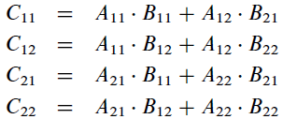
Strassen’s Algorithm for matrix multiplication
Let A and B are two matrices to be multiplied.
Two 2 x 2 matrices can be multiplied using eight scalar multiplications apparently required by the definition.

Slide 81
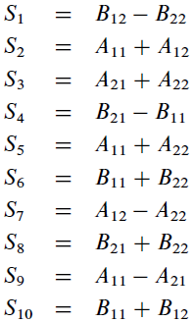
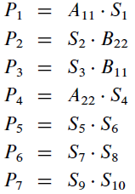
Strassen’s Algorithm for matrix multiplication
Step 1
Step 2
All above operations involve just one multiplication.

Slide 82

Strassen’s Algorithm for matrix multiplication
Now,
Where,
C₁₁ = P₅ + P₄ – P₂ + P₆
C₁₂ = P₁ + P₂
C₂₁ = P₃ + P₄
C₂₂ = P₅ + P₁ – P₃ – P₇

Slide 83
Strassen’s Algorithm for matrix multiplication
It is therefore possible to multiply two 2 x 2 matrices using only seven scalar multiplications.
Let t (n) be the time needed to multiply two n x n matrices by recursive use of equations.
t(n)= 7t(n/2) + g(n)
Where g(n) ϵ O(n²). This recurrence is another instance of our general analysis for divide-and-conquer algorithms.

Slide 84

Strassen’s Algorithm for matrix multiplication
The general equation applies with l = 7, b = 2 and k = 2.
Since l > b^{k}, the third case yields t(n) ϵ O(n^{lg7}).
Since lg7 < 2.81, it is thus possible to multiply two n x n matrices in a time in O(n^{2.81}), provided scalar operations are elementary.
$$t\left(n\right)=\left\{\begin{aligned}θ\left(n^{k}\right) if l < b^{k} \\ θ\left(n^{k}logn\right) if l= b^{k} \\ θ\left(n^{\log_{b}l}\right) if l >b^{k}\end{aligned}\right.$$
t(n)= 7t(n/2) + n²

Slide 85
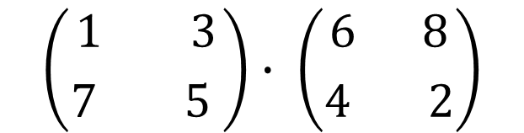
Strassen’s Algorithm
Use Strassen’s algorithm to compute the matrix product.
$$\left({1 3 \atop 7 5 }\right)∙ \left({6 8 \atop 4 2}\right)$$

Slide 86
Exponentiation
Let a and n be two integers. We wish to compute the exponentiation x = a^{n}.
Exponentiation using Sequential Approach
This algorithm takes a time in Θ(n) since the instruction r = a * r is executed exactly n-1 times, provided the multiplications are counted as elementary operations.
function exposeq(a, n)
r ← a
for i ← 1 to n - 1 do
r← a * r
return r

Slide 87
Exponentiation
But to handle larger operands, we must take account of the time required for each multiplication.
Let m be the size of operand a.
Therefore, the multiplication performed the i-th time round the loop concerns an integer of size m and an integer whose size is between im - i + 1 and im, which takes a time between M(m, im - i + 1) and M(m, im).
a = 5 so m = 1 and n = 25 and suppose i = 10
The body of loop executes 10th time as,
r = a * r (here 9 times multiplication is already done so r = 5⁹ = 1953125)
The size of r is between im-i+1 to im i.e. between 1 to 10

Slide 88
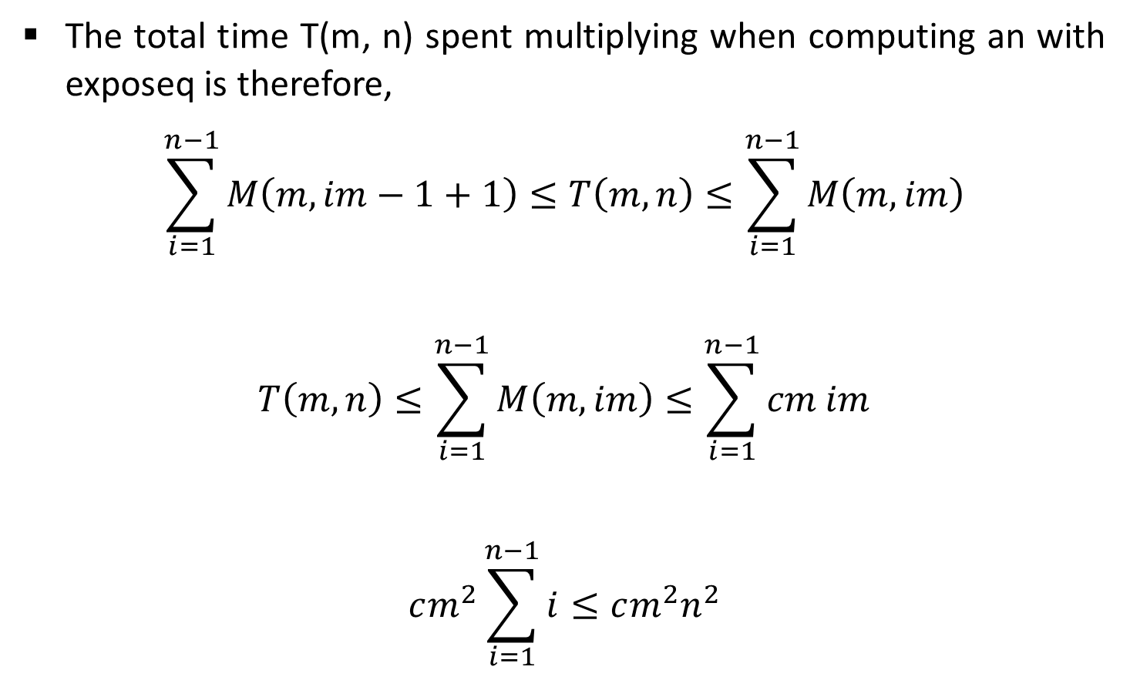
Exponentiation
The total time T(m, n) spent multiplying when computing an with exposeq is therefore,
$$\sum_{i=1}^{n−1}{M\left(m,im−1+1\right)≤T\left(m,n\right)≤\sum_{i=1}^{n−1}{M\left(m,im\right)}}$$
$$T\left(m,n\right)≤\sum_{i=1}^{n−1}{M\left(m,im\right)≤\sum_{i=1}^{n−1}{cm im}}$$
$$cm^{2}\sum_{i=1}^{n−1}{i≤cm^{2}n^{2}}$$

Slide 89
Exponentiation
Thus,
T(m, n) = Θ (m² n² )
If we use the divide-and-conquer multiplication algorithm,
T(m, n) ϵ Θ (m^{lg3} n²)

Slide 90

Exponentiation
Exponentiation using Divide & Conquer Technique.
Suppose to comput a¹⁰
a¹⁰ = (a⁵)² = (a.a⁴)² = (a.(a² )²)²

Slide 91


Exponentiation
function expoDC(a, n)
if n = 1 then return a
if n is even then return [expoDC(a, n/2)]²
return a * expoDC(a, n - 1)
Solving it, T(m, n) ϵ Θ (m^{lg3} n^{lg3})

